Slide 1
MSI Logic Circuits
Wen-Hung Liao, Ph.D.
5/22/2002

Slide 2
Objectives
Analyze and use decoders and encoders in various types of circuit applications.
Compare the advantages and disadvantages of LEDs and LCDs.
Understand the operation of multiplexers and demultiplexers by analyzing several circuit applications.
Compare two binary numbers by using the magnitude comparator circuit.

Slide 3
Objectives (cont’d)
Understand the function and operation of code converters.
Cite the precautions that must be considered when connecting digital circuits using the data bus concept.

Slide 4
Common Operations
Decoding/encoding
Multiplexing
De-multiplexing
Comparison
Code conversion
Data busing

Slide 5
Decoder
A decoder is a logic circuit that accepts a set of inputs that represents a binary number and activates only the output that corresponds to that input number.
Only one output is high for each input code.
A₀
O₀
Decoder
A₁
O₁
A_{N-1}
O_{M-1}

Slide 6
Decoders(cont’d)
Some decoders do not utilize all of the 2^N possible input codes, e.g., BCD-to-decimal decoder has a 4-bit input code and 10 output lines.
Figure 9-2: 3-line-to-8-line decoder, or binary-to-octal converter.
ENABLE inputs (Figure 9-3), 74LS138.
Combine four 74LS138s to function as a 1-of-32 decoder (Figure 9-4).
7442 BCD-to-decimal decoder (Figure 9-5).

Slide 7
BCD-to-7-Segment Decoder
Take a 4-bit BCD input and provide the outputs that will pass current thru the appropriate segments to display the decimal digit.
Figure 9-7 and 9-8 (TTL 7446, 7447).

Slide 8
LED vs. LCD Displays
A Light-Emitting-Diode (LED) display generates light energy as current is passed thru the individual segments.
A liquid-crystal display (LCD) controls the reflection of available light (such as ambient light or backlit.)
LED is generally much brighter, LCD uses very low power.

Slide 9
Encoders
The opposite of the decoding process.
An encoder has a number of input lines, only one of which is activated at a given time.
Octal-to-binary encoder (Figure 9-13).
Priority encoder: ensures that when two or more inputs are activated, the output code will correspond to the highest numbered input. (Figure 9-14, 74147 decimal to BCD priority encoder.)

Slide 10
Switch Encoder
Figure 9-15, 74LS147.
Switches corresponds to keyboards on a calculator representing digits 0 through 9.
Switches are normally open, so the encoder inputs are normally HIGH and BCD output is 0000.
When a digit key is pressed, the circuit will produce the BCD code for that digit.
Figure 9-16: circuit for keyboard entry of three-digit number into storage registers.

Slide 11
Multiplexers (Data Selectors)
A multiplexer (MUX) selects one of several input signals and passes it on to the output.
Routing of desired data input to the output is controlled by SELECT inputs.
MUX
SELECT

Slide 12
Basic Multiplexers
Two-input multiplexer (Figure 9.19):
Z =I₀S’+I₁S
Four-input multiplexer (Figure 9-20)
Eight-input multiplexer: 74151 (Figure 9-21).
16-input multiplexer: Figure 9-22.
74ALS157 multiplexer : Figure 9-23.

Slide 13
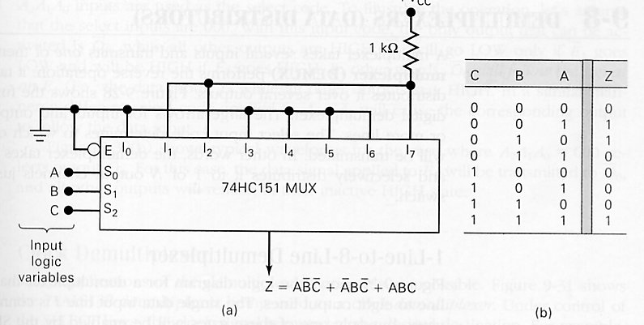
Multiplexer Applications
Data routing (Figure 9-24)
Parallel-to-serial conversion (Figure 9-25).
Operation sequencing (Figure 9-26).
Logic function generation (Figure 9-27).

Slide 14
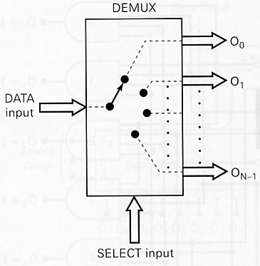
Demultiplexer (Data Distributors)
A demultiplexer (DEMUX) takes a single input and distributes it over several outputs.

Slide 15
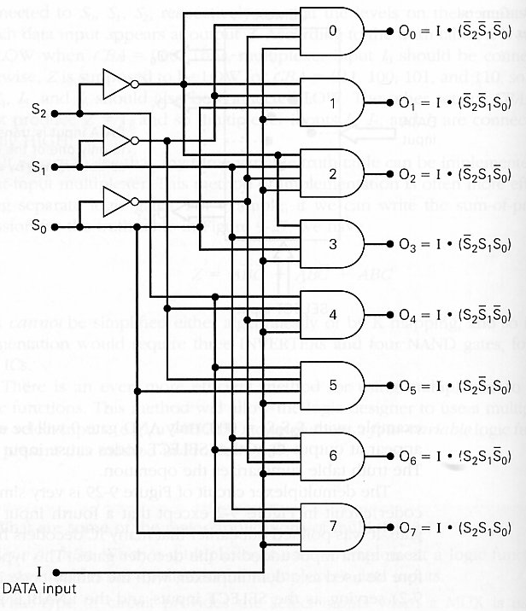
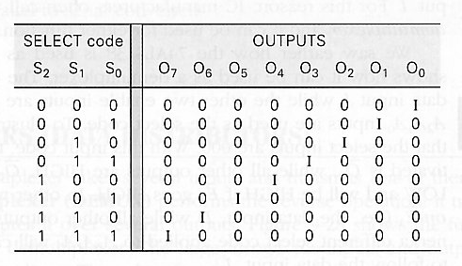
1-line-to-8-line Demultiplexer

Slide 16
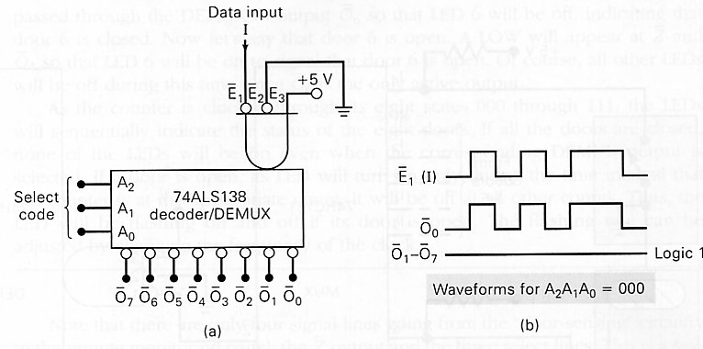
Clock Demultiplexer
Route clock signal to desired destination by controlling SELECT.

Slide 17
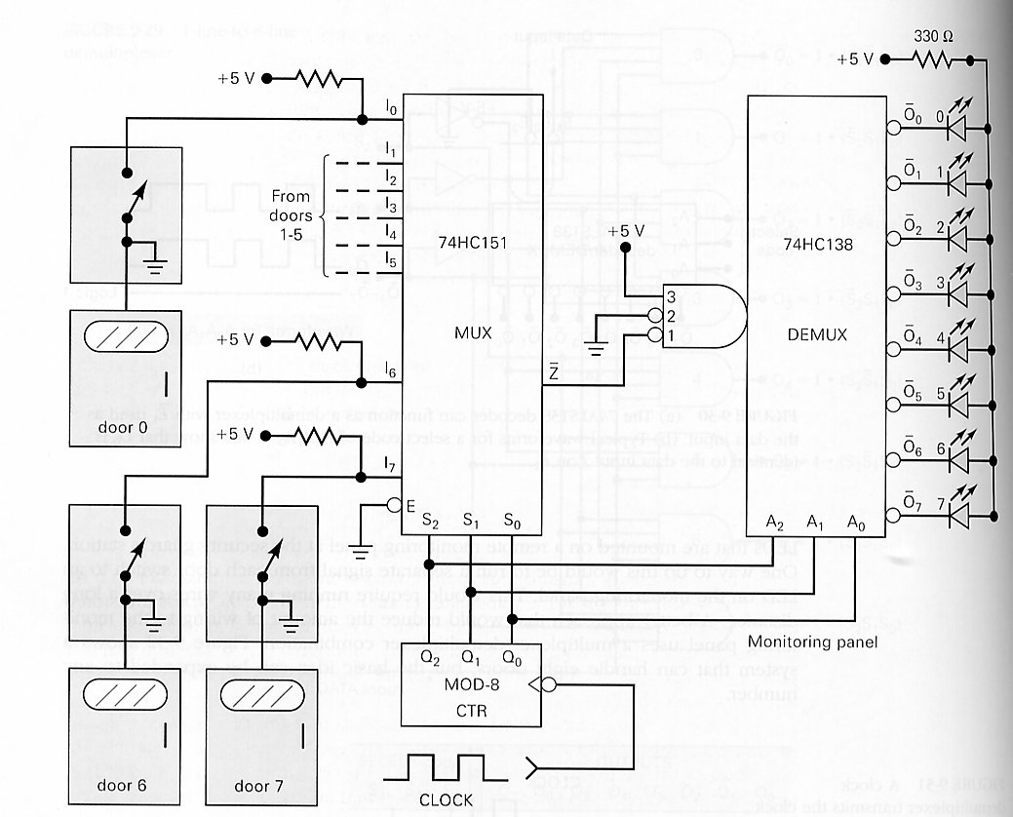
Security Monitoring System

Slide 18
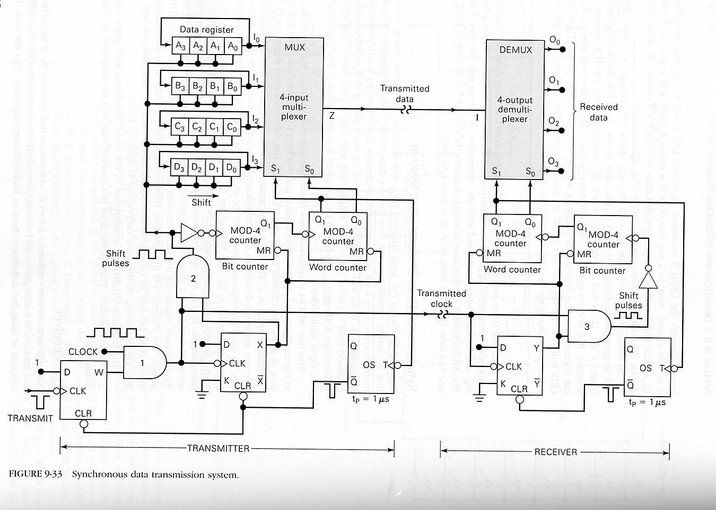
Synchronous Data Transmission
Figure 9.33: Serially transmit four 4-bit data words from a transmitter to a remote receiver.

Slide 19
The Transmitter
A,B,C,D: re-circulating shift registers.
The two MOD-4 counters control the transmission of the data register contents to the multiplexer output Z.
Word counter: selects register data
Bit counter: select which bit to be sent.
The data are said to be time-division-multiplexed.

Slide 20
The Receiver
1-to-4 demultiplexer
MOD-4 counters have the same function as their counterparts in the transmitter.

Slide 21
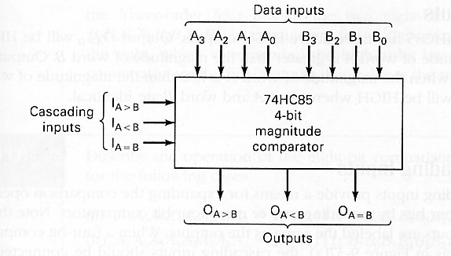
Magnitude Comparator
Figure 9-36: 74HC85.

Slide 22
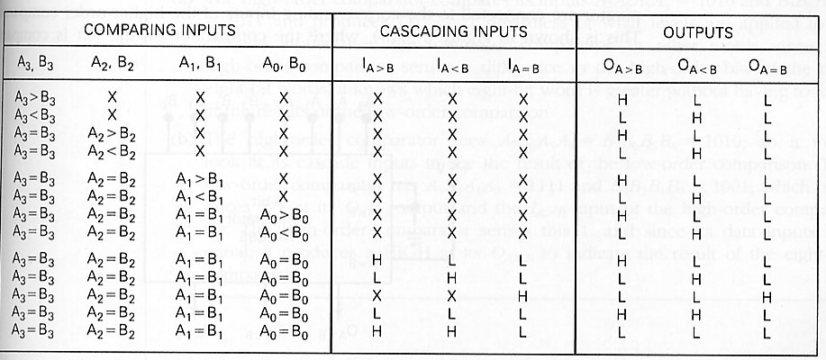
Truth Table

Slide 23
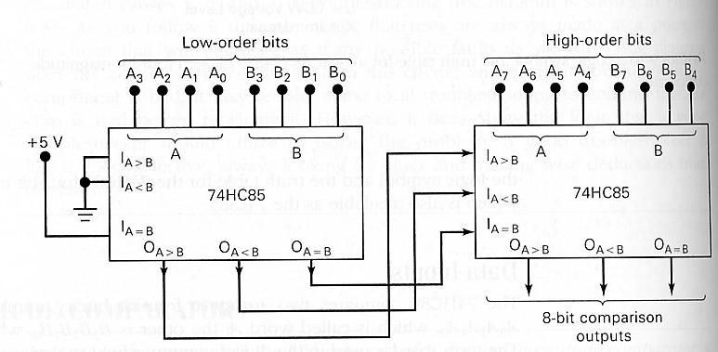
Cascading Inputs

Slide 24
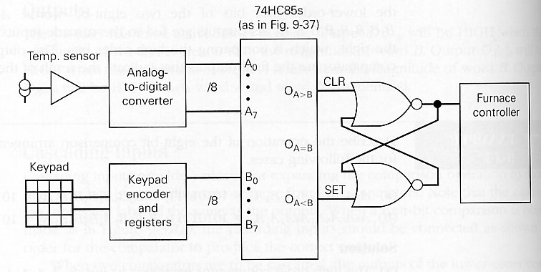
Applications: digital thermostat

Slide 25
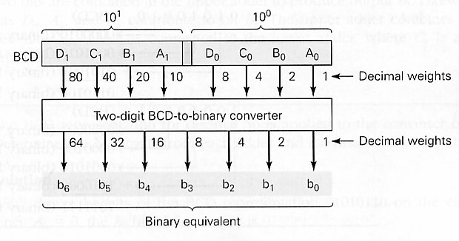
Code Converter
A code converter is a logic circuit that changes data represented in one type of binary code to another type of binary code.
BCD-to-7-segment code converter.
BCD-to-binary converter.

Slide 26
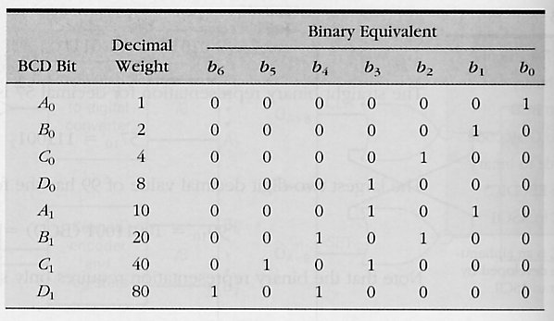
Binary equivalents of decimal weights

Slide 27
Conversion Process
Compute the binary sum of the binary equivalents of all bits in the BCD representation that are 1s.
Example: Convert 01010010 (BCD) to binary.

Slide 28
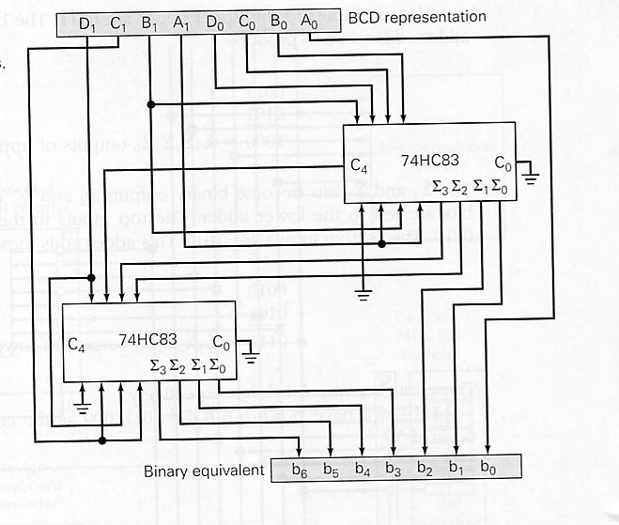
Circuit Implementation

Slide 29
Data Busing
In most modern computers the transfer of data takes place over a common set of connecting lines called a data bus.
Tri-state outputs or tri-state buffers are required.

Slide 30
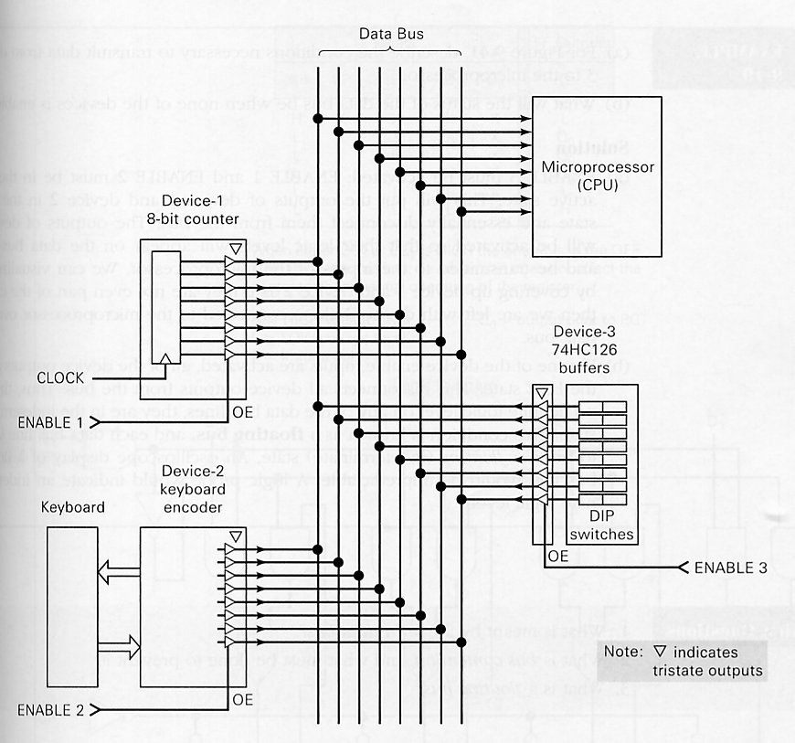

Slide 31
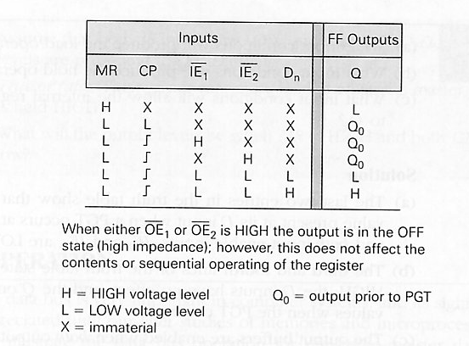
74ALS173/HC173 Tristate Register
load
hold

Slide 32
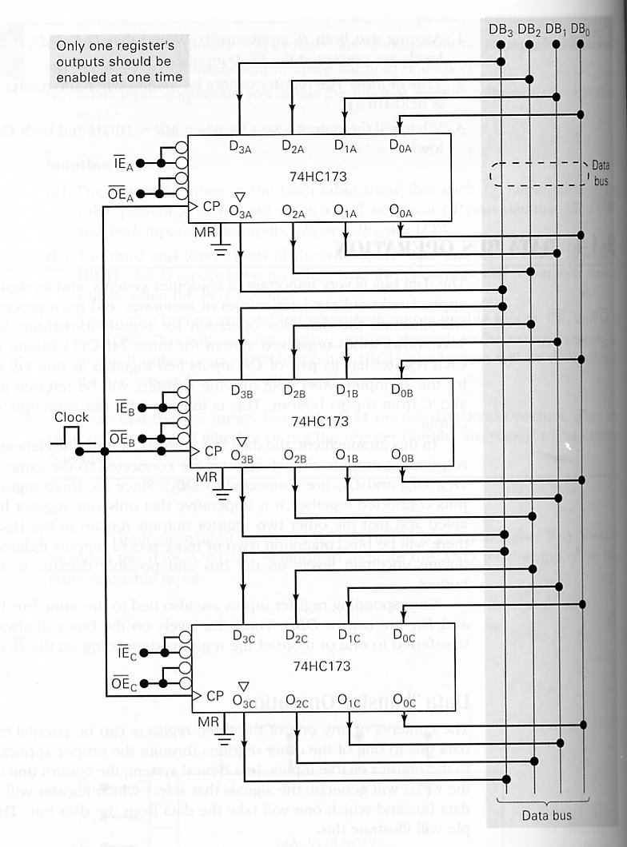
Data Bus Operation
Register-to-register
data transfer
(Figure 9-44).

Slide 33
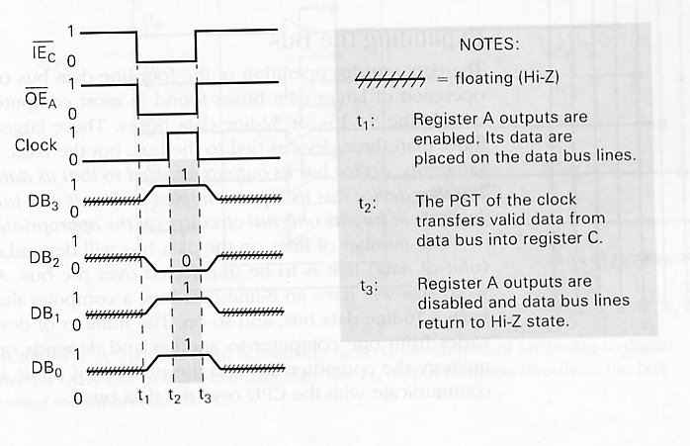
Bus Signals and Signal Activities

Slide 34
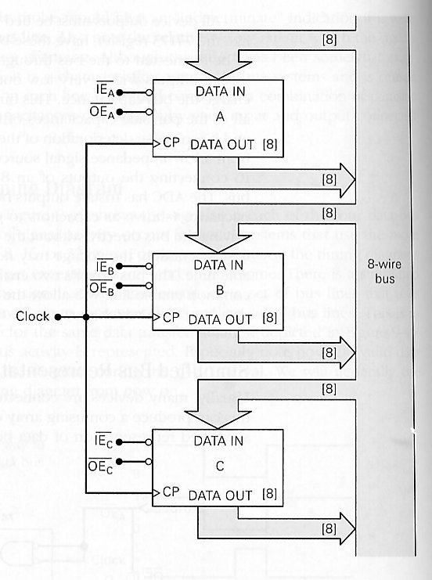
More on Bus
Simplified timing diagram
Expanding the bus
Simplified representation
of bus arrangement
Bidirectional Busing

