Slide 1
Digital Systems
Logic Gates and Boolean Algebra
Wen-Hung Liao, Ph.D.

Slide 2
Objectives
Perform the three basic logic operations.
Describe the operation of and construct the truth tables for the AND, NAND, OR, and NOR gates, and the NOT (INVERTER) circuit.
Draw timing diagrams for the various logic-circuit gates.
Write the Boolean expression for the logic gates and combinations of logic gates.
Implement logic circuits using basic AND, OR, and NOT gates.
Appreciate the potential of Boolean algebra to simplify complex logic circuits.

Slide 3
Objectives (cont’d)
Use DeMorgan's theorems to simplify logic expressions.
Use either of the universal gates (NAND or NOR) to implement a circuit represented by a Boolean expression.
Explain the advantages of constructing a logic-circuit diagram using the alternate gate symbols versus the standard logic-gate symbols.
Describe the concept of active-LOW and active-HIGH logic symbols.
Draw and interpret the IEEE/ANSI standard logic-gate symbols.

Slide 4
Boolean Constants and Variables
Boolean 0 and 1 do not represent actual numbers but instead represent the state, or logic level.
Logic 0 | Logic 1
False | True
Off | On
Low | High
No | Yes
Open switch | Closed switch

Slide 5
Three Basic Logic Operations
OR
AND
NOT

Slide 6
Truth Tables
A truth table is a means for describing how a logic circuit’s output depends on the logic levels present at the circuit’s inputs.
Inputs |  | Output
A | B | x
0 | 0 | 1
0 | 1 | 0
1 | 0 | 1
1 | 1 | 0
A
?
x
B

Slide 7

OR Operation
Boolean expression for the OR operation:
x =A + B
The above expression is read as “x equals A OR B”
Figure 3-2
OR
A | B | x
0 | 0 | 0
0 | 1 | 1
1 | 0 | 1
1 | 1 | 1
A
x= A+B
B

Slide 8

OR Gate
An OR gate is a gate that has two or more inputs and whose output is equal to the OR combination of the inputs.
Figure 3-3
A
B
x = A + B + C
C

Slide 9
Examples
Example 3-1: using an OR gate in an alarm system(refer to Fg03-04.ckt)
Example 3-2: timing diagram (refer to Fg03-05.ckt)

Slide 10

AND Operation
Boolean expression for the AND operation:
x =A B
The above expression is read as “x equals A AND B”
AND
A | B | x
0 | 0 | 0
0 | 1 | 0
1 | 0 | 0
1 | 1 | 1
A
x= AB
B

Slide 11

AND Gate
An AND gate is a gate that has two or more inputs and whose output is equal to the AND product of the inputs.
Figure 3-8
A
B
x = ABC
C

Slide 12
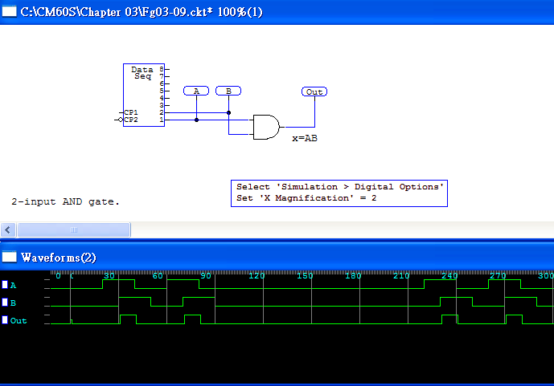
Timing Diagram for AND Gate

Slide 13
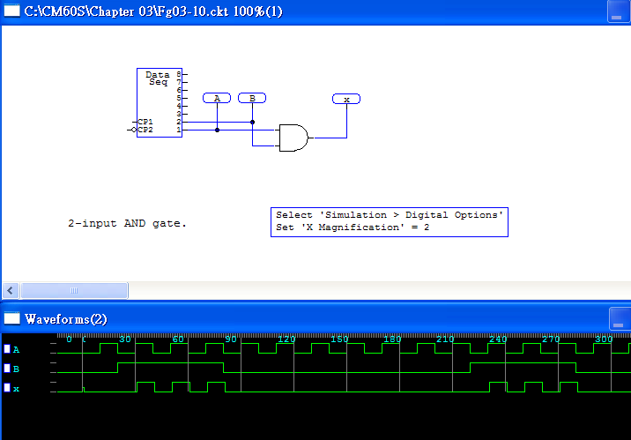
Enable/Disable Circuit

Slide 14
NOT Operation
The NOT operation is an unary operation, taking only one input variable.
Boolean expression for the NOT operation:
x = A
The above expression is read as “x equals the inverse of A”
Also known as inversion or complementation.
Can also be expressed as: A’
Figure 3-11
A
x=A’

Slide 15
NOT Circuit
Also known as inverter.
Always take a single input
NOT
A | x=A’
0 | 1
1 | 0

Slide 16
Describing Logic Circuits Algebraically
Any logic circuits can be built from the three basic building blocks: OR, AND, NOT
Example 1: x = A B + C
Example 2: x = (A+B)C
Example 3: x = (A+B)
Example 4: x = ABC(A+D)

Slide 17
Evaluating Logic-Circuit Outputs
x = ABC(A+D)
Determine the output x given A=0, B=1, C=1, D=1.
Can also determine output level from a diagram

Slide 18
Implementing Circuits from Boolean Expressions
We are not considering how to simplify the circuit in this chapter.
y = AC+BC’+A’BC
x = AB+B’C
x=(A+B)(B’+C)

Slide 19


NOR Gate
Boolean expression for the NOR operation:
x = A + B
Figure 3-20: timing
diagram
NOR
A | B | x
0 | 0 | 1
0 | 1 | 0
1 | 0 | 0
1 | 1 | 0

Slide 20

NAND Gate
Boolean expression for the NAND operation:
x = A B
Figure 3-23: timing diagram
NAND
A | B | x
0 | 0 | 1
0 | 1 | 1
1 | 0 | 1
1 | 1 | 0
A
AB
B

Slide 21
Boolean Theorems (Single-Variable)
x* 0 =0
x* 1 =x
x*x=x
x*x’=0
x+0=x
x+1=1
x+x=x
x+x’=1

Slide 22
Boolean Theorems (Multivariable)
x+y = y+x
x*y = y*x
x+(y+z) = (x+y)+z=x+y+z
x(yz)=(xy)z=xyz
x(y+z)=xy+xz
(w+x)(y+z)=wy+xy+wz+xz
x+xy=x
x+x’y=x+y
x’+xy=x’+y

Slide 23
DeMorgan’s Theorems
(x+y)’=x’y’
Implications and alternative symbol for NOR function (Figure 3-26)
(xy)’=x’+y’
Implications and alternative symbol for NAND function (Figure 3-27)
Example 3-17: Figure 3-28
Extension to N variables

Slide 24
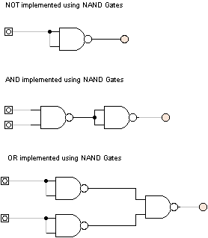
Universality of NAND Gates

Slide 25
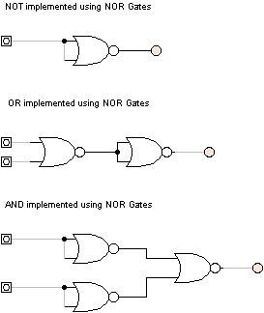
Universality of NOR Gates

Slide 26
Alternate Logic Symbols
Step 1: Invert each input and output of the standard symbol
Change the operation symbol from AND to OR, or from OR to AND.
Examples: AND, OR, NAND, OR, INV

Slide 27
Logic Symbol Interpretation
When an input or output on a logic circuit symbol has no bubble on it, that line is said to be active-HIGH.
Otherwise the line is said to be active-LOW.

Slide 28
Which Gate Representation to Use?
If the circuit is being used to cause some action when output goes to the 1 state, then use active-HIGH representation.
If the circuit is being used to cause some action when output goes to the 0 state, then use active-LOW representation.
Bubble placement: choose gate symbols so that bubble outputs are connected to bubble inputs , and vice versa.

Slide 29
IEEE Standard Logic Symbols
NOT
AND
OR
NAND
NOR
1
A
x
A
&
x
B
A
≧1
x
A
&
x
A
≧1
x
B
B
B

