Slide 1
Flip-Flops and Related Devices
Wen-Hung Liao, Ph.D.

Slide 2
Objectives
Recognize the various IEEE/ANSI flip-flop symbols.
Use state transition diagrams to describe counter operation.
Use flip-flops in synchronization circuits.
Connect shift registers as data transfer circuits.
Employ flip-flops as frequency-division and counting circuits.
Understand the typical characteristics of Schmitt triggers.
Apply two different types of one-shots in circuit design.
Design a free-running oscillator using a 555 timer.
Recognize and predict the effects of clock skew on synchronous circuits.

Slide 3
Clocked Flip-Flops
Controlled inputs + CLK
Setup and Hold times
Clocked S-C Flip-Flop
Clocked J-K Flip-Flop
Clocked D Flip-Flop

Slide 4
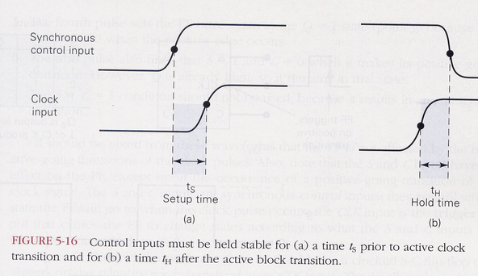
Setup and Hold Times

Slide 5
Setup and Hold Times (cont’d)
The setup time ts is the time interval immediately proceeding the active transition of the CLK signal during which the control input signal must be maintained at the proper level.
The hold time tH, is the time interval immediately following the active transition of the CLK signal during which the control input signal must be maintained at the proper level.

Slide 6
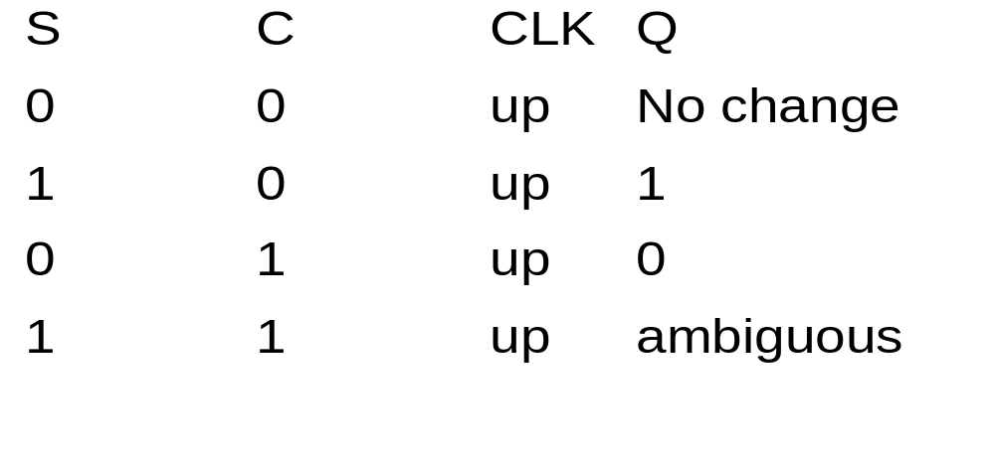
Clocked S-C Flip Flops
PGT S-C FF

Slide 7
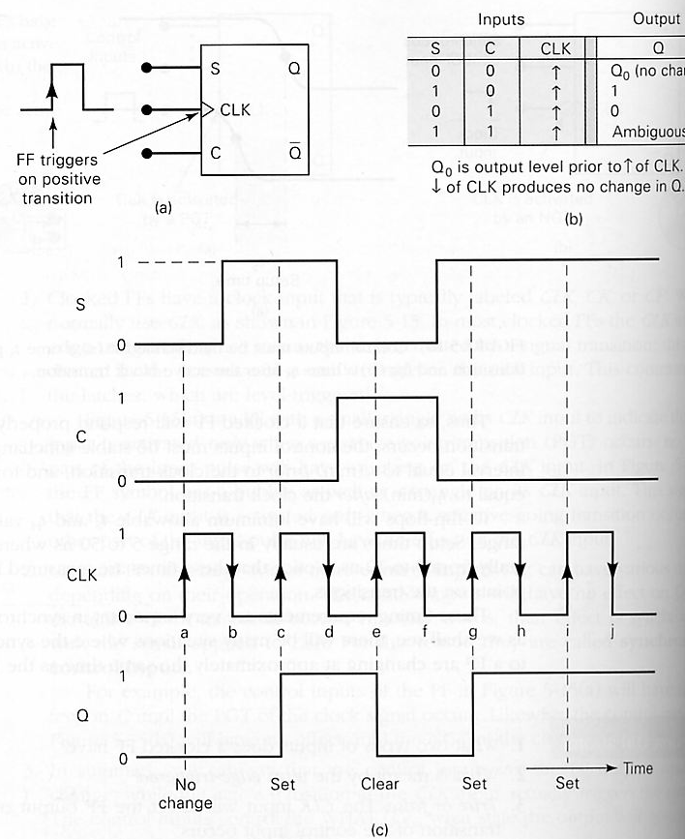
Clocked S-C
FF: Waveform
Figure 5-17

Slide 8
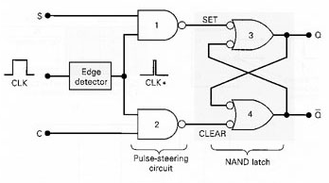
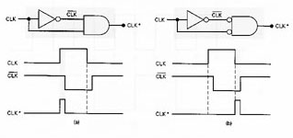
Internal Circuitry of S-C FF
Consists of:
  a basic NAND latch
  a pulse steering circuit
  an edge-detector circuit (Figure 5.20)

Slide 9
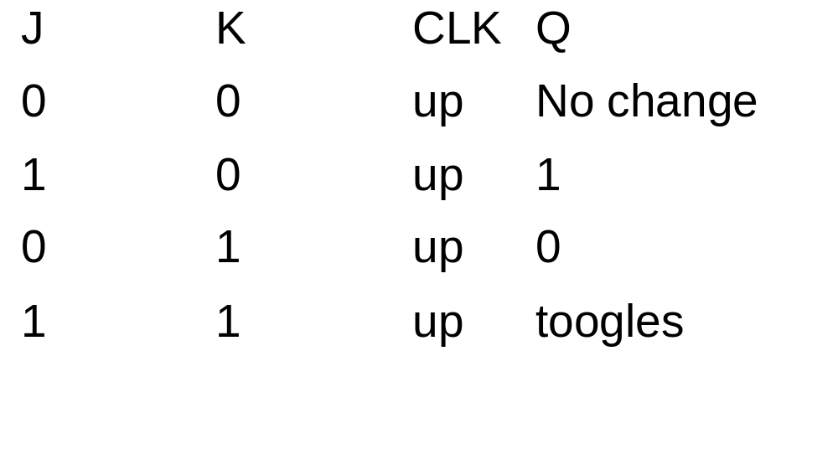
J-K Flip-Flop
J=K=1 does not result in an ambiguous output.
Goes to the opposite state instead.

Slide 10
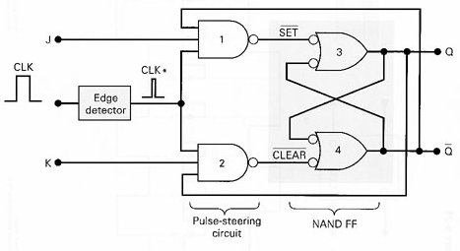
Internal Circuitry of J-K FF
The only difference between J-K FF and S-C FF is that Q and Q’ outputs are fed back to the pulse-steering NAND gates.
Analyze the condition: J=K=1 and Q_{before}=0

Slide 11
Clocked D Flip-flop
Has only one control input D, which stands for data.
Operation is simple: Q will go to the same state that is present on the D input when a PGT occurs at CLK.
In other words, the level presented at D will be stored in the FF at the instant the PGT occurs.

Slide 12
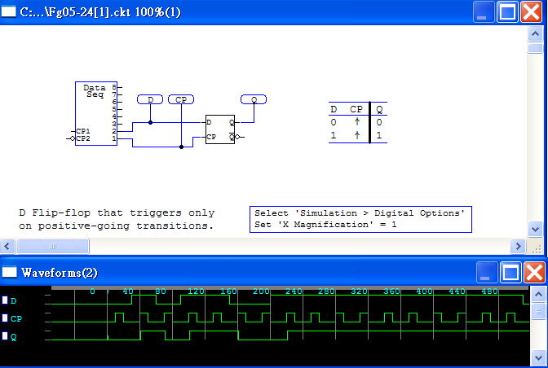
Clocked D Flip-Flop (cont’d)
Application: Parallel Data Transfer Using D FF (P.203, Figure 5.26)

Slide 13
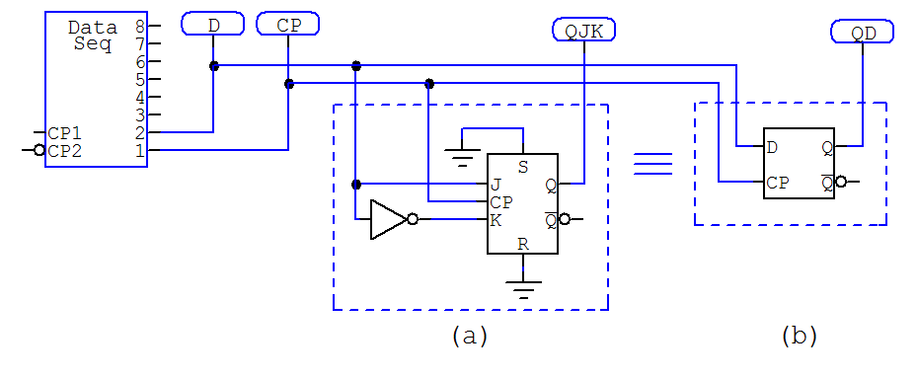
Implementation of the D Flip-Flop

Slide 14
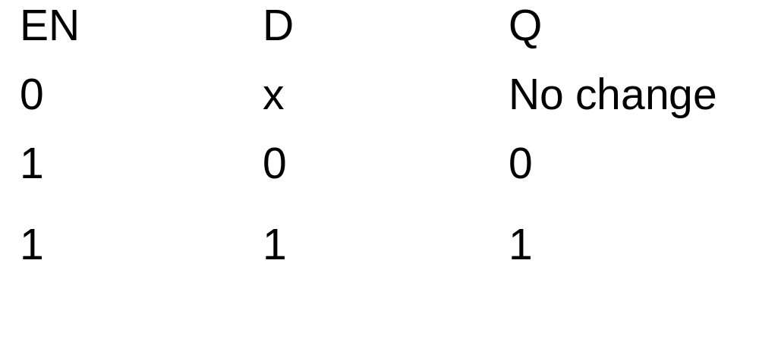
D Latch
D FF without the edge detector.
Has an enable input. (Figure 5-27)
Behave somewhat differently.

Slide 15
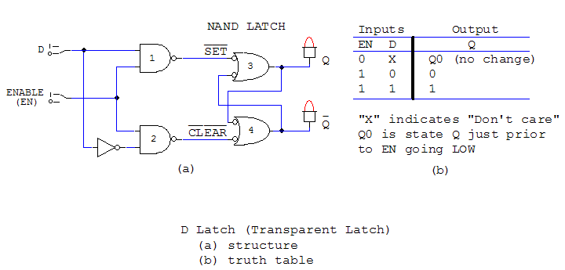
D Latch (cont’d)

Slide 16
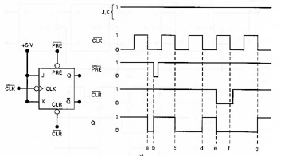

Asynchronous Inputs
Used to set the FF to the 1 state or clear to the 0 state at any time, regardless of the condition at the other inputs. (Figure 5.29)
Also known as override inputs.

Slide 17
IEEE/ANSI Symbols
D latch
Q
D
C
Q’
Enable

Slide 18
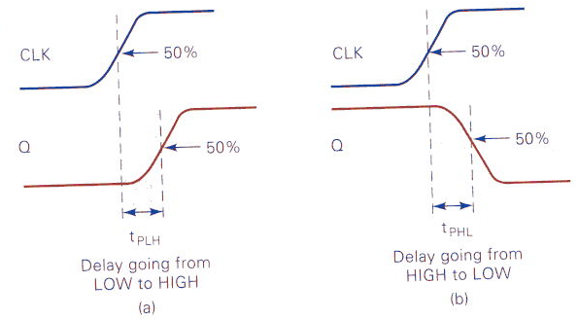
Flip-Flop Timing Considerations
Setup (t_{S})and hold time(t_{H}): for reliable FF triggering, minimum values are specified.
Propagation delays (t_{PHL}, t_{PLH}): the time the signal is applied to the time when output makes its change, maximum value is specified. (Fig 5-33)

Slide 19
Timing Considerations (cont’d)
Maximum clocking frequency, f MAX: the highest frequency that can be applied to the CLK input of a FF and still have it trigger reliably.

Slide 20
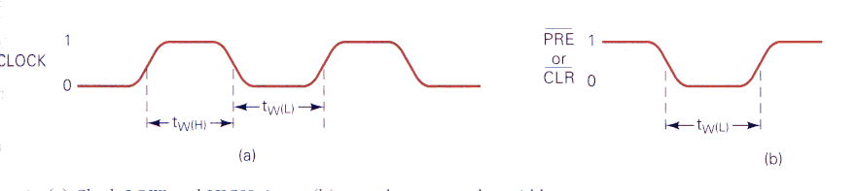
Timing Considerations (cont’d)
Clock pulse HIGH and LOW times: the minimum time duration that the CLK must remain LOW before it goes HIGH, t_{w}(L), and vice versa for t_{w}(H).
Asynchronous active pulse width: the minimum time duration that a PRESET or CLEAR input must be kept in its active state in order to reliably set or clear the FF.
Clock transition times: for reliable triggering, the clock waveform transition times must be kept very short.

Slide 21
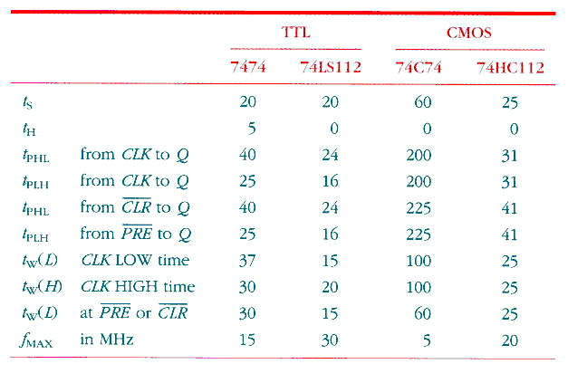
Table 5-2

Slide 22
Potential Timing Problem
Refer to Figure 5-35, problem can occur when output of one FF is connected to the input of another FF, and both FFs are triggered by the same clock signal.
What if hold time requirement of Q2 is greater than propagation delay of Q1?
Fortunately, all modern edge-triggered FFs have very short tH, so there wouldn’t be a problem.

Slide 23
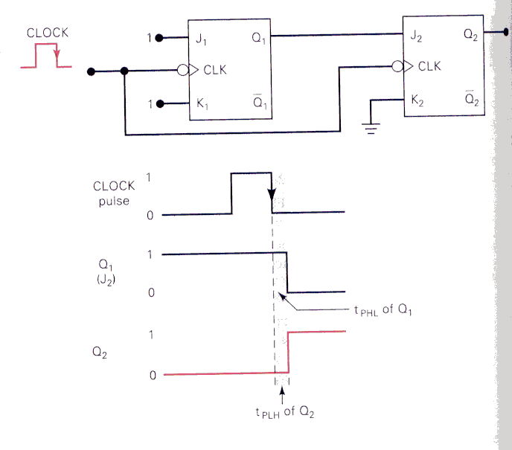
Figure 5-35

Slide 24
Master/Slave Flip-Flops
Used to solve the potential timing problem before the development of edge-triggered FFs with little or no hold-time requirement.
Can be treated as a negative-edge-triggered FF.

Slide 25
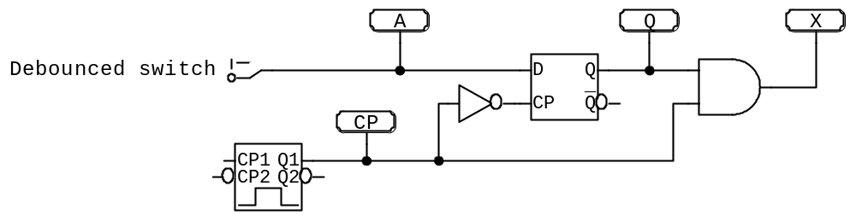
Flip-Flop Synchronization
Example 5-11
Figure 5-37: asynchronous signal A can produce partial pulses at X.
Figure 5-38: Use edge-triggered D flip-flop to synchronize the enabling of the AND gate to the NGT of the clock.

Slide 26
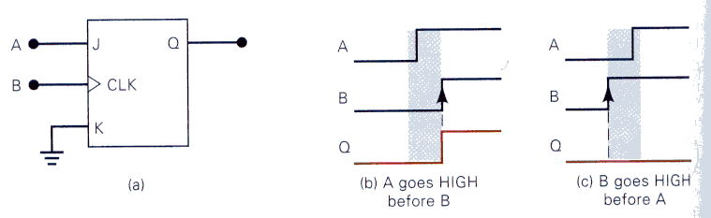
Flip-Flop Applications
Detecting an input sequence using J-K FFs. (Figure 5-39)

Slide 27
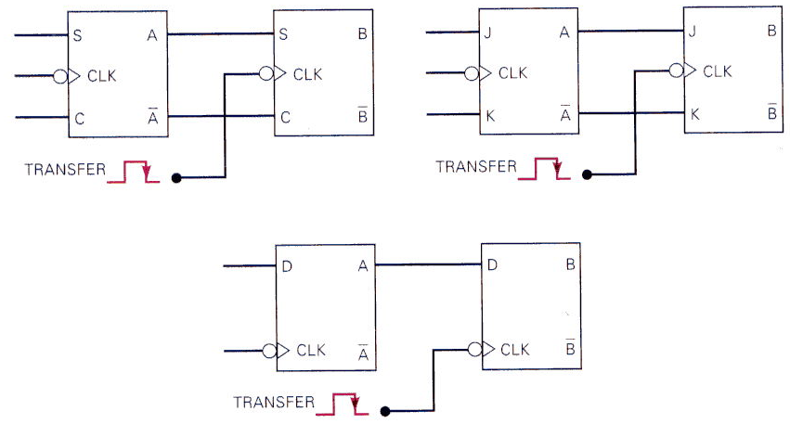
More Flip-Flop Applications
Data storage and transfer: synchronous and asynchronous transfer (Figure 5-40,41)

Slide 28
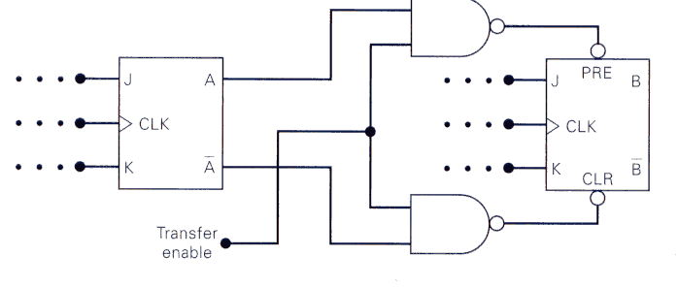
Asynchronous Transfer

Slide 29
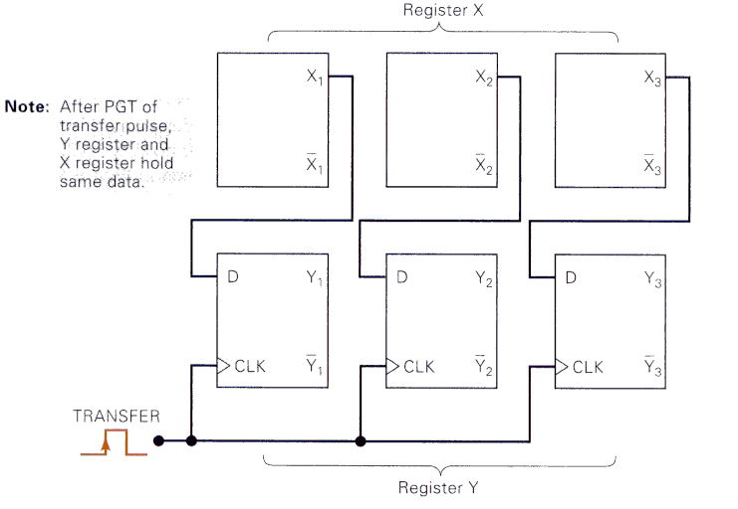
Parallel Data Transfer (Figure 5-42)

Slide 30
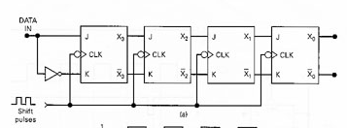
Serial Data Transfer: Shift Register
A shift register is a group of FFs arranged so that the binary numbers stored in the FFs are shifted from one FF to the next the every clock pulse.
Refer to Figure 5-43

Slide 31
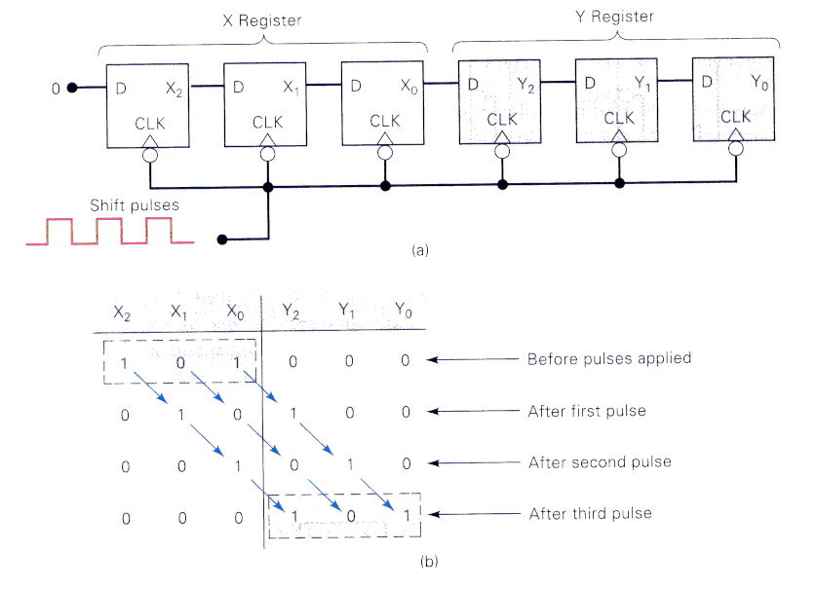
Serial Transfer Between Registers
Figure 5-44

Slide 32
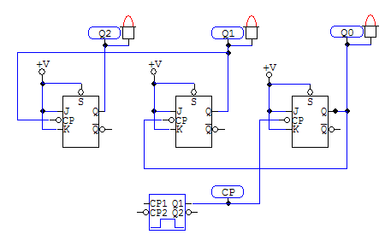
Frequency Division and Counting
J-K flip-flops wired as a three-bit binary counter
J=K=1

Slide 33
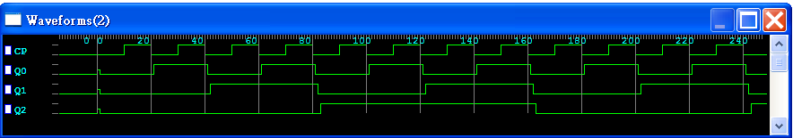
Waveform
Frequency division: Using N flip-flops --> 1/2^N
Counting operation
State transition diagram
MOD number

Slide 34
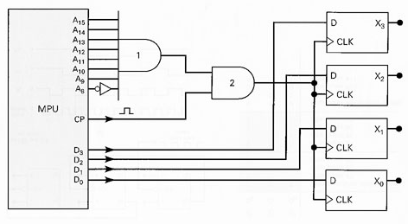
Microcomputer Application
Figure 5-48: example of a microprocessor transfer binary data to an external register.

Slide 35
Schmitt-Trigger Devices
A device that has a Schmitt-trigger type of input is designed to accept slow-changing signals and produce an output that has oscillation-free transitions.
See Figure 5-49, a Schmitt-trigger INVERTER

Slide 36
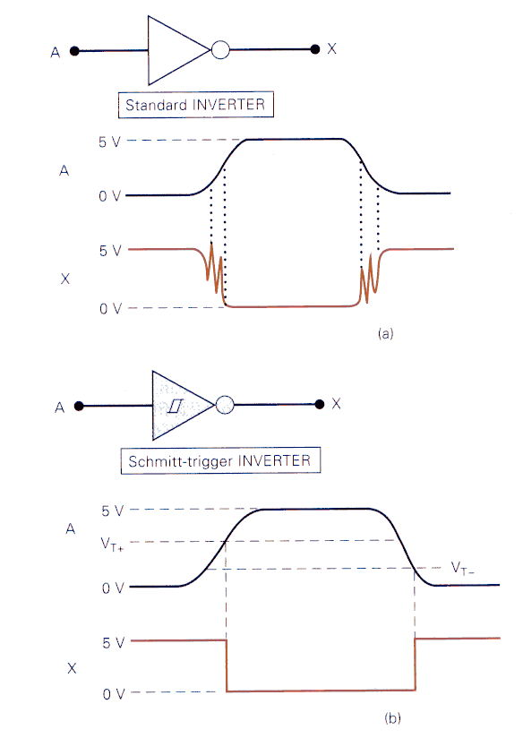
Figure 5-49
Positive-going
threshold voltage
Negative-going
threshold voltage

Slide 37
One-Shot
Has only one stable output state (normally Q=0, Q’=1), also known as monostable multivibrator
Once triggered, the output switches to the opposite state and remains in that ‘quasi-stable state’ for a fixed period of time, tp.
Non-retriggerable OS
Retriggerable OS

Slide 38
Analyzing Sequential Circuits
Step 1: Examine the circuit. Look for familiar components.
Step 2:Write down the logic levels present at each I/O prior to the occurrence of the first clock pulse.
Step 3:Using the initial conditions to determine the new states of each FFs in response to the first clock pulse.
Step 4: go back and repeat Steps 2,3 for the 2nd, 3rd …clock pulse

Slide 39
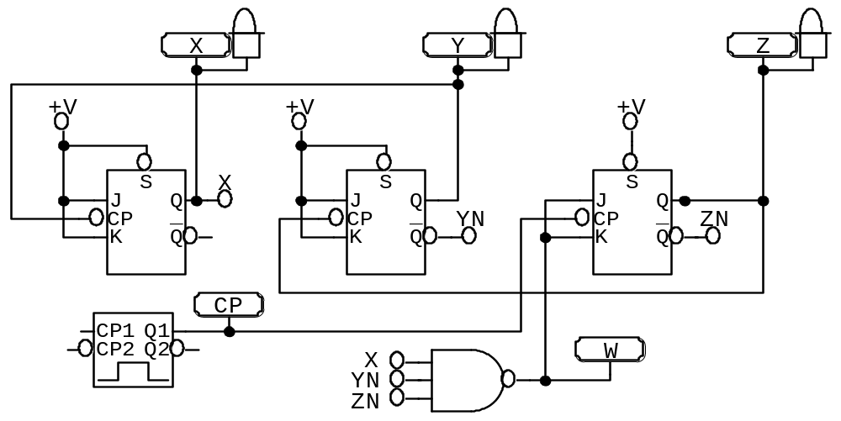
Example 5-16

