Slide 1
Counters and Registers
Wen-Hung Liao, Ph.D.

Slide 2
Objectives
Understand several types of schemes used to decode different types of counters.
Anticipate and eliminate the effects of decoding glitches.
Compare the major differences between ring and Johnson counters.
Analyze the operation of a frequency counter and of a digital clock.
Recognize and understand the operation of various types of IC registers.

Slide 3
Cascading BCD Counters
Figure 7-32: a multistage arrangement that counts from 000 to 999.
How does it work?

Slide 4
Synchronous Counter Design
J-K flip-flop excitation table
Transition | Present State | Next State | J | K
0→0 | 0 | 0 | 0 | X
0→1 | 0 | 1 | 1 | X
1→0 | 1 | 0 | X | 1
1→1 | 1 | 1 | X | 0

Slide 5
Design Procedure
Step1: Determine the desire number of bits (FFs) and the desired counting sequence.
Step2: Draw the state transition diagram showing all possible states, including those that are not part of the desired counting sequence.
Step 3: Use the state-transition diagram to set up a table that lists all PRESENT states and their NEXT states.

Slide 6
Design Procedure (cont’d)
Step4: Add a column to the above table for each J and K input to produce a circuit excitation table.
Step 5: Design the logic circuits to generate the levels required at each J and K input.
Step 6: Implement the final expressions.

Slide 7
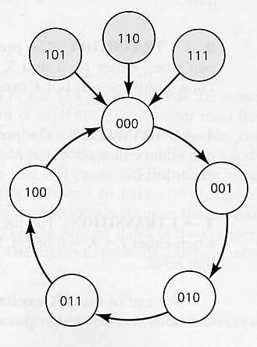
Example
MOD-5 synchronous counter
000→001→010→011→100→000→…
State transition diagram

Slide 8
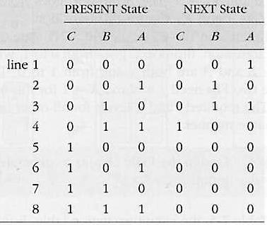
Present and Next States

Slide 9
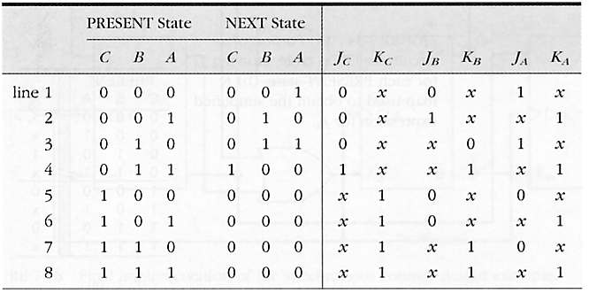
Circuit Excitation Table

Slide 10
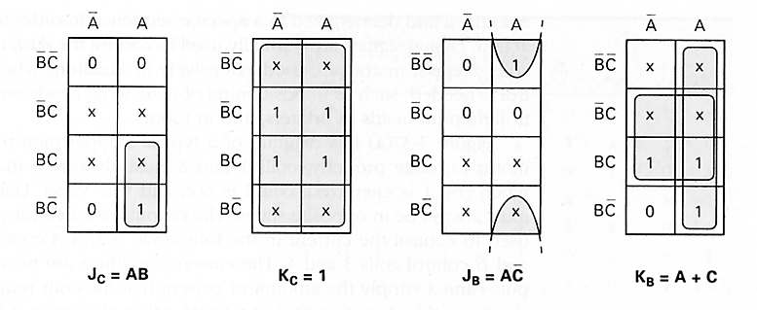
K-maps
J_{A}=C’, K_{A}=1 (Figure 7-34)

Slide 11
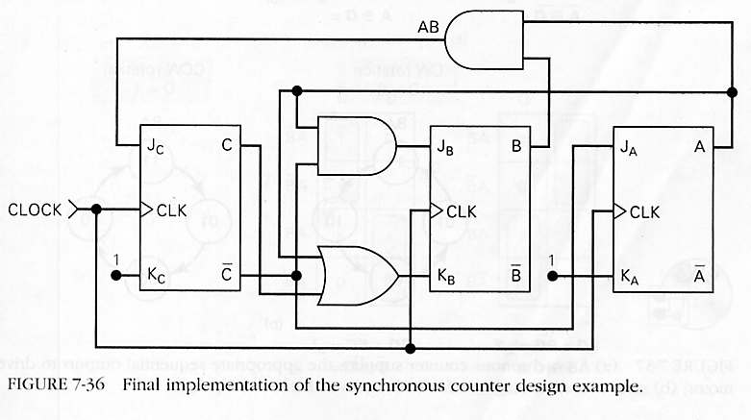
Final Implementation

Slide 12
Step Motor Control
A step motor is a motor that rotates in steps rather than in a continuous motion, typically 15 degrees per step.
Used in positioning of read/write heads on magnetic tapes, in controlling print heads…
Figure 7.37: CW rotation and CCW rotation.
Apply the design procedure to generate the circuit.

Slide 13
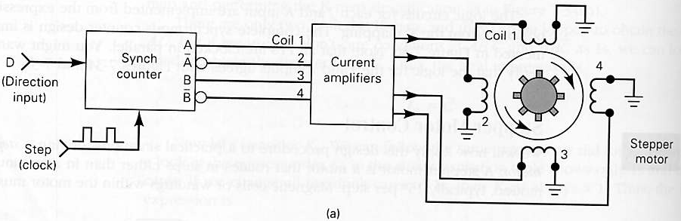
Step Motor Control (cont’d)

Slide 14
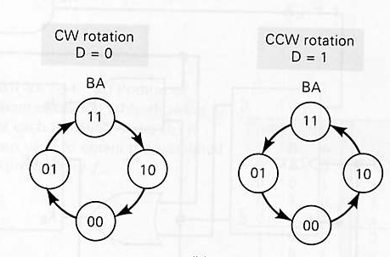
State Transition Diagrams

Slide 15
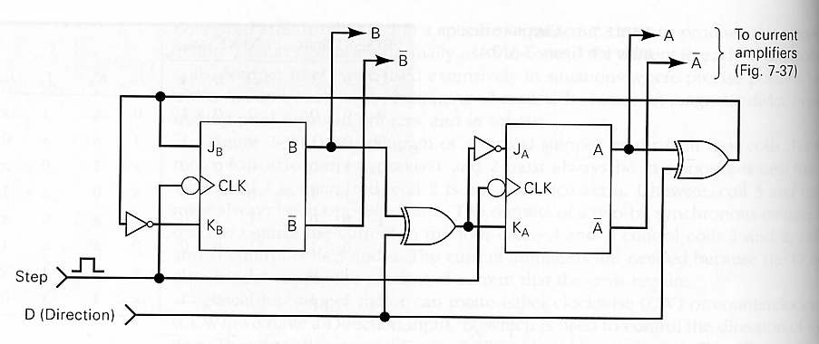
Final Implementation

Slide 16
Shift-Register Counters
Use feedback, output of last FF is connected back to the first FF in some way.
Ring counter: circulating shift register.
See Figure 7-40.
Why is it still a counter?

Slide 17
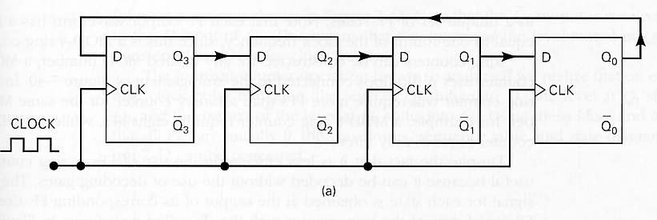
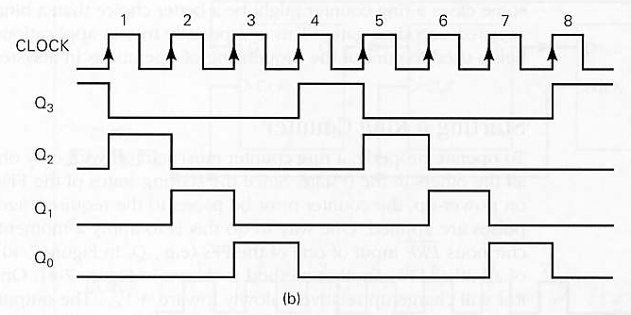
Four-Bit Ring Counter

Slide 18
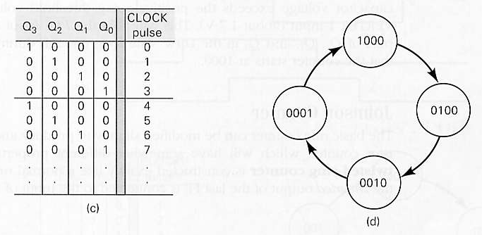
State Transition Diagram
MOD-4 Counter
Does not require decoding gates

Slide 19
Starting a Ring Counter
Start off with only one FF in the 1 state and all others in the 0 state.
Use PRE and CLR inputs and Schmitt-trigger INVERTERS(page 233).

Slide 20
Johnson Counter
Also known as the twisted-ring counter.
Same as the ring counter except that the inverted output of the last FF is connected to the input of the first FF.
Counting sequence: 000→100→110→111→011→001→000
A MOD-6 counter (twice the number of FFs)
Needs decoding gates.
Figure 7-42

Slide 21
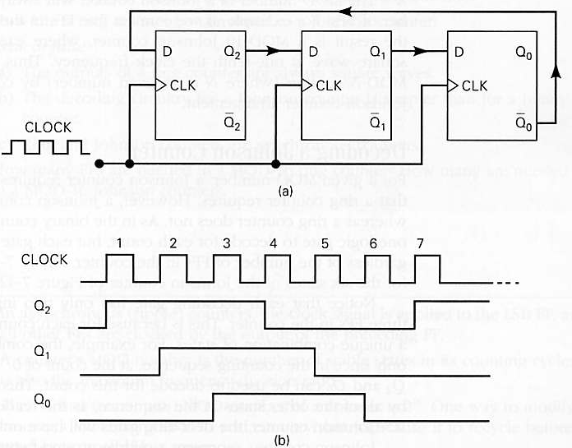
MOD-6 Johnson Counter

Slide 22
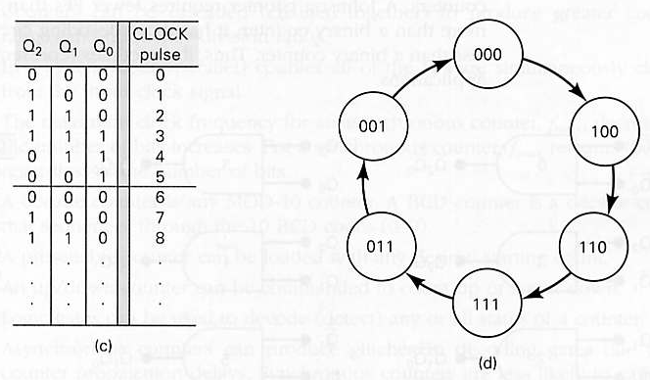
State Transition Diagram

Slide 23
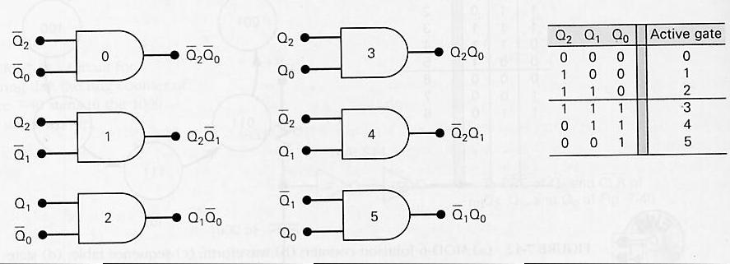
Decoding a Johnson Counter
Each decoding has only two inputs.
It can be shown that for any size Johnson counter, the decoding gates will have only two inputs.

Slide 24
Counter Applications
Frequency counter: a circuit that measures and displays the frequency of a signal.
Digital clock.

Slide 25
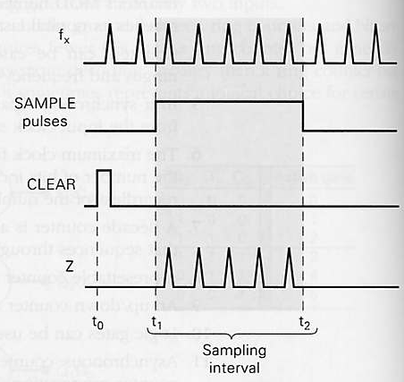
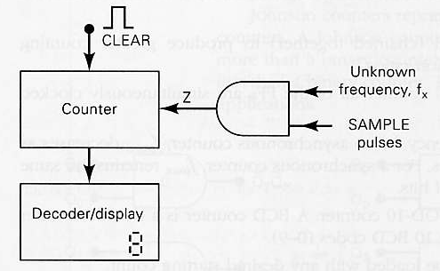
Basic Frequency-counter Method

Slide 26
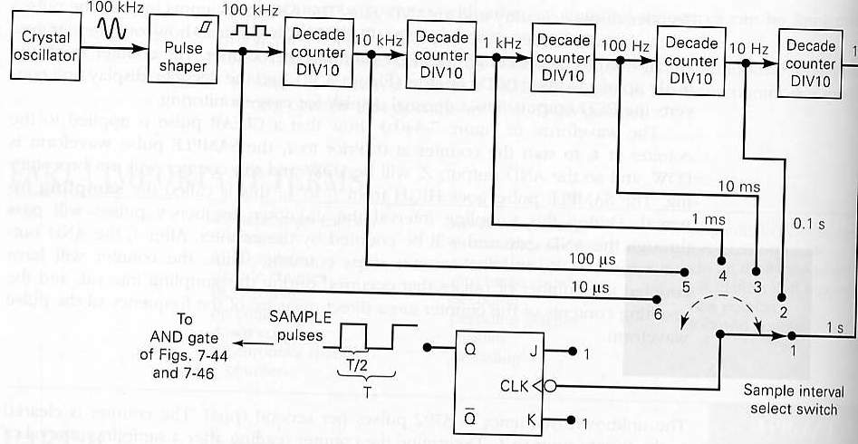
Obtaining Accurate Sampling Intervals

Slide 27
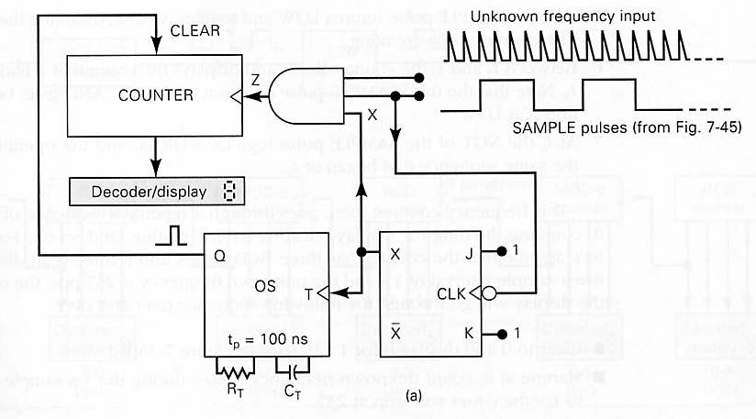
Complete Frequency Counter

Slide 28
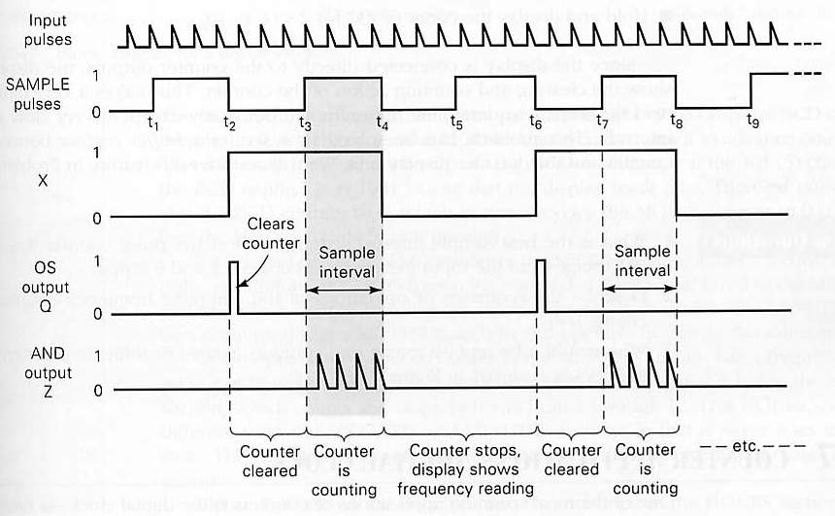
Timing Diagram

Slide 29
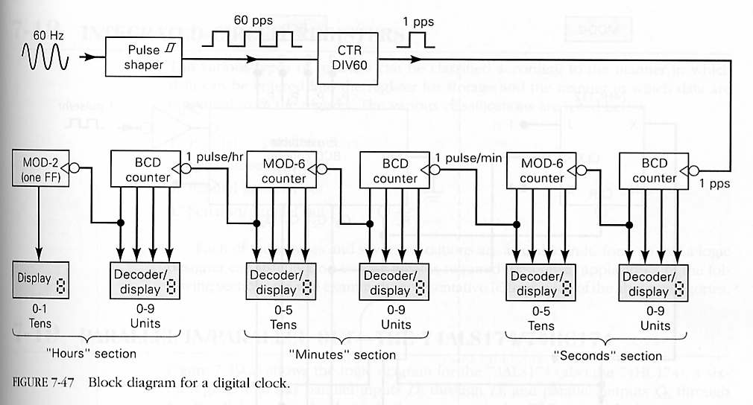
Digital Clock

Slide 30
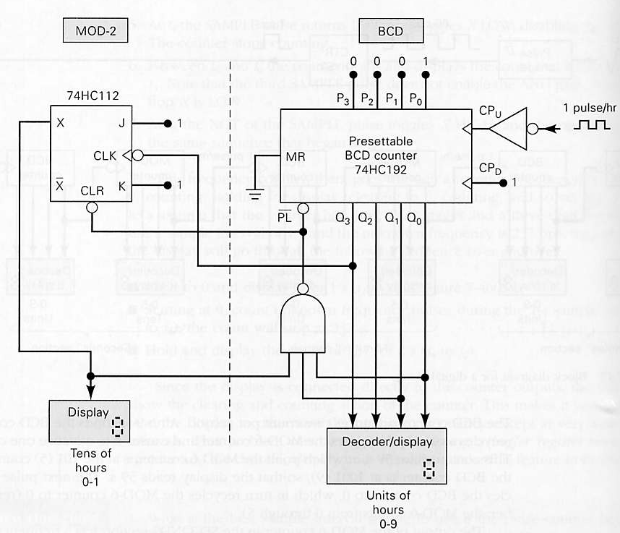
HOURS Section

Slide 31
Integrated-Circuit Registers
Parallel in/Parallel Out: 74174 and 74178
Serial in/Serial Out: 4731B
Parallel in/Serial Out:74165,74LS165,74HC165
Serial in/Parallel Out: 74164,74LS164,74HC164

