Slide 1
Digital Systems:
Number Systems and Codes
Wen-Hung Liao, Ph.D.

Slide 2
Objectives
Convert a number from one number system (decimal, binary, hexadecimal, gray code) to its equivalent in one of the other number systems.
Cite the advantages of the hexadecimal number systems.
Count in hexadecimal.
Gray code
Represent decimal numbers using the BCD code; cite the pros and cons of using BCD.
Understand the difference between BCD and straight binary.
Understand the purpose of alphanumeric codes such as the ASCII code.
Explain the parity method for error detection.
Determine the parity bit to be attached to a digital data string

Slide 3
Binary-to-Decimal Conversions
Example 1: 110112
Example 2: 101101012

Slide 4
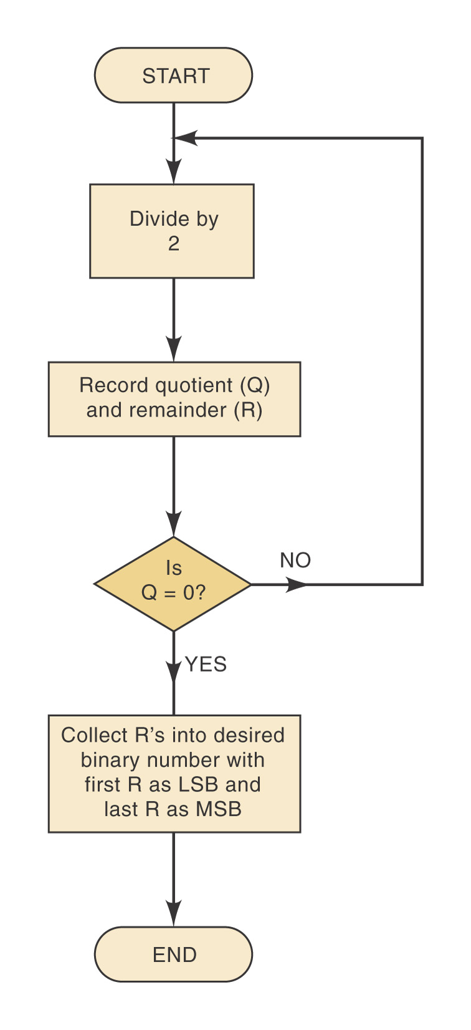
Decimal-to-Binary Conversions
Method one: reverse the process of binary-to-decimal conversion.
Method two: repeated division
LSB: Least Significant Bit
MSB: Most Significant Bit
Example: 37₁₀=100101₂

Slide 5
Hexadecimal Number System
The hexadecimal number system has a base of 16.
Sixteen possible digits: 0,1,2,3,4,5,6,7,8,9,A,B,C,D,E,F
Hex-to-decimal conversion
Decimal-to-hex conversion
Hex-to-binary conversion
Binary-to-hex conversion

Slide 6
BCD Code
Binary-Coded-Decimal versus straight binary coding.
0 → 0000, 1→ 0001, 2→0010, 3→0011, 4→0100, 5→0101, 6→0110, 7→0111, 8→ 1000, 9→ 1001
874 (decimal)→ 1000 0111 0100 (BCD)
Nibble: half byte

Slide 7
Gray Code
3-bit gray code
Hamming distance
between consecutive
codes=1
Decimal | Binary | Gray
0 | 000 | 000
1 | 001 | 001
2 | 010 | 011
3 | 011 | 010
4 | 100 | 110
5 | 101 | 111
6 | 110 | 101
7 | 111 | 100

Slide 8
Conversion Algorithms
From binary to Gray:
From Gray to binary:
Note: A XOR B = A’B+AB’
Let B[n:0] be the input array of bits in the usual binary representation, [0] being LSB
Let G[n:0] be the output array of bits in Gray code
G[n] = B[n]
for i = n-1 downto 0 G[i] = B[i+1] XOR B[i]
Let G[n:0] be the input array of bits in Gray code
Let B[n:0] be the output array of bits in the usual binary representation
B[n] = G[n]
for i = n-1 downto 0 B[i] = B[i+1] XOR G[i]

Slide 9
Alphanumeric Codes
ASCII code: American Standard Code for Information Interchange
The ASCII code is a 7 bit code, so it has 2^7=128 possible code groups.
Refer to Table 2-4.

Slide 10
Parity Method for Error Detection
Whenever information is transmitted from one device to another device, errors can occur due to noise.
Parity method can be used to detect error.
A parity bit is an extra bit that is attached to a code group that is being transferred.
In even-parity method, the value of the parity bit is chosen so that the total # of 1s in the code group (including the parity bit) is an even number.
In odd-parity method, the value of the parity bit is chosen so that the total # of 1s in the code group (including the parity bit) is an odd number.

Slide 11
Example
ASCII ‘C’: 1000011
Even-parity method: 1 1000011
Odd-parity method: 0 1000011
The parity bit is issued to detect any single-bit errors that occur during the transmission

