Slide 1
IC Logic Families
Wen-Hung Liao, Ph.D

Slide 2
Digital IC Terminology
Voltage Parameters:
  V_{IH}(min): high-level input voltage, the minimum voltage level required for a logic 1 at an input.
  V_{IL}(max): low-level input voltage
  V_{OH}(min): high-level output voltage
  V_{OL}(max): low-level output voltage

Slide 3
Current Parameters
I_{IH}(min): high-level input current, the current that flows into an input when a specified high-level voltage is applied to that input.
I_{IL}(max): low-level input current
I_{OH}(min): high-level output current
I_{OL}(max): low-level output current

Slide 4
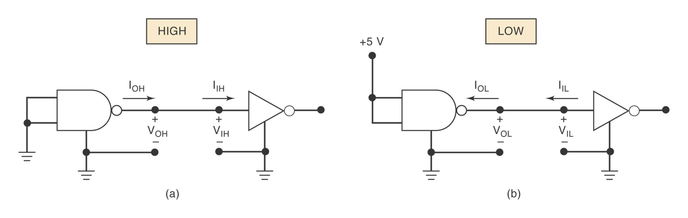
Figure 8-1

Slide 5
Fan-Out
The maximum number of standard logic inputs that an output can drive reliably.
Also known as the loading factor.
Related to the current parameters (both in high and low states.)

Slide 6
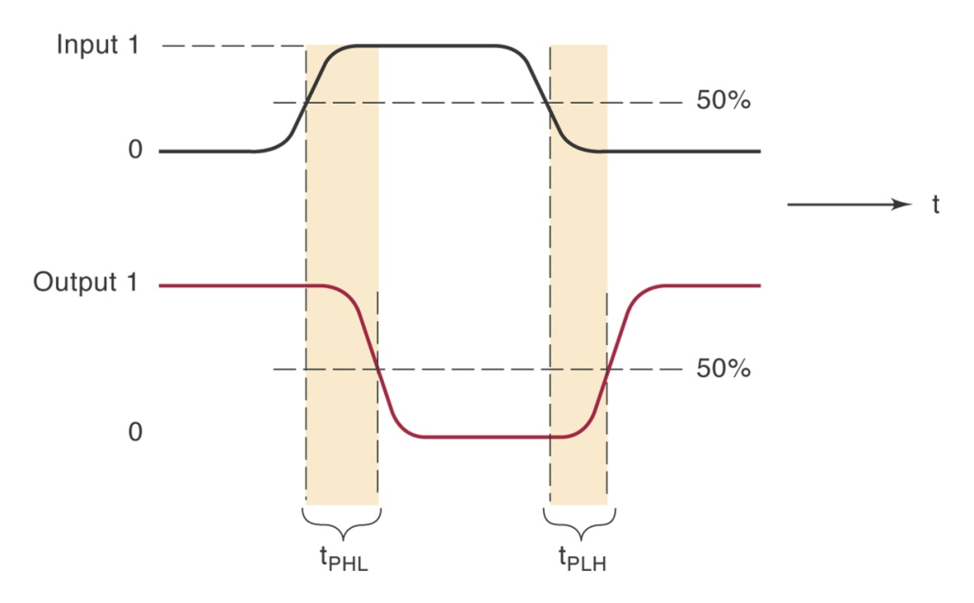
Propagation Delays
t_{pLH}: delay time in going from logical 0 to logical 1 state (LOW to HIGH)
t_{pHL}: delay time in going from logical 1 to logical 0 state (HIGH to LOW)
Measured at 50%
points.

Slide 7
Power Requirements
Every IC needs a certain amount of electrical power to operate.
V_{cc} (TTL)
V_{DD}(MOS)
Power dissipation determined by I_{cc} and V_{cc}.
Average I_{cc}(avg)= (I_{CCH} + I_{CCL})/2
P_{D}(avg) = I_{cc}(avg) x V_{cc}

Slide 8
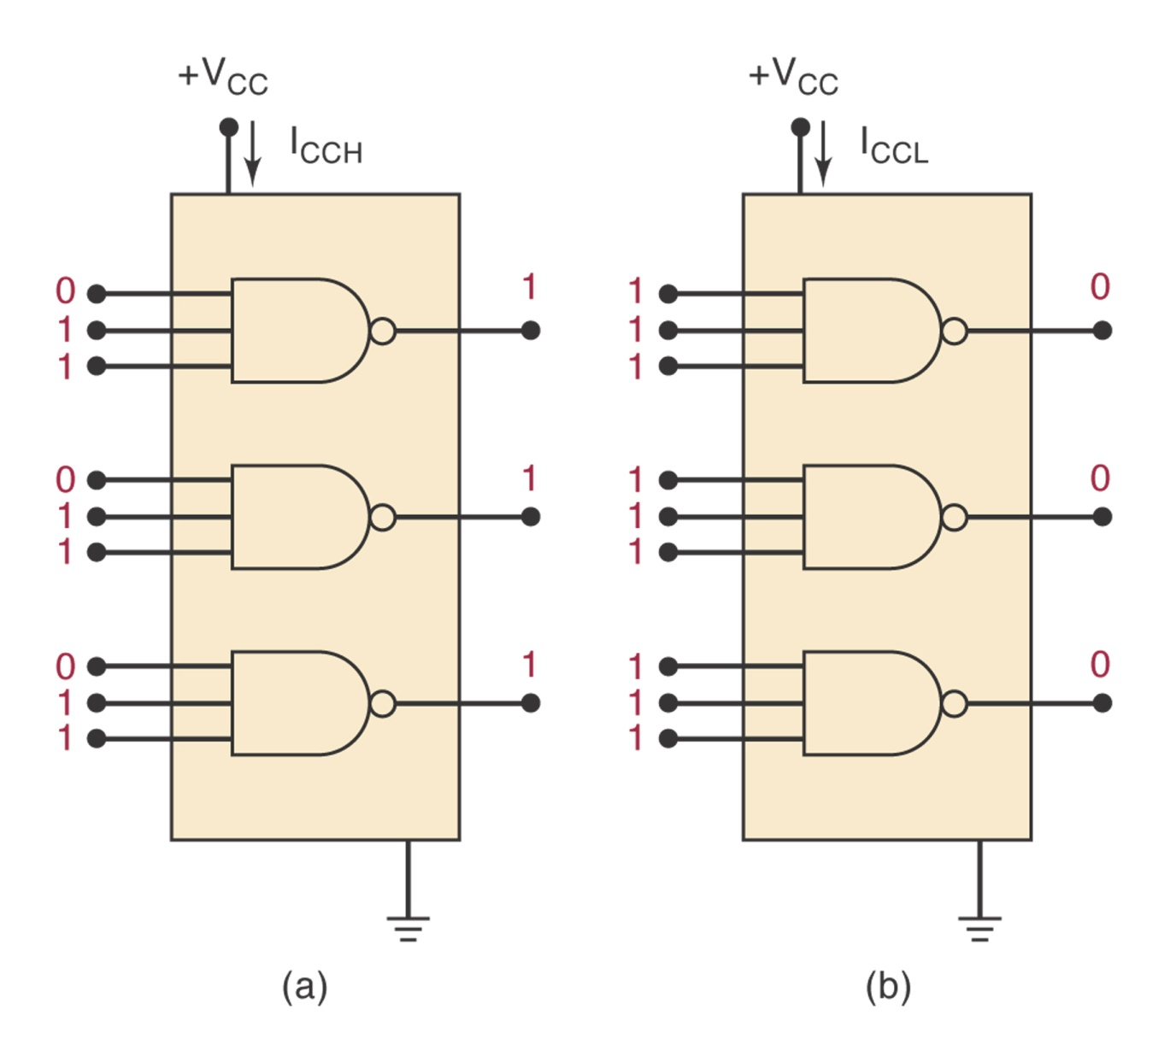
Figure 8-3: I_{CCH} and I_{CCL}.

Slide 9
Speed-Power Product
Desirable properties:
  Short propagation delays (high speed)
  Low power dissipation
Speed-power product measures the combined effect.

Slide 10
Noise Immunity
What happens if noise causes the input voltage to drop below V_{IH}(min) or rise above V_{IL}(max)?
The noise immunity of a logic circuit refers to the circuit’s ability to tolerate noise without causing spurious changes in the output voltage.
Noise margin: Figure 8-4.
V_{NH}=V_{OH}(min)-V_{IH}(min)
V_{NL}=V_{IL}(max)-V_{OL}(max)
Example 8-1.

Slide 11
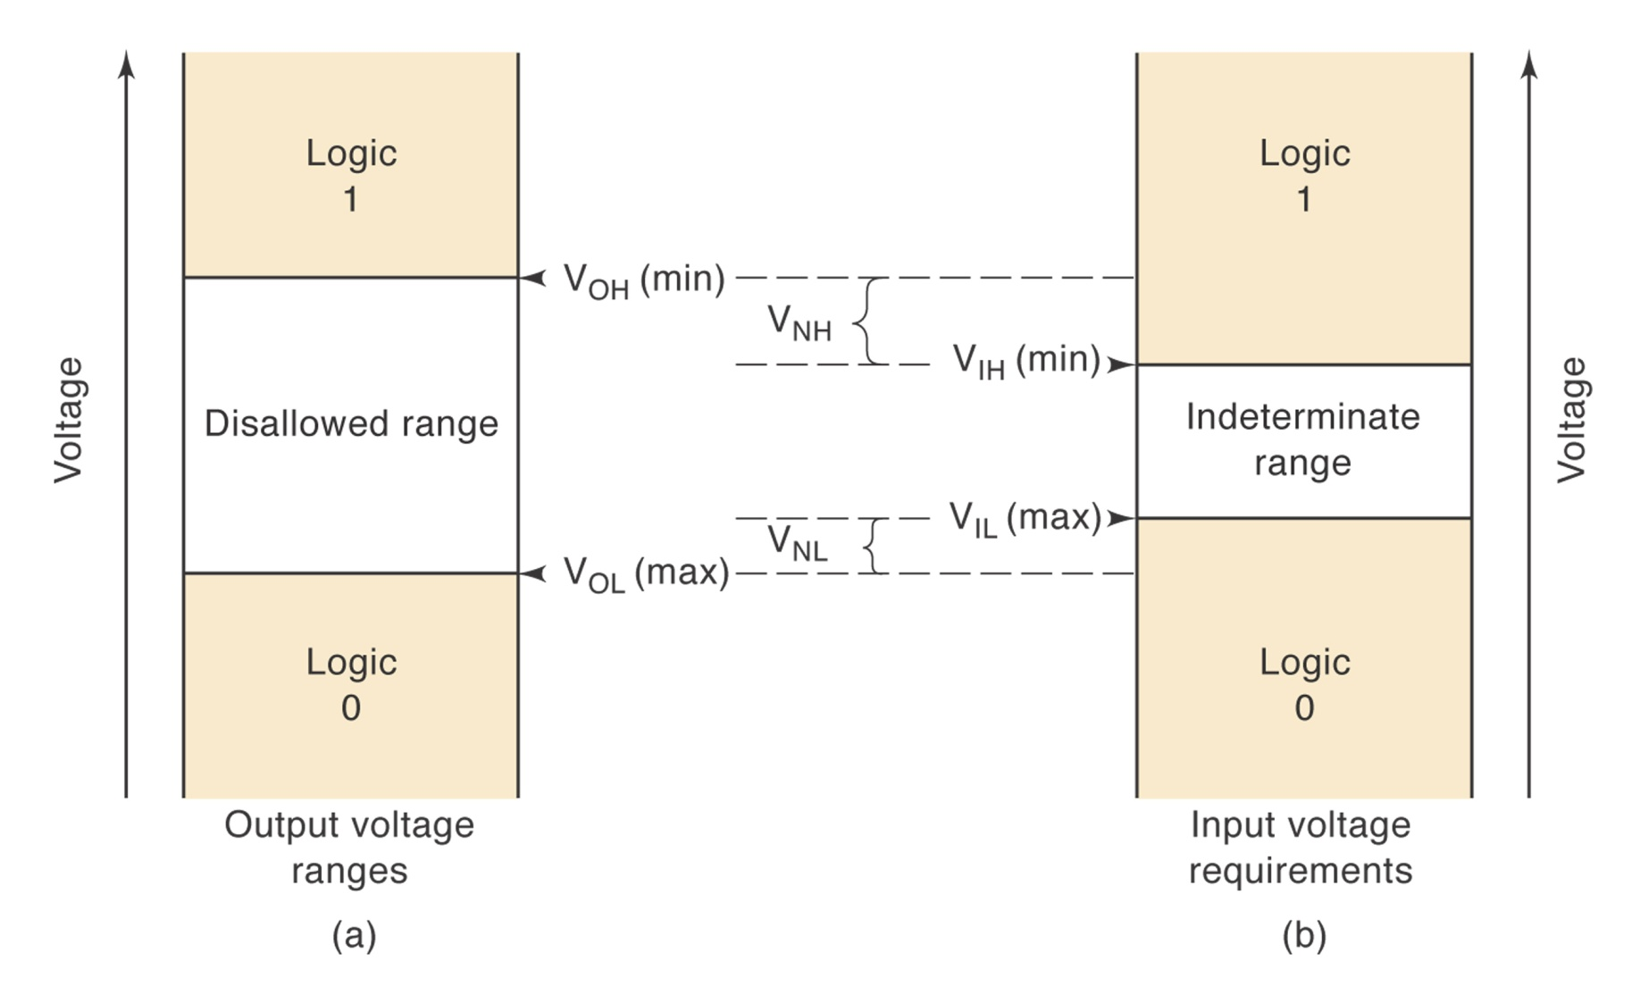
Figure 8-4: Noise Margin

Slide 12
Invalid Voltage Levels
For proper operation the input voltage levels to a logic must be kept outside the indeterminate range.
Lower than V_{IL}(max) and higher than V_{IH}(min).

Slide 13
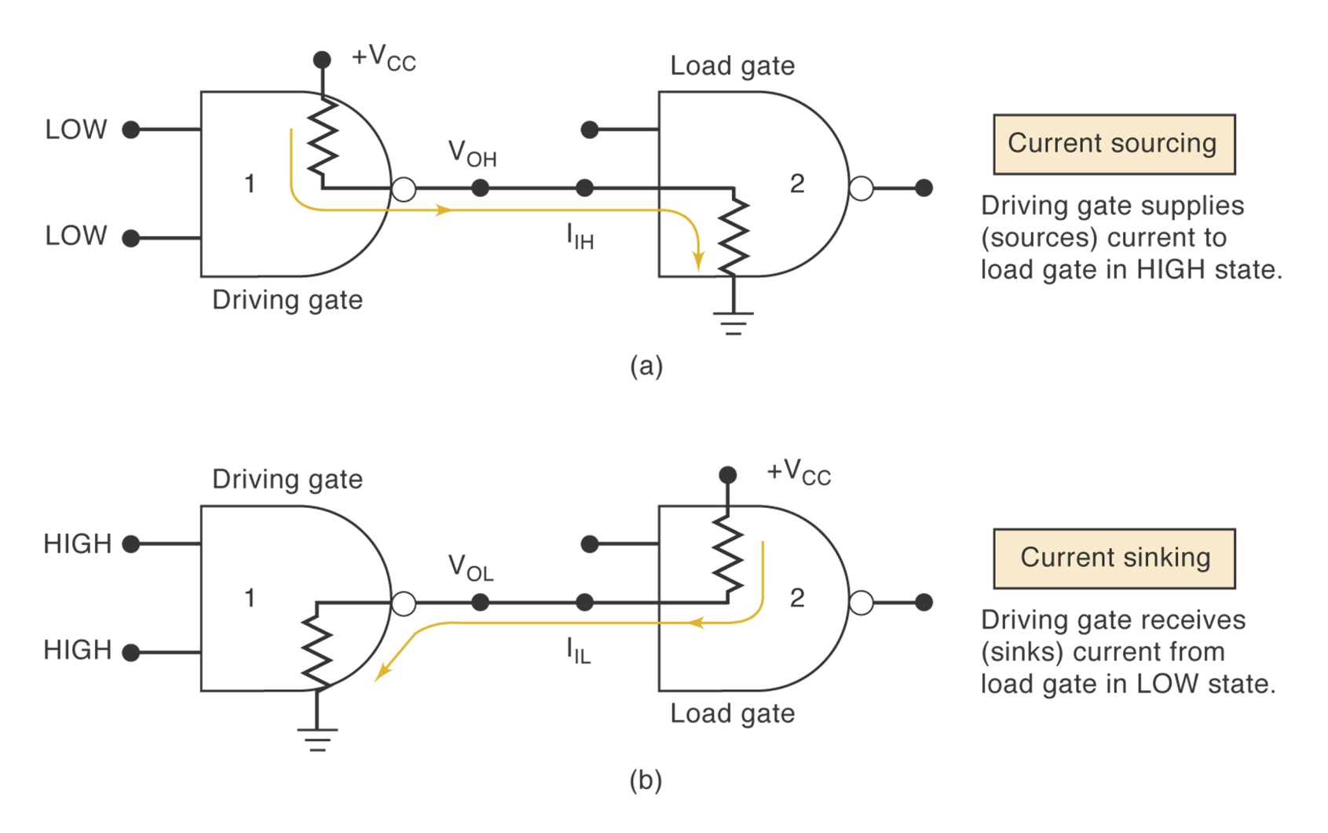
Current-Sourcing and Sinking

Slide 14
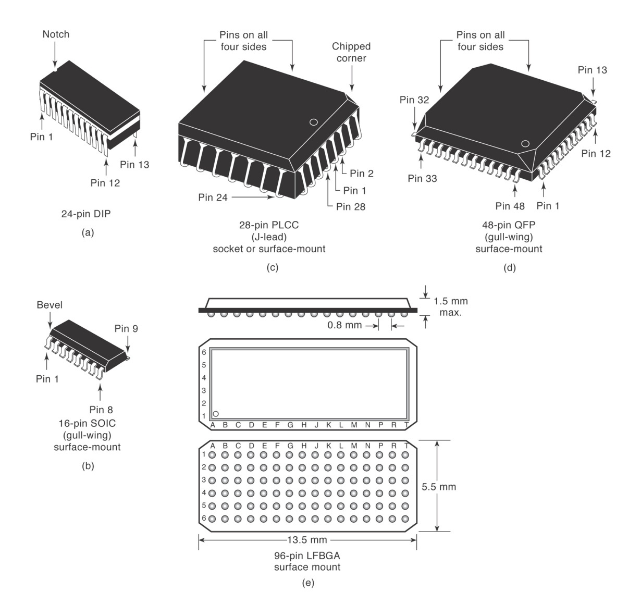
IC Packages
DIP
J-Lead
Gull-wing
Table 8-2 for a complete list.

Slide 15
The TTL Logic Family
Transistor-transistor logic
Figure 8-7: NAND gate.
Circuit operation: LOW state, current-sinking
Circuit operation: HIGH state, current-sourcing.

Slide 16
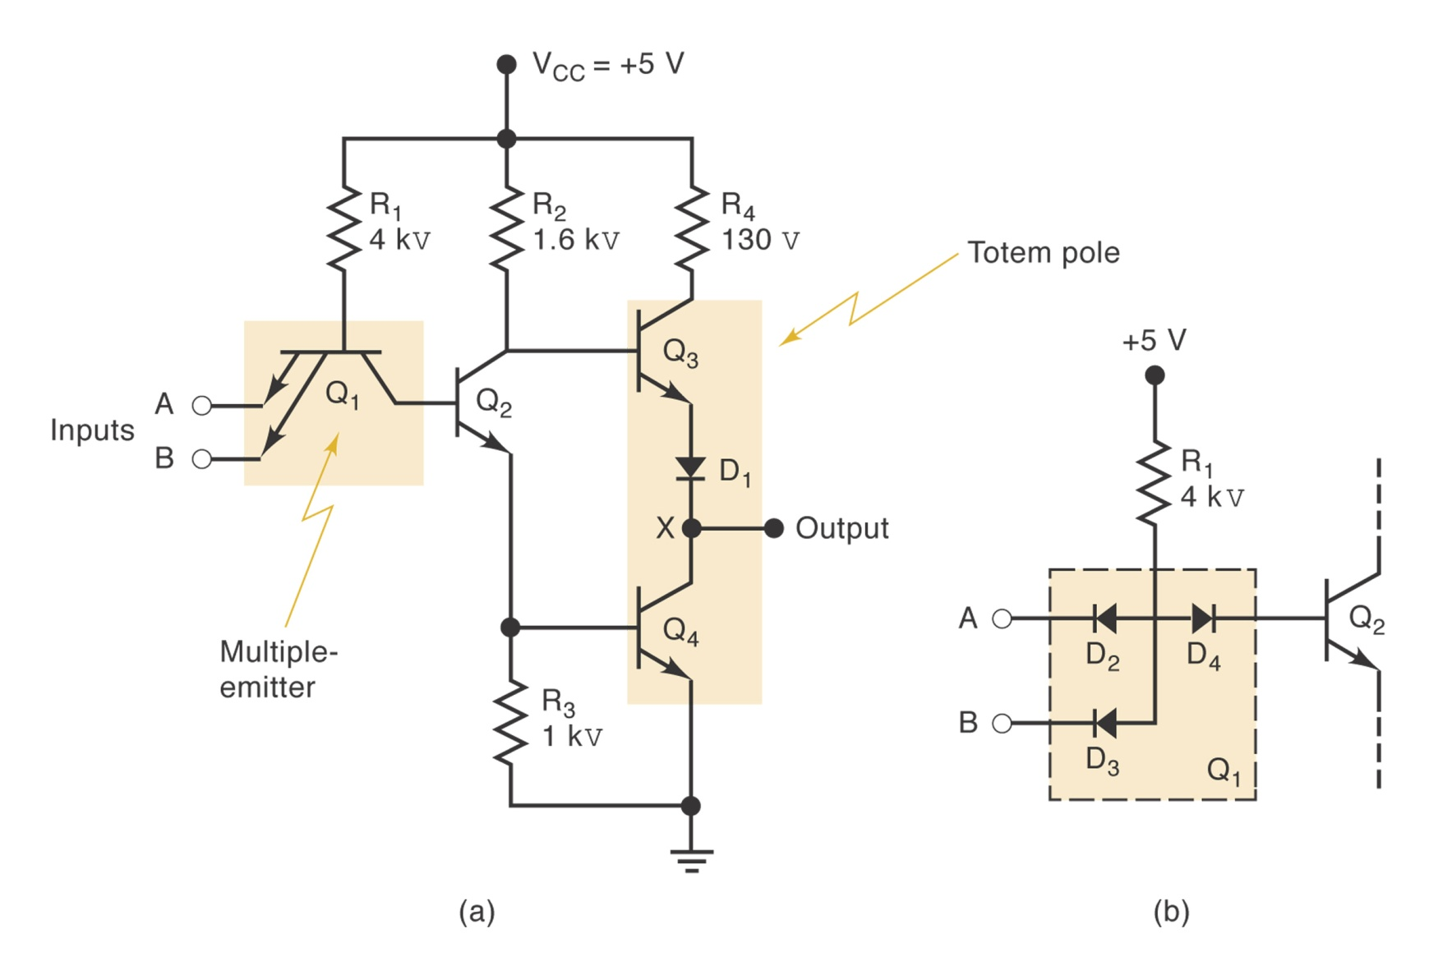
TTL NAND Gate

Slide 17
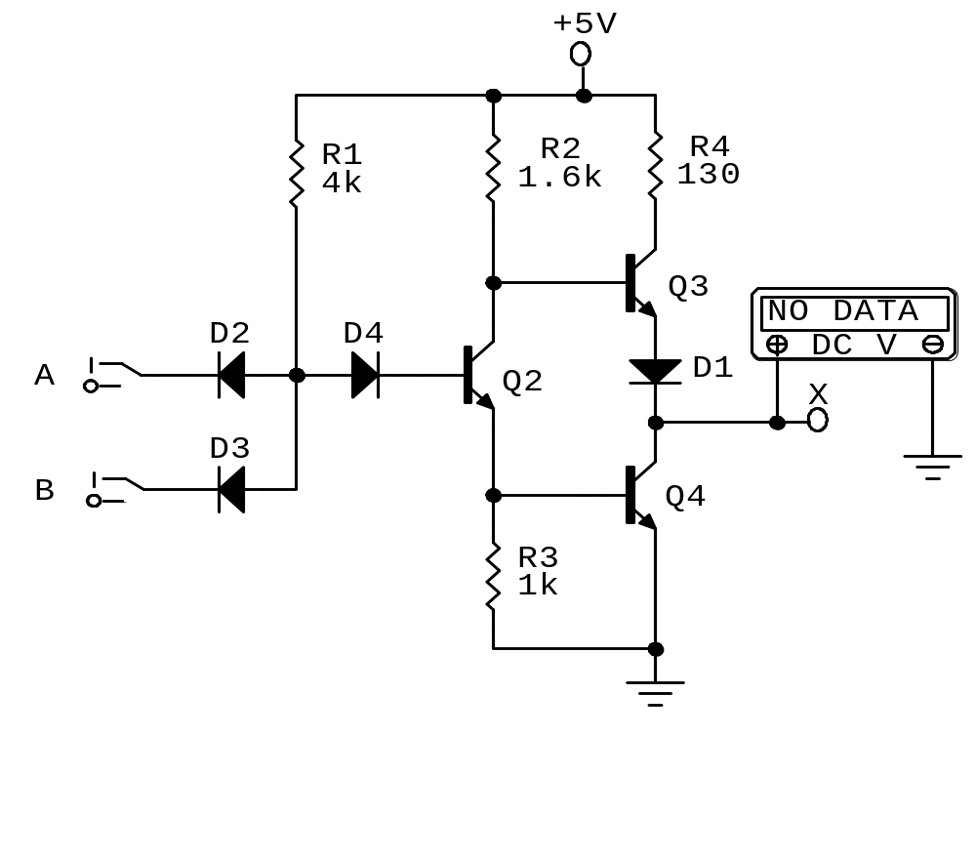
Figure 8-8: TTL NAND Gate

Slide 18
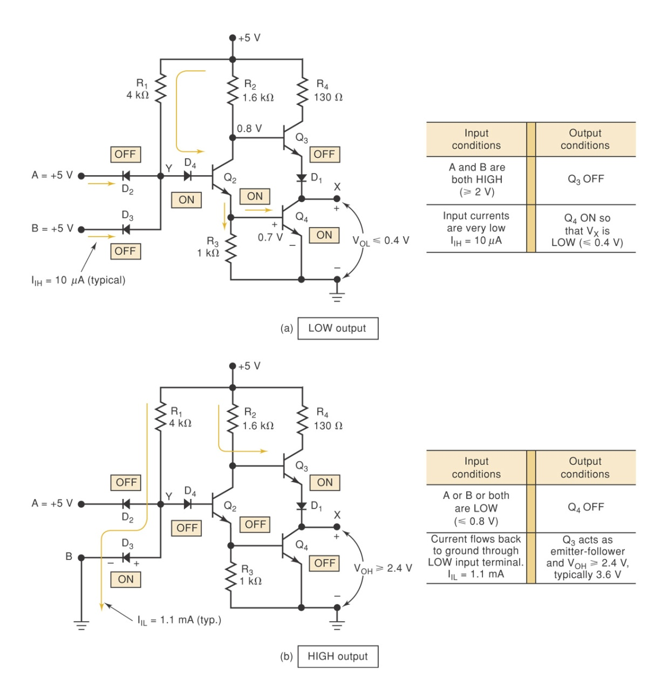
TTL NAND Gate

Slide 19
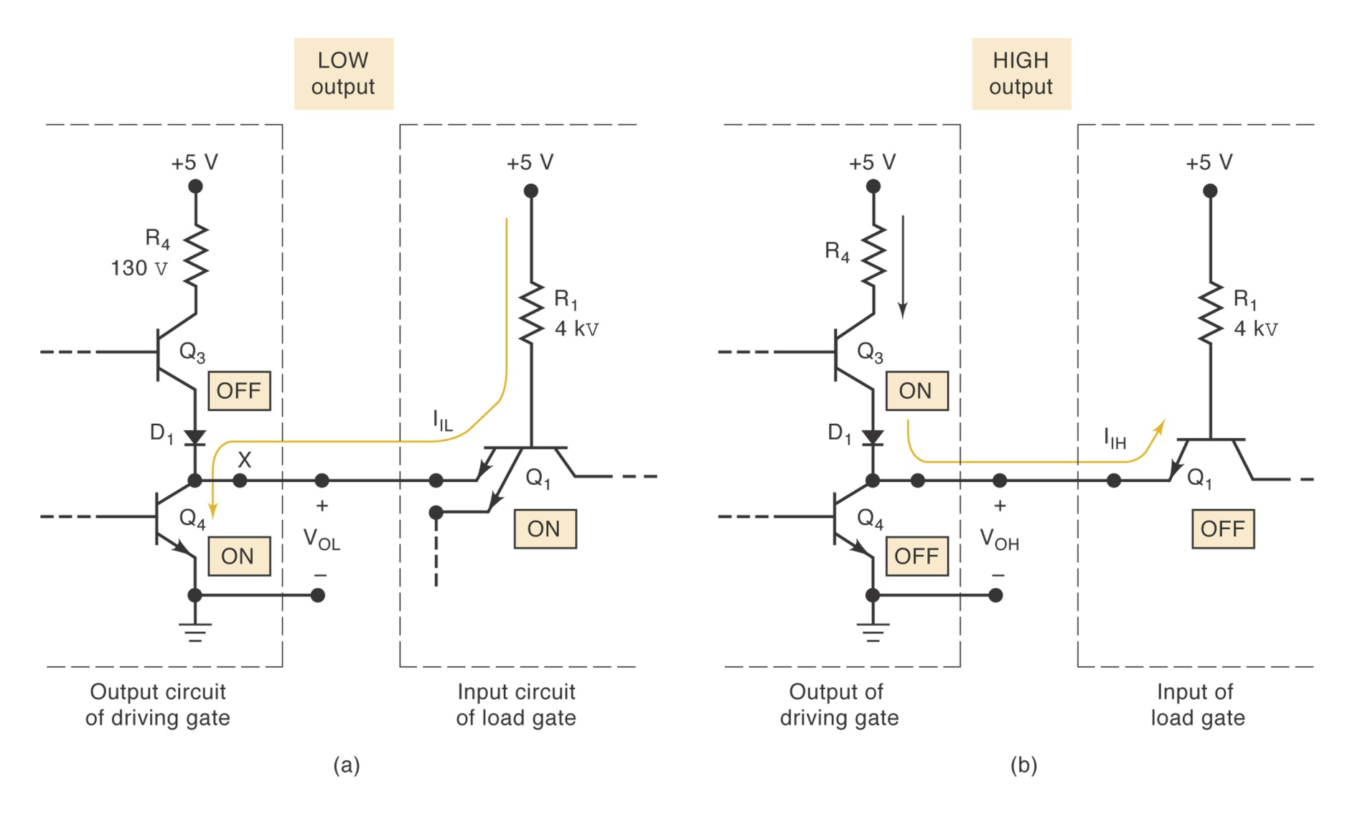
Current Sink/Source

Slide 20
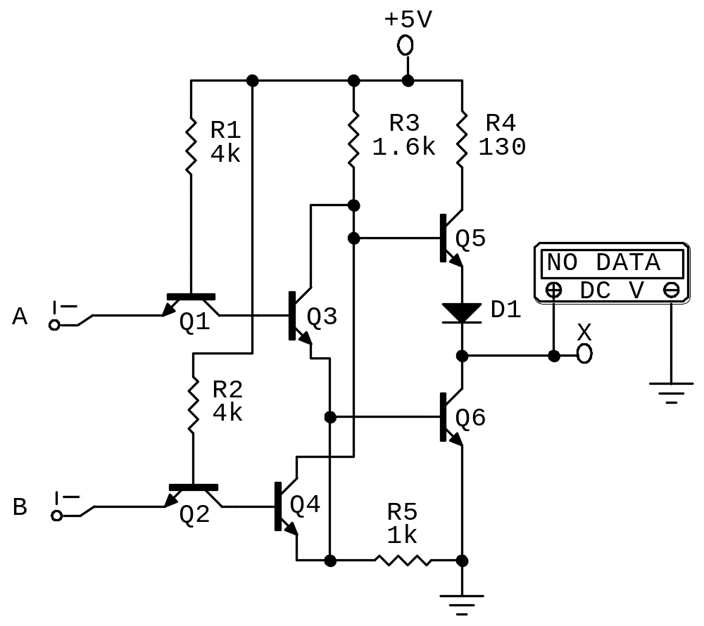
TTL NOR Gate Circuit

Slide 21
Standard TTL Characteristics
TI introduced first line of standard TTL: 54/74 series (1964)
Manufacturers’ data sheets (Figure 8-11)
  Supply voltage and temperature range
  Voltage levels
  Maximum voltage ratings
  Power dissipation
  Propagation delays
  Fan-out
Example 8-2: maximum average power dissipation and maximum average propagation delay.

Slide 22
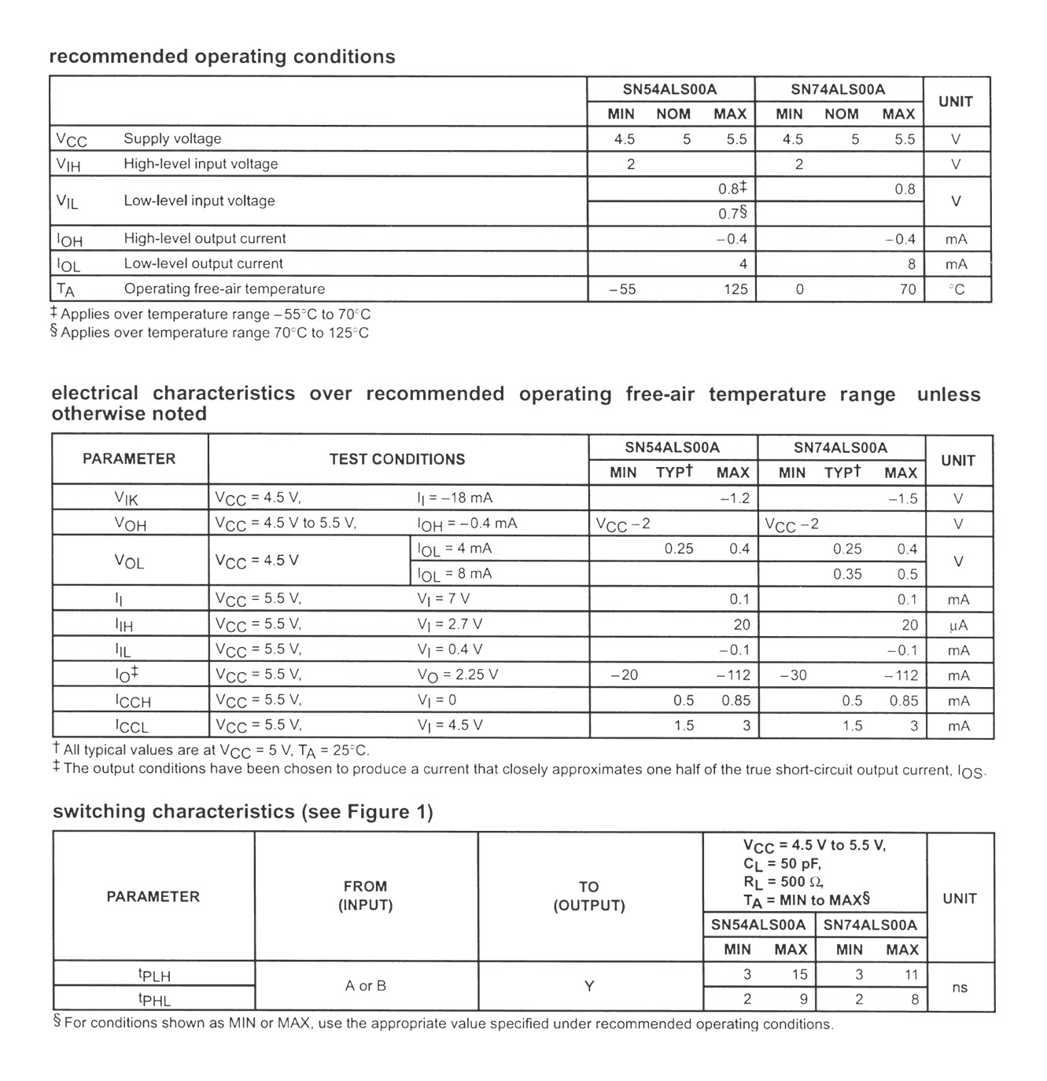
Manufacturers’ Data Sheet

Slide 23
Improved TTL Series
74 Series
Schottky TTL, 74S Series: higher speed
Low-Power Schottky TTL, 74LS series
Advanced Schottky TTL, 74AS Series
Advanced Low-Power Schottky TTL, 74ALS Series
74F-Fast TTL

Slide 24
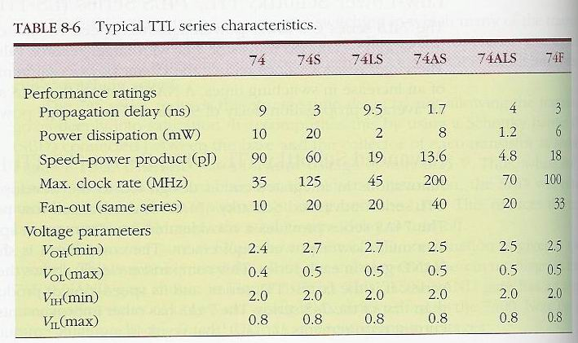
Comparison of TTL Series

Slide 25
Examples
Example 8-3: Noise margin of 74 and 74LS
Example 8-4: TTL series with max number of fan-out

Slide 26
TTL Loading and Fan-Out
Figure 8-13: currents when a TTL output is driving several inputs.
TTL output has a limit, I_{OL}(max), on how much current it can sink in the LOW state.
It also has a limit, I_{OH}(max), on how much current it can source in the HIGH state.

Slide 27
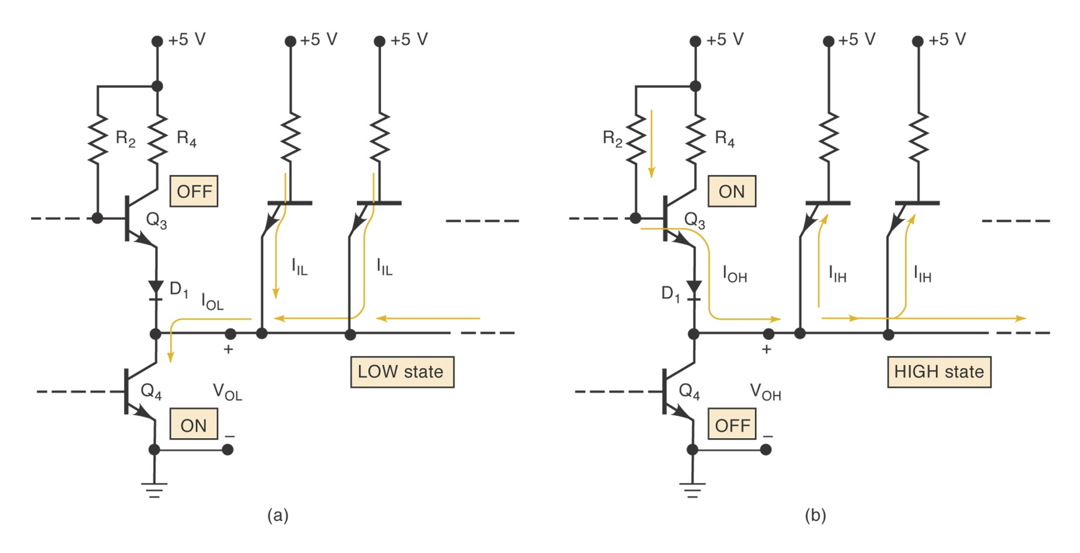
Figure 8-13

Slide 28
Determining the fan-out
Same IC family.
Find fan-out (LOW):I_{OL}(max)/I_{IL}(max)
Find fan-out (HIGH):I_{OH}(max)/I_{IH}(max)
Fan-out: smaller of the above
Example 8-5: Fan-out of 74ALS00 NAND gates
Example 8-6: Fan-out of 74AS20 NAND gates

Slide 29
Determining the fan-out
Different IC families
Step 1: add up the I_{IH} for all inputs connected to an output. The sum must be less than the output’s I_{OH} specification.
Step 2: add up the I_{IL} for all inputs connected to an output. The sum must be less than the output’s I_{OL} specification.
Examples 8-7 to 8-9.

Slide 30
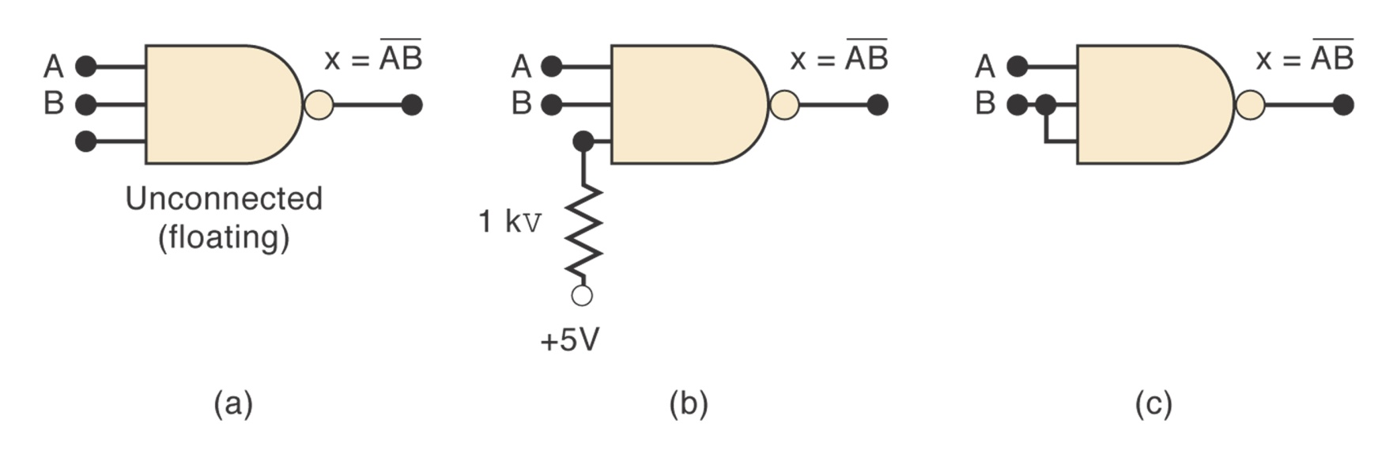
Other TTL Characteristics
Unconnected inputs (floating): acts like a logic 1.
Unused inputs: three different ways to handle.

Slide 31
Other TTL Characteristics (cont’d)
Tie-together inputs: common input generally represent a load that is the sum of the load current rating of each individual input. Exception: for AND and NAND gates, the LOW state input load will be the same as a single input no matter how many inputs are tied together.

Slide 32
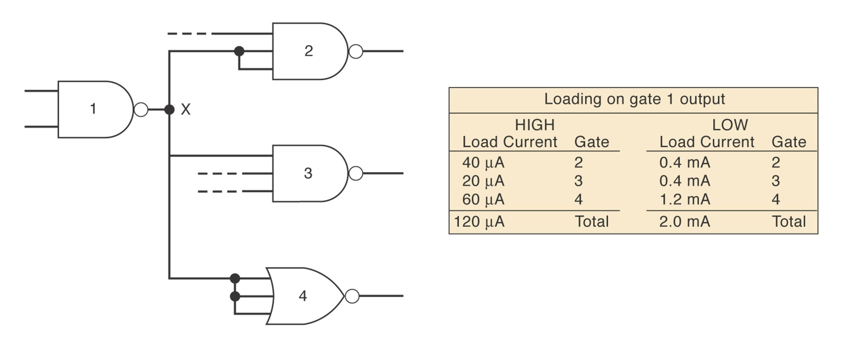
Example 8-10

Slide 33
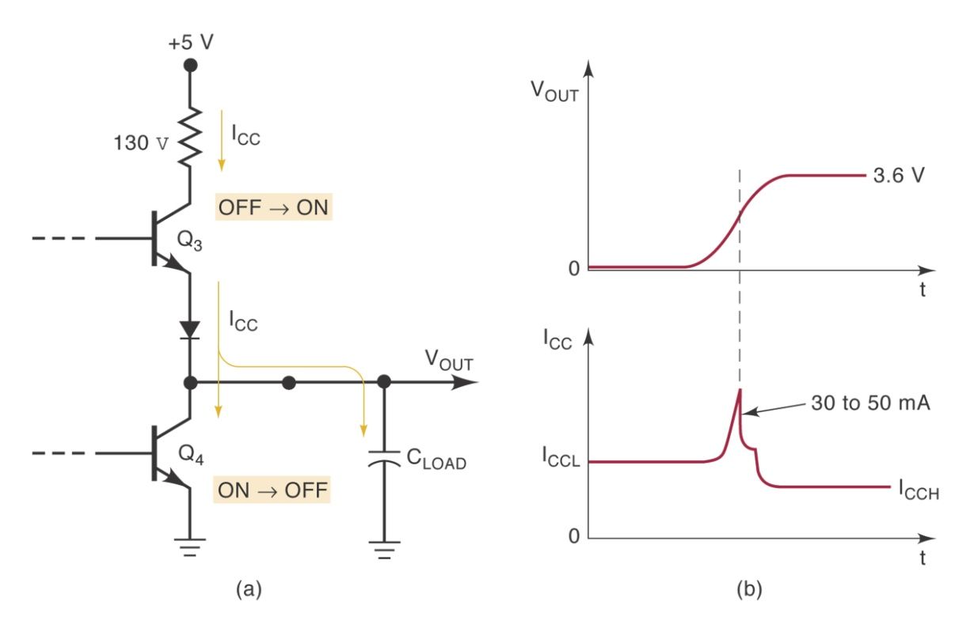
Other TTL Characteristics (cont’d)
Current transients (Figure 8-18)
Connecting TTL outputs together
  Totem-pole outputs should no be tied together

Slide 34
MOS Digital ICs
MOS: metal-oxide-semiconductor
MOSFET: MOS field-effect transistors.
The Good:
  Simple
  Inexpensive to fabricate
  Small
  Consumes little power
The bad:
  Static-electricity damage
  Slower than TTL

Slide 35
The MOSFET
P-MOS: P-channel MOS
N-MOS: N-channel MOS, fastest
CMOS: complementary MOS, higher speed, lower power dissipation.
Figure 8-20: how N-channel MOSFET works:
  V_{GS}=0V OFF State, R_{off}= 10¹⁰ ohms
  V_{GS}=5V ON State,R_{on}=1000 ohms

Slide 36
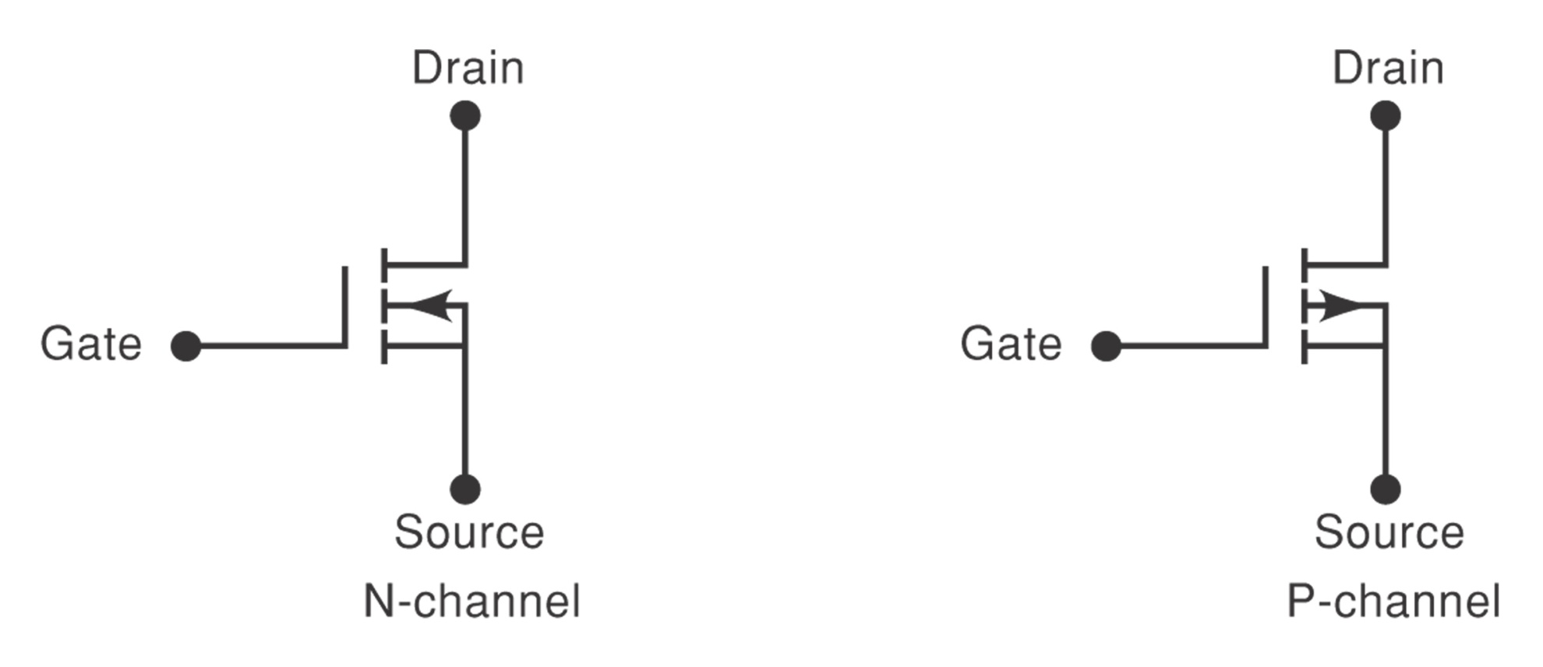
Schematic Symbols for MOSFET

Slide 37
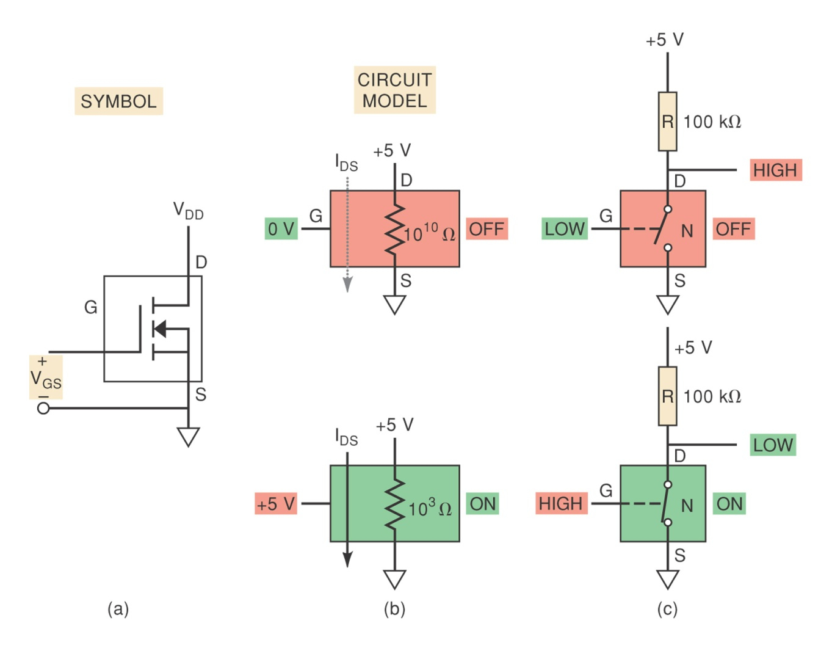
Fig. 8-20: N-channel MOSFET

Slide 38
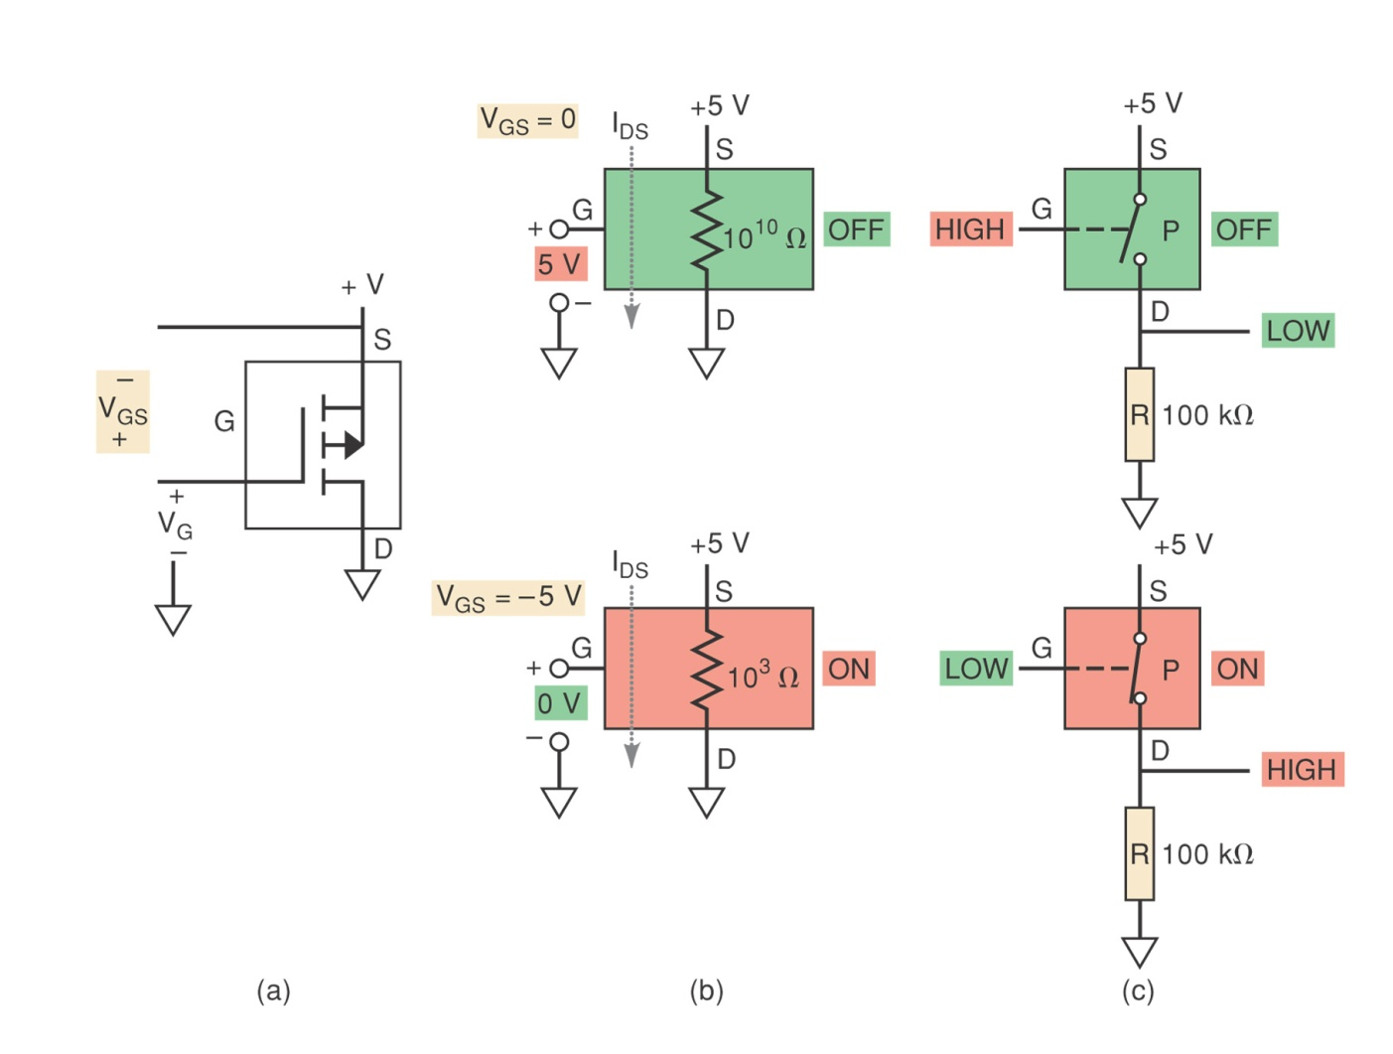
Fig. 8-21: P-channel MOSFET

Slide 39
CMOS
Uses both P- and N-channel MOSFETs in the same circuit to realize several advantages over the P-MOS and N-MOS families.
CMOS INVERTER (Figure 8-22)
CMOS NAND (Figure 8-23)
CMOS NOR (Figure 8-24)

Slide 40
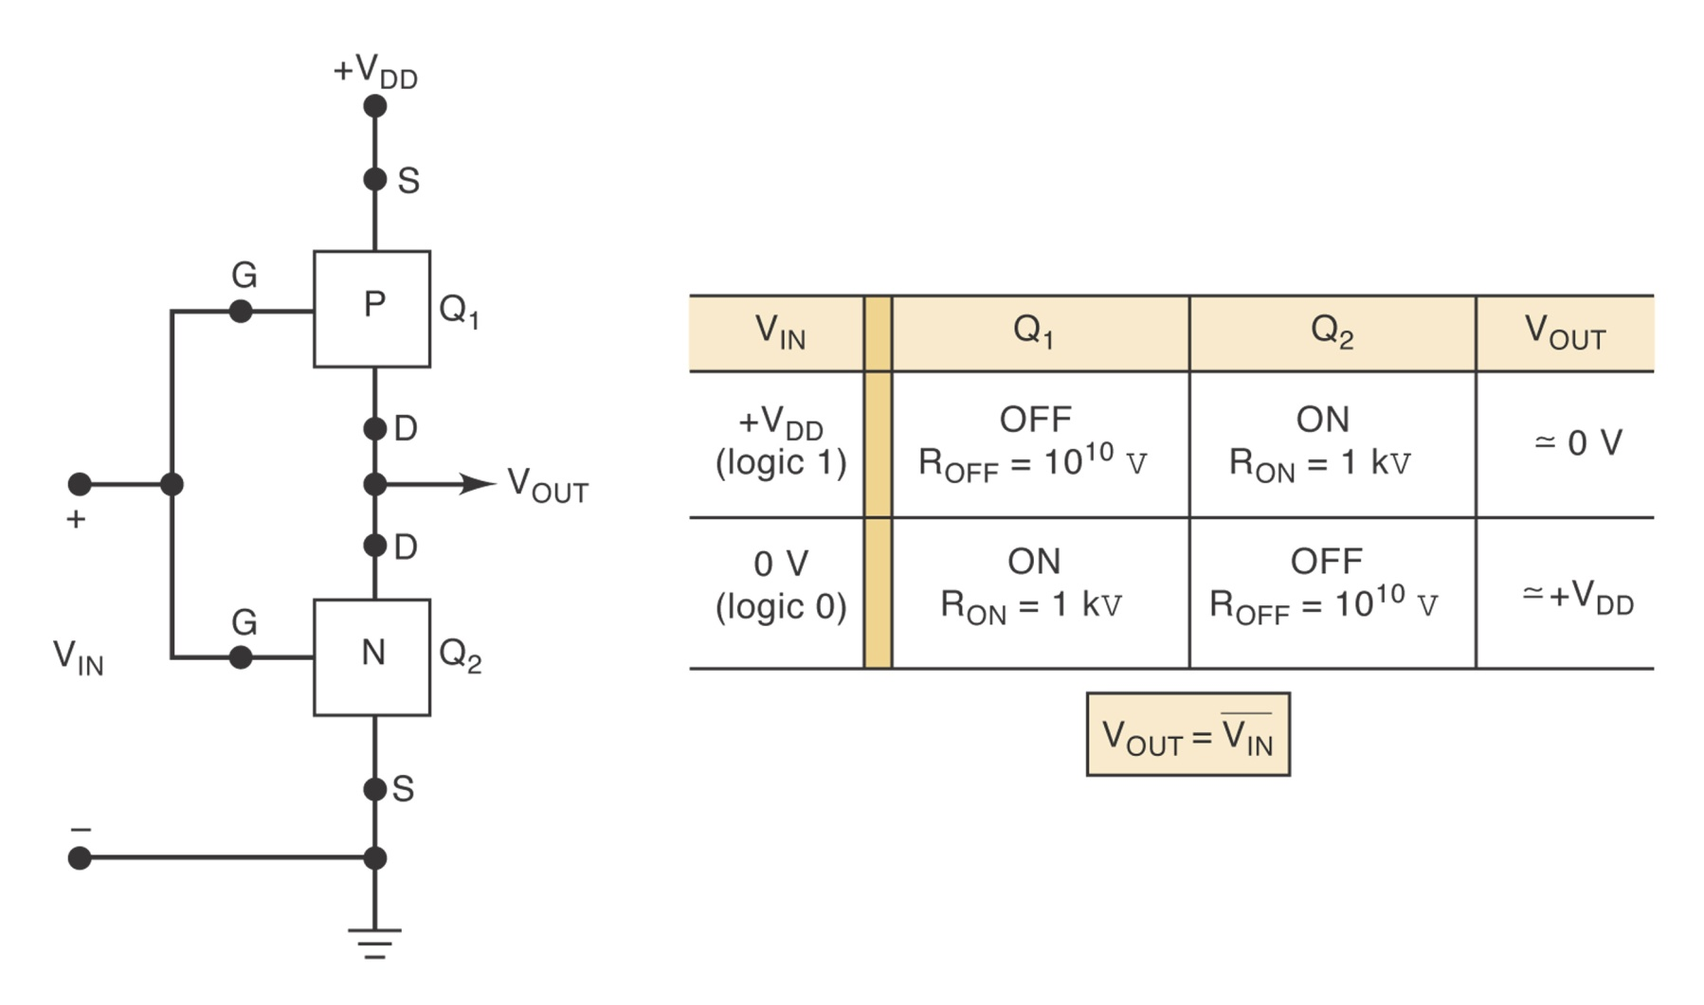
CMOS INVERTER (Figure 8-22)

Slide 41
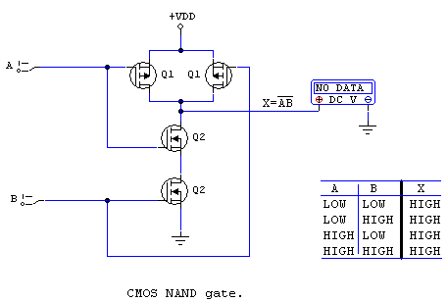
CMOS NAND Gate

Slide 42
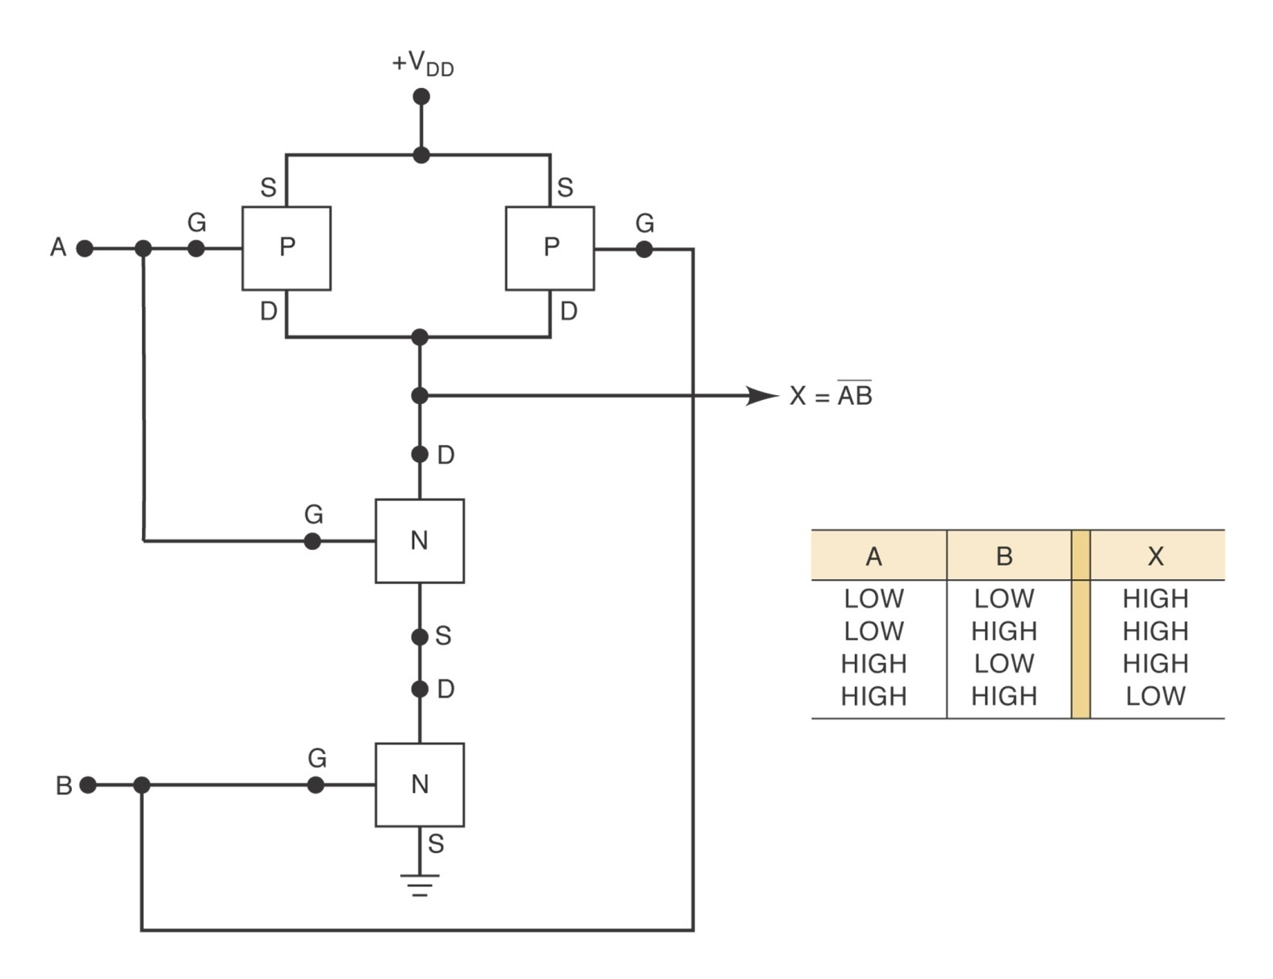
CMOS NAND Gate

Slide 43
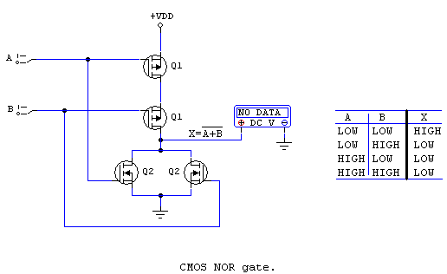
CMOS NOR Gate

Slide 44
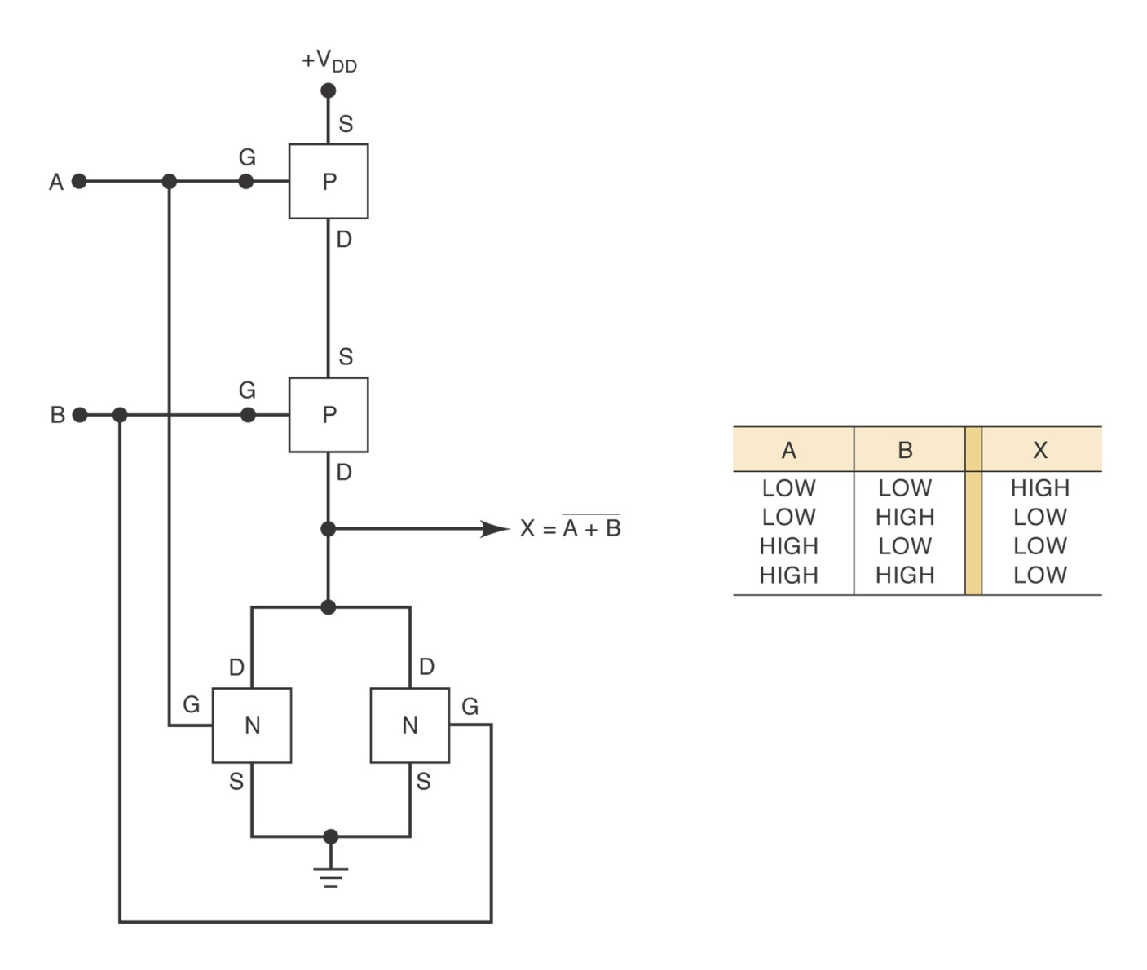
CMOS NOR Gate

Slide 45
CMOS Series Characteristics
Pin-compatible
Functionally equivalent
Electrically compatible
4000/14000 Series
74C, 74HC/HCT, 74AC/ACT, 74AHC,
BiCMOS (Bipolar + CMOS)
Table 8-10: low-voltage series characteristics
Table 8-11, comparison of ECL, CMOS and TTL Series

Slide 46
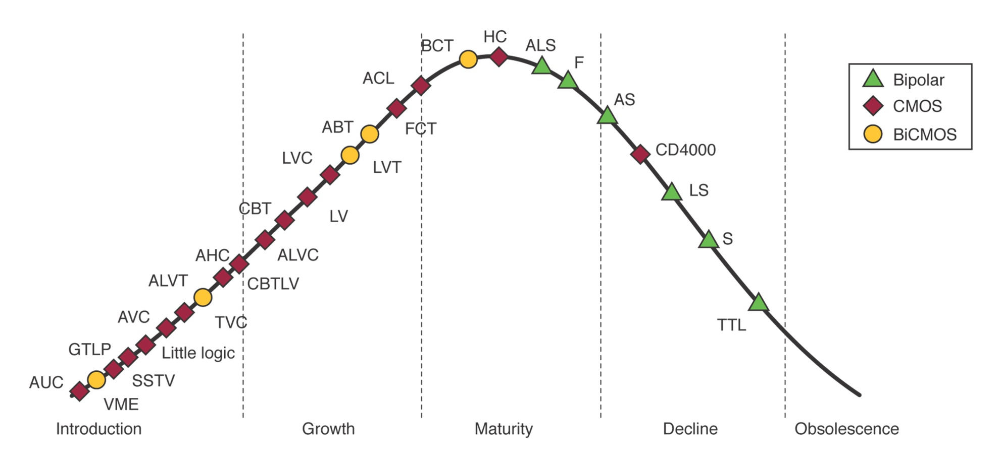
Logic Product Life Cycle

Slide 47
Low-Voltage Technology
5V → 3.3V
Reduces power dissipation
74LVC, 74ALVC, 74LV, 74LVT

Slide 48
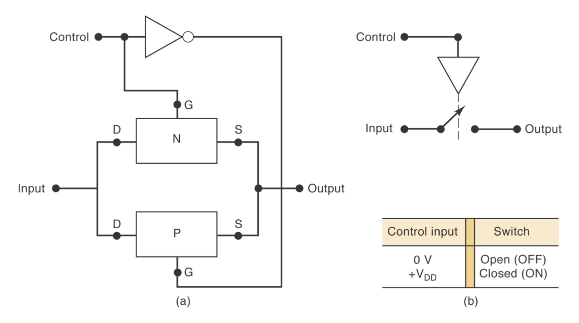
Other CMOS Issues
Conventional CMOS outputs should not be connected together.
Bilateral switch (Figure 8-43,44)

Slide 49
IC Interfacing
Connecting the output(s) of one circuit to the input(s) of another circuit that has different electrical characteristics.
Occurs often in complex digital systems, where designers utilize different logic families for different parts of system.
TTL driving CMOS
CMOS driving TTL

Slide 50
TTL driving CMOS
No problem with the current requirements (See Table 8-12)
V_{OH}(min) of TTL is low compared to V_{IH}(min) of some CMOS series (Table 8-9), use pull-up resistor to raise TTL output voltage (Figure 8-47)
TTL driving high-voltage CMOS (V_{DD} of CMOS is greater than 5V)
  Use 7407 buffer
  Use voltage level-translator (such as 4504B)

Slide 51
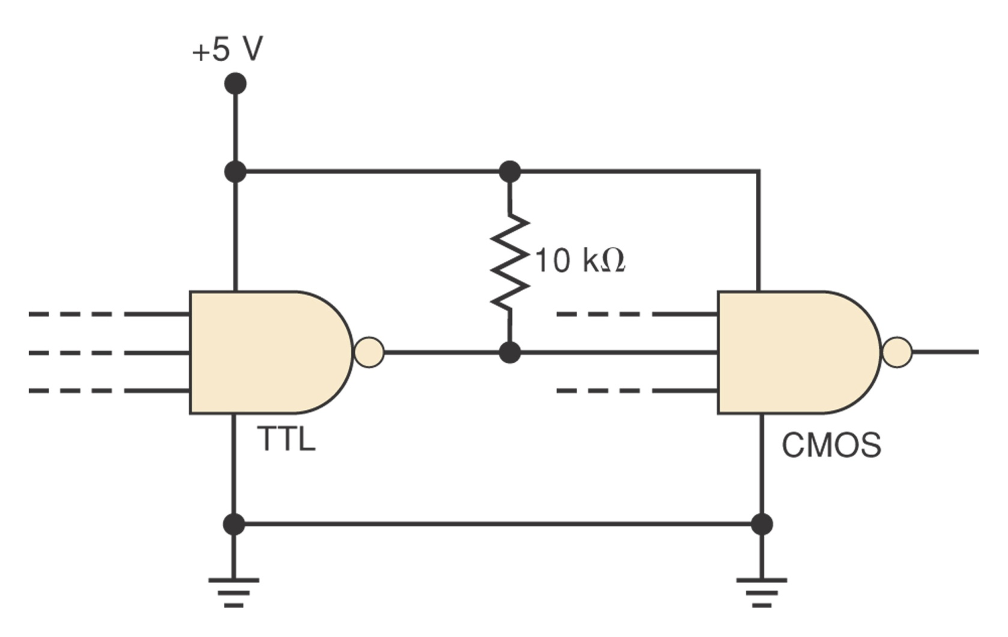
Figure 8-46

Slide 52
CMOS driving TTL
HIGH state:Table 8-9 and 8-12 indicate no special consideration the HIGH state.
LOW state: depends on the series used.

