Slide 1
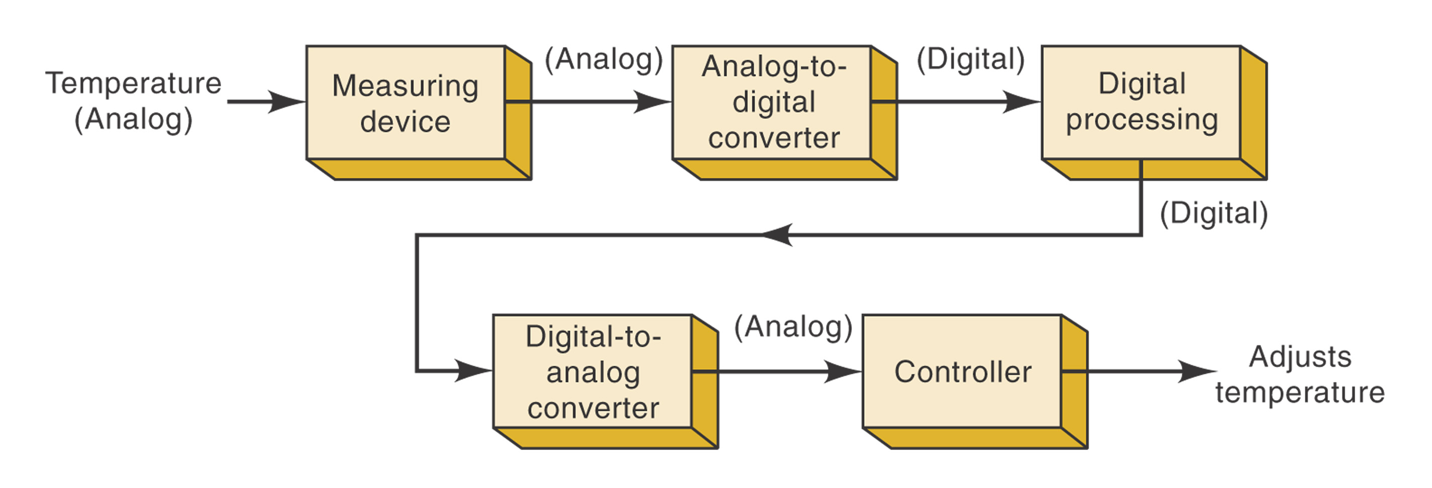
FIGURE 1-1 Block diagram of a temperature control system that requires analog/digital conversions to allow the use of digital processing techniques.
Ronald Tocci/Neal Widmer/Gregory Moss
Digital Systems: Principles and Applications, 9e
Copyright ©2004 by Pearson Education, Inc.
Upper Saddle River, New Jersey 07458
All rights reserved.

Slide 2
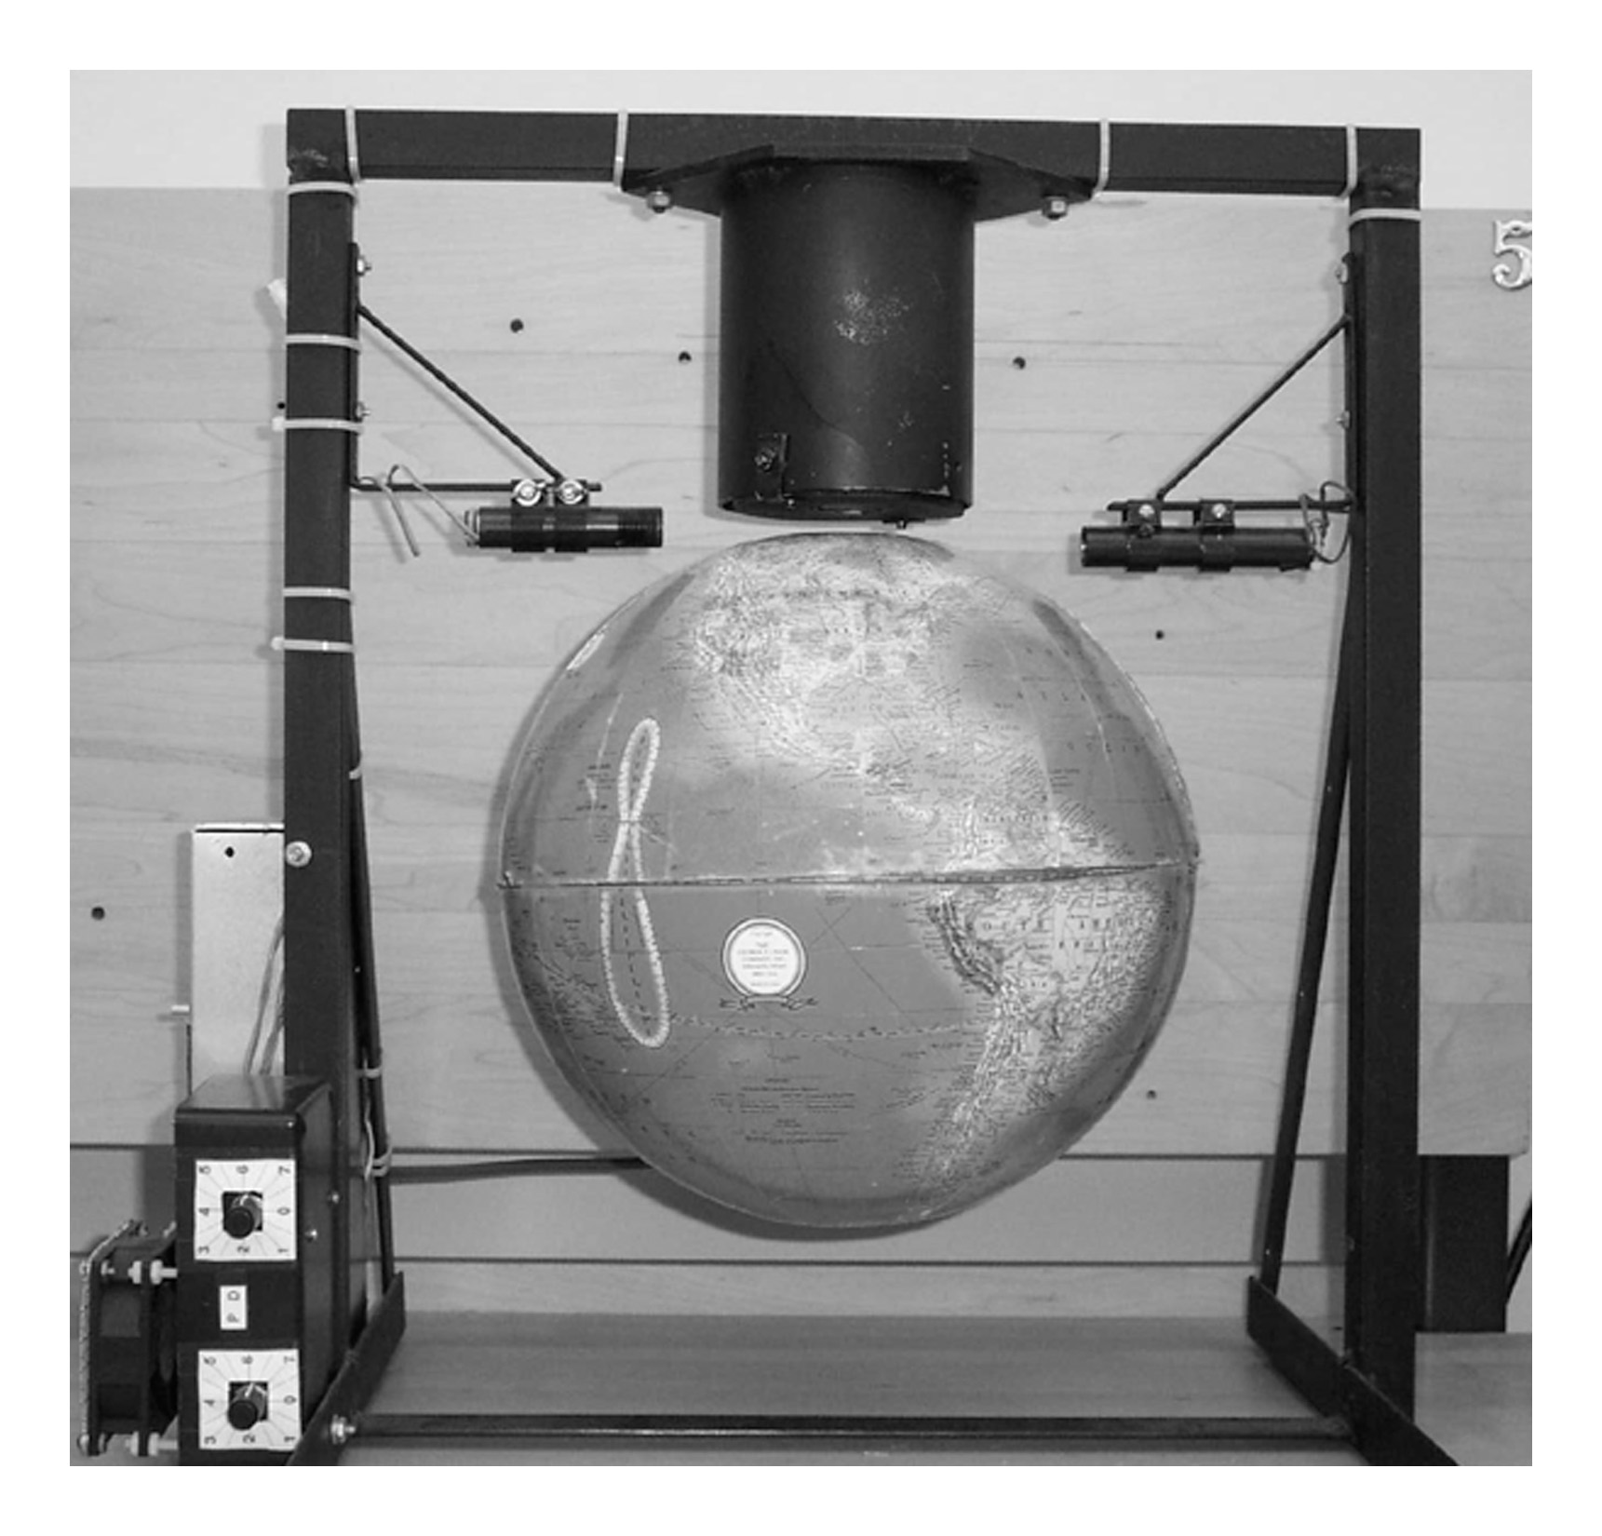
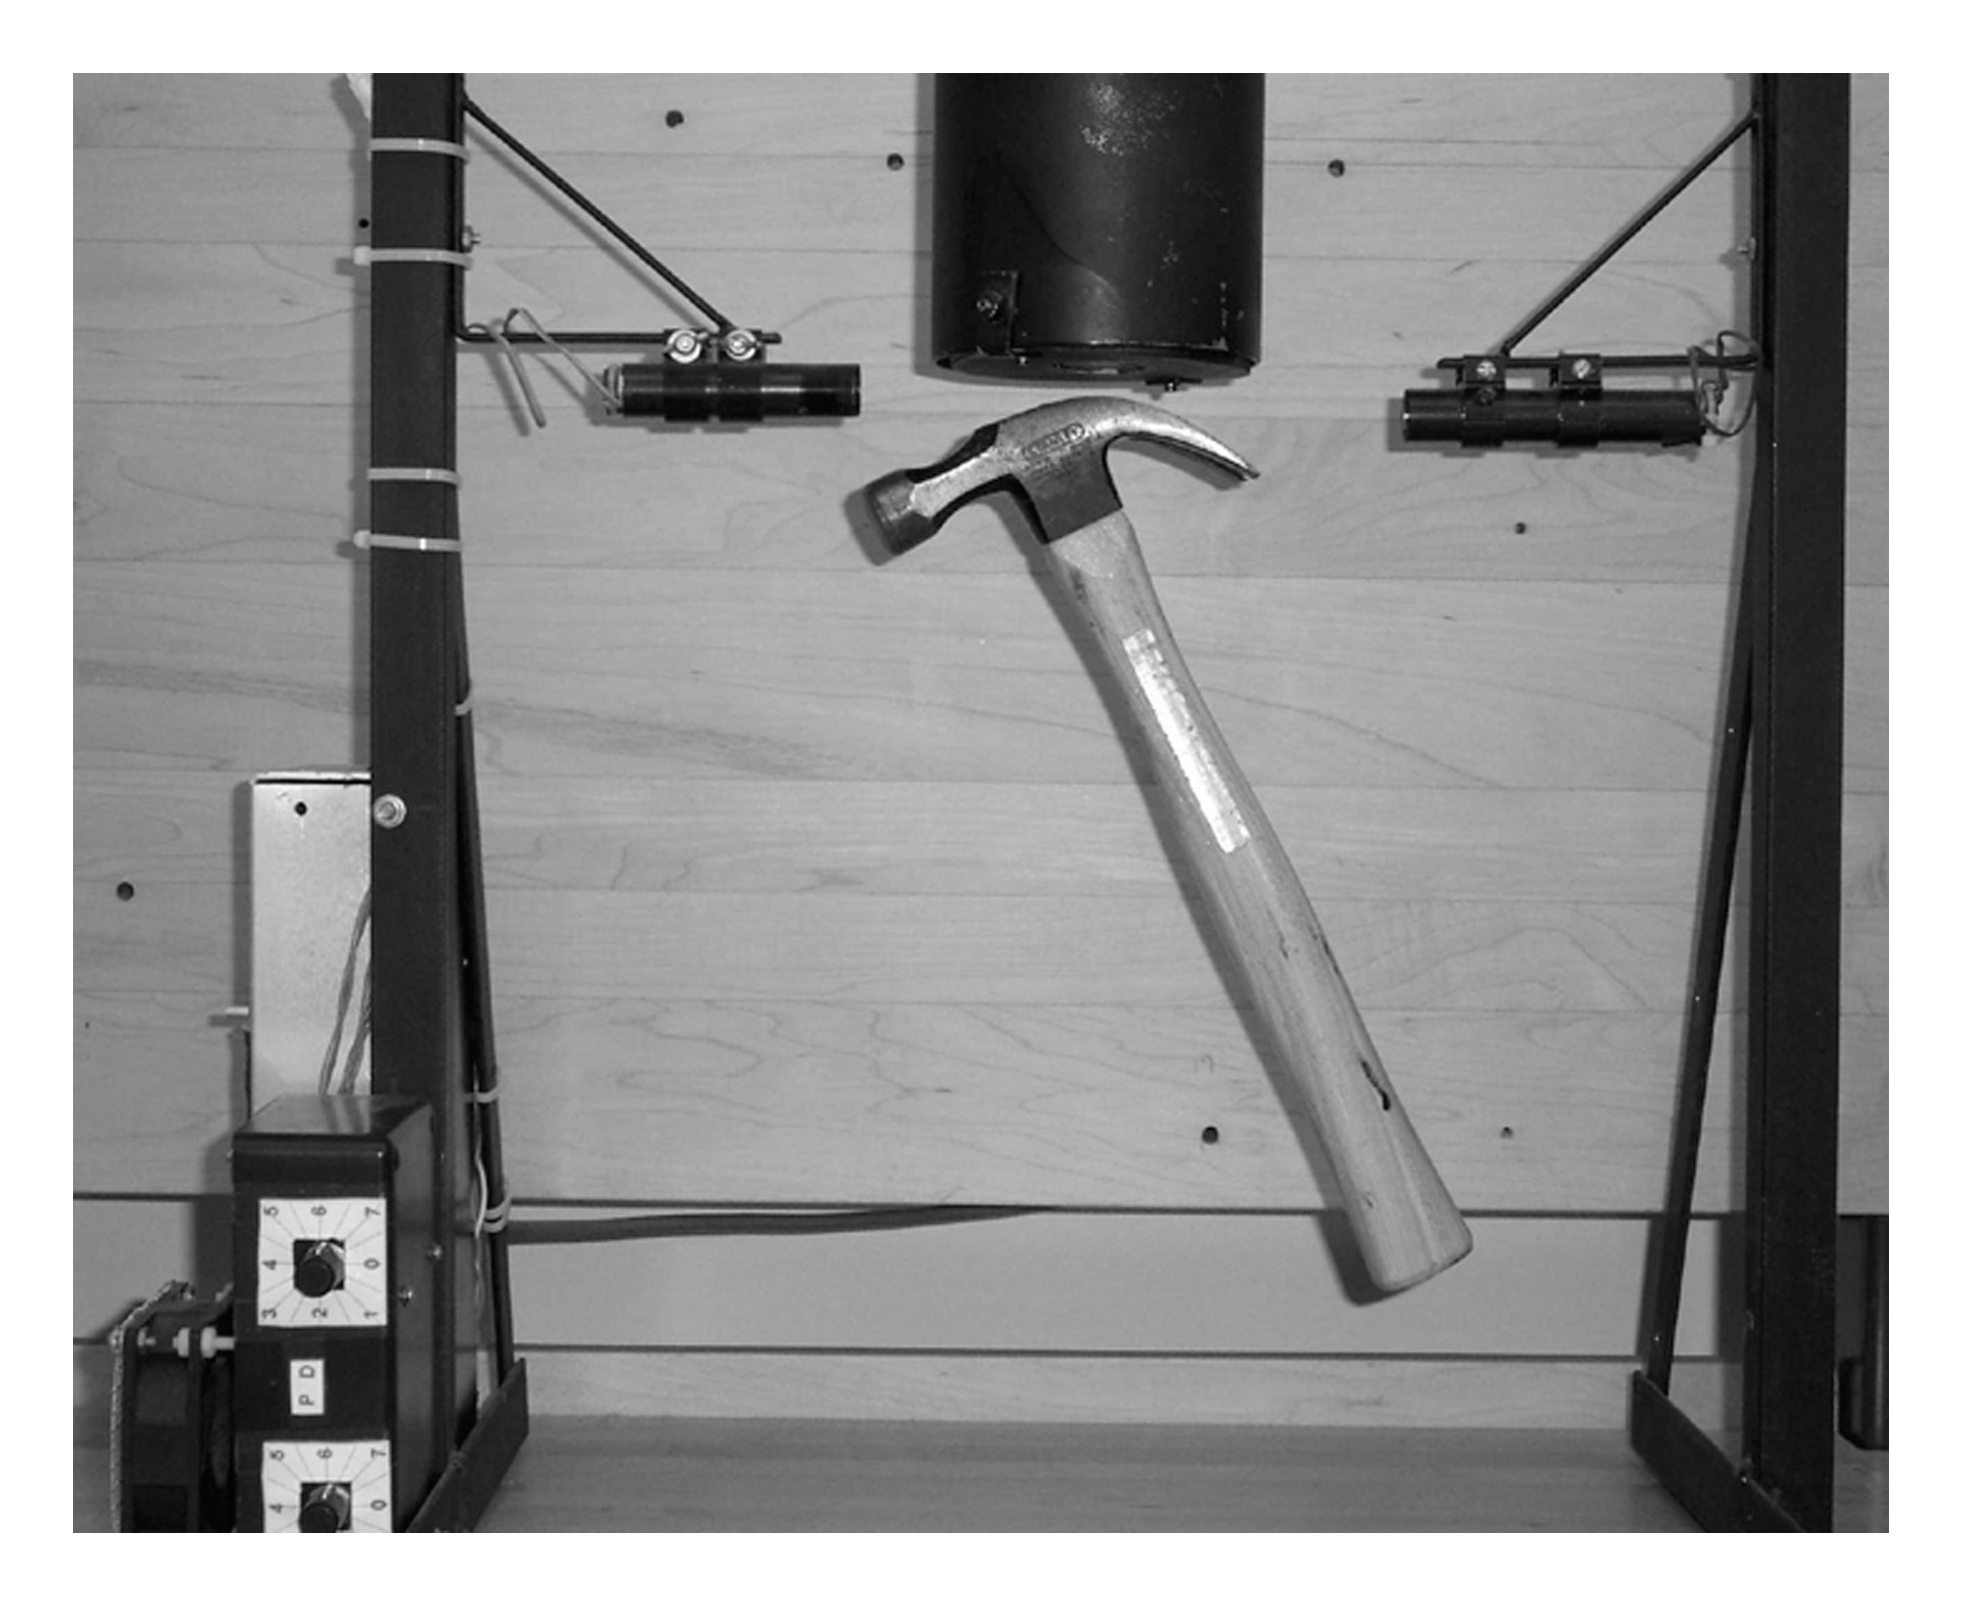
FIGURE 1-2 A magnetic levitation system suspending: (a) a globe with a steel plate inserted and (b) a hammer.
(a)
(b)
Ronald Tocci/Neal Widmer/Gregory Moss
Digital Systems: Principles and Applications, 9e
Copyright ©2004 by Pearson Education, Inc.
Upper Saddle River, New Jersey 07458
All rights reserved.

Slide 3
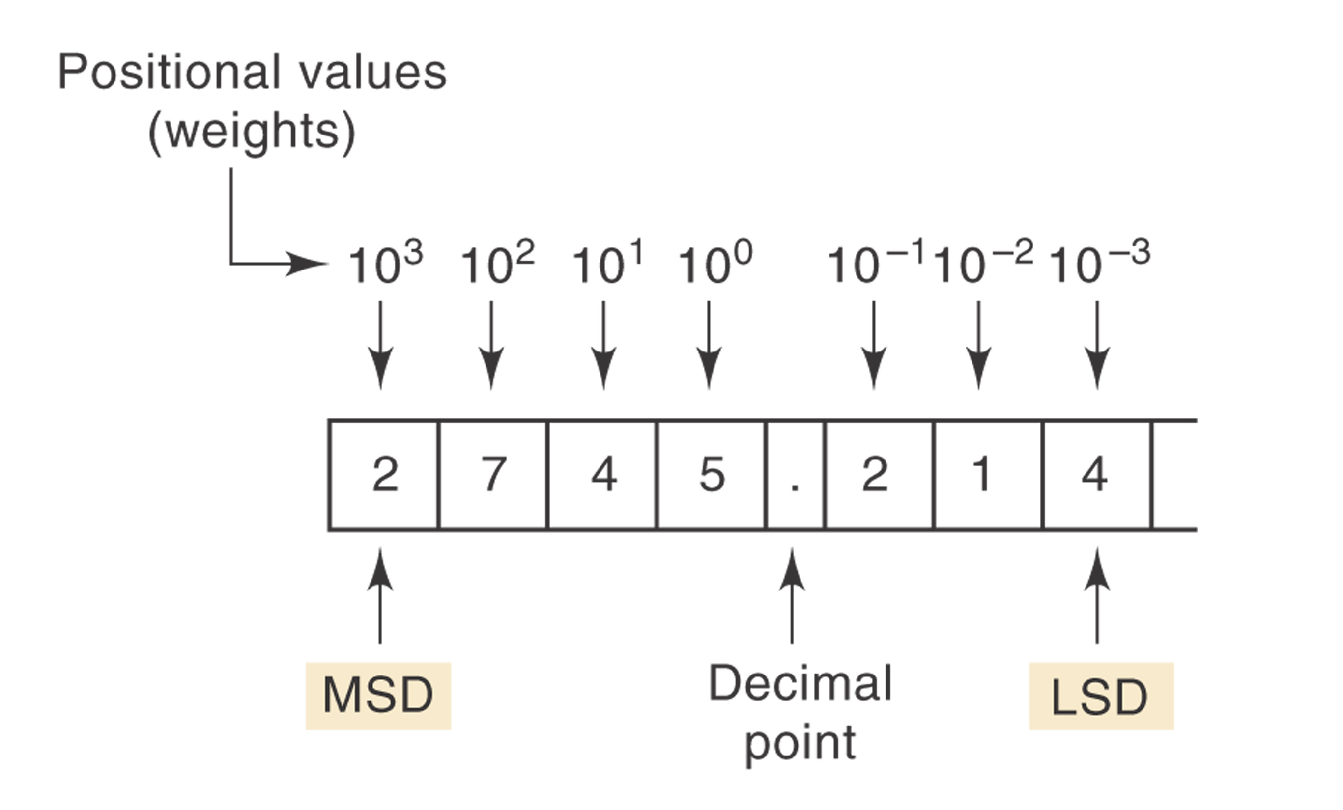
FIGURE 1-3 Decimal position values as powers of 10.
Ronald Tocci/Neal Widmer/Gregory Moss
Digital Systems: Principles and Applications, 9e
Copyright ©2004 by Pearson Education, Inc.
Upper Saddle River, New Jersey 07458
All rights reserved.

Slide 4
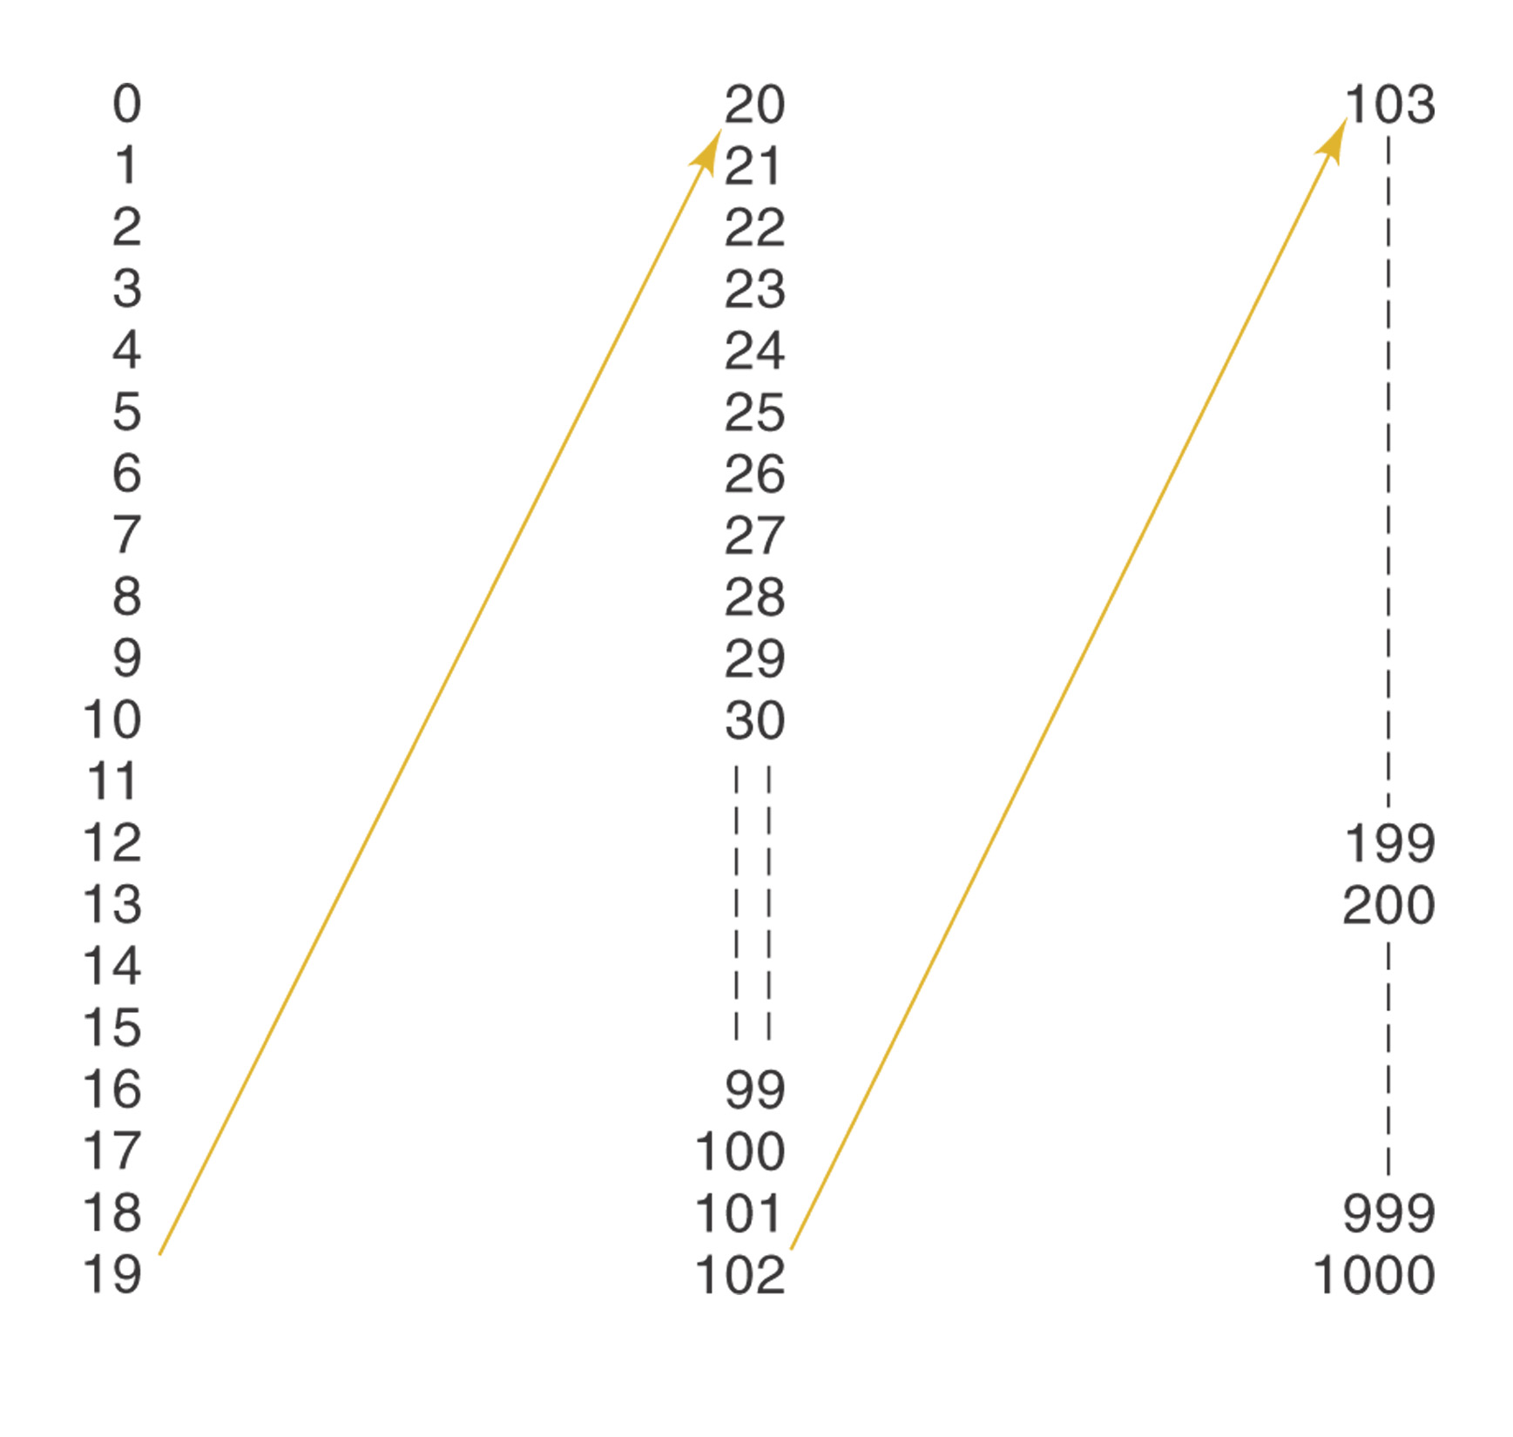
FIGURE 1-4 Decimal counting.
Ronald Tocci/Neal Widmer/Gregory Moss
Digital Systems: Principles and Applications, 9e
Copyright ©2004 by Pearson Education, Inc.
Upper Saddle River, New Jersey 07458
All rights reserved.

Slide 5
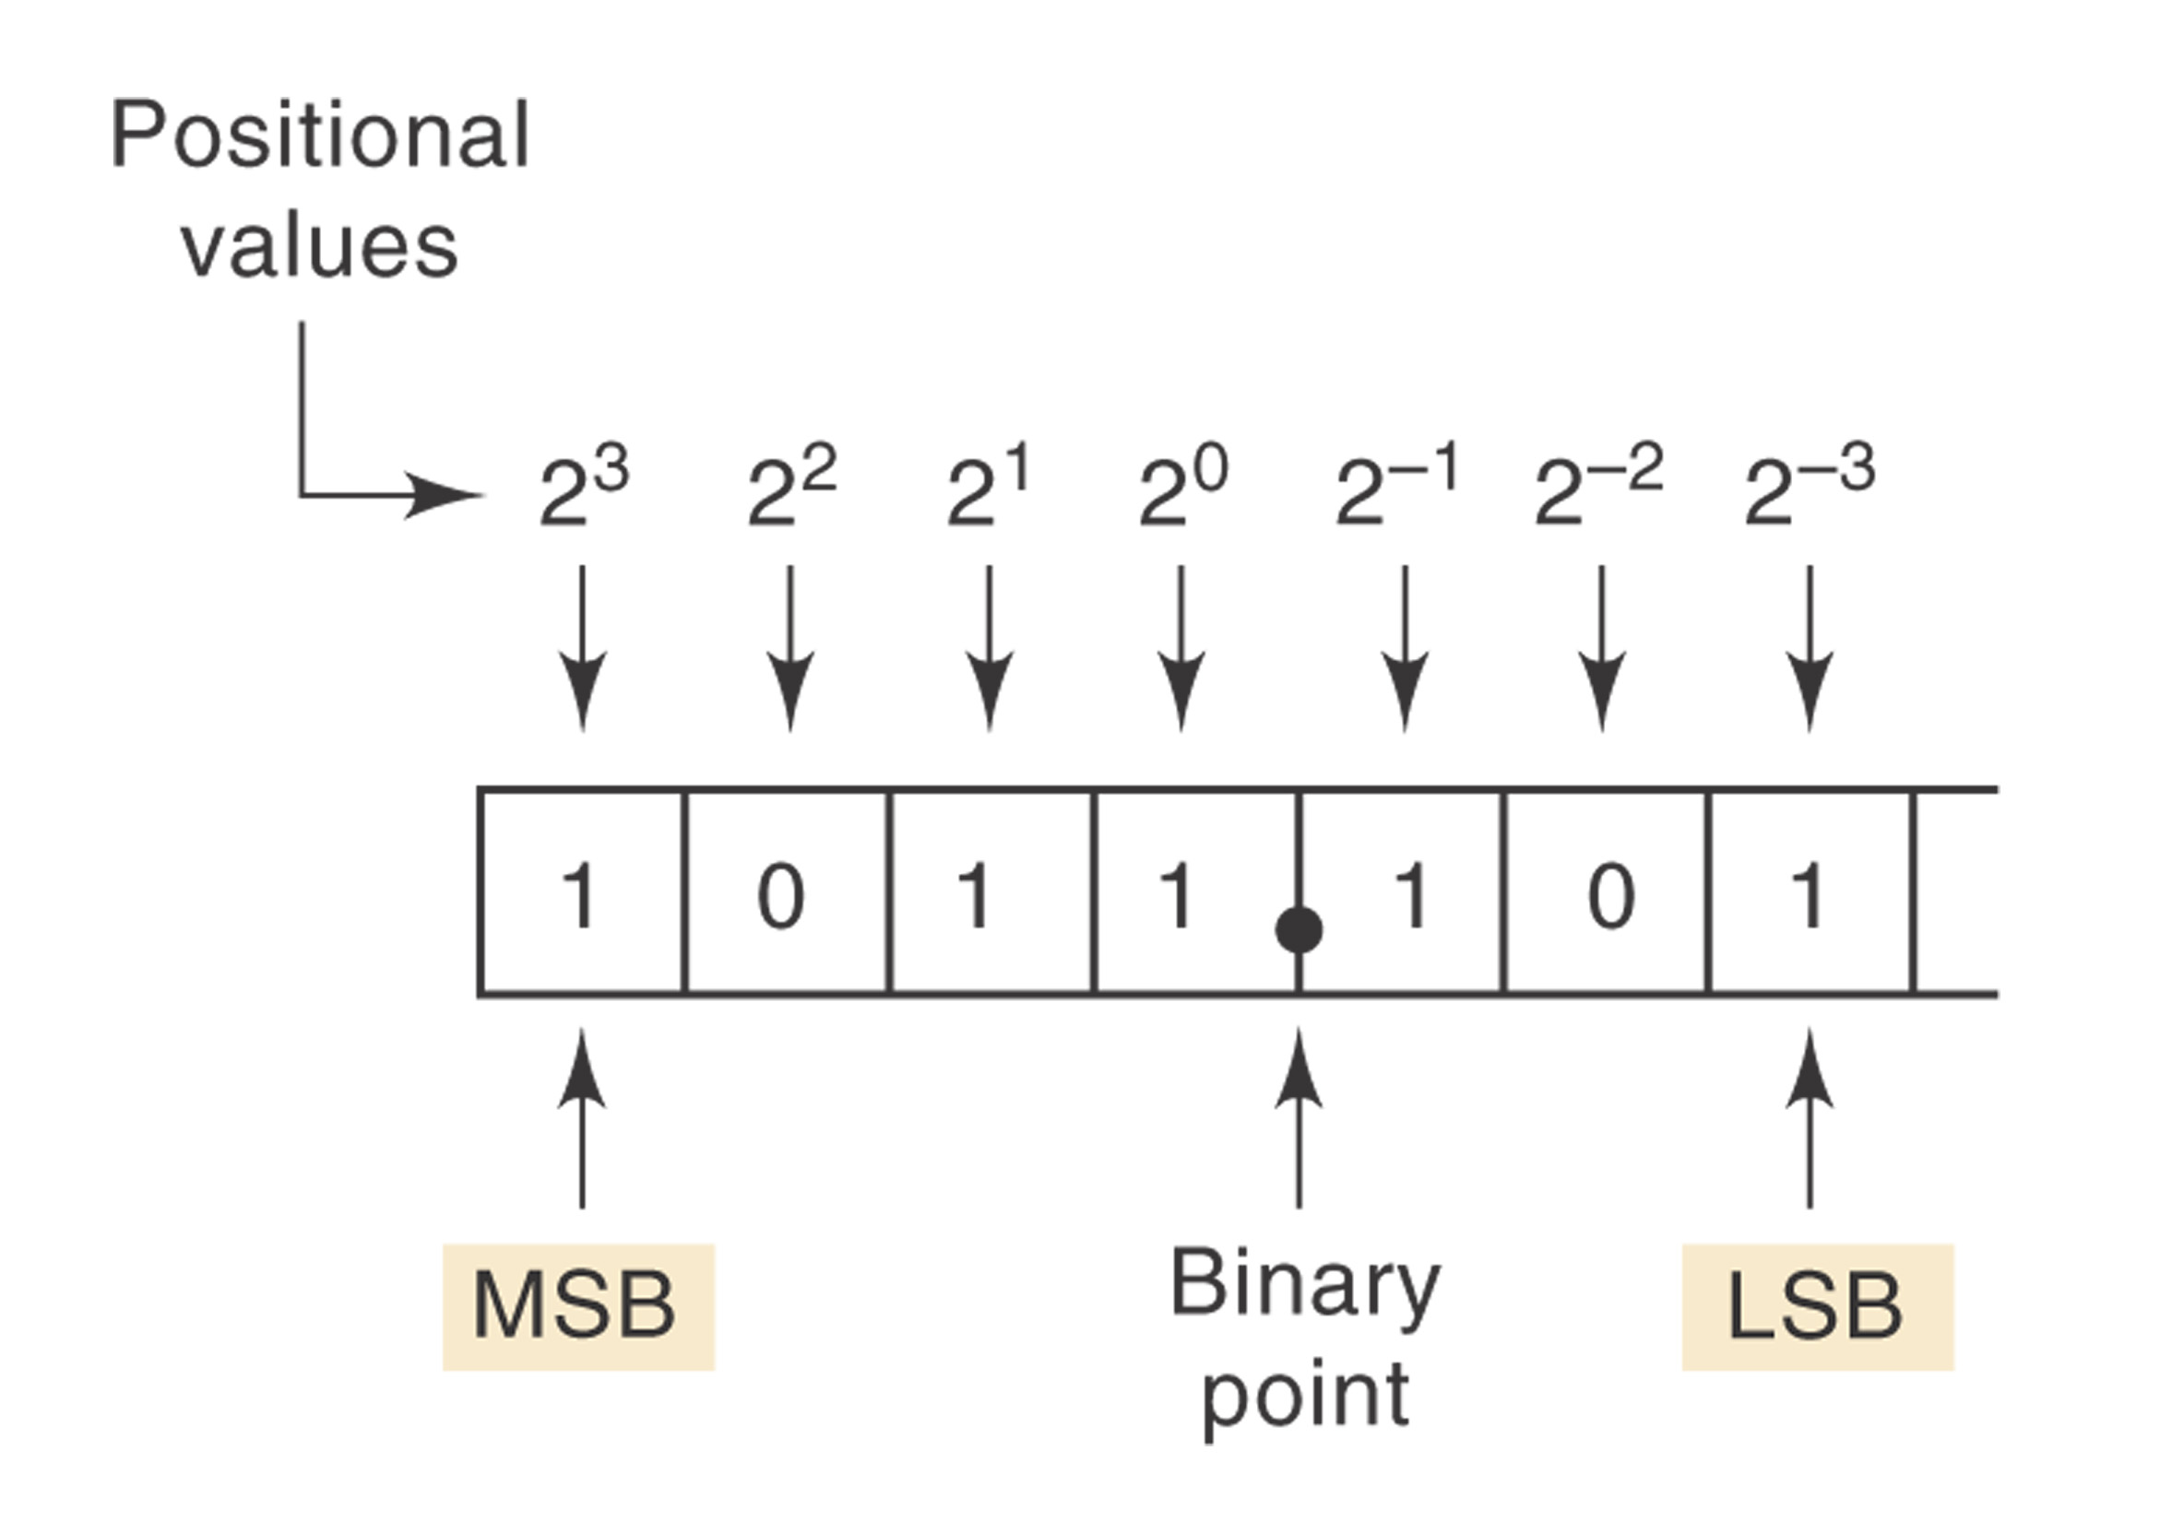
FIGURE 1-5 Binary position values as powers of 2.
Ronald Tocci/Neal Widmer/Gregory Moss
Digital Systems: Principles and Applications, 9e
Copyright ©2004 by Pearson Education, Inc.
Upper Saddle River, New Jersey 07458
All rights reserved.

Slide 6
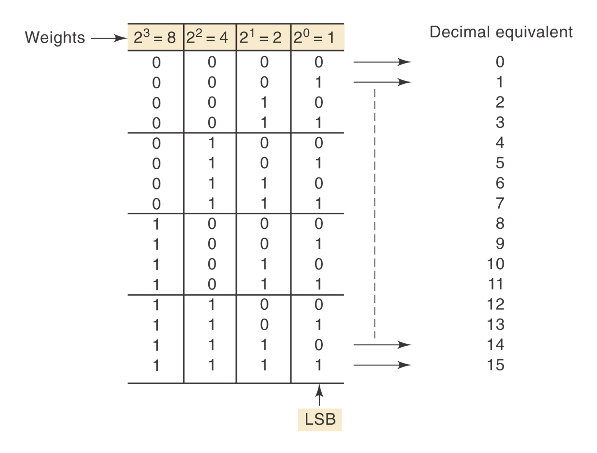
FIGURE 1-6 Binary counting sequence.
Ronald Tocci/Neal Widmer/Gregory Moss
Digital Systems: Principles and Applications, 9e
Copyright ©2004 by Pearson Education, Inc.
Upper Saddle River, New Jersey 07458
All rights reserved.

Slide 7
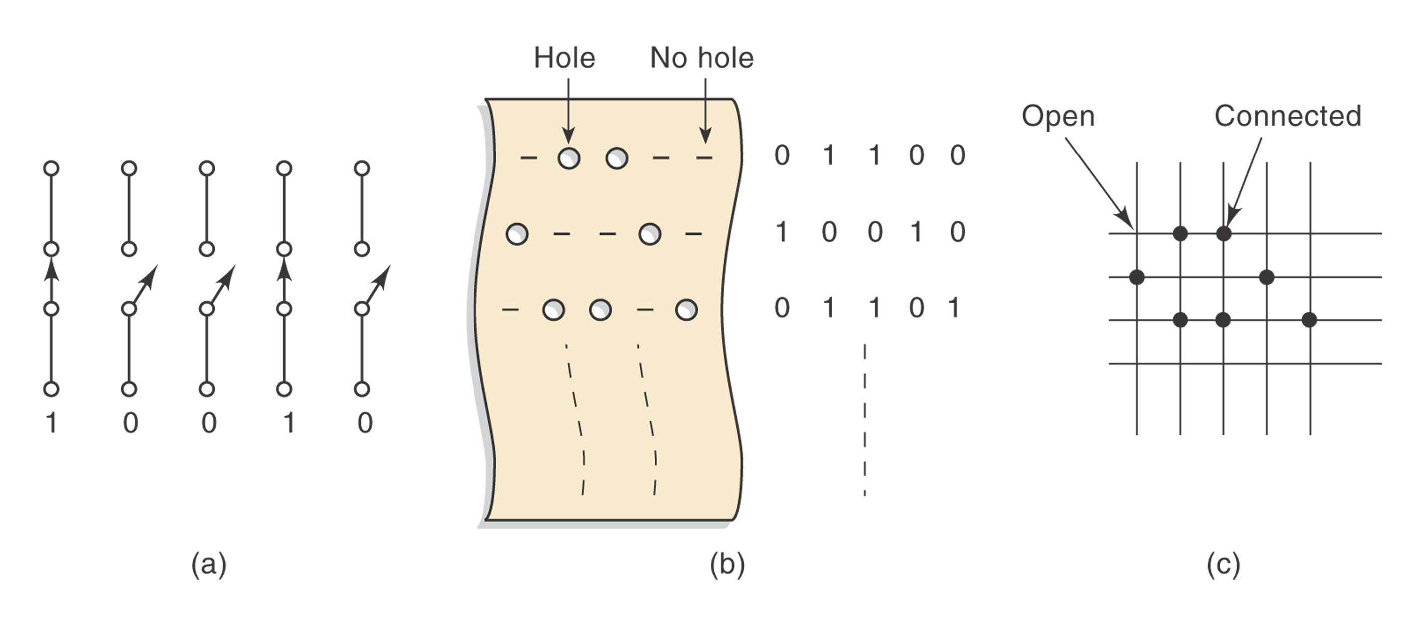
FIGURE 1-7 (a) Open and closed switches representing 0 and 1, respectively; (b) absence or presence of holes in paper tape representing 0 and 1, respectively; (c) connected or not connected junctions in a wiring matrix.
Ronald Tocci/Neal Widmer/Gregory Moss
Digital Systems: Principles and Applications, 9e
Copyright ©2004 by Pearson Education, Inc.
Upper Saddle River, New Jersey 07458
All rights reserved.

Slide 8
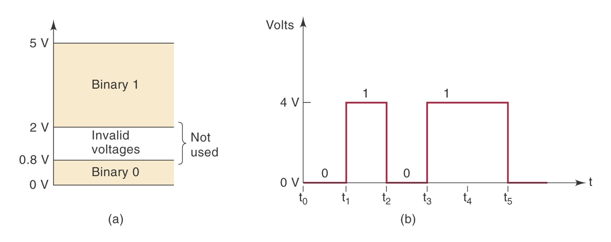
FIGURE 1-8 (a) Typical voltage assignments in digital system; (b) typical digital signal timing diagram.
Ronald Tocci/Neal Widmer/Gregory Moss
Digital Systems: Principles and Applications, 9e
Copyright ©2004 by Pearson Education, Inc.
Upper Saddle River, New Jersey 07458
All rights reserved.

Slide 9
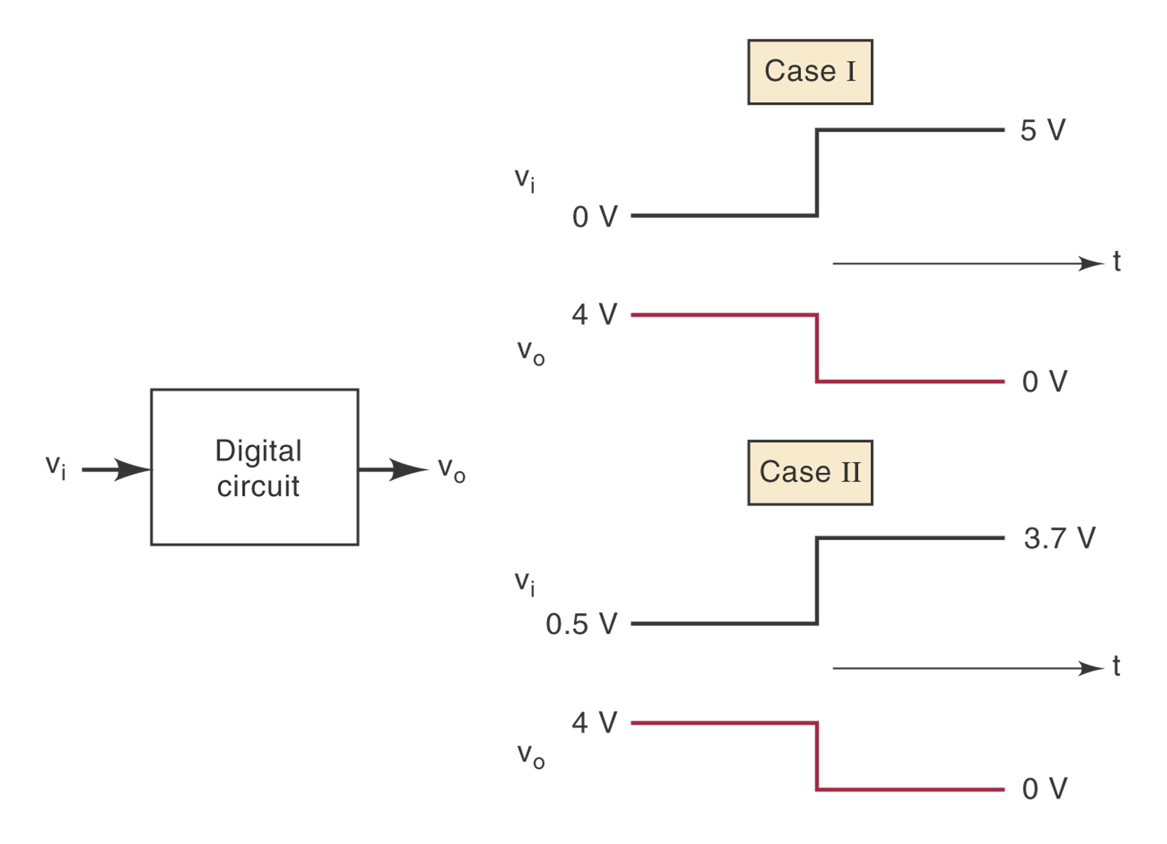
FIGURE 1-9 A digital circuit responds to an input’s binary level (0 or 1) and not to its actual voltage.
Ronald Tocci/Neal Widmer/Gregory Moss
Digital Systems: Principles and Applications, 9e
Copyright ©2004 by Pearson Education, Inc.
Upper Saddle River, New Jersey 07458
All rights reserved.

Slide 10
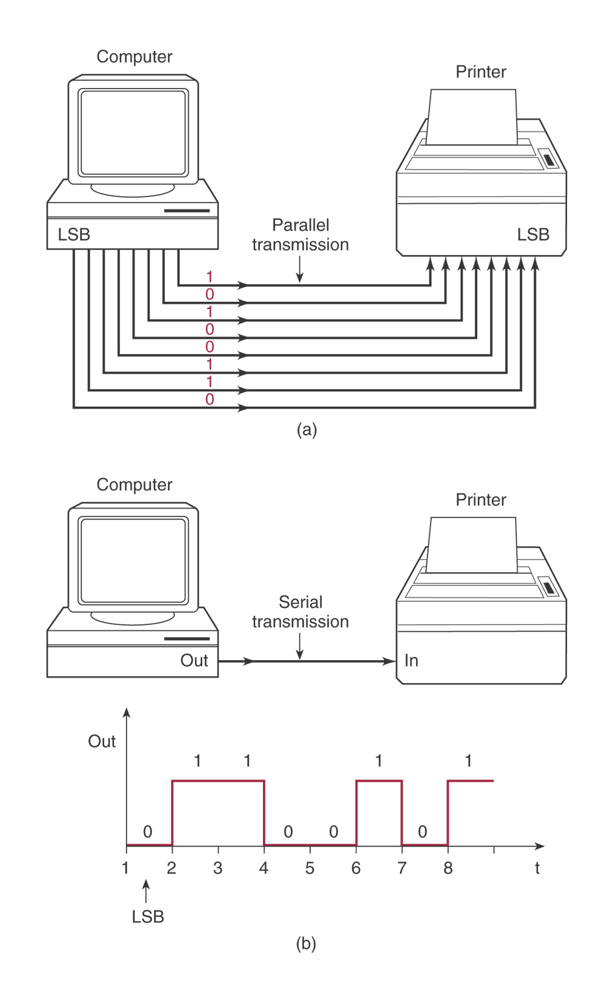
FIGURE 1-10 (a) Parallel transmission uses one connecting line per bit, and all bits are transmitted simultaneously; (b) serial transmission uses only one signal line, and the individual bits are transmitted serially (one at a time).
Ronald Tocci/Neal Widmer/Gregory Moss
Digital Systems: Principles and Applications, 9e
Copyright ©2004 by Pearson Education, Inc.
Upper Saddle River, New Jersey 07458
All rights reserved.

Slide 11
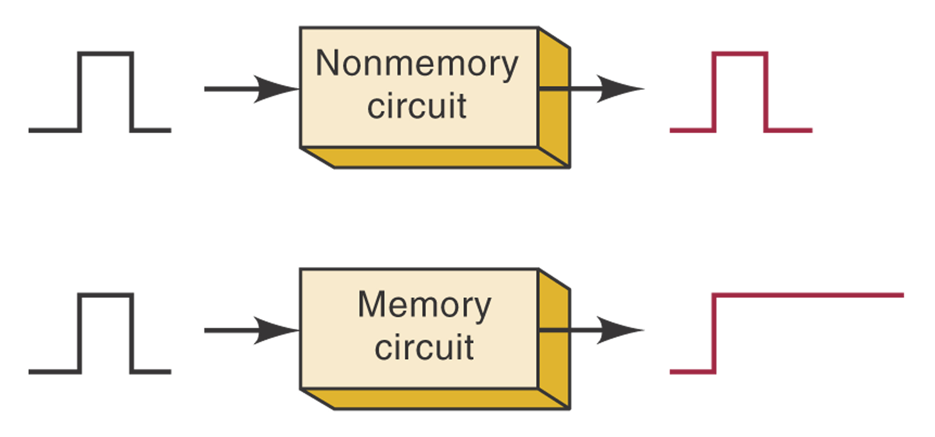
FIGURE 1-11 Comparison of nonmemory and memory operation.
Ronald Tocci/Neal Widmer/Gregory Moss
Digital Systems: Principles and Applications, 9e
Copyright ©2004 by Pearson Education, Inc.
Upper Saddle River, New Jersey 07458
All rights reserved.

Slide 12
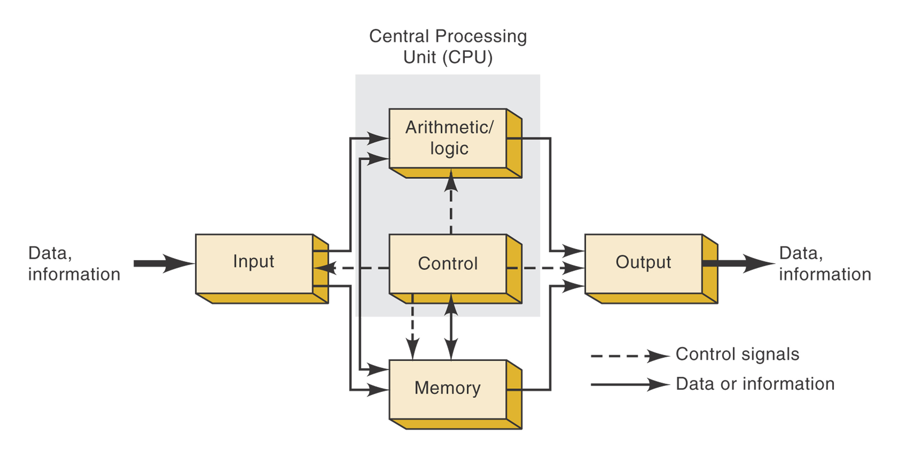
FIGURE 1-12 Functional diagram of a digital computer.
Ronald Tocci/Neal Widmer/Gregory Moss
Digital Systems: Principles and Applications, 9e
Copyright ©2004 by Pearson Education, Inc.
Upper Saddle River, New Jersey 07458
All rights reserved.

