Slide 1



Slide 2
Chapter 4 – Combinational Logic Circuits

Slide 3
Chapter 4 Objectives
Selected areas covered in this chapter:
  Converting logic expressions to sum-of-products expressions.
  Boolean algebra and the Karnaugh map as tools to simplify and design logic circuits.
  Operation of exclusive-OR & exclusive-NOR circuits.
  Designing simple logic circuits without a truth table.
  Basic characteristics of TTL and CMOS digital ICs.
  Basic troubleshooting rules of digital systems.
  Programmable logic device (PLD) fundamentals.
  Hierarchical design methods.
  Logic circuits using HDL control structures IF/ELSE, IF/ELSIF, and CASE.

Slide 4
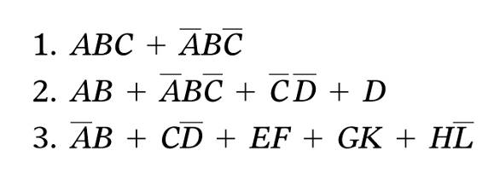
4-1 Sum-of-Products Form
A Sum-of-products (SOP) expression will appear as two or more AND terms ORed together.

Slide 5
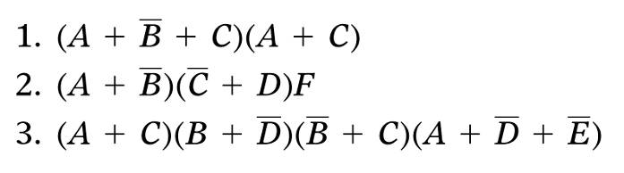
4-1 Sum-of-Products Form
The product-of-sums (POS) form consists of two or more OR terms (sums) ANDed together.

Slide 6
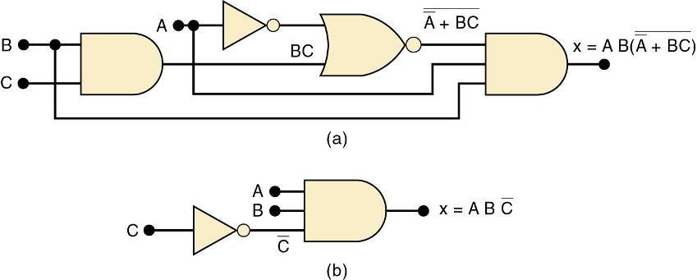
4-2 Simplifying Logic Circuits
The circuits shown provide the same output
  Circuit (b) is clearly less complex.
Logic circuits can be simplified using
Boolean algebra and Karnaugh mapping.

Slide 7
4-3 Algebraic Simplification
Place the expression in SOP form by applying DeMorgan’s theorems and multiplying terms.
Check the SOP form for common factors.
  Factoring where possible should eliminate one
  or more terms.

Slide 8
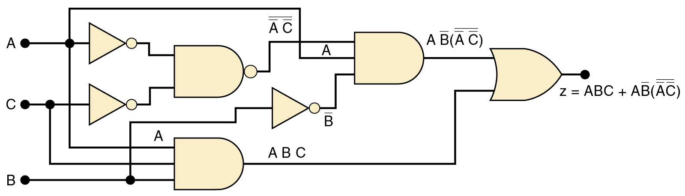
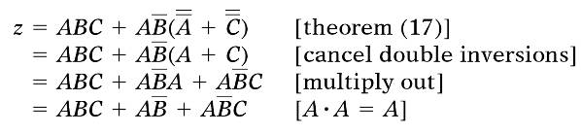
4-3 Algebraic Simplification
Simplify the logic circuit shown.
The first step is to determine the expression for the output:
z = ABC + AB • (A C)
Once the expression
is determined, break
down large inverter
signs by DeMorgan’s
theorems & multiply
out all terms.

Slide 9


4-3 Algebraic Simplification
Simplify the logic circuit shown.
Factoring—the first & third terms above have
AC in common, which can be factored out:
Since B + B = 1, then…
Factor out A, which results in…

Slide 10
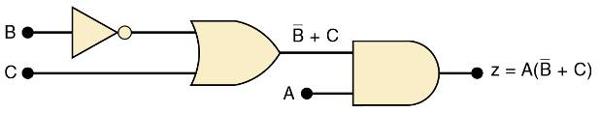
4-3 Algebraic Simplification
Simplifed logic circuit.
z = A(C + B)

Slide 11
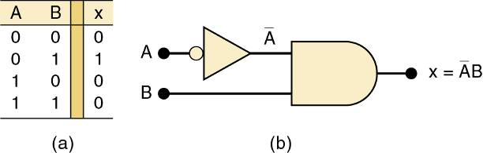
4-4 Designing Combinational Logic Circuits
To solve any logic design problem:
  Interpret the problem and set up its truth table.
  Write the AND (product) term for each case where output = 1.
  Combine the terms in SOP form.
  Simplify the output expression if possible.
  Implement the circuit for the final, simplified expression.
Circuit that produces a 1 output only for
the A = 0, B = 1 condition.

Slide 12
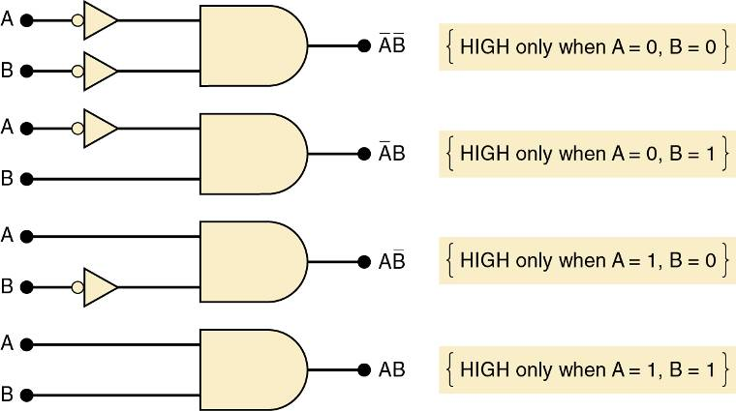
4-4 Designing Combinational Logic Circuits
An AND gate with appropriate inputs can be used to
produce a HIGH output for a specific set of input levels.

Slide 13
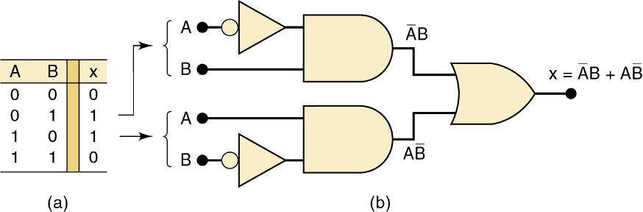
4-4 Designing Combinational Logic Circuits
Each set of input conditions that is to produce a
1 output is implemented by a separate AND gate.
The AND outputs are ORed to produce the final output.

Slide 14
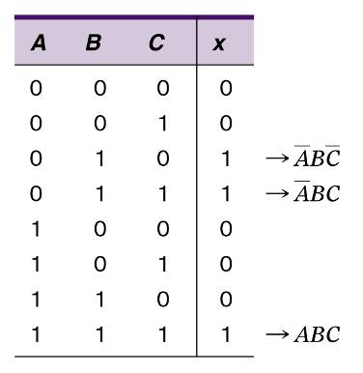
4-4 Designing Combinational Logic Circuits
Truth table for a 3-input circuit.
AND terms for each
case where output is 1.

Slide 15
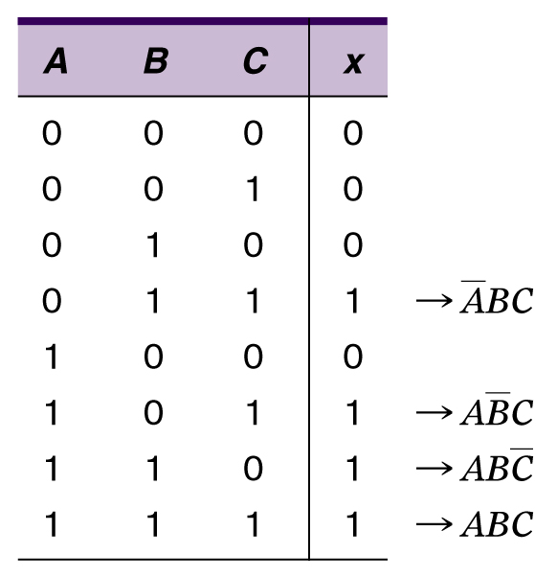

4-4 Designing Combinational Logic Circuits
Design a logic circuit with three inputs, A, B, and C. Output to be HIGH only when a majority inputs are HIGH.
AND terms for each
case where output is 1.
Truth table.
SOP expression for the output:

Slide 16
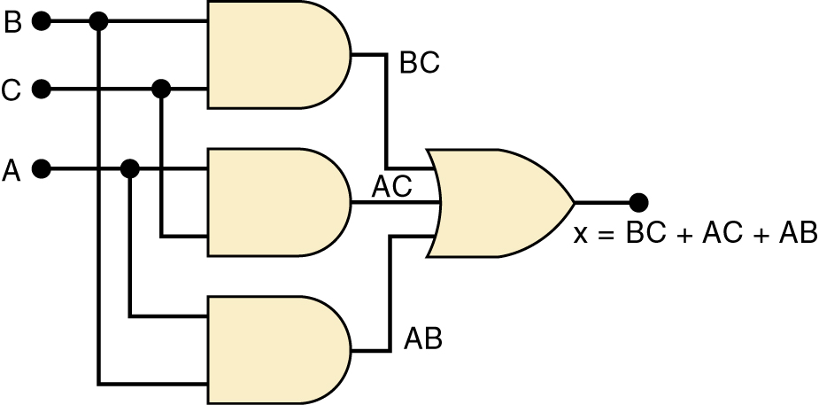

4-4 Designing Combinational Logic Circuits
Design a logic circuit with three inputs, A, B, and C. Output to be HIGH only when a majority inputs are HIGH.
Simplified output expression:
Implementing the
circuit after factoring:
Since the expression is in SOP form, the circuit is a group of AND gates, working into a single OR gate,

Slide 17
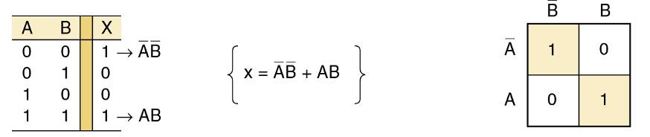
4-5 Karnaugh Map Method
A graphical method of simplifying logic equations or truth tables—also called a K map.
Theoretically can be used for any number of input variables—practically limited to 5 or 6 variables.
The truth table values are placed in the K map.
Shown here is a two-variable map.

Slide 18
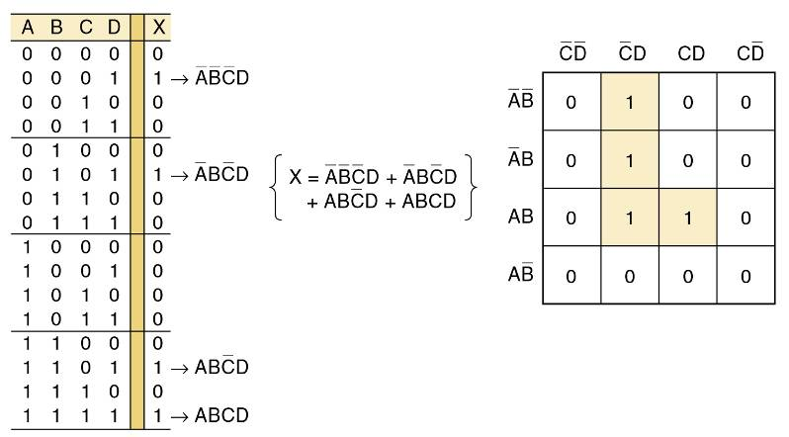
4-5 Karnaugh Map Method
Four-variable K-Map.
Adjacent K map square differ in only one variable both horizontally and vertically.
A SOP expression can be obtained by ORing all squares that contain a 1.

Slide 19
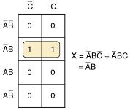
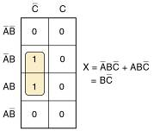
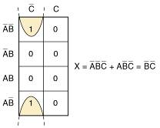
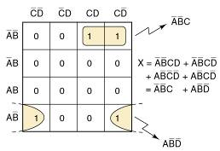
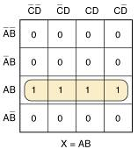
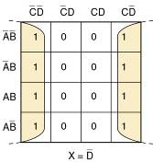
4-5 Karnaugh Map Method
Looping 1s in adjacent groups of 2, 4, or 8
will result in further simplification.
Looping groups of 2 (Pairs)
Groups of 4 (Quads)
Groups of 8 (Octets)

Slide 20
4-5 Karnaugh Map Method
When the largest possible groups have been looped, only the common terms are placed
in the final expression.
  Looping may also be wrapped between top, bottom, and sides.

Slide 21
4-5 Karnaugh Map Method
Complete K map simplification process:
  Construct the K map, place 1s as indicated in the truth table.
  Loop 1s that are not adjacent to any other 1s.
  Loop 1s that are in pairs.
  Loop 1s in octets even if they have already been looped.
  Loop quads that have one or more 1s not already looped.
  Loop any pairs necessary to include 1st not already looped.
  Form the OR sum of terms generated by each loop.
When a variable appears in both complemented and
uncomplemented form within a loop, that variable
is eliminated from the expression.
Variables that are the same for all squares of
the loop must appear in the final expression.

Slide 22
4-6 Exclusive OR and Exclusive NOR Circuits
The exclusive OR (XOR) produces a HIGH output whenever the two inputs are at
opposite levels.

Slide 23
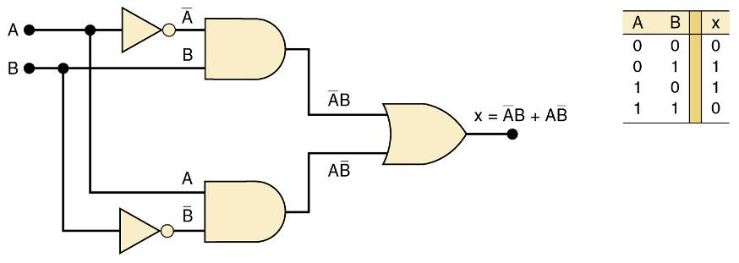
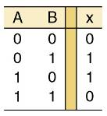
4-6 Exclusive OR and Exclusive NOR Circuits
Exclusive OR circuit and truth table.
Output expression:
x = AB + AB
This circuit produces a HIGH output whenever the two inputs are at opposite levels.

Slide 24


4-6 Exclusive OR and Exclusive NOR Circuits
Traditional XOR gate symbol.
An XOR gate has only two inputs, combined so that x = AB + AB.
A shorthand way indicate the XOR output expression is:
x = A B.
…where the symbol represents the XOR gate operation.
Output is HIGH only when the two inputs are at different levels.
Quad XOR chips containing four XOR gates.
74LS86 Quad XOR (TTL family)
74C86 Quad XOR (CMOS family)
74HC86 Quad XOR (high-speed CMOS)

Slide 25
4-6 Exclusive OR and Exclusive NOR Circuits
The exclusive NOR (XOR) produces a HIGH output whenever the two inputs are at the
same level.
  XOR and XNOR outputs are opposite.

Slide 26
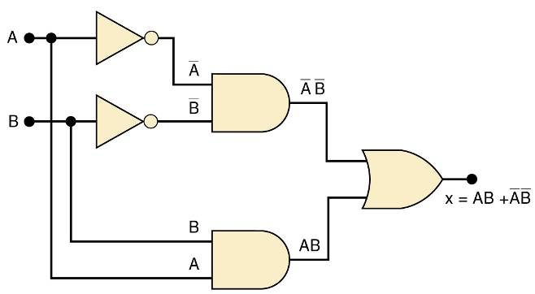
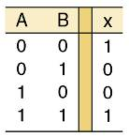
4-6 Exclusive OR and Exclusive NOR Circuits
Exclusive NOR circuit and truth table.
Output expression:
x = AB + AB
XNOR produces a HIGH output whenever
the two inputs are at the same levels.

Slide 27

4-6 Exclusive OR and Exclusive NOR Circuits
Traditional XNOR gate symbol.
An XNOR gate has only two inputs, combined so that x = AB + AB.
A shorthand way indicate the XOR output expression is:
x = A B.
XNOR represents inverse of the XOR operation.
Output is HIGH only when the two inputs are at the same level.
Quad XNOR chips with four XNOR gates.
74LS266 Quad XNOR (TTL family)
74C266 Quad XOR (CMOS)
74HC266 Quad XOR (high-speed CMOS)

Slide 28
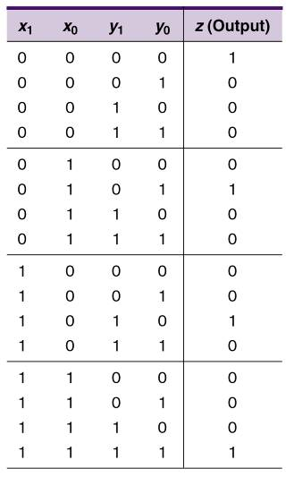
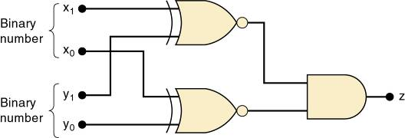
4-6 Exclusive OR and Exclusive NOR Circuits
Truth table and circuit for detecting equality of two-bit binary numbers.

Slide 29
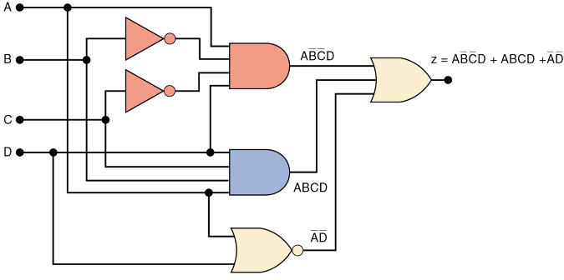
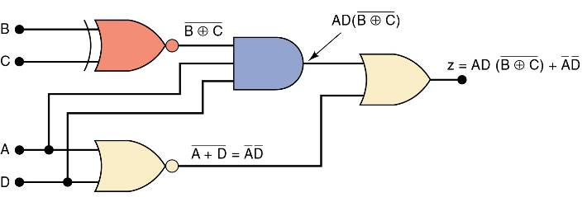
4-6 Exclusive OR and Exclusive NOR Circuits
How an XNOR gate may be used to simplify circuit implementation.

Slide 30
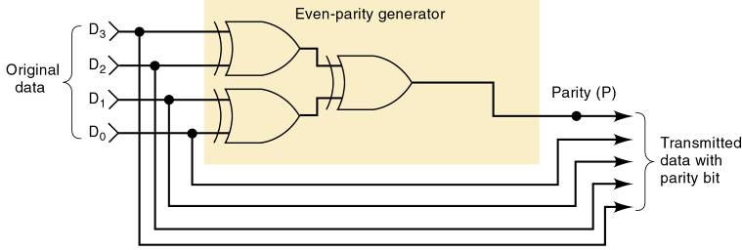
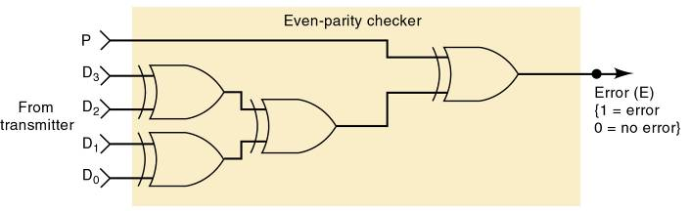
4-7 Parity Generator and Checker
XOR and XNOR gates are useful in circuits
for parity generation and checking.

Slide 31
4-8 Enable/Disable Circuits
Situations requiring enable/disable circuits occur frequently in digital circuit design.
  A circuit is enabled when it allows the passage
  of an input signal to the output.
  A circuit is disabled when it prevents the passage
  of an input signal to the output.

Slide 32


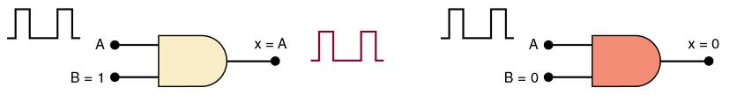
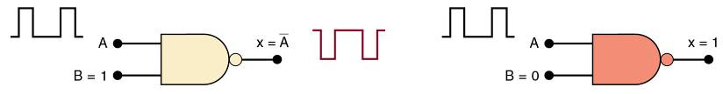
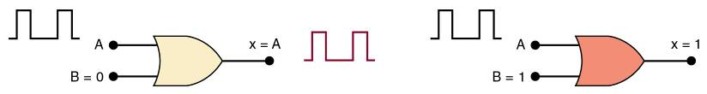
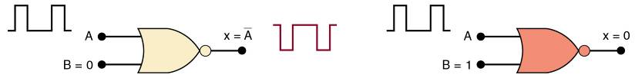
4-8 Enable/Disable Circuits

Slide 33

4-8 Enable/Disable Circuits
A logic circuit that will allow a signal to pass to output only when control inputs B and C are both HIGH.
Otherwise, output will stay LOW.

Slide 34
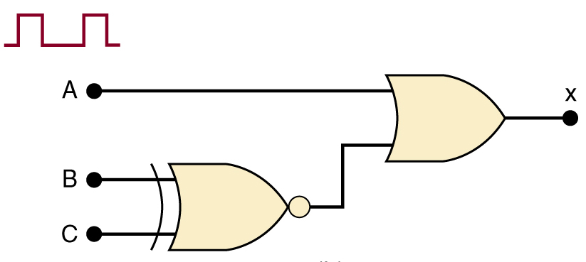
4-8 Enable/Disable Circuits
A logic circuit that will allow a signal to pass to output only when one, but not both control inputs are HIGH.
Otherwise, output will stay HIGH.

Slide 35
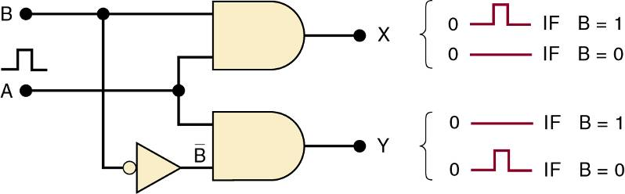
4-8 Enable/Disable Circuits
A logic circuit with input signal A, control
input B, and outputs X and Y, which operates as:
When B = 1, output X will follow input A, and output Y will be 0.
When B = 0, output X will be 0, and output Y will follow input A.

Slide 36
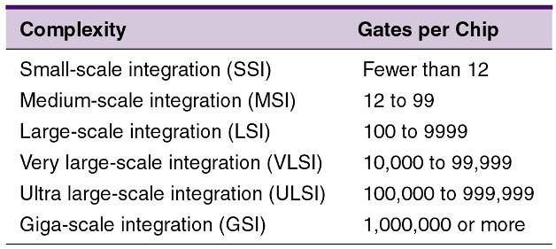
4-9 Basic Characteristics of Digital ICs
IC “chips” consist of resistors, diodes & transistors fabricated on a piece of semiconductor material called a substrate.
Digital ICs are often categorized by complexity,
according to the number of logic gates on the substrate.

Slide 37
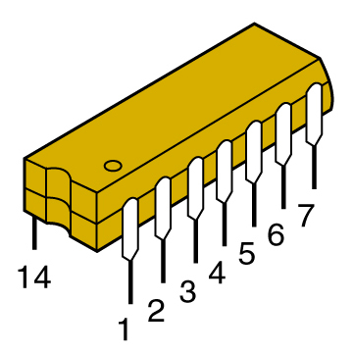
4-9 Basic Characteristics of Digital ICs
The dual-in-line package (DIP) contains two parallel rows of pins.
The DIP is probably the most common digital IC package found in older
digital equipment.

Slide 38
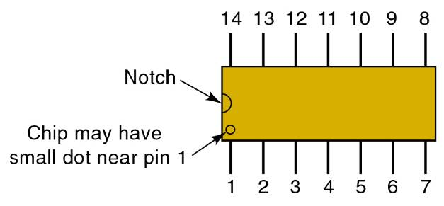
4-9 Basic Characteristics of Digital ICs
Pins are numbered counterclockwise, viewed
from the top of the package, with respect to
an identifying notch or dot at one end.
Shown is a 14-pin DIP
that measures .75” x .25”.

Slide 39
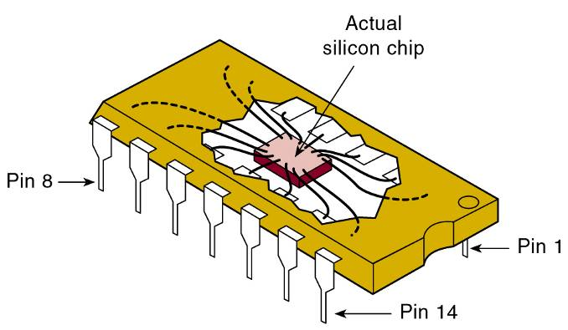
4-9 Basic Characteristics of Digital ICs
The actual silicon chip is much smaller than the DIP—typically about 0.05” square.
The silicon chip is connected to the pins
of the DIP by very fine
(1- mil) wires.

Slide 40
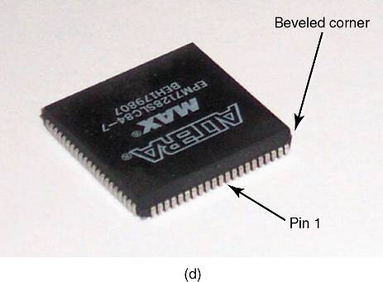
4-9 Basic Characteristics of Digital ICs
The PLCC is one of many packages common
in modern digital circuits.
  This type uses J-shaped leads which curl
  under the IC.

Slide 41
4-9 Basic Characteristics of Digital ICs
ICs are also categorized by the type of components used in their circuits.
  Bipolar ICs use NPN and PNP transistors
  Unipolar ICs use FET transistors.

Slide 42
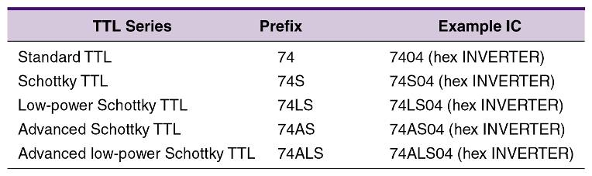
4-9 Basic Characteristics of Digital ICs
The transistor-transistor logic (TTL) family
consists of subfamilies shown here:
Differences between the TTL devices is limited to electrical characteristics such as power dissipation & switching speed.
Pin layout and logic operations are the same.

Slide 43
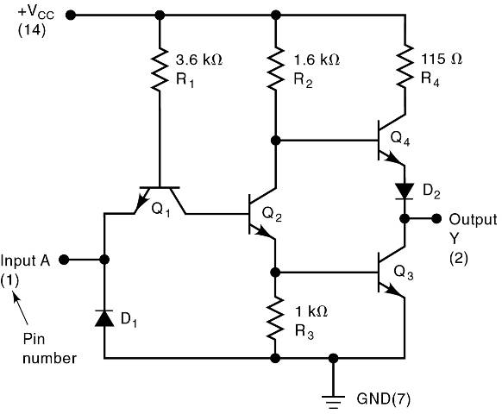
4-9 Basic Characteristics of Digital ICs
V_{CC} for TTL devices is normally +5 V.
Power (V_{CC}) and
ground connections
are required for
chip operation.
TTL
INVERTER

Slide 44
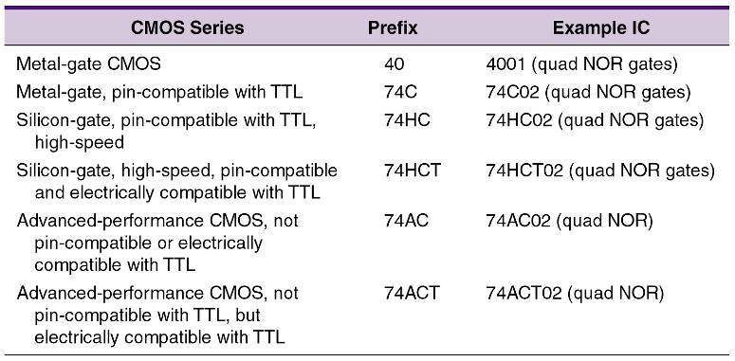
4-9 Basic Characteristics of Digital ICs
The Complimentary Metal-Oxide Semiconductor (CMOS) family consists of several series
CMOS devices perform the same function as, but are not
necessarily pin for pin compatible with TTL devices.

Slide 45
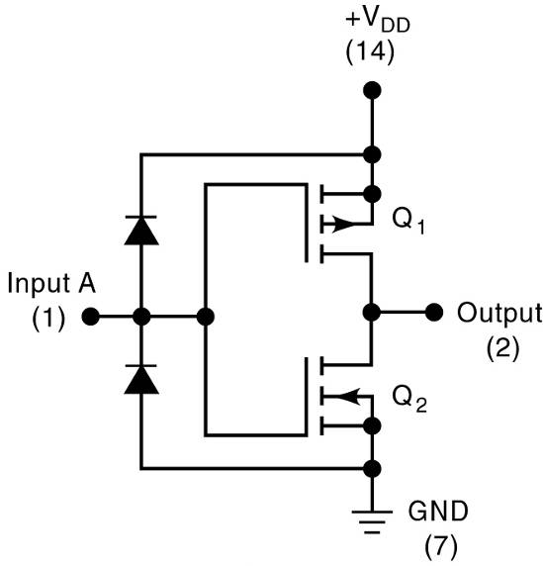
4-9 Basic Characteristics of Digital ICs
V_{DD} for CMOS
devices can be
from +3 to +18 V.
Power (V_{DD}) and
ground connections
are required for
chip operation.
CMOS
INVERTER

Slide 46
4-9 Basic Characteristics of Digital ICs
Inputs not connected are said to be floating.
  Floating TTL input acts like a logic 1.
    Voltage measurement may appear indeterminate,
    but the device behaves as if there is a 1 on the
    floating input
  Floating CMOS inputs can cause overheating and damage to the device.
Some ICs have protection circuits built in.
  The best practice is to tie all unused inputs.
    Either high or low.

Slide 47
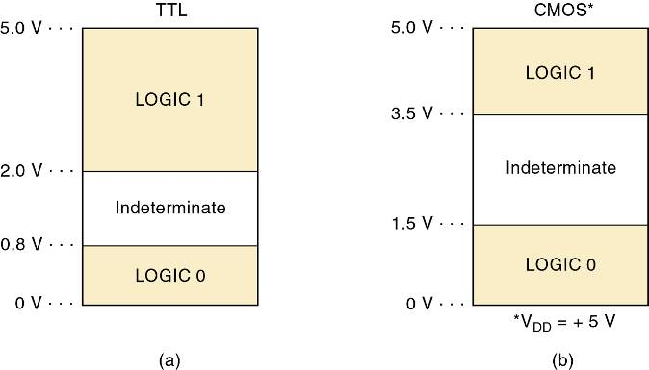
4-9 Basic Characteristics of Digital ICs
Voltages in the indeterminate range provide unpredictable results and should be avoided.
Logic levels for TTL and CMOS devices.

Slide 48

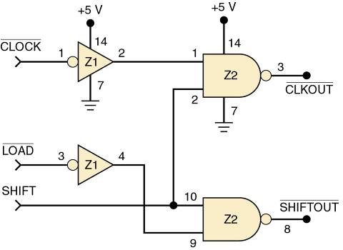
4-9 Basic Characteristics of Digital ICs
A connection diagram shows all electrical connections, pin numbers, IC numbers, component values, signal names, and power supply voltages.
This circuit uses logic gates from two different ICs.
Each gate input & output pin number is indicated on the diagram, to easily reference any point in the circuit.
Power/ ground connections to each IC are shown.

Slide 49
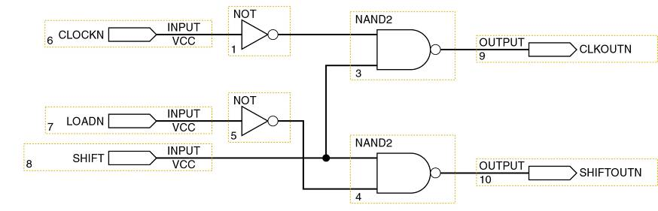
4-9 Basic Characteristics of Digital ICs
Logic diagram using Quartus II schematic capture.

Slide 50
4-10 Troubleshooting Digital Systems
Three basic steps in fixing a digital circuit or system that has a fault (failure):
  Fault detection—determine operation to expected operation.
  Fault isolation—test & measure to isolate the fault.
  Fault correction—repair the fault.
The basic troubleshooting tools are the logic probe, oscilloscope, and logic pulser.

Slide 51
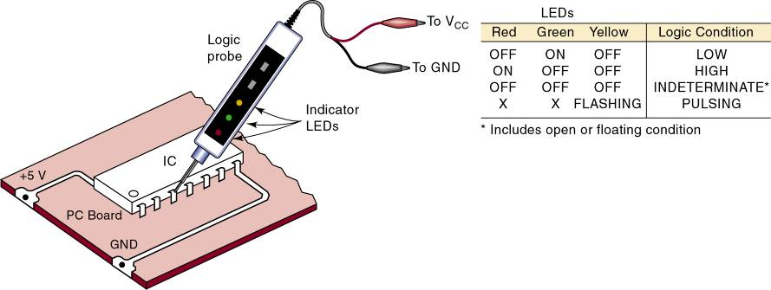
4-10 Troubleshooting Digital Systems
The logic probe will indicate the presence or absence of a signal when touched to a pin as indicated below.

Slide 52
4-11 Internal Digital IC Faults
Most common internal failures:
  Malfunction in the internal circuitry.
    Outputs do not respond properly to inputs.
    Outputs are unpredictable.
  Inputs or outputs shorted to ground or V_{CC} .
    The input will be stuck in LOW or HIGH state.
  Inputs or outputs open-circuited .
    An open output will result in a floating indication.
    Floating input in a TTL will result in a HIGH output.
    Floating input in a CMOS device will result
    in erratic or possibly destructive output.
  Short between two pins (other than ground or V_{CC}).
    The signal at those pins will always be identical.

Slide 53
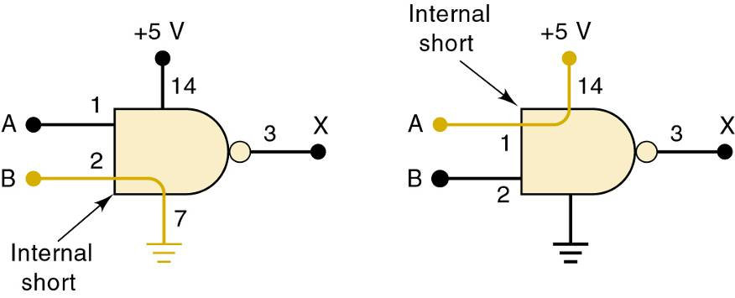
4-11 Internal Digital IC Faults
These two types of failures force the input signal
at the shorted pin to stay in the same state.
Left—IC input internally shorted to ground.
Right—IC input internally shorted to supply voltage.

Slide 54

4-11 Internal Digital IC Faults
These two types of failures do
not affect signals at the IC inputs.
Left—IC output internally shorted to ground.
Right—IC output internally shorted to supply voltage.

Slide 55

4-11 Internal Digital IC Faults
An IC with an internally open input will not respond to signals applied to that input pin.
An internally open output will produce an
unpredictable voltage at that output pin.

Slide 56

4-11 Internal Digital IC Faults
An internal short between two pins of an IC will force the logic signals at those pins always to be identical.
When two input pins are internally shorted, the signals driving these pins are forced to be identical, and usually a signal with three distinct levels results.

Slide 57
4-12 External Faults
Open signal lines—signal prevented from moving between points—can be caused by:
  Broken wire.
  Poor connections (solder or wire-wrap).
  Cut or crack on PC board trace.
  Bent or broken IC pins.
  Faulty IC socket.
This type of fault can be detected visually and verified with an ohmmeter between the points
in question.

Slide 58

4-12 External Faults
What is the most probable fault in the circuit shown?
The indeterminate level at the NOR gate output is
probably due to the indeterminate input at pin 2.
Because there is a LOW at Z1-6,
this LOW should also be at Z2-2.

Slide 59
4-12 External Faults
Shorted signal lines—the same signal appears on two or more pins—and V_{CC} or ground may
also be shorted, caused by:
  Sloppy wiring.
  Solder bridges.
  Incomplete etching.
This type of fault can be detected visually and verified with an ohmmeter between the points
in question.

Slide 60
4-12 External Faults
Faulty power supply—ICs will not operate or will operate erratically.
  May lose regulation due to an internal fault or because circuits are drawing too much current.
Verify that power supplies provide the specified range of voltages and are properly grounded.
  Use an oscilloscope to verify that AC ripple is not present and verify that DC voltages stay regulated.
Some ICs are more tolerant of power variations and may operate properly—others do not.
  Check power and ground levels at each IC that appears to be operating incorrectly.

Slide 61
4-12 External Faults
Output loading—caused by connecting too many inputs to the output of an IC, exceeding output current rating.
  Output voltage falls into the indeterminate range.
    Called loading the output signal.
  Usually a result of poor design or bad connection.

Slide 62
4-14 Programmable Logic Devices
The concept behind programmable logic devices is simple—lots of logic gates in a single IC.
  Control of the interconnection of these gates electronically.
PLDs allow the design process to be automated.
  Designers identify inputs, outputs, and logical relationships.
    PLDs are electronically configured to form the
    defined logic circuits.

Slide 63

4-14 Programmable Logic Devices
PLDs use a switch matrix that is often
referred to as a programmable array.
By deciding which intersections are connected & which are not, we can “program” the way the inputs are connected to the outputs of the array.

Slide 64

4-14 Programmable Logic Devices
For out-of-system programming the PLD is placed
in a programmer, connected to a PC.
  PC software translates and loads the information.

Slide 65
4-14 Programmable Logic Devices
In-system programming is done by connecting directly to “portal” pins while the IC remains in
the system.
  An interface cable connects the PLD to a PC
  running the software that loads the device.

Slide 66
4-14 Programmable Logic Devices
Logic circuits can be described using schematic diagrams, logic equations, truth tables, and HDL.
  PLD development software can convert any of these descriptions into 1s and 0s and loaded into the PLD.
Altera MAX+PLUS II is a development software that allows the user to describe circuits using graphic design files and timing diagrams.

Slide 67

4-14 Programmable Logic Devices
Hierarchical design—small logic circuits are defined and combined with other circuits to form a large section of a project.
  Large sections can be combined and connected for form a system.
Combining blocks
developed using
different description
methods.

Slide 68

4-14 Programmable Logic Devices
Top-down design—requires the definition of
subsections that will make up the system.
  And definition of the individual circuits that will
  make up each sub section.
    Each level can be designed and tested individually.

Slide 69

4-14 Programmable Logic Devices
Timing simulation of a circuit described in HDL.

Slide 70

4-14 Programmable Logic Devices
A system is built from
that bottom up.
Each block is described
by a design file.
After testing it is compiled
using development software.
The compiled block is tested
using a simulator for verify
correct operation.
A PLD is programmed to
verify correct operation.

Slide 71

4-15 Representing Data in HDL
Every programming language & HDL has its
own unique way of identifying number systems.
  Generally done with a prefix to indicate the system.
When we read one of these number designations, we must think of it as a symbol that represents a binary bit pattern.
  These numeric values are referred to as scalars or literals.

Slide 72

4-15 Representing Data in HDL
In order to describe a port with more than one data bit we assign a name and the number of bits.
  This is called a bit array or bit vector.
Each element (bit) has a unique index number
(0–7) to describe position in the overall structure.
  HDLs & computer programming languages use this notation.

Slide 73
4-15 Representing Data in HDL – AHDL Syntax
AHDL syntax—a name for the bit vector is followed by the range of index designations.
  Inside square brackets, in the SUBDESIGN section.
To declare an eight-bit input port called p1…
p1[7..0] :INPUT; --define an 8-bit input port

Slide 74
4-15 Representing Data in HDL – AHDL Syntax
Intermediate variables can be declared as an array of bits.
Eight-bit temperature port p1 assigned to a node named temp…
VARIABLE temp[7..0] :NODE;
BEGIN
temp[] = p1[]
END;
The empty braces mean that all bits in the array are being connected. Individual bits could be connected by specifying the bits inside the braces.

Slide 75
4-15 Representing Data in HDL – VHDL Syntax
VHDL syntax—a name for the bit vector is followed by the mode, the type, and the range.
  Enclosed in parenthesis, in the ENTITY section.
To declare an eight-bit input port called p1…
PORT (p1 :IN BIT_VECTOR (7 DOWNTO 0);

Slide 76
4-15 Representing Data in HDL – VHDL Syntax
Intermediate variables can be declared as an array of bits—in the ARCHITECTURE section
Eight-bit temperature port p1 assigned to a signal named temp…
SIGNAL temp :BIT_VECTOR {7 DOWNTO 0}; BEGIN
temp <= p1;
END;
When no elements in the bit vector are specified,
all bits in the array are being connected.
Individual bits could be connected by specifying
bit numbers inside the parentheses.

Slide 77

4-15 Representing Data in HDL
VHDL offers some standardized data types in libraries—collections of VHDL code that can be used to avoid reinventing the wheel.
  Many convenient functions such as standard TTL device descriptions are contained in macrofunctions.

Slide 78

4-16 Truth Tables Using HDL - AHDL
Circuits can be designed directly from truth tables,
using AHDL and VHDL.

Slide 79

4-16 Truth Tables Using HDL - VHDL
Circuits can be designed directly from truth tables,
using AHDL and VHDL.

Slide 80

4-17 Decision Control Structures in HDL – IF/THEN/ELSE
IF/THEN/ELSE statements provide a framework for making logical decisions in a system
  IF/THEN is used when there is a choice between doing something and doing nothing.

Slide 81

4-17 Decision Control Structures in HDL – IF/THEN/ELSE
IF/THEN/ELSE statements provide a framework for making logical decisions in a system
  IF/THEN/ELSE is used when there is a choice of two possible actions.

Slide 82

4-17 Decision Control Structures in HDL – IF/THEN/ELSE
IF/THEN/ELSE in AHDL:

Slide 83

4-17 Decision Control Structures in HDL – IF/THEN/ELSE
IF/THEN/ELSE in VHDL:

Slide 84

4-17 Decision Control Structures in HDL – ELSIF
By combining IF and ELSE decisions, we can create a control structure referred to as ELSIF
  Which chooses one of many
  possible outcomes.
As each condition is evaluated, it performs an action—if true—
or goes on to evaluate
the next condition.

Slide 85


4-17 Decision Control Structures in HDL – ELSIF
A temperature measuring system
using an A/D converter.
IF the digital value is less than or equal to 8…
THEN light only the Too Cold indicator.
ELSE IF the digital value is greater than 8 AND less than 11…
THEN light only the Just Right indicator.
ELSE light only the Too Hot indicator.

Slide 86

4-17 Decision Control Structures in HDL – ELSIF
ELSIF in AHDL:

Slide 87

4-17 Decision Control Structures in HDL – ELSIF
ELSIF in VHDL:

Slide 88
4-17 Decision Control Structures in HDL - CASE
The CASE construct determines the value of an expression or object.
  Then goes through a list of values (cases) to determine what action to take.
Different than the IF/ELSEIF, as there is only one action or match for a case statement.

Slide 89

4-17 Decision Control Structures in HDL - CASE
CASE construct in AHDL:

Slide 90

4-17 Decision Control Structures in HDL - CASE
CASE construct in VHDL:

Slide 91





4-17 Decision Control Structures in HDL - CASE
A vending machine coin detector accepts quarters, dimes & nickels, activating the corresponding digital signal (Q, D, N)
only when the correct coin is present.
A digital circuit must use the Q, D,
and N, signals as inputs and
produce a binary number that
represents the value of the coin

Slide 92

4-17 Decision Control Structures in HDL - CASE
The coin detector in AHDL:

Slide 93

4-17 Decision Control Structures in HDL - CASE
The coin detector in VHDL:

Slide 94
END

