Slide 1



Slide 2
Chapter 5 – Flip-Flops and Related Devices

Slide 3
Chapter 5 Objectives
Selected areas covered in this chapter:
  Constructing/analyzing operation of latch flip-flops made from NAND or NOR gates.
  Differences of synchronous/asynchronous systems.
  Major differences between parallel & serial transfers.
  Operation of edge-triggered flip-flops.
  Typical characteristics of Schmitt triggers.
  Effects of clock skew on synchronous circuits.
  Troubleshoot various types of flip-flop circuits.
  Sequential circuits with PLDs using schematic entry.
  Logic primitives, components & libraries in HDL code.
  Structural level circuits from components.

Slide 4
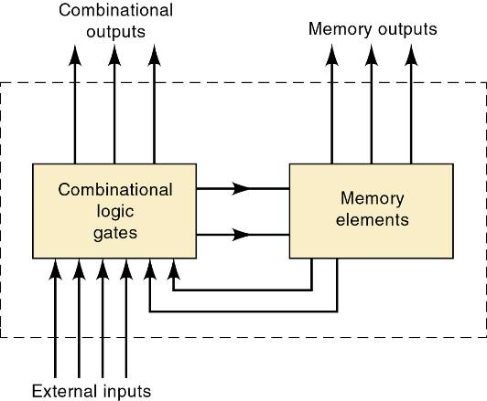
Chapter 5 Introduction
Block diagram of a general digital system that combines combinational logic gates with memory devices.

Slide 5
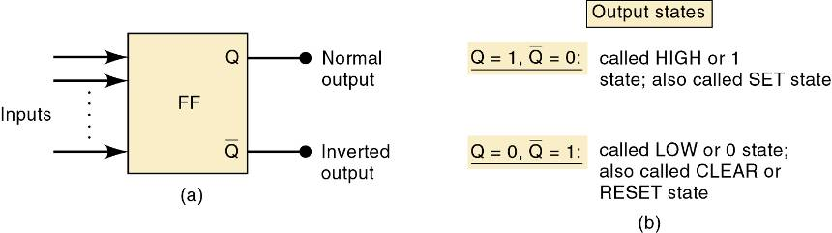
Chapter 5 Introduction
The most important memory element is the flip-flop (FF)—made up of an assembly of logic gates.
The flip-flop is known by other names,
including latch and bistable multivibrator.

Slide 6
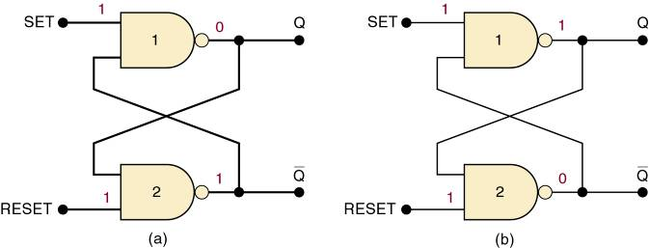
5-1 NAND Gate Latch
The NAND gate latch or simply latch is a basic FF.
  Inputs are SET and CLEAR (RESET).
Inputs are active-LOW—output will change when the input is pulsed LOW.
  When the latch is set: Q = 1 and Q = 0
  When the latch is clear or reset: Q = 0 and Q = 1

Slide 7
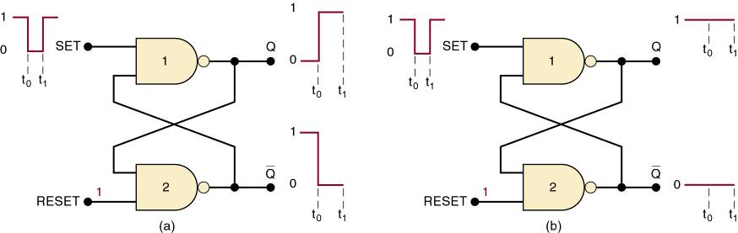
5-1 NAND Gate Latch – Setting the Latch (FF)
Pulsing the SET input to the 0 state...
  (a) Q = 0 prior to SET pulse.
  (b) Q = 1 prior to SET pulse.
In both cases, Q ends up HIGH.

Slide 8
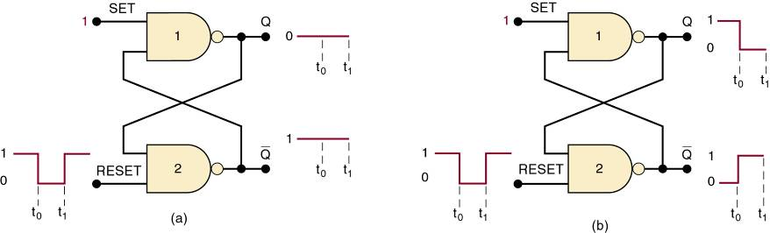
5-1 NAND Gate Latch – Resetting the Latch (FF)
Pulsing RESET LOW when...
  (a) Q = 0 prior to the RESET pulse.
  (b) Q = 1 prior to the RESET pulse.
In each case, Q ends up LOW.

Slide 9
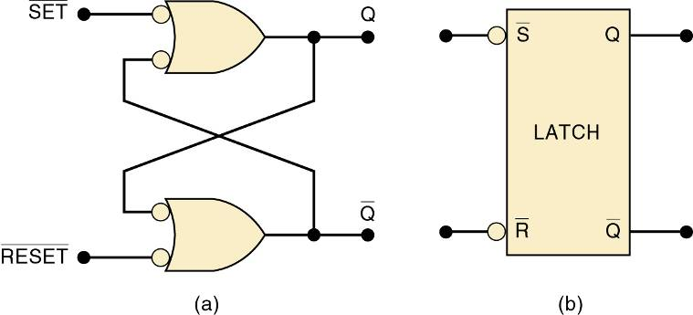
5-1 NAND Gate Latch – Alternate Representations
NAND latch equivalent representations
and simplified block diagram.

Slide 10
5-1 NAND Gate Latch - Summary
Summary of the NAND latch:
  SET = 1, RESET = 1—Normal resting state, outputs remain in state they were in prior to input.
  SET = 0, RESET = 1—Output will go to Q = 1 and remains there, even after SET returns HIGH.
    Called setting the latch.
  SET = 0, RESET = 0—Will produce Q = 0 LOW and remains there, even after RESET returns HIGH.
    Called clearing or resetting the latch.
  SET = 0, RESET = 0—Tries to set and clear the latch
  at the same time, and produces
    Output is unpredictable, and this input condition
    should not be used.
Q = Q = 1.

Slide 11
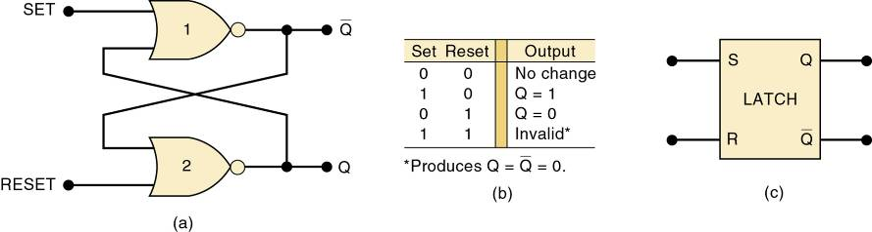
5-2 NOR Gate Latch
Two cross-coupled NOR gates can be used as a NOR gate latch—similar to the NAND latch.
  The Q and Q outputs are reversed.
The SET and RESET inputs are active-HIGH.
Output will change when the input is pulsed HIGH.

Slide 12
5-1 NOR Gate Latch - Summary
Summary of the NOR latch:
  SET = 0, RESET = 0—Normal resting state, No effect on output state.
  SET = 1, RESET = 0—will always set Q = 1, where it remains even after SET returns to 0.
  SET = 0, RESET = 1—will always clear Q = 0, where it remains even after RESET returns to 0.
  SET = 1, RESET = 1—Tries to set and reset the latch
  at the same time, and produces
    Output is unpredictable, and this input condition
    should not be used.
Q = Q = 0.

Slide 13
Chapter 5
When power is applied, it is not possible to predict the starting state of a flip-flop’s output.
  If SET and RESET inputs are in their inactive state.
To start a latch or FF in a particular state, it must be placed in that state by momentarily activating the SET or RESET input, at the start of operation.
  Often achieved by application of a pulse to the appropriate input.

Slide 14
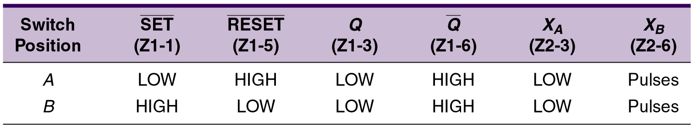
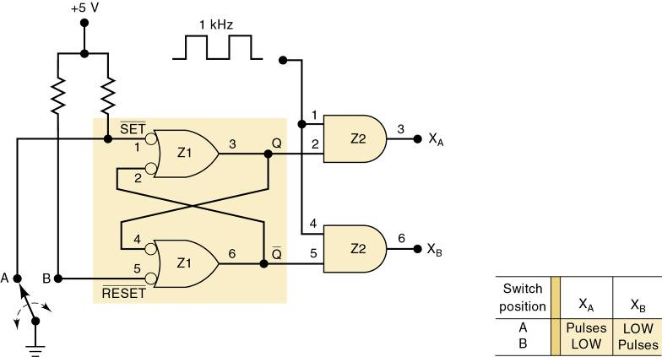
5-3 Troubleshooting Case Study
Troubleshoot
the circuit.

Slide 15
5-3 Troubleshooting Case Study
There are several possibilities:
  An internal open connection at Z1-1, which would prevent Q from responding to the input.
  An internal component failure in NAND gate Z1 that prevents it from responding properly.
  Q output is stuck LOW, which could be caused by:
    Z1-3 internally shorted to ground
    Z1-4 internally shorted to ground
    Z2-2 internally shorted to ground
    The Q node externally shorted to ground

Slide 16
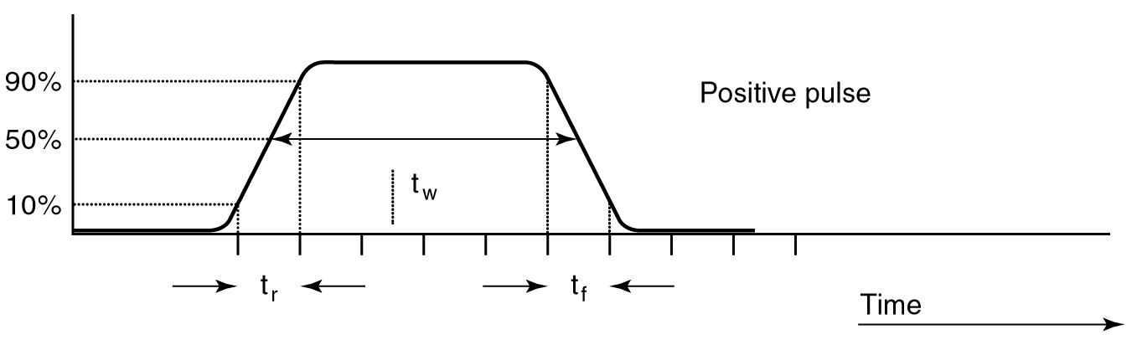
5-4 Digital Pulses
Signals that switch between active and
inactive states are called pulse waveforms.
A positive pulse has
an active-HIGH level.

Slide 17
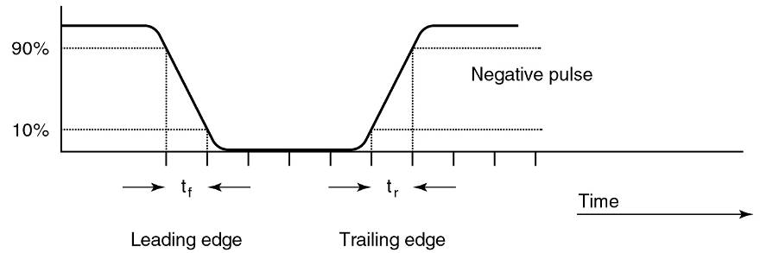
5-4 Digital Pulses
Signals that switch between active and
inactive states are called pulse waveforms.
A negative pulse has
an active-LOW level.

Slide 18
5-4 Digital Pulses
In actual circuits it takes time for a pulse waveform to change from one level to the other.
  Transition from LOW to HIGH on a positive pulse is called rise time (t_{r}).
Measured between the 10% and 90% points
on the leading edge of the voltage waveform.

Slide 19
5-4 Digital Pulses
In actual circuits it takes time for a pulse waveform to change from one level to the other.
  Transition from HIGH to LOW on a positive pulse is called fall time (t_{f}).
Measured between the 90% and 10% points on the trailing edge of the voltage waveform.

Slide 20
5-4 Digital Pulses
In actual circuits it takes time for a pulse waveform to change from one level to the other.
  A pulse also has a duration—width—(t_{w}).
The time between the points when the leading and trailing edges are
at 50% of the HIGH level voltage.

Slide 21
5-5 Clock Signals and Clocked Flip-Flops
Digital systems can operate either asynchronously or synchronously.
  Asynchronous system—outputs can change state at any time the input(s) change.
  Synchronous system—output can change state
  only at a specific time in the clock cycle.

Slide 22
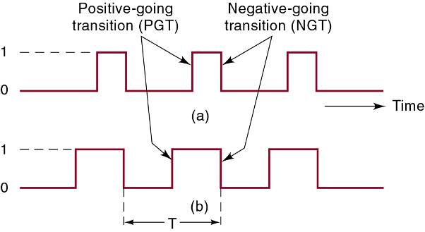
5-5 Clock Signals and Clocked Flip-Flops
The clock signal is a rectangular pulse train or square wave.
  Positive going transition (PGT)—clock pulse goes from 0 to 1.
  Negative going transition (NGT)—clock pulse goes from 1 to 0.
  Transitions are
  also called edges.

Slide 23
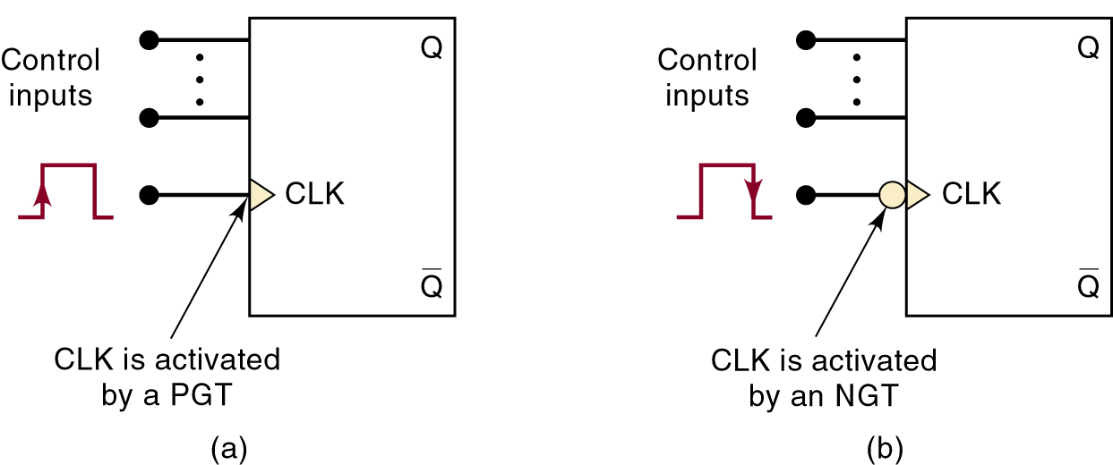
5-5 Clock Signals and Clocked Flip-Flops
Clocked FFs change state on one or the other clock transitions.
  Clock inputs are labeled CLK, CK, or CP.
A small triangle at the CLK input indicates that the input
is activated with a PGT.
A bubble and a triangle indicates that the CLK input
is activated with a NGT.

Slide 24
5-5 Clock Signals and Clocked Flip-Flops
Control inputs have an effect on the output only at the active clock transition (NGT or PGT)—also called synchronous control inputs.
  The control inputs get the outputs ready to change, but the change is not triggered until the CLK edge.

Slide 25
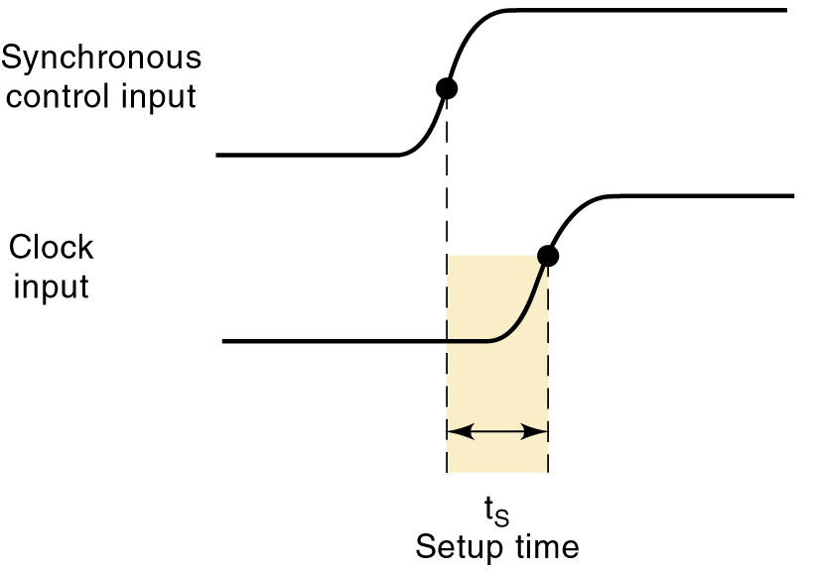
5-5 Clock Signals and Clocked Flip-Flops
Setup time (t_{S}) is the minimum time interval before the active CLK transition that the control input must be kept at the proper level.

Slide 26
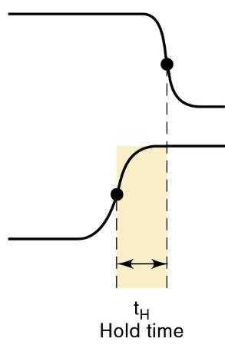
5-5 Clock Signals and Clocked Flip-Flops
Hold time (t_{H}) is the time following the active transition of the CLK, during which the control
input must kept at the proper level.

Slide 27
5-6 Clocked S-R Flip-Flop
The S and R inputs are synchronous control inputs, which control the state the FF will go to when the clock pulse occurs.
  The CLK input is the trigger input that causes the
  FF to change states according to the S and R inputs.
SET-RESET (or SET-CLEAR) FF will change states at positive- or negative-going clock edges.

Slide 28
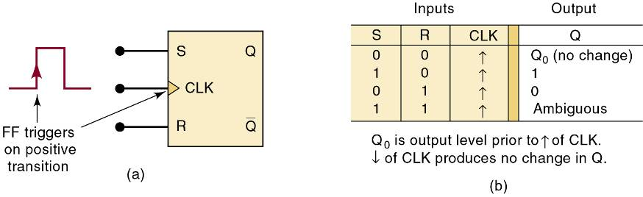
5-6 Clocked S-R Flip-Flop
A clocked S-R flip-flop triggered by the
positive-going edge of the clock signal.
The S and R inputs control the state of the FF in the same manner as described earlier for the NOR gate latch, but the FF does not respond
to these inputs until the occurrence of the PGT of the clock signal.

Slide 29
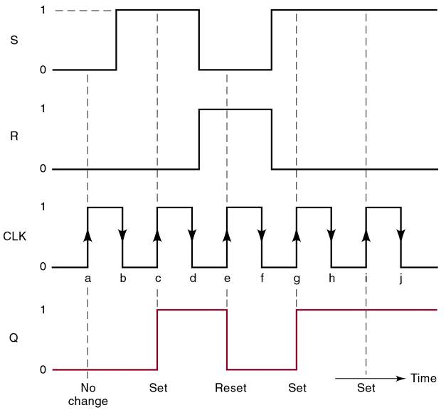
5-6 Clocked S-R Flip-Flop
Waveforms of
the operation of
a clocked S-R
flip-flop triggered by the positive-going edge of a clock pulse.

Slide 30
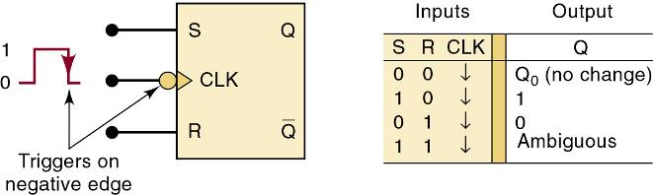
5-6 Clocked S-R Flip-Flop
A clocked S-R flip-flop triggered by the
negative-going edge of the clock signal.
Both positive-edge and negative-edge
triggering FFs are used in digital systems.

Slide 31
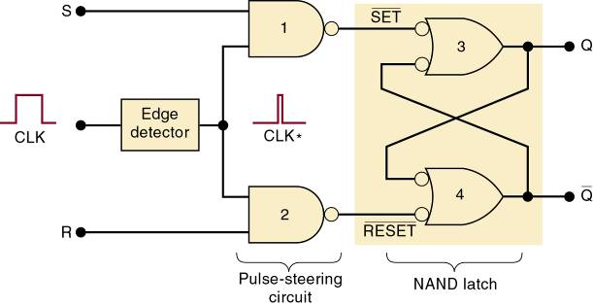
5-6 Clocked S-R Flip-Flop – Internal Circuitry
An edge-triggered S-R flip-flop circuit features:
  A basic NAND gate latch formed by NAND-3 and NAND-4.
  A pulse-steering circuit formed by NAND-1 and NAND-2.
  An edge-detector circuit.

Slide 32
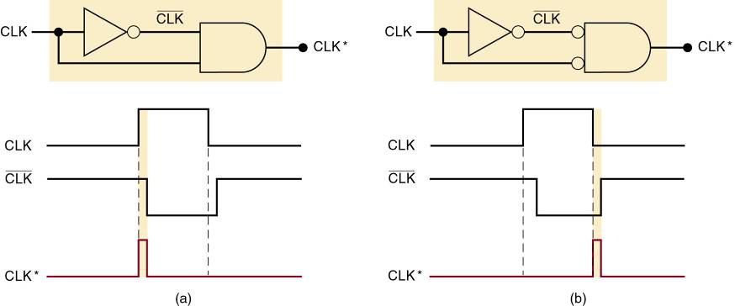
5-6 Clocked S-R Flip-Flop – Internal Circuitry
Implementation of edge-detector circuits used in edge-triggered flip-flops:
  (a) PGT; (b) NGT.
The duration of the CLK* pulses is typically 2–5 ns.

Slide 33
5-7 Clocked J-K Flip-Flop
Operates like the S-R FF.
  J is SET, K is CLEAR.
When J and K are both HIGH, output is toggled
to the opposite state.
  May be positive going or negative going clock trigger.
Much more versatile than the S-R flip-flop, as it has no ambiguous states.
  Has the ability to do everything the S-R FF does,
  plus operates in toggle mode.

Slide 34
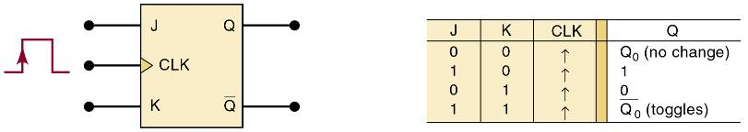
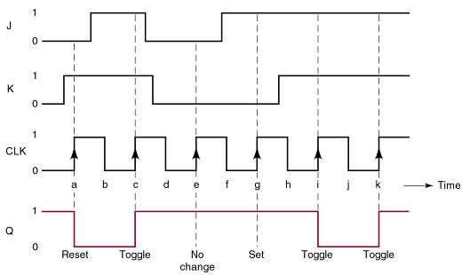
5-7 Clocked J-K Flip-Flop
Clocked J-K flip-flop that responds
only to the positive edge of the clock.

Slide 35
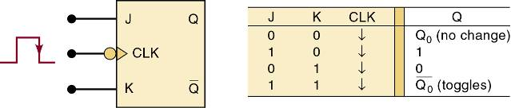
5-7 Clocked J-K Flip-Flop
Clocked J-K flip-flop that responds
only to the negative edge of the clock.

Slide 36
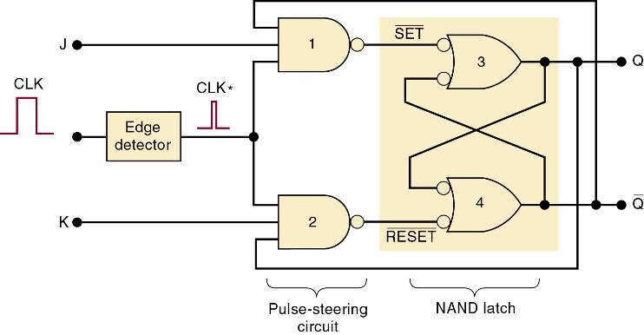
5-7 Clocked J-K Flip-Flop – Internal Circuitry
The internal circuitry of an edge-triggered J-K
flip-flop contains the same three sections as
the edge-triggered S-R flip-flop.

Slide 37
5-8 Clocked D Flip-Flop
One data input—output changes to the value of the input at either the positive- or negative-going clock trigger.
May be implemented with a J-K FF by tying
the J input to the K input through an inverter.
Useful for parallel data transfer.

Slide 38
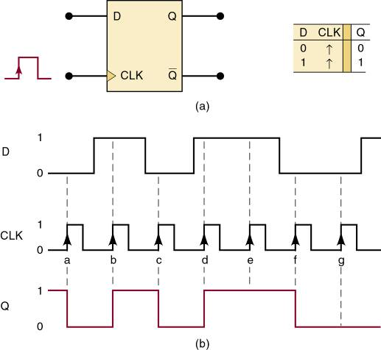
5-8 Clocked D Flip-Flop
D flip-flop that triggers only on
positive-going transitions.

Slide 39
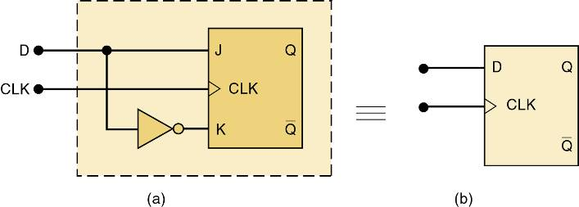
5-8 Clocked D Flip-Flop - Implementation
An edge-triggered D flip-flop is implemented by adding a single INVERTER to the edge-triggered J-K flip-flop.
  The same can be done to convert a S-R flip-flop
  to a D flip-flop.
Edge-triggered D flip-flop
implementation from a J-K flip-flop.

Slide 40
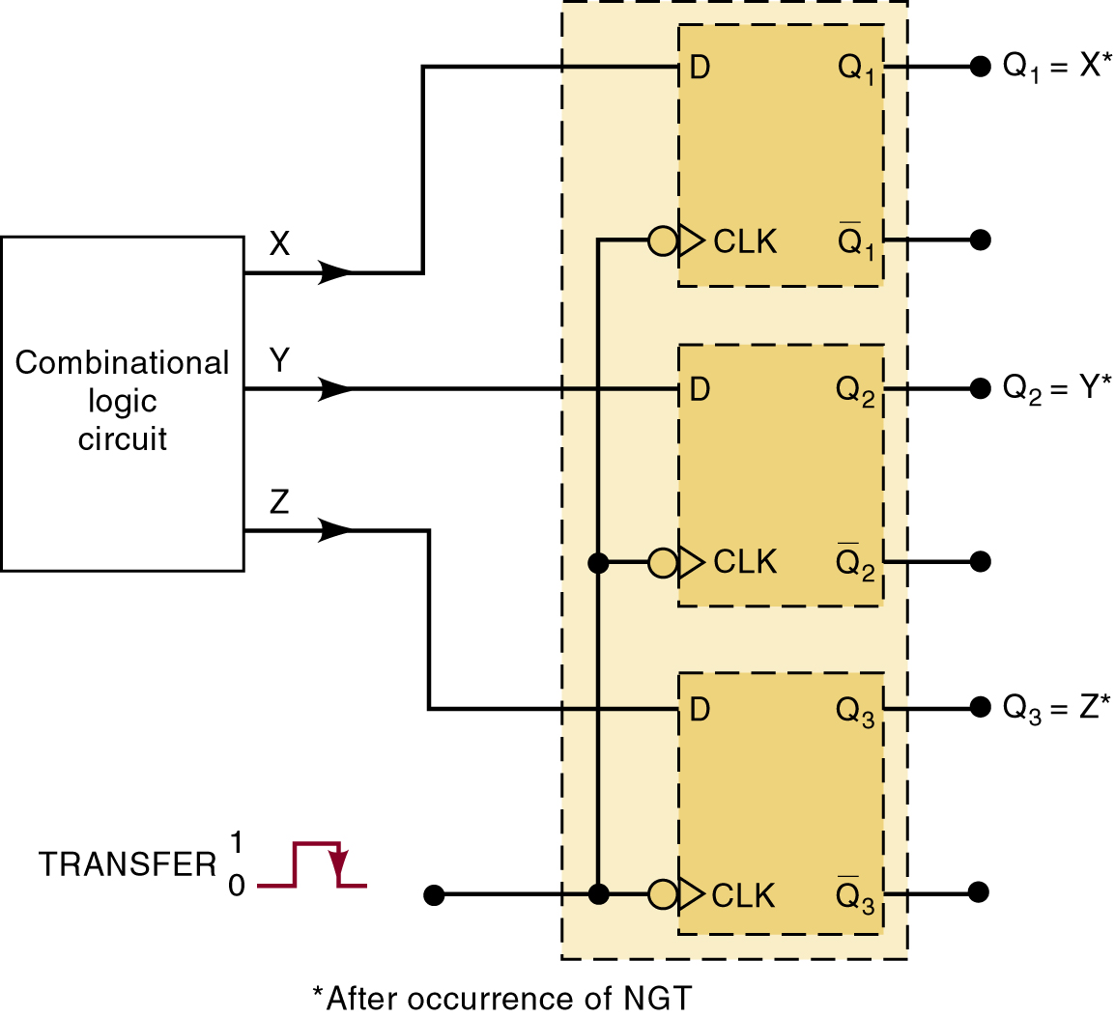
5-8 Clocked D Flip-Flop – Parallel Data Transfer
Outputs X, Y, Z are to be transferred
to FFs Q1, Q2, and Q3 for storage.
Using D flip-flops, levels present at X, Y & Z will be transferred to Q1, Q2 & Q3, upon application of a TRANSFER pulse to the common CLK inputs.

Slide 41
5-8 Clocked D Flip-Flop – Parallel Data Transfer
Outputs X, Y, Z are to be transferred
to FFs Q1, Q2, and Q3 for storage.
This is an example of parallel data transfer of binary data—the three bits X, Y & Z are transferred simultaneously.

Slide 42
5-9 D Latch (Transparent Latch)
The edge-triggered D flip-flop uses an edge-detector circuit to ensure the output responds to the D input only on active transition of the clock.
  If this edge detector is not used, the resultant circuit operates as a D latch.

Slide 43
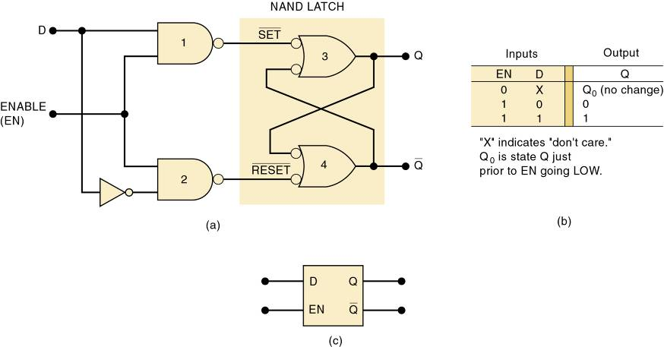
5-9 D Latch (Transparent Latch)
D latch structure, function table, logic symbol.

Slide 44
5-9 D Latch (Transparent Latch)
The circuit contains the NAND latch and the steering NAND gates 1 and 2 without the edge-detector circuit.
The common input to the steering gates is called an enable input (abbreviated EN)—rather than a clock input.
  Its effect on the Q and Q outputs is not restricted to occurring only on its transitions

Slide 45
5-10 Asynchronous Inputs
Inputs that depend on the clock are synchronous.
Most clocked FFs have asynchronous inputs that do not depend on the clock.
  Labels PRE & CLR are used for asynchronous inputs.
Active-LOW asynchronous inputs will have a bar over the labels and inversion bubbles.
If the asynchronous inputs are not used they will be tied to their inactive state.

Slide 46
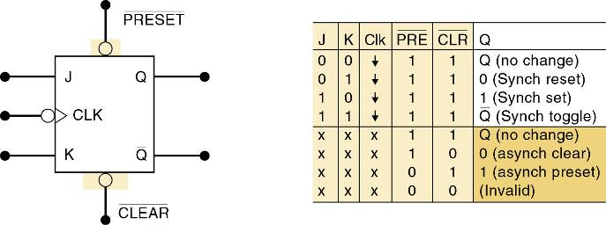
5-10 Asynchronous Inputs
Clocked J-K flip-flop with asynchronous inputs.

Slide 47
5-10 Asynchronous Inputs - Designations
IC manufacturers do not agree on nomenclature for asynchronous inputs.
  The most common designations are PRE (PRESET) and CLR (CLEAR).
    Clearly distinguished from synchronous SET & RESET.
  Labels such as S-D (direct SET) and R-D (direct RESET) are also used.

Slide 48
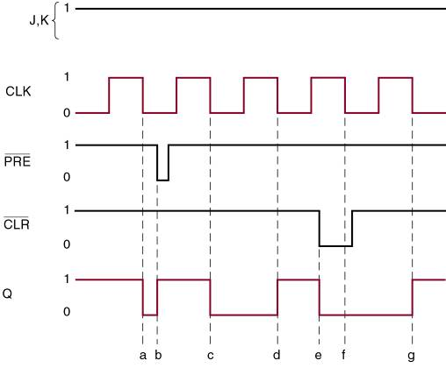
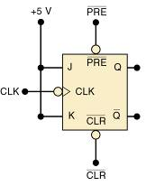
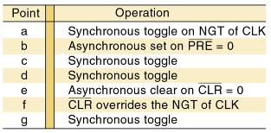
5-10 Asynchronous Inputs
A J-K FF that responds to a NGT on its clock
input and has active-LOW asynchronous inputs.

Slide 49
5-11 Flip-Flop Timing Considerations - Parameters
Important timing parameters:
  Setup and hold times
  Propagation delay—time for a signal at the input to be shown at the output. (t_{PLH} and t_{PHL})
  Maximum clocking frequency—Highest clock frequency that will give a reliable output. (f_{MAX})
  Clock pulse HIGH and LOW times—minimum clock-time between HIGH/LOW changes.( t_{W}(L); t_{W}(H) )
  Asynchronous Active Pulse Width—time the
  clock must HIGH before going LOW, and LOW
  before going HIGH.
  Clock transition times—maximum time for clock transitions,
    Less than 50 ns for TTL ; 200 ns for CMOS

Slide 50
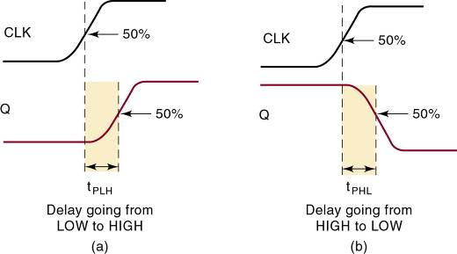
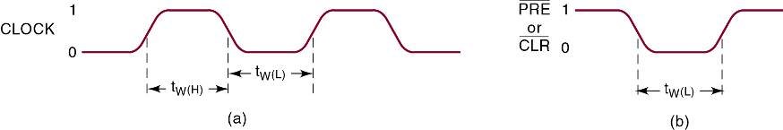
5-11 Flip-Flop Timing Considerations - Parameters
FF propagation delays.
Clock Pulse HIGH and LOW and Asynch pulse width.

Slide 51
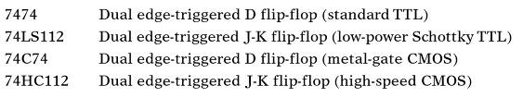
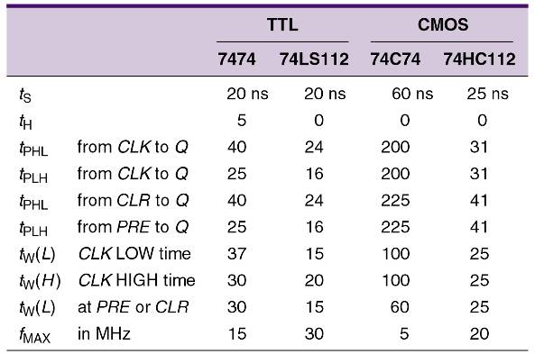
5-11 Flip-Flop Timing Considerations – Actual IC Values
Timing values for FFs
from manufacturer
data books.
All of the listed values
are minimum values, except propagation
delays, which are maximum values.

Slide 52
5-12 Potential Timing Problems in FF Circuits
When the output of one FF is connected to the input of another FF and both are triggered by the same clock, there is a potential timing problem.
  Propagation delay may cause unpredictable outputs.
Edge-triggered FFs have hold time requirements
5 ns or less—most have t_{H} = 0.
  They have no hold time requirement.
Assume the FF hold time requirement is short enough to respond reliably according to the following rule:
Flip-Flop output will go to a state determined by
logic levels present at its synchronous control inputs
just prior to the active clock transition.

Slide 53
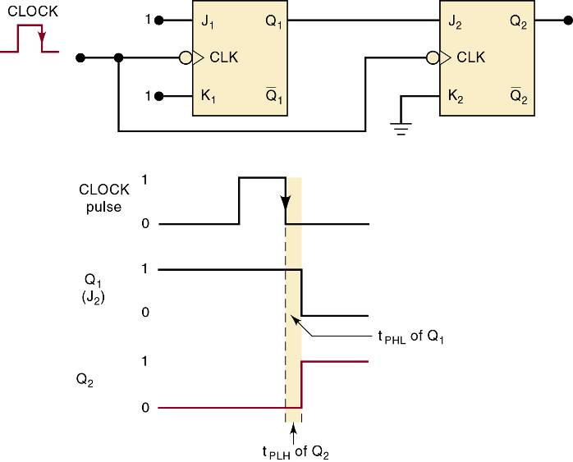
5-12 Potential Timing Problems in FF Circuits
Q2 will respond properly
to the level present at
Q1 prior to NGT of CLK—provided Q2 ’s hold time requirement, t_{H}, is less than Q1’s propagation delay.

Slide 54
5-13 Flip-Flop Applications
Examples of applications:
  Counting; Storing binary data
  Transferring binary data between locations
Many FF applications are categorized sequential.
  Output follows a predetermined sequence of states.

Slide 55
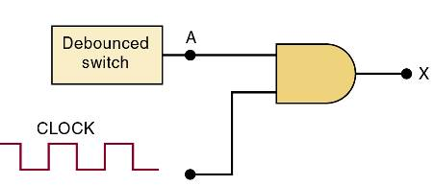
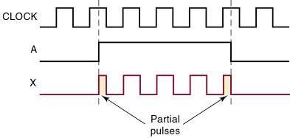
5-14 Flip-Flop Synchronization
Most systems are primarily synchronous in operation—in that changes depend on the clock.
Asynchronous and synchronous operations are
often combined—frequently through human input.
  The random nature of asynchronous inputs can
  result in unpredictable results.
The asynchronous signal A can produce partial pulses at X.

Slide 56
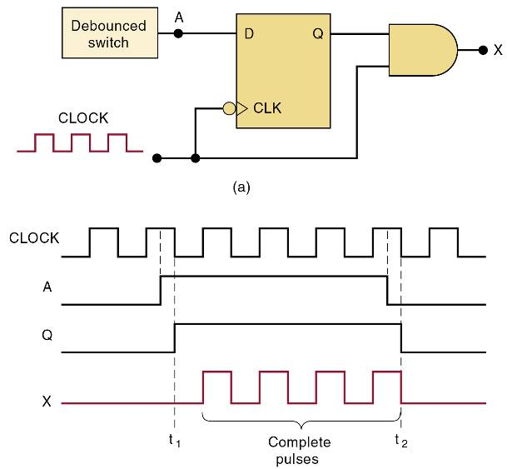
5-14 Flip-Flop Synchronization
An edge-triggered D flip-flop synchronizes the enabling of the AND gate to the NGTs of the clock.

Slide 57
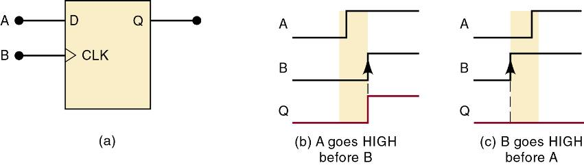
5-15 Detecting an Input Sequence
FFs provide features pure combinational logic gates do not—in many situations, output activates only when inputs activate in a certain sequence
  This requires the storage characteristic of FFs.
Clocked D flip-flop used to respond
to a particular sequence of inputs.
To work properly, A must go HIGH,
prior to B, by at least an amount
of time equal to FF setup time.

Slide 58
5-16 Data Storage and Transfer
FFs are commonly used for storage and transfer
of binary data.
  Groups used for storage are registers.
Data transfers take place when data is moved between registers or FFs.
  Synchronous transfers take place at clock PGT/NGT.
  Asynchronous transfers are controlled by PRE & CLR.

Slide 59
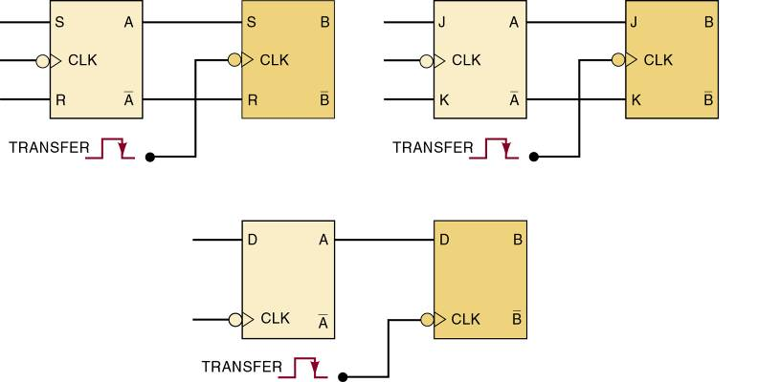
5-16 Data Storage and Transfer – Synchronous
Synchronous data transfer operation by various clocked FFs.
CLK inputs are used to perform the transfer.

Slide 60
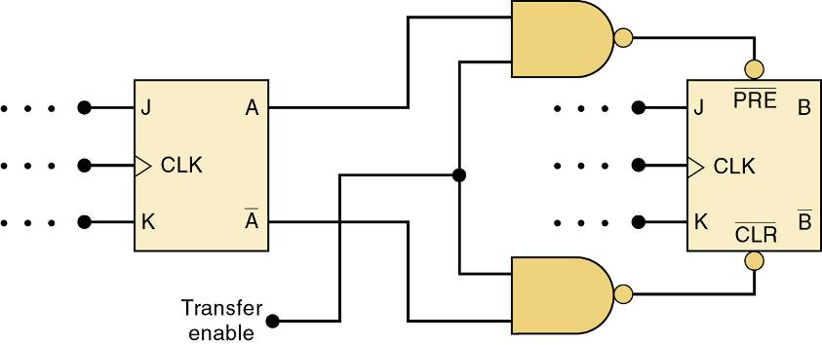
5-16 Data Storage and Transfer – Asynchronous
Asynchronous data transfer operation.
PRE and CLR inputs are used to perform the transfer.

Slide 61
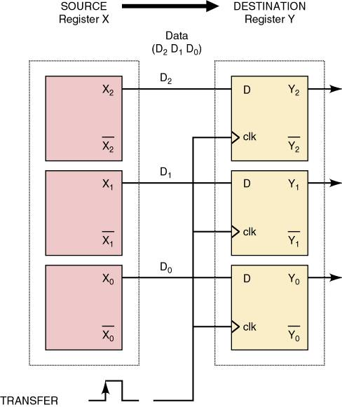
5-16 Data Storage and Transfer – Parallel
Transferring the bits of a register simultaneously is a parallel transfer.

Slide 62
5-17 Serial Data Transfer
Transferring the bits of a register a bit at a time is
a serial transfer.

Slide 63
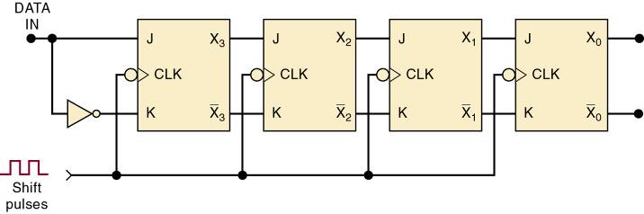
5-17 Serial Data Transfer – Shift Register
A shift register is a group of FFs arranged so the binary numbers stored in the FFs are shifted from one FF to the next, for every clock pulse.
J-K flip-flops operated as a four-bit shift register.

Slide 64
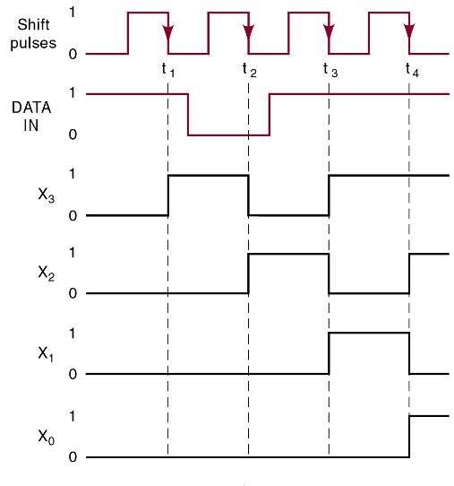
5-17 Serial Data Transfer – Shift Register
Input data are shifted
left to right from FF
to FF as shift pulses
are applied.
In this shift-register arrangement, it is necessary to have FFs with very small hold time requirements.
There are times when the J, K inputs are changing at about the same time as the CLK transition.

Slide 65
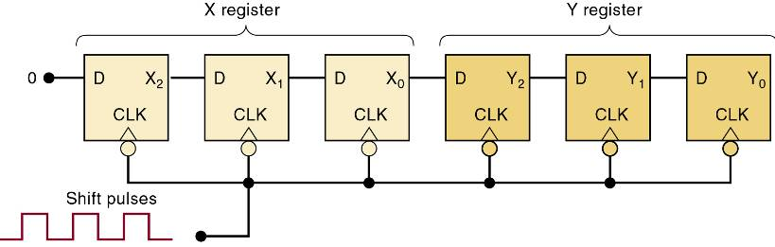
5-17 Serial Data Transfer – Shift Register
Two connected three-bit shift registers.
The contents of the X register will be serially
transferred (shifted) into register Y.
The D flip-flops in each shift register require fewer connections than J-K flip-flops.

Slide 66
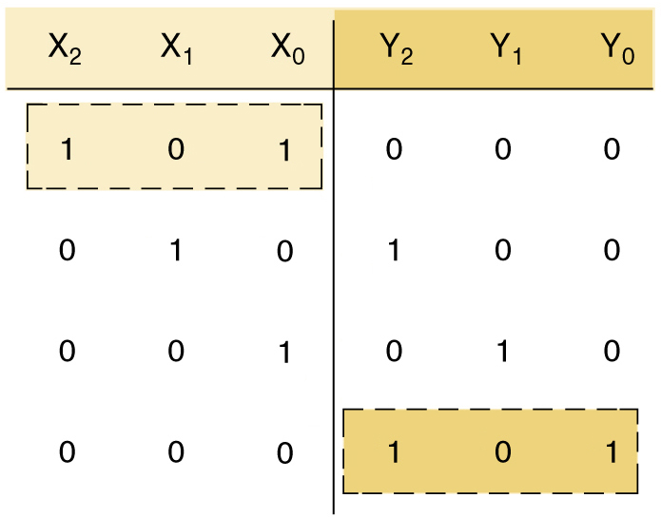
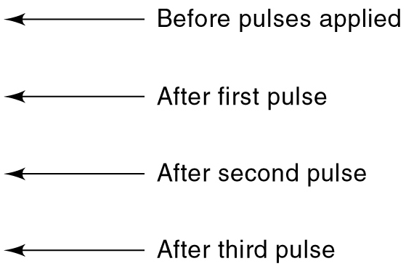
5-17 Serial Data Transfer – Shift Register
Two connected three-bit shift registers.
The complete transfer of the three bits
of data requires three shift pulses.

Slide 67

5-17 Serial Data Transfer – Shift Register
Two connected three-bit shift registers.
On each pulse NGT, each FF takes on the value
stored in the FF on its left prior to the pulse.

Slide 68
5-17 Serial Data Transfer – Shift Register
Two connected three-bit shift registers.
On each pulse NGT, each FF takes on the value
stored in the FF on its left prior to the pulse.

Slide 69
5-17 Serial Data Transfer – Shift Register
Two connected three-bit shift registers.
On each pulse NGT, each FF takes on the value
stored in the FF on its left prior to the pulse.

Slide 70
5-17 Serial Data Transfer – Shift Register
Two connected three-bit shift registers.
The 1 initially in X2 is in Y2.
The 0 initially in X1 is in Y1.
The 1 initially in X0 is in Y0.
After three pulses:
The 101 stored in the X register has now been
shifted into the Y register.
The X register has lost its original data, and is at 000.

Slide 71
5-17 Serial Data Transfer vs. Parallel
FFs in can just as easily be connected so that information shifts from right to left.
  No general advantage of one direction over another.
    Often dictated by the nature of the application.
Parallel transfer requires more interconnections between sending & receiving registers than serial.
  More critical when a greater number of bits of are being transferred.
Often, a combination of types is used
  Taking advantage of parallel transfer speed and serial transfer the economy and simplicity of serial transfer.

Slide 72
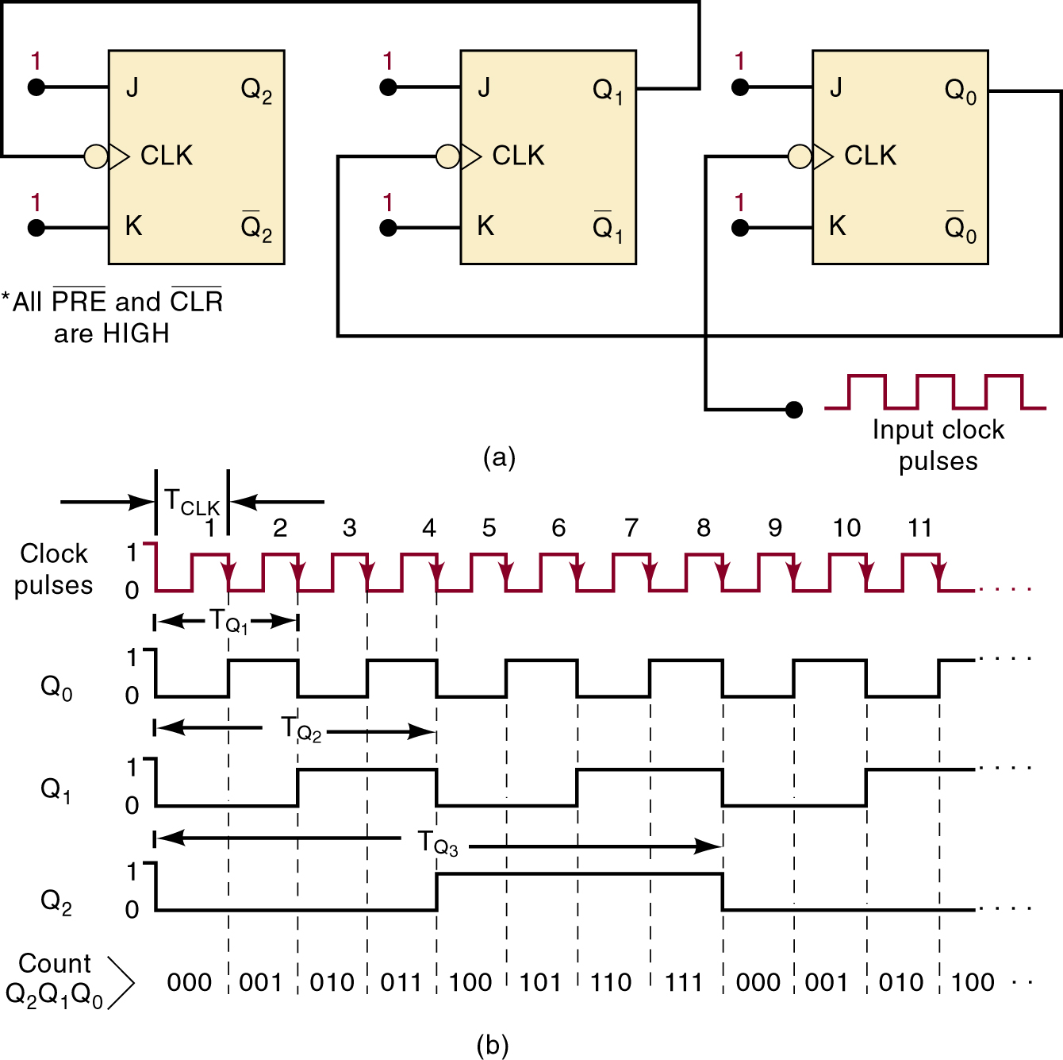
5-18 Frequency Division and Counting
J-K flip-flops wired
as a three-bit binary
counter (MOD-8).
Each FF divides the input frequency by 2.
Output frequency
is 1/8 of the input
(clock) frequency.
A fourth FF would make the frequency
1/16 of the clock.

Slide 73
5-18 Frequency Division and Counting
J-K flip-flops wired
as a three-bit binary
counter (MOD-8).
This circuit also acts as a binary counter.
Outputs will count
from 0002 to 1112
or 010 to 710.
The number of states possible in a counter
is the modulus
or MOD number.

Slide 74



5-18 Frequency Division and Counting
A MOD-8 (2³) counter.
If another FF is added it would
become a MOD-16 (2⁴) counter.

Slide 75
5-19 Microcomputer Application
Microprocessor units (MPUs) perform many functions involving use of registers for data transfer and storage.
MPUs may send data to external registers
for many purposes, including:
  Solenoid/relay control; Device positioning.
  Motor starting & speed controls.

Slide 76

5-19 Microcomputer Application
Microprocessor transferring binary
data to an external register.

Slide 77
5-20 Schmitt-Trigger Devices
Not classified as a FF—but has a useful a memory characteristic in certain situations.
Accepts slow changing signals and produces a signal that transitions quickly, oscillation-free.
A Schmitt trigger device will not respond to input until it exceeds the positive-(V_{T+}) or negative-(V_{T-}) going threshold.
Separation between the threshold levels means the device will “remember” the last threshold exceeded.
  Until the input goes to the opposite threshold.

Slide 78

5-20 Schmitt-Trigger Devices
Standard inverter response to slow noisy input.

Slide 79

5-20 Schmitt-Trigger Devices
Schmitt-trigger response to slow noisy input.

Slide 80
5-21 One-shot (Monostable Multivibrator)
Like the FF, the OS has two outputs, .
  The inverse of each other.
Q and Q
One shots are called monostable multivibrators because they have only one stable state.
  Prone to triggering by noise.
Changes from stable to quasi-stable state for a fixed time-period (t_{p}).
  Usually determined by an RC time constant from external components.

Slide 81
5-21 One-shot (Monostable Multivibrator)
Nonretriggerable devices trigger & return to stable.
Retriggerable devices can be triggered while in the quasi-stable state, to begin another pulse.

Slide 82


5-21 One-shot (Monostable Multivibrator)
OS symbol and typical waveforms
for nonretriggerable operation.
PGTs at points a, b, c, and e will trigger
the OS to its quasi-stable state for a time t_{p}.
After which it automatically returns to the stable state.

Slide 83
5-21 One-shot (Monostable Multivibrator)
OS symbol and typical waveforms
for nonretriggerable operation.
PGTs at points d and f have no effect on the OS because it has already been triggered quasi-stable.
OS must return to the stable before it can be triggered.

Slide 84
5-21 One-shot (Monostable Multivibrator)
OS symbol and typical waveforms
for nonretriggerable operation.
OS output-pulse duration is always the same, regardless of the duration of the input pulses.
Time t_{p} depends only on R_{T}, C_{T} & internal OS circuitry.

Slide 85

5-21 One-shot (Monostable Multivibrator)
Comparison of nonretriggerable and
retriggerable OS responses for t_{p} = 2ms.

Slide 86

5-21 One-shot (Monostable Multivibrator)
Retriggerable OS begins a new t_{p} interval
each time it receives a trigger pulse.

Slide 87

5-21 One-shot (Monostable Multivibrator)
74121 nonretriggerable one-shot IC.
Contains internal logic gates
to allow inputs A₁ , A₂ , and B to trigger OS.
Input B is a Schmitt-trigger—allowed to have slow transition times & still reliably trigger OS.
Pins R_{INT}, R_{EXT}/C_{INT}, , and C_{EXT} connect to an external resistor & capacitor to achieve desired output pulse duration.

Slide 88
5-22 Clock Generator Circuits
A third type multivibrator has no stable states—an astable or free-running multivibrator.
  Astable or free-running multivibrators switch back
  and forth between two unstable states.
  Useful for generating clock signals for synchronous circuits.

Slide 89

5-22 Clock Generator Circuits
Schmitt-trigger oscillator using a 7414 INVERTER.
A 7413 Schmitt-trigger NAND may also be used.

Slide 90
5-22 Clock Generator Circuits
The 555 timer IC is a TTL-compatible device that can operate in several different modes.
  Output is a repetitive rectangular waveform that switches between two logic levels.
  The time intervals at each logic level are determined by the R and C values.
The heart of the 555 timer is two voltage comparators and an S-R latch.
  The comparators produce a HIGH out when voltage on the (+) input is greater than on the (-) input.

Slide 91

5-22 Clock Generator Circuits
555 Timer IC used as an astable multivibrator.

Slide 92
5-22 Clock Generator Circuits
Crystal control may be used if a very stable clock is needed—used in microprocessor systems and microcomputers where accurate timing intervals are essential.

Slide 93
5-23 Troubleshooting Flip-Flop Circuits
FFs are subject to the same faults that occur in combinational logic circuits.
  Timing problems create some faults and symptoms that are not seen in combinational logic circuits.
Unconnected or floating inputs are particularly susceptible spurious voltage fluctuations—noise.
Given sufficient noise amplitude and duration, logic circuit output may change states in response.
  In a logic gate, output will return to its original state when the noise signal subsides.
  In a FF, output will remain in its new state due to its memory characteristic.

Slide 94
5-23 Troubleshooting Flip-Flop Circuits
Clock skew occurs when CLK signals arrive
at different FFs at different times.
  The fault may be seen only intermittently, or
  may disappear during testing.

Slide 95

5-23 Troubleshooting Flip-Flop Circuits
Extra gating circuits can cause clock skew.

Slide 96

5-23 Troubleshooting Flip-Flop Circuits
Extra gating circuits can cause clock skew.

Slide 97
5-24 Sequential Circuits In PLDs Using Schematic Entry
Altera’s Quartus II development system software allows designers to describe the desired circuit using schematics.
  The megafunction library contains high-level modules that can be used to create logic designs.
The Quartus II simulator can be used to verify the sequential circuits by schematic capture before you program a PLD.

Slide 98

5-25 Sequential Circuits Using HDL
Most PLDs have the ability to feed back the output signal to the input circuitry—to accommodate latching action.
  The port bit is an output with feedback.

Slide 99

5-25 Sequential Circuits Using HDL
The logic of a behavioral
description of an S-R latch.

Slide 100
5-25 Sequential Circuits Using HDL
Sequential circuits that feed output value back to inputs, may possibly create an unstable system.
  A change in the output state might be fed back to the inputs, which changes the output state again, which feeds back to the inputs, which changes the output back again….
It is very important to make sure no combination
of inputs & outputs can make this undesirable oscillation undesirable happen.

Slide 101

5-26 Edge Triggered Devices
Edge-triggered device output respond to the inputs when the clock input sees an “edge.”
  An edge is a transition from HIGH to LOW, or vice versa—and is often referred to as an event.
The J-K flip-flop is a standard building block of clocked (sequential) logic circuits
known as a logic primitive.

Slide 102

5-27 HDL Circuits with Multiple Components
A three-bit binary counter.
These logic symbols are
negative edge-triggered.
These flip-flops do not have
asynchronous inputs prn or clrn.

Slide 103
END

