Slide 1
Programmable Logic Device Architectures
Wen-Hung Liao, Ph.D.

Slide 2
Outline
Digital systems family tree
Fundamentals of PLD circuitry
PLD architecture
The GAL 16V8
The Altera EPM7128S CPLD
The Altera FLEX10K Family
The Altera Cyclone Family

Slide 3
Objectives
Describe the different categories of digital system devices
Describe the different types of PLDs.
Interpret PLD data book information.
Define PLD terminology
Compare the different programming technologies used in PLDs.
Compare the architectures of different types of PLDs.
Compare the feature of the Altera MAX70000S and FLEX10K families of PLDs.

Slide 4
Introduction
We have learned how the building blocks of digital systems work and combine them to solve a wide variety of digital problems.
Instead of simple gates or MSI-type ICs, programmable logic devices (PLDs) are being used to implement digital systems.

Slide 5
Why PLD?
With programmable devices, the same functionality can be obtained with one IC rather than using several individual logic chips.
Less board space, less power required, greater reliability, less inventory, and overall lower cost in manufacturing.

Slide 6
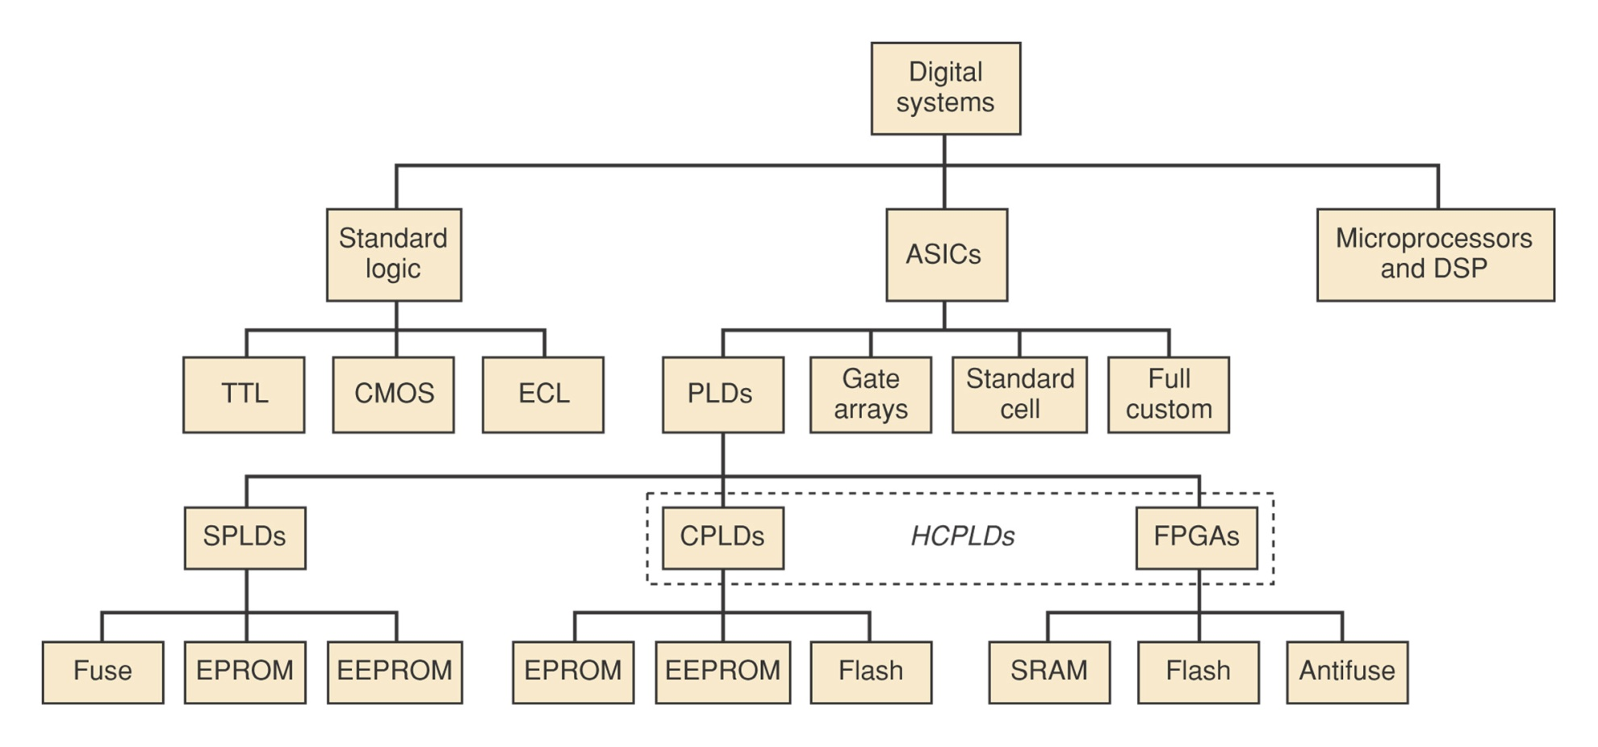
Digital Systems Family Tree

Slide 7
Three Major Categories
Standard logic: TTL, CMOS, ECL families.
Application specific integrated circuits (ASICs): PLDS, gate arrays, standard cell, full custom.
Microprocessors and digital signal processors (DSP): great flexibility, but slower. Using a hardware solution for your digital system design is always faster than a software solution.

Slide 8
Programmable Logic Devices
Programmable logic devices: (do not need to contract with an IC foundry to fabricate)
  Simple PLDs (SPLDs)
  Complex PLDS (CPLDs)
  Field programmable gate arrays (FPGAs)
CLPDs and FPGAs are often referred to as high-capacity programmable logic devices (HCPLDs).

Slide 9
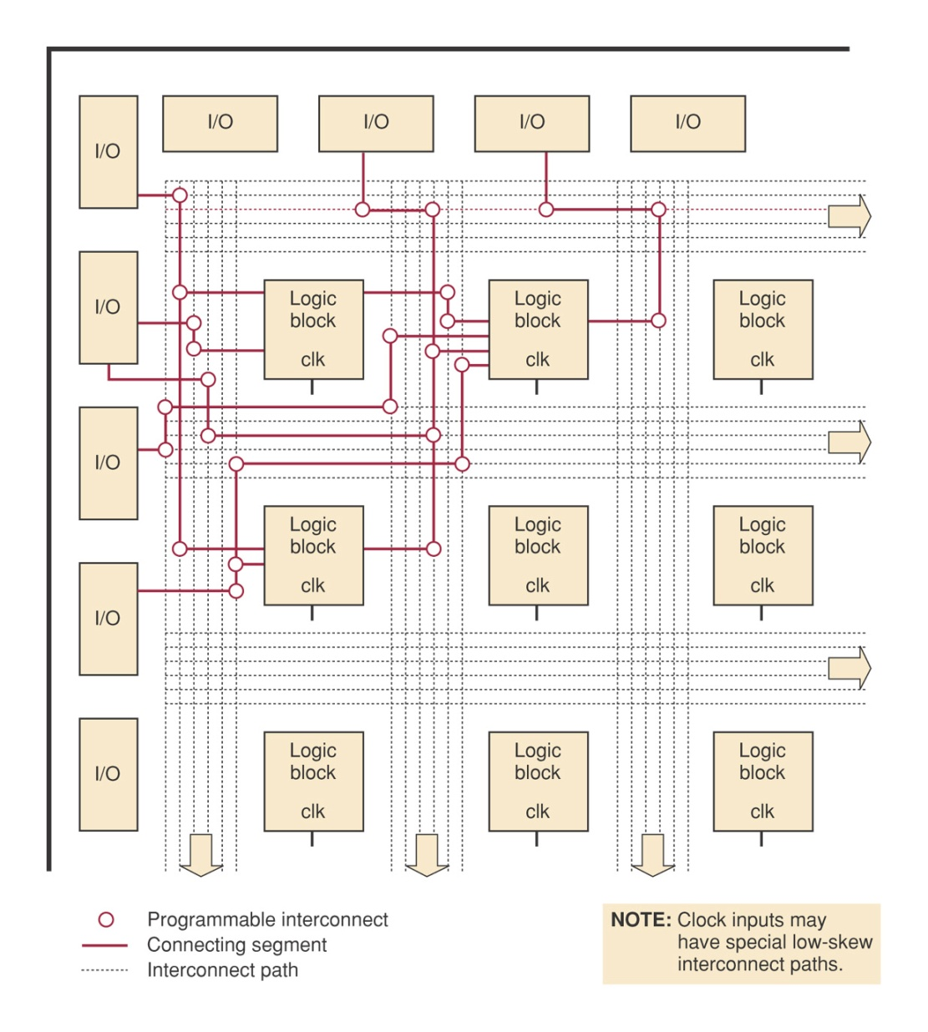
FPGA Architecture

Slide 10
Gate Array
ULSI circuits that offers hundreds of thousands of gates.
The desired logic functions are created by interconnections of these prefabricated gates.
A custom-designed mask for the specific application determines the gate interconnection. (MPGAs).

Slide 11
Standard-cell ASICs
Use predefined logic function building blocks called cells to create the desired digital systems.
IC layout of each cell has been designed previously.
A library of available cell is stored in a computer database.
The needed cells are laid out for the desired application, and the interconnections between the cells are determined.

Slide 12
Full-custom ASICs:
All components and the interconnections between them are custom-designed by the IC designed.
Higher design cost, but can operate at highest possible speed and require smallest die.

Slide 13
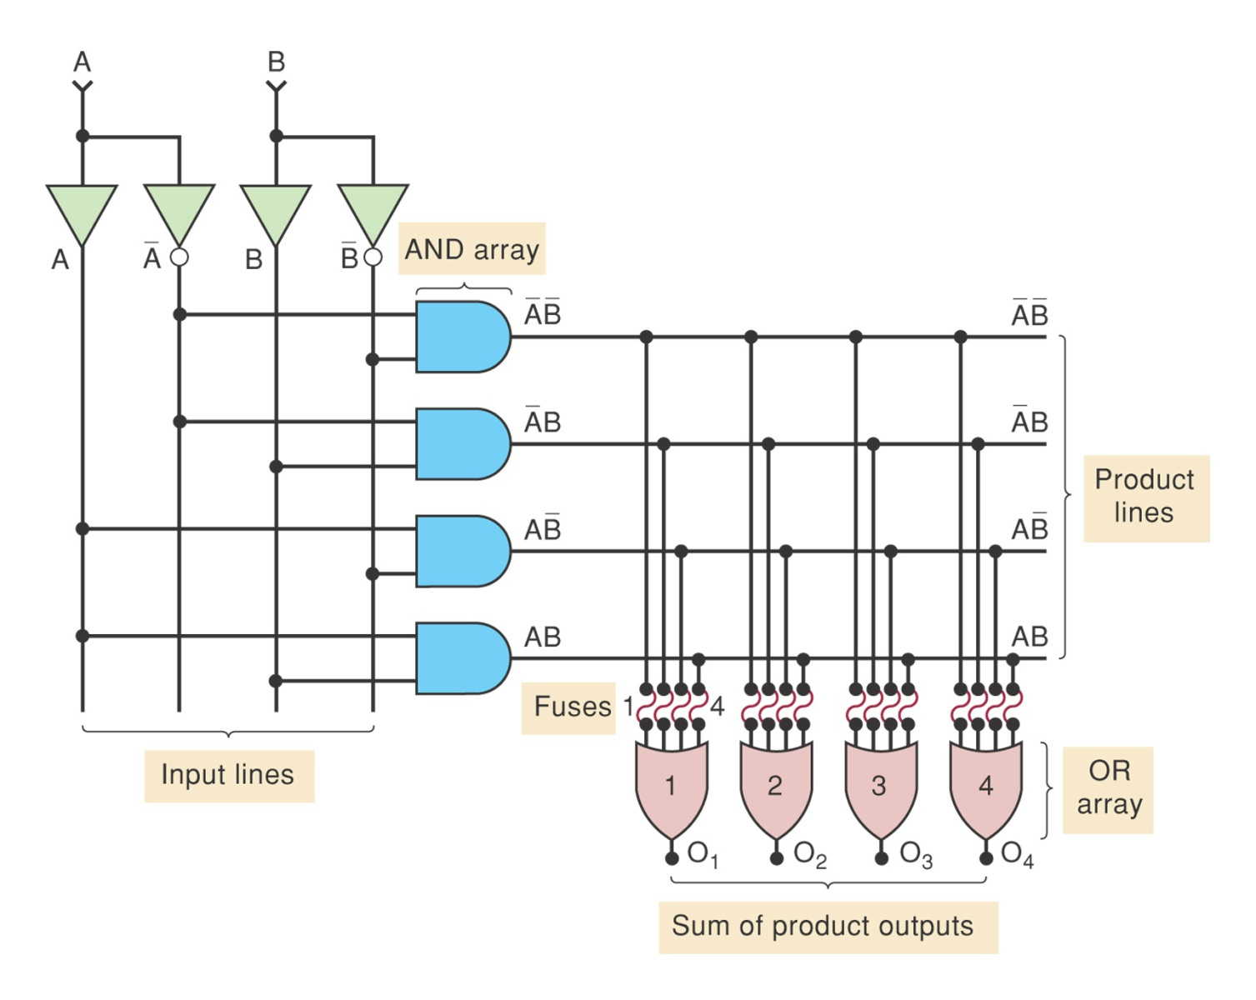
Fundamentals of PLD Circuitry

Slide 14
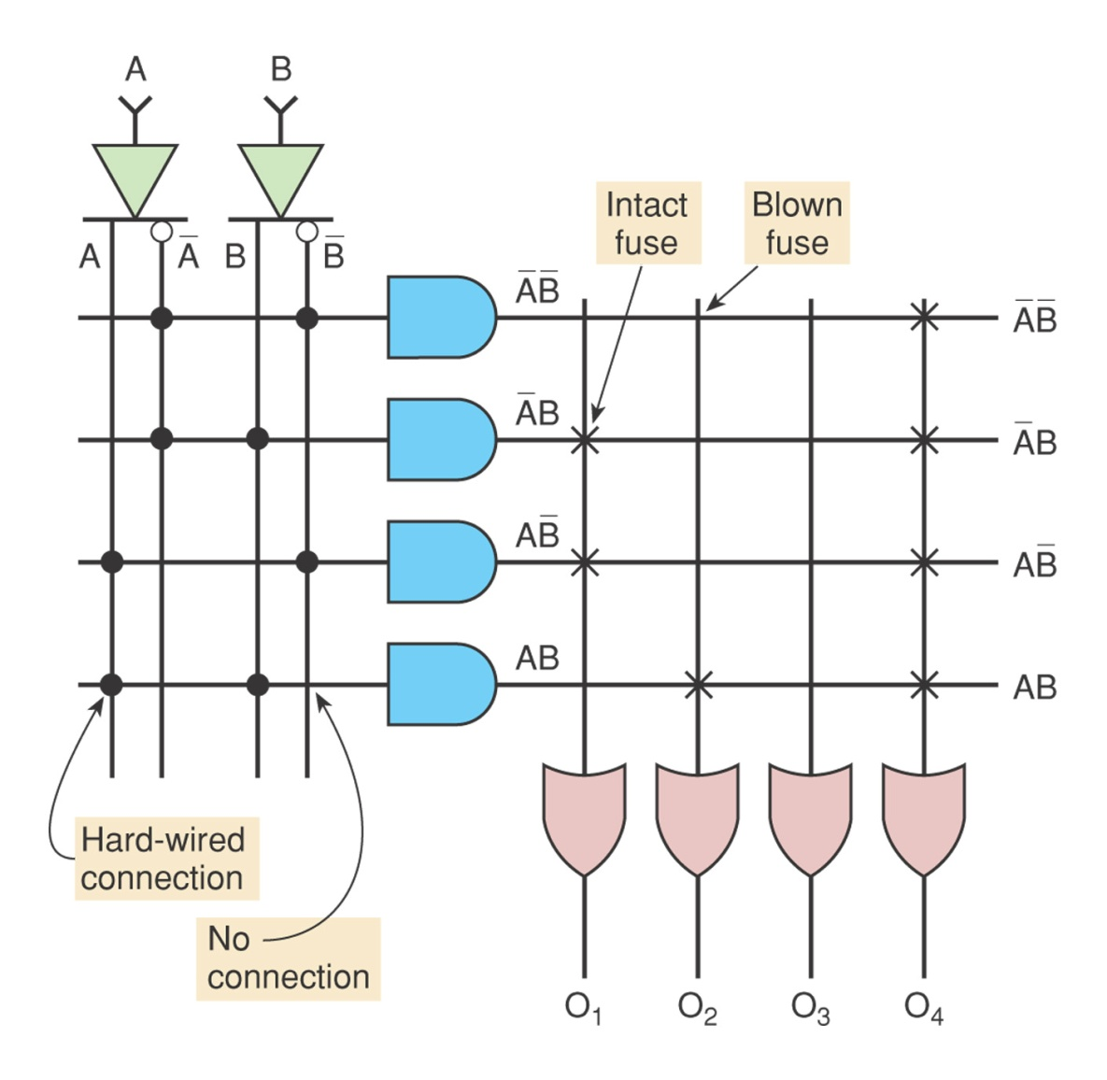
Simplified PLD Symbology

Slide 15
PLD Architectures
Different architectural designs of the inner circuitry of PLDs.
PROM: programmable ROM
PAL: programmable array logic
FPLA: field programmable logic array

Slide 16
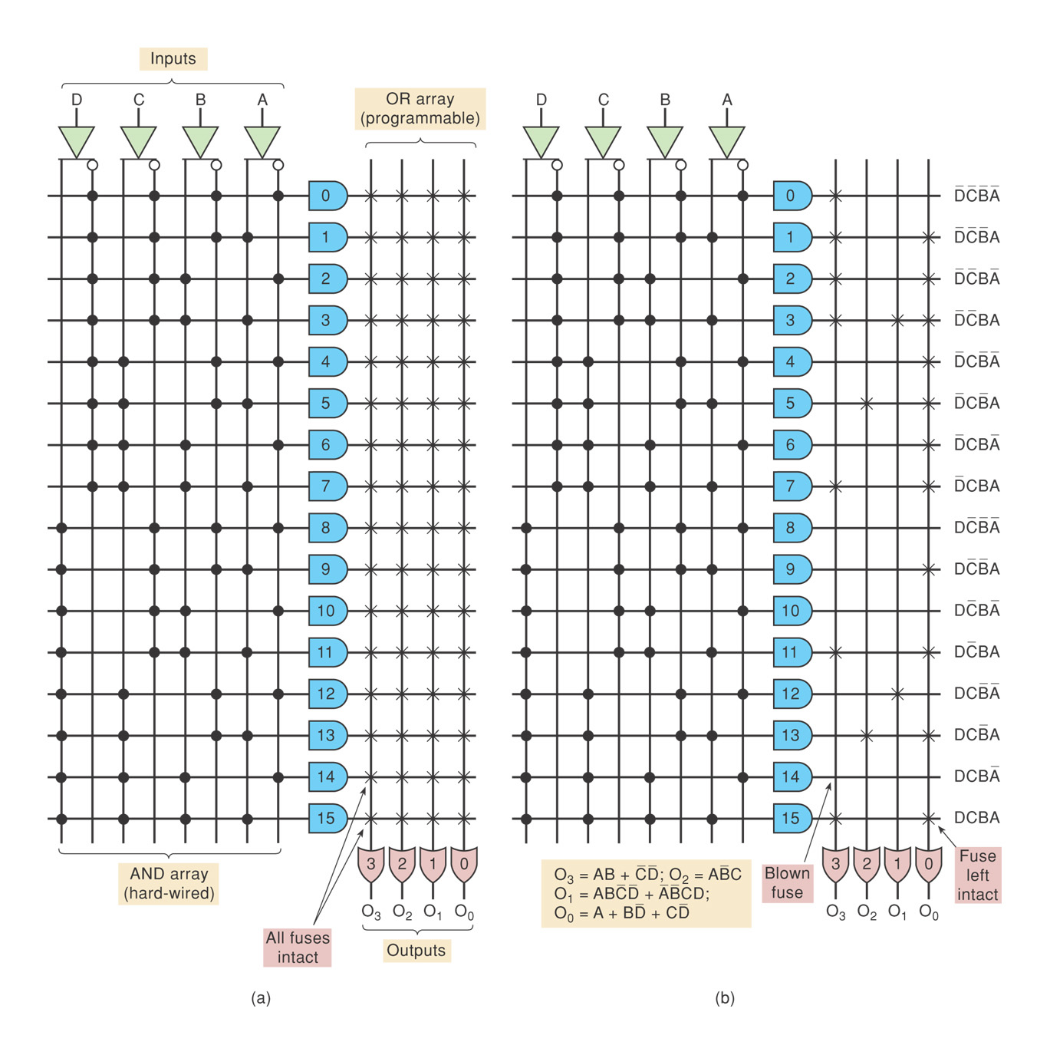
PROM
Table 13-1

Slide 17
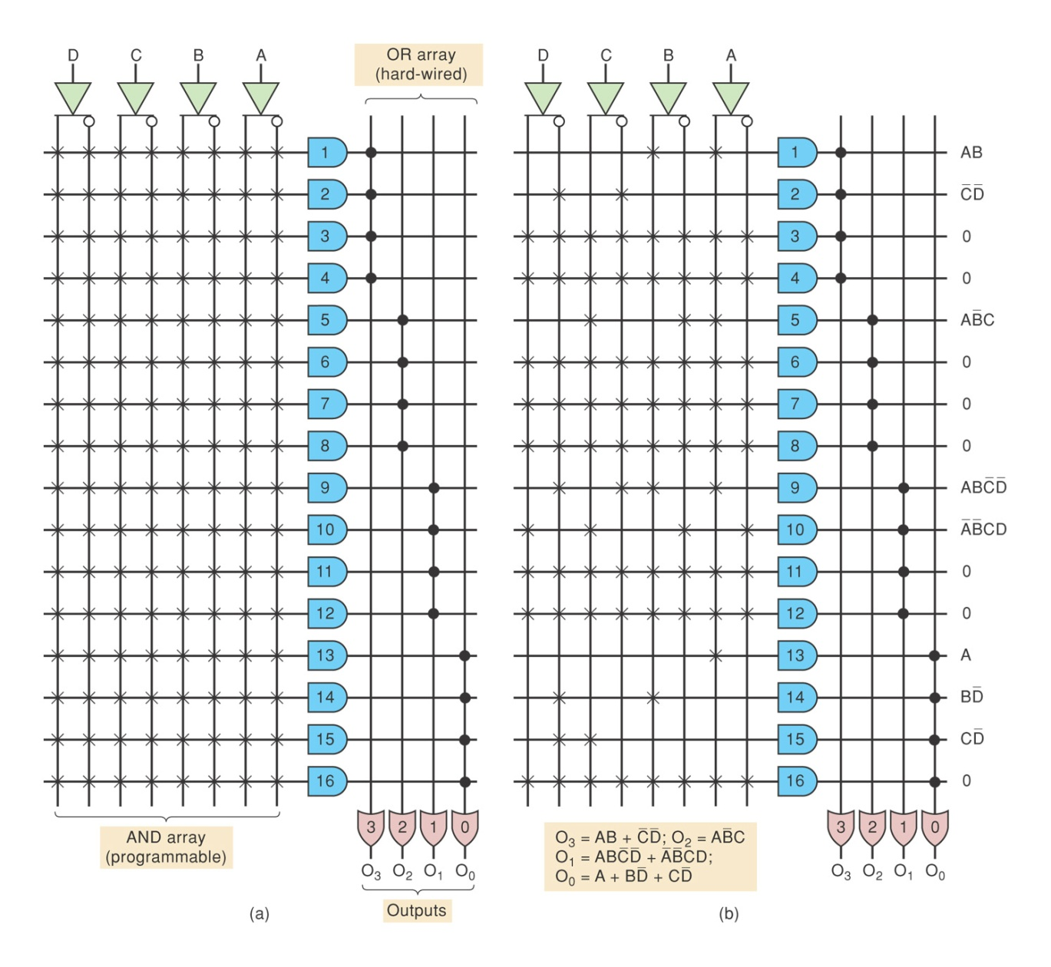
PAL Architecture

Slide 18
FPLA
Used a programmable AND array as well as a programmable OR array.

