Slide 1



Slide 2
Chapter 2 – Number Systems and Codes

Slide 3
Chapter 2 Objectives
Selected areas covered in this chapter:
  Converting between number systems.
    Decimal, binary, hexadecimal.
  Advantages of the hexadecimal number system.
    Counting in hexadecimal.
  Representing decimal numbers using the BCD code.
    Pros and cons of using BCD.
    Differences between BCD and straight binary.
  Purpose of alphanumeric codes such as ASCII code.
  Parity method for error detection.
    Determine the parity bit to be attached to a digital data string.
Digital Systems: Principles and Applications, 11/e
Ronald J. Tocci, Neal S. Widmer, Gregory L. Moss

Slide 4
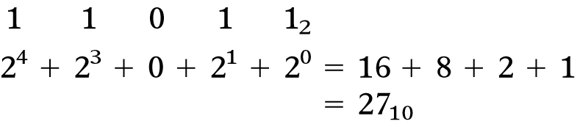
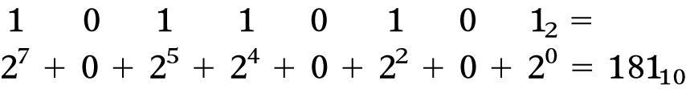
2-1 Binary to Decimal Conversion
Convert binary to decimal by summing the positions that contain a 1:
An example with a greater number of bits:
Ronald Tocci/Neal Widmer/Gregory Moss
Digital Systems: Principles and Applications, 10e
Copyright ©2007 by Pearson Education, Inc.
Columbus, OH 43235
All rights reserved.
Digital Systems: Principles and Applications, 11/e
Ronald J. Tocci, Neal S. Widmer, Gregory L. Moss

Slide 5
2-1 Binary to Decimal Conversion
The double-dabble method avoids addition of large numbers:
  Write down the left-most 1 in the binary number.
  Double it and add the next bit to the right.
  Write down the result under the next bit.
  Continue with steps 2 and 3 until finished with
  the binary number.
Ronald Tocci/Neal Widmer/Gregory Moss
Digital Systems: Principles and Applications, 10e
Copyright ©2007 by Pearson Education, Inc.
Columbus, OH 43235
All rights reserved.
Digital Systems: Principles and Applications, 11/e
Ronald J. Tocci, Neal S. Widmer, Gregory L. Moss

Slide 6
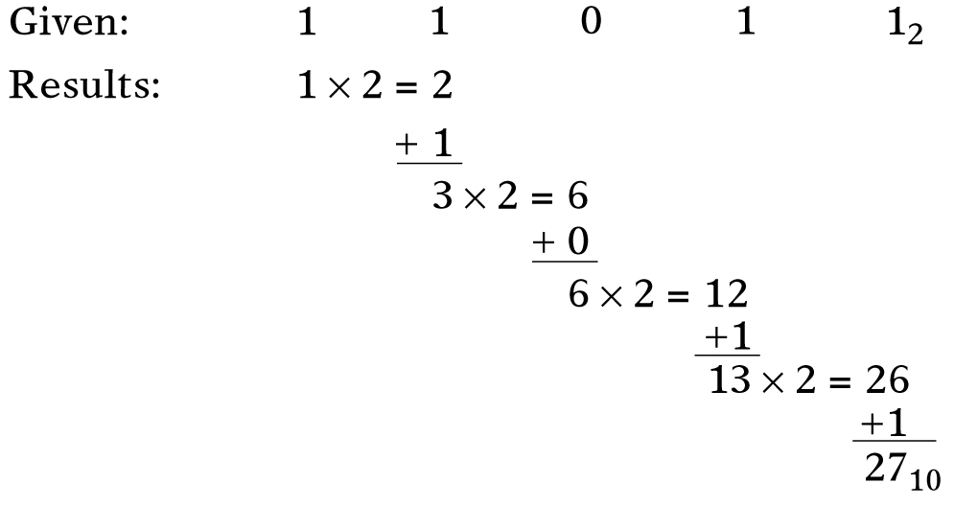
2-1 Binary to Decimal Conversion
Binary numbers verify the double-dabble method:
Ronald Tocci/Neal Widmer/Gregory Moss
Digital Systems: Principles and Applications, 10e
Copyright ©2007 by Pearson Education, Inc.
Columbus, OH 43235
All rights reserved.
Digital Systems: Principles and Applications, 11/e
Ronald J. Tocci, Neal S. Widmer, Gregory L. Moss

Slide 7
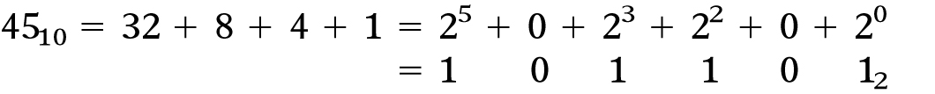
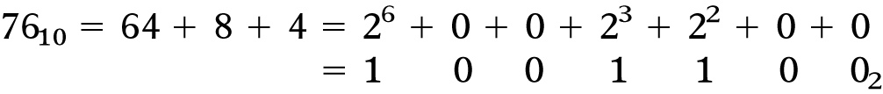
2-1 Binary to Decimal Conversion
Reverse process described in 2-1.
  Note that all positions must be accounted for.
Another example:
Ronald Tocci/Neal Widmer/Gregory Moss
Digital Systems: Principles and Applications, 10e
Copyright ©2007 by Pearson Education, Inc.
Columbus, OH 43235
All rights reserved.
Digital Systems: Principles and Applications, 11/e
Ronald J. Tocci, Neal S. Widmer, Gregory L. Moss

Slide 8
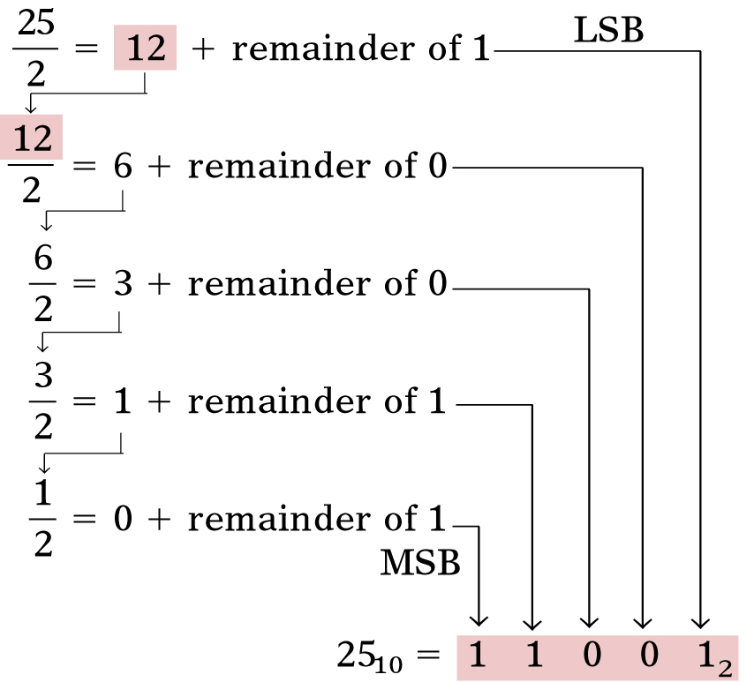
2-1 Binary to Decimal Conversion
Repeated
Division
Divide the decimal number by 2.
Write the remainder
after each division
until a quotient of
zero is obtained.
The first remainder
is the LSB.
The last is the MSB.
Ronald Tocci/Neal Widmer/Gregory Moss
Digital Systems: Principles and Applications, 10e
Copyright ©2007 by Pearson Education, Inc.
Columbus, OH 43235
All rights reserved.
Digital Systems: Principles and Applications, 11/e
Ronald J. Tocci, Neal S. Widmer, Gregory L. Moss

Slide 9
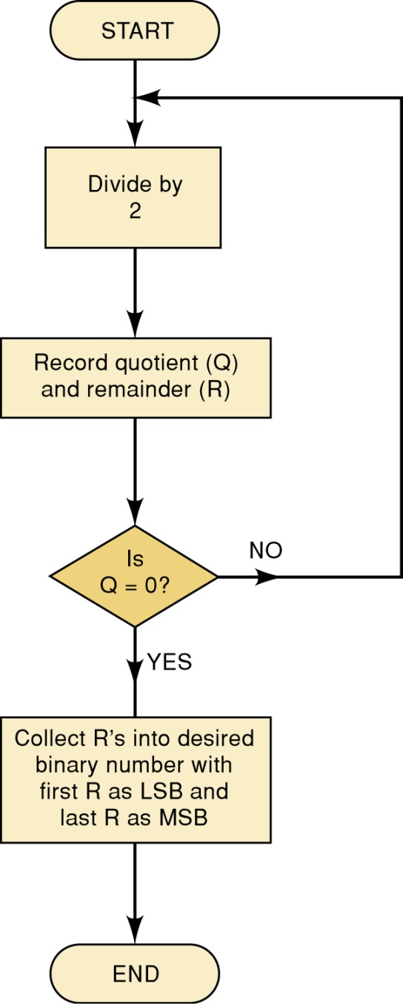
2-2 Decimal to Binary Conversion
Repeated
Division
This flowchart describes the process and can
be used to convert from decimal to
any other number system.
Ronald Tocci/Neal Widmer/Gregory Moss
Digital Systems: Principles and Applications, 10e
Digital Systems: Principles and Applications, 11/e
Ronald J. Tocci, Neal S. Widmer, Gregory L. Moss

Slide 10
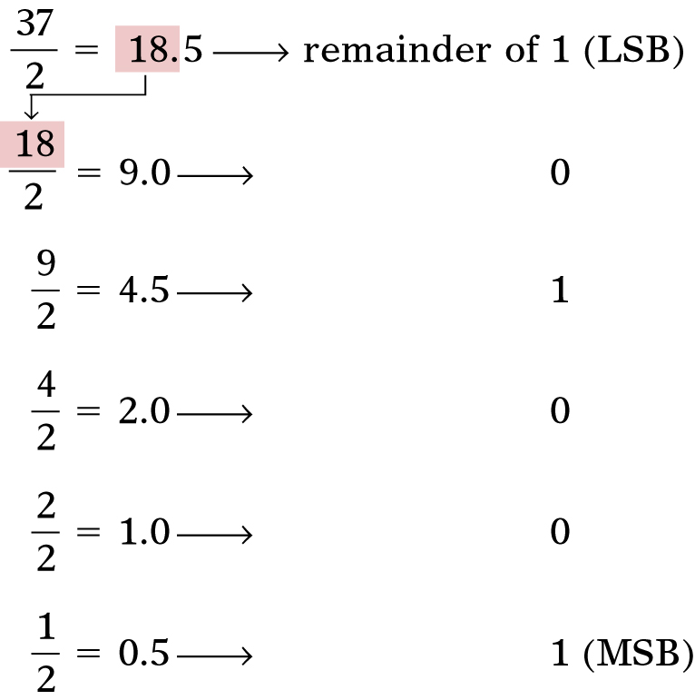
2-3 Hexadecimal Number System
Convert 37₁₀ to binary:
Ronald Tocci/Neal Widmer/Gregory Moss
Digital Systems: Principles and Applications, 10e
Copyright ©2007 by Pearson Education, Inc.
Columbus, OH 43235
All rights reserved.
Digital Systems: Principles and Applications, 11/e
Ronald J. Tocci, Neal S. Widmer, Gregory L. Moss

Slide 11
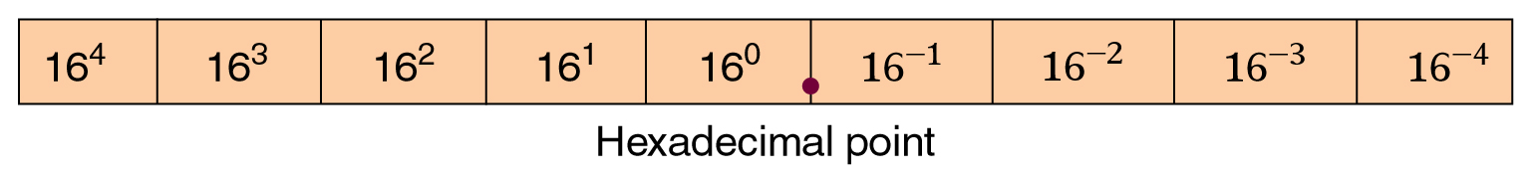
2-3 Hexadecimal Number System
Hexadecimal allows convenient handling of long binary strings, using groups of 4 bits—Base 16
  16 possible symbols: 0-9 and A-F
Ronald Tocci/Neal Widmer/Gregory Moss
Digital Systems: Principles and Applications, 10e
Copyright ©2007 by Pearson Education, Inc.
Columbus, OH 43235
All rights reserved.
Digital Systems: Principles and Applications, 11/e
Ronald J. Tocci, Neal S. Widmer, Gregory L. Moss

Slide 12
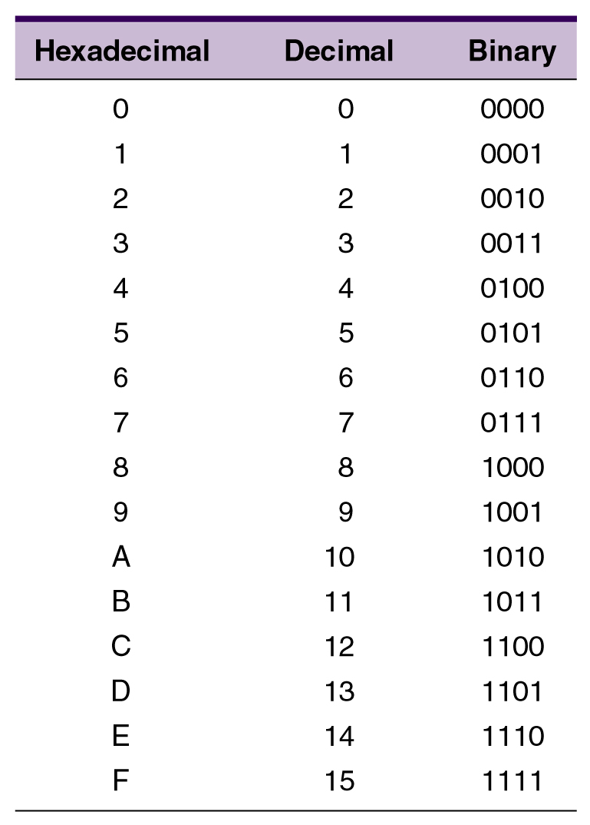
2-3 Hexadecimal Number System
Relationships between hexadecimal, decimal, and binary numbers.
Ronald Tocci/Neal Widmer/Gregory Moss
Digital Systems: Principles and Applications, 10e
Copyright ©2007 by Pearson Education, Inc.
Columbus, OH 43235
All rights reserved.
Digital Systems: Principles and Applications, 11/e
Ronald J. Tocci, Neal S. Widmer, Gregory L. Moss

Slide 13
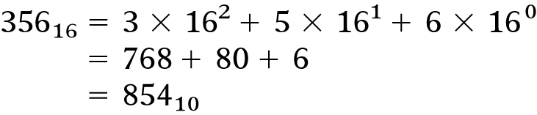
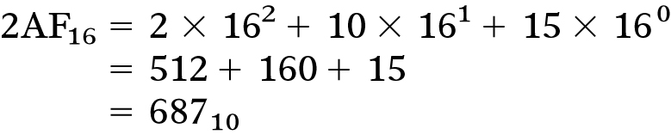
2-3 Hexadecimal Number System – Hex to Decimal
Convert from hex to decimal by multiplying each hex digit by its positional weight.
In a 2nd example, the value 10 was substituted for A and 15 substituted for F.
For practice, verify that 1BC2₁₆ is equal to 7106₁₀
Ronald Tocci/Neal Widmer/Gregory Moss
Digital Systems: Principles and Applications, 10e
Copyright ©2007 by Pearson Education, Inc.
Columbus, OH 43235
All rights reserved.
Digital Systems: Principles and Applications, 11/e
Ronald J. Tocci, Neal S. Widmer, Gregory L. Moss

Slide 14
2-3 Hexadecimal Number System – Decimal to Hex
Convert from decimal to hex by using the repeated division method used for decimal
to binary conversion.
Divide the decimal number by 16
  The first remainder is the LSB—the last is the MSB.
Ronald Tocci/Neal Widmer/Gregory Moss
Digital Systems: Principles and Applications, 10e
Copyright ©2007 by Pearson Education, Inc.
Columbus, OH 43235
All rights reserved.
Digital Systems: Principles and Applications, 11/e
Ronald J. Tocci, Neal S. Widmer, Gregory L. Moss

Slide 15
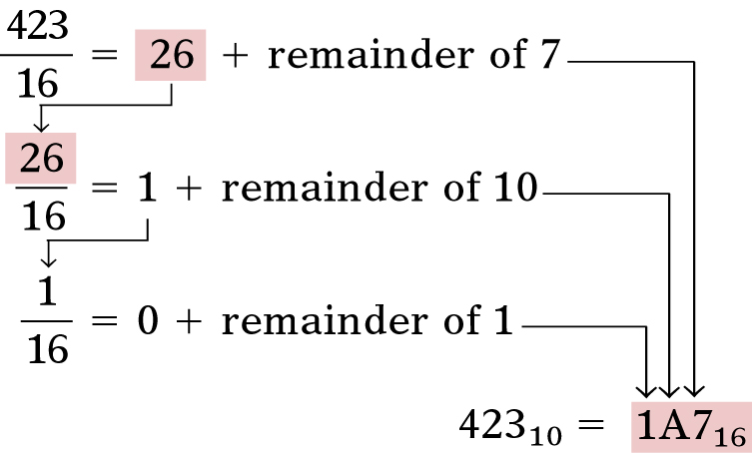
2-3 Hexadecimal Number System – Decimal to Hex
Convert 423₁₀ to hex:
Ronald Tocci/Neal Widmer/Gregory Moss
Digital Systems: Principles and Applications, 10e
Copyright ©2007 by Pearson Education, Inc.
Columbus, OH 43235
All rights reserved.
Digital Systems: Principles and Applications, 11/e
Ronald J. Tocci, Neal S. Widmer, Gregory L. Moss

Slide 16
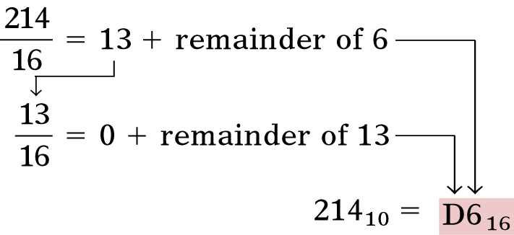
2-3 Hexadecimal Number System – Decimal to Hex
Convert 214₁₀ to hex:
Ronald Tocci/Neal Widmer/Gregory Moss
Digital Systems: Principles and Applications, 10e
Copyright ©2007 by Pearson Education, Inc.
Columbus, OH 43235
All rights reserved.
Digital Systems: Principles and Applications, 11/e
Ronald J. Tocci, Neal S. Widmer, Gregory L. Moss

Slide 17
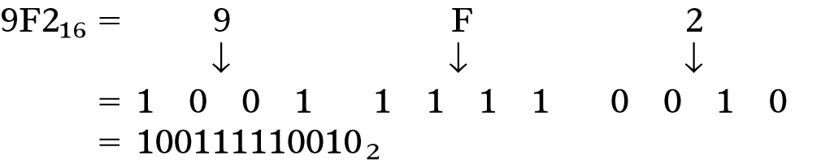
2-3 Hexadecimal Number System – Hex to Binary
Leading zeros can be added to the left of the MSB to fill out the last group.
For practice, verify that BA6₁₆ = 101110100110₂
Ronald Tocci/Neal Widmer/Gregory Moss
Digital Systems: Principles and Applications, 10e
Copyright ©2007 by Pearson Education, Inc.
Columbus, OH 43235
All rights reserved.
Digital Systems: Principles and Applications, 11/e
Ronald J. Tocci, Neal S. Widmer, Gregory L. Moss

Slide 18
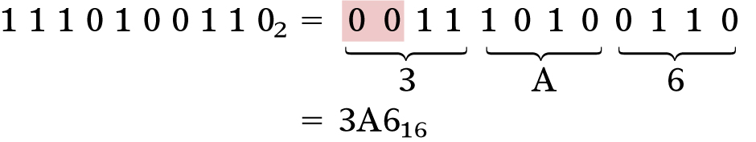
2-3 Hexadecimal Number System – Binary to Hex
Convert from binary to hex by grouping bits in four starting with the LSB.
  Each group is then converted to the hex equivalent
The binary number is grouped into groups of four bits & each is converted to its equivalent hex digit.
For practice, verify that 101011111 2 = 15F₁₆
Ronald Tocci/Neal Widmer/Gregory Moss
Digital Systems: Principles and Applications, 10e
Copyright ©2007 by Pearson Education, Inc.
Columbus, OH 43235
All rights reserved.
Digital Systems: Principles and Applications, 11/e
Ronald J. Tocci, Neal S. Widmer, Gregory L. Moss

Slide 19
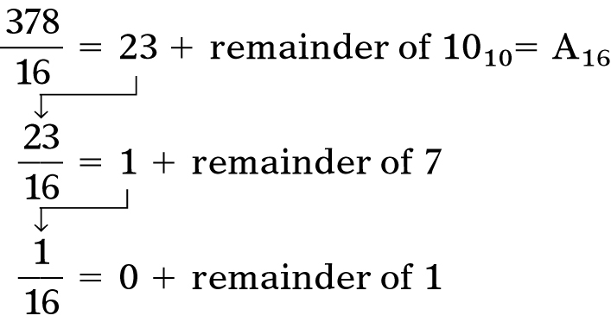
2-3 Hexadecimal Number System – Decimal to Hex to Binary
Convert decimal 378 to a 16-bit binary number
by first converting to hexadecimal.
Digital Systems: Principles and Applications, 11/e
Ronald J. Tocci, Neal S. Widmer, Gregory L. Moss

Slide 20
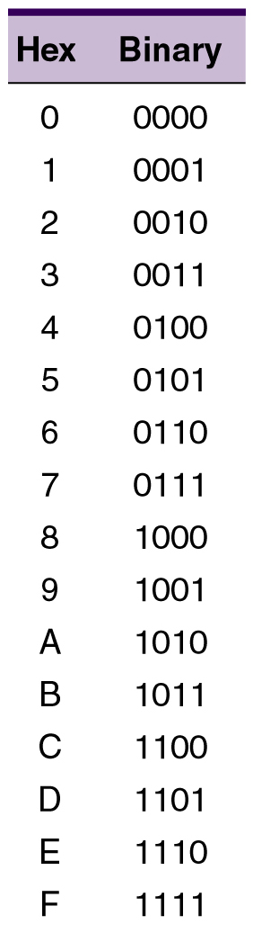
2-3 Hexadecimal Number System
To perform conversions between hex & binary, it
is necessary to know the
four-bit binary numbers
(0000 - 1111), and their equivalent hex digits.
Ronald Tocci/Neal Widmer/Gregory Moss
Digital Systems: Principles and Applications, 10e
Copyright ©2007 by Pearson Education, Inc.
Columbus, OH 43235
All rights reserved.
Digital Systems: Principles and Applications, 11/e
Ronald J. Tocci, Neal S. Widmer, Gregory L. Moss

Slide 21
2-3 Hexadecimal Number System – Counting in Hex
When counting in hex, each digit position can
be incremented (increased by 1) from 0 to F.
  On reaching value F, it is reset to 0, and the
  next digit position is incremented.
Example:
38,39,3A,3B,3C,3D,3E,3F,40,41,42
When there is a 9 in a digit position, it
becomes an A when it is incremented.
With three hex digits, we can count from 000₁₆ to FFF₁₆
which is 0₁₀ to 4095₁₀ — a total of 4096 = 16³ values.
Digital Systems: Principles and Applications, 11/e
Ronald J. Tocci, Neal S. Widmer, Gregory L. Moss

Slide 22
2-4 BCD Code
Binary Coded Decimal (BCD) is a widely used
way to present decimal numbers in binary form.
  Combines features of both decimal and binary systems.
    Each digit is converted to a binary equivalent.
BCD is not a number system.
  It is a decimal number with each digit encoded
  to its binary equivalent.
A BCD number is not the same as a straight binary number.
  The primary advantage of BCD is the relative
  ease of converting to and from decimal.
Ronald Tocci/Neal Widmer/Gregory Moss
Digital Systems: Principles and Applications, 10e
Copyright ©2007 by Pearson Education, Inc.
Columbus, OH 43235
All rights reserved.
Digital Systems: Principles and Applications, 11/e
Ronald J. Tocci, Neal S. Widmer, Gregory L. Moss

Slide 23
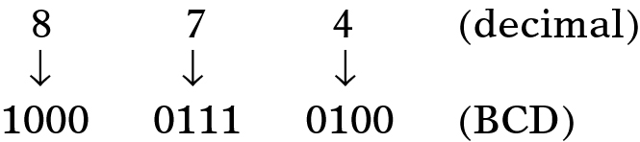
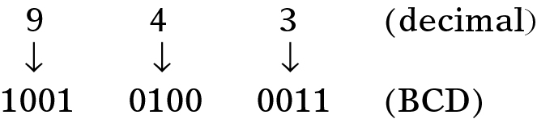
2-4 BCD Code
Convert the number 874₁₀ to BCD:
  Each decimal digit is represented using 4 bits.
    Each 4-bit group can never be greater than 9.
Reverse the process to convert BCD to decimal.
Ronald Tocci/Neal Widmer/Gregory Moss
Digital Systems: Principles and Applications, 10e
Copyright ©2007 by Pearson Education, Inc.
Columbus, OH 43235
All rights reserved.
Digital Systems: Principles and Applications, 11/e
Ronald J. Tocci, Neal S. Widmer, Gregory L. Moss

Slide 24
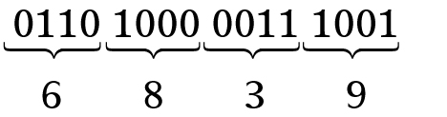
2-4 BCD Code
Convert 0110100000111001 (BCD) to its
decimal equivalent.
Divide the BCD number into four-bit
groups and convert each to decimal.
Ronald Tocci/Neal Widmer/Gregory Moss
Digital Systems: Principles and Applications, 10e
Copyright ©2007 by Pearson Education, Inc.
Columbus, OH 43235
All rights reserved.
Digital Systems: Principles and Applications, 11/e
Ronald J. Tocci, Neal S. Widmer, Gregory L. Moss

Slide 25
2-4 BCD Code
Convert 0110100000111001 (BCD) to its
decimal equivalent.
Divide the BCD number into four-bit
groups and convert each to decimal.
Ronald Tocci/Neal Widmer/Gregory Moss
Digital Systems: Principles and Applications, 10e
Copyright ©2007 by Pearson Education, Inc.
Columbus, OH 43235
All rights reserved.
Digital Systems: Principles and Applications, 11/e
Ronald J. Tocci, Neal S. Widmer, Gregory L. Moss

Slide 26
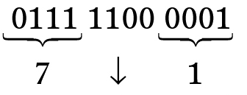
2-4 BCD Code
Convert BCD 011111000001 to its decimal equivalent.
The forbidden group represents
an error in the BCD number.
Ronald Tocci/Neal Widmer/Gregory Moss
Digital Systems: Principles and Applications, 10e
Copyright ©2007 by Pearson Education, Inc.
Columbus, OH 43235
All rights reserved.
Digital Systems: Principles and Applications, 11/e
Ronald J. Tocci, Neal S. Widmer, Gregory L. Moss

Slide 27
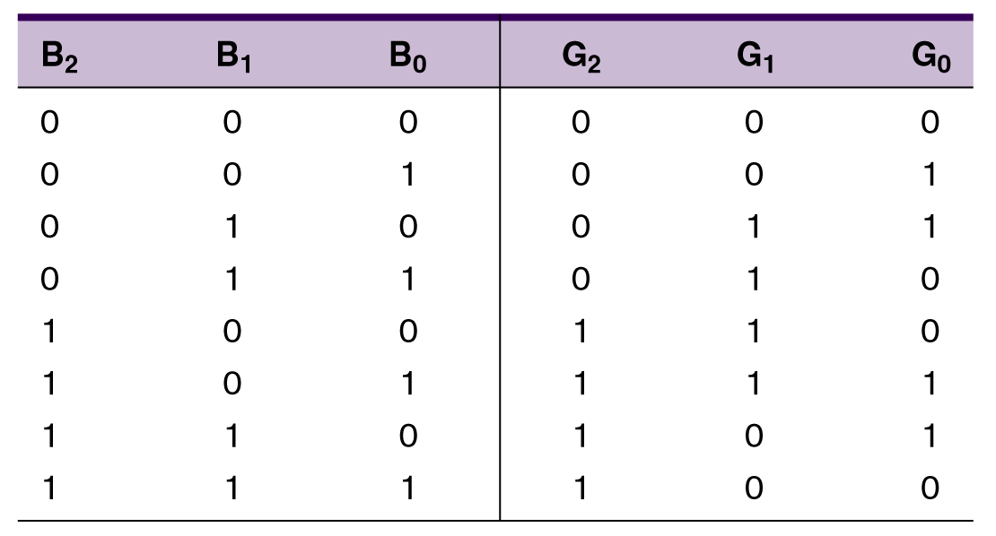
2-5 The Gray Code
The Gray code is used in applications where numbers change rapidly.
  Only one bit changes from each value to the next.
Three bit binary
and Gray code equivalents.
Ronald Tocci/Neal Widmer/Gregory Moss
Digital Systems: Principles and Applications, 10e
Copyright ©2007 by Pearson Education, Inc.
Columbus, OH 43235
All rights reserved.
Digital Systems: Principles and Applications, 11/e
Ronald J. Tocci, Neal S. Widmer, Gregory L. Moss

Slide 28
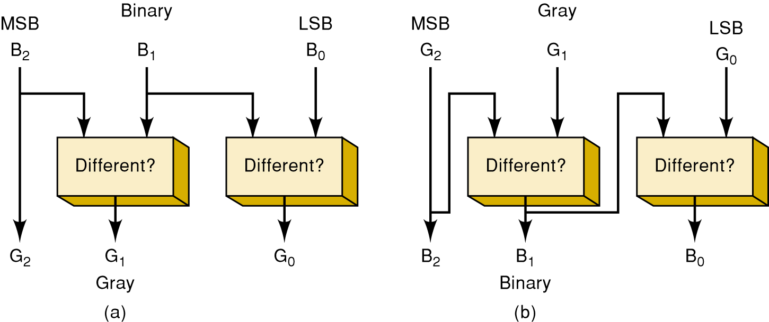
2-5 The Gray Code
Binary to Gray Gray to Binary
Ronald Tocci/Neal Widmer/Gregory Moss
Digital Systems: Principles and Applications, 10e
Copyright ©2007 by Pearson Education, Inc.
Columbus, OH 43235
All rights reserved.
Digital Systems: Principles and Applications, 11/e
Ronald J. Tocci, Neal S. Widmer, Gregory L. Moss

Slide 29
Conversion Algorithm
From binary to Gray:
From Gray to binary:
Note: A XOR B = A’B+AB’
Let B[n:0] be the input array of bits in the usual binary representation, [0] being LSB
Let G[n:0] be the output array of bits in Gray code
G[n] = B[n]
for i = n-1 downto 0 G[i] = B[i+1] XOR B[i]
Let G[n:0] be the input array of bits in Gray code
Let B[n:0] be the output array of bits in the usual binary representation
B[n] = G[n]
for i = n-1 downto 0 B[i] = B[i+1] XOR G[i]
Digital Systems: Principles and Applications, 11/e
Ronald J. Tocci, Neal S. Widmer, Gregory L. Moss

Slide 30
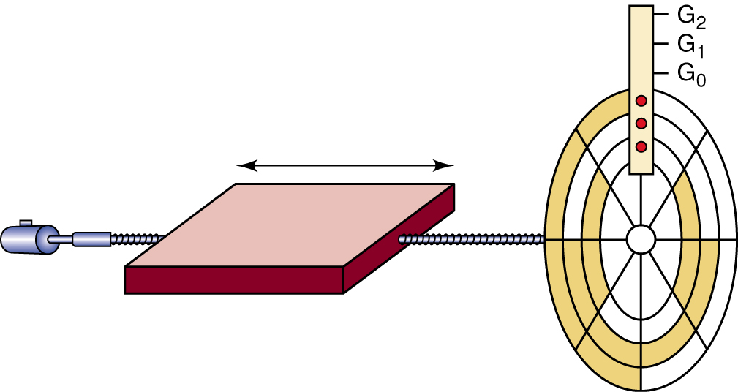
2-5 The Gray Code
An eight-position, three-bit shaft encoder
These devices produce a binary
value that represents the position
of a rotating mechanical shaft.
Ronald Tocci/Neal Widmer/Gregory Moss
Digital Systems: Principles and Applications, 10e
Copyright ©2007 by Pearson Education, Inc.
Columbus, OH 43235
All rights reserved.
Digital Systems: Principles and Applications, 11/e
Ronald J. Tocci, Neal S. Widmer, Gregory L. Moss

Slide 31
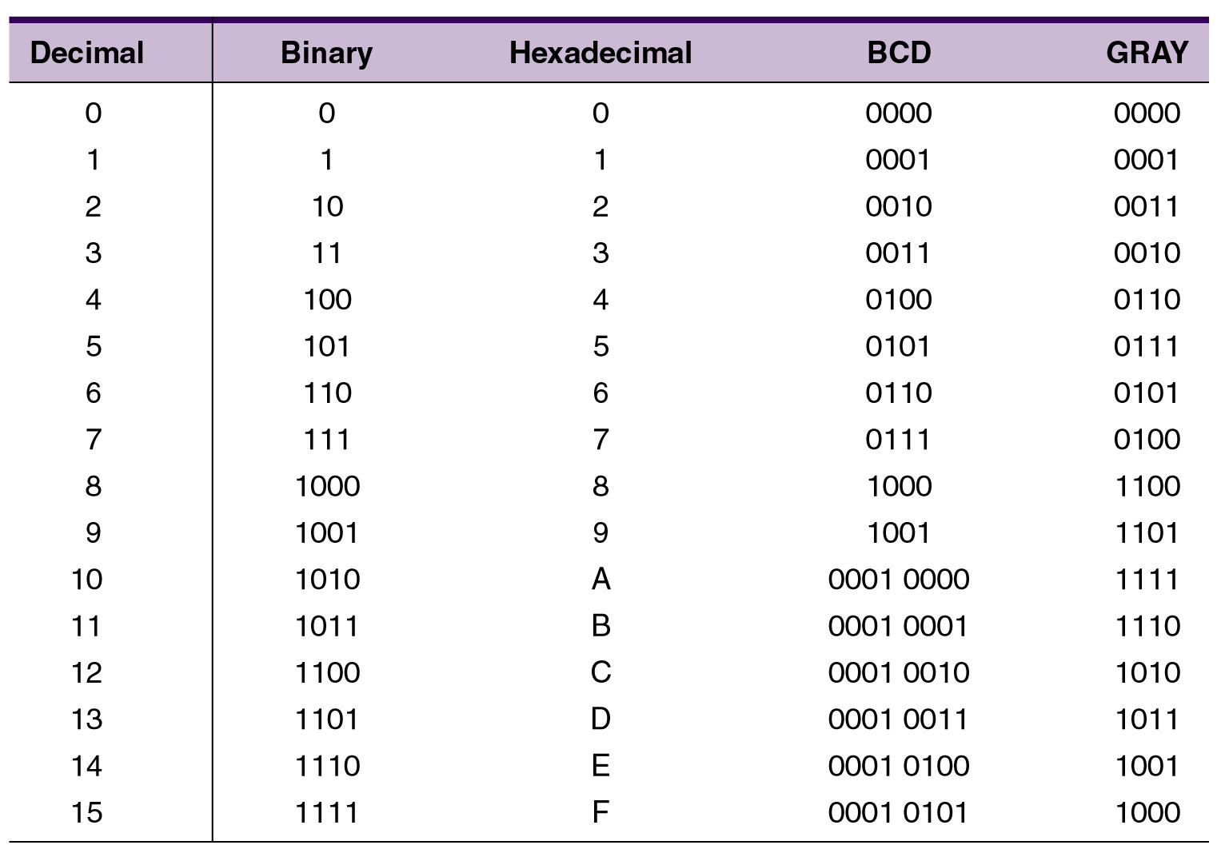
2-6 Putting It All Together
Decimal numbers 1 – 15 in binary, hex, BCD, Gray
Ronald Tocci/Neal Widmer/Gregory Moss
Digital Systems: Principles and Applications, 10e
Copyright ©2007 by Pearson Education, Inc.
Columbus, OH 43235
All rights reserved.
Digital Systems: Principles and Applications, 11/e
Ronald J. Tocci, Neal S. Widmer, Gregory L. Moss

Slide 32
2-7 The Byte, Nibble, and Word
Most microcomputers handle and store binary data and information in groups of eight bits.
  8 bits = 1 byte.
    A byte can represent numerous types of data/information.
Binary numbers are often broken into groups
of four bits.
  Because a group of four bits is half as big as a
  byte, it was named a nibble.
A word is a group of bits that represents a
certain unit of information.
  Word size can be defined as the number of bits
  in the binary word a digital system operates on.
    PC word size is eight bytes (64 bits).
Ronald Tocci/Neal Widmer/Gregory Moss
Digital Systems: Principles and Applications, 10e
Copyright ©2007 by Pearson Education, Inc.
Columbus, OH 43235
All rights reserved.
Digital Systems: Principles and Applications, 11/e
Ronald J. Tocci, Neal S. Widmer, Gregory L. Moss

Slide 33
2-8 Alphanumeric Codes
Represents characters and functions found on
a computer keyboard.
  26 lowercase & 26 uppercase letters, 10 digits,
  7 punctuation marks, 20 to 40 other characters.
ASCII – American Standard Code for Information Interchange.
  Seven bit code: 2⁷ = 128 possible code groups
  Examples of use: transfer information between computers; computers & printers; internal storage.
Ronald Tocci/Neal Widmer/Gregory Moss
Digital Systems: Principles and Applications, 10e
Copyright ©2007 by Pearson Education, Inc.
Columbus, OH 43235
All rights reserved.
Digital Systems: Principles and Applications, 11/e
Ronald J. Tocci, Neal S. Widmer, Gregory L. Moss

Slide 34
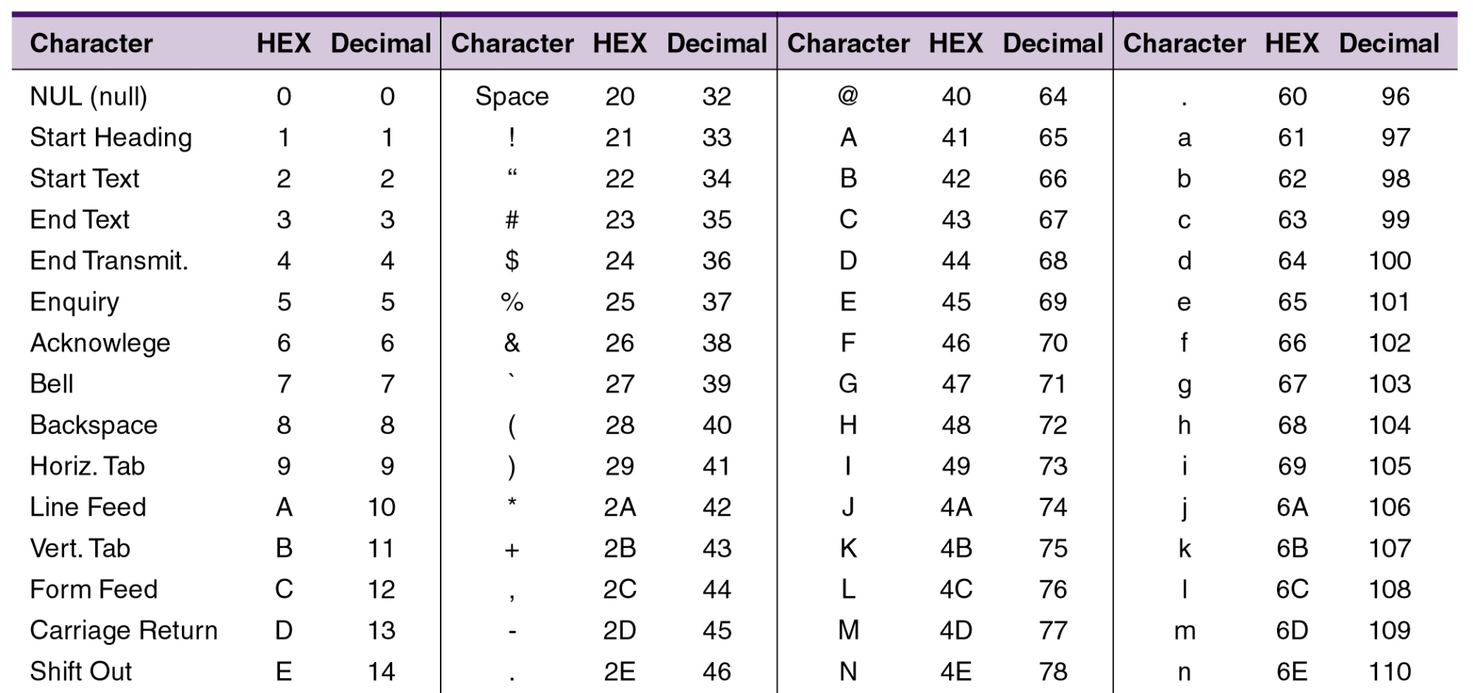
2-8 Alphanumeric Codes
ASCII – American Standard Code
for Information Interchange
See the entire table on page 49 of your textbook.
Ronald Tocci/Neal Widmer/Gregory Moss
Digital Systems: Principles and Applications, 10e
Copyright ©2007 by Pearson Education, Inc.
Columbus, OH 43235
All rights reserved.
Digital Systems: Principles and Applications, 11/e
Ronald J. Tocci, Neal S. Widmer, Gregory L. Moss

Slide 35
2-9 Parity Method for Error Detection
Binary data and codes are frequently moved between locations:
  Digitized voice over a microwave link.
  Storage/retrieval of data from magnetic/optical disks.
  Communication between computer systems
  over telephone lines, using a modem.
Ronald Tocci/Neal Widmer/Gregory Moss
Digital Systems: Principles and Applications, 10e
Copyright ©2007 by Pearson Education, Inc.
Columbus, OH 43235
All rights reserved.
Digital Systems: Principles and Applications, 11/e
Ronald J. Tocci, Neal S. Widmer, Gregory L. Moss

Slide 36
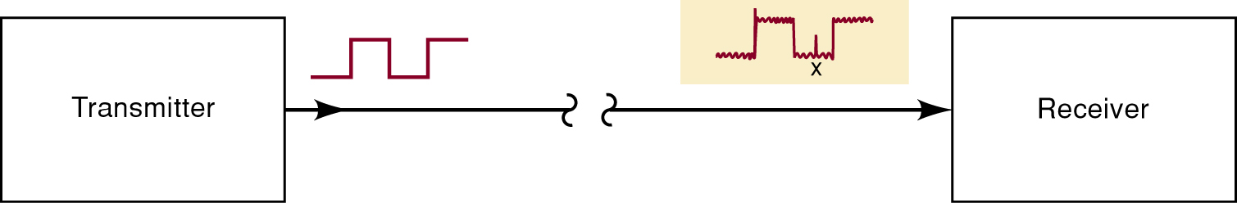
2-9 Parity Method for Error Detection
Electrical noise can cause errors during transmission.
  Spurious fluctuations in voltage or current present
  in all electronic systems.
Many digital systems employ methods for error detection—and sometimes correction.
  One of the simplest and most widely used schemes for error detection is the parity method.
Ronald Tocci/Neal Widmer/Gregory Moss
Digital Systems: Principles and Applications, 10e
Copyright ©2007 by Pearson Education, Inc.
Columbus, OH 43235
All rights reserved.
Digital Systems: Principles and Applications, 11/e
Ronald J. Tocci, Neal S. Widmer, Gregory L. Moss

Slide 37
2-9 Parity Method for Error Detection
The parity method of error detection requires the addition of an extra bit to a code group.
  Called the parity bit, it can be either a 0 or 1, depending on the number of 1s in the code group.
There are two parity methods, even and odd.
  The transmitter and receiver must “agree” on
  the type of parity checking used.
    Even seems to be used more often.
Ronald Tocci/Neal Widmer/Gregory Moss
Digital Systems: Principles and Applications, 10e
Copyright ©2007 by Pearson Education, Inc.
Columbus, OH 43235
All rights reserved.
Digital Systems: Principles and Applications, 11/e
Ronald J. Tocci, Neal S. Widmer, Gregory L. Moss

Slide 38
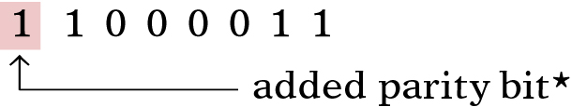
2-9 Parity Method for Error Detection
Even parity method—the total number of bits in
a group including the parity bit must add up to
an even number.
  The binary group 1 0 1 1 would require the addition
  of a parity bit 1, making the group 1 1 0 1 1.
    The parity bit may be added at either end of a group.
Ronald Tocci/Neal Widmer/Gregory Moss
Digital Systems: Principles and Applications, 10e
Copyright ©2007 by Pearson Education, Inc.
Columbus, OH 43235
All rights reserved.
Digital Systems: Principles and Applications, 11/e
Ronald J. Tocci, Neal S. Widmer, Gregory L. Moss

Slide 39
2-9 Parity Method for Error Detection
Odd parity method—the total number of bits in a group including the parity bit must add up to an odd number.
  The binary group 1 1 1 1 would require the addition
  of a parity bit 1, making the group 1 1 1 1 1.
The parity bit becomes a part of the code word.
Adding a parity bit to the seven-bit ASCII
code produces an eight-bit code.
Ronald Tocci/Neal Widmer/Gregory Moss
Digital Systems: Principles and Applications, 10e
Copyright ©2007 by Pearson Education, Inc.
Columbus, OH 43235
All rights reserved.
Digital Systems: Principles and Applications, 11/e
Ronald J. Tocci, Neal S. Widmer, Gregory L. Moss

Slide 40
2-10 Applications
When ASCII characters are transmitted there
must be a way to tell the receiver a new
character is coming.
  There is often a need to detect errors in the transmission as well.
The method of transfer is called asynchronous data communication.
Digital Systems: Principles and Applications, 11/e
Ronald J. Tocci, Neal S. Widmer, Gregory L. Moss

Slide 41
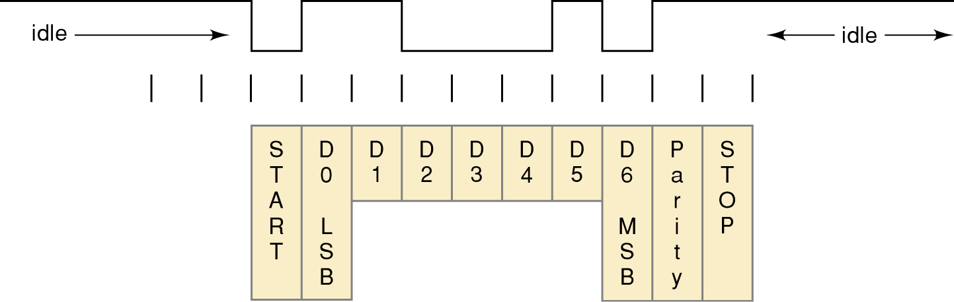
2-10 Applications
An ASCII character must be “framed” so the receiver knows where the data begins and ends.
  The first bit must always be a start bit (logic 0).
ASCII code is sent LSB first and MSB last.
  After the MSB, a parity bit is appended to check
  for transmission errors.
  Transmission is ended by sending a stop bit (logic 1).
Digital Systems: Principles and Applications, 11/e
Ronald J. Tocci, Neal S. Widmer, Gregory L. Moss

Slide 42
END

