Slide 1
Digital Arithmetic
Wen-Hung Liao, Ph.D.

Slide 2
Objectives
Perform binary addition, subtraction, multiplication, and division on two binary numbers.
Add and subtract hexadecimal numbers.
Know the difference between binary addition and OR addition.
Compare the advantages and disadvantages among three different systems of representing signed binary numbers.
Manipulate signed binary numbers using the 2's complement system.
Understand the BCD adder circuit and the BCD addition process.
Describe the basic operation of an arithmetic/logic unit.

Slide 3
Objectives (cont’d)
Employ full adders in the design of parallel binary adders.
Cite the advantages of parallel adders with the look-ahead carry feature.
Explain the operation of a parallel adder/subtractor circuit.
Use an ALU integrated circuit to perform various logic and arithmetic operations on input data.

Slide 4
Binary Addition
Performed in the same manner as the addition of decimal numbers.
Most important arithmetic operation in digital systems, since subtraction, multiplication and division are all based on addition.

Slide 5
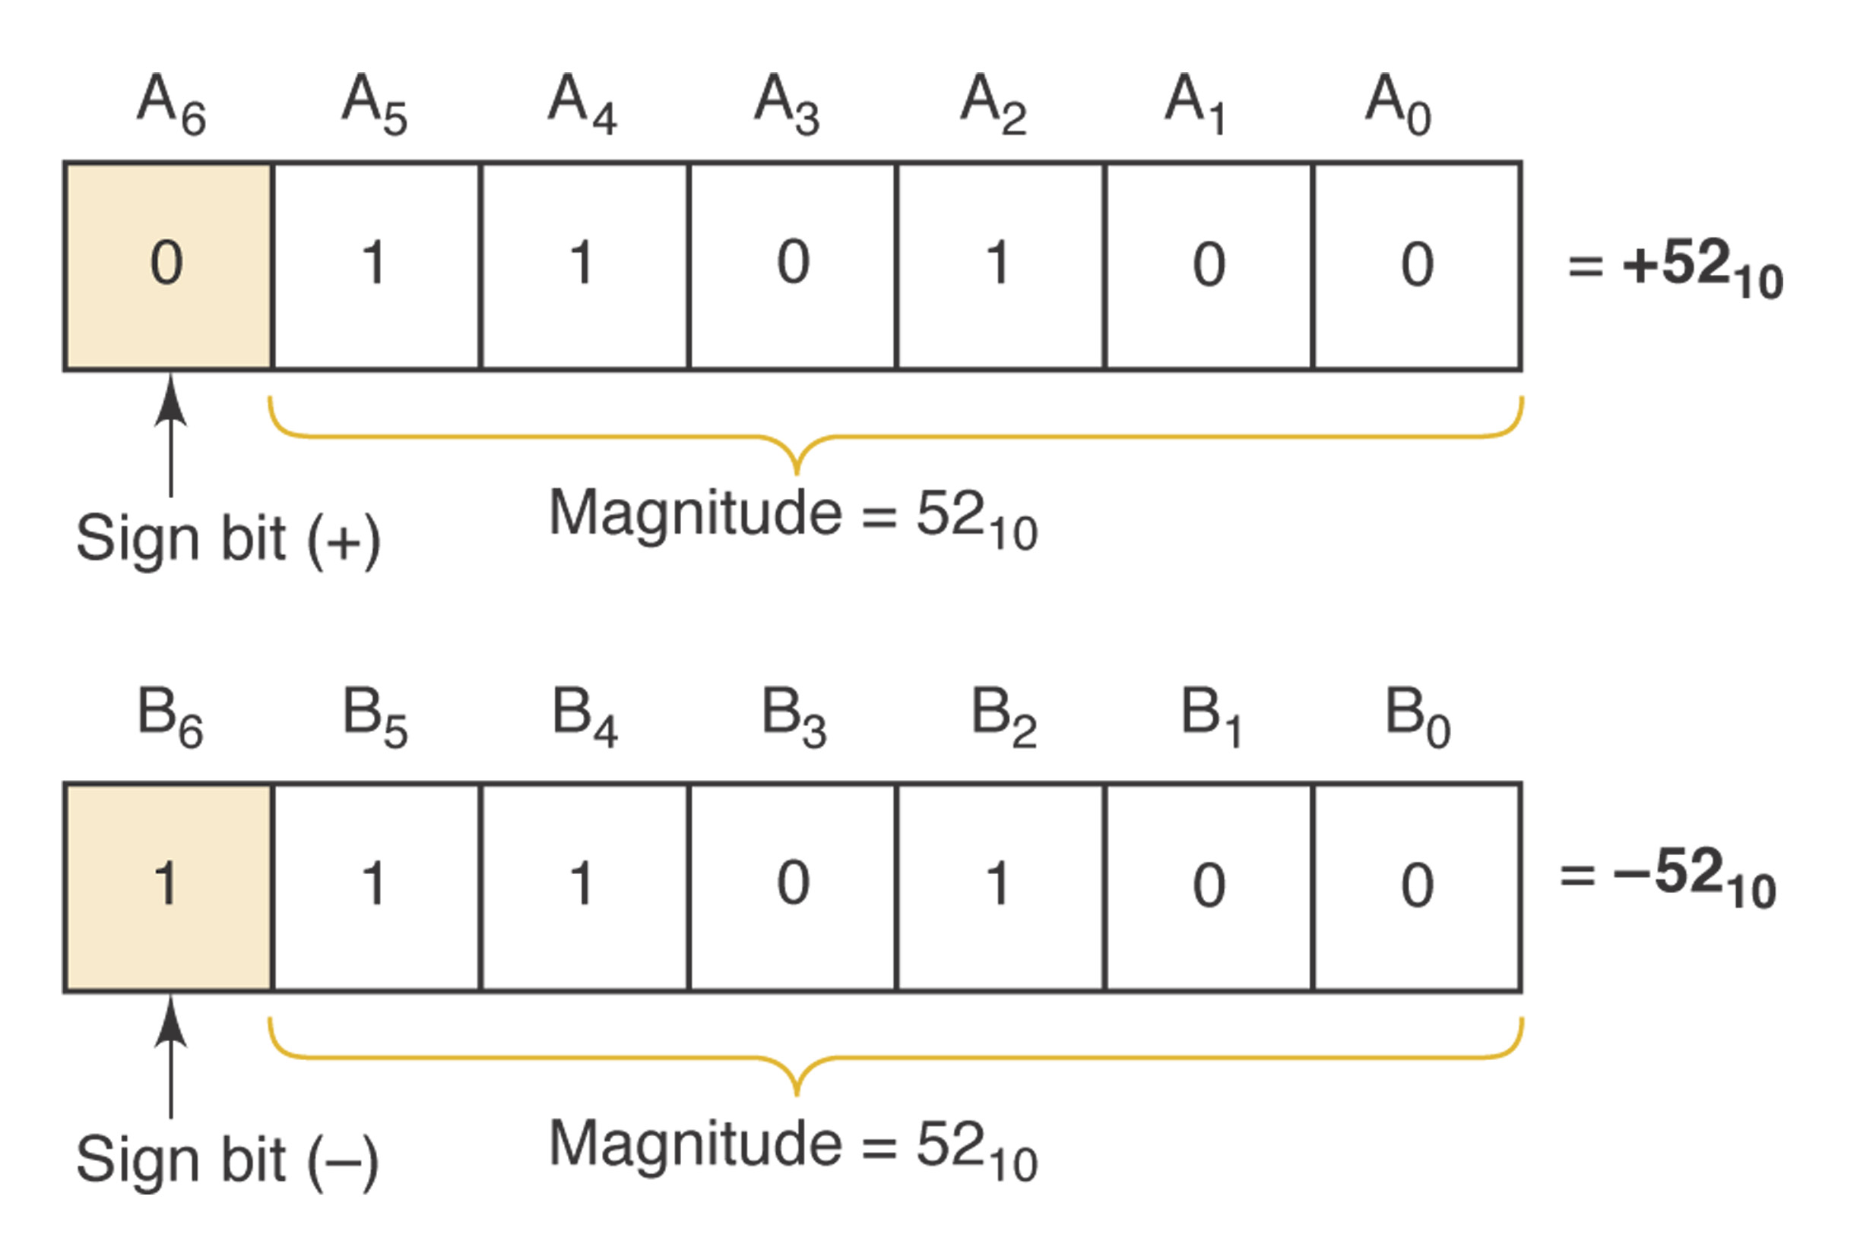
Representing Signed Numbers
Sign-magnitude system: left most bit as sign bit (0 for +, 1 for -), remaining bits as the magnitude.
Problems:
  How to perform addition?
  Two zeros: 1 0000 and
  0 0000

Slide 6
1’s and 2’s-Complement Form
1‘s complement: change 0 to 1 and 1 to 0.
2’s complement: take 1’s complement and add 1 to the LSB.
Examples: +13, -9,+3,-2,-8
Negation vs. complement

Slide 7
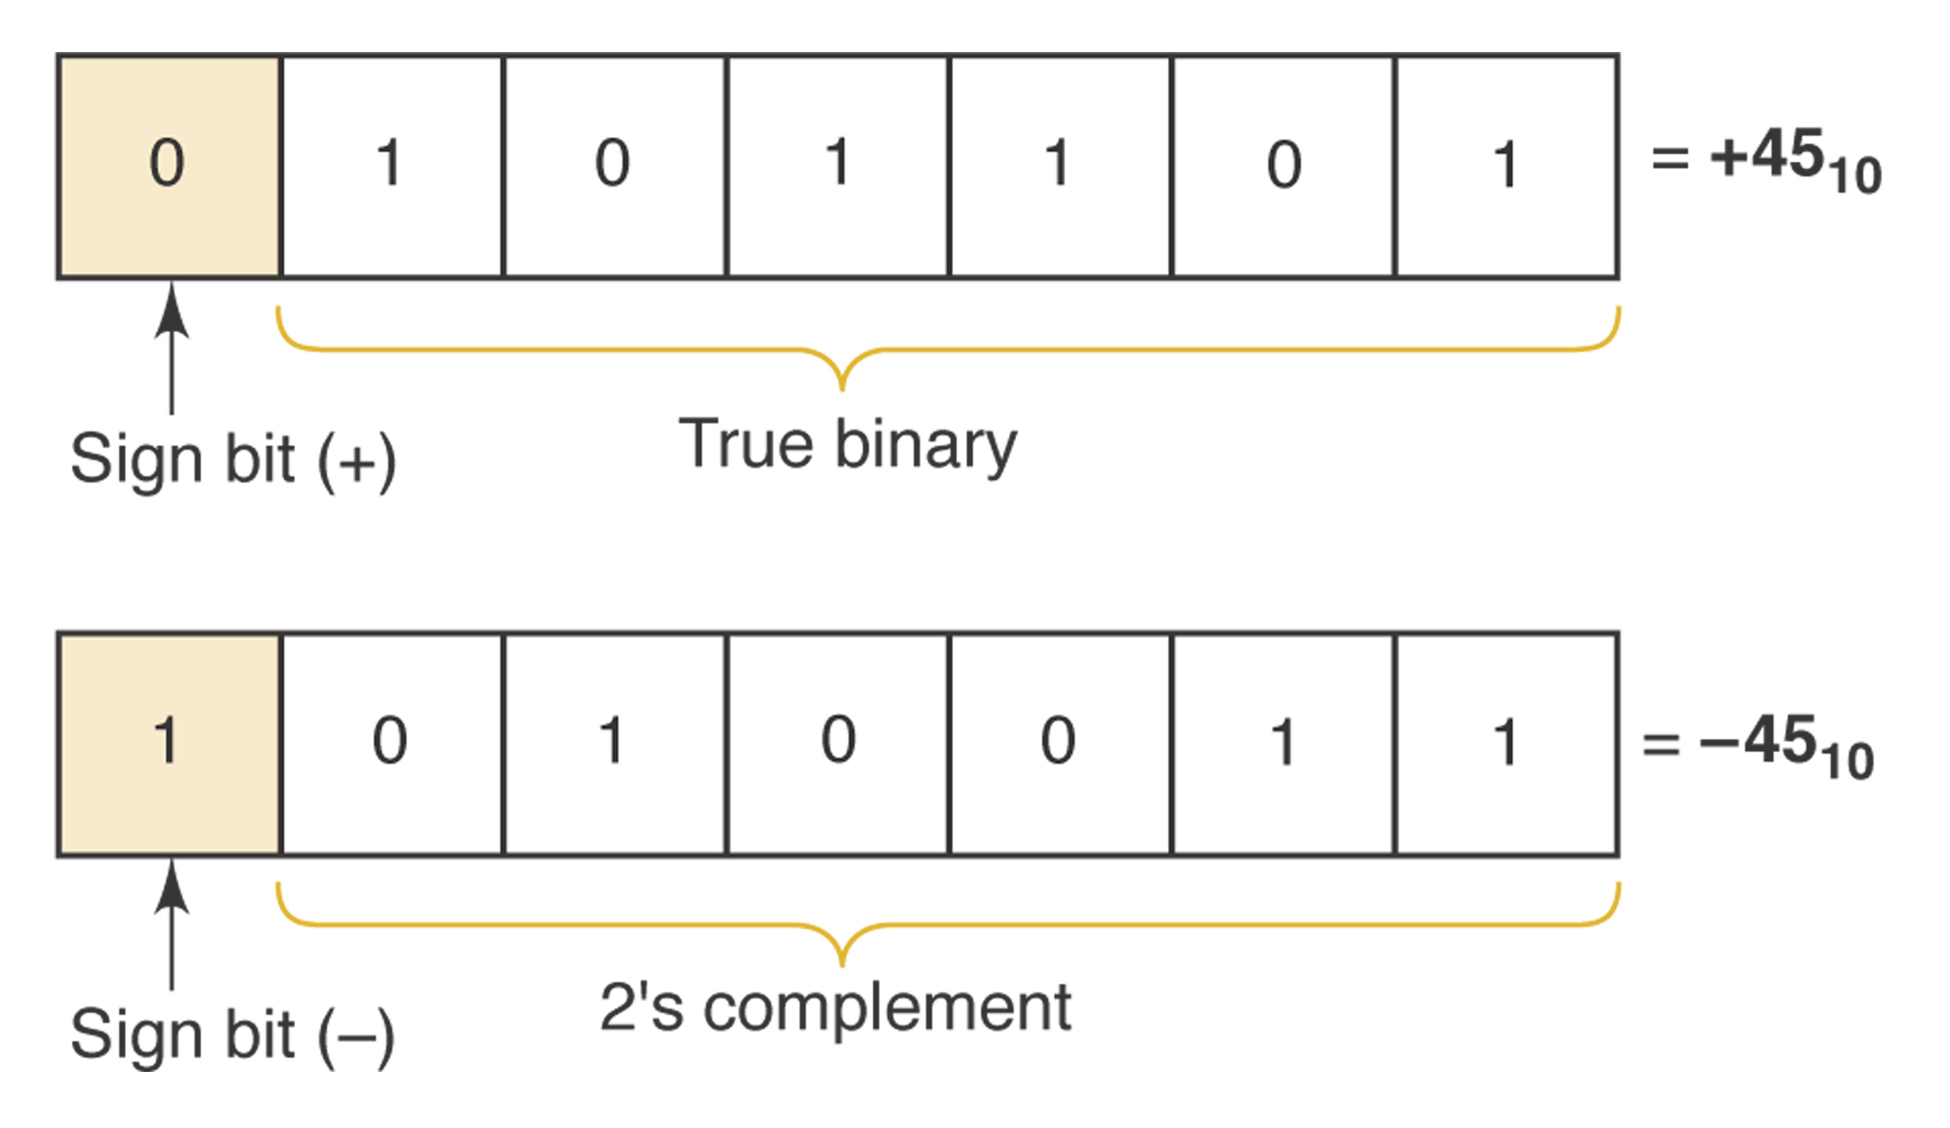
2’s Complement
Range of values can be represented using 1 sign bit and N magnitude bits:
-2^N to 2^N-1
1000 = -2^3 =-8
10000 = -2^4 = -16…

Slide 8
Addition in 2’s Complement Form
Case I: Two positive numbers
Case II: Positive number and smaller negative number
Case III: Positive number and larger negative number
Case IV: Two negative numbers
Case V: Equal and opposite numbers

Slide 9
Subtraction in 2’s Complement
A – B = A + (-B)
Arithmetic overflow: results of addition or subtraction fall outside the range of values that can be represented.

Slide 10
Binary Multiplication
Similar to multiplication of decimal numbers
1001 x 1011
What about the sign?
Overflow?

Slide 11
Binary Division
1001 divided by 11

Slide 12
BCD Addition
Sum equals 9 or less: digit-by-digit addition
Sum greater than 9:
  Example: 6 + 7
  Add 6 (0110) to correct the result
  (will produce a carry)

Slide 13
Hexadecimal Arithmetic
Hex addition
Hex subtraction
  Convert to binary,take 2’s complement, convert back to Hex
  Subtract each hex digit from F, then add 1
Hex representation of signed numbers:
  3A ←→ +58
  E5 ←→ -29
  When MSD >=8, negative

Slide 14
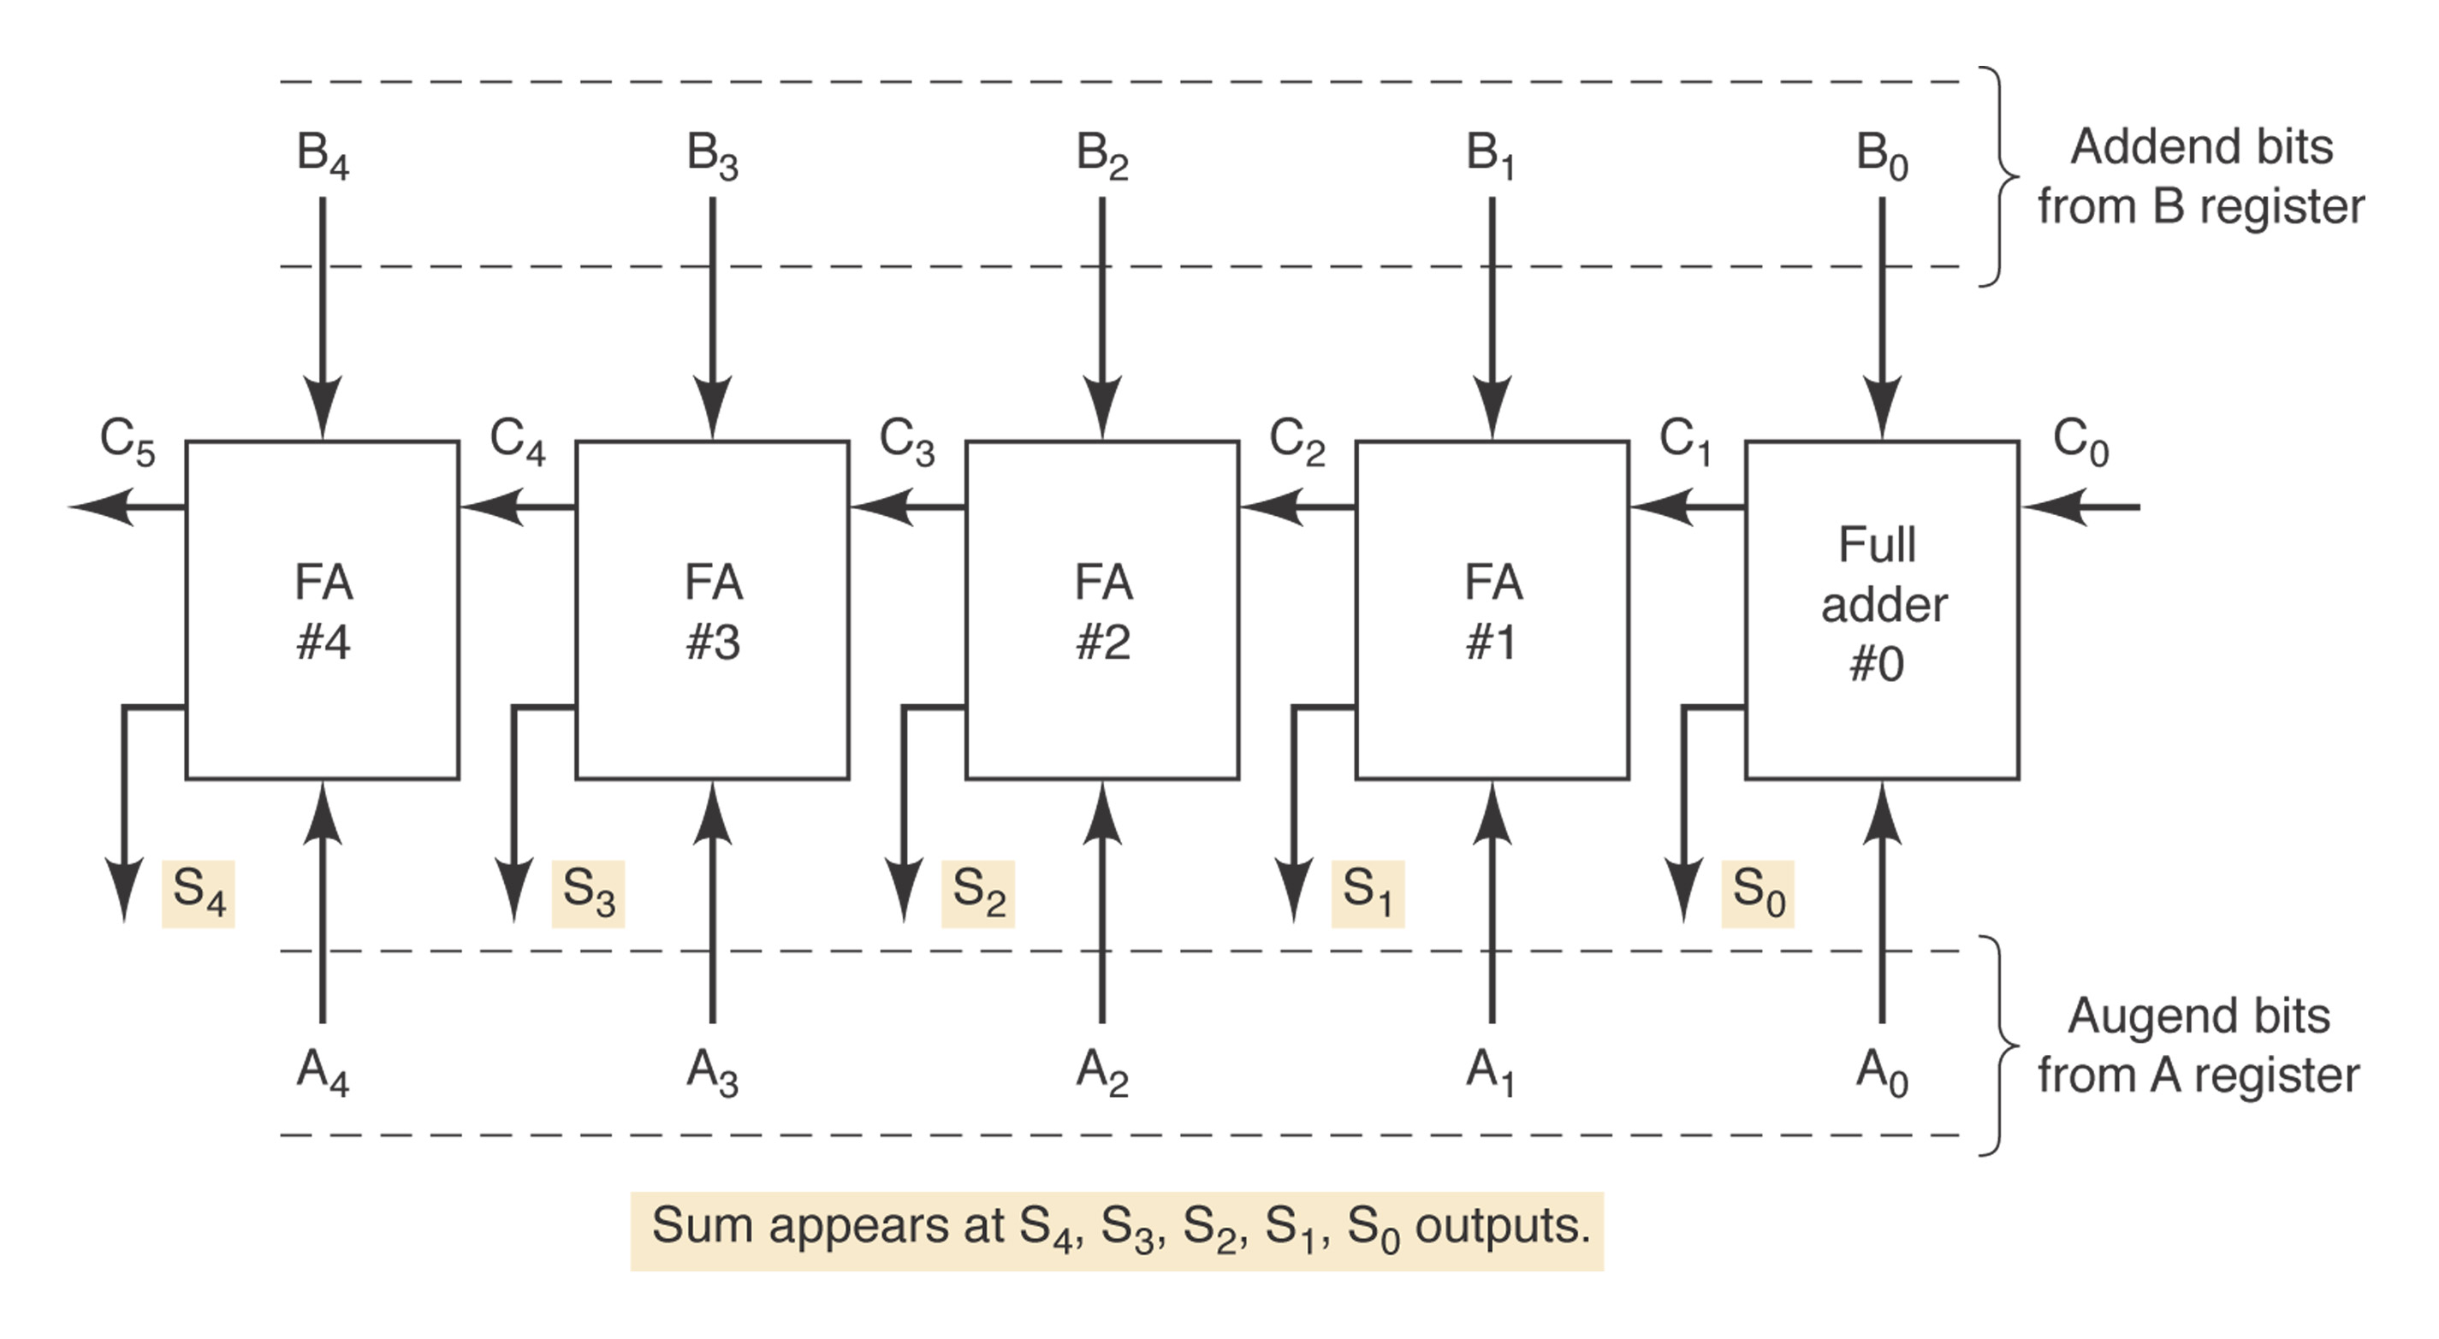
Arithmetic Circuits
Parallel Binary Adder (Figure 6-5*): sum and carry bit.

Slide 15
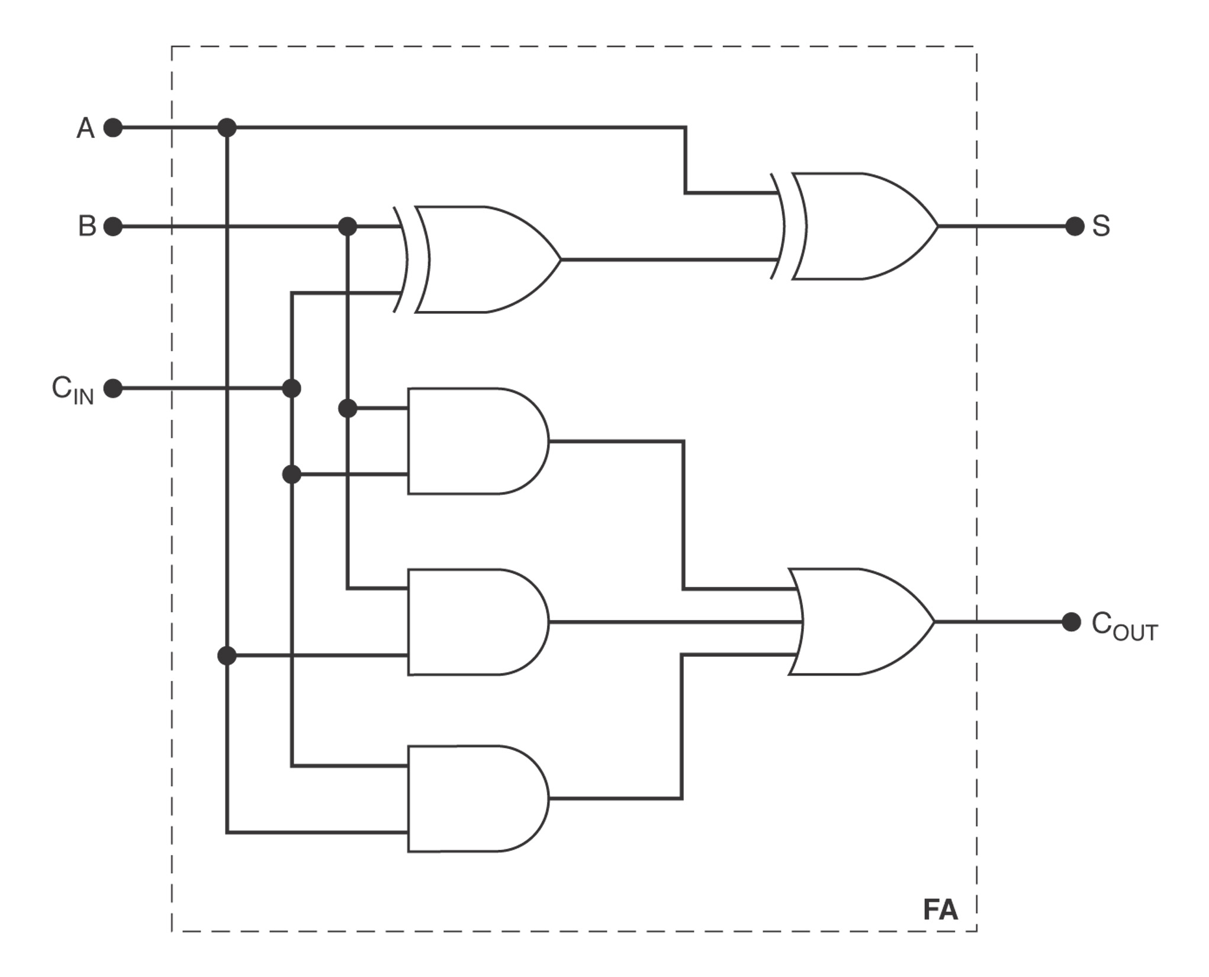
Design of a Full Adder
Figure 6-6 (Truth Table)
Figure 6-7*
Half adder:
take 2 inputs
and generate
sum and carry bits.

Slide 16
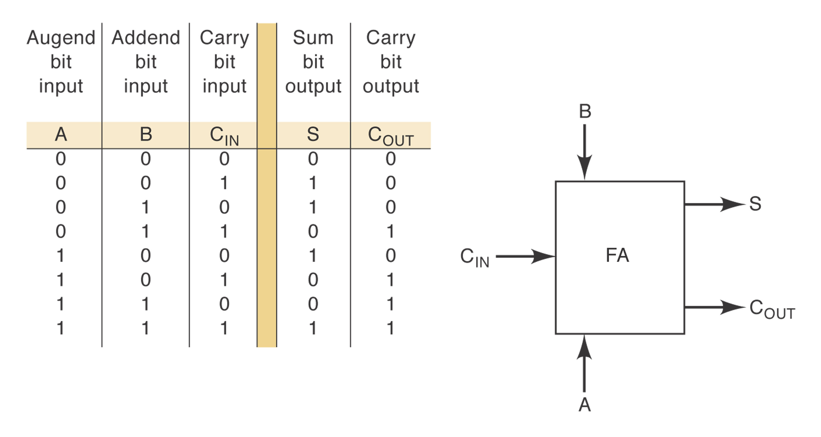
Truth Table for a Full-Adder

Slide 17
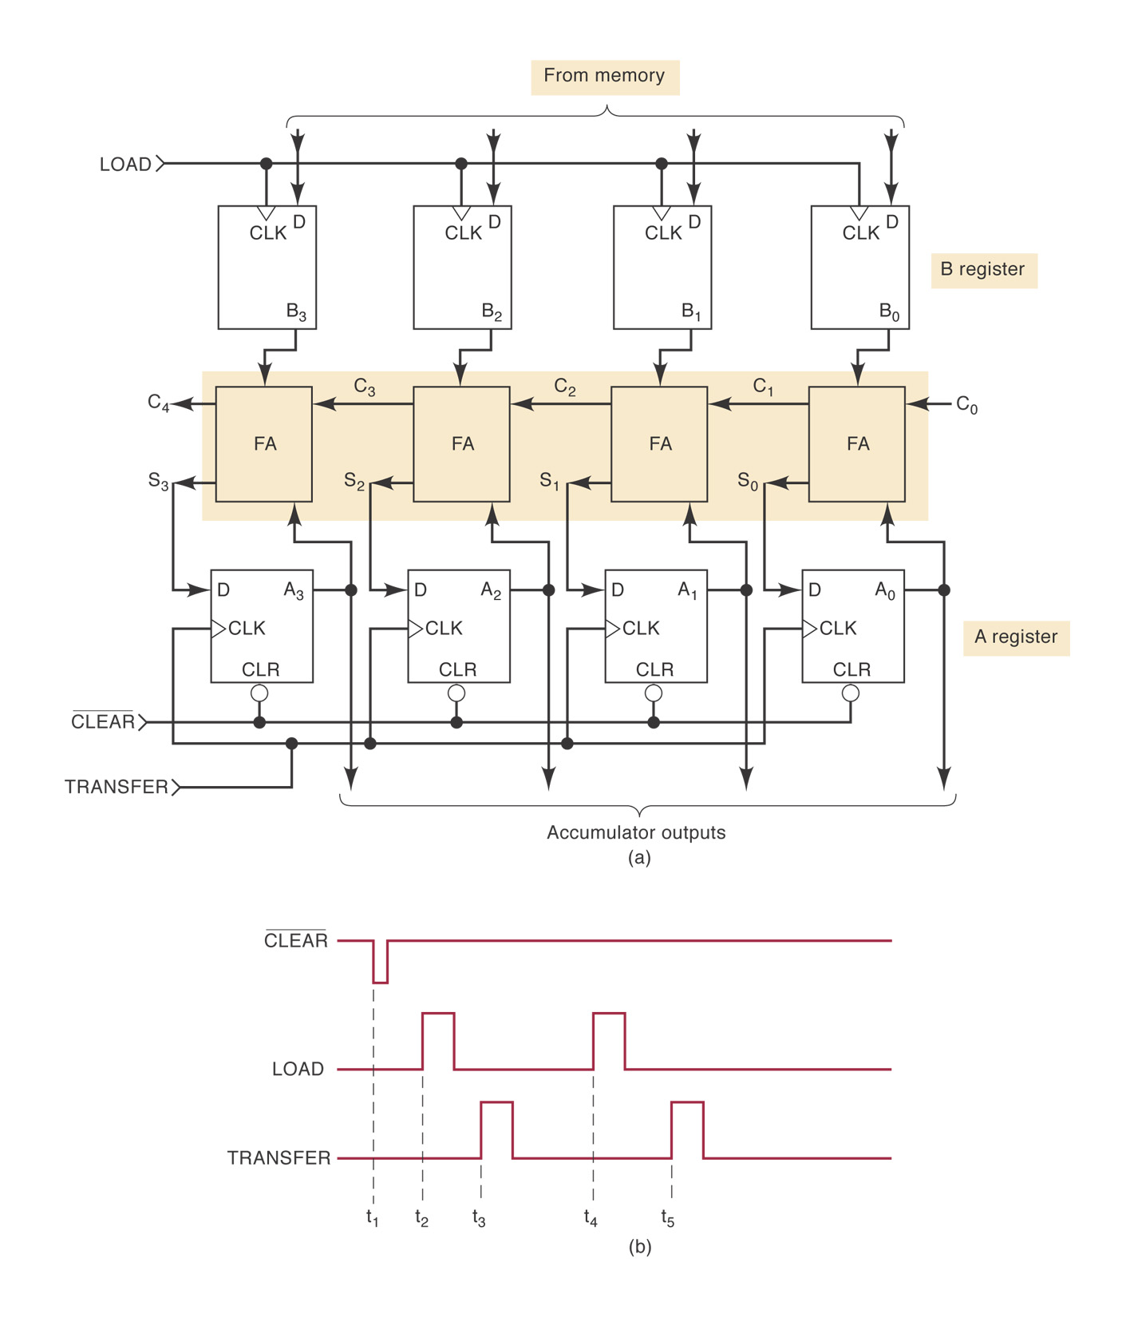
Four-Bit Parallel Adder
Complete parallel adder with registers (Figure 6-9):

Slide 18
Register Notation
Register notation:
[A]: the content of register A
Example:
[A]=1011 means that A₃=1, A₂=0, A₁=1, A₀=1.

Slide 19
Carry Propagation
For parallel adders, sum bit generated in the last position (MSB) depended on the carry that was generated by the addition in the first position (LSB).
More delay for addition of 32 or 64 bit numbers.
Use look-ahead carry to reduce propagation delay.

Slide 20
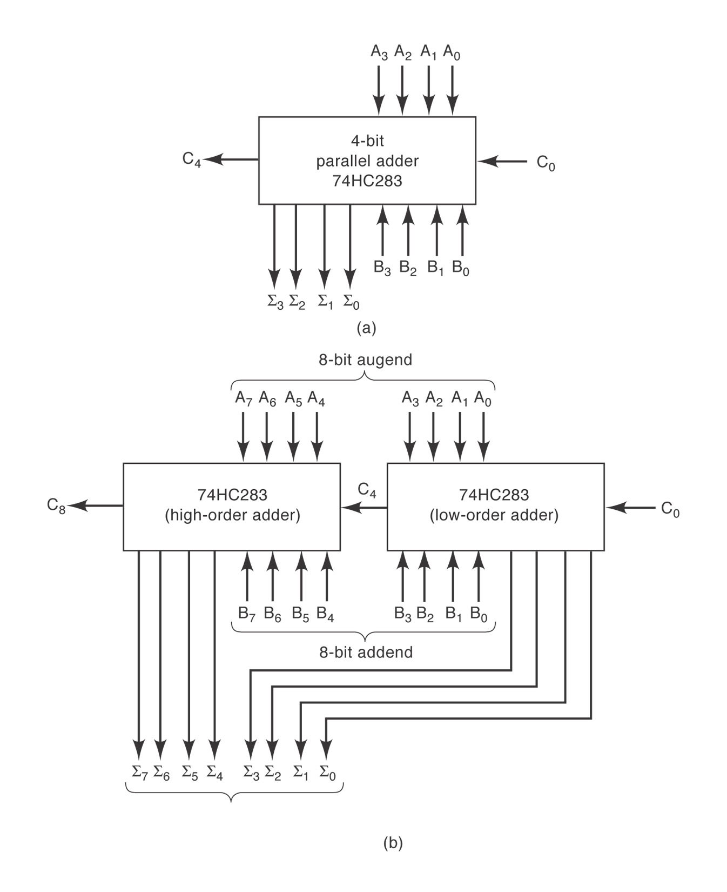
Integrated-Circuit Parallel Adder
4-bit parallel adder: 74HC283
Cascading parallel
adders

Slide 21
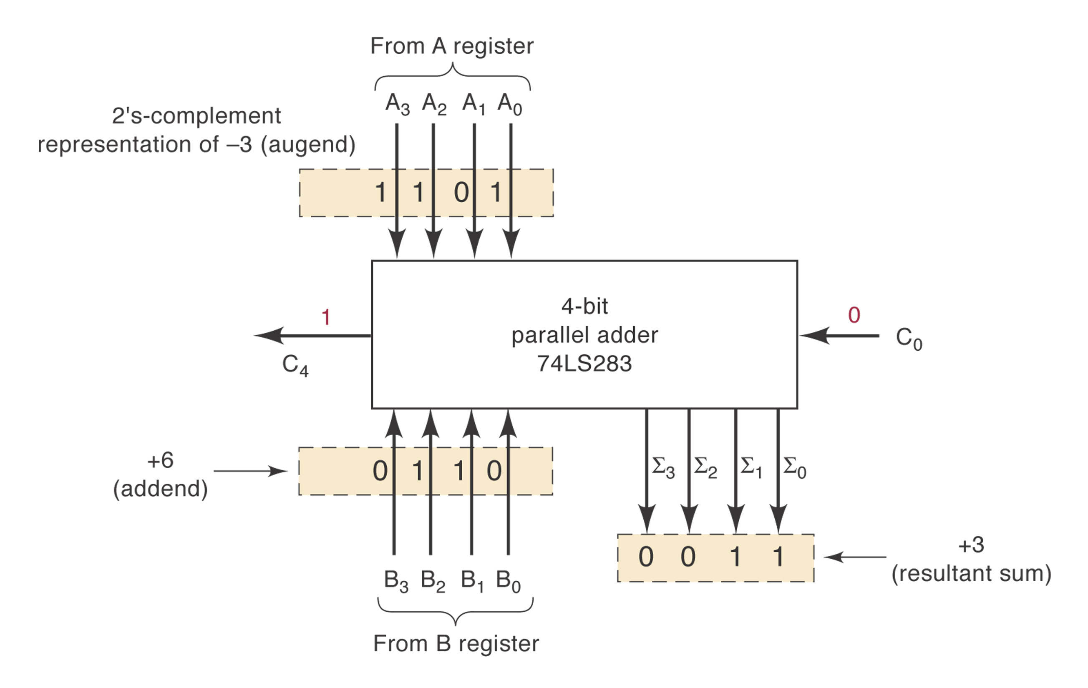
2’s Complement System
Figure 6.11: addition (C₀=0)

Slide 22
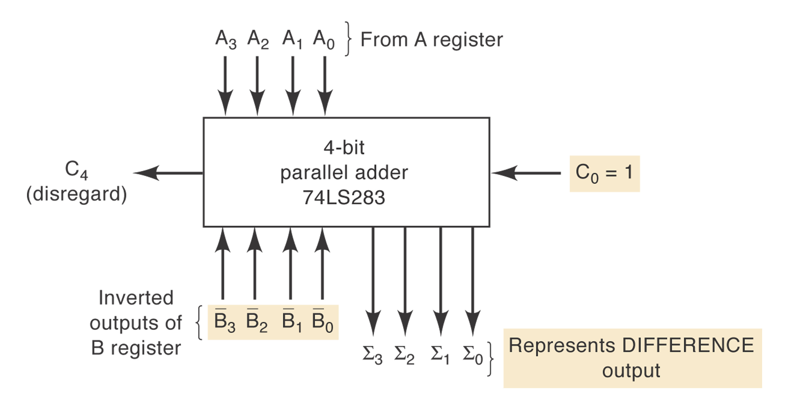
Figure 6.12: Subtraction (C₀=1)

Slide 23
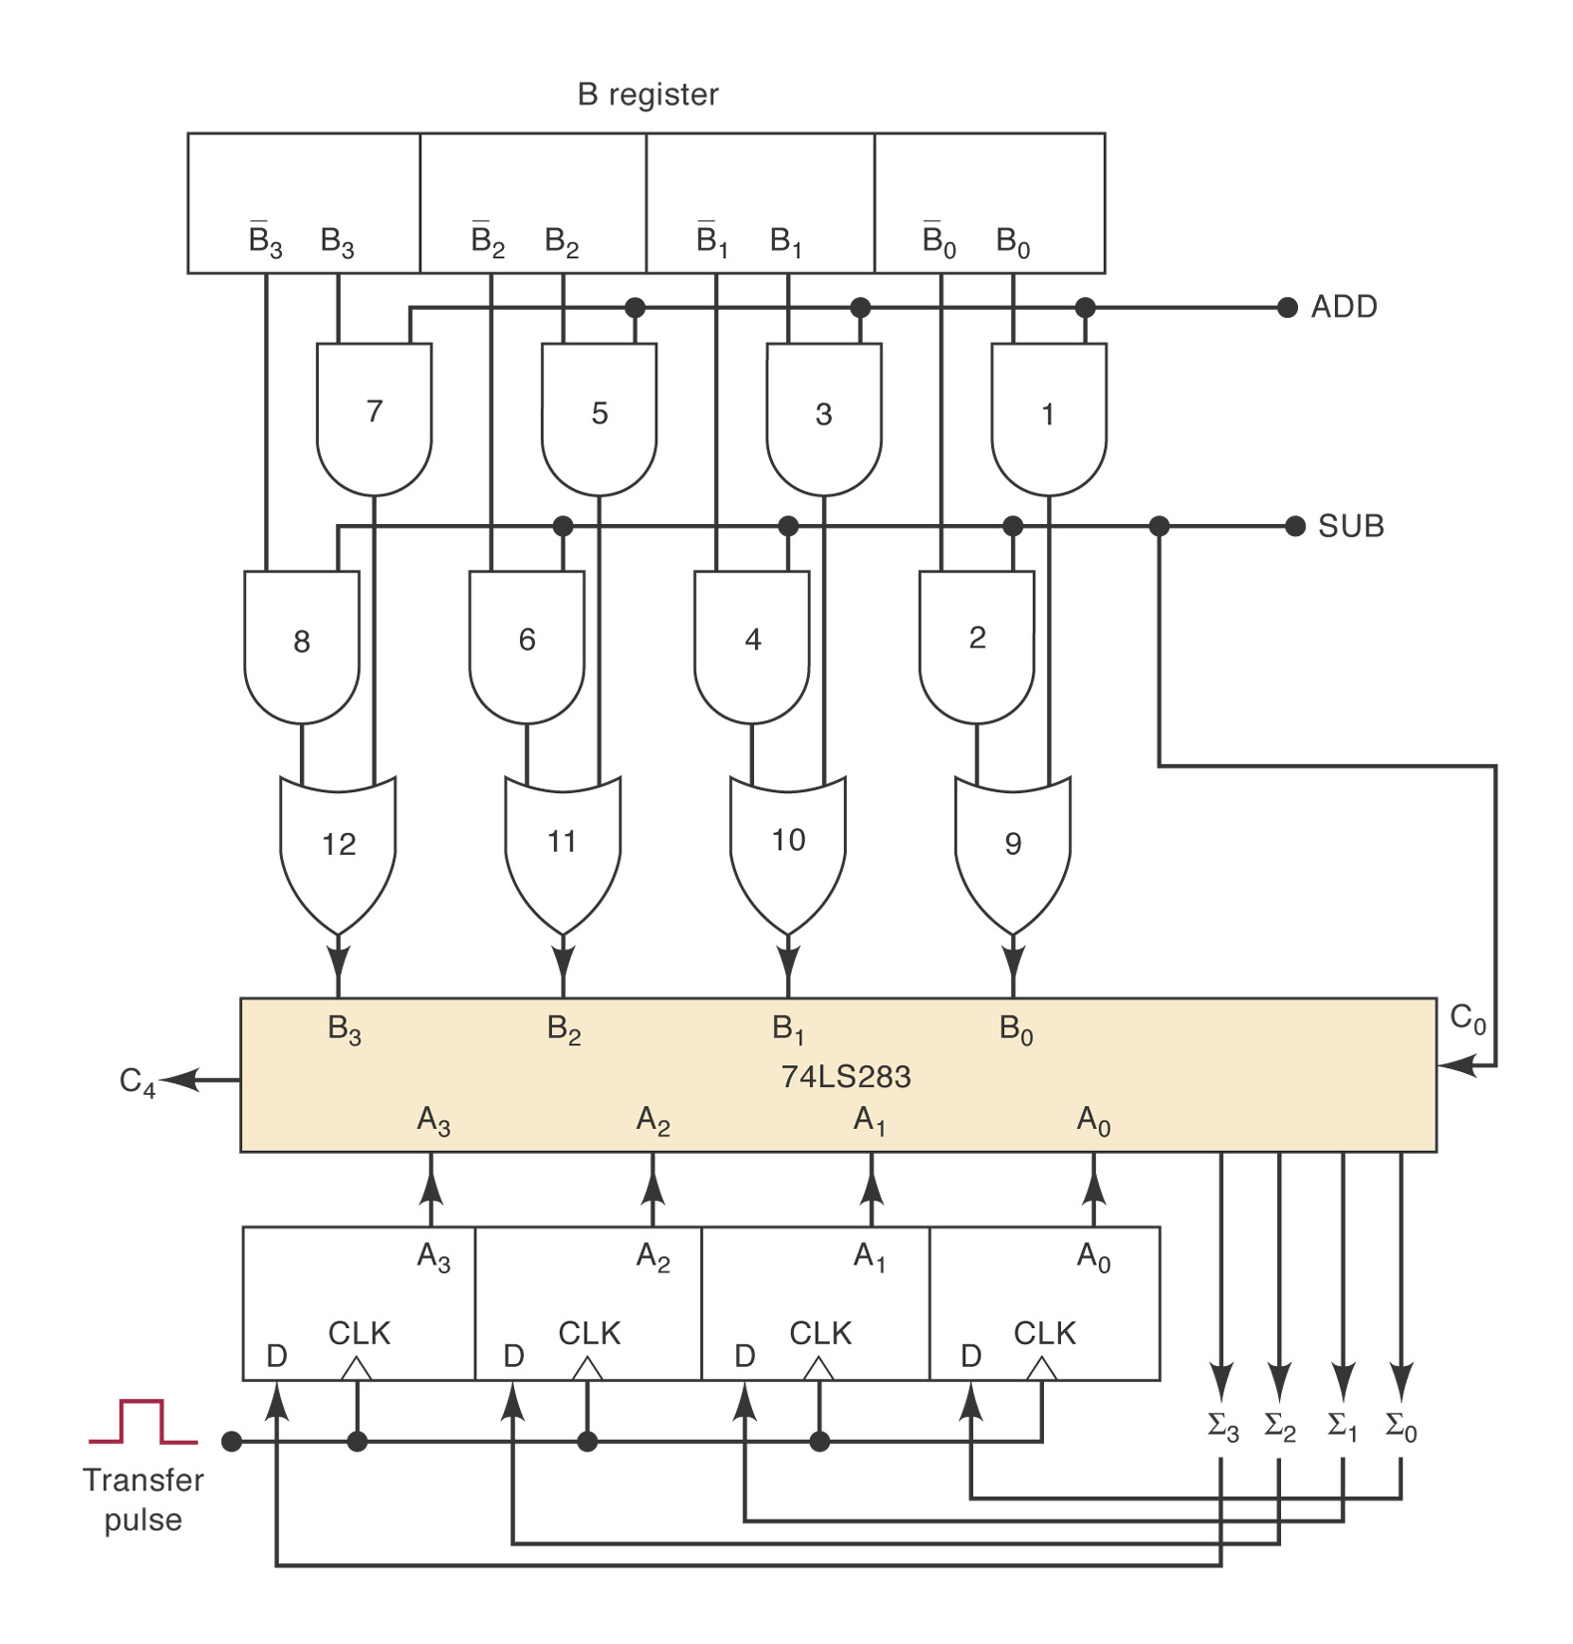
Combined Addition & Subtraction
Figure 6-13

Slide 24
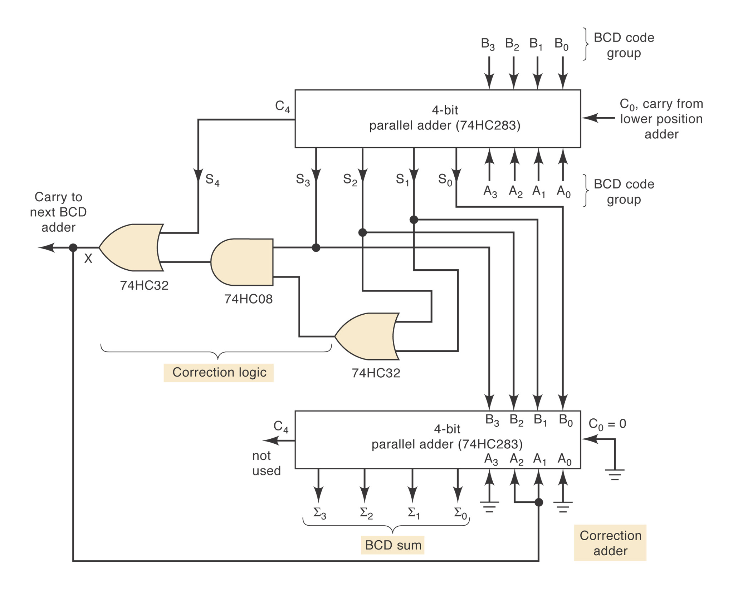
BCD Adder
How to detect when sum > 9?
X=S₄+S₃(S₂+S₁)
Figure 6-14

Slide 25
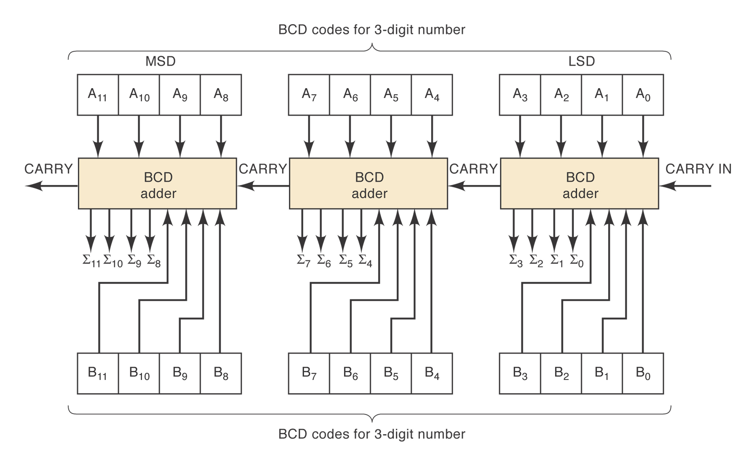
Cascading BCD Adders

Slide 26
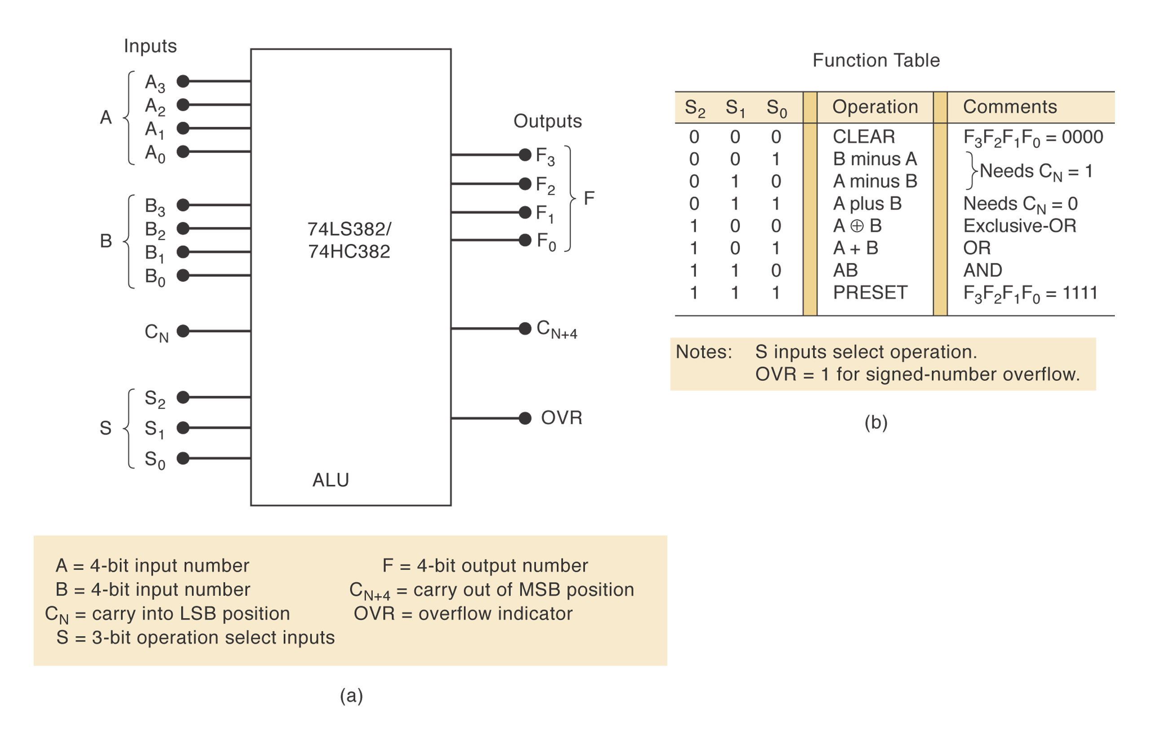
ALU Integrated Circuits

Slide 27
ALU ICs
74LS382/74HC382
CLEAR, B minus A, A minus B, A plus B, A XOR B, A+B, AB, preset
Expanding the ALU: combining 2 4-bit ALUs.
IEEE symbols

