Slide 1
AHDL: Introduction

Slide 2
Hardware Description Languages
Altera hardware description language (AHDL)
Very high speed integrated circuit (VHSIC) hardware description language (VHDL)
Verilog HDL
Tool: MAX+PLUS II supports both AHDL and VHDL.

Slide 3

HDL Format and Syntax
The basic format of any hardware circuit description involves two vital elements:
  The definition of what goes in and what comes out of it. (I/O specs)
  The definition of how outputs respond to the inputs. (operation)
Documentation
I/O Definitions
Functional Description

Slide 4
AHDL
The textbook includes information on both AHDL and VHDL.
We will be discussing only the AHDL format and syntax for the sake of simplicity.

Slide 5
Simple Boolean Expression
SUBDESIGN and_gate
(
a,b : INPUT;
y : OUTPUT;
)
BEGIN
y = a & b;
END;
Keywords:
  SUBDESIGN: gives a name to the circuit block. (Not case-sensitive)
  INPUT
  OUTPUT
  BEGIN
  END

Slide 6
Basic Boolean Operators
& AND
# OR
! NOT
$ XOR

Slide 7
Intermediate Variables in AHDL
% (Figure 3-49) %
SUBDESIGN fig3_50
(
a, b, c : INPUT; -- define input to block
y : OUTPUT; --define block output
)
VARIABLE
m : NODE; --name an intermediate signal
BEGIN
m = a & b; --generate buried product term
y = m # c; --generate sum on output
END;
Keyword: VARIABLE
Comments:
Between two %’s
After two dashes (--)

Slide 8
Representing Data in AHDL
Numbers
  Binary: B”101”
  Hexadecimal H”101”
  Decimal 101
Bit Array/Vectors
  p1 [7..0] :INPUT; --define an 8-bit input port
  Assignment:
    VARIABLE temp [7..0] : NODE;
    BEGIN
    temp[]=p1[];
    END

Slide 9
Define a Truth Table in AHDL
SUBDESIGN FIG4_50
(
a,b,c :INPUT; --define inputs to block
y :OUTPUT; --define block output
)
BEGIN
TABLE
(a,b,c) => y; --column headings
(0,0,0) => 0;
(0,0,1) => 0;
(0,1,0) => 0;
(0,1,1) => 1;
(1,0,0) => 0;
(1,0,1) => 1;
(1,1,0) => 1;
(1,1,1) => 1;
END TABLE;
END;
Keywords:
TABLE
END TABLE

Slide 10
Decision Control: IF/THEN/ELSE
SUBDESIGN FIG4_54
(
digtal_value[3..0] :INPUT; -- define inputs to block
z :OUTPUT; --define block output
)
BEGIN
IF digital_value[] > 6 THEN
z = VCC; -- output a 1
ELSE z = GND; -- output a 0
END IF;
END;
Keywords:
IF THEN
ELSE
END IF

Slide 11
ELSEIF
SUBDESIGN fig4_58
(
digtal_value[3..0] :INTPUT; --define inputs to block
too_cold, just_right, too_hot :OUTPUT; --define outputs
)
VARIABLE
status[2..0] :NODE; --holds state of too_cold, just_right, too_hot
BEGIN
IF digital_value[] <= 8 THEN status[] = b"100";
ELSEIF digital_value[] > 8 AND digital_value[] < 11 THEN
status[] = b"010";
ELSE status[] = b"001";
END IF;
(too_cold, just_right, too_hot) = status[]; --update output bits
END;

Slide 12
CASE/WHEN
SUBDEDSIGN fig4_60
(
p,q,r :INPUT; --define inputs to block
s : OUTPUT; --define outputs
)
VARIABLE
status[2..0] :NODE;
BEGIN
status[] = (p, q, r); --link input bits in order
CASE status[] IS
WHEN b"100" => s = GND;
WHEN b"101" => s = GND;
WHEN b"110" => s = GND;
WHEN OTHERS => s = VCC;
END CASE
END;
Keywords:
CASE
WHEN
OTHERS
END CASE

Slide 13
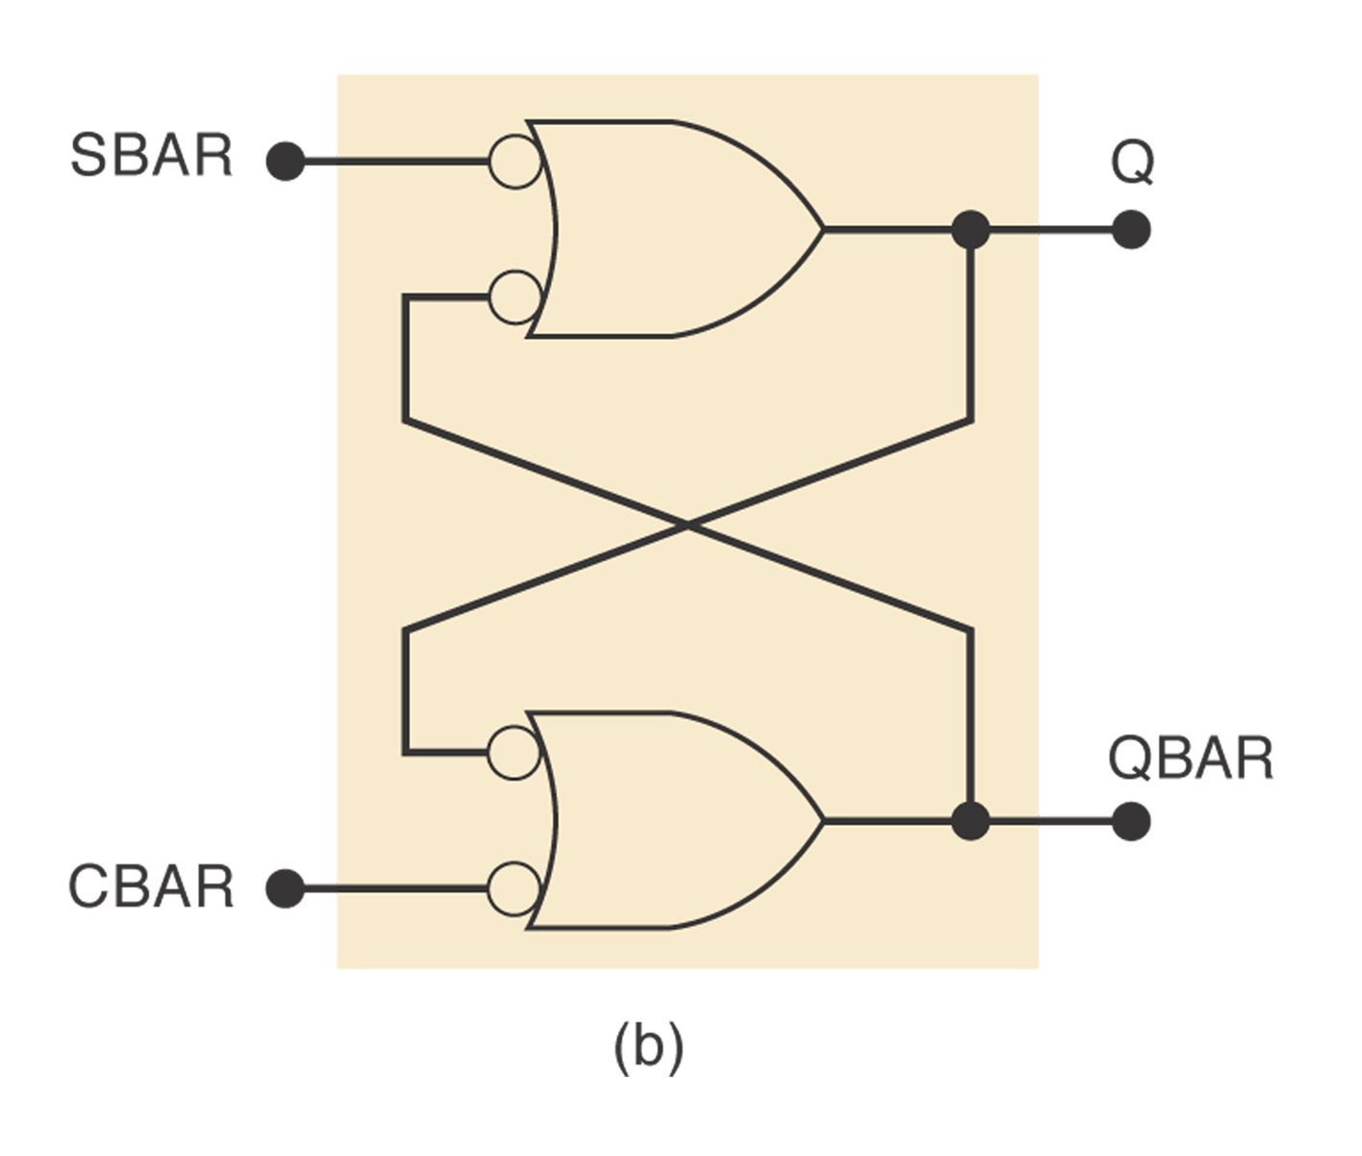
The NAND Latch
SUBDESIGN fig5_61
(
sbar, cbar : INPUT; -- active low inputs
q, qbar : OUTPUT; -- allow feedback
)
BEGIN
q = !sbar # !qbar; -- Boolean equations
qbar = !cbar # !q;
END;

Slide 14
AHDL Flip-Flops
JK, D, SR and latch registers are available for use in AHDL.
Standard Part Function | Primitive Identifier
Clock input | clk
Asynchronous preset (active-LOW) | prn
Asynchronous clear (active-LOW) | clrn
J,K,S,R,D inputs | j,k,s,r,d
Level triggered ENABLE input | ena
Q output | q

Slide 15
Single JK Flip-Flop
SUBDESIGN fig5_64
(
jin,kin,clkin,preset,clear :INPUT;
qout :OUTPUT;
)
VARIABLE
ff1 :JKFF; -- define the FF as JKFF type
BEGIN
ff1.prn=preset; --optional, default to vcc
ff1.clrn=clear;
ff1.j=jin;
ff1.k=kin;
ff1.clk=clkin;
qout=ff1.q;
END;

Slide 16
MOD 8 Ripple Up Counter
SUBDESIGN fig5_71
(
clock : INPUT;
q[2..0] : OUTPUT;
)
VARIABLE
q[2..0] : JKFF; --defines three JK FFs
BEGIN
q[2..0].j = VCC; -- toggle mode J=K=1 for all FFs
q[2..0].k = VCC;
q[0].clk = !clock;
q[1].clk = !q[0].q;
q[2].clk = !q[1].q; -- connect clocks in ripple form
END;

