Slide 1



Slide 2
Chapter 6 – Digital Arithmetic: Operations & Circuits

Slide 3
Chapter 6 Objectives
Selected areas covered in this chapter:
  Binary addition, subtraction, multiplication, division.
  Differences between binary addition and OR addition.
  Advantages & disadvantages among three different systems of representing signed binary numbers.
  Basic operation of an arithmetic/logic unit.
  Operation of a parallel adder/subtractor circuit.
  ALU integrated circuits for various logic and arithmetic operations on input data.
  Digital functions from libraries to implement more complex circuits.
  Boolean equation description to perform operations on entire sets of bits.

Slide 4
6-1 Binary Addition & Subtraction
Binary numbers are added like decimal numbers.
  In decimal, when numbers sum more than 9,
  a carry results.
  In binary when numbers sum more than 1,
  a carry takes place.
Addition is the basic arithmetic operation used by digital devices for subtraction, multiplication & division.

Slide 5
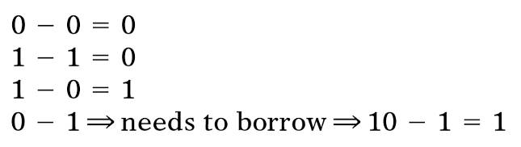
6-1 Binary Addition & Subtraction
Binary subtraction is performed just like the subtraction of decimal numbers.
Four possible situations when subtracting one bit from another in any position of a binary number.

Slide 6
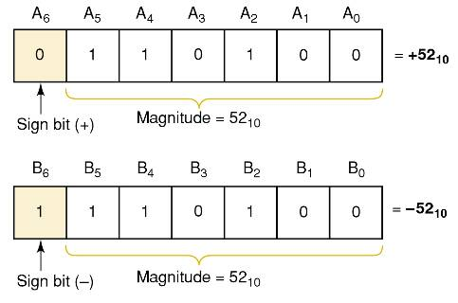
6-2 Representing Signed Numbers
Since it is only possible to show magnitude with
a binary number, the sign (+) or (-) is shown by adding an extra “sign” bit.
  A sign bit of 0 indicates a positive number.
  A sign bit of 1 indicates a negative number.

Slide 7
6-2 Representing Signed Numbers
The 2’s complement system is the most commonly used way to represent signed numbers.
To change a binary number to 2’s complement it
must first be changed to 1’s complement.
  Change each bit to its complement (opposite).
  To convert 1’s complement to 2’s complement,
  add 1 to the 1’s complement.
A number is negated when converted to the opposite sign.
  A binary number can be negated by taking
  the 2’s complement of it.

Slide 8
6-3 Addition in the 2’s Complement System
Perform normal binary addition of magnitudes.
  The sign bits are added with the magnitude bits.
If addition results in a carry of the sign bit, the carry bit is ignored.
  If the result is positive, it is in pure binary form.
  If the result is negative, it is in 2’s complement form.

Slide 9
6-4 Subtraction in the 2’s Complement System
Subtraction using the 2’s-complement system actually involves the operation of addition.
  The number subtracted (subtrahend) is negated.
  The result is added to the minuend.
  The answer represents the difference.

Slide 10
6-4 Subtraction in the 2’s Complement System
Overflow can occur only when two positive or two negative numbers are being added—which always produces an incorrect result.
  If the answer exceeds the number of magnitude bits, an overflow results.

Slide 11
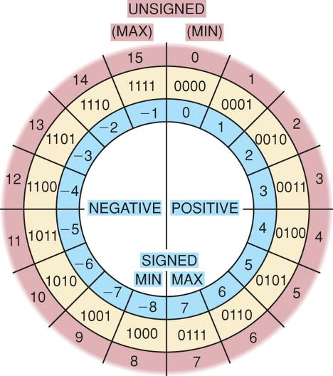
6-4 Subtraction in the 2’s Complement System
Using a number circle to add.
Start at the value of the augend.
Advance around the number
circle clockwise by the
number of spaces
in the addend.
The most apparent
way to subtract is to move counterclockwise around the circle
Any subtraction operation between
four-bit numbers of opposite sign producing a result greater than
7 or less than -8 is an overflow.

Slide 12
6-5 Multiplication of Binary Numbers
Similar to multiplication of decimal numbers.
  Each bit in the multiplier is multiplied by the multiplicand.
Results are shifted as we move from LSB to MSB in the multiplier.
  All of the results are added to obtain the final product.

Slide 13
6-6 Binary Division
Similar to decimal long division—simpler, as only 1 or 0 are possible.
The subtraction part of the operation is done
using 2’s complement subtraction.
  If the signs of the dividend & divisor are the same…
    The answer will be positive.
  If the signs of the dividend & divisor are different…
    The answer will be negative.

Slide 14
6-7 BCD Addition
When the sum of each decimal digit is less
than 9, the operation is the same as normal
binary addition.
When the sum of each decimal digit is greater than 9, a binary 6 is added.
  This will always cause a carry.

Slide 15
6-8 Hexadecimal Arithmetic
Hex addition:
  Add the hex digits in decimal.
  If the sum is 15 or less—express directly in hex digits.
  If the sum is greater than 15—subtract 16 and carry 1 to the next position.
Hex subtraction—use the same method as for binary numbers.
  When the MSD in a hex number is 8 or greater, the number is negative.
  When the MSD is 7 or less, the number is positive.

Slide 16
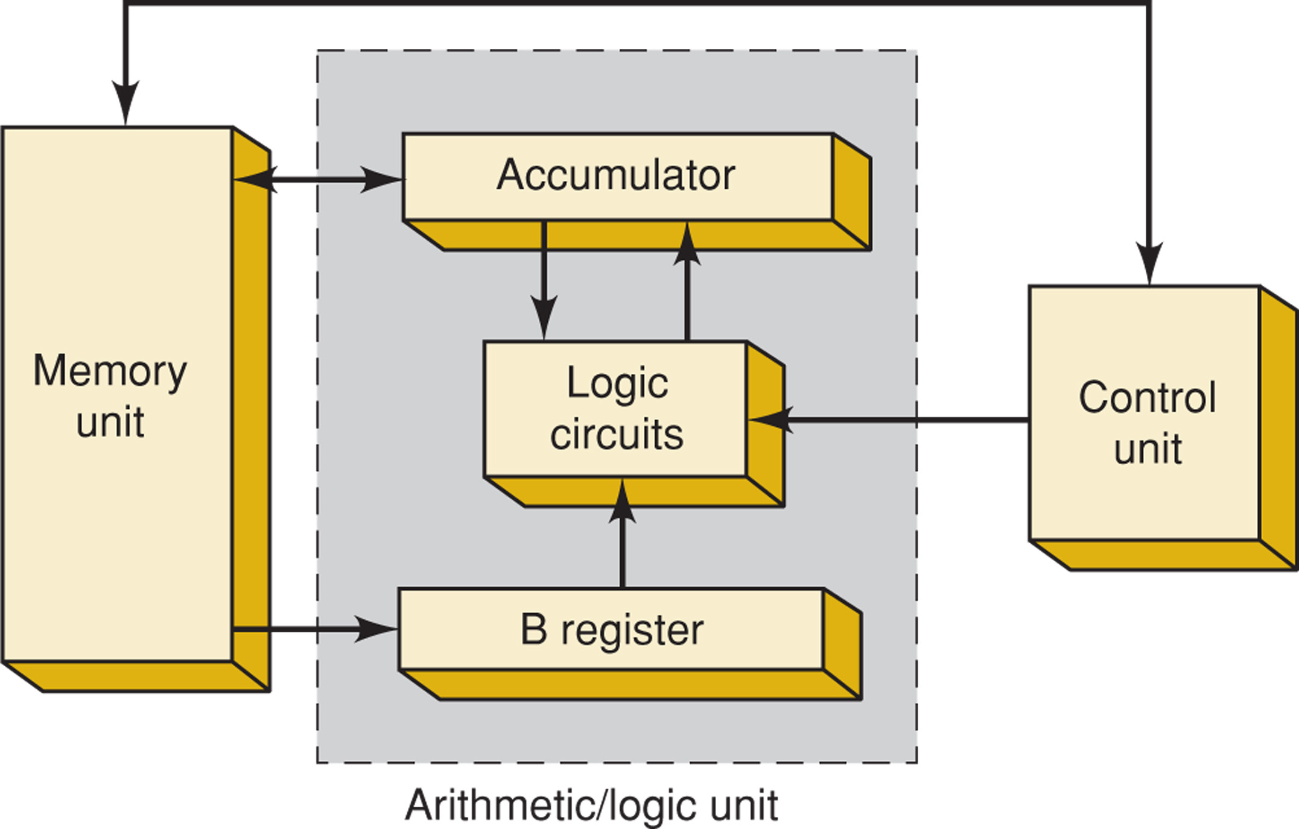
6-9 Arithmetic Circuits
An arithmetic/logic unit (ALU) accepts data stored
in memory, and executes arithmetic and logic operations as instructed by the control unit.

Slide 17
6-9 Arithmetic Circuits
  The control unit is instructed to add a specific number from a memory location to a number
  stored in the accumulator register.

Slide 18
6-9 Arithmetic Circuits
  The number is transferred from
  memory to the B register.

Slide 19
6-9 Arithmetic Circuits
  The number in B register and accumulator
  register are added in the logic circuit,
  with sum sent to accumulator for storage.

Slide 20
6-9 Arithmetic Circuits
  The new number remains in the accumulator
  for further operations—or can be transferred
  to memory for storage

Slide 21
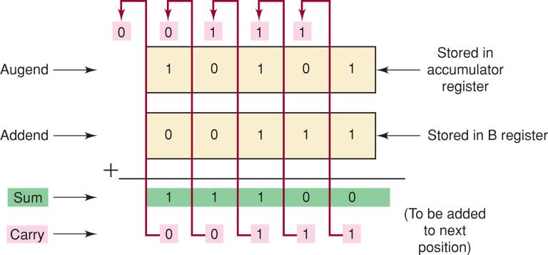
6-10 Parallel Binary Adder
Computers and calculators perform the addition operation on two binary numbers at a time.
  Each binary number can have several binary digits.

Slide 22
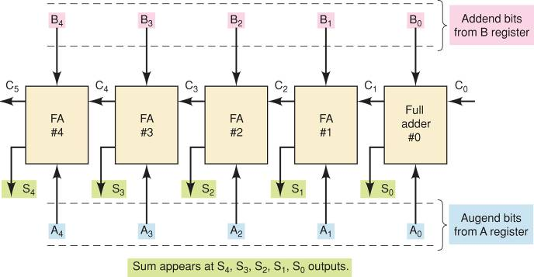
6-10 Parallel Binary Adder
Block diagram of a five-bit parallel
adder circuit using full adders.

Slide 23
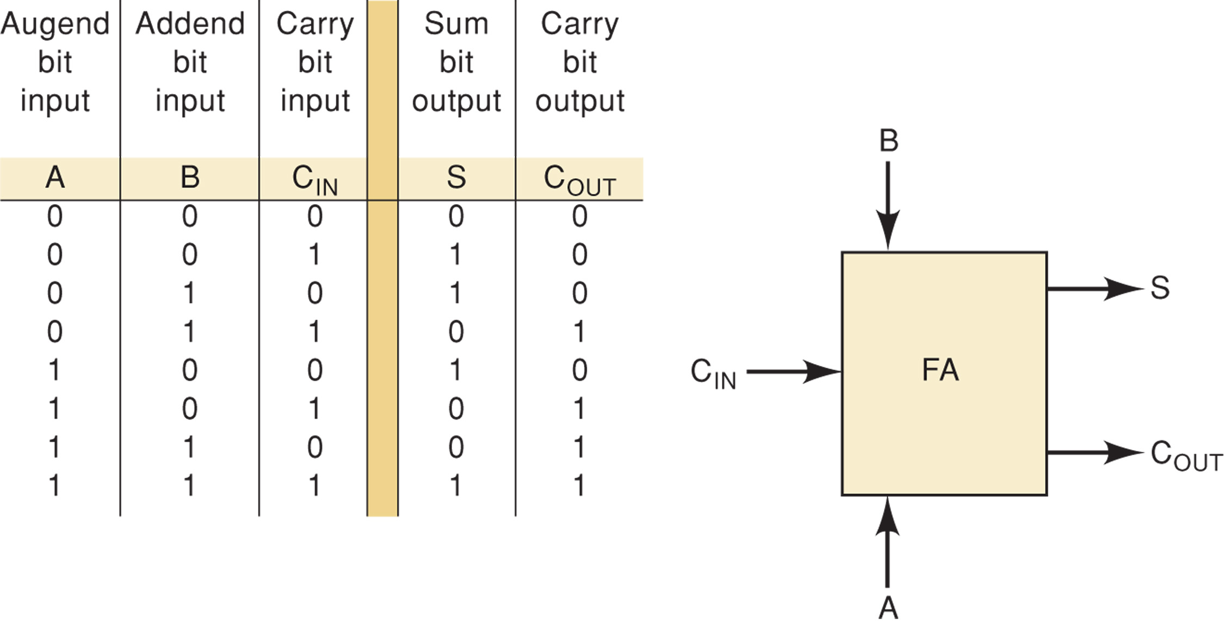
6-11 Design of a Full Adder
Construct a truth table…
  3 inputs (2 numbers to be added and carry in).
  2 outputs (sum and carry out).

Slide 24
6-11 Design of a Full Adder
Use algebraic methods or K-maps to simplify
the resulting SOP form.
  The result is the logic circuit shown here.

Slide 25
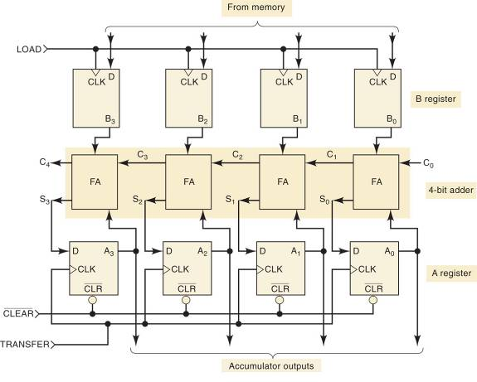
6-12 Complete Parallel Adder With Registers
Four-bit parallel adder circuit,
including the storage registers.

Slide 26
6-12 Complete Parallel Adder With Registers
Adding binary 1001 and 0101 using the circuit:
  A CLR pulse is applied at t₁ .
  The first binary number 1001 is transferred
  from memory to the B register at t₂ .
  The sum of 1001 and 0000 is transferred
  to the A register at t₃ .
  0101 is transferred from memory to B register at t₄ .
  Sum outputs are transferred to the A register at t₅.
  The sum of the two numbers is now present in the accumulator.

Slide 27
6-12 Complete Parallel Adder With Registers
Brackets indicate the contents of a register:
  [A]=1011 is the same as A₃=1,A₂=0,A₁=1,A₀=1
    The contents of register A.
Transfer of data to or from a register is indicated with an arrow [B]→[A].
  “…the contents of register B have been transferred to register A.”

Slide 28
6-13 Carry Propagation
Parallel adder speed is limited by carry propagation—also called carry ripple.
  Results from having to wait for the carry bits to “ripple” through the device.
    Additional bits will introduce more delay.
The look-ahead carry scheme is commonly used in high speed devices to reduce the delay.

Slide 29
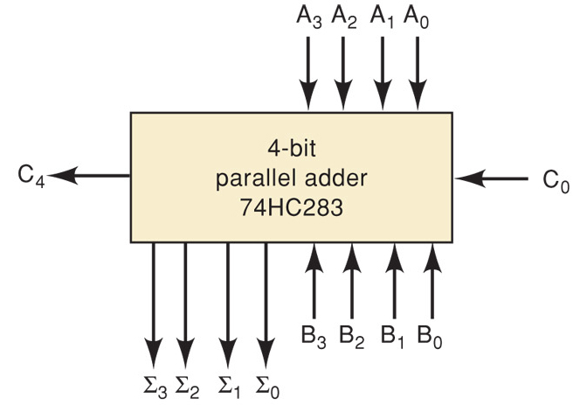
6-14 Integrated Circuit Parallel Adder
The most common parallel adder is a 4 bit device.
  4 interconnected FAs, and look-ahead carry circuits.
    7483A, 74LS83A, 74LS283, and 74HC283 are all
    four-bit parallel-adder chips.

Slide 30
6-14 Integrated Circuit Parallel Adder
The A and B lines each represent 4 bit numbers
to be added.
  C₀ is the carry-in, C₄ is the carry-out, Σ is the sum.

Slide 31
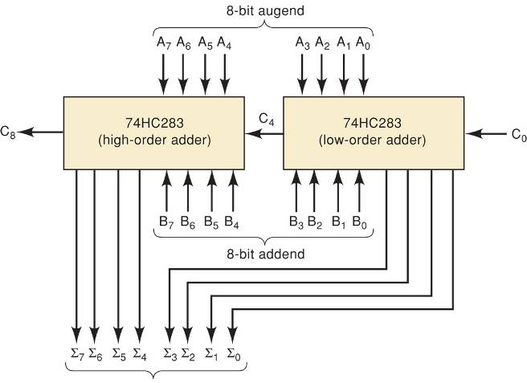
6-14 Integrated Circuit Parallel Adder
  Parallel adders may be cascaded together to add
  larger numbers, in this case two 8 bit numbers.

Slide 32
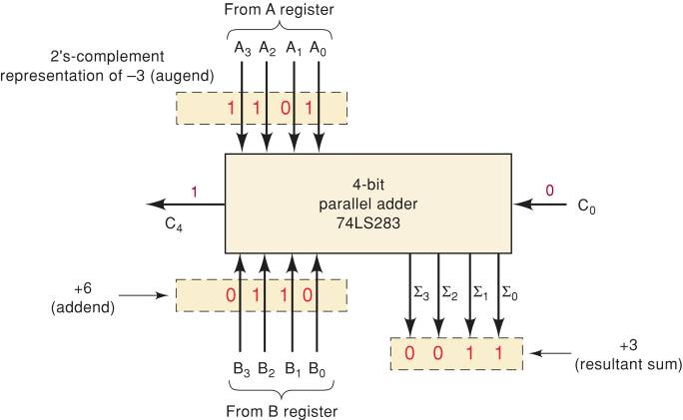
6-15 2’s Complement System
Addition of negative & positive numbers with adders is done by placing the negative number into 2’s complement form, then normal addition.

Slide 33
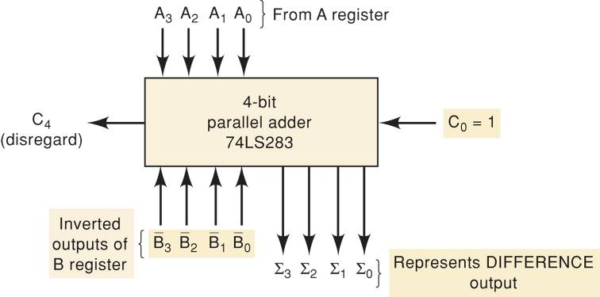
6-15 2’s Complement System
An adder can be used to perform subtraction by designing a way to take the 2’s complement for subtraction—as shown.

Slide 34
6-15 2’s Complement System
The adder/subtractor circuit is controlled by
the two control signals ADD and SUB.
  When ADD is HIGH, the circuit performs addition
  of numbers stored in the A and B registers.
  When SUB is HIGH, the circuit subtracts the
  B-register number from the A-register number.

Slide 35
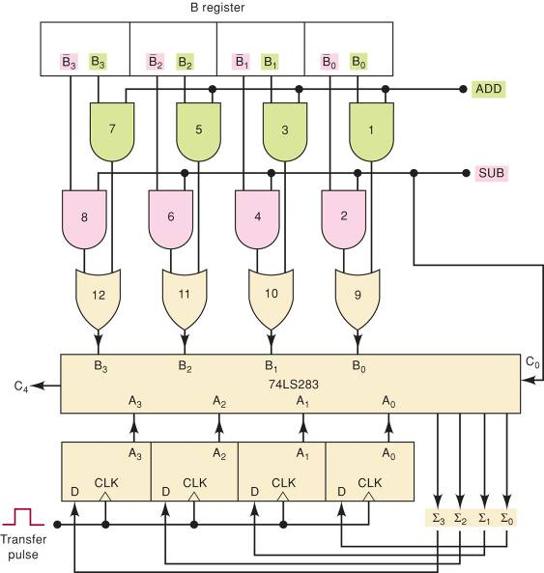
6-15 2’s Complement System
Parallel adder/subtractor
using the 2’s-complement
system.

Slide 36
6-16 ALU Integrated Circuits
ALUs can perform different arithmetic and logic functions as determined by a binary code on the function select inputs.

Slide 37
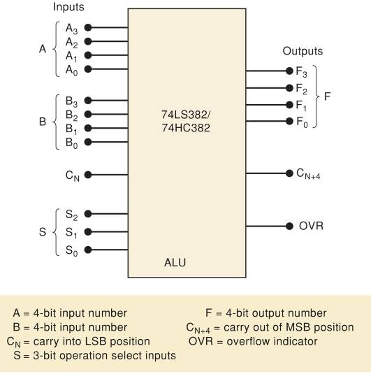
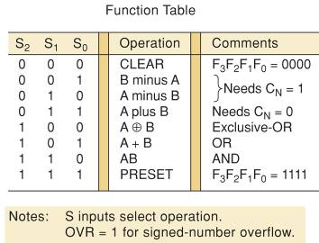
6-16 ALU Integrated Circuits
The 74LS382 (TTL) and
HC382 (CMOS) is a typical device with 8 functions.

Slide 38
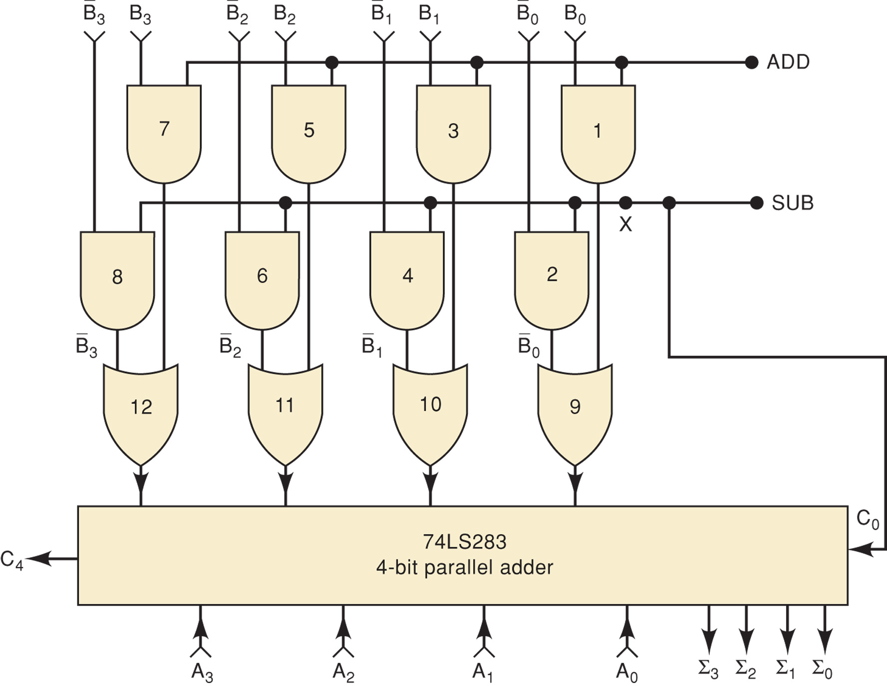
6-17 Troubleshooting Case Study
Determine the most likely fault…
Mode 1:
ADD = 0, SUB = 0.
The sum outputs are always equal to the number in the A register plus one.

Slide 39
6-17 Troubleshooting Case Study
Determine the most likely fault…
Mode 2:
ADD = 1, SUB = 0.
The sum is always 1
more than it should be.

Slide 40
6-17 Troubleshooting Case Study
Determine the most likely fault…
Mode 3:
ADD = 0, SUB = 1.
The Σ outputs are
always equal to [A] - [B].

Slide 41
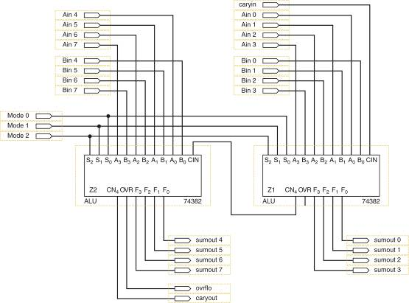
6-18 Using TTL Library Functions with ALTERA
Altera offers pre-defined logic circuits in macrofunctions.
  ALUs may be defined graphically.
Graphic description may seem intuitive, but it is often easier to define a device using text and macrofunctions.

Slide 42
6-19 Logical Operations on Bit Arrays
Two main areas of HDL techniques require understanding:
  Specifying groups of bits in arrays
  Using logical operations to combine arrays using Boolean expressions
HDLs use arrays of bits—a method similar to register notation—to describe signals.
The four-bit signal named d is defined as…
  AHDL:
  VHDL:
  VARIABLE d[3..0] :NODE
  SIGNAL d:BIT_VECTOR (3 DOWNTO 1)

Slide 43
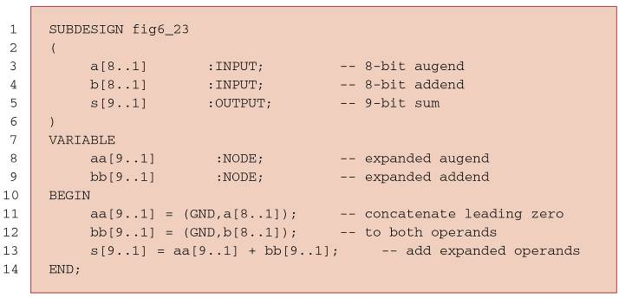
6-20 HDL Adders
8-bit parallel adder circuit using HDL languages.
  Will add 8-bit values A[8..1] and B[8..1] to produce
  the 9-bit sum.
AHDL

Slide 44
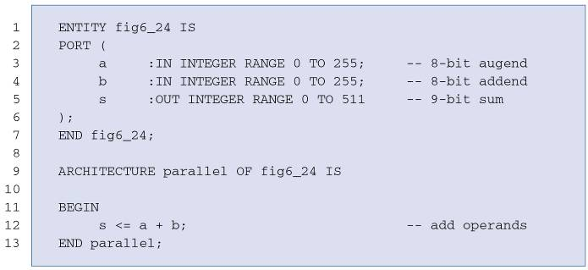
6-20 HDL Adders
8-bit parallel adder circuit using HDL languages.
  Will add 8-bit values A[8..1] and B[8..1] to produce
  the 9-bit sum.
VHDL

Slide 45
6-21 Parameterizing the Bit Capacity of a Circuit
Constants are fixed numbers represented by
a name (symbol).
  Define a symbol (name) at the top of the source code.
    Assign the value for the total number of bits.
  Use this symbol (name) throughout the code.
To modify or expand the circuit, only one line of code needs to be changed.

Slide 46
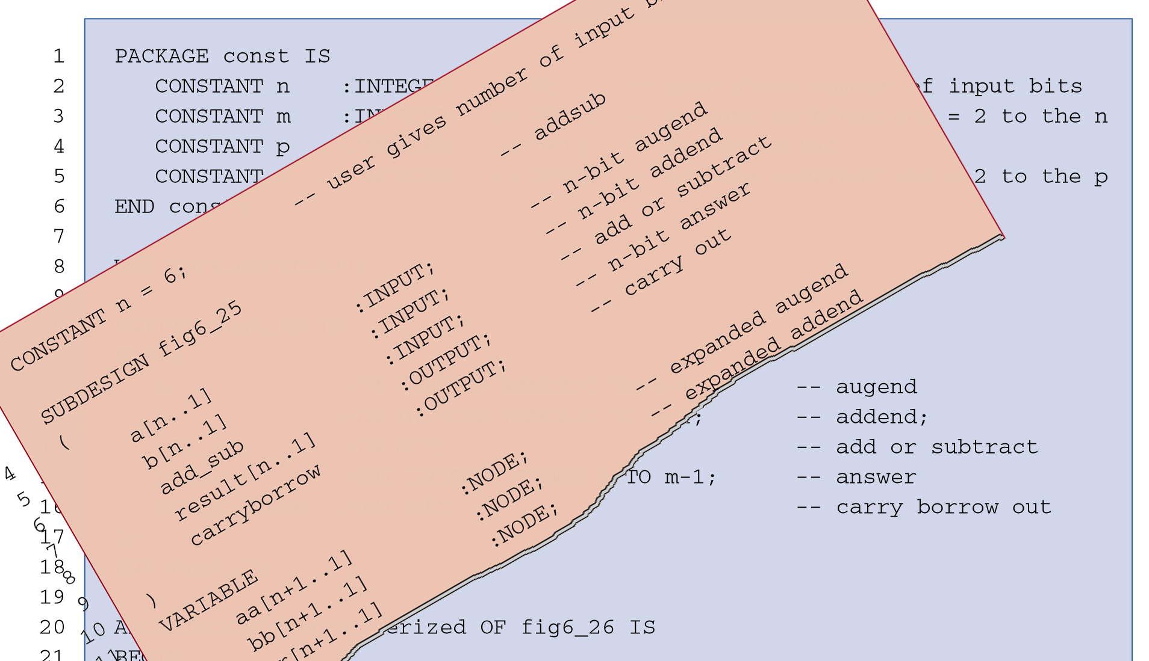
6-21 Parameterizing the Bit Capacity of a Circuit
Add a constant feature to the HDL code for an adder/subtractor circuit.
  A single input bit named add_sub will control the adder/subtractor’s function.
Add the two operands when add_sub = 0.
Subtract b from a
when add_sub = 1.
See complete HDL code on pgs. 360 - 361

Slide 47
6-21 Parameterizing the Bit Capacity of a Circuit
Add a constant feature to the HDL code for an adder/subtractor circuit.
  AHDL—Keyword CONSTANT is followed by the symbolic name and value assigned.
Check for overflow for a signed number operation.
See complete HDL code on pgs. 360 - 361

Slide 48
6-21 Parameterizing the Bit Capacity of a Circuit
Add a constant feature to the HDL code for an adder/subtractor circuit.
  VHDL—Keyword CONSTANT is followed by the symbolic name, type, and the value to be assigned.
The VHDL generate statement can be used to concisely replicate several components that are cascaded together.
See complete HDL code on pgs. 360 - 361

Slide 49
6-21 Parameterizing the Bit Capacity of a Circuit
Altera offers a library of parameterized modules (LPMs) which offer generic solutions for the various logic circuits used in digital systems.

Slide 50
END

