Slide 1



Slide 2
Chapter 8 – Integrated Circuit Logic Families

Slide 3
Chapter 8 Objectives
Selected areas covered in this chapter:
  Digital IC terminology as in manufacturer data sheets.
  Characteristics of various TTL series.
  Characteristics of the various CMOS series.
  Major characteristics & differences among TTL, ECL, MOS, and CMOS logic families.
  Considerations when interfacing digital circuits from different logic families.
  Using voltage comparators to allow a digital system
  to be controlled by analog signals.
  Using a logic pulser and a logic probe as digital
  circuit troubleshooting tools.

Slide 4
Chapter 8
Digital IC technology has advanced rapidly from integrations which can 1 million or more gates.
ICs pack more circuitry in a small package, so overall size of almost any system is reduced.
  Cost is reduced because of the economies of
  mass-producing large volumes of similar devices.
ICs have made digital systems more reliable by reducing the number of external interconnections from one device to another.
  Protected from poor soldering, breaks or shorts
  in connecting paths on a circuit board, and other
  physical problems.

Slide 5
Chapter 8
ICs cannot handle very large currents or voltage.
  Heat generated in such small spaces would cause temperatures to rise beyond acceptable limits.
    For higher power levels, an interfacing circuit will be needed—typically of components or special power ICs.
ICs can’t easily implement certain devices such
as inductors, transformers, and large capacitors.
  Principally used to perform low-power circuit operations—commonly called information processing.

Slide 6
Chapter 8
Various logic families differ in major components
in their circuitry.
  TTL and ECL use bipolar transistors as their major circuit element.
  PMOS, NMOS, and CMOS use unipolar MOSFET transistors.

Slide 7
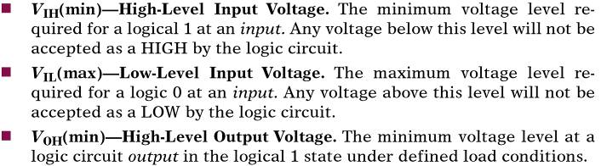
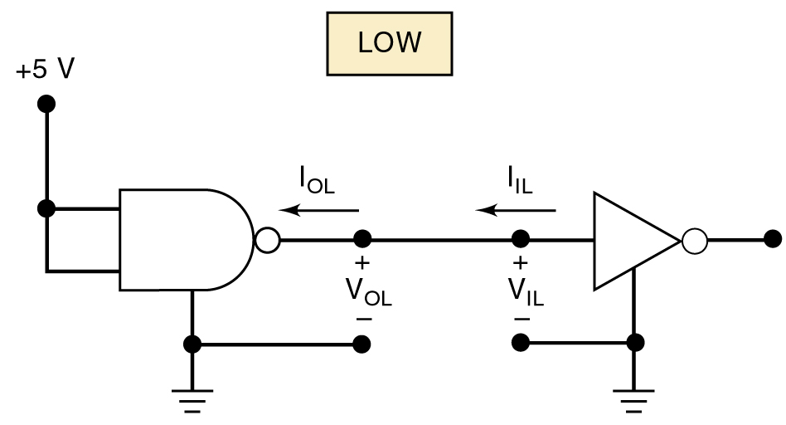
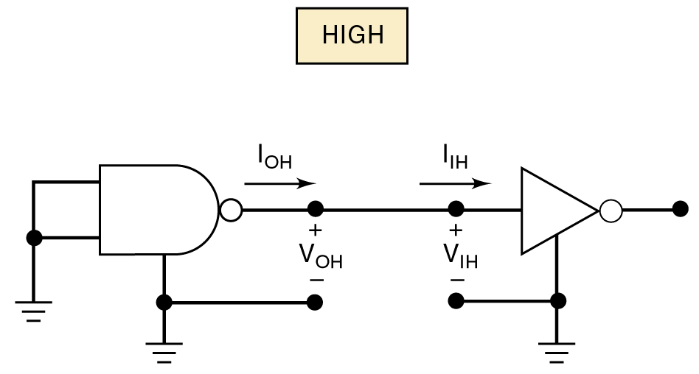
8-1 Digital IC Terminology
IC nomenclature & terminology
is fairly standardized.

Slide 8
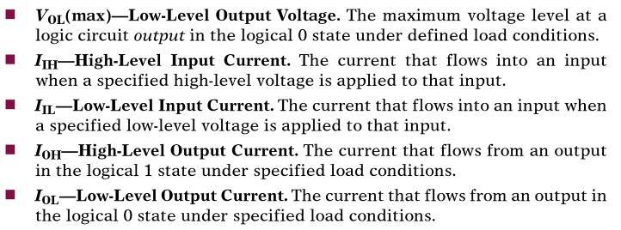
8-1 Digital IC Terminology
IC nomenclature & terminology
is fairly standardized.

Slide 9
8-1 Digital IC Terminology – Fan Out
A logic-circuit output is generally required to drive several logic inputs.
  Sometimes all ICs are from the same logic family.
    But many systems have a mix of various logic families.
  The fan-out—loading factor—is the maximum number of logic inputs an output can drive reliably.

Slide 10
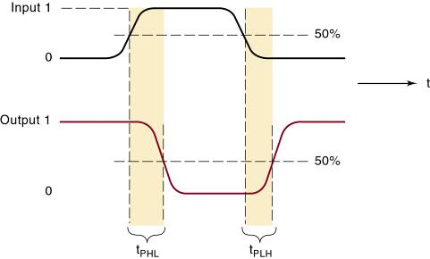
8-1 Digital IC Terminology – Propogation Delay
A logic signal always experiences a delay going through a circuit.
  The two propagation delay times are defined as:
Propagation
delays.

Slide 11
8-1 Digital IC Terminology – Power Requirements
Every IC requires a certain amount of electrical power to operate.
  Supplied by one or more power-supply voltages connected at V_{CC} (TTL) or V_{DD} (MOS devices).
  For many ICs, current drawn from the supply varies depending on logic states of the circuits on the chip.

Slide 12
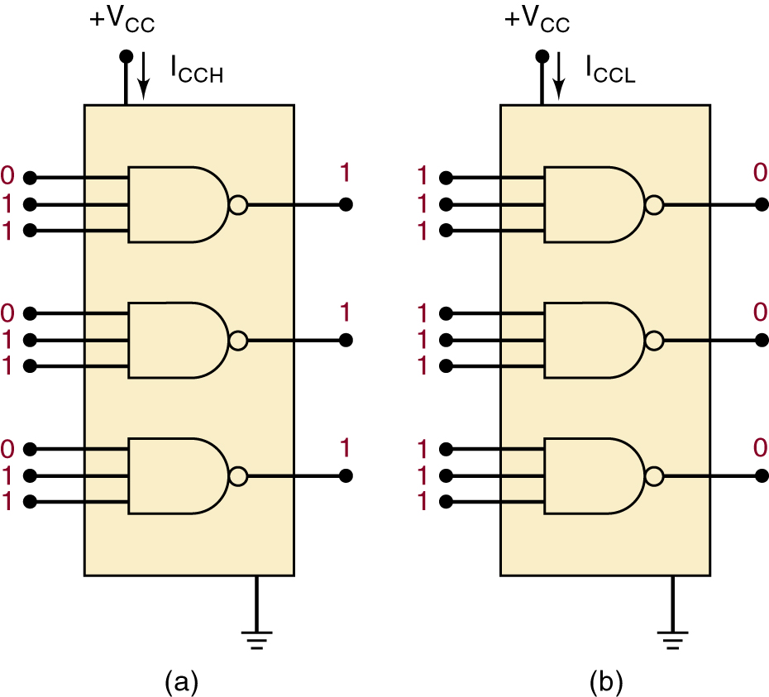
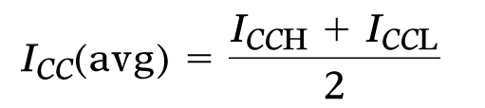
8-1 Digital IC Terminology – Power Requirements
The amount of power an IC requires is determined by the current, I_{CC} (or I_{DD}) it draws from the supply.
  Actual power is the product I_{CC} x V_{CC} (I_{DD} x V_{DD} ).
In some logic circuits, average
current is computed based
on the assumption that gate
outputs are LOW half the
time and HIGH half the time.

Slide 13

8-1 Digital IC Terminology – Power Requirements
The amount of power an IC requires is determined by the current, I_{CC} (or I_{DD}) it draws from the supply.
  Actual power is the product I_{CC} x V_{CC} (I_{DD} x V_{DD} ).
can be rewritten to calculate
average power dissipated:

Slide 14
8-1 Digital IC Terminology – Noise
Stray electric/magnetic fields can induce voltages on the connecting wires between logic circuits
  Called noise, these unwanted, spurious signals can sometimes cause unpredictable operation.

Slide 15


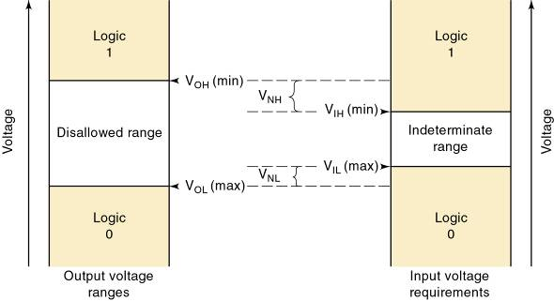
8-1 Digital IC Terminology – Noise
Noise immunity refers to the circuit’s ability to tolerate noise without changes in output voltage.
  A quantitative measure is called noise margin.
High-state noise margin:
Low-state noise margin:

Slide 16
8-1 Digital IC Terminology – Invalid Voltage
For proper operation, logic circuit input voltage levels must be kept out of the indeterminate range.
  Lower than V_{IL}(max) or higher than V_{IH} (min).
    Invalid voltage will produce unpredictable output.
It is important to know valid voltage ranges for the logic family being used so invalid conditions can be recognized when testing or troubleshooting.
Logic families can be described by how current flows between the output of one logic circuit and the input of another.

Slide 17
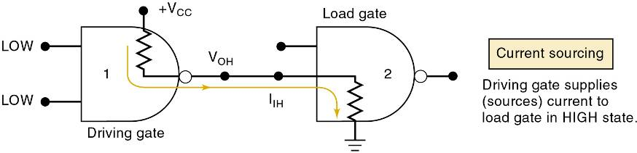
8-1 Digital IC Terminology – Current Sourcing/Sinking
Current-sourcing action.
  When the output of gate 1 is HIGH, it supplies
  current I_{IH} to the input of gate 2.
    Which acts essentially as a resistance to ground.
  The output of gate 1 is acting as a source of
  current for the gate 2 input.

Slide 18
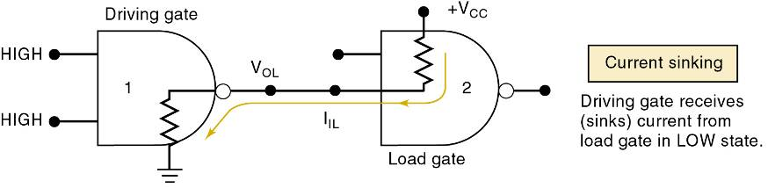
8-1 Digital IC Terminology – Current Sourcing/Sinking
Current-sinking action.
  Input circuitry of gate 2 is represented as a resistance tied to +V_{CC} —the positive terminal of a power supply.
  When gate 1 output goes LOW, current will flow from the input circuit of gate 2 back through the output resistance of gate 1, to ground.
    Circuit output that drives the input of gate 2 must be able to sink a current, I_{IL} , coming from that input.

Slide 19
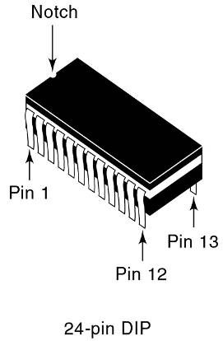
8-1 Digital IC Terminology – IC Packages
There are many IC packages, differing in
physical size, environmental & power consumption conditions, and circuit board mounting
The DIP (dual-in-line package)
has pins (leads) down the
two long sides of the
rectangular package.
The notch on one end,
is used to locate pin 1.
Some DIPs use a small
dot to locate pin 1.

Slide 20
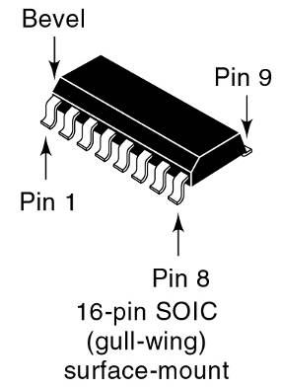
8-1 Digital IC Terminology – IC Packages
Current manufacturing methods use surface-mount technology (SMT), which places an IC
onto conductive pads on the surface of the board.
Held in place by a solder paste,
and the entire board is heated to
create a soldered connection.
Precision machine placement
allows for very tight lead spacing.
Leads are bent out from the plastic case, providing adequate surface
area for the solder joint.

Slide 21
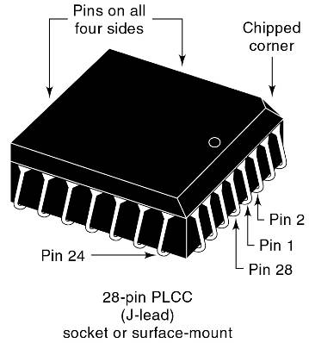
8-1 Digital IC Terminology – IC Packages
Need for more connections to a complex IC has resulted in another very popular package with
pins on all four sides of the chip.
The PLCC has J-shaped
leads that curl under the IC.
These devices can be surface-mounted to a circuit board—but can
also be placed in a special socket.
Commonly used for components
likely to need to be replaced
for repair or upgrade.

Slide 22
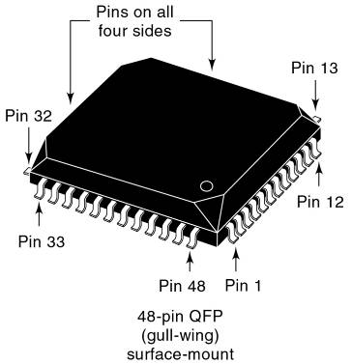
8-1 Digital IC Terminology – IC Packages
Need for more connections to a complex IC has resulted in another very popular package with
pins on all four sides of the chip.
QFP and TQFP packages
have pins on all four sides
in a gull-wing surface-
mount package.

Slide 23
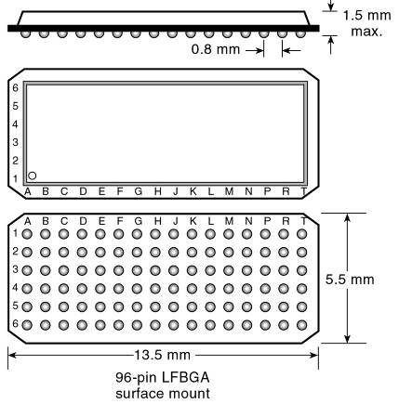
8-1 Digital IC Terminology – IC Packages
The ball grid array (BGA) shown in is a surface-mount package that offers even more density.
The pin grid array (PGA) is a similar package, use when components must be in a
socket to allow easy removal.
The PGA has a long pin instead of a contact ball (BGA) at each position in the grid.

Slide 24
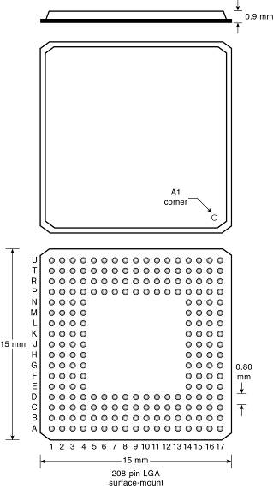
8-1 Digital IC Terminology – IC Packages
The land grid array (LGA)
package is essentially a
BGA package without the
solder balls attached.

Slide 25
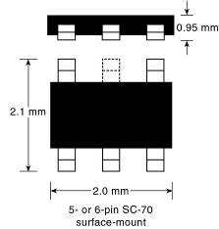
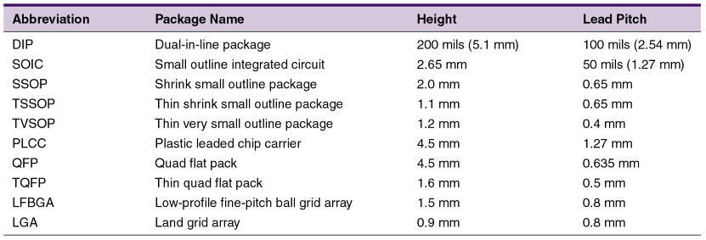
8-1 Digital IC Terminology – IC Packages
Logic gates are available in individual surface-mount packages containing
one, two, or three gates, and as few
as five or six pins (power, ground,
two to three inputs, and an output)

Slide 26
8-2 The TTL Logic Family
Most TTL circuits have a similar structure
  NAND and AND gates use multiple-emitter transistor or multiple diode junction inputs.
  NOR and OR gates use separate input transistors.
The input will be the cathode of a P-N junction
  A HIGH input will turn off the junction.
    Only a leakage current is generated.
  A LOW input turns on the junction.
    Relatively large current is generated.
Most TTL circuits have some type of totem-pole output configuration.

Slide 27
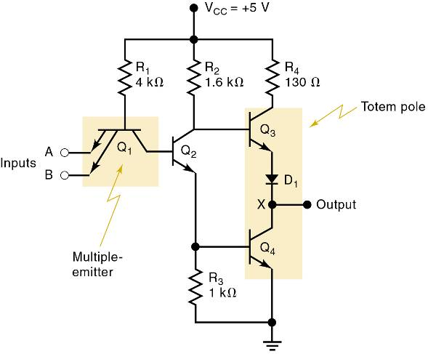
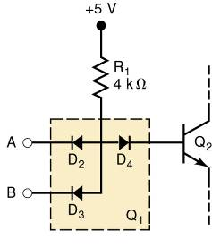
8-2 The TTL Logic Family
The basic TTL logic circuit is the NAND gate.
Diode equivalent for Q₁ .
Basic TTL
NAND gate.

Slide 28
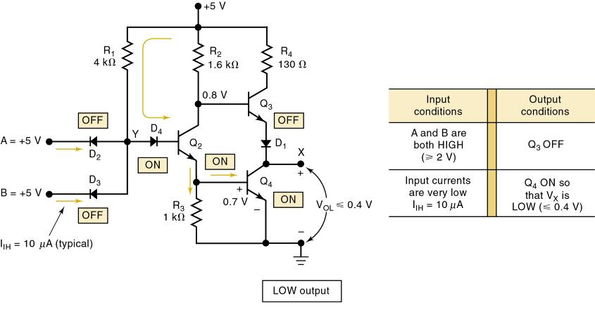
8-2 The TTL Logic Family
TTL NAND gate LOW output

Slide 29
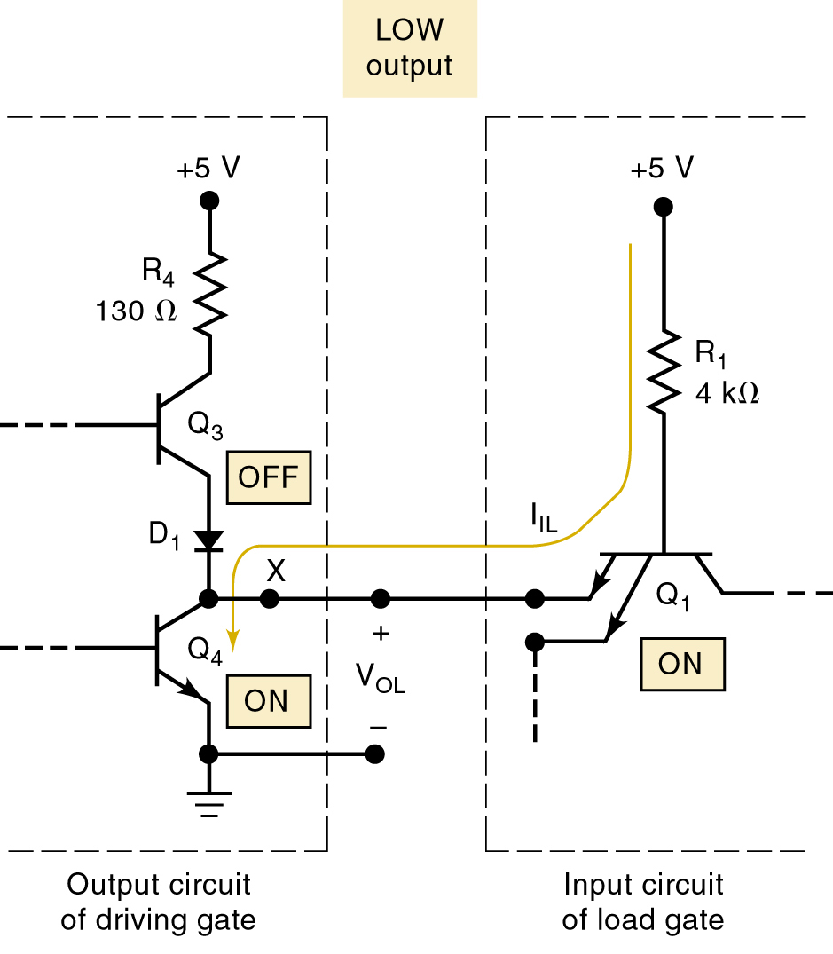
8-2 The TTL Logic Family
A TTL output acts as a current sink in the LOW state because it receives current from the input of the gate that it is driving.
Transistor Q₄ of the driving gate is on and essentially “shorts” point X to ground.
LOW voltage at X forward-biases the emitter–base junction of Q₁ & current
flows back through Q₄.

Slide 30
8-2 The TTL Logic Family
A TTL output acts as a current sink in the LOW state because it receives current from the input of the gate that it is driving.
Q₄ is performing a current-sinking action—deriving its current from the input
current (I_{IL}) of the load gate.
Q₄ is often called the current-sinking transistor or pull-down transistor because
it brings the output voltage down to its LOW state.

Slide 31
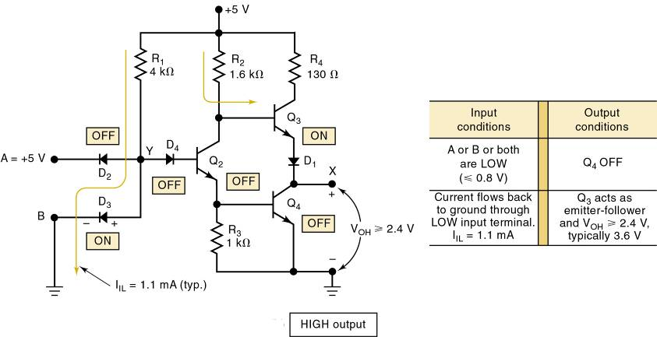
8-2 The TTL Logic Family
TTL NAND gate HIGH output

Slide 32
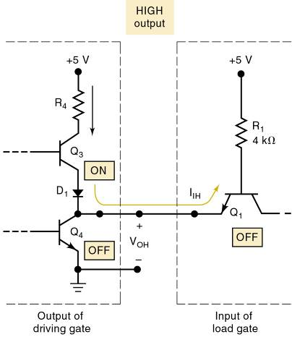
8-2 The TTL Logic Family
A TTL output acts as a current source in the HIGH state—a small reverse-bias leakage current.
Transistor Q₃ is supplying the input current (I_{IH}) required
by Q₁ of the load gate.
Q₃ is often called the current-sourcing or pull-up transistor.
In more modern TTL series,
the pull-up circuit is made
up of two transistors.

Slide 33
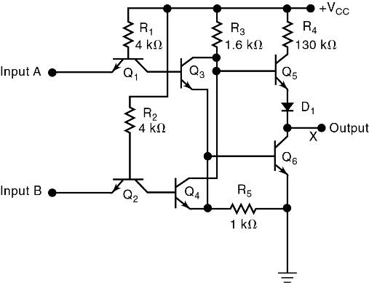
8-2 The TTL Logic Family
Internal circuit for a TTL NOR gate.
The NOR circuit does not use a multiple-emitter transistor.
Each input is applied to
the emitter of a separate transistor.
The NOR circuit uses
the same totem-pole arrangement as the NAND circuit on the output side

Slide 34
8-3 TTL Data Sheets
The first line of TTL ICs was the 54/74 series from Texas Instruments—introduced in 1964.
Manufacturers use the same numbering system.
  Prefix indicates manufacturer.
    SN – Texas Instruments.
    DM – National Semiconductor.
    S – Signetics.
  DM7402, SN7402, S7402 perform the same function.
Data sheets contain electrical characteristics, switching characteristics, and recommended operating conditions.

Slide 35
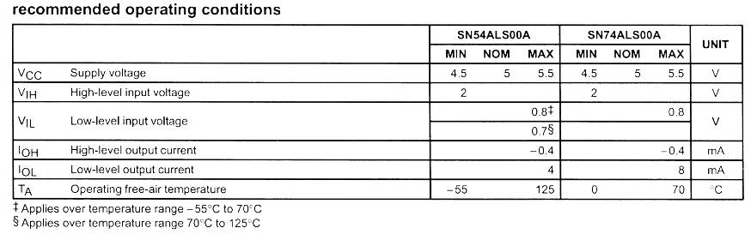
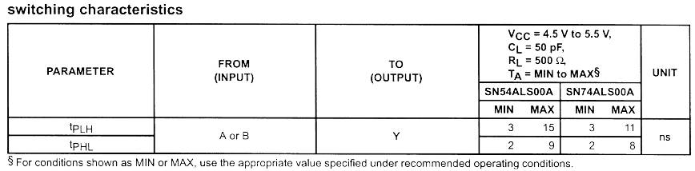
8-3 TTL Data Sheets
Data sheet for the 74ALS00 NAND gate IC

Slide 36
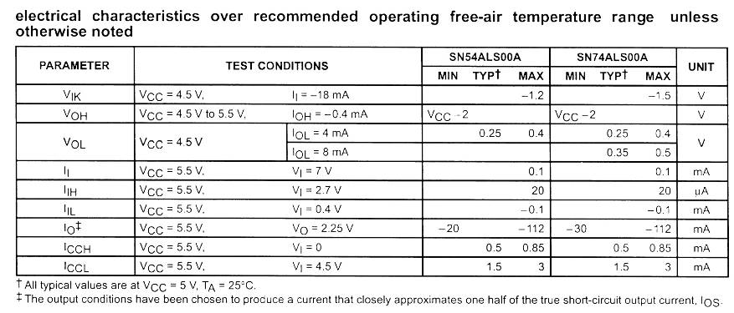
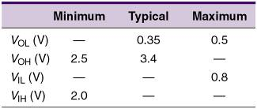
8-3 TTL Data Sheets
Data sheet for the 74ALS00 NAND gate IC
74ALS series
voltage levels.

Slide 37
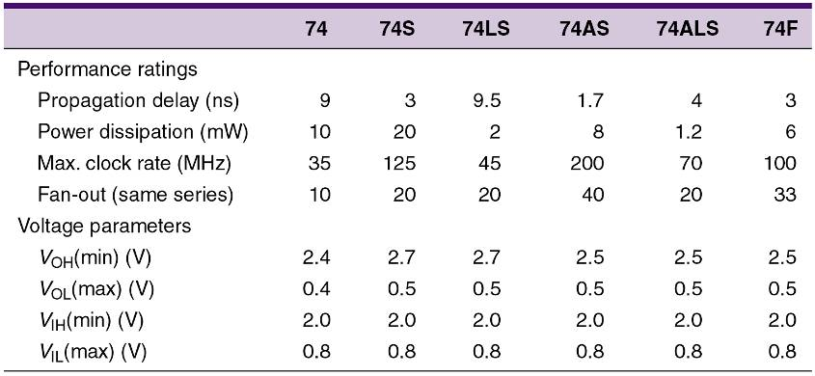
8-4 TTL Series Characteristics
Typical TTL series characteristics.

Slide 38
8-5 TTL Loading and Fan-Out
Fan-out refers to the load drive capability of an
IC output
  A TTL output has a limit on how much current it can sink in the LOW state, or source in the HIGH state.
  Exceeding these currents will result in output voltage levels outside specified ranges.
Determining fan out
  Add the I_{IH} for all inputs connected to an output.
    Sum must be less than the output I_{OH} specification.
  Add the I_{IL} for all inputs connected to an output.
    Sum must be less than the output I_{OL} specification.

Slide 39
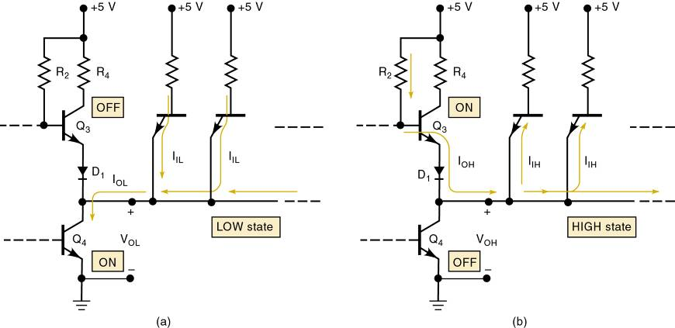
8-5 TTL Loading and Fan Out
Currents when a TTL output is driving several inputs.

Slide 40
8-6 Other TTL Characteristics
Unconnected (floating) inputs.
  On any TTL IC, all of the inputs are 1s if they are
  not connected to some logic signal.
    An input left unconnected, it is said to be floating.

Slide 41
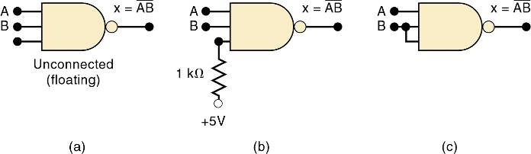
8-6 Other TTL Characteristics – Unused Inputs
Frequently, not all inputs on a TTL IC are being used in a particular application.
  A common example is when not all the inputs to a logic gate are needed for the required logic function.
  Unused input can be connected to +5V through a
  1k-Ohm resistor, so the logic level is a 1.
  A third possibility is where the unused input is tied
  to a used input.
Three ways to handle unused logic inputs.

Slide 42
8-6 Other TTL Characteristics – Tied-Together Inputs
Two (or more) TTL inputs on the same gate connected to form a common input will generally represent a load that is the sum of the load
current rating of each individual input.
The only exception is for NAND and AND gates.
  The LOW-state input load will be the same as a
  single input—no matter how many inputs are tied together.

Slide 43
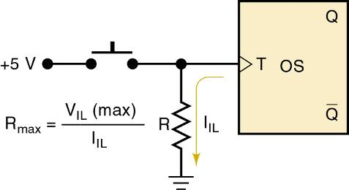
8-6 Other TTL Characteristics – Biasing TTL Inputs LOW
Occasionally a TTL input must be held normally LOW and caused to go HIGH by actuation of a mechanical switch.
  The one-shot triggers on a positive transition that occurs when the switch is momentarily closed.
Resistor R keeps
the T input LOW
while the switch
is open.

Slide 44
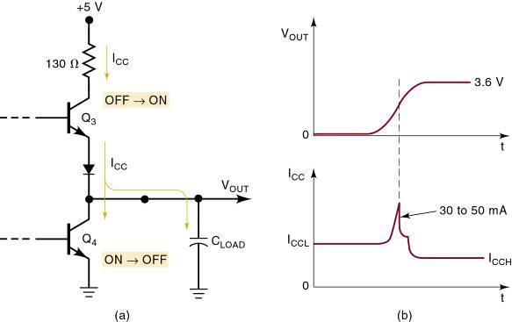
8-6 Other TTL Characteristics – Current Transients
TTL logic circuits suffer from internally generated current transients or spikes due to the totem-pole output structure.
  Ceramic disk capacitors (.01 or
  .1 μF) are used to short these
  high frequency spikes to ground.

Slide 45
8-7 MOS Technology
MOS technology derives its name from the basic structure of a metal electrode, over an oxide insulator, over a semi-conductor substrate.
  Transistors of MOS technology are field-effect
  transistors—called MOSFETs.
The electric field on the metal electrode side of the oxide insulator has an effect on the resistance of the substrate.
Most of the MOS digital ICs are constructed entirely of MOSFETs and no other components.
  MOSFETs are relatively simple and inexpensive
  to fabricate, small, and consume very little power.

Slide 46
8-7 MOS Technology
The principal disadvantage of MOS devices is their susceptibility to static-electricity damage.
  Although minimized by proper handling, TTL is
  still more durable for laboratory experimentation.

Slide 47
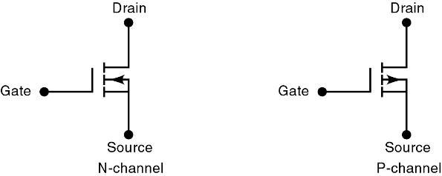
8-7 MOS Technology
There are presently two general types of MOSFETs—depletion and enhancement.
  MOS ICs use enhancement MOSFETs exclusively.
The direction of the arrow indicates either P- or N-channel. The symbols show a broken line between the source and the drain to indicate there
is normally no conducting channel between these electrodes.

Slide 48
8-7 MOS Technology – Basic MOSFET Switch
An N-channel MOSFET is the basic element in a family of devices known as N-MOS.
  Drain is always biased positive relative to the source.

Slide 49
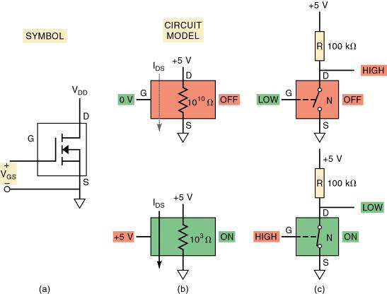
8-7 MOS Technology – Basic MOSFET Switch
Gate-to-source voltage V_{GS} is the input voltage.
  Used to control resistance between drain & source.
    Determines whether the device is on or off.

Slide 50
8-7 MOS Technology – Basic MOSFET Switch
The P-channel MOSFET—P-MOS—operates in the same manner as the N-channel.
  Except that it uses voltages of opposite polarity.
The drain is connected to the lower side of the circuit so it is biased with a more negative
voltage relative to the source.

Slide 51
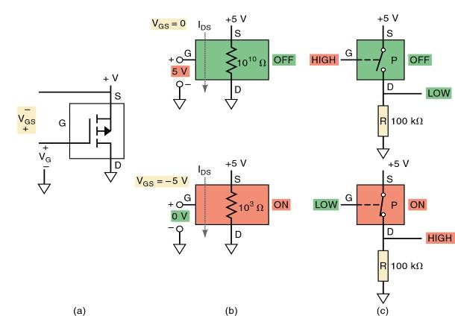
8-7 MOS Technology – Basic MOSFET Switch
To turn the P-MOSFET ON, a voltage lower than the source by V_{T} must be applied to the gate.
  Voltage at the gate, relative to the source, must be negative.

Slide 52
8-8 Complementary MOS Logic – CMOS Inverter
P-MOS & N-MOS circuits began to dominate the LSI and VLSI markets in the 1970s and 1980s.
  Use fewer components & are much simpler to manufacture than TTL circuits.
During this era, technology emerged that used
P-MOS & N-MOS transistors in the same circuit.
  Complementary MOS, or CMOS, technology.

Slide 53
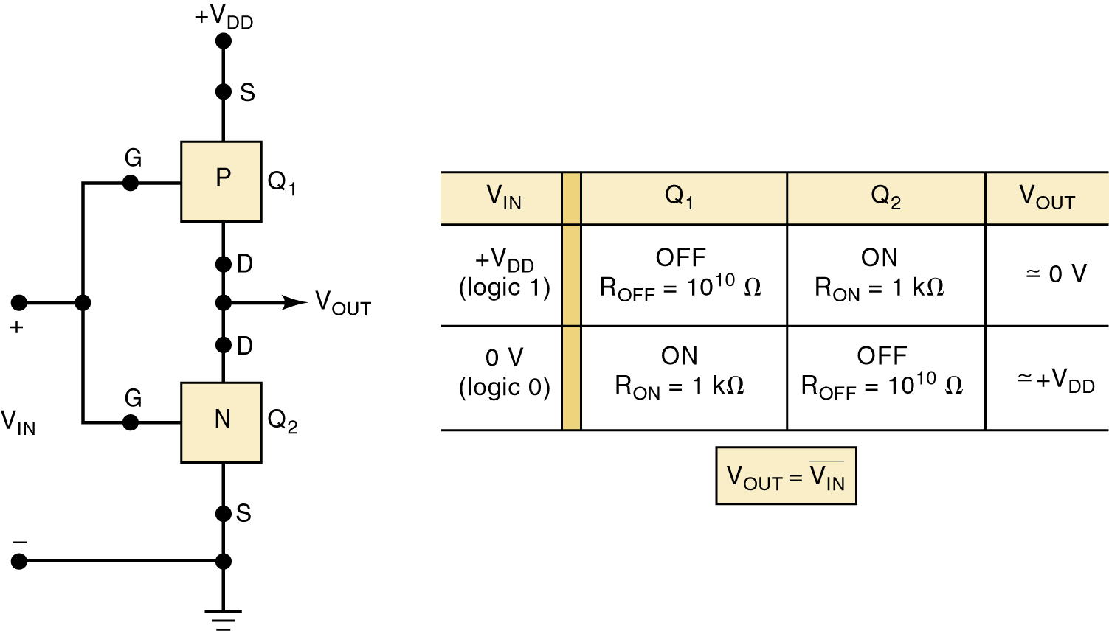
8-8 Complementary MOS Logic – CMOS Inverter
The CMOS INVERTER has two MOSFETs in series.
  The P-channel device source is connected to V_{DD} .
  The N-channel device has its source connected to ground—usually labeled V_{SS}.
Basic CMOS INVERTER.

Slide 54
8-8 Complementary MOS Logic – CMOS Inverter
The CMOS INVERTER has two MOSFETs in series.
  Gates of the two devices are connected together
  as a common input.
  Drains are connected together as common output.
Basic CMOS INVERTER.

Slide 55
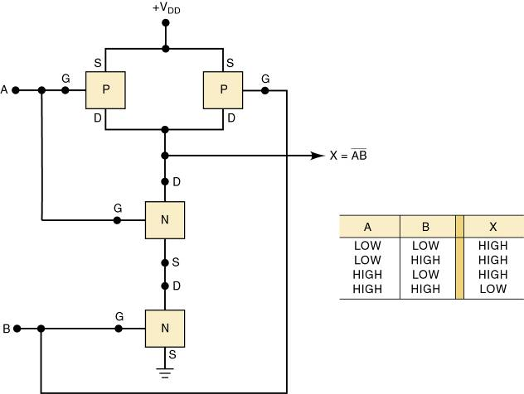
8-8 Complementary MOS Logic
A NAND gate is formed by modifying the basic INVERTER.
Adding parallel P-channel & series N-channel MOSFETs
to the basic INVERTER.

Slide 56
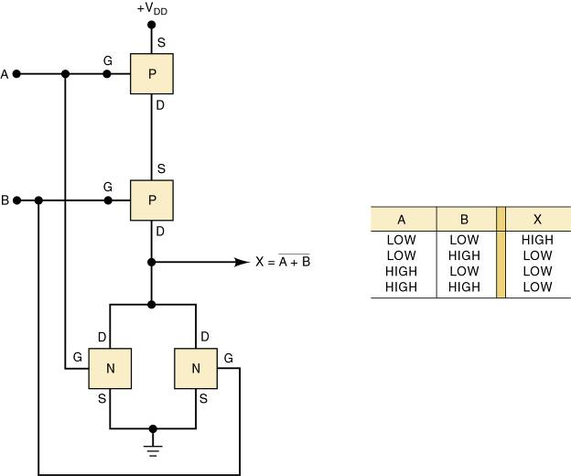
8-8 Complementary MOS Logic
A CMOS NOR gate.
Formed by adding a series
P-MOS and a parallel N-MOS to the basic INVERTER.

Slide 57
8-8 Complementary MOS Logic
Two CMOS NOR gates or NAND gates can be cross-coupled to form a simple SET-RESET latch
  Additional gating circuitry is used to convert the basic SET-RESET latch to clocked D and J-K flip-flops.

Slide 58
8-9 CMOS Series Characteristics - Terms
CMOS ICs provide all TTL logic functions, and special-purpose functions not provided by TTL.
Terms used when ICs from different families or series are to be used together or as replacements.
  Pin-compatible—two ICs are pin-compatible when their pin configurations are the same.
  Functionally equivalent—ICs are functionally equivalent when the logic functions they perform are exactly the same.
  Electrically compatible—ICs are electrically compatible when they can be connected directly to each other without special measures to ensure
  proper operation.

Slide 59
8-9 CMOS Series Characteristics – IC Series
The oldest CMOS series is the 4000 series by RCA—functionally equivalent to Motorola 14000.
  Rarely used in new designs except when a special-purpose IC is not available in other series.
The 74HC/HCT series has a 10-fold increase in switching speed, comparable to 74LS devices.
  Pin-compatible with, functionally equivalent to TTL
  ICs with the same device number.
The 74AC/ACT series is often referred to as ACL for advanced CMOS logic.
  Functionally equivalent various TTL series, but not pin-compatible with TTL.

Slide 60
8-9 CMOS Series Characteristics – IC Series
Series 74AHC/AHCT offers a natural migration path from the HC series to faster, lower-power, low-drive applications.
  Three times faster, with similar noise immunity
  to HC without the over- under-shoot problems.
BiCMOS combines the best of bipolar & CMOS
  Characteristics are integrated to produce an extremely low-power, high-speed logic family.
    Limited to functions used in microprocessor
    and bus interfacing applications.

Slide 61
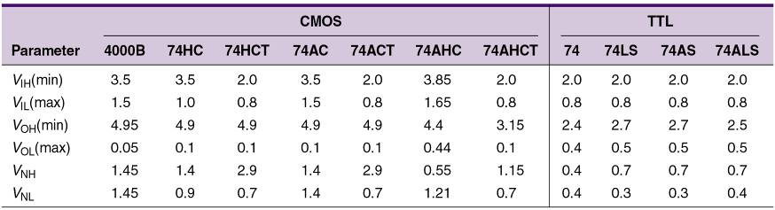
8-9 CMOS Series Characteristics – Power
When devices using different supply voltages are interconnected, special measures must be taken.
  The 4000/14000 series and 74C series devices operate with V_{DD} values ranging from 3 to 15 V.
  74 series ICs operate over a much narrower range
  of supply voltages—typically between 2 and 6 V.
  Lower-voltage series (2.5 or 3.3 V) are available.

Slide 62
8-9 CMOS Series Characteristics – Power
In general, CMOS devices have greater noise margins than TTL.
When a CMOS logic circuit is in a static state—not changing—its power dissipation is extremely low.
  Ideally suited for applications using battery power.
Power dissipation of a CMOS IC will be very low as long as it is in a dc condition.
  P_{D} will increase in proportion to the frequency at which the circuits are switching states.

Slide 63
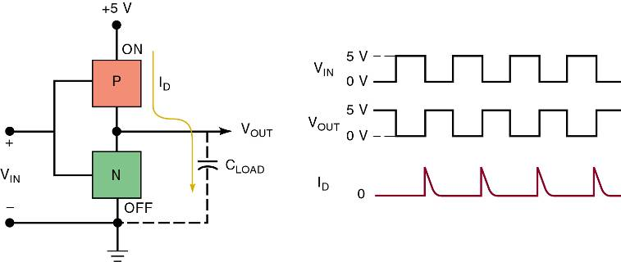
8-9 CMOS Series Characteristics – Power Dissipation
Each time a CMOS output switches from LOW
to HIGH, a transient charging current must be supplied to the load capacitance.
  The combined input capacitances of any loads being driven and the device’s own output capacitance.
Current spikes are drawn from V_{DD} each
time the output switches from LOW to HIGH.

Slide 64
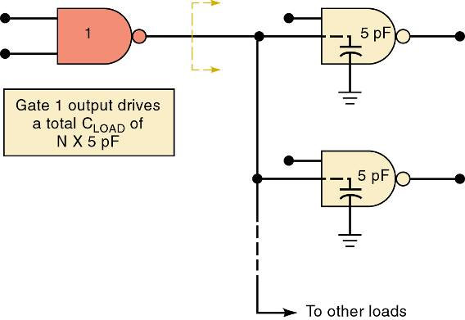
8-9 CMOS Series Characteristics – Fan-Out
CMOS inputs have an extremely large resistance that draws essentially no current from the source.
  10¹² Ohms.
Each CMOS input, typically presents a
5-pF load to ground.
This input capacitance limits the number of
CMOS inputs that
one CMOS output
can drive.

Slide 65
8-9 CMOS Series Characteristics – Switching Speed
Although CMOS must drive relatively large load capacitances, switching speed is somewhat faster.
  Due to low output resistance in each state.
In the CMOS circuit, output resistance in the
HIGH state is the R_{ON} of the P-MOSFET.
  Typically 1-k Ohms or less.

Slide 66
8-9 CMOS Series Characteristics – Static Sensitivity
All electronic devices, to varying degrees, are sensitive to damage by static electricity.
  MOS logic families are especially susceptible.

Slide 67
8-9 CMOS Series Characteristics – Static Sensitivity
Precautions against Electrostatic discharge:
  Connect the chassis of all test instruments, soldering-iron tips, and your metal workbench to earth ground.
  Connect yourself to ground with a special wrist strap.
  Keep ICs in conductive foam or aluminum foil.
    So no dangerous voltages develop between any pins.
  Avoid touching IC pins—insert the IC into the circuit immediately after removing from the protective carrier.
  Place shorting straps across the edge connectors of PC boards when the boards are carried/transported.
    Avoid touching the edge connectors.
  Do not leave any unused IC inputs unconnected.
    Open inputs tend to pick up stray static charges.

Slide 68
8-9 CMOS Series Characteristics – Switching Speed
Unavoidable existence of parasitic (unwanted) PNP and NPN transistors embedded in CMOS substrate can cause a condition called latch-up.
  If triggered, they will latch-up (stay ON permanently), and a large current will destroy the IC.
Most modern CMOS ICs are designed with protection circuitry that helps prevent latch-up
  It can still occur when the device’s maximum voltage ratings are exceeded.
  Latch-up can be triggered by high-voltage spikes
  or ringing at the device inputs and outputs.

Slide 69
8-10 Low Voltage Technology
Increased chip density has major benefits:
  It allows more circuits to be packed onto the chip;
    With the circuits closer together, the time for signals
    to propagate from one circuit to another will decrease.
There are also drawbacks to higher chip density
  When circuits are closer together, insulating material that isolates one circuit from another is narrower.
    Decreases the amount of voltage that the device can withstand before dielectric breakdown occurs.
  Chip power dissipation increases, which can raise chip temperature above maximum for reliable operation.
    These drawbacks can be neutralized by operating the chip at lower volt-age levels,

Slide 70
8-10 Low Voltage Technology – CMOS
Several low-voltage series are currently available:
  74LVC (Low-Voltage CMOS) series contains the widest assortment of the familiar SSI gates and
  MSI functions of the 5-V families.
  74ALVC (Advanced Low-Voltage CMOS) offers the highest performance.
  74LV (Low-Voltage) series offers CMOS technology and many SSI gates/MSI logic functions, along with some popular octal buffers, latches, and flip-flops.
  74AVC (Advanced Very-Low-Voltage CMOS) series
  is optimized for 2.5-V systems.
    It has many of the bus interface features of the BiCMOS series that will make it useful in future generations.

Slide 71
8-10 Low Voltage Technology – CMOS
Several low-voltage series are currently available:
  74AUC (Advanced Ultra-Low-Voltage CMOS) series is optimized to operate at 1.8-V logic levels.
  74AUP (Advanced Ultra-low Power) is the lowest-power logic series—used in battery-operated portable applications.
  74CBT (Cross Bar Technology) series offers high-speed bus-interface circuits that can switch quickly.
    74CBTLV (Cross Bar Technology Low Voltage) is
    the 3.3-V complement to the 74CBT series.
  74GTLP (Gunning Transceiver Logic Plus) series is made for high-speed parallel backplane applications.

Slide 72
8-10 Low Voltage Technology – CMOS
Several low-voltage series are currently available:
  74SSTV (Stub Series Terminated Logic) is useful in high-speed advanced-memory systems.
  TS Switch (TI Signal Switch) series is made for mixed-signal applications and offers some analog/digital switching & multiplexing solutions.
  74TVC (Translation Voltage Clamp) series is used
  to protect the inputs and outputs of sensitive devices from voltage overshoot on the bus lines.

Slide 73
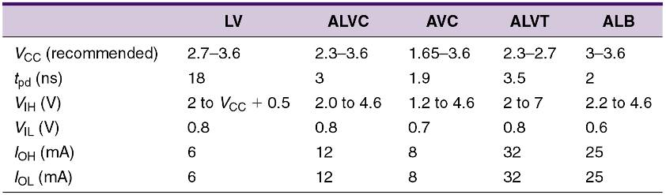
8-10 Low Voltage Technology – BiCMOS
BiCMOS family:
  The 74LVT (Low-Voltage BiCMOS Technology) contains BiCMOS parts intended for 8- and 16-bit
  bus-interface applications.
  Because output levels [V_{OH} (min) and V_{OL} (max)] are equivalent
  to TTL levels, they are fully electrically compatible with TTL.

Slide 74
8-10 Low Voltage Technology
BiCMOS family:
  74ALVT (Advanced Low-Voltage BiCMOS Technology) series is an improvement over the LVT.
    It offers 3.3-V or 2.5-V operation at 3 ns, pin-compatible with ABT and LVT, also intended for bus-interface uses.
  74ALB (Advanced Low-Voltage BiCMOS) series is designed for 3.3-V bus-interface applications.
    25 mA output drive & propagation delays of only 2.2 ns.
  74VME (VERSA Module Eurocard) series is designed to operate with the standard VME bus technology.

Slide 75
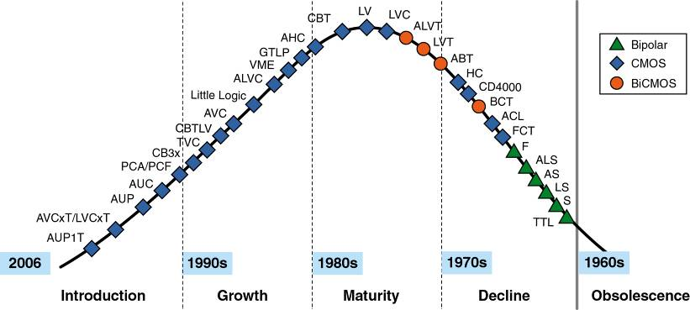
8-10 Low Voltage Technology
Continued development of low-voltage technology promises a complete revolution from the original
5-V system, to pure 3.3-V, 2.5-V, or even lower-voltage digital systems.

Slide 76
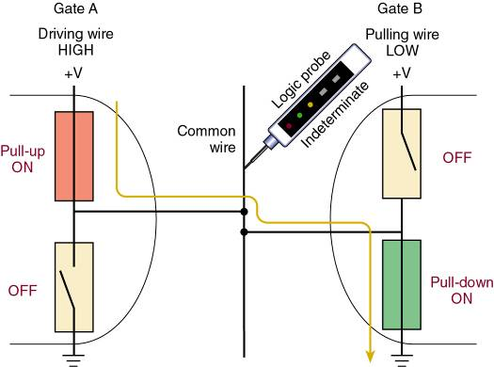
8-11 Open Collector/Open Drain Outputs
Conventional CMOS or TTL totem pole outputs
should never be connected to the same point.
Two outputs contending for control of a wire.

Slide 77
8-11 Open Collector/Open Drain Outputs
One solution to the problem of sharing a common wire among gates is to remove the active pull-up transistor from each gate’s output circuit.
  In this way, none of the gates will ever try to assert
  a logic HIGH.

Slide 78
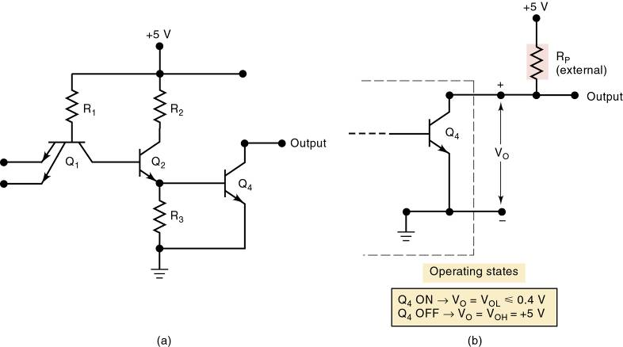
8-11 Open Collector/Open Drain Outputs
TTL outputs modified this way
are called open-collector outputs.
CMOS outputs modified this way
are called open-drain outputs.

Slide 79
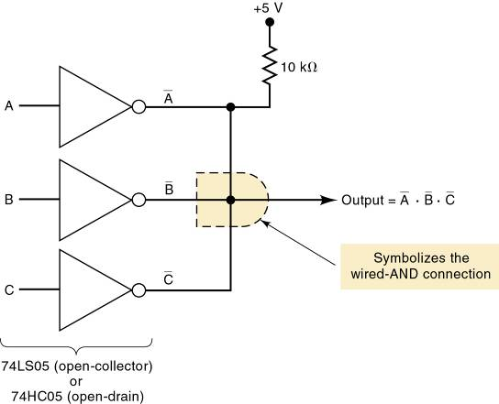
8-11 Open Collector/Open Drain Outputs
Wired-AND operation
using open-collector gates.

Slide 80
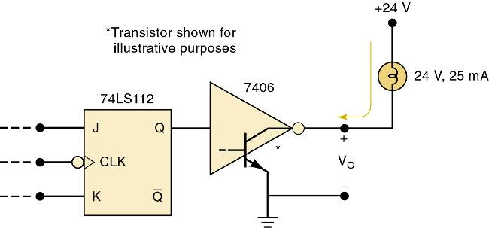
8-11 Open Collector/Open Drain Outputs
A common use of open-collector/drain outputs is as a buffer/driver.
  Logic circuit designed to have a greater output current and/or voltage capability than an ordinary logic circuit.
    They allow a weaker output circuit to drive a heavy load.
An open-collector buffer/driver drives a high-current, high-voltage load.

Slide 81
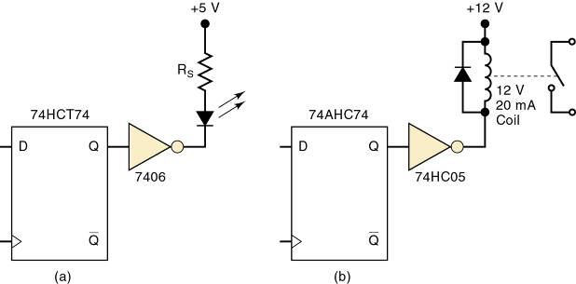
8-11 Open Collector/Open Drain Outputs
Open-collector outputs are
often used to drive indicator LEDs.
An open-collector output can be used to drive
an LED indicator.
An open-drain
CMOS output.

Slide 82

8-11 Open Collector/Open Drain Outputs
IEEE/ANSI symbology uses a distinctive
notation to identify open-collector/drain outputs.
Standard IEEE/ANSI designation
for an open-collector/drain output
is an underlined diamond.

Slide 83
8-12 Tristate (Three-State) Logic Outputs
The tristate configuration takes advantage of the high-speed operation of the pull-up/ pull-down output arrangement.
  While allowing outputs to be connected together
  to share a common wire.
Called tristate because it allows three possible output states:
  HIGH, LOW, and high-impedance (Hi-Z).
Hi-Z is a condition in which both pull-up & pull-down transistors are turned OFF.
  The output terminal is a high impedance to both ground and the power supply.

Slide 84

8-12 Tristate (Three-State) Logic Outputs
Devices with tristate outputs have an enable input.
  Often labeled E for enable or OE for output enable.
When OE = 1, the circuit operates as a normal INVERTER because the HIGH logic level at OE enables the output.
  Output will be either HIGH or LOW, depending
  on the input level.

Slide 85
8-12 Tristate (Three-State) Logic Outputs
Devices with tristate outputs have an enable input.
  Often labeled E for enable or OE for output enable.
When OE = 0, output is disabled. It goes into Hi-Z state with both transistors in nonconducting state.
  In this state, the output terminal is essentially an open circuit (not connected to anything).

Slide 86
8-12 Tristate (Three-State) Logic Outputs
Outputs of tristate ICs can be connected together without sacrificing switching speed.
  When tristate outputs are connected together,
  only one of them should be enabled at one time.
    Two active outputs could fight for control of the
    common wire.
Many ICs are designed with tristate outputs.
  74LS374 is an octal D-type FF register IC with tristate outputs.

Slide 87

8-12 Tristate (Three-State) Logic Outputs
A tristate buffer is a circuit used to control the passage of a logic signal from input to output
  Some tristate buffers invert the signal as passes.
Tristate noninverting buffers.

Slide 88

8-12 Tristate (Three-State) Logic Outputs
IEEE/ANSI symbology to identify tristate outputs.
Standard IEEE/ANSI
designation for tristate
output is a triangle
pointing downward.

Slide 89

8-13 High-Speed Bus Interface Logic
At high frequencies, bus wires of more than about 4” in length act like transmission lines.
  To prevent reflected pulse waves, the end of the bus must be terminated with a resistance equal to the
  line impedance—about 50 Ohms.
50 Ohm resistor.

Slide 90


8-13 High-Speed Bus Interface Logic
Bus termination techniques.
Using a voltage divider with resistances larger than line impedance.
A capacitor blocks dc when the line is not changing—effectively appears as
a resistor to the rising
or falling pulse.

Slide 91


8-13 High-Speed Bus Interface Logic
Bus termination techniques.
Diode termination clips off or clamps the overshoot/undershoot of the ringing caused
by the reactive LC nature of the line.
Series termination at the source, slows down switching speed, reducing bus frequency limits, but substantially improving reliability of the bus signals.

Slide 92
8-13 High-Speed Bus Interface Logic
The GTLP (Gunning Transceiver Logic Plus) series of bus interface devices is specially designed to drive relatively long buses.
Low-voltage differential signaling (LVDS)
uses two wires for each signal.
  Differential signaling means it responds to the difference between the two wires.

Slide 93
8-14 The ECL Digital IC Family
8-14 The ECL Digital IC Family
The emitter-coupled logic (ECL) family operates on the principle of current switching whereby…
  A fixed bias current less than I_{C} (sat) is switched
  from one transistor’s collector to another.
    Also referred to as current-mode logic (CML).

Slide 94

8-14 The ECL Digital IC Family
8-14 The ECL Digital IC Family
Basic ECL circuit – differential amplifier
This circuit produces complementary outputs: V_{OUT1} , equal to V_{IN} ,
and V_{OUT2} , equal to V_{IN}.

Slide 95


8-14 The ECL Digital IC Family
8-14 The ECL Digital IC Family
ECL OR/NOR Gate
The fundamental ECL gate.
The basic ECL circuit can be used as an INVERTER if
the output is taken at V_{OUT1}.

Slide 96
8-14 The ECL Digital IC Family
8-14 The ECL Digital IC Family
ECL characteristics:
  Very fast switching with typical propagation delay of 360 ps—faster than TTL or CMOS.
  The standard ECL logic levels are nominally
  -0.8 V and 1.7 V for logical 1 and 0 respectively.
  Worst-case noise margins approximately 150 mV.
  ECL logic gates usually produce an output and its complement, eliminating the need for inverters.
  Current flow remains constant, eliminating noise spikes

Slide 97
8-15 CMOS Transmission Gate (Bilateral Switch)
A CMOS circuit with no TTL or ECL counterpart is the transmission gate or bilateral switch.
  Essentially acts as a single-pole, single-throw switch controlled by an input logic level.
  Passes signals in both directions—useful for
  digital and analog applications.
  Input must be between 0 and V_{DD} volts.

Slide 98

8-15 CMOS Transmission Gate (Bilateral Switch)
CMOS bilateral switch (transmission gate).

Slide 99

8-15 CMOS Transmission Gate (Bilateral Switch)
Logic diagram for a 4016 quad bilateral switch IC
The IC contains four
bilateral switches.
Each switch is
independently controlled
by its own control input.
Because switches are bidirectional, either switch terminal can serve
as input or output.

Slide 100
8-16 IC Interfacing
Interfacing means connecting output(s) of one circuit/system to input(s) of another circuit/system.
The simplest and most desirable interface circuit between a driver and a load is a direct connection.
  Often a direct connection cannot be made due to
  a difference in electrical characteristics.
An interface circuit is connected between the driver and the load, to condition the driver output signal so it is compatible with requirements of the load.

Slide 101


8-16 IC Interfacing

Slide 102

8-16 IC Interfacing

Slide 103


8-16 IC Interfacing
Logic devices will be voltage-compatible, and no interface will be necessary under the following circumstances:
Nominal values for different families/series of digital devices.

Slide 104

8-16 IC Interfacing
External pull-up resistor
is used when TTL drives CMOS.

Slide 105

8-16 IC Interfacing
Equivalent CMOS output
circuits for both logic states.

Slide 106

8-17 Mixed-Voltage Interfacing
A substantial shift in voltage because driver & load operate on different supply voltages requires a voltage-level translator interface circuit.
The simplest way to accomplish this is with
a buffer that has an
open drain—with
a pull-up resistor.

Slide 107

8-17 Mixed-Voltage Interfacing
A substantial shift in voltage because driver & load operate on different supply voltages requires a voltage-level translator interface circuit.
Another solution is
a dual-supply-level translator circuit using two different supply voltages, one each
for inputs & outputs, translating between
the two levels.

Slide 108

8-17 Mixed-Voltage Interfacing
A substantial shift in voltage because driver & load operate on different supply voltages requires a voltage-level translator interface circuit.
Another common solution is an interface using a
buffer from a series that can withstand higher input.
A low-voltage series with 5-V tolerant inputs
as an interface.

Slide 109
8-18 Analog Voltage Comparators
Another very useful device for interfacing to digital systems is the analog voltage comparator.
  An comparator compares two voltages.
    If (+) input voltage is greater than (-) input voltage, the output is HIGH.
    If (-) input voltage is greater than (+) input voltage, the output is LOW.
Comparator inputs can be thought of as analog.
  Output is digital—always either HIGH or LOW.
The comparator is often referred to as a one-bit analog-to-digital (A/D) converter.

Slide 110

8-18 Analog Voltage Comparators
A temperature-limit detector using an
LM339 analog voltage comparator.

Slide 111

8-19 Troubleshooting
A logic pulser is a testing/troubleshooting tool that generates a short-duration pulse when actuated.
  It senses existing voltage level at the node and
  produces a voltage pulse in the opposite direction.
A logic pulser can inject a pulse at any
node not shorted directly to ground or V_{CC}.

Slide 112
8-20 Characteristics of an FPGA
Consider the electrical and timing characteristics for the Altera Cyclone™ II family of devices.
  A subcategory of PLD devices referred to as field
  programmable gate arrays (FPGAs).
Two different power-supply voltages must be applied to a Cyclone II chip.
  V_{CCINT} provides power for the internal logic of the chip.
    The nominal value is 1.2 V
  A separate supply voltage, V_{CCIO} , will power the
  input and output buffers of the Cyclone chips.

Slide 113

8-20 Characteristics of an FPGA
Cyclone devices support a variety of input/output standards that gives flexibility in system design.
Altera Cyclone II characteristics using general-purpose I/O standards.
In addition, the Cyclone family supports a number of differential I/O standards that can provide…
  Improved noise immunity.
  Lower electromagnetic interference (EMI) generation.
  Reduced power consumption.

Slide 114
8-20 Characteristics of an FPGA
The Cyclone II devices use CMOS, so power consumption will be low—power will be dependent on voltage level, frequencies & I/O signal loads.
The Quartus II software has two tools to estimate the amount the power usage for an application
  The PowerPlay Early Power Estimator is typically used during the early stages of design
  The PowerPlay Power Analyzer is often used with sample test vectors, for more accurate estimate.

Slide 115

8-20 Characteristics of an FPGA
The speed of an application will be dependent upon the application and how it is implemented in the programmable device.
  Cyclone II chips are available in three different speed grades, called –6 (dash six), –7, and –8.

Slide 116
END

