Slide 1
Identity Management
Sprint 1
Jacob Gianakopoulos, Steven Scott, Samuel Vitale, Alex Bowen, Andy Jolagh, Nick Attisha

Slide 2
Motivation
Our motivation for this project is to develop a straightforward and easy to use biometrics-based login tool. With this approach, we intend to accomplish the following goals:
Improve login security
Circumvent the need for a password manager
Provide an alternative to existing systems
Allow other developers to add this technology to their own website

Slide 3
Sprint 1 Plan
Our main goals for this sprint included devising a general project plan/sprint schedule, establishing the scope of the project, and deciding on the languages and libraries we wanted to use for each component. We decided much of this in team meetings, and divided the tasks as follows:
Jacob - Condensing ideas into presentation, database E.R. diagram
Nick - Research and selection of APIs
Alex - UI Design
Steven - Motivation and Vision, Sprint Plan
Samuel - Project Requirements
Andy- Risk Analysis and Challenges

Slide 4
Project Requirements
Web Server hosting a MySQL database for user information storage. This database will be accessed by both the app and the API.
Android app with user registration/login and profile configuration
API that uses OAuth 2.0 to allow user authorization via the following technologies:
Facial recognition
Iris authentication
Fingerprint analysis
Voice recognition

Slide 5
Application Use Scenarios
Any system with sensitive information and high security requirements as a result
Developers looking for login alternatives to circumvent the use of passwords altogether
Organizations looking to increase the perceived legitimacy by using cutting edge technology and adding a slightly higher barrier to entry

Slide 6
Risk Analysis
Unfamiliarity with software environment
Missing deadlines
Group members drop out of class
We are working with sensitive information, and therefore must value security very highly when creating this product
Preventing fraudulent sign-ins (using a picture, audio clip, etc.)

Slide 7
Challenges
Distanced Communication and work
Learning the interaction between languages
Making the login system work for every different authorization technology
Getting everyone on the same schedule and meeting regularly to keep everyone on the same page

Slide 8
Tool Chain
Github (code version control, collaboration)
Java (Android app)
MySQL (Database)
Biometric API for facial recognition, fingerprint authentication, and iris recognition (https://developer.android.com/reference/android/hardware/biometrics/package-summary)
SpeechRecognizer API for speech recognition (https://developer.android.com/reference/android/speech/SpeechRecognizer)

Slide 9
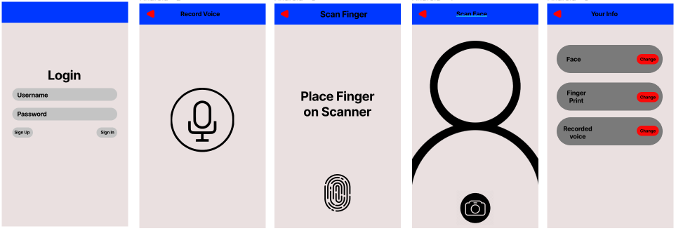
Conceptual UI Design (App)

Slide 10
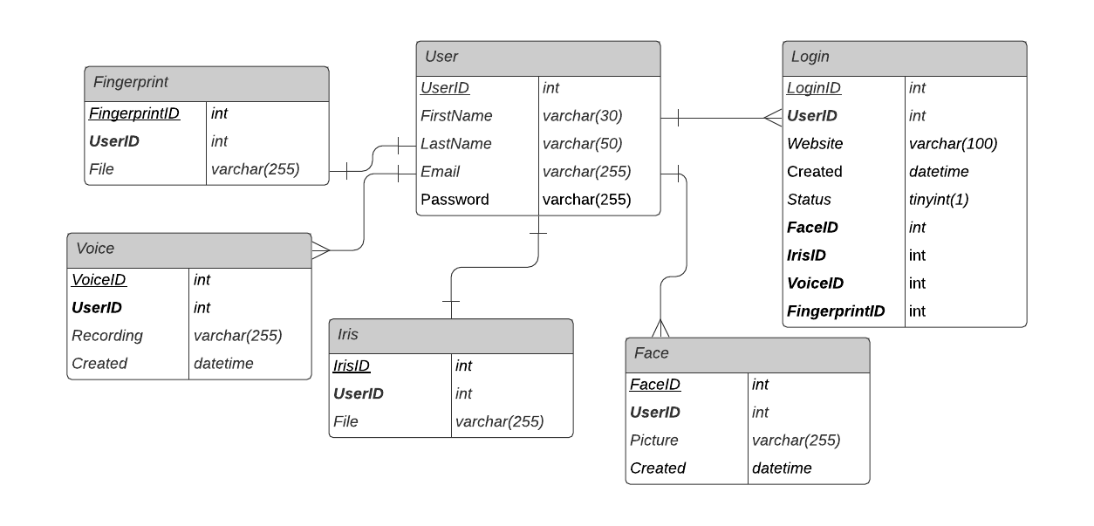
Database Schema

Slide 11
Sprint Schedule
Project Details and Requirements
User Account Creation (Jan 21st - 25th)
Facial Recognition (Jan 26th - Feb 8th)
Iris Recognition (Feb 9th - 15th)
Fingerprints (Feb 16th - March 1st)
Voice Detection (March 2nd - 15th)
Oauth Integration (March 16th - 29th)
Stretch Goals (March 30th - April 5th)
Finishing Touches & Presentation (April 6th - 21st)

Slide 12
Sprint 2 Preview: Creating a Login System
Our approach for this sprint is to form groups of 2 and work together on the necessary tasks. We split the responsibilities as follows:
Database Setup- Steven and Samuel
Front-End design- Alex and Andy
Backend design- Jacob and Nick

