Slide 1
Elicitation and Aggregation of data in knowledge-intensive crowdsourcing
Dohoon(Andy) Kim

Slide 2
Appreciation
I wish to express my gratitude to the committee members
Prof. Chien-Ju Ho
Prof. Sanjoy Baruah
Prof. Roman Garnett

Slide 3
Agenda
Crowdsourcing
Knowledge-Intensive crowdsourcing
Hierarchical Tree structure
Model
Methods
Analysis
Conclusion

Slide 4

Crowdsourcing
Information
Platform
Task
Agent
Payment
Figure source: https://medium.com/@BloombergCities/how-crowdsourcing-drives-citizen-engagement-eb5a7eeaf2b1
Notes:
Crowdsourcing is a participative online activity in which crowdsourcers present the tasks to the workers with some sort of payment and receives the information.
With the significant advance in internet and online services, various crowdsourcing came out such as Amazon Mturk, FigureEight, or Zooniverse.
General crowdsourcing was based on less specific and more public tasks that it does not require workers to have specific expertise or knowledge in certain domain to solve the tasks.
For example, at Amazon Mturk, crowdworkers are taking simple microtasks.
But, various knowledge-intensive crowdsourcing platforms such as Zooniverse started to come out and present the tasks which require some specific knowledge in domain.

Slide 5
Knowledge-Intensive Crowdsourcing
Tasks that require certain degree of expertise
Agents should be in specific knowledge domain related to the task
Real world problem
Hard to crowdsource only highly competitive workers for the specific task
Workers can differ in their levels of expertise and knowledge
Some workers in the same domain might have more experiences at different task related in the same domain
Example: Medical image annotation and domain of doctors
Natural Knowledge Hierarchy
Problem:
How should platform choose the task for the agents given their different levels of expertise and knowledge?
Notes:
As we discussed, knowledge-intensive sourcing requires particular knowledge and expertise from the agents.
And, we need the agents to have specific knowledge or at least some experiences in specific domain related to the task.
If we were able to get only competitive workers for the specific task, it would be more toward the outsourcing of the experts rather than crowdsourcing.
In real world, not all workers are comprised of competitive experts for the specific task because we crowdsource.
We have constraints on our resources that it is not always possible to draw only experts for the specific task.
And, workers we crowdsourced can differ in their levels of expertise and further the information gained from some workers can be less useful if we ask uniform task.
Some workers might be discerning at relatively more general task in the same domain.
Some workers might have more experiences and will be discerning at other task from the same domain.
To illustrate in example, we think about asking the medical image of a single patient to multiple workers to realize ground truth of the image.
Knowledge domain we say as “Medical” domain and agents can be comprised of general doctors who just finished the school, cardiovascular doctors, Neurologists, etc…
In general sense, we can think general doctors may have competence at discerning whether the image is heart or brain or other organs, cardiovascular doctors would be good at discerning whether it is heart disease or not, and neurologists would good at discerning whether it is brain disease or not corresponding to their expertise.
From the example, we can think that medical domain has wide range of possible questions and is hierarchical in that task has corresponding tasks that are more general and more knowledge-specific.
For example, asking whether the image is heart or other organ has the possible answer for heart. And, this task can be followed by more knowledge-specific task as whether the image is heart disease or not.
And, the other possible answers could be followed with more knowledge-specific tasks.
We capture this as a natural knowledge hierarchy in domain and depict as a hierarchical tree model.

Slide 6

Hierarchical Tree Structure
Q₀$,θ$₀
Q₀,𝜃₀
Q₁$,θ$₁
Q₁,𝜃₁
$θ$_{1_1}
𝜃_{1_1}
$θ$_{1_2}
𝜃_{1_2}
Q₂$,θ$₂
Q₂,𝜃₂
$θ$_{2_1}
𝜃_{2_1}
$θ$_{2_2}
𝜃_{2_2}
Hierarchical knowledge structure
Upper node has more general question
Lower node has more knowledge-specific question
Common for platform and agent
Real world model
More complex tree with more possible answers and different levels of expertise
(Question, Answer) pairs
(Q₀ , [$θ$₁, $θ$₂])
(Q₁ , [$θ$_{1_1}, $θ$_{1_2}])
(Q₂ , [$θ$_{2_1}, $θ$_{2_2}])
Notes:
Following the previous example on medical image annotation, in the medical domain, the knowledge structure would be actually a complex tree that captures all the relationships between the possible tasks and is hierarchical as there needs more specific knowledge for bottom tasks.
Here this tree depicts as a snippet of a complex tree model discussed. Then, each child node has corresponding answer, $θ$ for its parent node(Task).
We assume the hierarchical knowledge tree model is general for both the agents and platform.
Parent node involves the less knowledge requiring task, while subsequent nodes follow more knowledge intensive tasks.
We adopt the tree model since it is widely used in many other fields, and it conserves high accuracy for predictive model as we aim to realize the ground truth of the data presented.
Tree model also captures the relationship between the questions, as questions on lower nodes involve more “knowledge intensive” question.
Following the previous examples, root node contains the question for distinguishing whether it is heart or brain, and child nodes will have the question for distinguishing the heart diseases, and brain diseases as well.

Slide 7

Hierarchical Tree Structure
$θ$₀
𝜃₀
$θ$₁
𝜃₁
$θ$_{1_1}
𝜃_{1_1}
$θ$_{1_2}
𝜃_{1_2}
$θ$₂
𝜃₂
$θ$_{2_1}
𝜃_{2_1}
$θ$_{2_2}
𝜃_{2_2}
Constraint
Real world knowledge structure is more complex and hard to capture entire structure
Assumption
Fix the tree to be 2-way 2-layer model
Restricted knowledge domain with only [$θ$₁ , $θ2$ , $θ$_{1_1} , $θ$_{1_2} , $θ$_{2_1} , $θ$_{2_2}]
Proof of Concept
This restricted assumption downsizes the real world problem we have to solve
This setting gives an evidence of feasibility for more complex tree model with high dimensional knowledge domain
Notes:
We have a constraint that real world knowledge structure is more complex and it may be hard to capture the entire structure.
With our assumptions on the knowledge domain that is common to agents and platform, we fix the tree to be 2-way 2-layer model, and we use this as proof of concept for feasibility of our model.
To conserve the feasibility of this tree, we restrict the knowledge domain in the world to be only comprised of the nodes in the tree [$θ$₁ , $θ2$ , $θ$_{1_1} , $θ$_{1_2} , $θ$_{2_1} , $θ$_{2_2}].
So, it is reasonable to say that
We will use this 2-way 2-layer tree to explain the model and further use in simulation for analysis.

Slide 8
Research Objective
Assumption:
For this project, we assume the platform presents tasks related to categorical data
Platform asks task to multiples agents based on single image of single patient
Platform takes the answer as confidence values
Both platform and agent know about the prior distribution of the nodes in the tree
Objective: Based on the tree knowledge structure, how should platform decide on the question to ask to achieve high prediction on the ground truth of the data presented to the workers?
Notes:
Before we talk about the research objective,
For this project, we assume platform aims to realize the ground truth of the categorical data,
which means we want to get high prediction belief on the ground truth by eliciting from workers.

Slide 9

Model
$θ$₀
𝜃₀
$θ$₁
𝜃₁
$θ$_{1_1}
𝜃_{1_1}
$θ$_{1_2}
𝜃_{1_2}
$θ$₂
𝜃₂
$θ$_{2_1}
𝜃_{2_1}
$θ$_{2_2}
𝜃_{2_2}
Root question(e.g. $θ$₀) has k finite number of possible answers, $χ$
|$χ$| = k
Child question(e.g. $θ$₁) has k’ finite number of possible answers, $χ′$
$χ′$ ∈ $χ$
answers in $χ^{′}$ are sub-family of the answer θ ∈ $χ$
The ground truth, θ* is drawn from the prior distribution p(θ) with realized value in $χ$
With hierarchical structure, ground truth θ* exists in the leaf nodes at the bottom
The ground truth, θ* is unknown to both agent and platform
Notes:
In our model, we follow Bayes’ rule to update the posterior beliefs of agent and platform.

Slide 10
Agent Model
$θ$_{0 ,} ε₀
𝜃_{0 ,} ε₀
$θ$_{1 ,} ε₁
𝜃_{1 ,} ε₁
$θ$_{1_1}
𝜃_{1_1}
$θ$_{1_2}
𝜃_{1_2}
$θ$_{2 ,} ε₂
𝜃_{2 ,} ε₂
$θ$_{2_1}
𝜃_{2_1}
$θ$_{2_2}
𝜃_{2_2}
Notes:
Use this to explain together with the previous slide on agent model with epsilons.

Slide 11

Agent Model
To model agent’s ability, we assume that workers encountered the independent noisy samples related to ground truth
Each sample x, with x ∈ $χ$, is i.i.d. drawn from p(x|θ *)
Set the distribution p(x|θ *) to be symmetric noise distribution
p(x|θ) = (1-ε) 𝟙 {θ = x} + ε * 1/k
ε stands as a randomness constant that is used to generate signal ratio of the nodes
Low ε indicates less randomness and high ε indicates high randomness
There exists one-to-one mapping from ε_{i} to task node i
Assume the total number of samples agent encountered is n
Sample = [x₁ , x₂ , … , x_{n}]
Agent belief is determined by counts, C = {c_{θ} : θ ∈ $χ$} , where c_{θ} is the number of sample θ that agent observed
Notes:
Why do we use symmetric distribution and what is epsilon?
Symmetric distribution helps the model to be without loss of generality as we can symmetrically flip the tree when the ground truth changes.
(So, the ground truth is toward the left bottom side for our model)
Epsilon works as a randomness constant that is used to help generating signals based on signal ratio based on epsilon.

Slide 12

Agent Model
Using the Bayes’ rule, we update the posterior belief of worker on θ
p(θ|x₁, … ,x_{n’})
= p(θ_{parent}|x₁, … ,x_{n}) * $\frac{\prod_{j=1}^{n}{p(x_{j}|θ)p(θ)}}{p(x_{1},…x_{n′})}$
= p(θ_{parent}|x₁, … ,x_{n}) *$\frac{α^{c′}β^{nparent−c′}p(θ′)}{\sum_{θ′∈ χ}{α^{c′}β^{nparent−c′}p(θ′)}}$
,where
c’ = number of signals for θ’ ,
θ’ ∈ θ_{parent} ,
n’ = number of signals for parent node ,
[x₁, … ,x_{n’}] ∈ [x₁, … ,x_{n}]
$α=1−$ ε_{i} + ε_{i}/k
$β=$ε_{i} /k
ε_{i} is epsilon value of agent on task i
Notes:
This formula holds valid in that the samples [x₁, … ,x_{n’}] are extracted from the bigger set of samples [x₁, … ,x_{n}] and they are conditional on θ, which is the root node of the subtree.
Thus, it should maintain that
p(θ|x₁, … ,x_{n}) = p(θ’|x₁, … ,x_{n’}) + p(θ’’|x₁, … ,x_{n’}),
where θ’ and θ’’ ∈ θ
How to validate on root node.
p(θ_{parent}|x₁, … ,x_{n}) -> 1
This is 1

Slide 13
Platform Model
$θ$₀
𝜃₀
$θ$₁
𝜃₁
$θ$_{1_1}
𝜃_{1_1}
$θ$_{1_2}
𝜃_{1_2}
$θ$₂
𝜃₂
$θ$_{2_1}
𝜃_{2_1}
$θ$_{2_2}
𝜃_{2_2}
None
None
To update the posterior belief of platform,
Assume platform knows about the prior distribution and epsilon values of agent
For each elicitation step,
platform asks a single question to the agent
Platform takes “real” posterior belief of agent for the answer nodes in current subtree
“None” node takes the belief of agent on rest nodes outside of the current subtree
Confidence is uniformly distributed according to the prior distribution of the nodes
Notes:
For elicitation step, platform asks a single question to the agent, and receives the confidence value on the answer.
Except for the root task, other tasks involve None node to update the other nodes outside of the current subtree.
We use None node here to update the full distribution of the nodes because we are only asking a single question for each elicitation step.
Why do we introduce None node?
To update the posteriors for the other nodes, since we ask single question at a time.

Slide 14

Platform Model
$θ$₀
𝜃₀
$θ$₁
𝜃₁
$θ$_{1_1}
𝜃_{1_1}
$θ$_{1_2}
𝜃_{1_2}
$θ$₂
𝜃₂
$θ$_{2_1}
𝜃_{2_1}
$θ$_{2_2}
𝜃_{2_2}
After elicitation,
Platform has the posterior beliefs of agent on all the nodes
Platform converts those posteriors into signal difference
Diff_θ = $c_{′}−c_{}$ = $\frac{\log\left(\frac{q^{′}}{q}\right)−log (\frac{p^{′}}{p})}{log (\frac{α}{β})}$
where $′$ and $$are child nodes in same subtree
$q^{′}$ and $q$ are posterior beliefs of agent on $′$ and $$
$p^{′}$ and $p$ are prior beliefs on $′$ and $$
$α=1−$ ε_{p} + ε_{p}/k
$β=$ε_{p} /k
ε_{p} is uniform epsilon value for platform
After converting to signal differences,
Platform generates signal counts for the nodes
Platform updates her posterior belief on all the nodes
Platform update is same as agent update
Notes:
Reasoning for One-to-one mapping for posterior and signal difference
Answer: We can convert posteriors into the signal differences by log.
Reasoning for uniform epsilon value for platform
Answer:

Slide 15
Methods
Random Method
Ask random question to the agent and updates the signal counts and posteriors of platform
Greedy Method
Ask question that has smallest epsilon value since agent is most discerning on that task
Heuristics Method
Ask question based on the epsilon values of agent and current posterior belief of platform
Notes:
Talk about 3 methods

Slide 16
Heuristic Method
For heuristic method, platform uses the epsilon values of agent and her current belief to decide on the task to present to the agent
For each elicitation step, platform calculates the expected entropy of the “leaf nodes” at the bottom of the tree assuming platform hypothetically asks each of 3 questions and get hypothetical updates on the signal counts
With the hypothetical platform posterior sets, platform figures the expected entropy of the “leaf nodes” at the bottom layer, and selects the question based on the lowest entropy
Notes:
The reason we use the lowest entropy value to choose the question is since we know the ground truth exists in the leaf nodes and entropy gets lower when the distribution of posteriors gets less uniform.
Thus, with lowest entropy, we can find the set with least uniformly distributed and we need the least uniform distribution of posteriors to achieve maximal posterior belief of platform on ground truth.
Possible question: Why only leaf nodes at the bottom of the tree?
Possible answer: From the model, we know that ground truth exists at the bottom of the tree and all the posterior beliefs on leaf nodes sum to 1, which means we care about maximizing the confidence for ground truth at the leaf nodes. So, we can only check the question that makes entropy to be least, which is most information gain for the leaf nodes.

Slide 17

Simulation
For simulation, we generate
3 worker types:
G-type: Relatively general worker with more discerning for general question G
ε₀ ∈ [0.87, 0.9]
ε₁ ∈ [0.94, 0.96]
ε₂ ∈ [0.94, 0.96]
A-type: Relatively more discerning worker for more knowledge specific question A
ε₀ : [0.91, 0.93]
ε₁ : [0.85, 0.87]
ε₂ : [0.94, 0.96]
B-type: Relatively more discerning worker for more knowledge specific question B
ε₀ : [0.91, 0.93]
ε₁ : [0.94, 0.96]
ε₂ : [0.85, 0.87]
Parameters:
ε^{p} = 0.95
N = 25,
k = 2 (same for all the task nodes),
$θ$* = $θ$_{1_1},
P($θ$) = ﻿[1.0, 0.5, 0.5, 0.25, 0.25, 0.25, 0.25]
$G, θ$_{0 ,} ε₀
𝐺, 𝜃_{0 ,} ε₀
$A, θ$_{1 ,} ε₁
𝐴, 𝜃_{1 ,} ε₁
$θ$_{1_1}
𝜃_{1_1}
$θ$_{1_2}
𝜃_{1_2}
$B, θ$_{2 ,} ε₂
𝐵, 𝜃_{2 ,} ε₂
$θ$_{2_1}
𝜃_{2_1}
$θ$_{2_2}
𝜃_{2_2}
Notes:
For simulation, we generated 3 worker types.
G-type stands as a relatively general worker for the question G, and his discerning ability is higher for question G since lower epsilon value gives a sense that agent’s posterior belief ratio is higher.
A-type stands as a relatively more discerning worker for more knowledge specific question A.
B-type stands as a relatively more discerning worker for more knowledge specific question B.
I tried to maintain the worker to be reasonable in real-world in that any type of worker does not become too discerning on certain task.
The parameters we gave,
Epsilons for platform do not matter when updating her posterior, thus we set random constant 0.95
We set total number of signals for agent to be 25 since we give high randomness to the agents to make them reasonable, and this randomness would not be secured if we give high number of signals at first.
For this proof of concept model, we gave k = 2 uniformly to all the task nodes.
Prior distribution is uniform, so that we don’t give any bias toward the ground truth from the beginning.

Slide 18
Simulation
We test on 4 distributions with worker types
G-distribution: 21G-type workers
A-distribution: 21 A-type workers
B-distribution: 21 B-type workers
Hetero-distribution: 7 G, 7 A, 7 B-type
$G, θ$_{0 ,} ε₀
𝐺, 𝜃_{0 ,} ε₀
$A, θ$_{1 ,} ε₁
𝐴, 𝜃_{1 ,} ε₁
$θ$_{1_1}
𝜃_{1_1}
$θ$_{1_2}
𝜃_{1_2}
$B, θ$_{2 ,} ε₂
𝐵, 𝜃_{2 ,} ε₂
$θ$_{2_1}
𝜃_{2_1}
$θ$_{2_2}
𝜃_{2_2}
Notes:
We set up 4 distributions,
First one is the G-distribution which is homogenous distribution with only G-type workers.
What do we expect for these distributions?
We test these 3 methods on 4 distributions and try to analyze how our methods are working on the specific distributions.

Slide 19
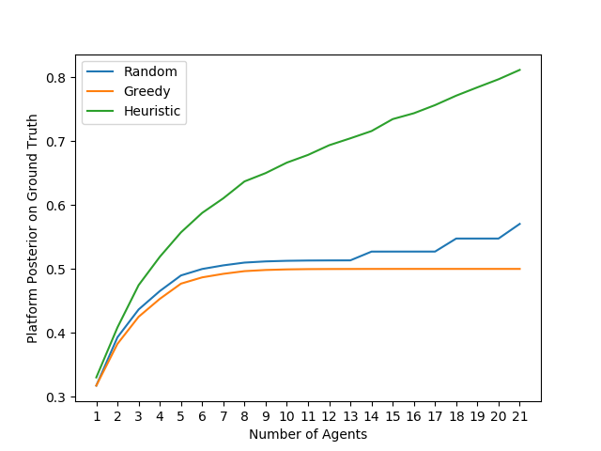
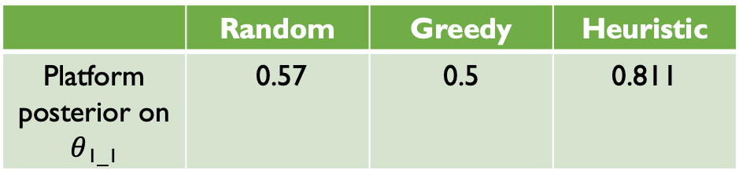
G-Distribution Analysis
 | Random | Greedy | Heuristic
Platform posterior on $θ$_{1_1} | ﻿0.57 | ﻿0.5 | ﻿0.811
Notes:
Greedy approach is poor in performance for this distribution because as we only ask the Q₀, which means the signal counts are uniformly distributed among the leaf nodes, thus it is not possible to have high posterior belief on ground truth. Also as the belief on $θ$₁ gets higher to 1.0 as updated, the belief in ground truth goes to 0.5.
Random approach shows better performance than greedy approach because it has higher chance of asking question that has ground truth as an answer. And, even with small number of cases where agents are asked Q₁, we can gather more information on the ground truth than greedy method.
Heuristic method shows high performance even with this distribution because it always tries to select the question with least entropy, and asking Q₀ will incur high entropy with the randomness of the leaf nodes. And, asking Q₁ updates that the posterior belief on $θ$₁ goes high and, high posterior belief on $θ$₁ and small signal ratio of $θ$_{1_1} and $θ$_{1_2} of the agent affect the heuristic method to ask on Q₁.

Slide 20
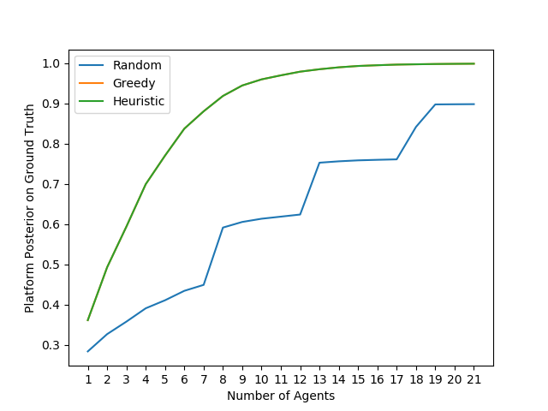

A-Distribution Analysis
 | Random | Greedy | Heuristic
Platform posterior on $θ$_{1_1} | ﻿0.899 | 0.999 | 0.999
Notes:
Random approach has poor performance since asking other questions cannot get more information for the ground truth. But since there are chances that agents are asked with Q1, thus it shows steep but increasing graph.
Both greedy method and heuristic method achieve high prediction and convergence for ground truth as they both ask the right question to the agent and gets more information on the ground truth.

Slide 21
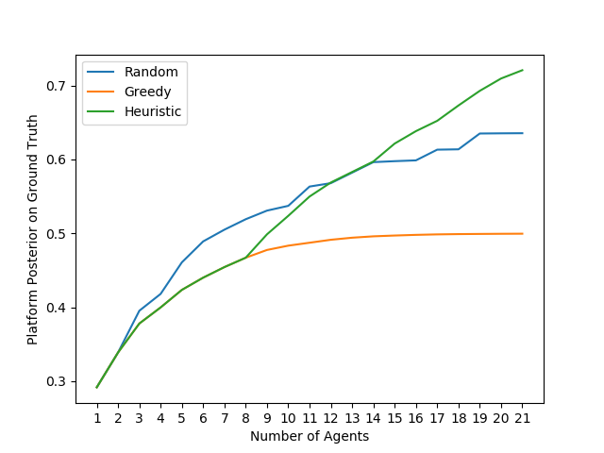
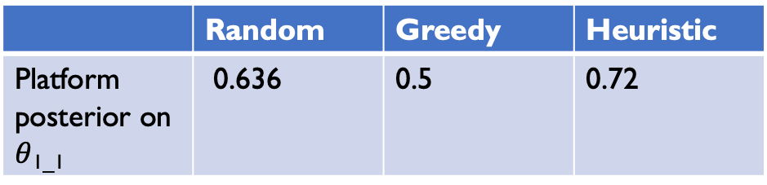
B-Distribution Analysis
 | Random | Greedy | Heuristic
Platform posterior on $θ$_{1_1} | ﻿0.636 | 0.5 | 0.72
Notes:
Greedy approach is converging to 0.5 because as we only ask the Q₂, which means the signal counts are uniformly distributed among the leaf nodes, thus it is not possible to have high posterior belief on ground truth. Also as the belief on $θ$₁ gets higher to 1.0 as updated, the belief in ground truth goes to 0.5.
Heuristic approach performs better than greedy method since as asking Q₂ updates that the posterior belief on $θ$₁ goes higher because of the None node and, high posterior belief on $θ$₁ and small signal ratio of $θ$_{1_1} and $θ$_{1_2} of the agent affect the heuristic method to ask on Q₁.
Heuristic approach surpasses random approach during the update as it figures out where the ground truth would be while updating.
Random approach performs better than other two methods since it has higher chance of gathering information for ground truth as it can ask Q₁ from the beginning and more often.

Slide 22
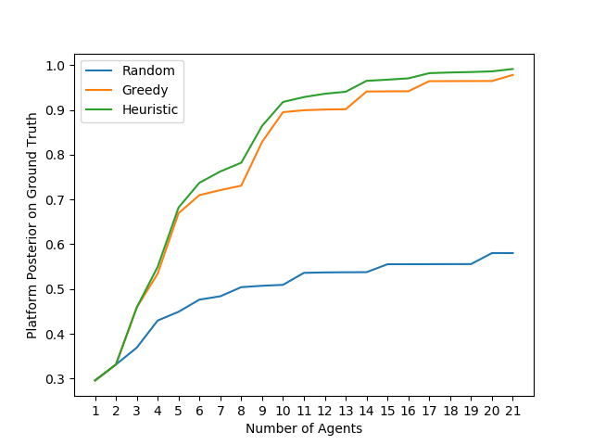
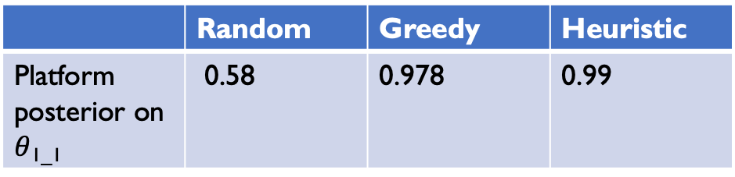
Heterogenous Distribution Analysis
 | Random | Greedy | Heuristic
Platform posterior on $θ$_{1_1} | ﻿0.58 | ﻿0.978 | 0.99
Notes:
Random approach is poor in performance for heterogeneous distribution as is a constraint on getting more information for ground truth since we just randomly ask the question.
Greedy approach is better in performance than random approach because it can tightly earn information from the A-type worker on ground truth, and the information from G-type and B-type workers do not directly update on ground truth but still they give indirect information on where ground truth may exist in.
Heuristic approach shows high performance as the platform uses both currently updated beliefs and worker’s ability simultaneously to decide on the question asked to get more information on the ground truth. Thus, during the process of elicitation, platform avoid asking question outside of ground truth and the graph maintains converging to high confidence for the ground truth.

Slide 23
Conclusion

Slide 24
Acknowledgement
I wish to express my gratitude to my advisor who provided me valuable insights for this research.
Prof. Chien-Ju Ho

