Slide 1
Human Body Systems
On-Level Biology Book: Chapters 34 – 39
Pre-AP Biology Book: Chapters 35 - 40

Slide 2
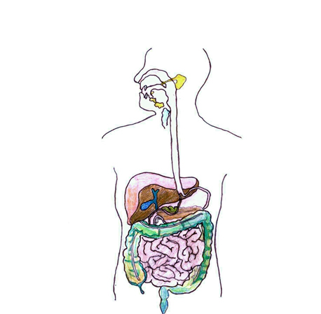
Digestive System
On-Level Biology Book: Pages 917 – 928
Pre-AP Biology Book: Pages 970 - 984

Slide 3
Purpose
The Digestive System converts food into simpler molecules that can be used by cells; absorbs food; eliminates waste
The entire digestive process takes between 24 and 33 hours

Slide 4
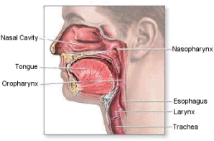
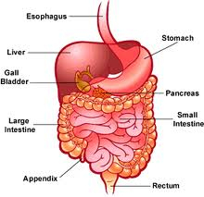
Organs/Components
Mouth
The first stop in the disassembly of your food;
Mechanical digestion = chewing and Chemical digestion = enzymes found in saliva
Pharynx (throat)
Epiglottis
Small flap that closes over the opening of the respiratory system when swallowing, preventing food from entering the airway.
Esophagus
Muscular tube connecting the mouth to the stomach

Slide 5
Organs/Components
Liver
Produces bile, a substance that helps break down fats
Gall Bladder
Stores bile produced by the liver
Stomach
Muscular pouch like organ where involuntary muscular churning and chemical digestion occurs
Pancreas
Secretes enzymes to help break down carbohydrates, proteins and fats
Small Intestine
Narrow muscular tube where digestion of food is completed with the help of enzymes secreted by the liver and pancreas

Slide 6
Organs/Components
Villi (plural: Villus)
Little projections in the lining of the small intestine that function in the absorption of digested food
Large Intestine (colon)
Muscular tube where water and salts are absorbed; material spends 18-24 hours here
Appendix
Tube like extension off of the large intestine
Rectum
The last part of the digestive system, feces are eliminated from the rectum through the anus

Slide 7
How Does this System Relate to others?
Muscular – contains smooth muscle
Nervous – gets signals that control the rate of digestion
Circulatory – broken down food travels through blood vessels to cells
Endocrine – hormones (ex. Insulin) control blood sugar levels

Slide 8
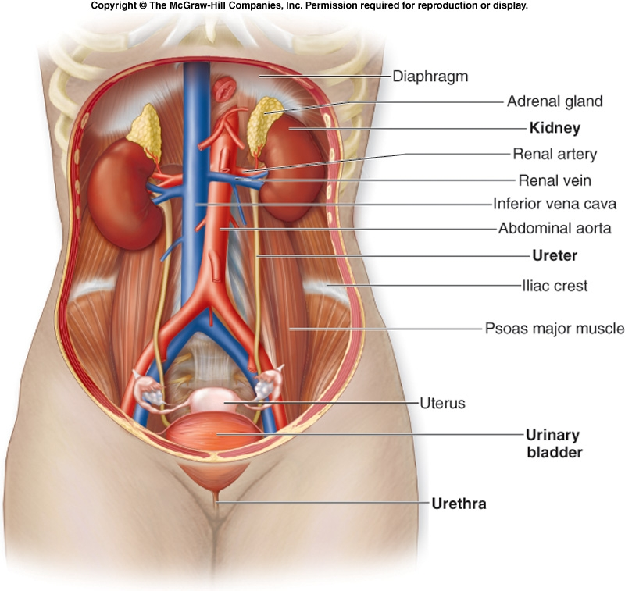
Excretory System
On-Level Biology Book: Pages 985 – 991
Pre-AP Biology Book: Pages 985 - 995

Slide 9
Purpose
The Excretory System eliminates waste products from the body

Slide 10
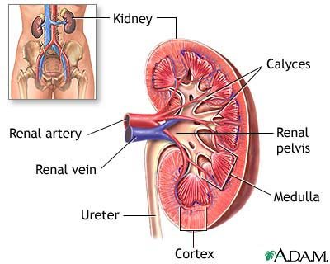
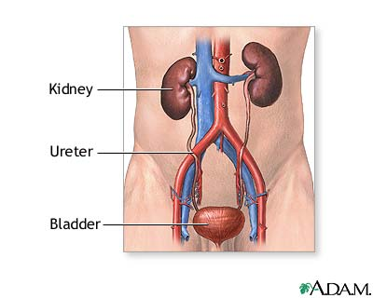
Organs/Components
Kidneys
Help maintain homeostasis by filtering blood to remove waste
Nephron
Tiny filter that makes up the kidney, there are millions
Ureters
Tubes connecting the kidneys to the bladder
Urinary Bladder
Smooth muscle bag that stores a solution of wastes called urine
Urethra
Tube where urine passed out of the body
Skin
Lungs

Slide 11
How Does this System Relate to others?
Circulatory – waste products are carried from the cells to the kidney through blood vessels
Endocrine – hormones are sent that control water levels and homeostasis
Respiratory – expels toxic CO2 out of body

Slide 12
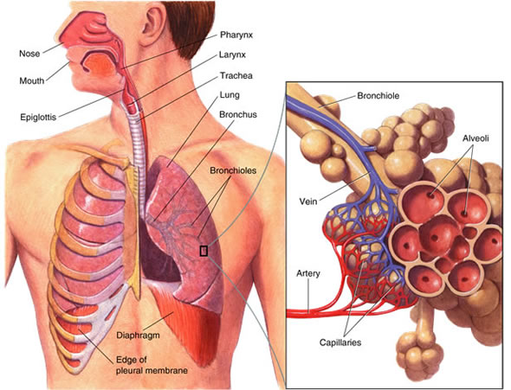
Respiratory System
On-Level Biology Book: Pages 971 – 974
Pre-AP Biology Book: Pages 956 - 969

Slide 13
Purpose
The Respiratory System provides oxygen needed for cellular respiration and removes carbon dioxide from the body

Slide 14
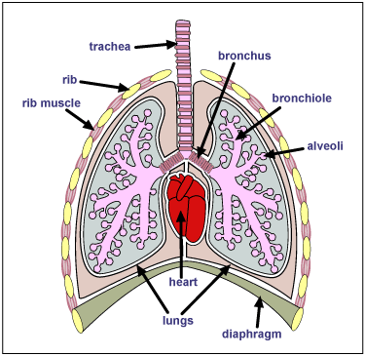
Organs/Components
Nose and Mouth
Respiration begins with taking in air
Pharynx (Throat)
Larynx
Where your vocal cords are
Trachea (Windpipe)
Passes air into the bronchi
Bronchi (singular: Bronchus)
Passes air from trachea to the lungs

Slide 15
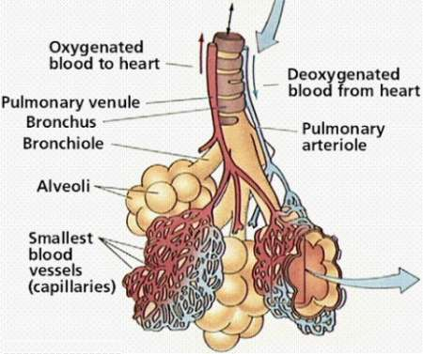
Organs/Components
Bronchioles
Each Bronchus in the lungs branches out like a tree into bronchioles
Alveoli
Sacs at the end of the Bronchioles where oxygen and carbon dioxide are exchanged
Diaphragm
Muscle that enables you to breathe

Slide 16
How Does this System Relate to others?
Circulatory – brings O2 to the cells and CO2 back to the lungs
Excretory – part of the excretory system to get rid of toxic CO2 from the body

Slide 17
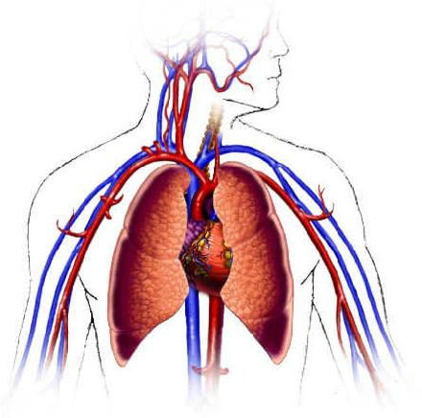
Circulatory System
On-Level Biology Book: Pages 975 – 984
Pre-AP Biology Book: Pages 942 - 955

Slide 18
Purpose
The Circulatory Systems brings oxygen, nutrients and hormones to cells; fights infections; removes cell wastes; regulates body temperature

Slide 19
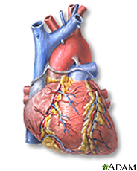
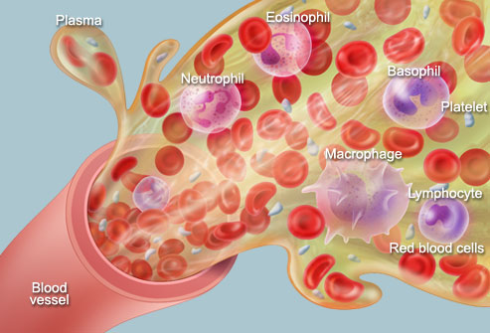
Organs/Components
Heart
The pump that keeps blood flowing through your body
Blood Vessels
Arteries
Carry blood away from the heart
Blood
Red Blood Cells
Carry oxygen to the body cells
White blood cells
Defend body against disease
Platelets
Cell fragments needed for blood clotting
Plasma
Fluid portion of the blood

Slide 20
How Does this System Relate to others?
Connected to almost all other systems since the circulatory system carries oxygen to all cells

Slide 21
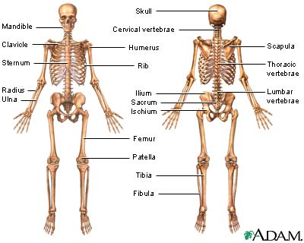
Skeletal System
On-Level Biology Book: Pages 899 -904
Pre-AP Biology Book: Pages 920-925

Slide 22
Purpose
The Skeletal System supports the body; protects internal organs; allows movement; stores mineral reserves; provides blood cell formation

Slide 23
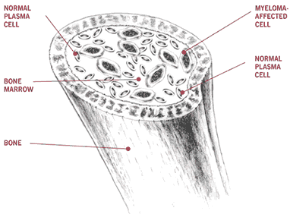
Organs/Components
Bones
Produce blood cells
Red Marrow
Produce red and white blood cells
Yellow Marrow
Consists of stored fat
Joints
Found where two (2) bones meet
Cartilage
Surrounds the end on bone to prevent grinding upon another bone
Ligaments
Tough band of tissue attaching one bone to another
Tendons
Thick bands of tissue connecting muscle to bone

Slide 24
How Does this System Relate to others?
Muscular system – bones and muscles work together for movement
Circulatory system and immune system – all blood cells (red and white) are made in the bone marrow

Slide 25
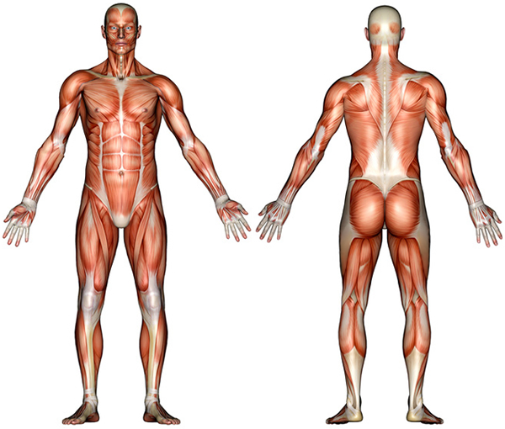
Muscular System
On-Level Biology Book: Pages 905 – 913
Pre-AP Biology Book: Pages 926 - 932

Slide 26
Purpose
The Muscular System produces voluntary movement; circulates blood, moves food through digestive system

Slide 27
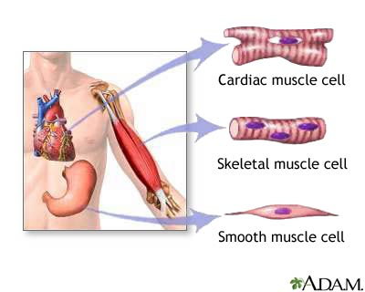
Organs/Components
Cardiac Muscle
Makes up your heart, is adapted to generate and conduct electrical impulses
Skeletal Muscle
(voluntary muscle)
Attaches to and moves
bones
Smooth Muscle
(involuntary muscle)
Found on walls of internal organs and blood vessels

Slide 28
How Does this System Relate to others?
Works closely with the:
skeletal system
Circulatory – brings O2 to muscles and waste products such as lactic acid away
Nervous – how muscles contract

Slide 29
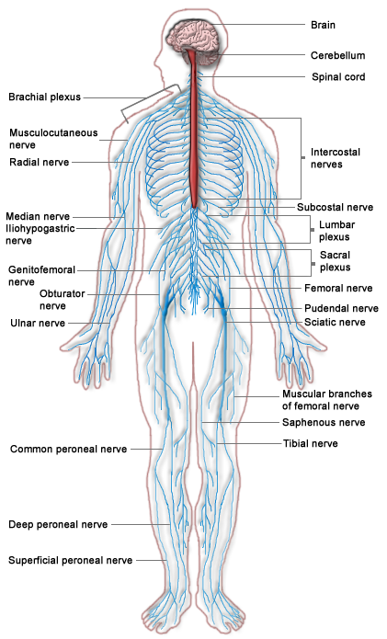
Nervous System
On-Level Biology Book: Pages 943 – 950
Pre-AP Biology Book: Pages 890 - 919

Slide 30
Purpose
The Nervous System recognizes and coordinates the body's response to changes in its internal and external environments

Slide 31
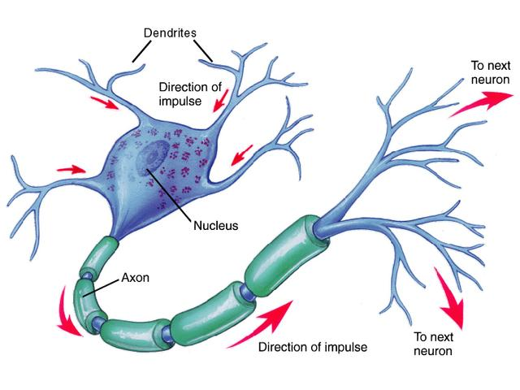
Organs/Components
Neurons (Nerve Cells)
Basic unit of structure and function of the nervous system
Long cell with 3 regions
Cell body
Dendrites
Receive impulses and deliver them to the cell
Axon
Extension of the neuron that carry impulses away from the cell

Slide 32
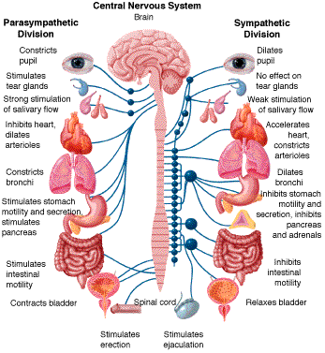
Organs/Components
Brian
Control center
Spinal Cord
Central Nervous System
Made up of the brain and spinal cord and coordinates your body’s activities
Peripheral Nervous System
Made up of the nerves which carry messages to and from the central nervous system

Slide 33
How Does this System Relate to others?
The nervous system works with many other systems, but works closely with the:
Digestive system
Muscular system

Slide 34
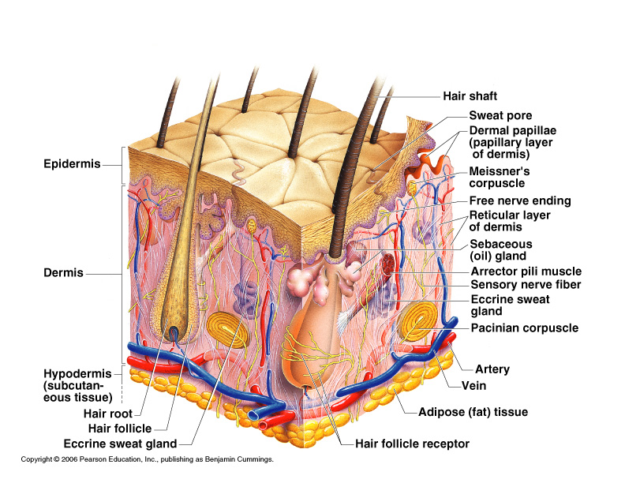
Integumentary System
On-Level Biology Book: Pg 893 – 898
Pre-AP Biology Book: Pages 933 - 941

Slide 35
Purpose
The Integumentary System is the barrier against infections and injury; regulates body temperature; protects against ultraviolet radiation

Slide 36
Organs/Components
Skin
Epidermis: outermost layer of skin
covers the surfaces of the body
Dermis: inner layer of skin
Contains blood vessels, nerve cells, hair follicles, sweat and oil glands
Hair, Skin and Nails
Made up of Keratin
Pigment of skin and hair
Controlled by melanin
Sweat
Produced to help maintain homeostasis
Oil Glands

Slide 37
How Does this System Relate to others?
The integumentary contains blood vessels and nerves

Slide 38
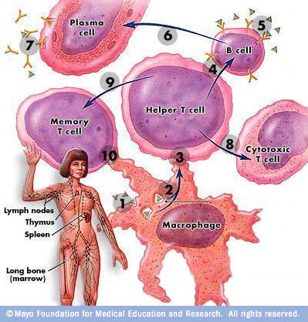
Immune System
On-Level Biology Book: Pages 1022 – 1045
Pre-AP Biology Book: Pages 1030 - 1059

Slide 39
Purpose
The Immune System helps protect the body from disease; collects fluid lost from blood vessels and return it to the circulatory system

Slide 40
Organs/Components
White Blood Cells
Thymus
Spleen
Lymph Vessels
Lymph Nodes

Slide 41
How Does this System Relate to others?
The immune system works closely with the circulatory system

Slide 42
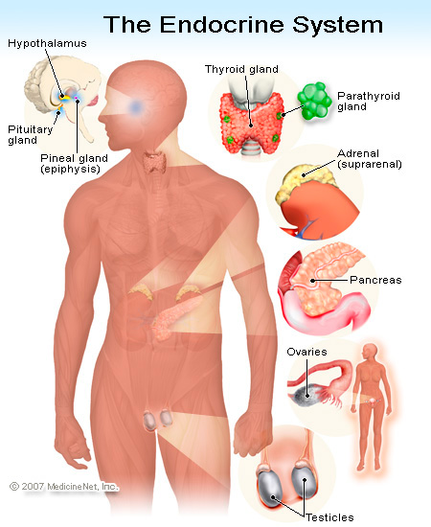
Endocrine System
On-level Biology Book: Pages 929 – 939
Pre-AP Biology Book: Pages 996 - 1008

Slide 43
Purpose
The Endocrine System controls growth, development, and metabolism; maintains homeostasis

Slide 44
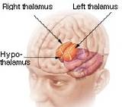
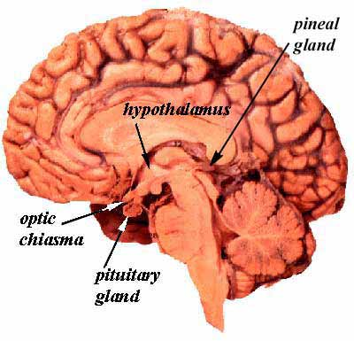
Organs/Components
Hypothalamus
Part of the brain that the main link between the endocrine and nervous systems
Pituitary
The main gland of the endocrine system. It is stimulated by the hypothalamus when changes in homeostasis are detected and produces chemicals and stimulates other glands.

Slide 45
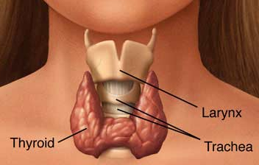
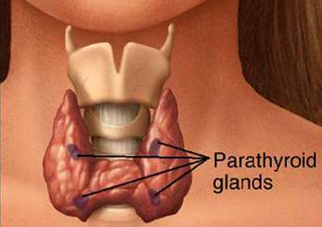
Organs/Components
Thyroid
Produces thyroxin, the main growth and metabolic hormone
Also regulates calcium levels in the blood
Parathyroid
Regulates minerals by producing PTH (parathyroid hormone)

Slide 46
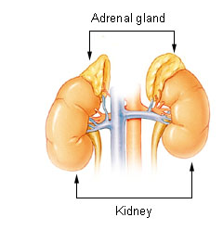
Organs/Components
Adrenal Glands
Prepare the body for stress by releasing hormones
epinephrine (adrenaline) norephinephrine which increases blood pressure and heart rate
called corticosteroids that influence or regulate salt and water balance in the body

Slide 47
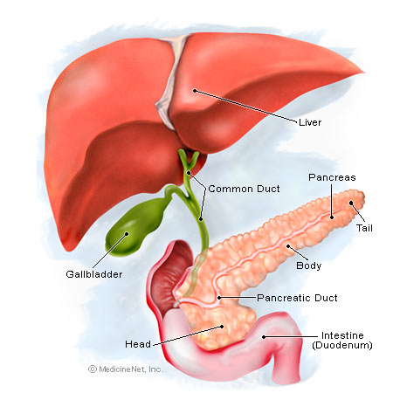
Organs/Components
Pancreas
produces two important hormones
insulin and glucagon: they work together to maintain a steady level of glucose, or sugar, in the blood and to keep the body supplied with fuel to produce and maintain stores of energy
Ovaries
Secretes female sex hormones
Testes
Secretes male sex hormones

Slide 48
How Does this System Relate to others?
The endocrine system works closely with the reproductive system and the digestive system. Several hormones originate in the brain, part of the nervous system.

Slide 49
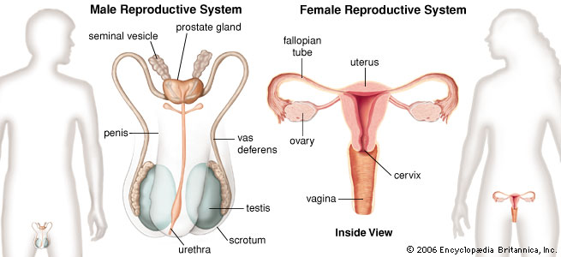
Reproductive System
On-Level Biology Book: Pages 995 – 1019
Pre-AP Biology Book: Pages 1009 - 1029

Slide 50
Purpose
The Reproductive System produces reproductive cells; in females nurtures and protects developing embryo

Slide 51
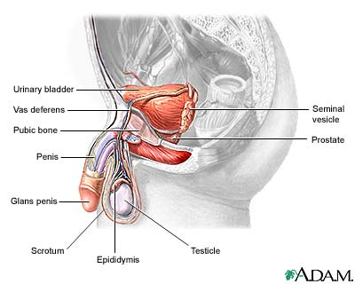
Organs/Components
Males
Penis
Testes
Site of sperm production
Epididymis
Where sperm mature
Vas Deferens
Duct where mature sperm are stored before being transported to the urethra
Urethra
Transports sperm out of the male body

Slide 52
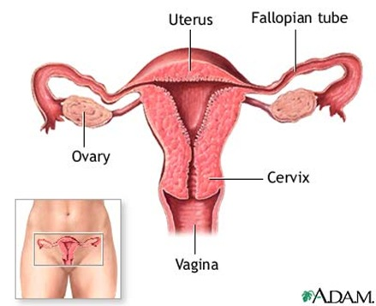
Organs/Components
Females
Ovaries
Where eggs mature
Fallopian Tubes
Tube connecting ovaries to the uterus
Uterus
Where a fetus develops during pregnancy
Vagina
Canal leading to the uterus

Slide 53
How Does this System Relate to others?
The reproductive system works most closely with the endocrine system (hormones)

