Slide 1
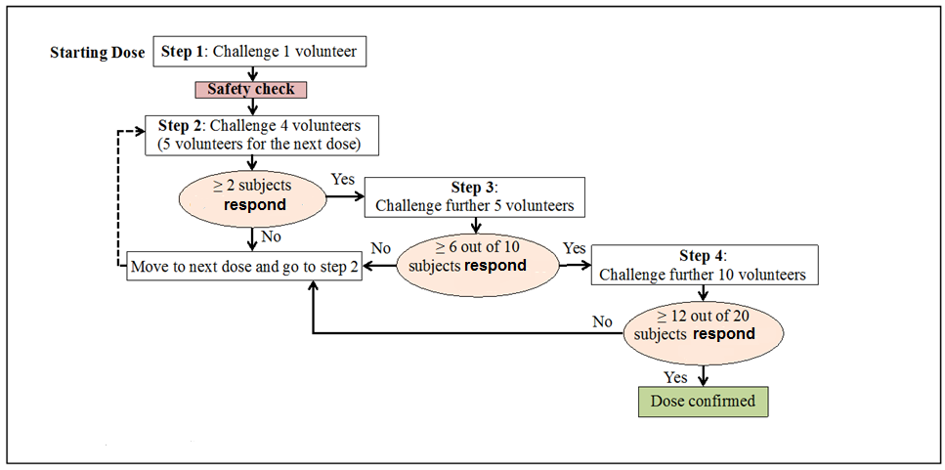
3. Sample size planning in phase I studies using Bayesian statistics
H₀ : success rate < 0.6
Actually we want to know this:
H₁ : success rate >= 0.6
P(success rate >=0.6|dose escalation successful)

Slide 2

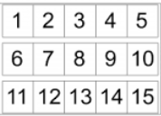

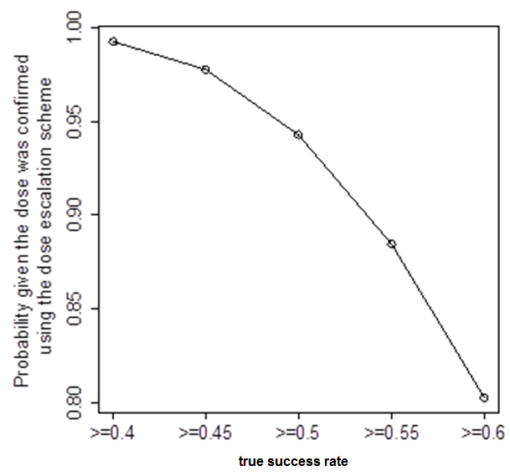
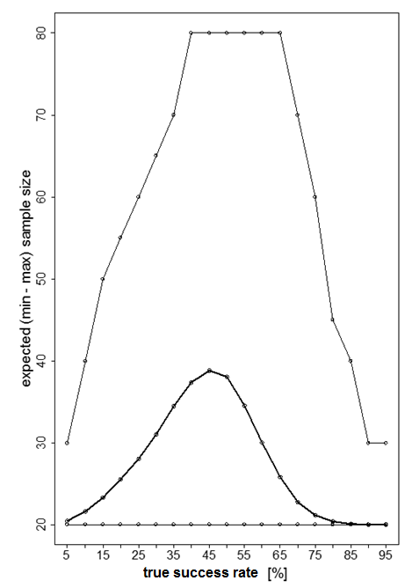
drag & drop
graphical construction
stage
1,…j..,k
n₁
r₁
n₂
r₂
n_{k}
r_{k}
1.
n_{j}
…
2.
number
of n_{j}
STOP
3.
rule r_{j} to
proceed
output
if e_{j}/n_{j} < c_{j}
if e_{j}/n_{j} ≥ c_{j}

