Slide 1
A machine learning approach to House
Price Indexes with the `hpiR` package
Andy Krause – Zillow Group Home Valuations
American Real Estate Society 2019 Meeting

Slide 2
Outline
0. Lit Review
1. ‘hpiR’ package and data
2. A Random Forest House Price Index
3. Performance Comparison
4. Discussion

Slide 3
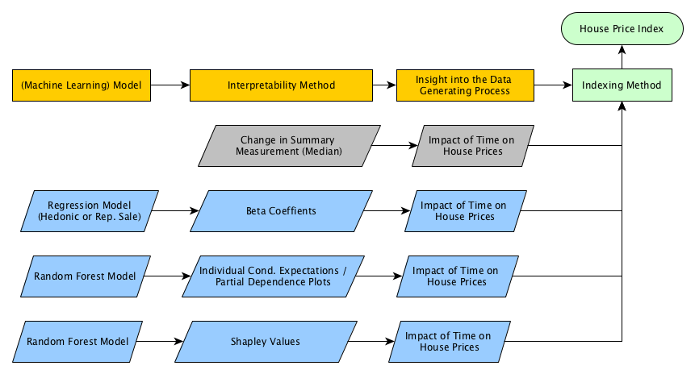
Conceptual Model

Slide 4
HPIR package
R package for house price indexes :https://cran.r-project.org/web/packages/hpiR/index.html
Methods for generating coefficients and converting to index
Hedonic
Repeat Sales
Random Forests (Github/development version only)
Methods for index validation and comparison
Accuracy
Revision
Volatility
Generic Functionality
Smoothing
Imputation
Series Creation
Data Set
Seattle home sales from 2010 through 2016 (43k, 5k repeat)
Rich hedonic characteristics

Slide 5
A Random Forest House Price Index
House price indexes generation require an estimate of the impact of time on prices
Exception: Median-generated methods
Random Forests do not produce readily interpretable coefficients
But we can simulate these with a Model Agnostic Interpretability Methods (Molner 2019)
1. Individual Conditional Expectations / Partial Dependence Plots
What would property Z have sold for in each period?
Build RF Model X
(ICE) Value property Z with Model X at period t, t+1, t+2, t+k
Convert this price trend to an index
(PDP) Apply the above to all instances and average
2. Shapley Values
Game theory approach
‘Coefficients’ show how to fairly pay each player (feature/variable in the model)
Average over all games (instances/observations)
Convert to an index

Slide 6
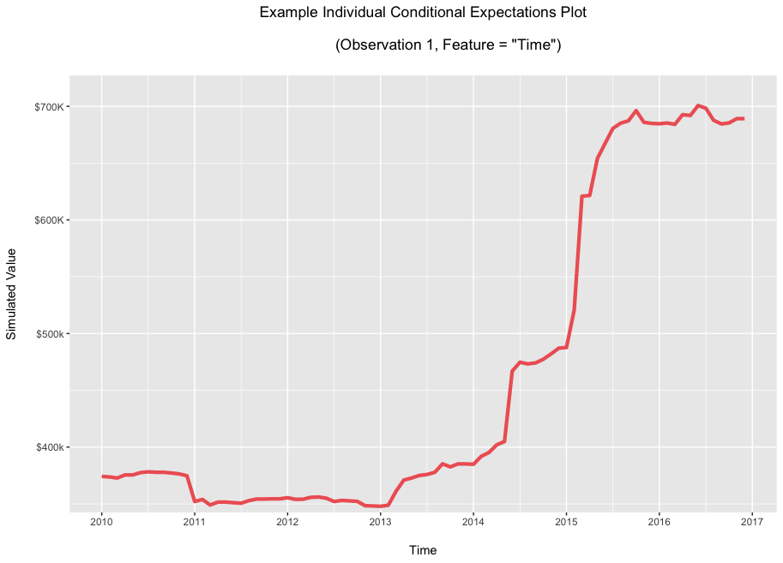
PDP/ICE Method

Slide 7
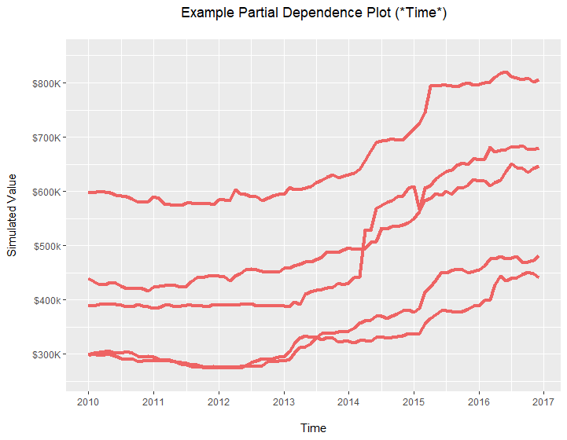
PDP/ICE Method

Slide 8
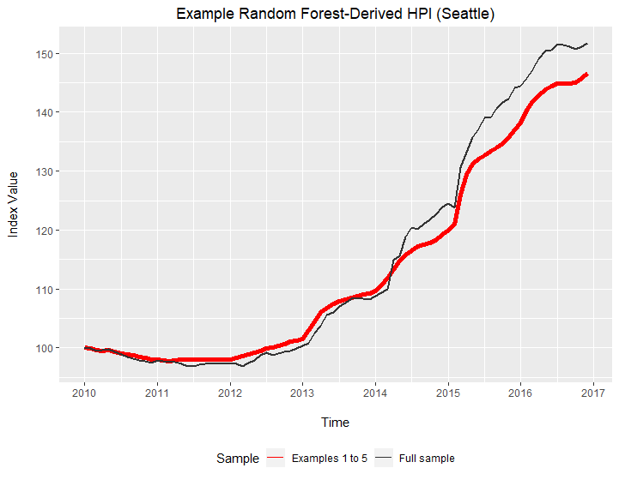
PDP/ICE Method

Slide 9
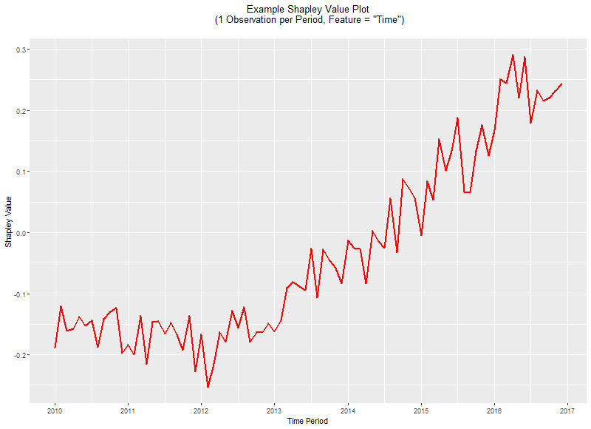
Shapley Value Method

Slide 10
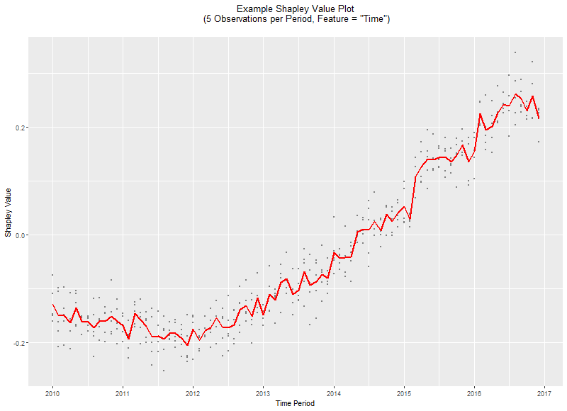
Shapley Value Method

Slide 11
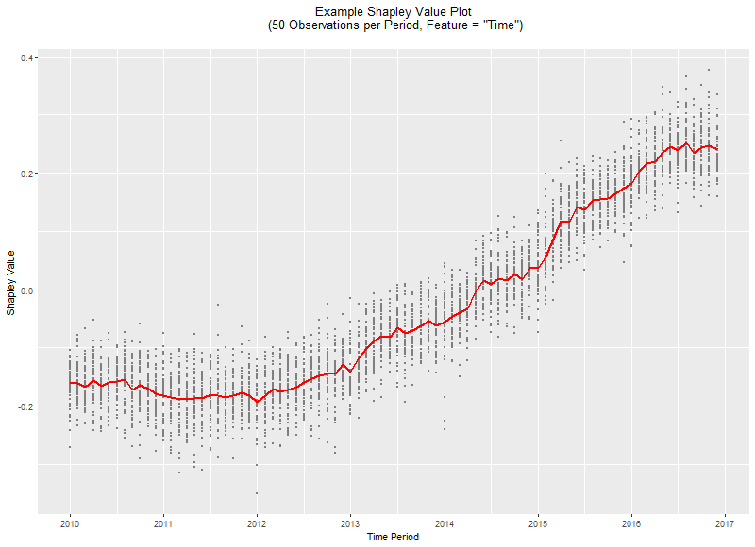
Shapley Value Method

Slide 12
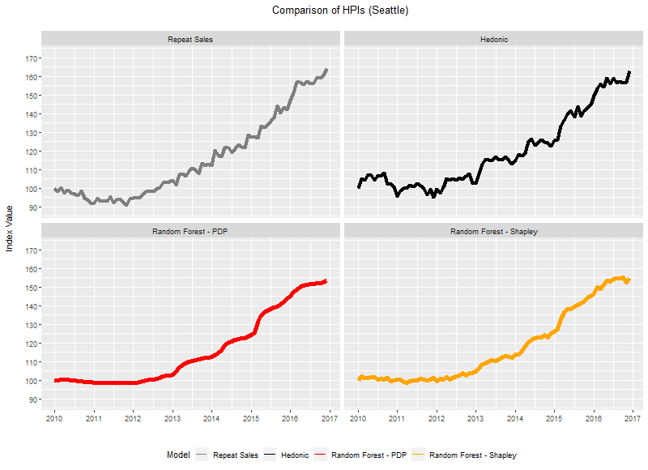
Comparison

Slide 13
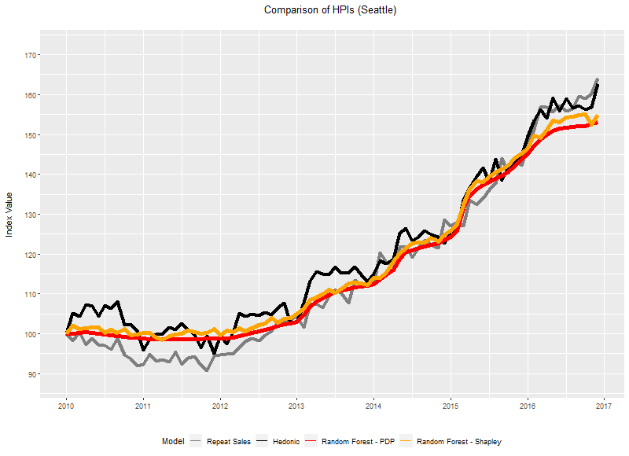
Comparison

Slide 14
Comparison to Existing Methods
Looks competitive (and certainly smoother), but is it better?
‘hpiR’ allows comparison by:
1) Volatility – st.dev of three month moving average
2) Revision – how much does value change as index series grown over time
3) Accuracy – how well can we predict second transaction in a repeat sales pair?
In Sample – How well does it fit data?
Out of Sample – How well does it prediction in a K-Fold situation?
Future Prediction – How well does it predict at t+1?
`forecast` package, simple exponential smoothing

Slide 15
Comparison to Existing Methods
Compute index and series for city (~43k transactions, ~5k repeat)
Full 20110 through 2017 time period
Accuracy = Ability to predict the price of a repeat transaction
Method | Volatility | Revision | In Sample Accuracy | K-Fold Accuracy | Prediction Accuracy
Repeat Sales | .020 | .398 | .094 | .096 | .117
Hedonic | .021 | .010 | .095 | .097 | .095
RF - PDP | .001 | .062 | .093 | .093 | .100
RF – Shap | .006 | .060 | .094 | .094 | .102

Slide 16
Small Geographic Area Comparison
25 King County Assessment Zones
~ 2000 sales in each over the 7 year period
~ 250 repeat transactions in each
Method | Volatility | Revision | In Sample Accuracy | K-Fold Accuracy | Prediction Accuracy
Repeat Sales | .119 | .086 | .123 | .201 | .217
Hedonic | .061 | .013 | .101 | .105 | .099
RF - PDP | .002 | .077 | .093 | .095 | .110
RF – Shap | .012 | .064 | .096 | .097 | .112

Slide 17
Takeaways
Random Forest with Interpretability
Smoothest
Most accurate In and out of sample
Computationally expensive
Repeat Sales
High revision + worse accuracy
Faster + least data intensive
Hedonic model
Least Revision, Best Prediction accuracy
ML interpretability models offer some competitive performance
At the expense of compute time
Struggle at the ‘leading end’ of the index
Only tried one model type (RF) and two interpretability methods (PDP and Shapley)
hpiR offer quick way to test a model/method
Dataset, benchmark and a framework for comparison

