Slide 1

Moneyball (a true fintech story)
Andy Liang
Priscilla Wong
Sean Brennan
Somya Panda
John-Francis Kraemer
Faith Warari

Slide 2

Backstory
Based on the 2003 Michael Lewis book, “Moneyball: The Art of Winning an Unfair Game”, about the Oakland Athletics baseball team and its general manager Billy Beane
The concept genesis is the team's analytical, evidence-based, sabermetric (the empirical analysis of baseball) approach to assembling a competitive baseball team with the Oakland Athletics’ minimal budget
Traditional methods of assessing a player's ability and signing long-term expensive contracts were deemed obsolete
Utilizing sabermetrics to compile a competitive roster with players on free agency or under contract at an inexpensive salary

Slide 3



Assumptions
Traditional methods of assessing players was based on Batting Average, Runs Batted in (RBI), and Stolen Bases
The ability of a player to get on base and to facilitate existing players on base to score is the core metric to isolate
Using the equations to quantify a players’ On Base Percentage (OPS), Slugging Percentage (SLG), and On Base plus Slugging (OPS)
H = hits; BB = bases on balls; HBP = times hit by pitch; AB = at bats; SF = sacrifice flies; TB = total bases

Slide 4
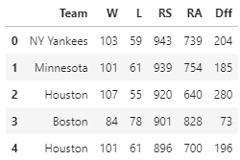
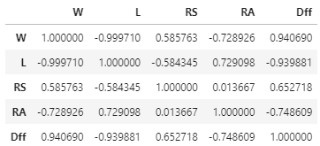
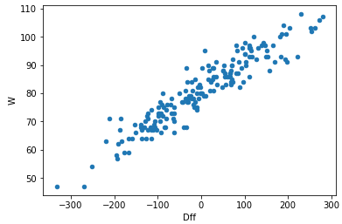
Assumptions
The baseline assumption is teams that have more players on base, statistically score more runs, and teams that have a higher proportion of Runs Scored (RS) compared to Runs Allowed (RA) have a high correlation of winning (0.94)
Taking MLB team stats from the past 6 seasons (2014 – 2019)

Slide 5




Motivation and Summary
Use a machine learning model to predict the 2021 OPS (On-base Plus Slugging) for the entire roster of MLB players and select a full roster of players with the highest OPS for their salary.

Slide 6
Data Clean Up and Exploration.
Sources:
Kaggle
mlb.com
Spotrac.com
Data Parameters:
MLB historical game/player data from 2010 through 2020
2021 player salaries

Slide 7
Data Clean Up and Exploration.
Pandas: Parsing, column name changes, dropping nulls, normalizing data types.

Slide 8



Models
LSTM
RMSE
Epochs used 50, 100 and 300.

Slide 9
LSTM

Slide 10
RMSE

Slide 11
Results and Conclusion

Slide 12
Postmoterm
Difficulties and additional questions
reflections

Slide 13
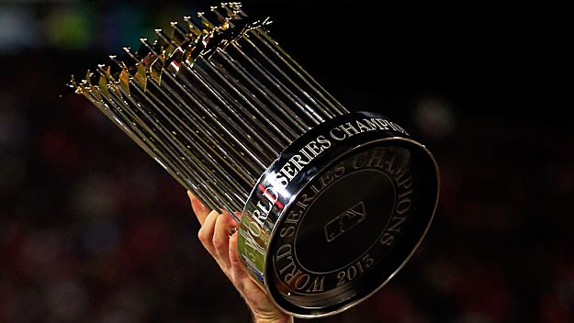
Thank you!

Slide 14

Questions?

