Slide 1
ALWAYS – Design a Microservice by Business Functionality
A microservice should only deliver a single or strongly related business functions – contributing to complete a business process.
bounded by business responsibility,
independently deployable and scalable.
E.g. Loan origination application could be decomposed into –
loan-application-service,
loan-underwriting-service, or
loan-funding-service

Slide 2
DO NOT – Design a Microservice by Technological Capability
A microservice that does not deliver any business function by itself, are often bounded by a technological capability – such as
Running a rule for other microservices
Listen to received files and notifying other microservices
Translate received message to other microservices
If a microservice needs all other microservices to be available to complete a business function, then that’s a distributed monolith – application that ‘s deployed like a microservices but built like a monolith

Slide 3
Name a Microservice by Business Functionality
ALWAYS name the microservice according to the business function such as
loan-application-service,
loan-underwriting-service, or
loan-funding-service
DO NOT name the microservice by
loan-non-financial-service and loan-financial-service, or
loan-business-service or loan-parameter-service,
loan-common-service

Slide 4
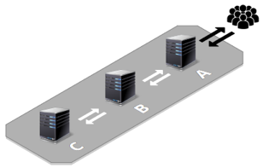
AVIOD – Chatty Microservices
Chatty microservices uses traditional request-driven communication – such as REST that call and wait for response as inter-service communication.
Chatty microservices are difficult to scale, potentially create performance bottleneck – or worse, a downtime of the dependent microservices.

Slide 5
AVOID – Transactions Across Microservices
Distributed transaction is a set of operations on data to be performed across multiple microservices – ensuring either all or none operations are completed.
Distributed transaction is a complex process with lots of moving parts that can fail, and the process of commiting a transaction is very long and unreliable.
So one of the best ways to solve the problem of distributed transactions is to avoid them completely.

Slide 6
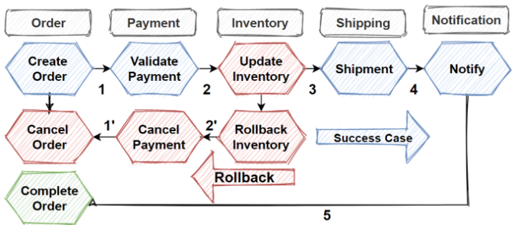
ALWAYS – Use Saga Pattern for Transactions Across Microservices
Saga pattern is a sequence of local transactions that guarantees either all operations complete or the corresponding compensation operations are run to undo the work of previously completed operation.
The saga orchestrator creates an Order and return response in the PENDING state, instead of waiting for Order to complete.

Slide 7
ALWAYS – Able to Auto Scale by Workload
Autoscaling is one of the key feature in Kubernetes – it can automatically increase or decrease the number of Microservice (Pods) in response to the workload's CPU or memory consumption, or in response to a custom metrics – such as
Request per seconds
Record size in batch job processing
Kafka lag threshold – message haven’t been read
Microservice must be able to adapt to dynamic increase or decrease of pods in response to workload – especially for batch processing Microservice
Eliminates the need to respond manually to traffic or workload spikes by automatically changing the active number of Microservice instances.

Slide 8
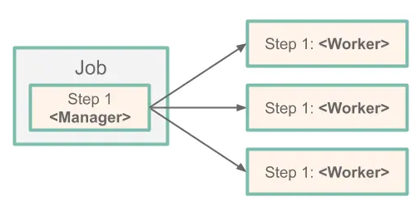
ALWAYS – Use Remote Partitioning or Remote Chunking Strategy
Remote partitioning strategy allow large sets of data to be split into multiple smaller sets of data and processed concurrently by multiple workers to reduce the time required to process long running batch job.
Prerequisite to use remote partitioning is the records or input file can be split into multiple sets, allowing the worker to run against different sets of data.

Slide 9
ALWAYS – Benchmark Concurrency Level vs Memory Consumption
Each request to Microservices consumes an amount of memory and these memory footprint will be only be collected and released at an time interval.
If the Microservice is overloaded with too many concurrent request and the memory footprint exceed the configured allowed memory, the Microservice will be terminated because they used more memory than allowed (OOMKilled).
We need to benchmark our Microservice to know the memory footprint of a number of concurrency request or processing, then set-up pod autoscaling metrics to relief workload from existing running instances during high load.

Slide 10
ALWAYS – Use FlywayDB to Deploy SQL Scripts
Many projects rely on manually SQL scripts deployment and a quick SQL statement to fix a problem and soon many questions arise -
What state is the database in on this machine?
Has this script already been applied or not?
Has the quick fix in production been applied in test afterwards?
How do you set up a new database instance?
FlywayDB tracks SQL scripts that have been run, and runs the change scripts to get your database up to date, allowing -
Recreate a database from scratch with the SQL scripts
Make it clear at all times what state a database is in
Migrate in a deterministic way from your current version of the database to a newer one

Slide 11
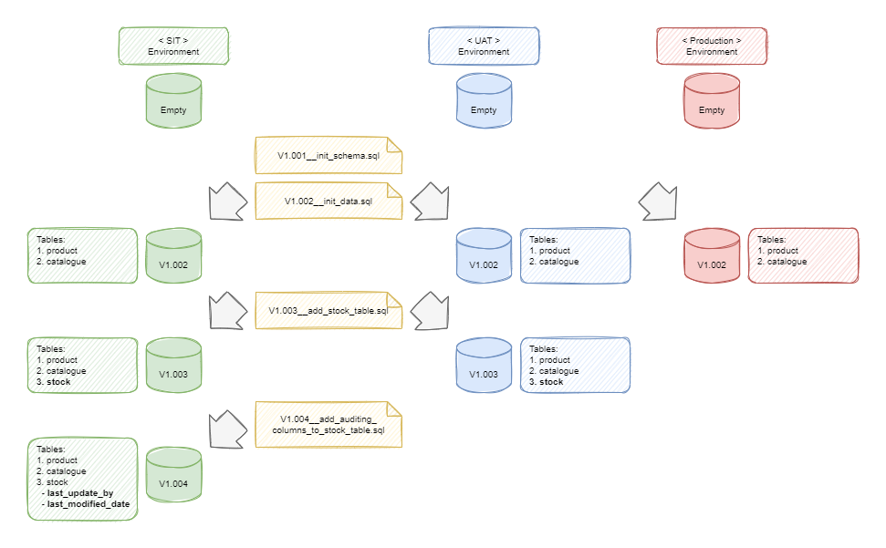
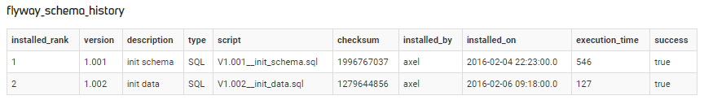

Slide 12
ALWAYS – Choose a Git Workflow
Git focus on flexibility and there is no standardized process on how to interact with Git.
To ensure the team is on the same page, an agreed-upon Git workflow should be developed or selected.
Refer to 5 Different Git workflows for more details.

Slide 13
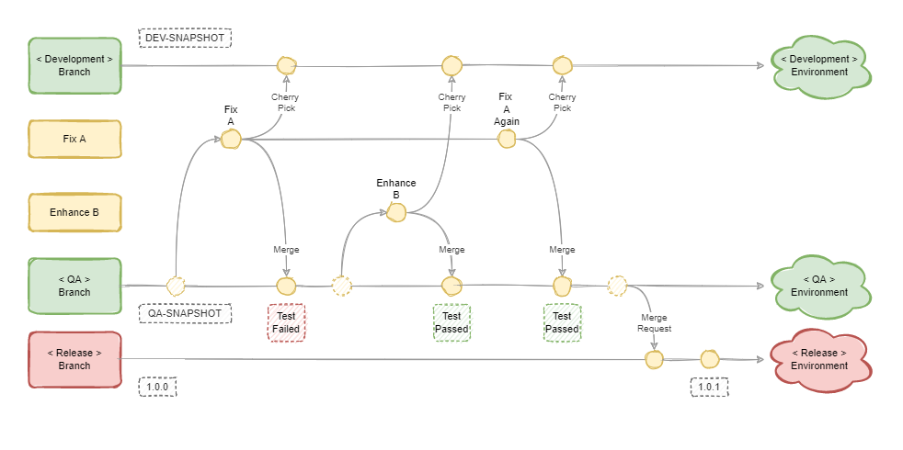
Stable Release Git Workflow

Slide 14
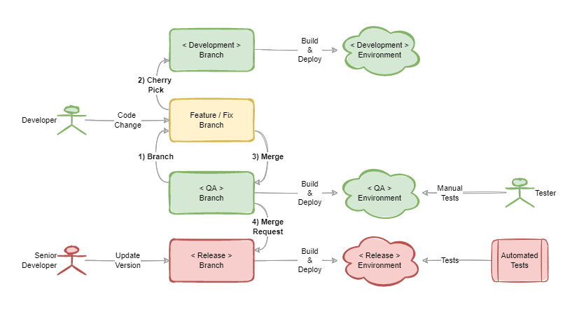
Stable Release Git Workflow

Slide 15
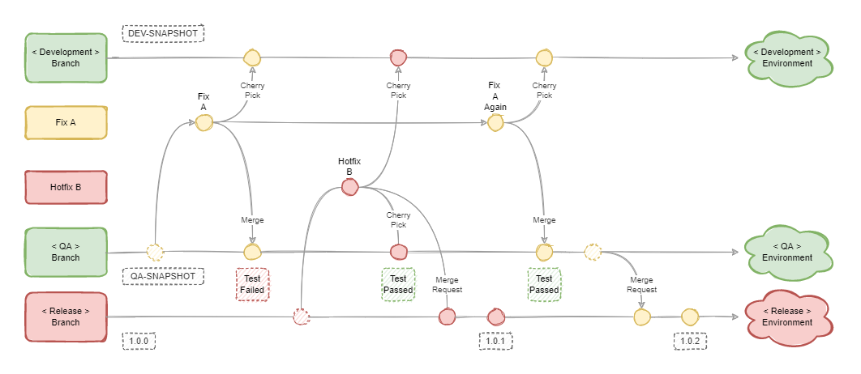
Hotfix Release Git Workflow

