Slide 1
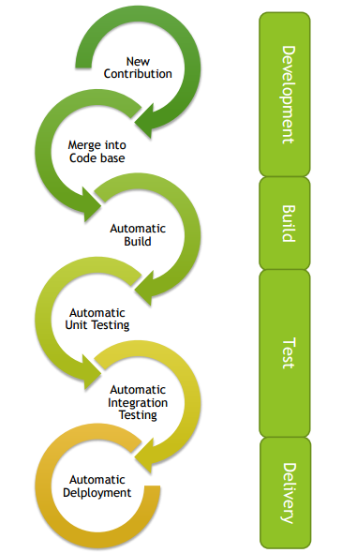
Azure DevOps
DevOps – 4 ECTS
Abhishek Kumar, abhishek.kumar@hamk.fi
Slides from Deepak KC

Slide 2
What is DevOps?
DevOps is a combination of cultural philosophies, practices, and tools.
It emphasizes collaboration and communication between development and operations teams to improve software delivery speed, quality, and reliability.
It uses automation, continuous integration and delivery (CI/CD) pipelines, and monitoring and feedback loops, and fosters a culture of continuous improvement and experimentation.
DevOps helps organizations compete more effectively in the market.
Popular DevOps tools include Docker, Kubernetes, Git, Jenkins, and cloud services

Slide 3
Development vs Operational Team
Development Team
Responsible for designing, coding, testing, and delivering software applications or systems
They create new software features, fix bugs, and improving the overall functionality of the software.
Operational Team
Responsible for deploying, maintaining, and monitoring software applications or systems in a production environment
The operational team ensures smooth software operation and quick issue resolution to minimize downtime or disruption to end-users.

Slide 4
DevOps Tools
Version Control Systems (e.g., Git)
Continuous Integration Tools (e.g., Jenkins, Travis CI)
Containerization (e.g., Docker)
Configuration Management Tools (e.g., Ansible, Puppet)

Slide 5
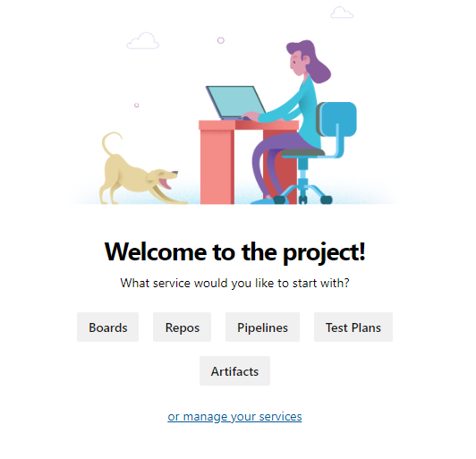
Azure DevOps
It provides several tools for
Better team collaboration
Automated build processes
Testing
Package Management
https://dev.azure.com/

Slide 6
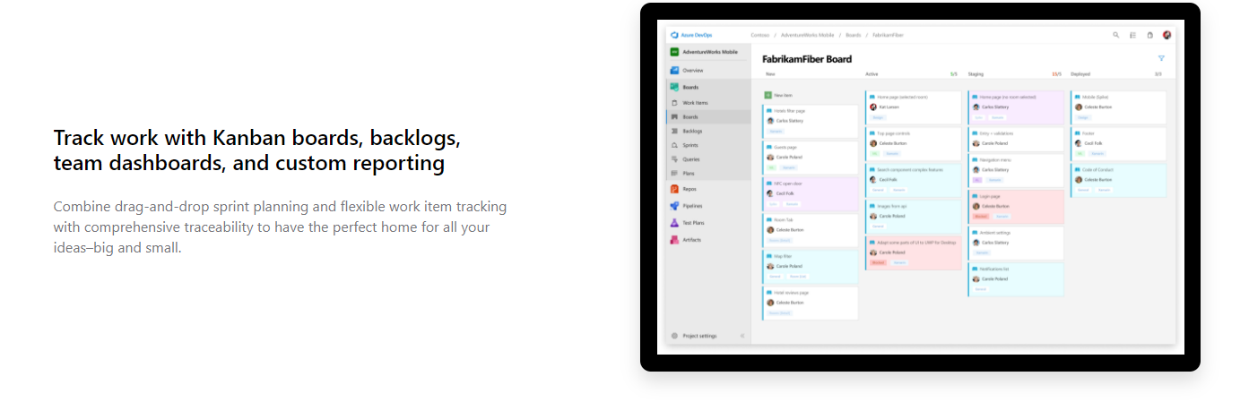
Azure Boards
Agile tool for planning, tracking and discussing work within your teams of between teams
https://azure.microsoft.com/en-us/services/devops/boards/

Slide 7
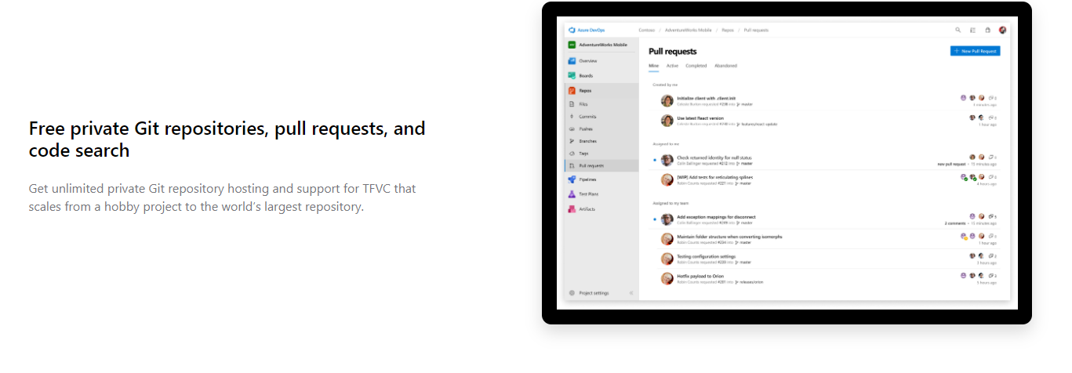
Azure Repos
Unlimited, cloud-hosted private and public Git repos
https://azure.microsoft.com/en-us/services/devops/repos/

Slide 8
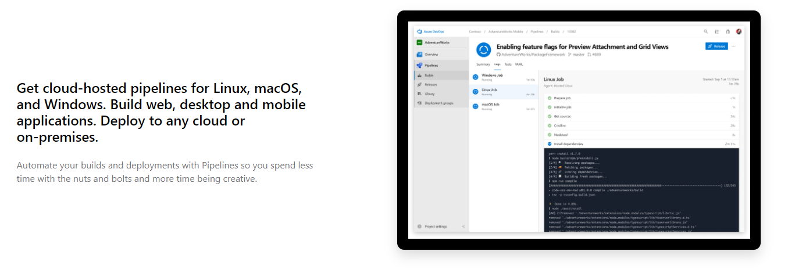
Azure Pipelines
For building, testing and deploying with CI/CD that works with any language, platform, and cloud
https://azure.microsoft.com/en-us/services/devops/pipelines/

Slide 9
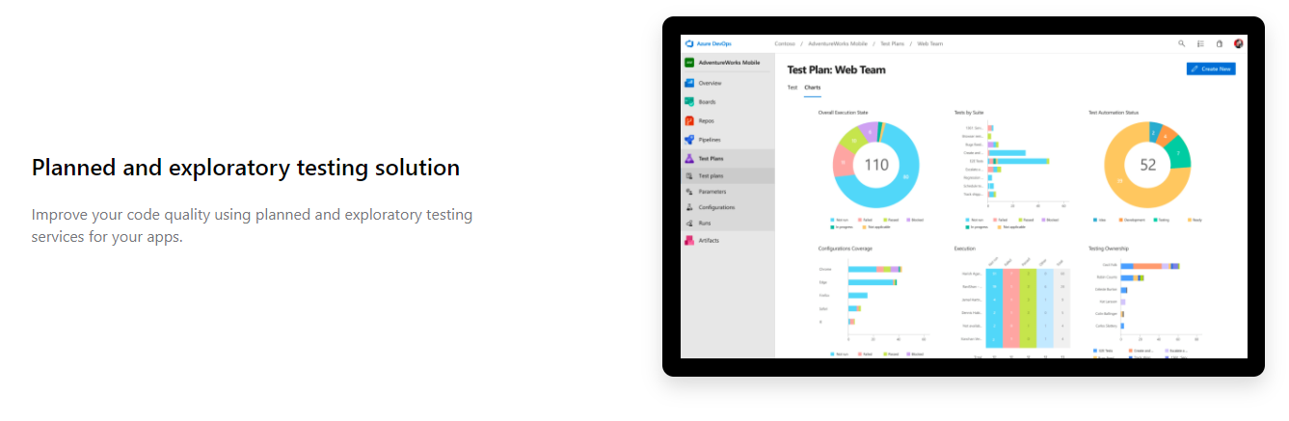
Azure Test Plans
For software testing that includes manual and exploratory testing tools
https://azure.microsoft.com/en-us/services/devops/test-plans/

Slide 10

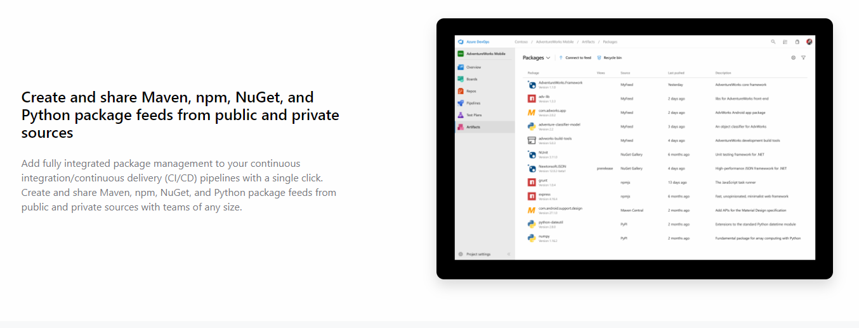
Azure Artifacts
For creating, hosting and sharing packages.
https://azure.microsoft.com/en-us/services/devops/artifacts/

Slide 11
Flash Understanding of Azure Devops
Board: Define, Plan and Track works
Pipeline: Build and Deploy
Repos: Cloud-based source control
Test Plans: Test Apps
Artifacts: Manage all dependencies in a single feed (e.g. Maven, Cargo)
Integrations/extensions that be included in Azure Devops: Slack, Trello, Github, Campfire

Slide 12
Azure DevOps organization
Organization is created to connect groups of related projects
Organization are manually created via the web portal
You may have one organization for your entire company or separate organizations for specific units such as business units, regional units
Start with one organization and add additional organizations as per your need
In this course, we will have a single code repo (only 1 project) and therefore one organization is enough
In case you have separate teams, and they work on different code repositories (projects) in isolation then you can create separate organizations for those teams
Free Azure DevOps accounts for individuals, small teams, and open-source projects.

Slide 13
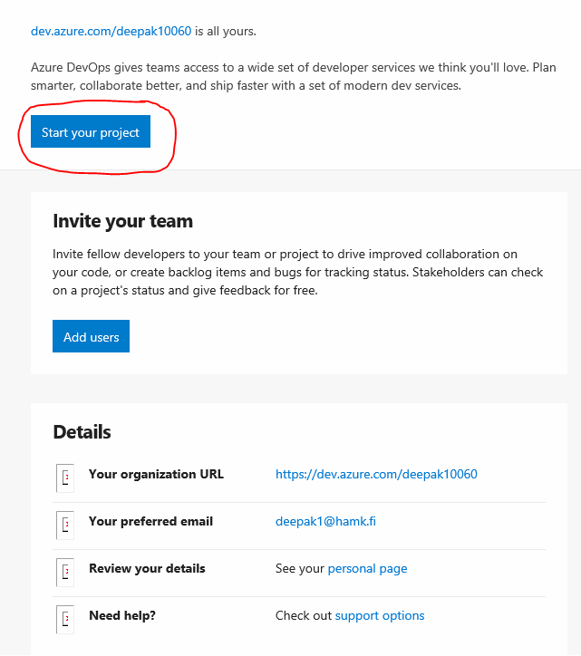
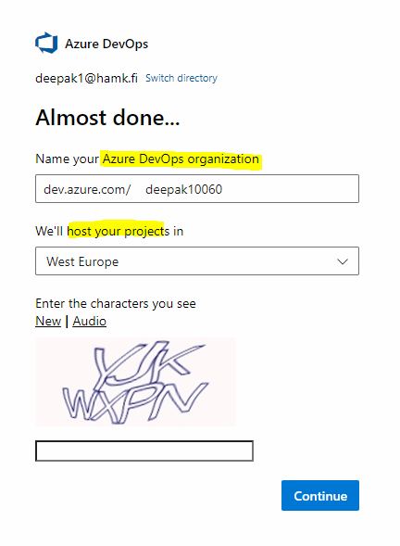
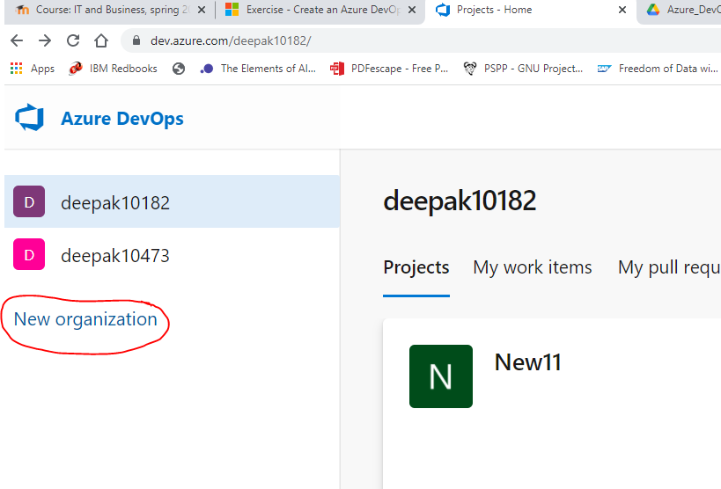
Create an Azure DevOps organization:
https://docs.microsoft.com/en-us/learn/modules/get-started-with-devops/4-create-an-azure-devops-account
Notes:
You get an email in a while after creating an organization. To get started, you can create a project

Slide 14
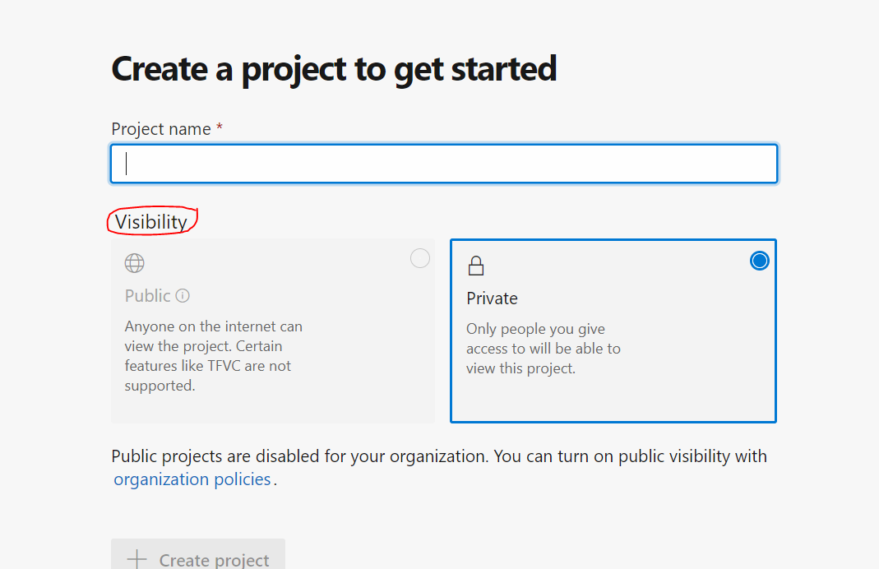
Project
Each organization will have one or more projects
A project will have
boards and backlogs for agile planning
Pipelines for continuous integration and deployment
Repos for version control and management of source code
Continuous test integration
Within an organization
You may create a single project that has many repos and teams
You may create multiple projects with its own set of teams, repos and other elements

Slide 15

Agile Approach to Software development
“Agile development is an iterative software-development methodology which teams use in projects. Self-organized, cross-functional teams frequently analyze circumstances and user needs to adapt projects. Scrum teams constantly improve quality in sprints with short-term deliverables.”

Slide 16
Objectives
Create
Create new project in your organization
Add
Add teams and team members
Create
Create Work Items & Sprints
Associate
Associate work items with a sprint

Slide 17
Agile
The agile approach emphasizes on
incremental delivery, team collaboration, continual planning, and continual learning
Based on iterative development
Agile Manifesto https://agilemanifesto.org/
Individuals and interactions over processes and tools
Working software over comprehensive documentation
Customer collaboration over contract negotiation
Responding to change over following a plan

Slide 18
General recommendations when adopting agile
An organizational structure that supports agile practices
Vertical teams are considered for best results in Agile projects
Educate your team members on Agile techniques and practices
Collaboration: in-team and cross-team collaboration
Clear and transparent communication
Cross functional teams to work collaboratively
Tools for collaboration
Microsoft Teams
Slack
Google Hangouts, Asana, Trello, GoToMeeting …
Notes:
Horizontal teams: Specific teams for specific tasks (layers) such as a team for developing User interface, a team for working on the database. Each team is focused in their own specific goals. Rather than values, it is focused on delivering stuff.
Vertical team: Focus is on delivering as much value as possible.
https://agilevelocity.com/agile-team-structure/

Slide 19
Azure Boards
It is a tool in Azure DevOps for planning the work that is to be done
Interactive customizable tools for managing software projects
Quickly see and share progress for instance with Kanban boards you add work, update work status and monitor progress
Product backlogs: Add work items
Native support for Agile, Scrum & Kanban process
Built in scrum boards and planning tools
Easy to organize stand-ups meeting (Daily scrum), planning meetings and retrospectives
Built in social tools and communications
Tracking work issues

Slide 20
Setting up Azure Boards
Four options to select from
Capability Maturity Model Integration (CMMI)
For large organizations
Scrum
Agile
Basic
A basic workflow: To DO >> Doing >> Done

Slide 21
Planning work with Azure boards
Set up Azure boards with Scrum process
Create the project
Create a team
Add team members
Create the board
Define a sprint
Assign tasks and set the iteration
Notes:
Manage your Scrum process template artifacts : https://docs.microsoft.com/en-us/azure/devops/boards/work-items/guidance/scrum-process?view=azure-devops

Slide 22
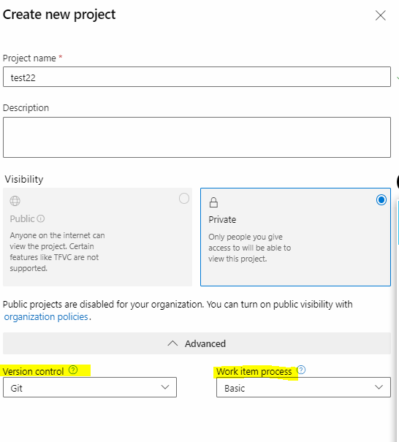
Create the project
Select your organization.
Select + New project. The Create a project dialog box opens.
In the Project name field, enter the project name
In the Description field, enter The project description
Under Visibility, choose whether to make your project public or private. For now, you can select private.
Select Advanced.
Under Version control, make sure that Git is selected. Under Work item process, make sure that Basic is selected.
Select Create.

Slide 23
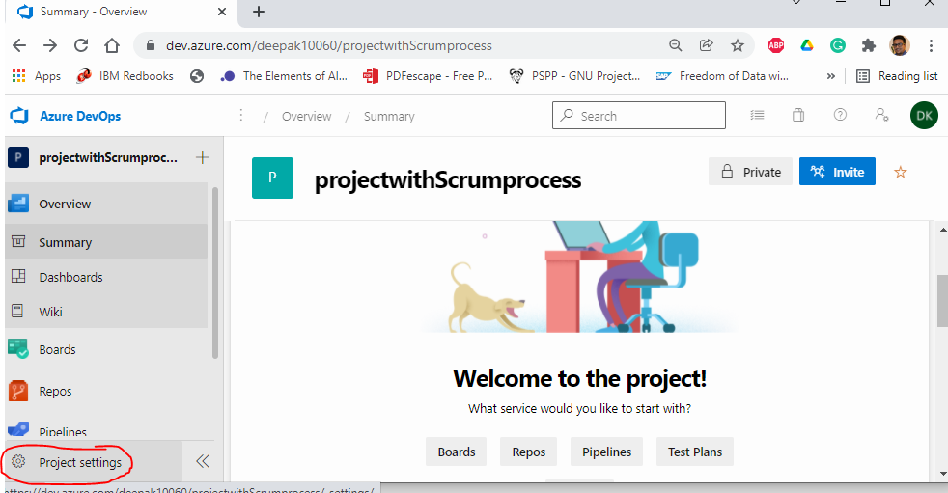
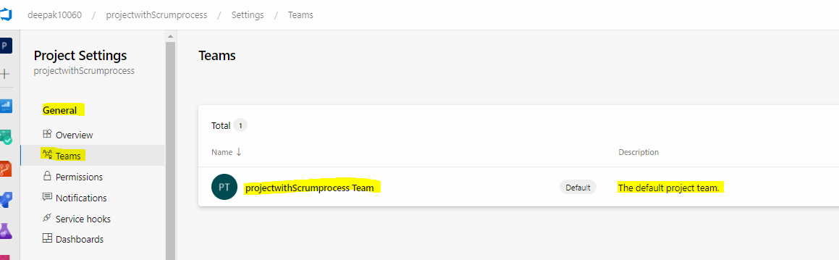
Create a team for the project
Project Settings (in the lower corner)
Project Details >> General >> Teams
A default team is created according to the project name, we can use this but in principle we can have multiple teams contributing to the same project
Select the default team and add more members

Slide 24
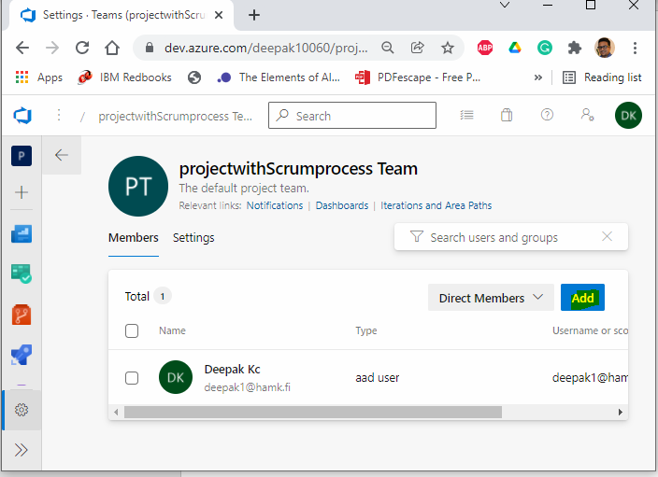
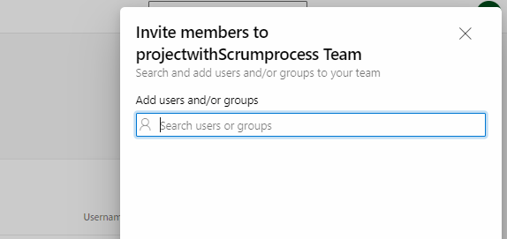
Add Team Members
Under Members, select + Add.
Enter the email address of the user you'd like to add. Then select Save changes

Slide 25
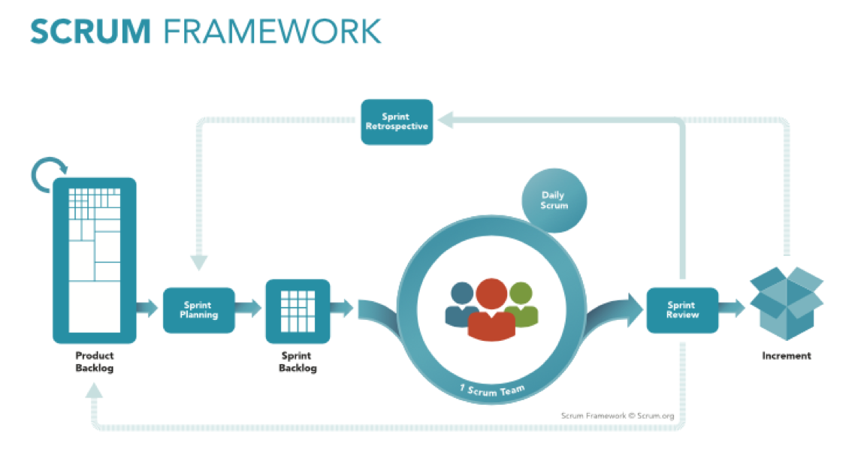

Slide 26
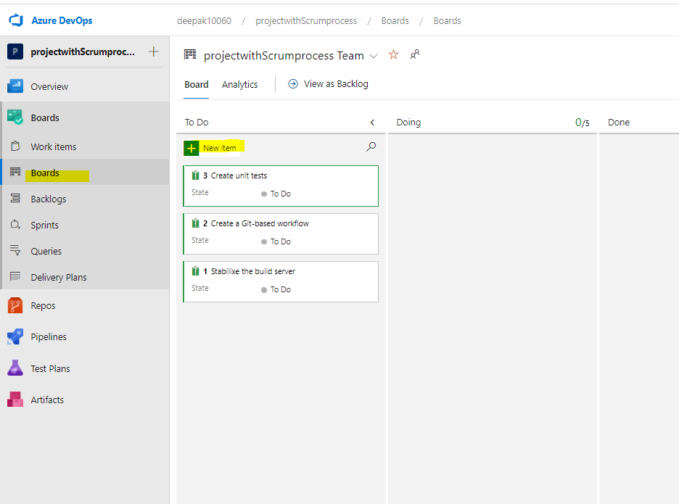
Create the board – Add work items
One the left column, select Boards
A blank board appears.
As we have selected the Basic process that is we will have tasks with 3 states: To Do, Doing & Done
On selecting other process such as Scrum , it will present the layout that supports that process.
https://learn.microsoft.com/en-us/training/modules/choose-an-agile-approach/4-plan-work-azure-boards

Slide 27
Backlogs (Product Backlogs)
Since we have selected the Basic Process for our project. On Clicking Backlogs, you have two options
Epics
Epics are large bodies of work that can be broken down into smaller tasks or user stories.
Epics are often used to group related user stories or tasks together.
Epics can have child work items, such as tasks or user stories, to break down the work into smaller, manageable pieces.
Issues
Issue is often used as a general category for different types of work items, including bugs, tasks, and other types.
Issues represent individual pieces of work that need to be tracked and managed within the project.

Slide 28
Let’s make a product backlog for a simple task management application
Issues: User Stories as Issues
User Story: As a user, I want to be able to create a new task.
Desc: Tasks can have a title, description, due date, and priority.
User Story: As a user, I want to view a list of all tasks.
Desc: The user should see a summary of tasks with key details such as title, due date, and priority.
User Story: As a user, I want to mark a task as complete.
Desc: Completed tasks should be visually distinguished from incomplete ones.
User Story: As a user, I want to edit the details of an existing task.
Desc: Users should be able to update the title, description, due date, and priority of a task.
User Story: As a user, I want to categorize tasks into different projects.
Desc: Users can assign tasks to different projects for better organization.
User Story: As a user, I want to set reminders for tasks.
Desc: Users can set reminders for upcoming tasks to receive notifications.

Slide 29
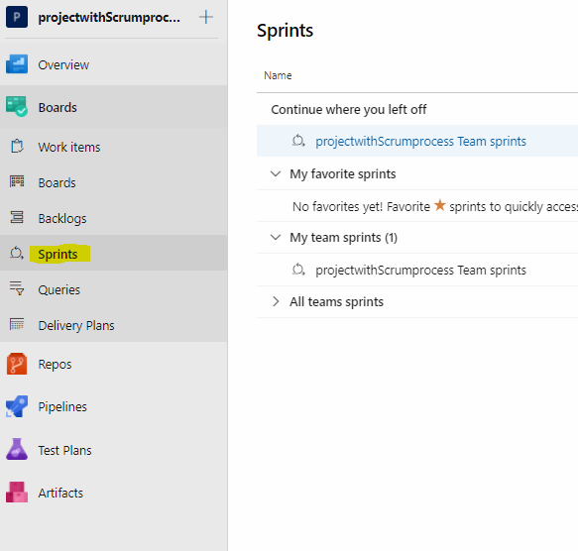
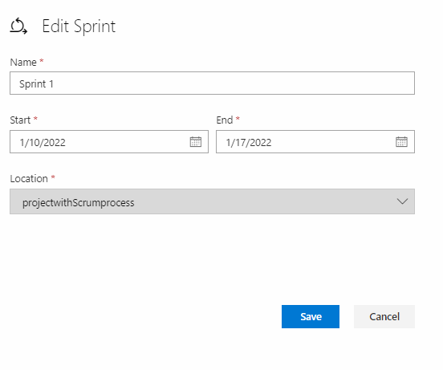
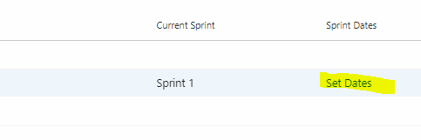
Define a sprint
An initial sprint called Sprint 1 is available
You can assign date to the sprint and if needed add tasks
Add Sprints as you need

Slide 30
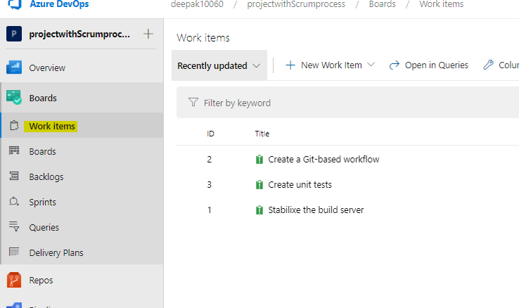
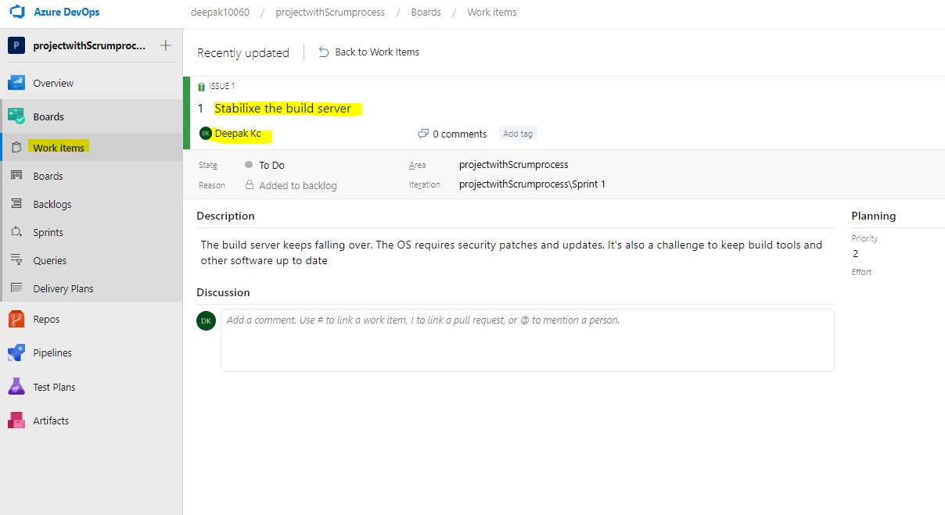
Assign Tasks and Set the iteration
Boards >> Work Items
Select the Item
In the Iteration dropdown, select Sprint 1
Select Unassigned and set yourself as the task owner
Repeat for other tasks
Notes:
Azure Board Documentation: https://docs.microsoft.com/en-us/azure/devops/boards/?view=azure-devops

Slide 31
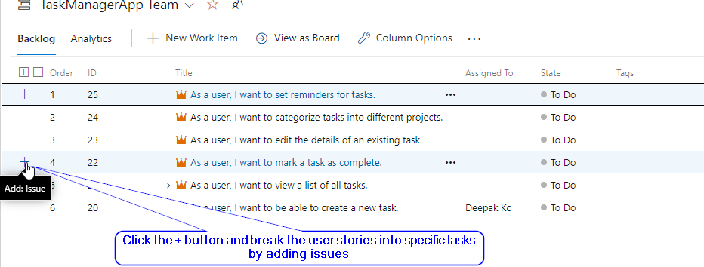
Let's create Sprint Backlog
Sprint 1: Assume that you picked up a user story "As a user, I want to create a new task" for this sprint. Now you need to break this task down into multiple tasks such as: Specific tasks as issues
Task: Design Task Creation Form
Task: Implement Backend Logic for Task Creation
Task: Create Frontend for Task Creation
Task: Validate Task Creation Input
Task: Write Tests for Task Creation
Task:Integrate Task Creation with Database
Task: Handle Error Cases
Task: Implement Success Feedback
Task: Test End-to-End Functionality
Task: Document Task Creation Process

Slide 32
References
https://azure.microsoft.com/en-us/overview/what-is-devops/
https://docs.microsoft.com/en-us/learn/modules/get-started-with-devops/3-what-is-azure-devops

