Slide 1
Analysis reports for
Workplace satisfaction survey dataset

Slide 2
Background of the survey
The survey was conducted by interviewing employees from 05 September to 12 September 2024
We got total 82 responders who finished the survey during the Design Factory Project (DFP)

Slide 3
Variables of the survey
Variables | 1 | number (identifier for the person)
 | 2 | gender (male=1, female=2)
 | 3 | age (years)
 | 4 | family (single=1, not single=2)
 | 5 | education (primary school=1, secondary school graduate=2, bachelor level=3, master level=4)
 | 6 | years_of_service (the number of years the person has been working for the company)
 | 7 | salary (salary per month in euros)
 | 8 | sat_management (satisfaction with management) (scale 1-5; 1=very unsatisfied, 5=very satisfied)
 | 9 | sat_colleques (satisfaction with colleagues)
 | 10 | sat_workEnvironment (satisfaction with working environment)
 | 11 | sat_salary (satisfaction with salary)
 | 12 | sat_tasks (satisfaction with job tasks)
 | 13 | HealtCare (1 if the person has used the services of work healthcare)
 | 14 | HolidayCabin (1 if the person has used company's holiday cottage)
 | 15 | Gyn (1 if the person has used company's gym)
 | 16 | MuscleCare (1 if the person has used the massagist pointed by the company (compary pays half))
Background variables 1-7
Variables of main interest 8-9 (Likert scale)

Slide 4

Background analysis (variable by variable)

Slide 5
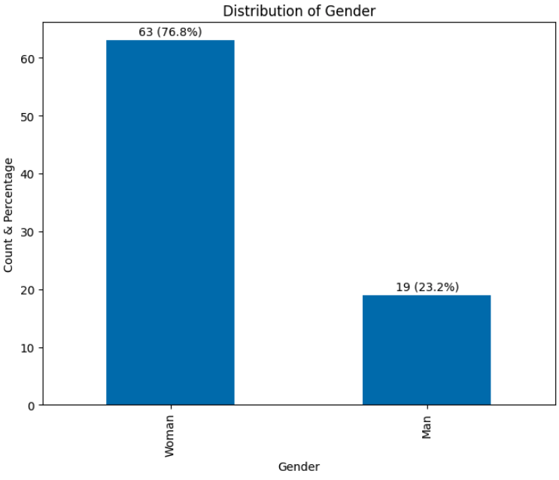
Background analysis (Gender variable)
Based on the survey, there is a significant gender imbalance, with the majority of respondents being women.
77% of the respondents are women, while only 23% are men.
This imbalance might influence other survey outcomes, especially in areas like job satisfaction or management opinions.

Slide 6
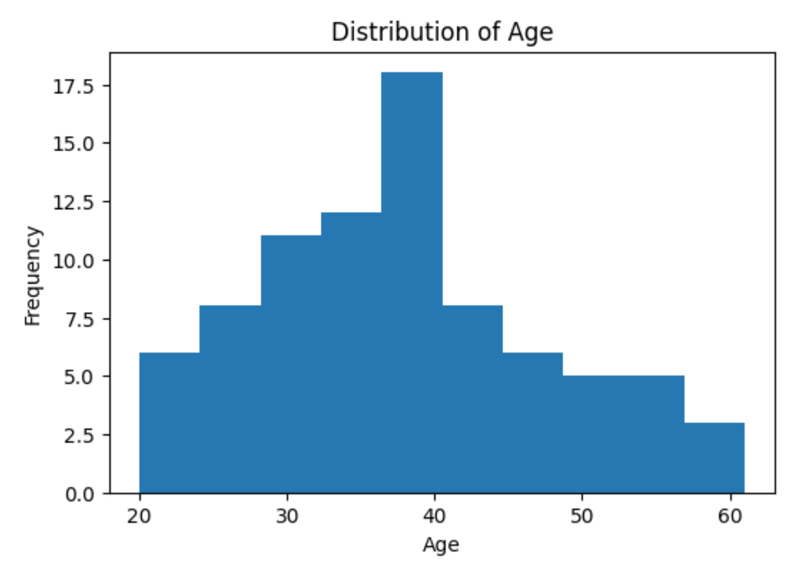
Background analysis (Age variable)
This histogram displays the age distribution of the respondents in the dataset.
Most respondents are between 30 to 40 years old, with a noticeable peak at around 40. Fewer respondents are in the younger (20-30) and older (50-60) age ranges.
The age concentration in the 30-40 range could affect how different age groups perceive workplace satisfaction, with potential differences in priorities for younger vs. older employees.

Slide 7
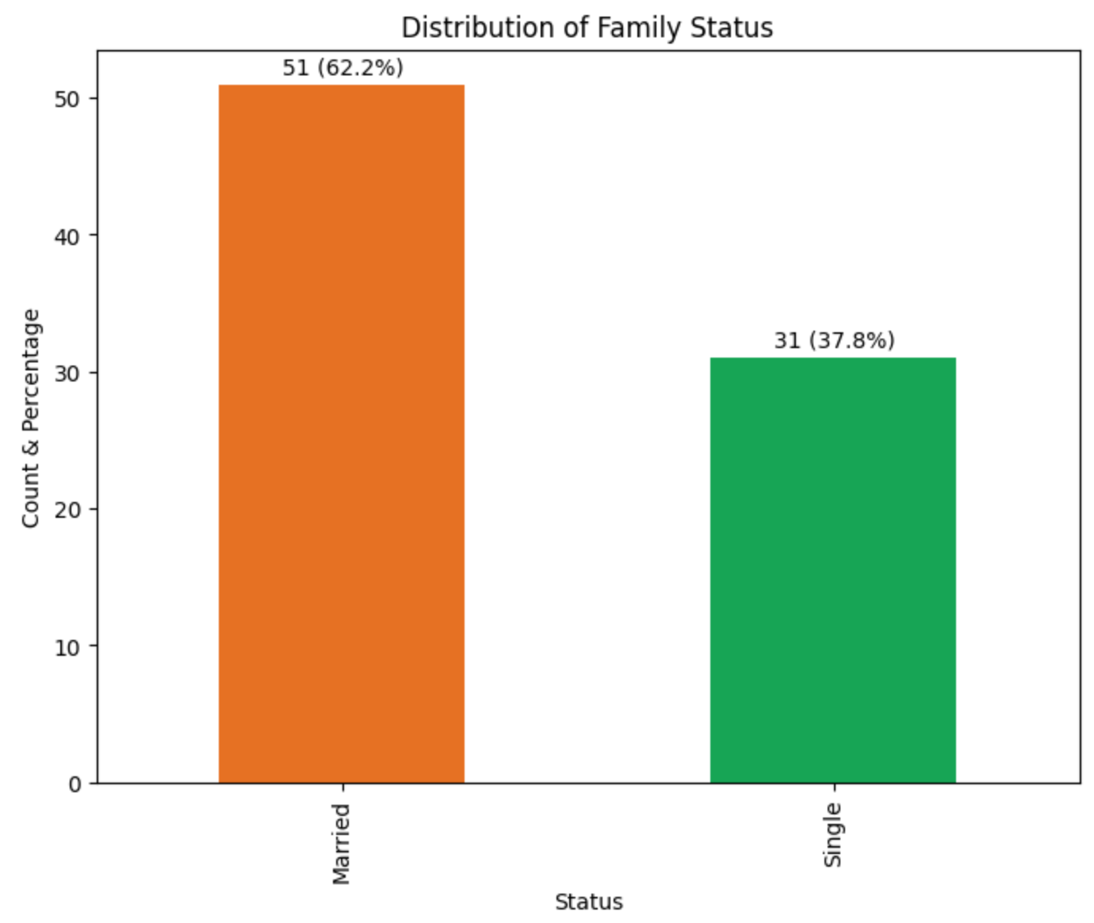
Background analysis (Family variable)
This bar chart displays the distribution of respondents by family status.
The majority of respondents are Married (62.2%), while Single respondents make up 37.8%.
The family status may influence workplace satisfaction factors such as work-life balance, where married respondents may have different priorities compared to single respondents.

Slide 8
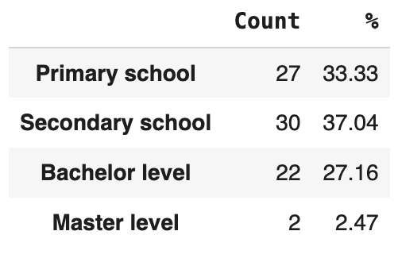
Background analysis (Education variable)
Based on the survey, the educational levels of our employees are distributed based on the percentage table shown here.
The most popular education level in Secondary school and got 37% of total amount
The least level of education in Master and got 2.5% of total amount.

Slide 9
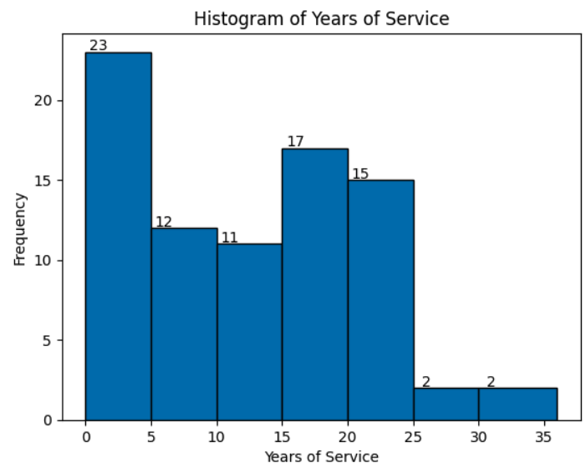
Background analysis (Years of Service variable)
This histogram illustrates the distribution of respondents based on their years of service at the company.
A large portion of respondents have less than 5 years of service, with a peak at 0 years (23 respondents). Fewer employees have been with the company for more than 25 years.
The concentration of employees with fewer years of service may influence perceptions of job satisfaction, training, and career growth opportunities.

Slide 10
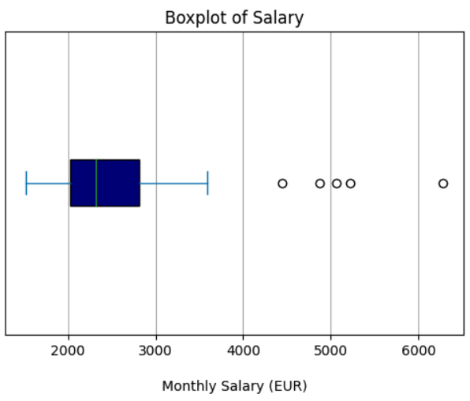
Background analysis (Salary variable)
Based on the survey, the monthly salary of employees is much distributed as shown in the boxplot diagram.
The median salary lies between 2000 and 3000 euros.
With several outliers above 4000 euros, we can see that some respondents earn significantly more than the majority.

Slide 11
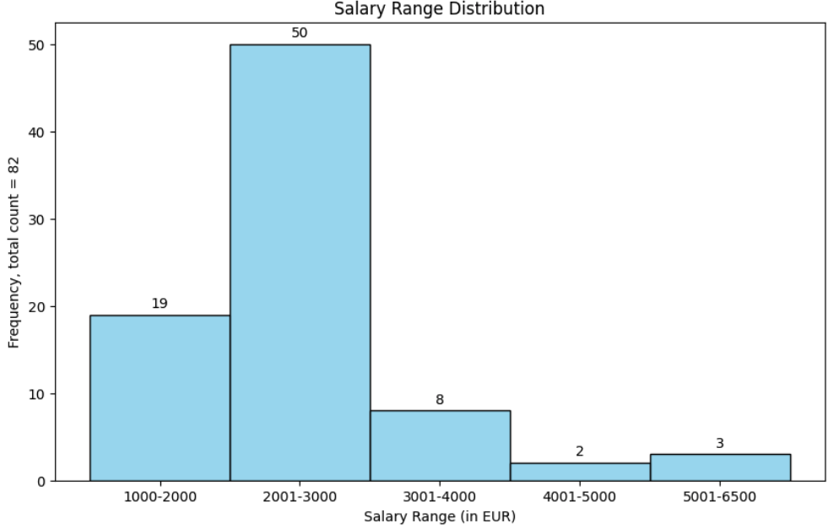
Background analysis (Salary variable)
This histogram displays the monthly salary of employees which is classified into 5 ranges as following:
1000-2000
2001-3000
3001-4000
4001-5000
5001-6500
About 84% (69 out of 82) of respondents earn between 1000 and 3000 euros monthly, with the highest concentration (50 respondents) in the 2001-3000 euros range.

Slide 12
Analyzes two variables
Here we will report analysis between two variables such as:
Gender and Education
Salary and Years of Service
Salary and Education

Slide 13
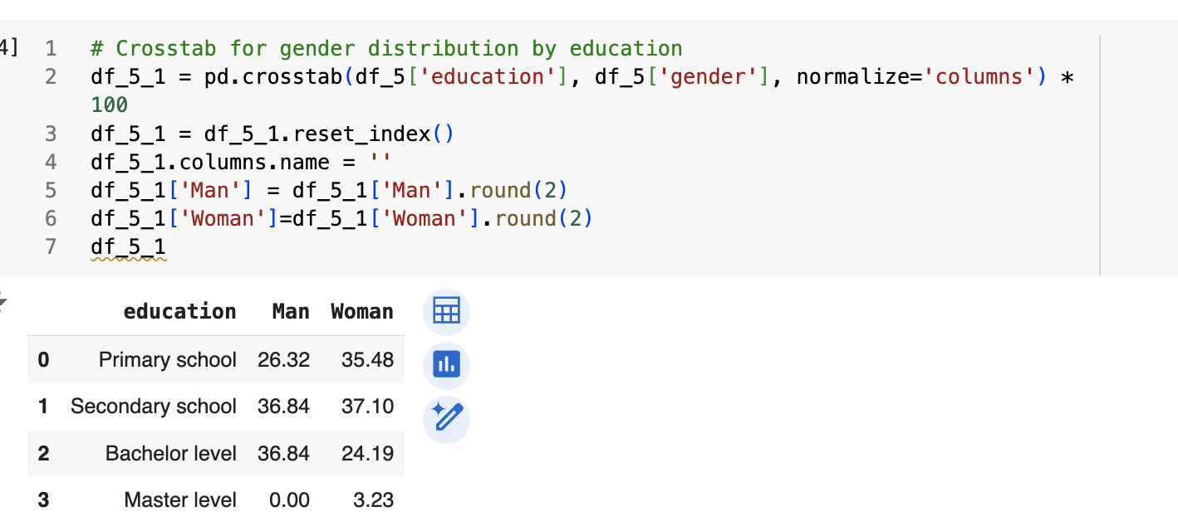
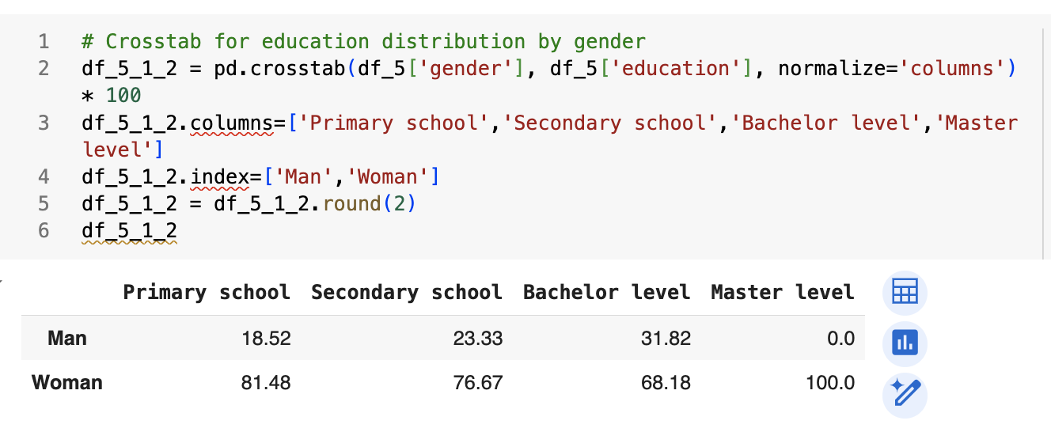
Analyzing dependency between variables gender and education

Slide 14
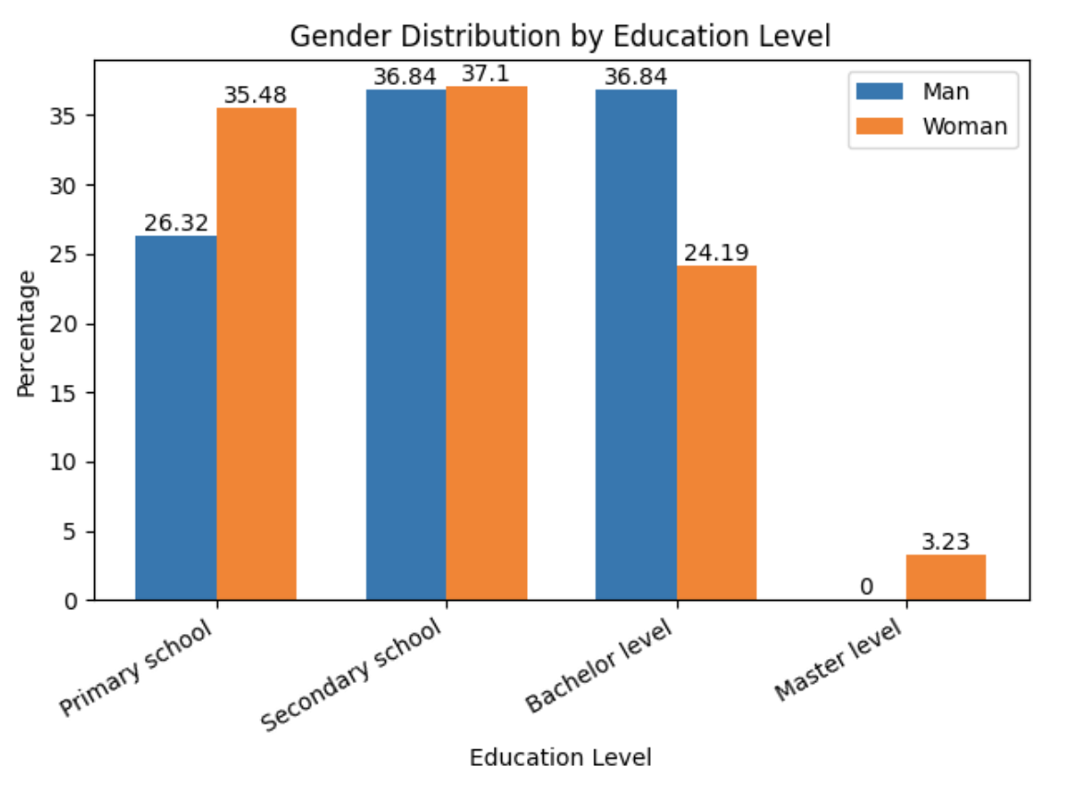
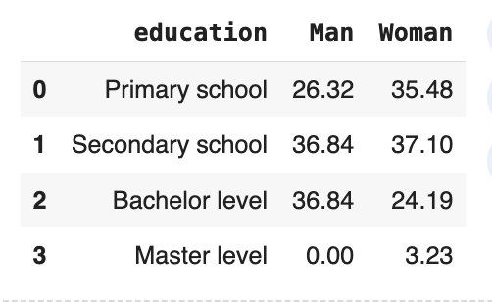
Analyzing dependency between variables gender and education
This bar chart examines the relationship between Gender and Education Level among the respondents.
There is a noticeable difference in the distribution of education levels between men and women. Women are more prevalent at the Bachelor and Secondary school levels, while men have no representation at the Master level.
This dependency suggests that education levels may vary by gender, which could influence career development opportunities and workplace experiences across different education levels.

Slide 15
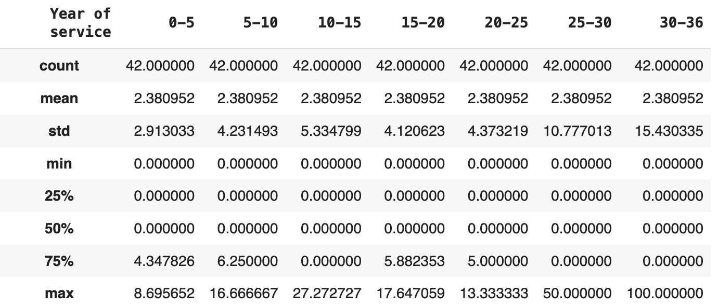
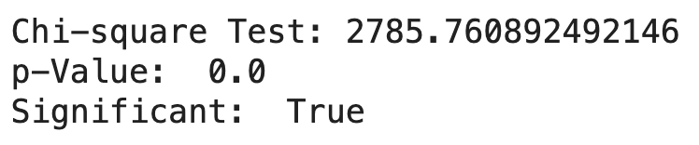
Analyzing dependency between variables salary and years of service
The statistics of frequency table presents the distribution of salaries across different year-of-service categories, with each group consisting of 42 respondents.
Observing the p-value of Chi-square test (0.00 < 0.05), we can conclude that there is a significant association between these two variables. It means that this relationship is not due to random chance, and salary levels are likely influenced by years of service.

Slide 16
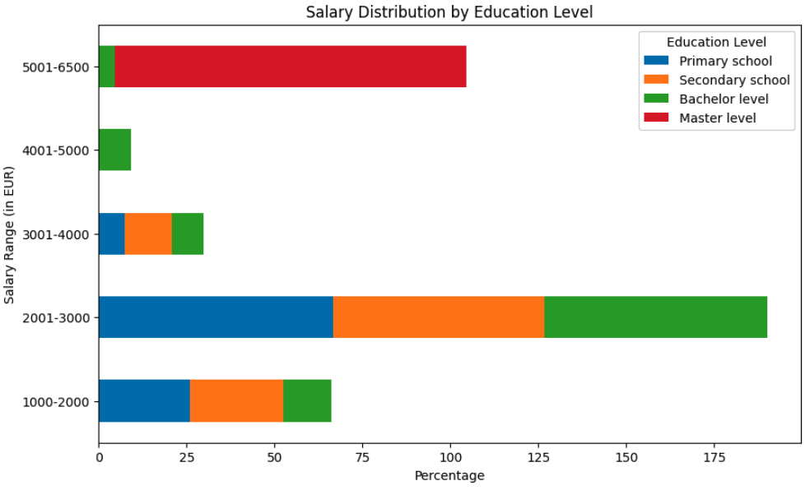
Analyzing dependency between variables salary and education
This bar chart allows us to observe how different salary ranges are distributed across various educational backgrounds.
Respondents with Master level education tend to be in the highest salary range (5001-6500 EUR), while those with Primary school education are mainly concentrated in the lower salary ranges (1000-3000 EUR).
We run a proper Chi-square test with a p-value of 0.0, it confirms that there is a strong dependency between salary and education level. This relationship highlights the critical role education plays in salary progression within the company, with higher degrees translating to greater salary opportunities.

Slide 17
The End
Group members:
Hiep Huynh
Dinh Nguyen
Dan Vu
Duy Tran

