Slide 1
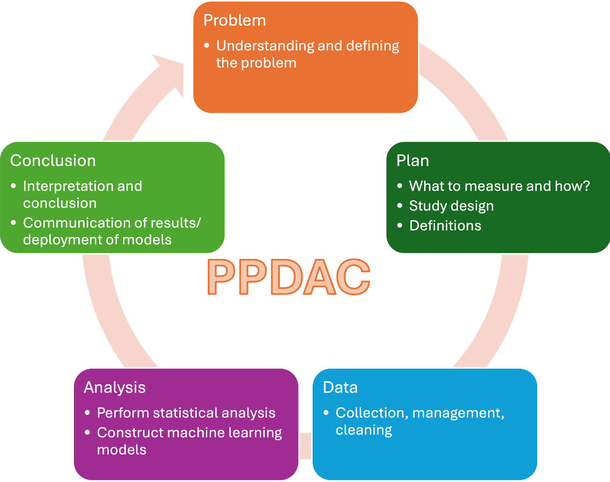
Data Science Pipeline
Immerse Education Tokyo 2025
Innovation

Slide 2
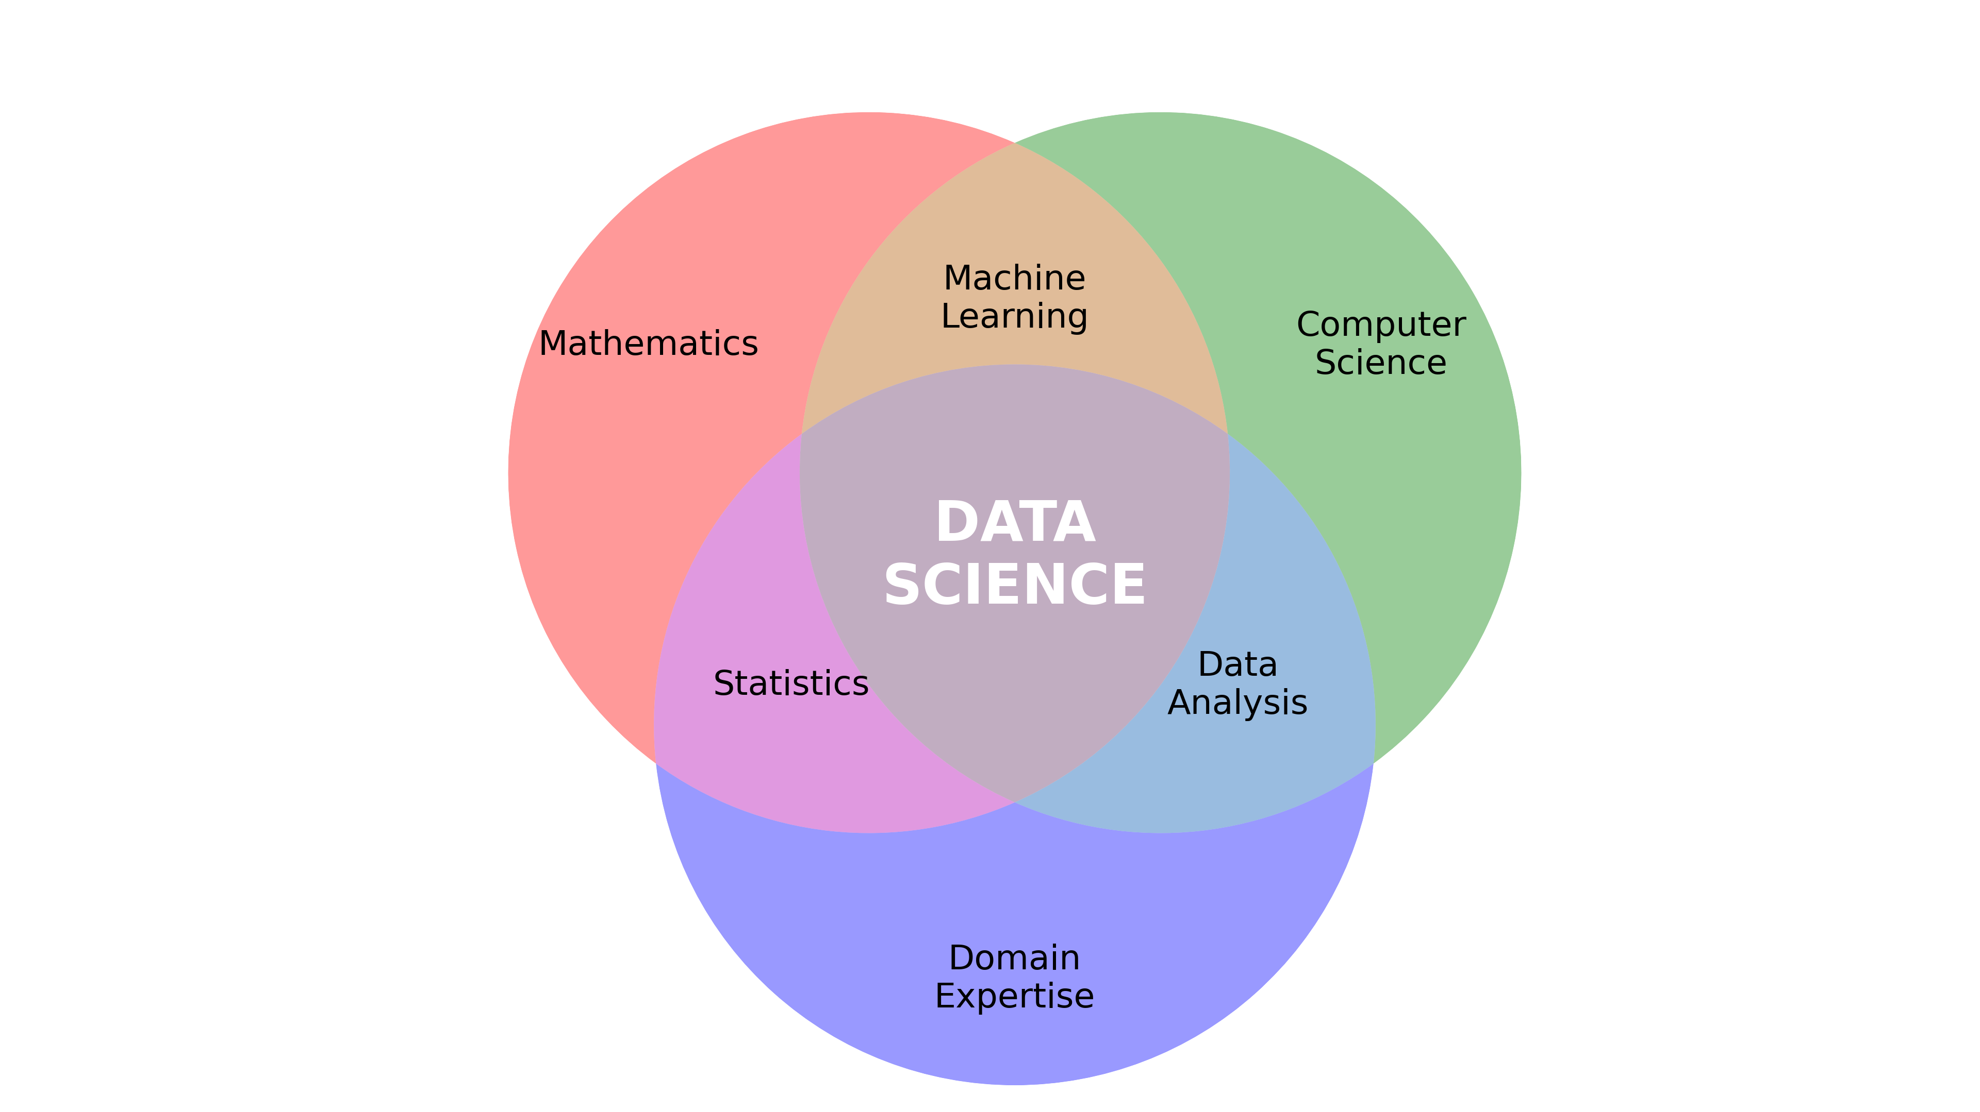
Review
Two important definitions from last week:
Data is a collection of facts, numbers, words, observations or other useful information.
Data science is the process of collecting, organizing, and analysing data to find useful information, make decisions, or solve problems.

Slide 3
Data Science Pipeline
Problem
Plan
Data
Analysis
Conclusion
Understanding and defining the problem
What to measure and how?
Collection, management, cleaning
Perform statistical analysis
Construct machine learning models
Interpretation and conclusion
Communication of results/ deployment of models
Study design
Definitions

Slide 4
Data Science Pipeline
Problem and Planning
Data
Analysis
Conclusion
Activity

Slide 5
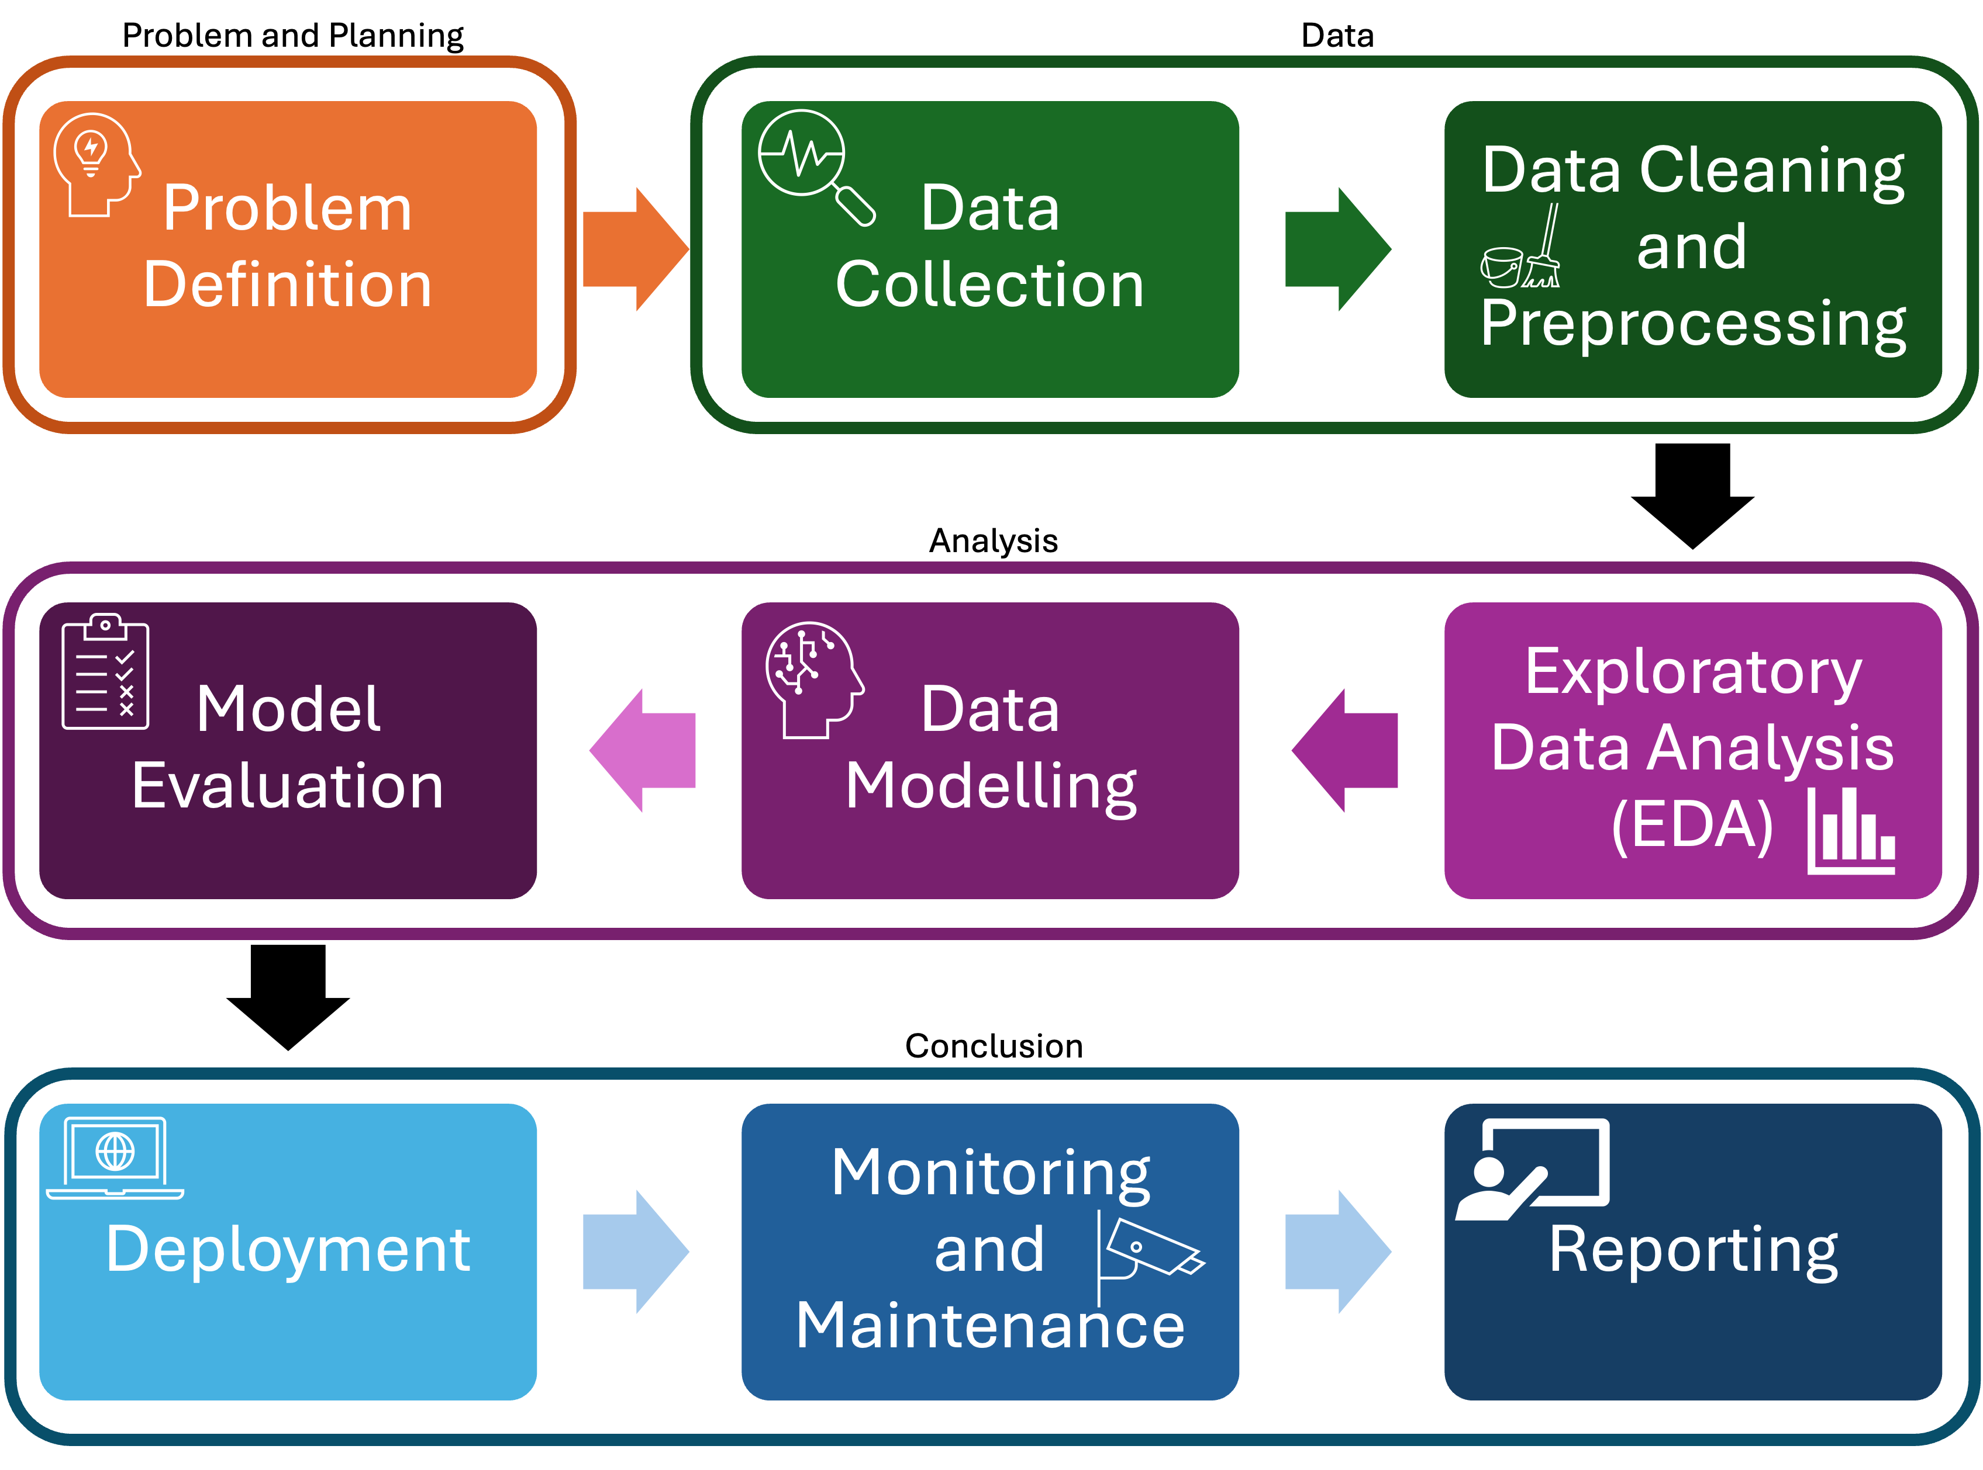
Data Science Pipeline
Data
Collection, management, cleaning
Analysis
Perform statistical analysis
Construct machine learning models
Conclusion
Interpretation and conclusion
Communication of results/ deployment of models

Slide 6
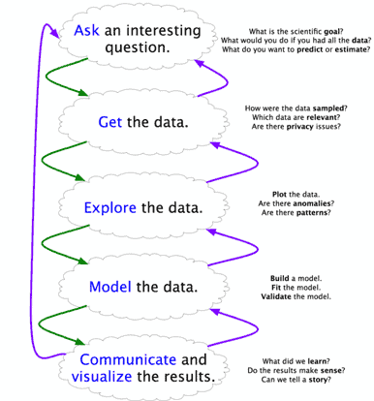
Data Science Pipeline
Alternatives

Slide 7


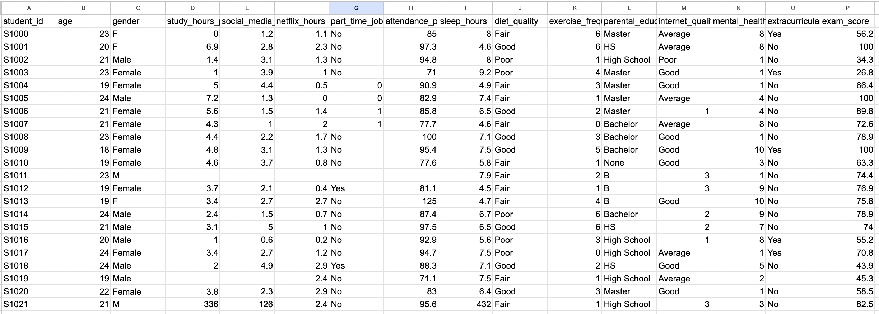
Data Collection
Data Cleaning and Preprocessing

Slide 8

Data Cleaning and Preprocessing
https://tinyurl.com/2s4tdseb

Slide 9


Exploratory Data Analysis (EDA)
https://tinyurl.com/bdpukce7

Slide 10
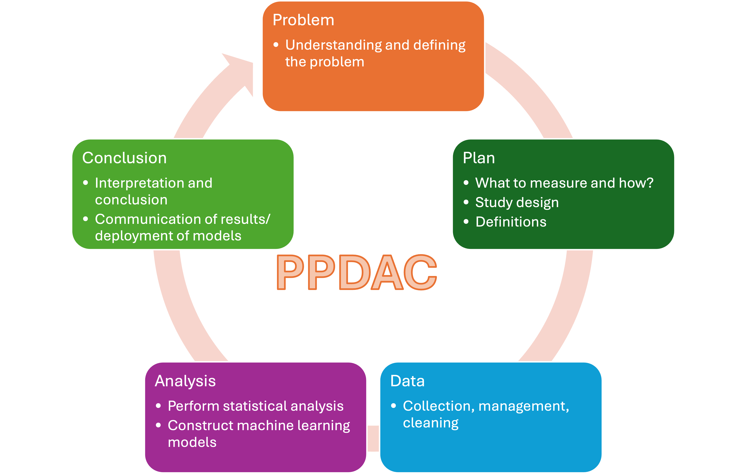
Preview
This afternoon we’ll do some introductory programming in Python
Tomorrow we’ll look a little bit at the kind of math you can expect to learn if you choose to study data science
We’ll learn about probability and linear algebra
We’ll also practice doing these using Python

