Slide 1
🎯 Account Intelligence Agent
André Oliveira

Slide 2
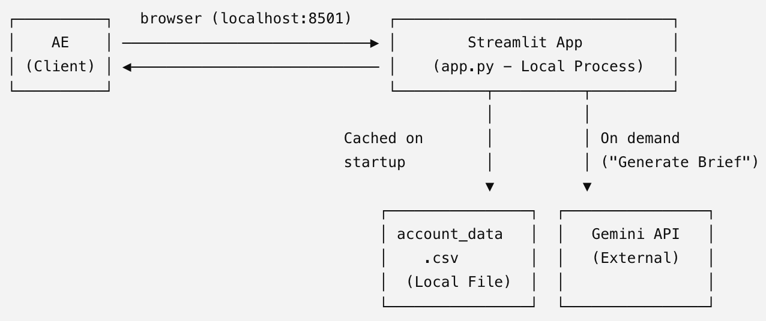
Overview
Account Executive's daily briefing tool.
It answers two questions:
Which accounts should I focus on today?
What should I know before my next meeting with them?
It surfaces the accounts that most need AE’s attention today, ranked by risk and growth signals, helping users prepare the next meeting with the customer.

Slide 3
Model
Validation target: Revenue was used only for validation, never as a score input.
Scoring model:
Risk: days_since_last_sales_activity + nr_support_tickets (negative correlation)
Opportunity: ai_usage + seat_utilization (positive correlation)
Urgency: Inverse of days_to_next_renewal
Priority = Urgency × max(Risk, Opportunity) to prioritize accounts with immediate business impact.
Methodology: Used percentile ranks (instead of min-max scaling) for robustness to outliers and consistent normalization across features.
Validation: Top 100 At Risk accounts averaged −36.3% revenue change, while top 100 Growth Opportunity accounts averaged +21.9%, compared with a dataset average of −1.4%, demonstrating strong alignment with real revenue outcomes.

Slide 4
Decisions
Region parsing fix: Prevented NA (North America) from being interpreted as missing values by configuring read_csv correctly.
Missing value handling: Imputed (~2–3%) missing ai_usage and days_since_last_sales_activity values instead of dropping accounts, using industry-based medians (higher explanatory power than segment or region).
Why not anomaly detection: Rejected because the task is prioritizing accounts, not detecting statistical outliers. With only a single snapshot (no historical baseline), anomalies would often be irrelevant to AEs.
Prompt design: Separated system instructions (persona, format, guardrails) from account data, instructed the model to treat free text as data only, and constrained outputs to concise meeting-prep sections with anti-hallucination safeguards.

Slide 5
Improvements
Test alternative weightings inside risk/opportunity drivers (currently equal 0.5/0.5, chosen because the underlying correlations are similar in magnitude) against the revenue-delta holdout, rather than eyeballing the correlation table.
Add per-account history if it existed, to properly justify (or rule out) an anomaly-detection layer for catching an account breaking its own pattern, rather than comparing accounts to each other.
Cache/persist AI-generated briefs to disk instead of only in Streamlit's in-memory cache, so they survive a server restart.
Add a lightweight eval of the LLM's brief quality (e.g. a rubric check for "did it use the transcript when available") rather than trusting output quality by inspection alone.

