Slide 1
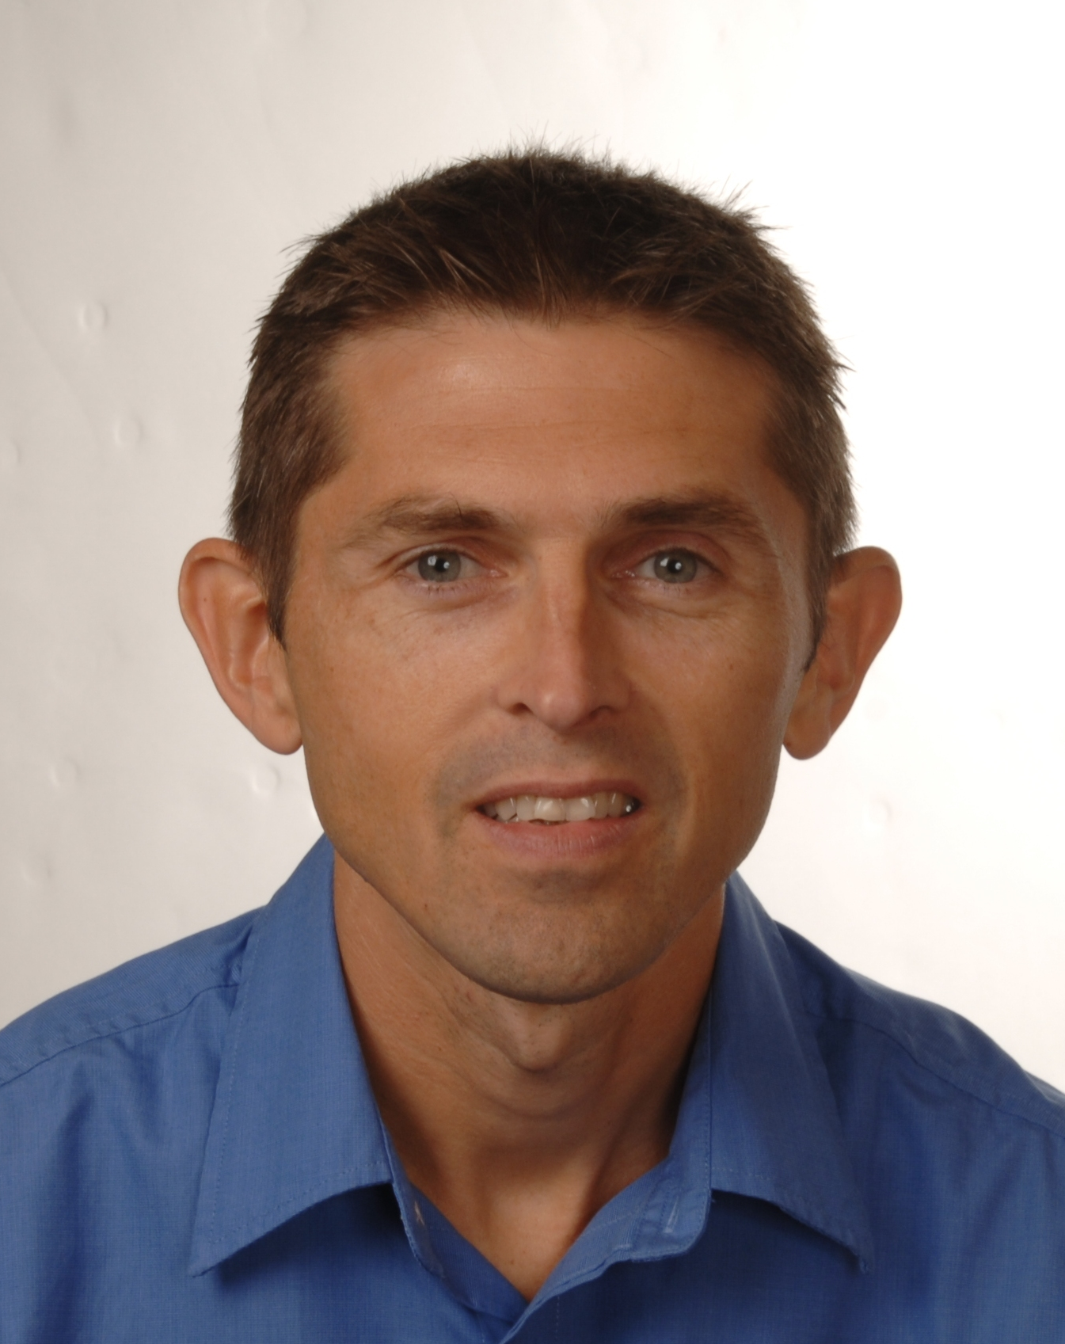
Angular in 4 Hours
https://olsensoft.com/angular
Andy Olsen
andyo@olsensoft.com

Slide 2
Course Contents
Introduction to Angular
Single-page applications
Data binding
View techniques
Component interactions
Annex
Additional techniques

Slide 3
Full Materials Online
You can get full materials for this course online
https://olsensoft.com/angular
What's there?
All the slides for this course
Comprehensive demos

