Slide 1
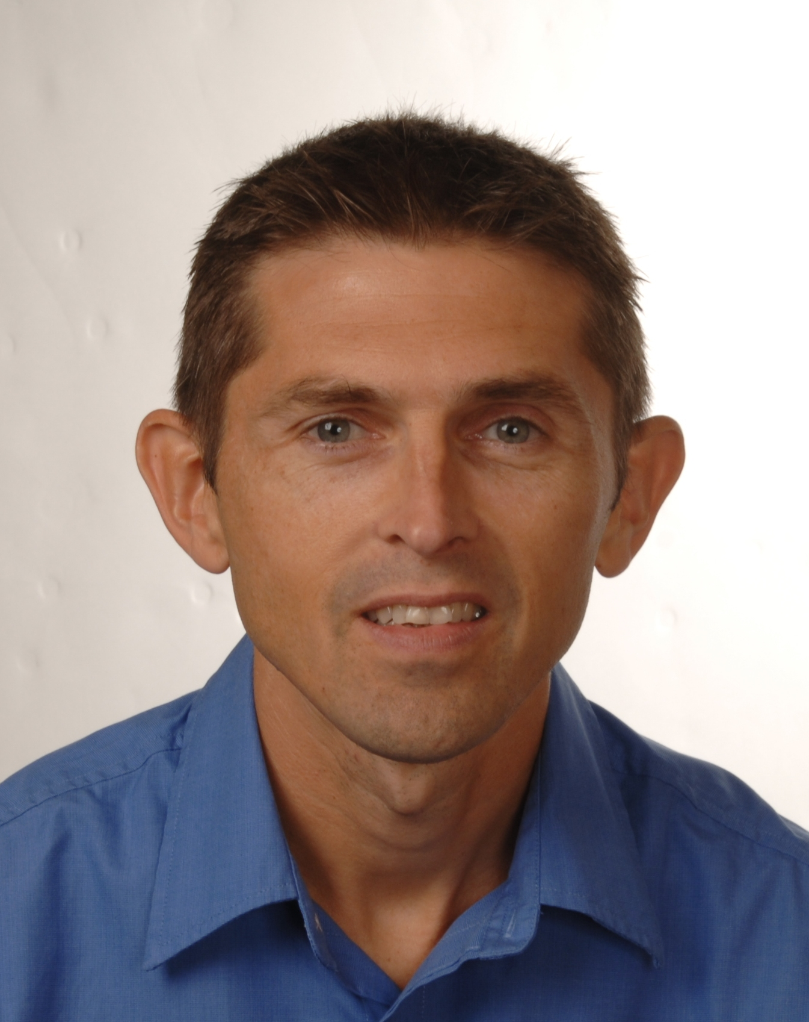
Hands-On JavaScript Deep Dive
https://olsensoft.com/jsdeepdive
Andy Olsen
andyo@olsensoft.com

Slide 2
Course Contents - Day 1
Getting started with ECMAScript
Destructuring
Miscellaneous APIs
Array enhancements
Object enhancements

Slide 3
Course Contents - Day 2
Classes
Collections
Iterables, iterators, and generators
Asynchronous JavaScript
Annex
Modules

Slide 4
Full Materials Online
You can get full materials for this course online
http://olsensoft.com/jsdeepdive
What's there?
All the slides for this course
Comprehensive step-by-step lab docs
All the lab code (and solutions ☺)

