Slide 1
Modules
Introduction to modules
Additional techniques

Slide 2
Section 1: Introduction to Modules
Setting the scene
Modules in ES6++
Example: Exporting artifacts
Example: Importing artifacts
Running the example
Importing files in HTML

Slide 3
Setting the Scene
A large web application might contain hundreds of classes and/or functions
It's infeasible to put all this code into a single source file
Instead, you split the code across separate source files
In JavaScript:
A source file can be interpreted as a module
There can be only one module per file
A module is defined in 1 file (can't span multiple files)
3

Slide 4
Modules in ES6++
A module is an ES6++ source file
Defines artifacts such as variables, functions, classes etc.
Artifacts are local and private to that module, by default
You can export artifacts from one module
Other modules can import them
4

Slide 5
Example: Exporting Artifacts
Here's module1.js, it exports some artifacts
console.log("Start of module1.js")
let a = 100
function funcA() {console.log('funcA')}
class ClassA {}
export let b = 42
export function funcB() {console.log('funcB')}
export class ClassB {}
console.log("End of module1.js")
module1.js
5

Slide 6
Example: Importing Artifacts (1 of 2)
Here's module2.js, it imports some artifacts
import { b } from './module1'
import { funcB, ClassB } from './module1'
console.log("Start of module2.js")
console.log(b)
funcB()
let obj = new ClassB()
console.log("End of module2.js")
module1.js
6

Slide 7
Example: Importing Artifacts (2 of 2)
When you import artifacts:
Put your import statements at the top of the file
Use {} to import named artifacts (more on this shortly)
Typically omit the .js file extension
7

Slide 8
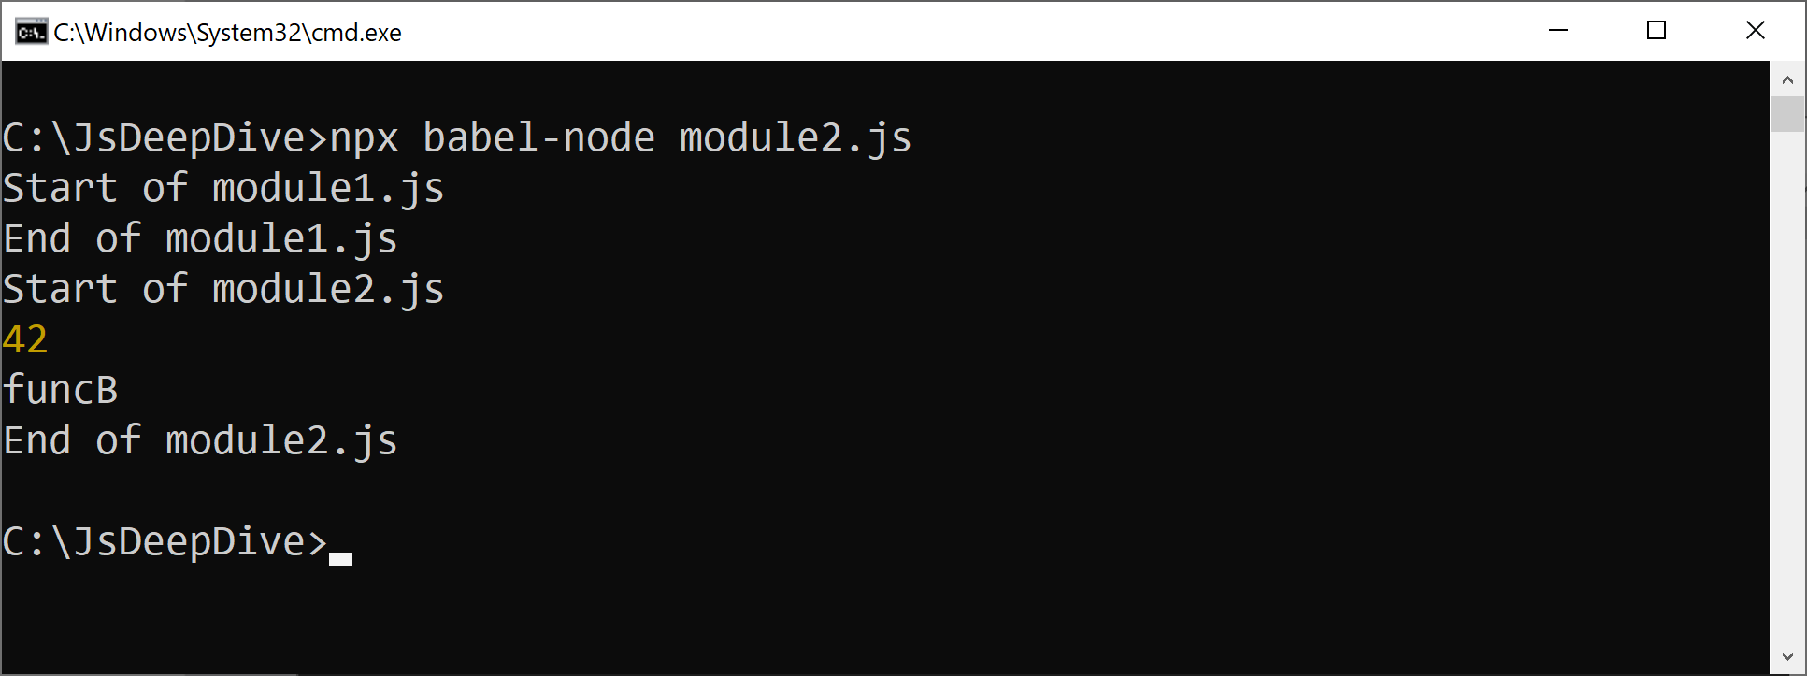
Running the Example
You can run the example using Babel, as follows
8

Slide 9
Importing Files in HTML (1 of 2)
In HTML, to import a script:
In HTML, to import a module:
There are important differences on how HTML treats scripts and modules - see next slide for details
<script src="script1.js"></script>
<script src="mod1.js" type="module"></script>
9

Slide 10
Importing Files in HTML (2 of 2)
In a script file:
Top-level variables are global across all files
Default value of this is window
Script file is loaded synchronously
In a module file:
Top-level variables are local to the module
Default value of this is undefined
Module file is loaded asynchronously
10

Slide 11
Section 2: Additional Technqiues
Alternative import syntax
Default exports

Slide 12
Alternative Import Syntax
Imagine module1.js exports some artifacts:
There are several ways to import these artifacts:
export let b = 42
export function funcB() {console.log('funcB')}
export class ClassB {}
import {b, funcB, ClassB} from './module1'
import {b as x, funcB, ClassB} from './module1'
import * as mod1 from './module1'
let obj = new mod1.ClassB()
12

Slide 13
Default Exports
A module can optionally specify a default export
Via the export default keywords
There can only be one default export per module
You use a different syntax to import a default export
Omit the {} around the name
export let b = 42
export function funcB() {console.log('funcB')}
export default class ClassB {}
import {b, funcB} from './module1'
import ClassB from './module1'
13

Slide 14
Summary
Introduction to modules
Additional techniques

