Slide 1
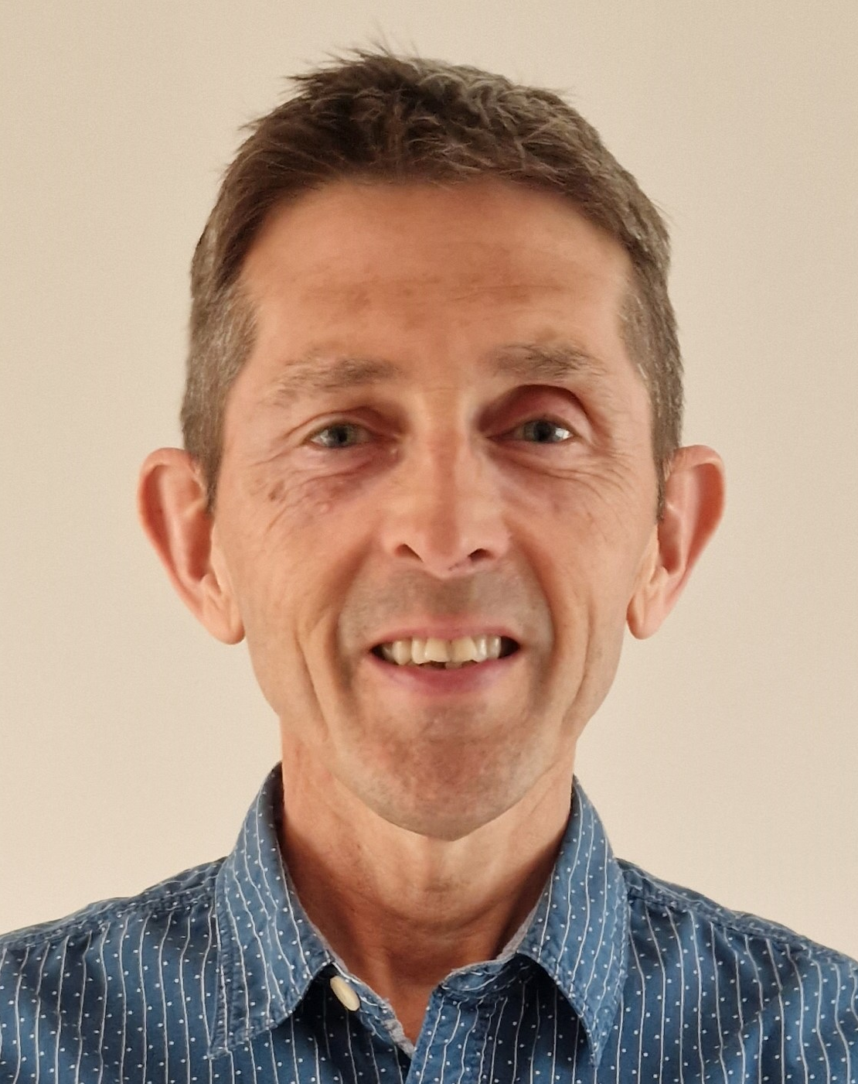
SOLID Python Development Techniques
https://olsensoft.com/python-solid
https://github.com/andyolsen/python-solid
Andy Olsen
andyo@olsensoft.com

Slide 2
Course Contents
Using Object Orientation Effectively
Python Typing
Test Automation
SOLID Principles and Best Practices
Appendix
Pydantic

