Slide 1
Creating Spring Boot Applications
Creating a console application
Creating a web application
Defining application properties

Slide 2
1. Creating a Console Application
Overview
Creating a Spring Boot project
Specifying project dependencies
Understanding the application structure
Understanding the Maven POM file
Understanding the application code
Running the application
Demo project: demo-simpleapp-console

Slide 3
Overview
IntelliJ IDEA Ultimate has excellent support for Spring
Spring Boot and Spring Framework
IntelliJ Java dependencies:
JDK (e.g. JDK 21)
Set JAVA_HOME to the JDK folder
Set PATH to include the JDK binary folder

Slide 4
Creating a Spring Boot Project
Start IntelliJ, click New Project, and select Spring Initializr
Specify project info as follows:
Enter a suitable project name and location
Language - Java
Type - Maven
Enter a suitable group ID, artifact ID, and package name
Project SDK - Java 21
Java version - 21
Packaging - Jar
Then click Next

Slide 5
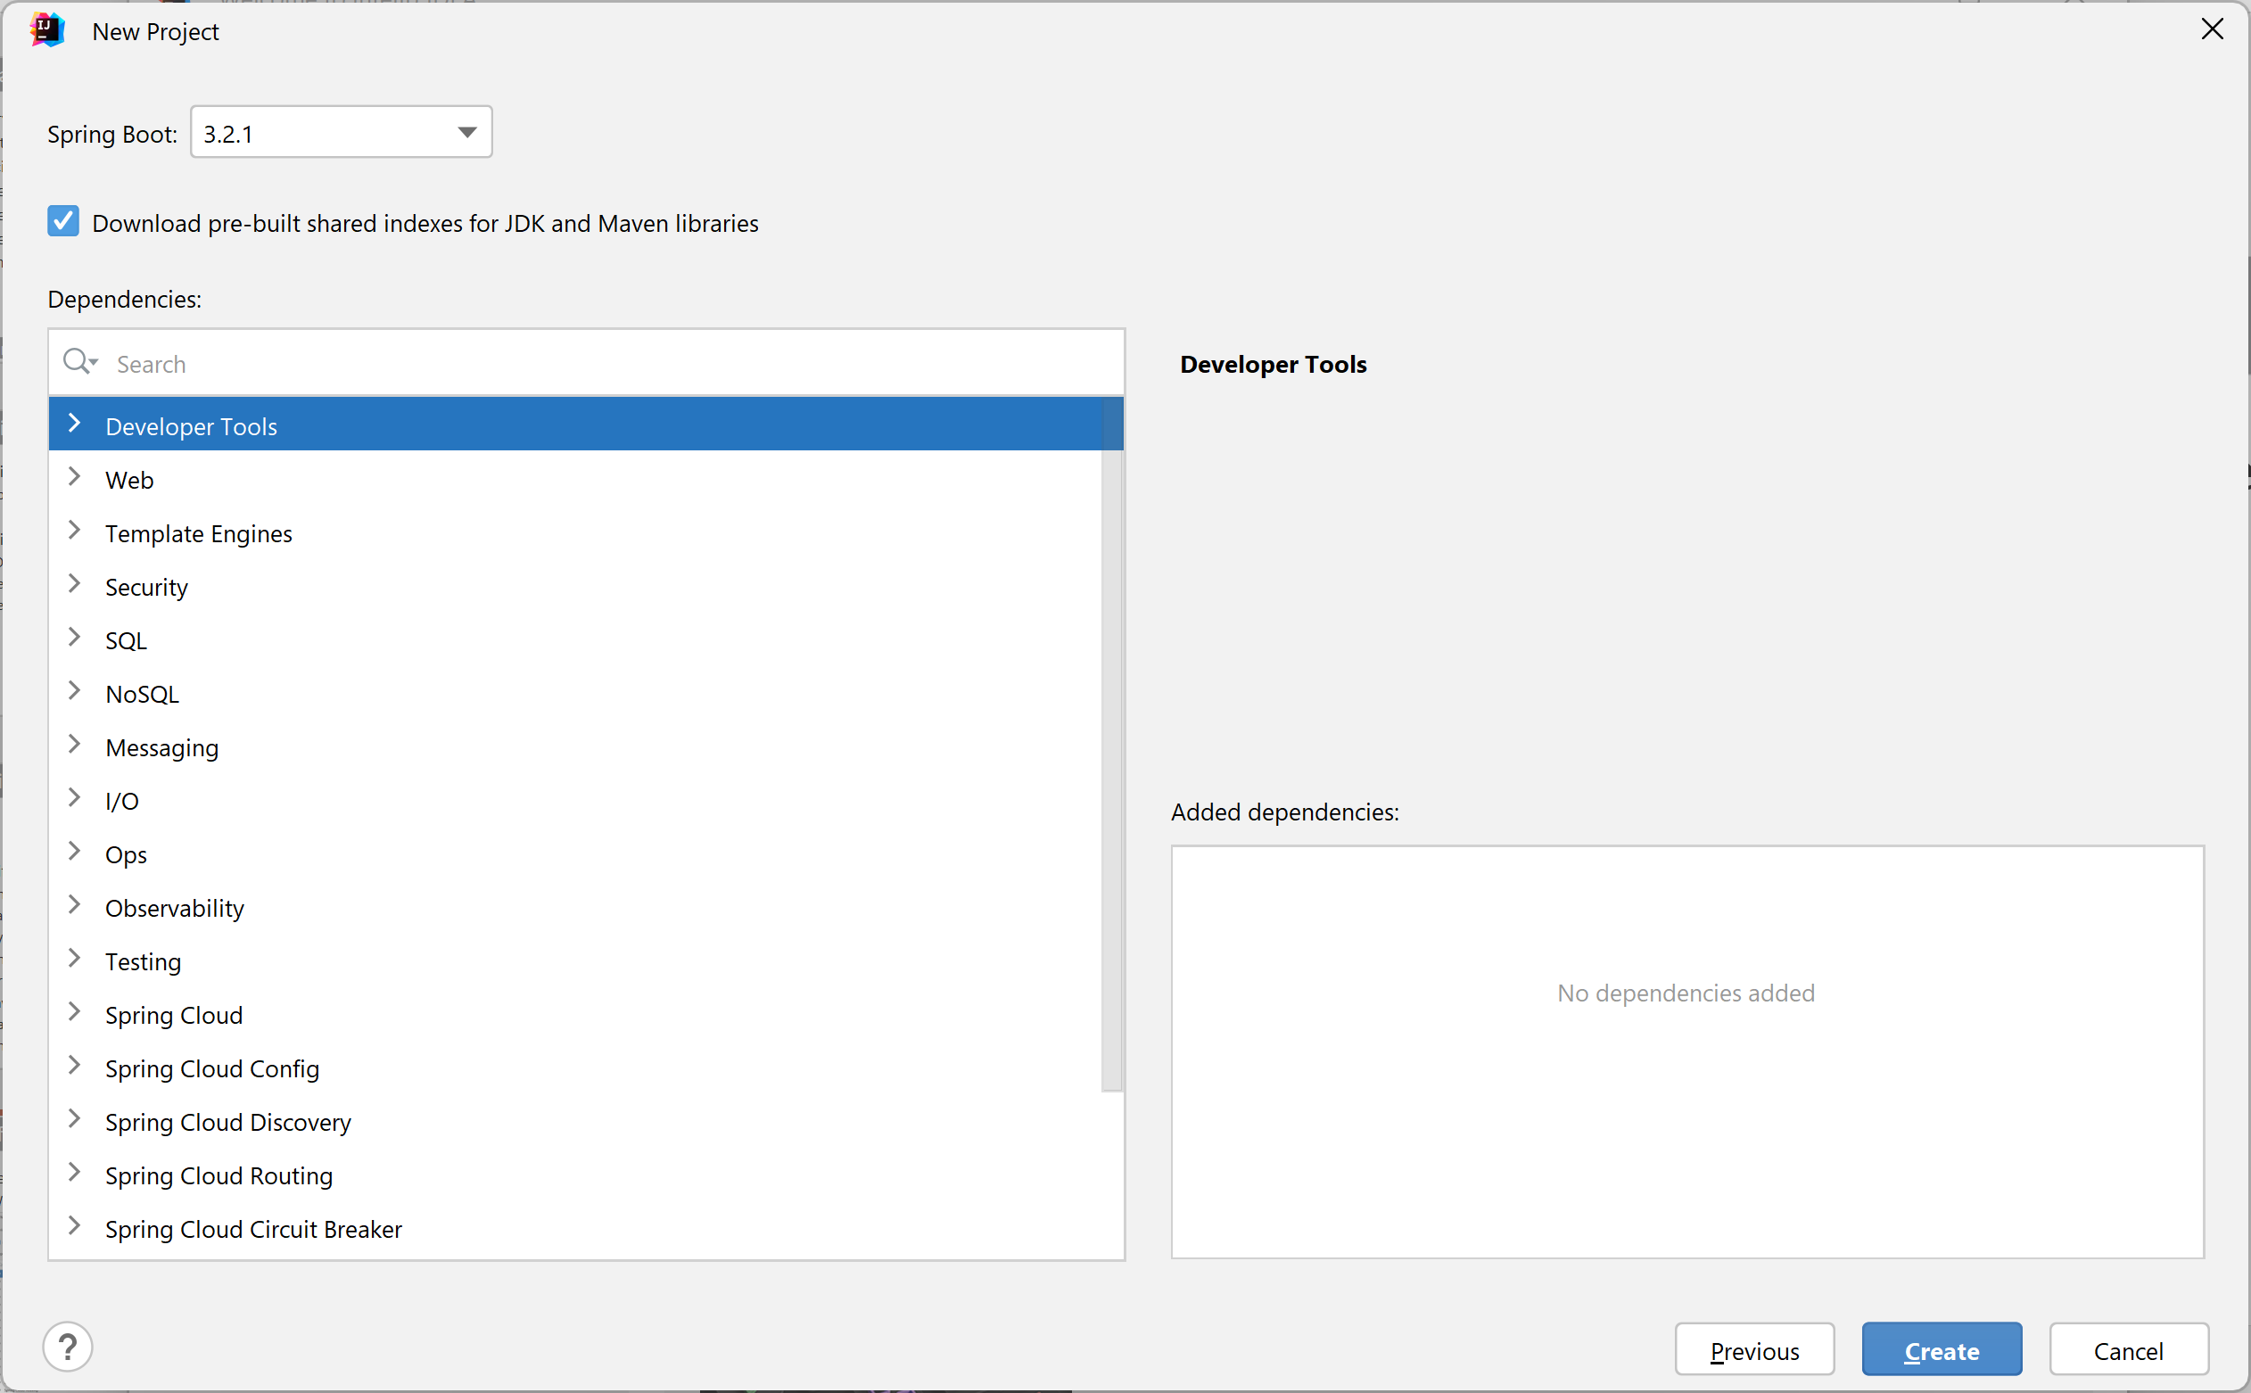
Specifying Project Dependencies
In the next window you can add dependencies to your project
We don't need any dependencies yet, so just click Create

Slide 6
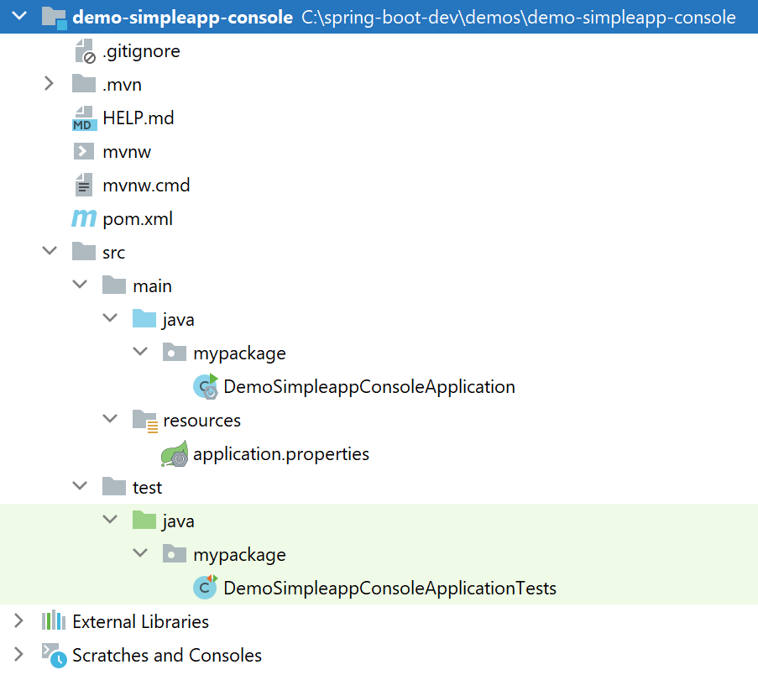
Understanding the Application Structure
The generated application is a regular Maven project

Slide 7
Understanding the Maven POM File
Here are the relevant sections in the Maven POM file:
<project … >
…
<parent>
<groupId>org.springframework.boot</groupId>
<artifactId>spring-boot-starter-parent</artifactId>
<version>3.2.1</version>
<relativePath/>
</parent>
<dependencies>
<dependency>
<groupId>org.springframework.boot</groupId>
<artifactId>spring-boot-starter</artifactId>
</dependency>
<dependency>
<groupId>org.springframework.boot</groupId>
<artifactId>spring-boot-starter-test</artifactId>
<scope>test</scope>
</dependency>
</dependencies>
…
Parent POM
Spring Boot dependency
Spring Boot test dependency
pom.xml

Slide 8
Understanding the Application Code
Here's the generated application code:
@SpringBootApplication is equivalent to:
@Configuration
@EnableAutoConfiguration
@ComponentScan
import org.springframework.boot.SpringApplication;
import org.springframework.boot.autoconfigure.SpringBootApplication;
@SpringBootApplication
public class DemoSimpleappConsoleApplication {
public static void main(String[] args) {
SpringApplication.run(DemoSimpleappConsoleApplication.class, args);
}
}
DemoSimpleappConsoleApplication.java

Slide 9
Running the Application (1 of 2)
You can build/run the app via the mvn command in the project root directory as follows:
If you don't have Maven installed separately on your machine, you can run the following command instead:
It's also possible to run the application directly in IntelliJ
Right-click in the main class, and click Run
mvn spring-boot:run
mvnw spring-boot:run

Slide 10
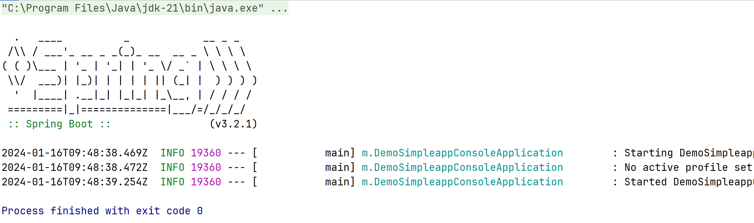
Running the Application (2 of 2)
This is the application output
Displays a "Spring Boot" banner
The app terminates immediately, because it's so simple 😊

Slide 11
2. Creating a Web Application
Overview
Creating a Spring Boot web project
Specifying project dependencies
Understanding the web application structure
Understanding the Maven POM file
Adding web content
Running the application
Pinging the application
Demo project: demo-simpleapp-web

Slide 12
Overview
Spring Boot applications are typically "web apps"
Listen for HTTP requests from web client (e.g. a browser)
Return static or dynamic content
We'll see how to return static content for now
Later we'll see how to return dynamic content, via REST services
Web client
HTTP request
Spring Boot web app
HTTP response
Static or dynamic content

Slide 13
Creating a Spring Boot Web Project
Start IntelliJ, click New Project, and select Spring Initializr
Specify project info as follows:
Enter a suitable project name and location
Language - Java
Type - Maven
Enter a suitable group ID, artifact ID, and package name
Project SDK - Java 21
Java version - 21
Packaging - Jar
Then click Next

Slide 14
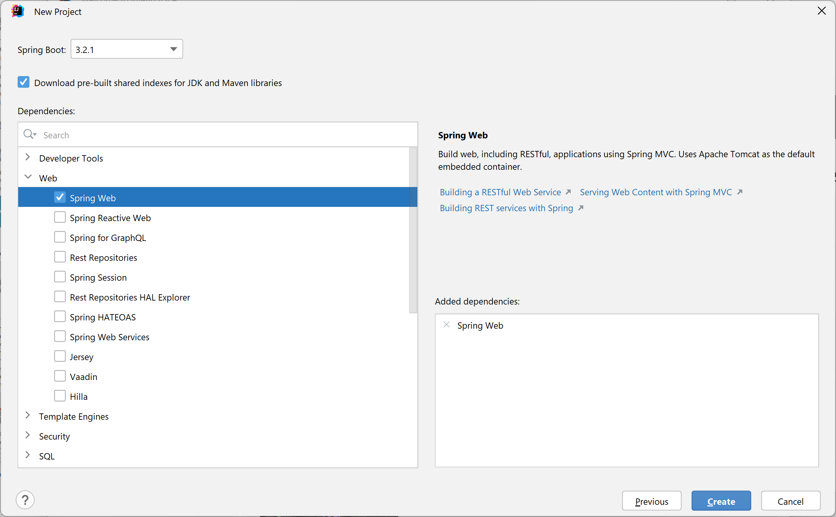
Specifying Project Dependencies
In the next window you can add dependencies to your project
Expand Web and select Spring Web

Slide 15
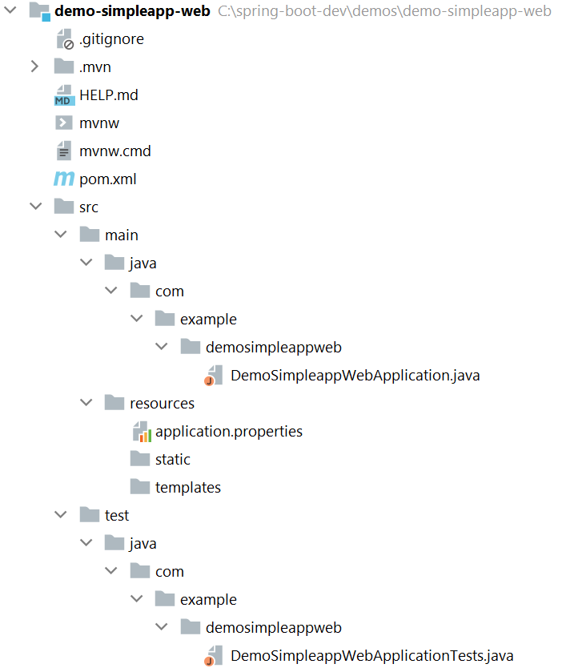
Understanding the Web Application Structure
The generated application is a regular Maven web project:
Put static web content here

Slide 16
Understanding the Maven POM File
Here's the relevant section in the Maven POM file:
<project … >
…
<dependencies>
<dependency>
<groupId>org.springframework.boot</groupId>
<artifactId>spring-boot-starter-web</artifactId>
</dependency>
<dependency>
<groupId>org.springframework.boot</groupId>
<artifactId>spring-boot-starter-test</artifactId>
<scope>test</scope>
</dependency>
</dependencies>
…
Spring Boot web dependency
pom.xml

Slide 17
Adding Web Content
You can add static web content in the following directory:
src\main\resources\static
For example, add an index.html file:
<!DOCTYPE html>
<html lang="en">
<head>
<meta charset="UTF-8">
<title>Home</title>
</head>
<body>
Hello world!
</body>
</html>
index.html

Slide 18
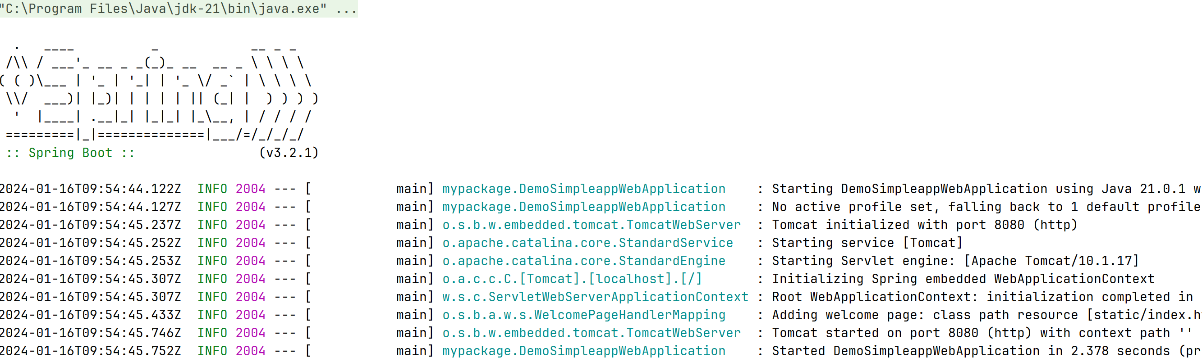
Running the Application
To run the application:
Right-click the Java app file, then click Run
Compiles the code, bundles into a JAR, then runs the JAR
The application has an embedded Tomcat web server

Slide 19
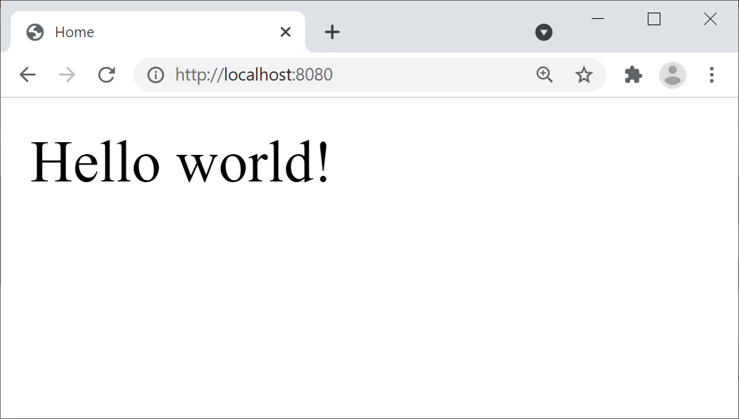
Pinging the Application
Open a browser and go to http://localhost:8080
Renders index.html (a standard welcome page in Java web)

Slide 20
3. Defining Application Properties
Overview of application properties
Editing application properties
Restarting the application

Slide 21
Overview of Application Properties
Spring Boot applications have a standard text file named application.properties
Very important!
The recommended place to set application properties
i.e. name=value pairs
You can also use YAML if you like
YAML = "YAML Ain't Markup Language"
More on YAML files later…
21

Slide 22
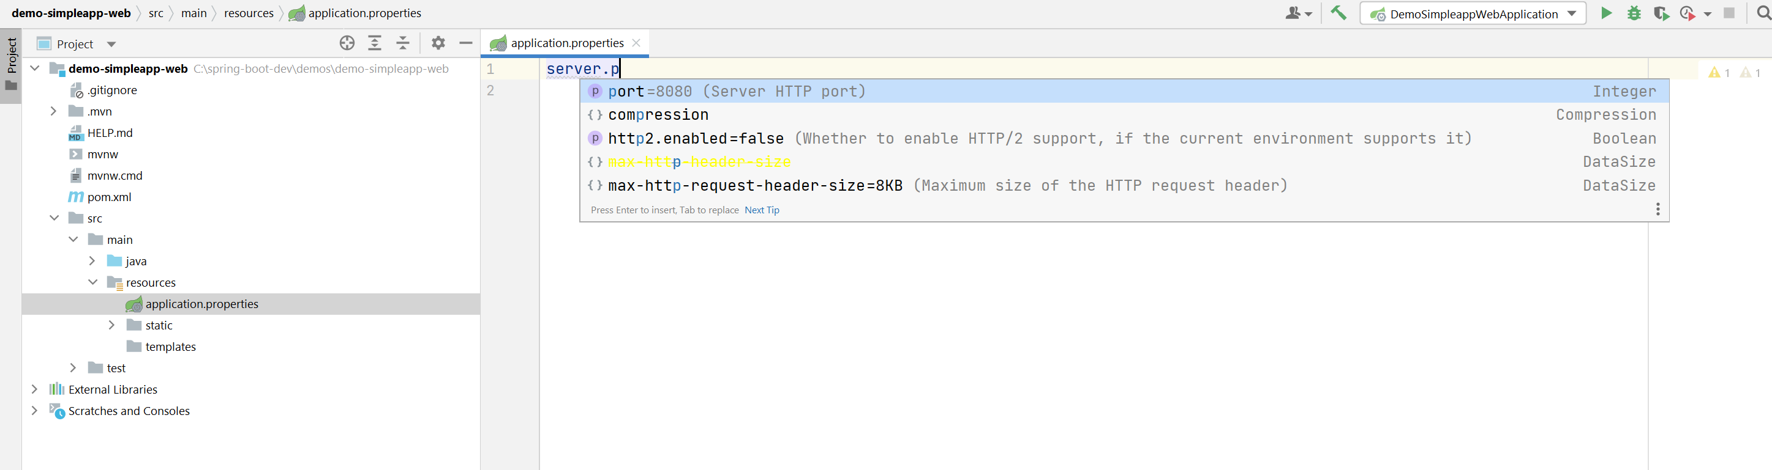
Editing Application Properties
To help you edit application.properties, IntelliJ provides a Spring Properties Editor tool
Provides nice content assistance and error checking
server.port=8111
22

Slide 23
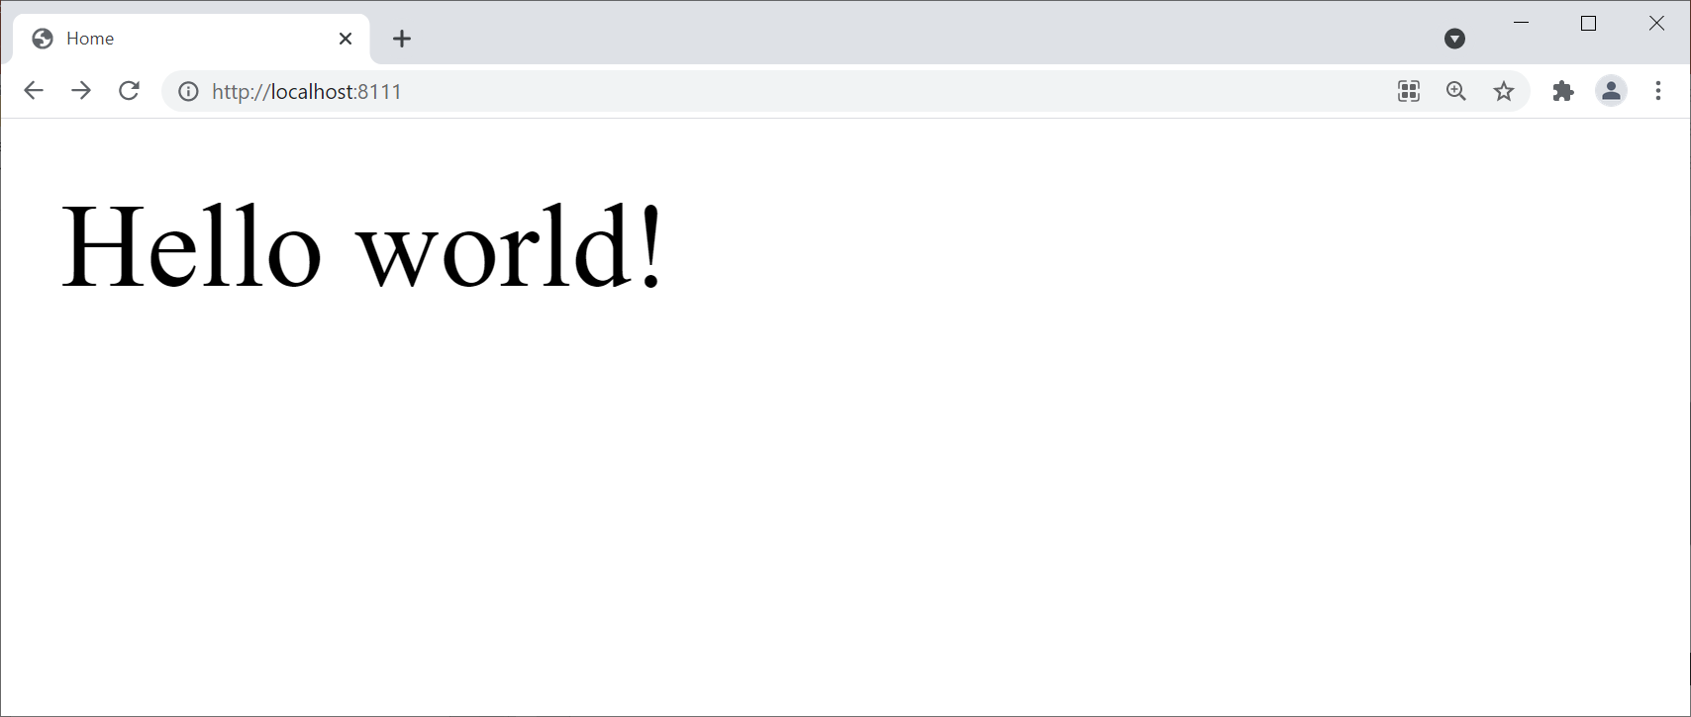
Restarting the Application
Restart the application, and verify Tomcat starts on the new port number, 8111
Ping the Web server using the new port number, 8111
23

Slide 24
Summary
Creating a console application
Creating a web application
Defining application properties

