Slide 1
Spring Boot Techniques
Setting app properties at the command line
Specifying which properties file to use
Defining YAML properties files
Using Spring profiles
Spring Boot Actuator
Demo project: demo-spring-boot-techniques

Slide 2
1. Setting App Properties at the Command Line
Recap of application properties
Source of external configuration
Setting properties at the command line
Demo package: demo.commandlineproperties

Slide 3
Recap of Application Properties
A Spring Boot application can define properties in an application.properties file:
You can inject properties via @Value("${propName}")
name=John Smith
application.properties
@Component
public class MyBean1 {
@Value("${name}")
private String name;
…
}
MyBean1.java

Slide 4
Source of External Configuration
Spring Boot lets you define application properties in many places, such as:
Command-line arguments
Environment variable SPRING_APPLICATION_JSON
Operating system environment variables
Application properties outside your JAR
Application properties inside your JAR

Slide 5
Setting Properties at the Command Line
If you define command-line args that start with --
Spring Boot converts them into application properties
E.g., set the name property via a command-line arg:
Let's see an example in IntelliJ:
Edit configurations
Specify a command-line arg, as shown above
Run the configuration
--name="Mary Jones"

Slide 6
2. Specifying which Properties File to Use
Location of properties files
Specifying a different properties file
Demo package: demo.differentpropertiesfile

Slide 7
Location of Properties Files
SpringApplication looks in the following places to find properties files (highest priority first):
/config subdirectory of your Java app directory
Your Java app directory
/config package on classpath
Root package on classpath

Slide 8
Specifying a Different Properties File (1 of 2)
You can tell Spring to use a different properties file:
Alternatively, you can set the SPRING_CONFIG_NAME environment variable
@SpringBootApplication
public class Application {
private static void demo2(String[] args) {
System.setProperty("spring.config.name", "app2");
ApplicationContext ctx = SpringApplication.run(Application.class, args);
…
name=Bill Jones
app2.properties
Application.java

Slide 9
Specifying a Different Properties File (2 of 2)
You can also use a command-line argument to specify which application properties file to use:
This enables you to specify a properties file as part of your overall CI/CD process
E.g. in a Jenkins build script
--spring.config.name=app2

Slide 10
3. Defining YAML Properties Files
Overview of YAML files
Using YAML properties in beans - technique 1
Using YAML properties in beans - technique 2
Demo package: demo.yamlpropertiesfiles

Slide 11
Overview of YAML Files
Spring Boot supports YAML as an alternative format for defining application properties:
YAML is convenient for specifying hierarchical config data
contact:
tel: 555-111-2222
email: contact@mydomain.com
web: http://mydomain.com
app3.yml

Slide 12
Using YAML Properties in Beans - Technique 1
Here's one way to use YAML properties in a bean:
@Component
public class MyBean3a {
@Value("${contact.tel}")
private String tel;
@Value("${contact.email}")
private String email;
@Value("${contact.web}")
private String web;
…
}
MyBean3a.java

Slide 13
Using YAML Properties in Beans - Technique 2
Here's another way to use YAML properties in a bean:
You also need this dependency:
@Component
@ConfigurationProperties(prefix="contact")
public class MyBean3b {
private String tel;
private String email;
private String web;
…
// Plus getters and setters - these are essential!
}
MyBean3b.java
<dependency>
<groupId>org.springframework.boot</groupId>
<artifactId>spring-boot-configuration-processor</artifactId>
</dependency>
pom.xml

Slide 14
4. Using Spring Profiles
Overview
Defining profile-specific components
Defining profile-specific properties
Setting the active profile
Demo package: demo.profiles

Slide 15
Overview
Spring profiles provide a way to segregate parts of your application configuration
So, configuration is only available in certain environments
For example:
"development" profile
"production" profile

Slide 16
Defining Profile-Specific Components
You can annotate component classes with @Profile:
public interface MyBean4 {}
@Component
@Profile("development")
public class MyBean4Dev implements MyBean4 {
@Override
public String toString() { return "Hello from MyBean4Dev"; }
}
MyBean4Dev.java
@Component
@Profile("production")
public class MyBean4Prod implements MyBean4 {
@Override
public String toString() { return "Hello from MyBean4Prod"; }
}
MyBean4Prod.java

Slide 17
Defining Profile-Specific Properties
You can also define profile-specific properties:
Alternatively, define profile-specific property files:
app4-development.yml, app4-production.yml
apiserver:
address: 192.168.1.100
port: 8080
---
spring:
config:
activate:
on-profile: development
apiserver:
address: 127.0.0.1
---
spring:
config:
activate:
on-profile: production
apiserver:
address: 192.168.1.120
Default values for properties
Properties for "development" profile
Properties for "production" profile
app4.yml

Slide 18
Setting the Active Profile
You must tell Spring what is the active profile
Set the spring.profiles.active property
To set the active profile via application properties:
To set it at the command-line:
spring.profiles.active=development
app4.properties
--spring.profiles.active=production

Slide 19
Annex: Spring Boot Actuator
Overview of Spring Boot Actuator
Enabling the Actuator
Enabling Actuator endpoints
Viewing mappings
Health monitoring
Gathering metrics
Additional built-in actuator endpoints
Demo project: demo-actuator

Slide 20
Overview of Spring Boot Actuator
Spring Boot Actuator is a sub-project of Spring Boot
Includes a number of additional features to help you monitor and manage your application when it’s pushed to production
You can manage and monitor your application using:
HTTP endpoints
JMX
Remote shell (SSH or Telnet)

Slide 21
Enabling the Actuator
The simplest way to enable the Actuator is to add spring-boot-starter-actuator to your POM file
<dependencies>
<dependency>
<groupId>org.springframework.boot</groupId>
<artifactId>spring-boot-starter-actuator</artifactId>
</dependency>
…
</dependencies>

Slide 22
Enabling Actuator Endpoints
From version 2 onwards, Spring Boot Actuator only has the following endpoints enabled by default:
/actuator/health
/actuator/info
To enable other Spring Boot Actuator endpoints, set the following application property:
application.properties
management.endpoints.web.exposure.include=*

Slide 23
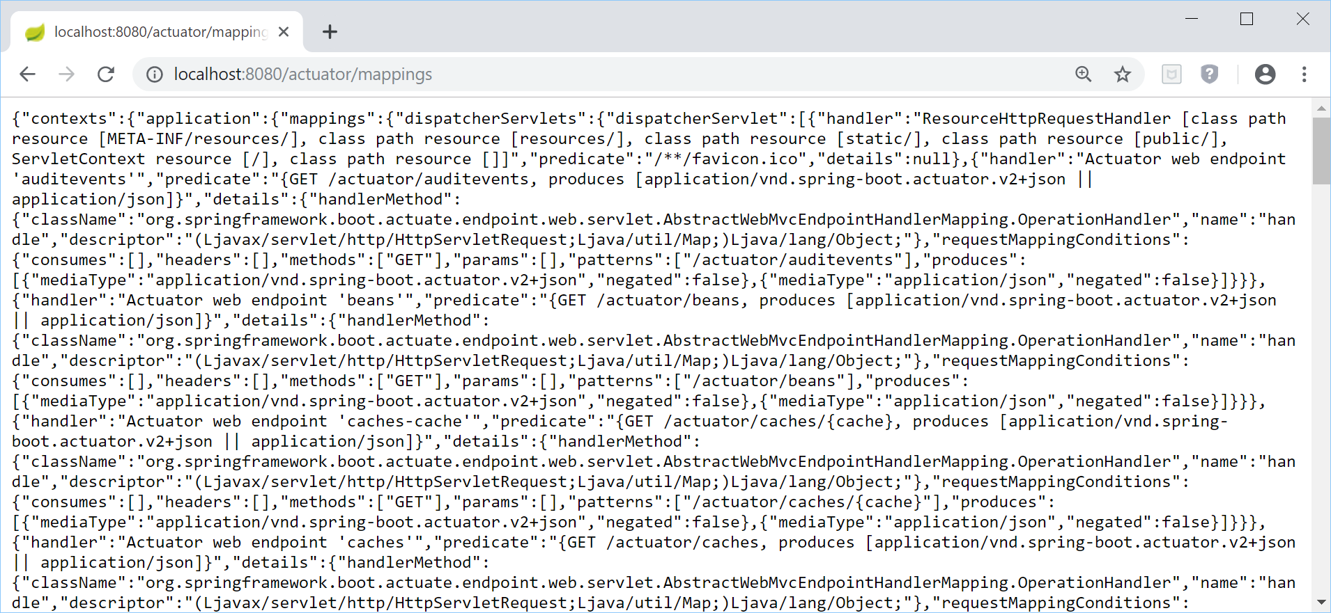
Viewing Mappings
Spring Boot Actuator endpoints allow you to monitor and interact with your application, e.g. actuator/mappings
Note:
Depending on your Spring Boot version, you might need to allow access to the Actuator endpoints

Slide 24
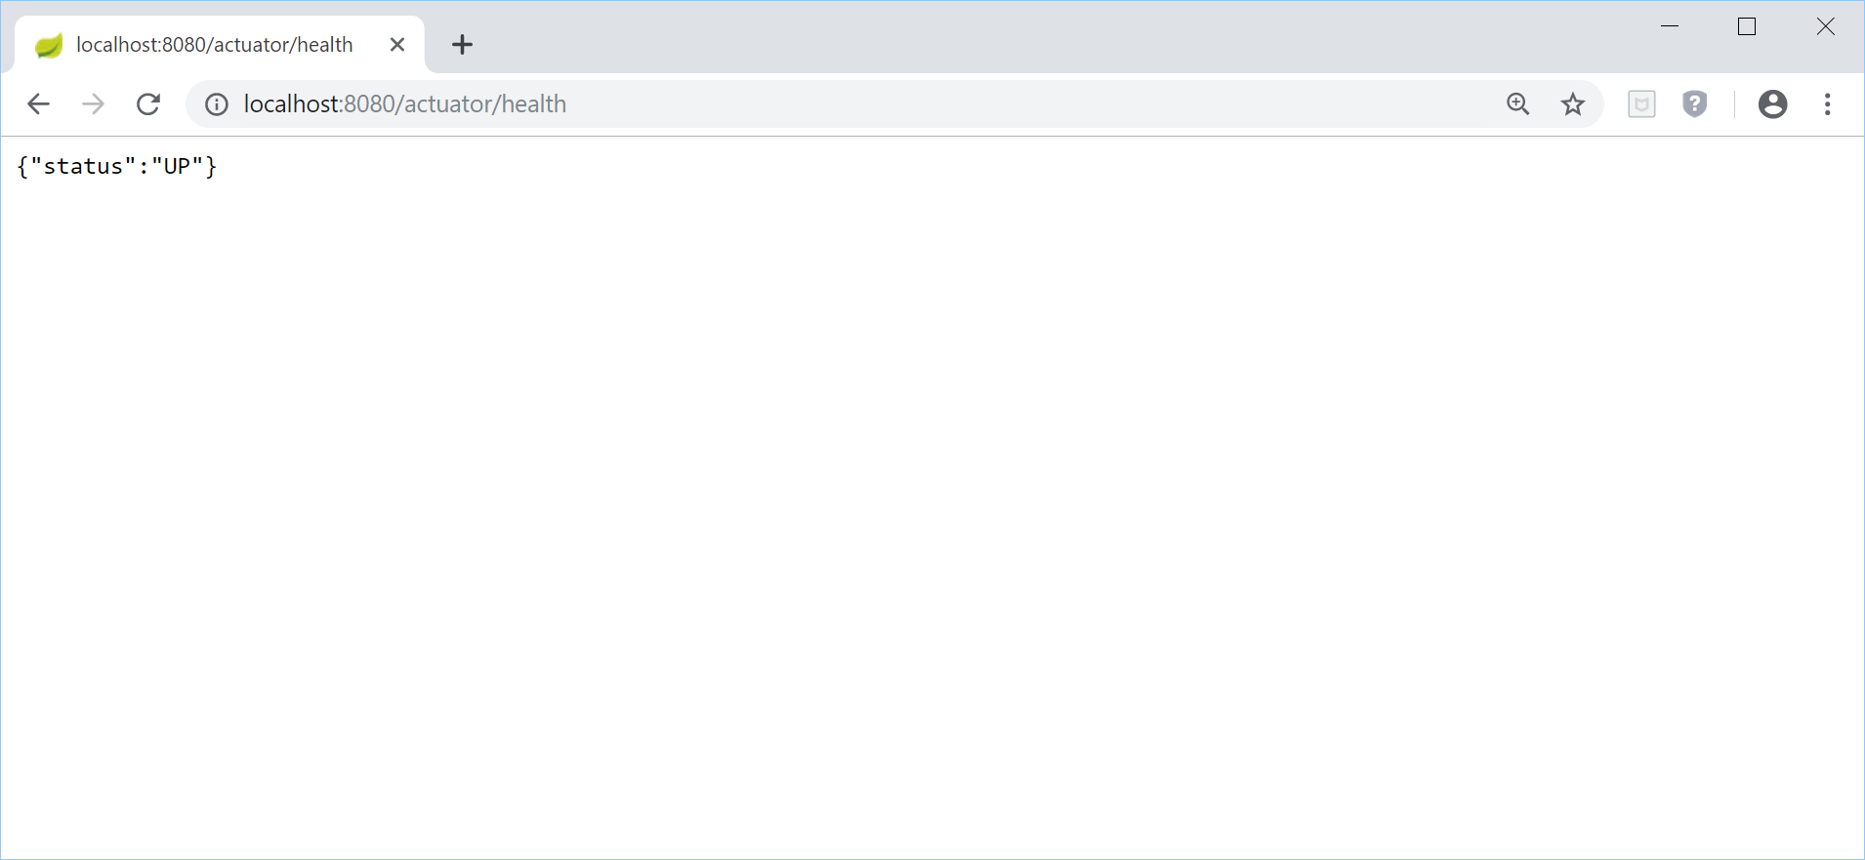
Health Monitoring
The actuator/health endpoint provides basic health information about your application

Slide 25
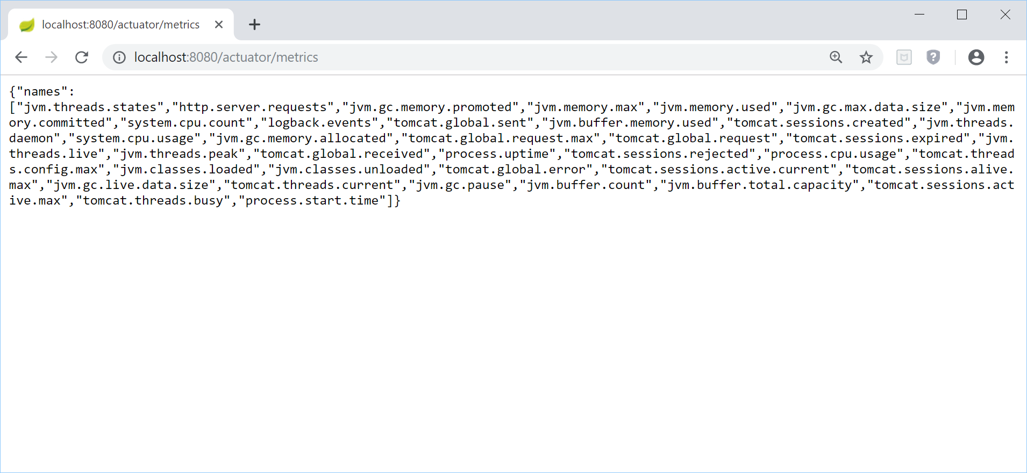
Gathering Metrics
The actuator/metrics endpoint provides metrics that help you identify bottlenecks and optimize performance
To get info for any of these metrics, append the metric name - e.g. actuator/metrics/jvm.memory.max

Slide 26
Additional Built-in Actuator Endpoints
Here are some more built-in Actuator endpoints …
/actuator/beans - Lists all the beans in the app
/actuator/configprops - Lists @ConfigurationProperties
/actuator/env - Lists environment variables
/actuator/scheduledtasks - Lists scheduled tasks in the app
/actuator/threaddump - Performs a thread dump
For full details of all the built-in Actuator endpoints, and info on how to define custom endpoints, see:
https://docs.spring.io/spring-boot/docs/current/reference/html/production-ready-features.html

Slide 27
Summary
Setting app properties at the command line
Specifying which properties file to use
Defining YAML properties files
Using Spring profiles
Spring Boot Actuator

