Slide 1
Additional REST Service Techniques
Consuming REST services
Microservice architecture
Circuit breakers

Slide 2
1. Consuming REST Services
Overview
How to use RestClient
Example
Other ways to consume a REST service
Consuming a REST service from HTML

Slide 3
Overview
Spring Web provides 2 ways to consume REST services:
RestClient - fluent coding style, recommended
RestTemplate - traditional approach, not recommended
In either case, you must include the following dependency:
We'll concentrate on using RestClient
See following slides…
<dependency>
<groupId>org.springframework.boot</groupId>
<artifactId>spring-boot-starter-web</artifactId>
</dependency>
pom.xml

Slide 4
How to Use RestClient
Here's an example of how to use RestClient for a GET API:
There are similar methods for other types of requests
post()
put()
delete()
RestClient client = RestClient.create();
String someUri = "http://localhost:8080/full/products/1";
ResponseEntity<Product> response = client
.get()
.uri(someUri))
.retrieve()
.toEntity(Product.class);
System.out.printf("\nGot product 1, response details:");
System.out.printf(" Status code: %d\n", response.getStatusCodeValue());
System.out.printf(" Response body: %s\n", response.getBody());

Slide 5
Example
Let's see a complete example of using RestClient:
See the code here:
Project: demo-consumingrest-client
Class: ConsumerViaRestClient.java
REST request
REST client
ConsumerViaRestClient
REST service
/full/products
REST response
demo-consumingrest-client
http://localhost:8181
demo-consumingrest-service
http://localhost:8080

Slide 6
Other Ways to Consume a REST Service
Via RestTemplate
This is the original way to consume a REST service
Not as elegant as RestClient, but widely used in the past
See ConsumerViaRestTemplate.java
Via WebClient
Can be synchronous or asynchronous
Well suited to calling reactive REST services (WebFlux)
See ConsumerViaWebClient.java and pom.xml

Slide 7
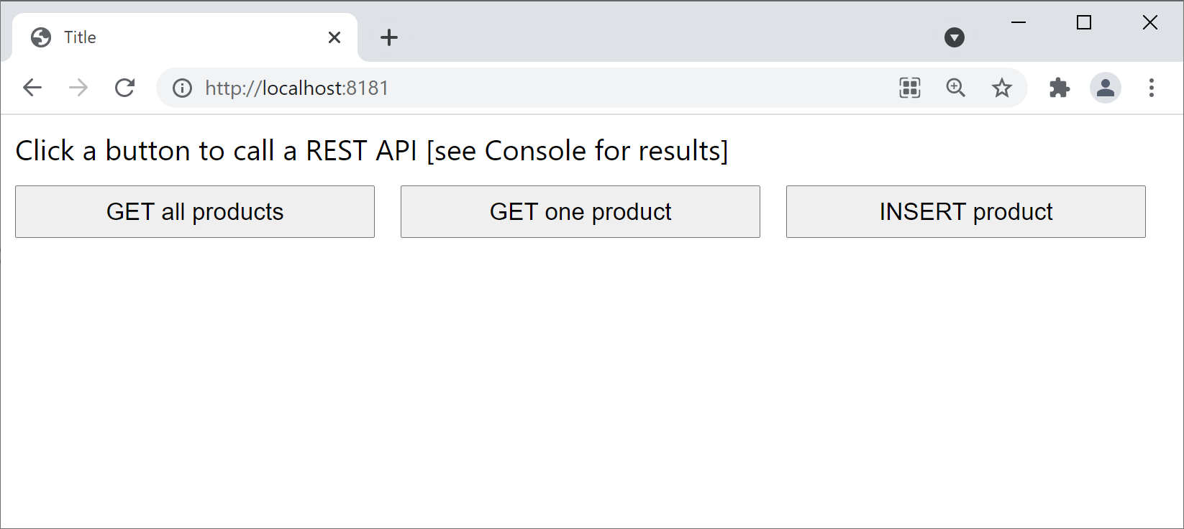
Consuming a REST Service from HTML
We've also implemented a simple HTML page to show how to consume a REST service from a web UI
Project: demo-consumingrest-client
Folder: src/main/resources/static
Open a browser and browse to http://localhost:8181

Slide 8
2. Microservice Architecture
What are microservices
Microservice application example
Implementing the catalog service
Implementing the client service

Slide 9
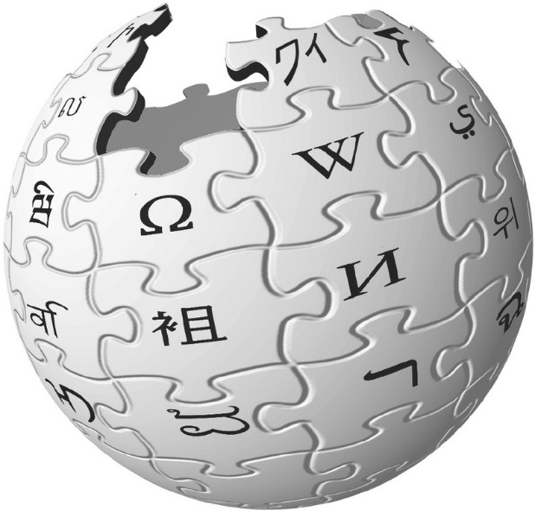
What are Microservices?
According to Wiki:
Microservices is a specialisation of an implementation approach for service-oriented architectures (SOA) used to build flexible, independently deployable software systems.
Services in a microservice architecture (MSA) are processes that communicate with each other over a network in order to fulfil a goal. These services use technology-agnostic protocols.
The microservices approach is a first realisation of SOA that followed the introduction of DevOps and is becoming more popular for building continuously deployed systems.

Slide 10
Microservice Application Example
Let's see a complete (simple) example of how to create a microservice application
There are two Spring Boot applications in the demo:
demo-msa-clientservice
demo-msa-catalogservice
client service
catalog service

Slide 11
Implementing the Catalog Service (1 of 2)
The "catalog" service is a Spring Boot application with a REST service that returns catalog info
See demo-msa-catalogservice
The server.port property is 8081
Take a look at the endpoints in CatalogController:
/catalog
/catalog/{index}

Slide 12
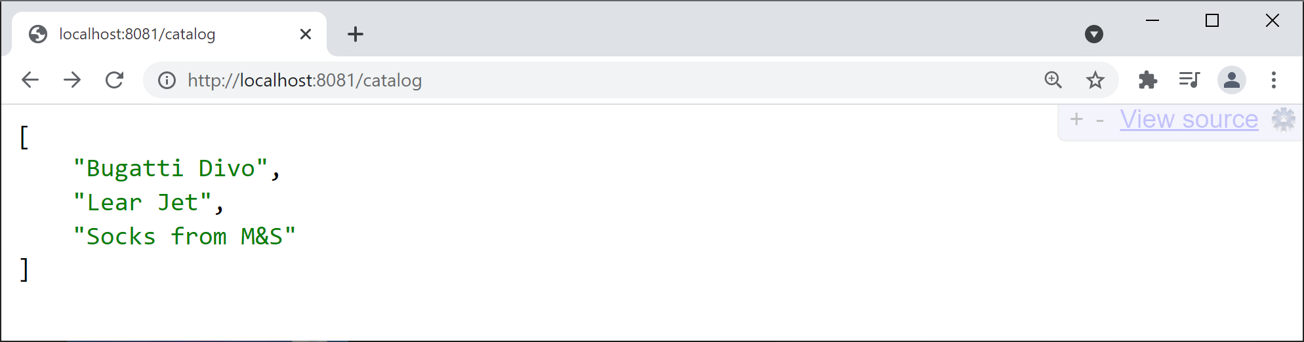
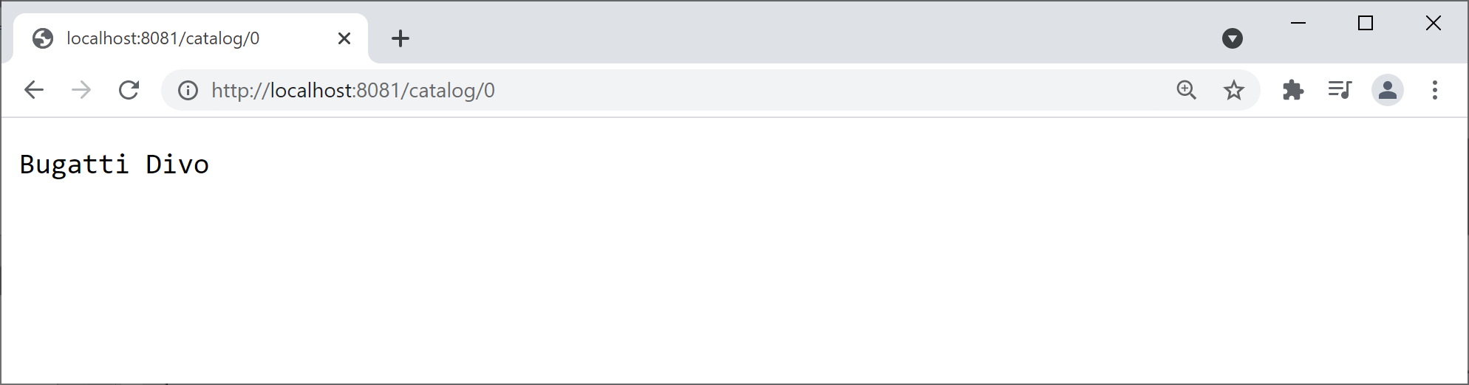
Implementing the Catalog Service (2 of 2)
Run the catalog app and ping the following URLs…
http://localhost:8081/catalog
http://localhost:8081/catalog/0

Slide 13
Implementing the Client Service (1 of 3)
The "client" service is another Spring Boot application with a REST service
See demo-msa-clientservice
The server.port property is 8080
Take a look at the endpoint in ClientController:
/client/{index}

Slide 14
Implementing the Client Service (2 of 3)
The "client" service invokes the "catalog" service
@RestController
public class ClientController {
@GetMapping("/client/{index}")
public String getItem(@PathVariable int index){
String result = getData(index);
return String.format("[%s] Item %d %s", LocalTime.now(), index, result);
}
public String getData(int index) {
URI catalogUri = URI.create("http://localhost:8081/catalog/" + index);
RestClient client = RestClient.create();
return client
.get()
.uri(catalogUri)
.retrieve()
.body(String.class);
}
}
HTTP request
Catalog service

Slide 15
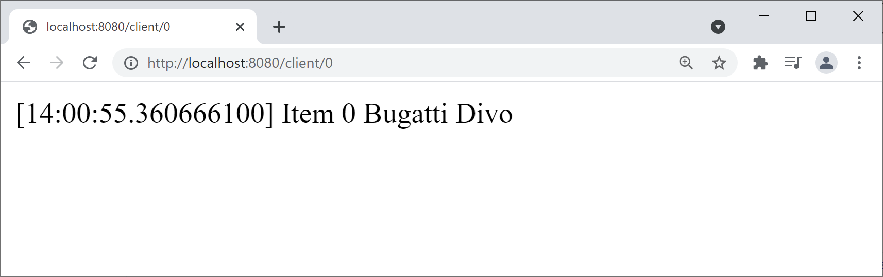
Implementing the Client Service (3 of 3)
Run the client app and ping the following URL…
http://localhost:8080/client/0

Slide 16
3. Circuit Breakers
Overview
Circuit breakers in Spring Cloud
Spring Cloud circuit breaker dependency
Spring Cloud circuit breaker example
Seeing a circuit breaker in action

Slide 17
Overview
In a microservice application, services call other services
E.g. ServiceA calls ServiceB, ServiceB calls ServiceC, etc.
If any service is down, you get a ripple effect of failures
E.g. if ServiceC is down…
Then ServiceB will fail (because it depends on ServiceC)
Then ServiceA will fail (because it depends on ServiceB), etc.
To avoid the ripple effect of failures, use a circuit breaker
Specify a fallback method that can be called, if a service fails

Slide 18
Circuit Breakers in Spring Cloud
Spring Cloud provides a circuit breaker API
Via the CircuitBreakerFactory class
CircuitBreakerFactory is an abstraction over various circuit breaker implementations, including:
Resilience4J (we'll use this)
Netflix Hystrix
Sentinel
Spring Retry

Slide 19
Spring Cloud Circuit Breaker Dependency
To use the Resilience4J circuit breaker implementation, add the following dependency to the pom file in your (client) project :
Once you've added this dependency, Spring Boot autoconfig will automatically create a Resilience4J bean
This bean is exposed via CircuitBreakerFactory
See next slide for an example of how to use a circuit breaker…
<dependency>
<groupId>org.springframework.cloud</groupId>
<artifactId>spring-cloud-starter-circuitbreaker-resilience4j</artifactId>
<version>3.1.0</version>
</dependency>
pom.xml (client project)

Slide 20
Spring Cloud Circuit Breaker Example
@RestController
public class ClientWithFallbackController {
@Autowired
private CircuitBreakerFactory factory;
@GetMapping("/clientWithFallback/{index}")
public String getItem(@PathVariable int index){
CircuitBreaker circuitBreaker = factory.create("circuitbreaker");
String result = circuitBreaker.run(
() -> getData(index),
err -> getFallbackData(index));
return String.format("[%s] Item %d %s", LocalTime.now(), index, result);
}
public String getData(int index) { … }
public String getFallbackData(int index) {return "FALLBACK-DATA-" + index;}
}
HTTP request
Catalog service

Slide 21
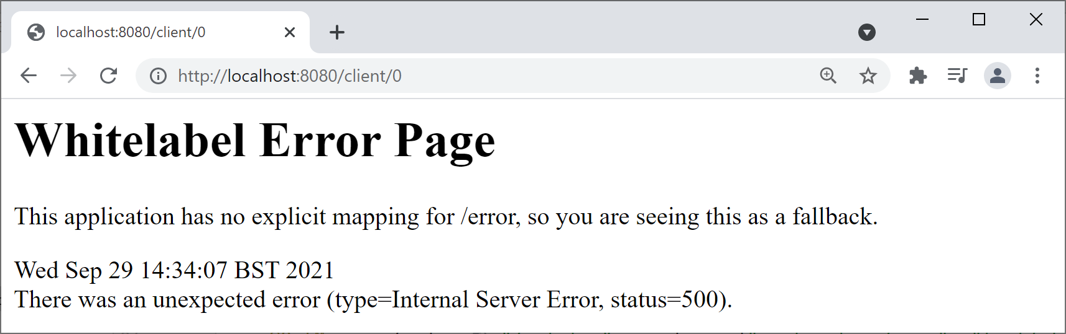
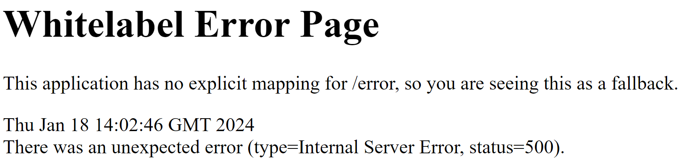
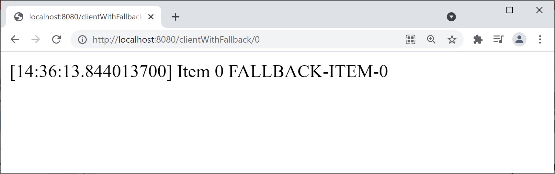
Seeing a Circuit Breaker in Action
To see the effect of the circuit breaker, follow these steps:
Stop the catalog service
Then ping the following client endpoints…
http://localhost:8080/client/0
http://localhost:8080/clientWithFallback/0

Slide 22
Summary
Consuming REST services
Microservice architecture
Circuit breakers

