Slide 1
Creating Enterprise Reactive Apps
Part One
Project Reactor and Spring WebFlux
Implementing a reactive data layer
Implementing a reactive service layer
Testing the reactive service layer
Demo project: demo-webflux

Slide 2
1. Project Reactor and Spring WebFlux
Overview of Project Reactor
Overview of Spring WebFlux
Overview of the demo application
Adding support for Spring WebFlux
Adding support for Reactive MongoDB
Test dependencies

Slide 3
Overview of Project Reactor
The previous chapter covered Reactive Streams, available since Java 9
Specifies 4 interfaces…
Publisher, Subscriber, Subscription, Processor
Project Reactor is an open-source library from Pivotal that builds on Reactive Streams, see https://projectreactor.io/
Provides 2 specializations of Publisher<T>…
Mono<T> is a publisher that produces 0 or 1 value
Flux<T> is a publisher that produces 0 or more values
Recommended usage:
Method params - use Publisher<T> for substitutability
Method results - use Mono<T> or Flux<T> for specificity

Slide 4
Overview of Spring WebFlux
Spring Boot 2 introduced support for Spring WebFlux
Enables you to create reactive web applications
Produce and consume HTTP resources, WebSockets, SSE
Should I use Spring WebFlux or Spring MVC?
Use Spring WebFlux for apps that create huge/streaming data
Use Spring MVC for CRUD-style applications
Spring WebFlux doesn't depend on the Servlet APIs
It has a new reactive web runtime
There are adapters to the Servlet API, if you still want to use it

Slide 5
Overview of the Demo Application
We're going to see how to build a complete reactive app using Spring WebFlux
We'll define a reactive data repository for a MongoDB database
We'll define a reactive service layer, to consume the repository
We'll define a reactive Web layer, to consume the service
The reactive Web layer will be implemented using Spring WebFlux
Reactive web
Reactive service
Reactive MongoDB repository
Spring
WebFlux
Reactive calls
Reactive calls
Async I/O

Slide 6
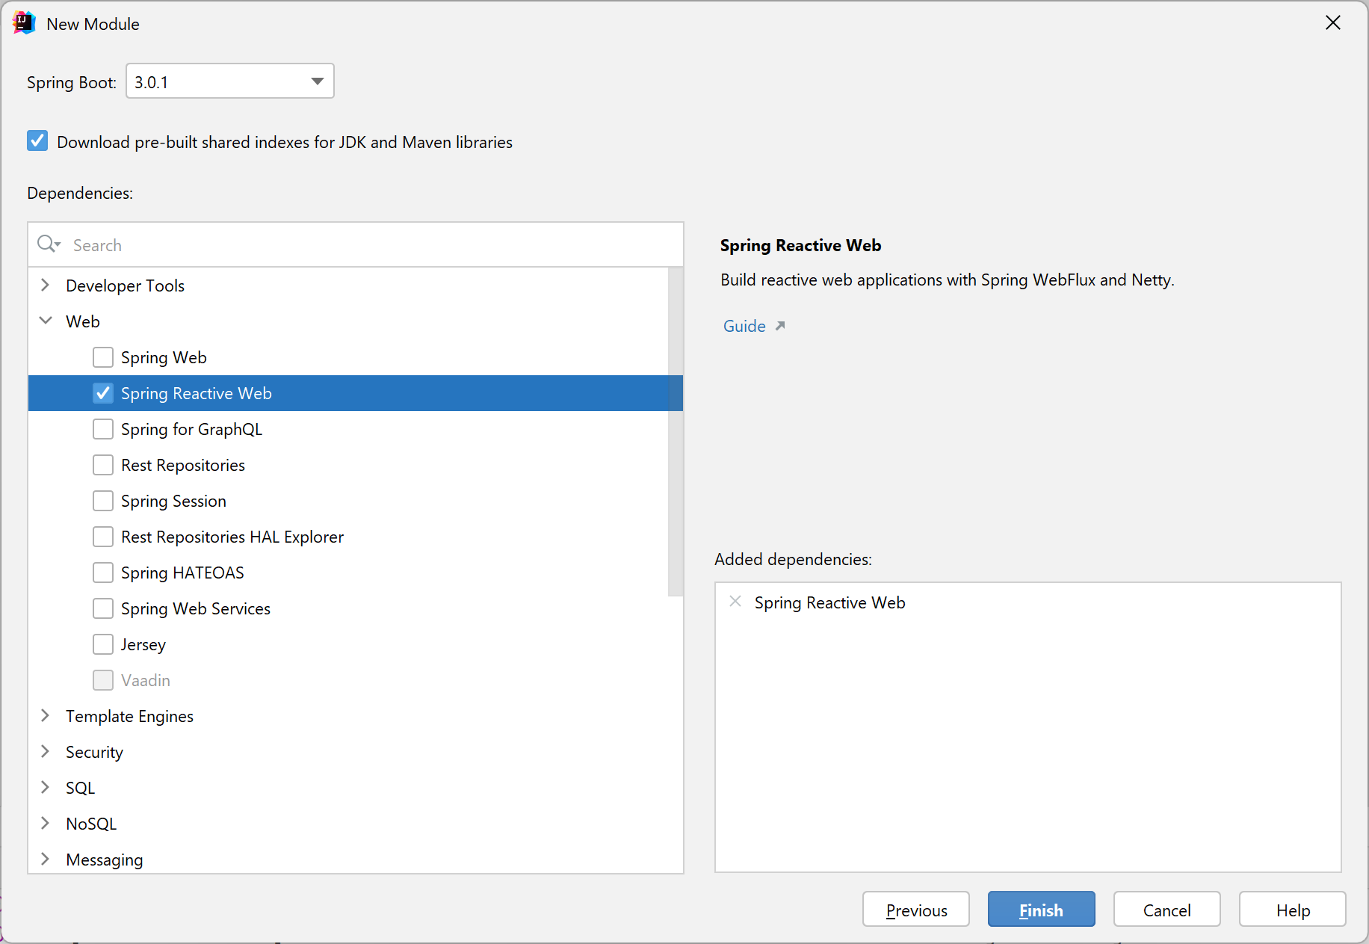
Adding Support for Spring WebFlux
When you create a Spring project using Spring Initializr, add the Spring Reactive Web dependency
Uses Netty by default, but you can switch to use Tomcat, Jetty etc.
Adds this dependency to your pom
<dependency>
<groupId>org.springframework.boot</groupId>
<artifactId>spring-boot-starter-webflux</artifactId>
</dependency>
pom.xml

Slide 7
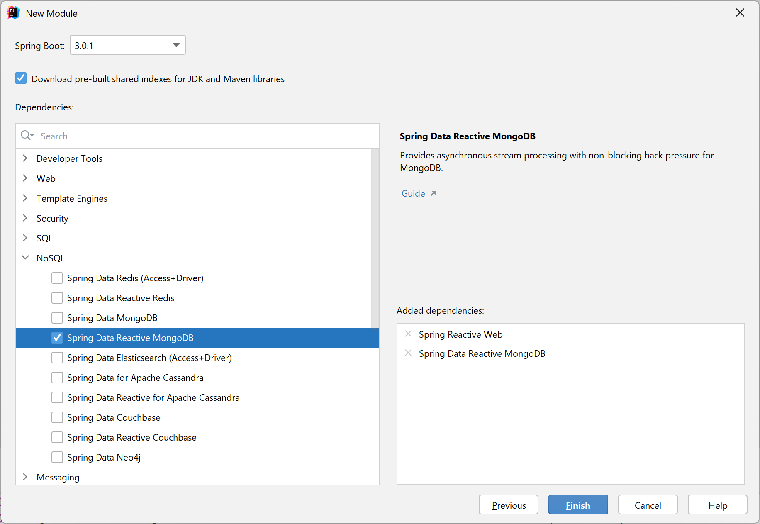
Adding Support for Reactive MongoDB
If you want to use reactive data access, e.g. a MongoDB database, then add the appropriate dependency
Adds this dependency to your pom
<dependency>
<groupId>org.springframework.boot</groupId>
<artifactId>spring-boot-starter-data-mongodb-reactive</artifactId>
</dependency>
pom.xml

Slide 8
Test Dependencies
Your pom file will contain two sets of test dependencies
JUnit tests
Project Reactor tests
<dependency>
<groupId>org.springframework.boot</groupId>
<artifactId>spring-boot-starter-test</artifactId>
<scope>test</scope>
</dependency>
<dependency>
<groupId>io.projectreactor</groupId>
<artifactId>reactor-test</artifactId>
<scope>test</scope>
</dependency>
pom.xml

Slide 9
2. Implementing a Reactive Data Layer
Overview
MongoDB documents
Defining a reactive data repository
Seeding the MongoDB database
Setting the active profile
Running the application
Reminder of the big picture

Slide 10
Overview
To obtain the true value of reactive systems, it really helps if the database driver itself supports async I/O ☺
Otherwise you won't be able to scale-out reads without scaling-out threads, which is exactly what you want to avoid
Spring Data has several reactive data repositories
Reactive MongoDB
Reactive Redis
Reactive Cassandra
Etc.
You just need to add the appropriate Spring Boot starter to your project - we added Spring Data Reactive MongoDB

Slide 11
MongoDB Documents (1 of 2)
MongoDB is a document-oriented database
A MongoDB document is a BSON object (effectively binary JSON)
MongoDB documents contain fieldname/value pairs
var financialTransaction = {
_id: ObjectId("21aa914e0405a59ce30a94a2"), // Unique ID for this object.
amount: 5000,
when: new Date('Jul 2, 1997')
}

Slide 12
MongoDB Documents (2 of 2)
In work with MongoDB documents in Java:
Define a class and annotate with @Document
Define fields as appropriate, plus an ID field annotated with @Id
Conceptually similar to defining entity classes in JPA
import org.springframework.data.mongodb.core.mapping.Document;
import org.springframework.data.annotation.Id;
…
@Document
@Data
@AllArgsConstructor
@NoArgsConstructor
public class Tx {
@Id
private String id;
private double amount;
private LocalDateTime when;
}
Tx.java

Slide 13
Defining a Reactive Data Repository (1 of 4)
Spring Data is a data-access abstraction mechanism in Spring Boot
Makes it much easier to access a wide range of data stores
It provides the CrudRepository interface that specifies synchronous I/O operations
Sub-interfaces available for many types of data source
E.g. MongoRepository
It provides the ReactiveCrudRepository interface that specifies asynchronous I/O operations
Sub-interfaces available for many types of data source
E.g. ReactiveMongoRepository

Slide 14
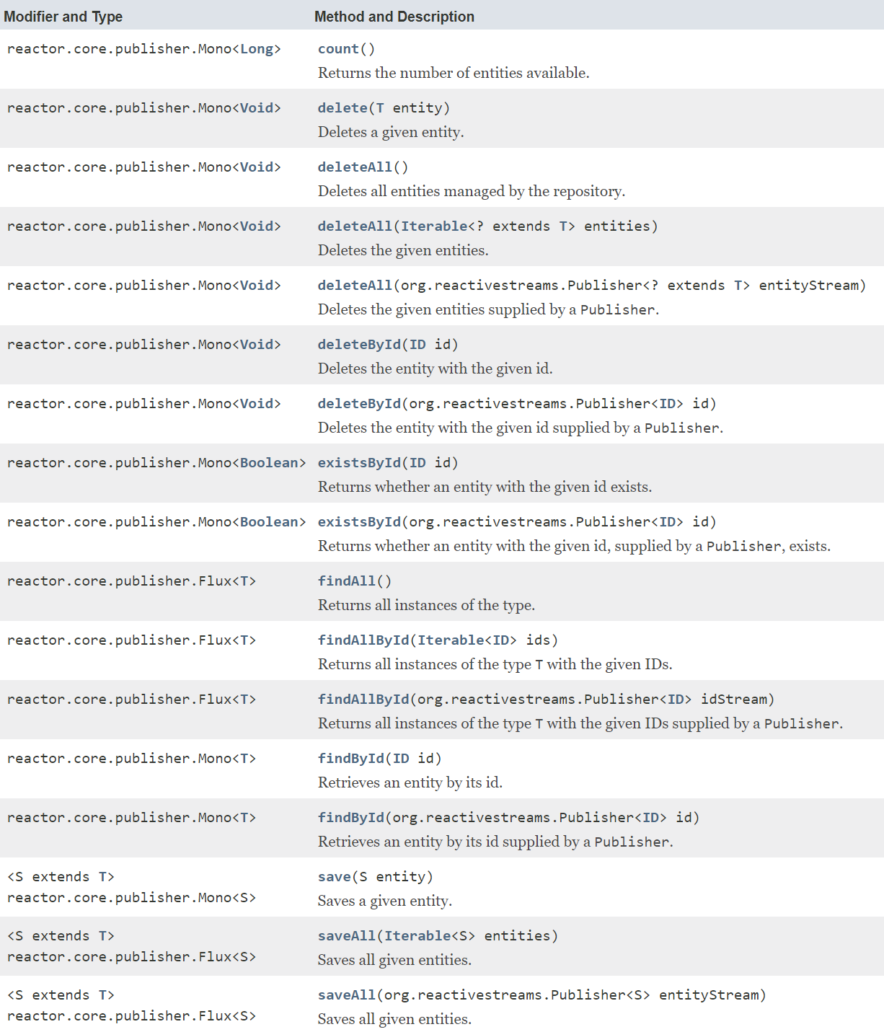
Defining a Reactive Data Repository (2 of 4)
ReactiveCrudRepository
Specifies CRUD operations in an agnostic manner
All methods are reactive
They return a Publisher…
Either Mono (0-1 result)
Or Flux (* results)
In your client code:
Call a method
Subscribe to returned publisher
Obtain result(s) reactively

Slide 15
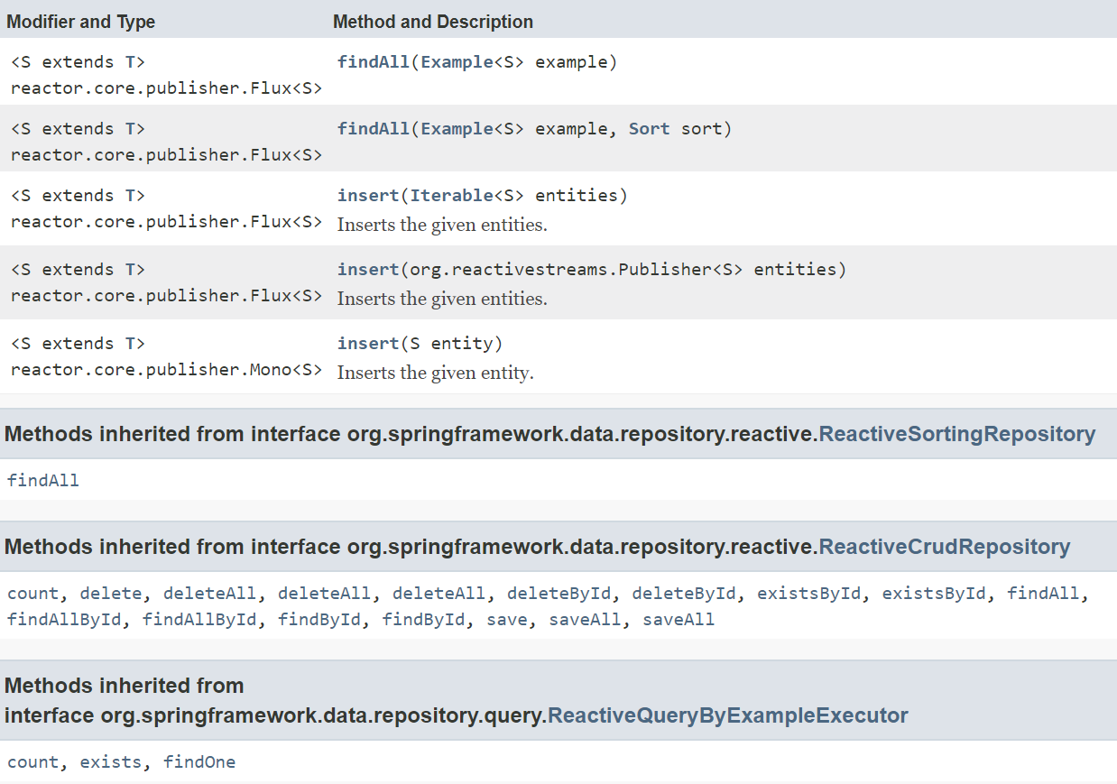
Defining a Reactive Data Repository (3 of 4)
ReactiveMongoRepository
Inherits the basic methods from the previous slide and adds a few more…

Slide 16
Defining a Reactive Data Repository (4 of 4)
To define a reactive MongoDB repository in your app:
Define an interface that extends ReactiveMongoRepository
Specify the document type and the ID type
Optionally define custom finder methods
This is what a custom finder method might look like
This method finds all documents in the MongoDB database that have a when attribute equal to the specified value
import org.springframework.data.mongodb.repository.ReactiveMongoRepository;
interface TxRepository extends ReactiveMongoRepository<Tx, String> {
}
TxRepository.java
Flux<Tx> findByWhen(LocalDateTime when);

Slide 17
Seeding the MongoDB Database (1 of 3)
For demo purposes, it's handy to seed the MongoDB database with some sample Tx documents
See following slides for explanations of this code…
@Log4j2
@Component
@Profile("onlyForDemoPurposes")
public class SeedDb implements ApplicationListener<ApplicationReadyEvent> {
private final TxRepository repo;
public SeedDb(TxRepository repo) { this.repo = repo; }
@Override
public void onApplicationEvent(ApplicationReadyEvent event) {
repo.deleteAll()
.thenMany(Flux.just(100.0, 200.0, 300.0)
.map(amount -> new Tx(UUID.randomUUID().toString(),
amount,
LocalDateTime.now()))
.flatMap(tx -> repo.save(tx))
)
.thenMany(repo.findAll())
.subscribe(tx -> log.info("Tx document successfully inserted: " + tx));
}
}
SeedDb.java

Slide 18
Seeding the MongoDB Database (2 of 3)
@Log4j2
@Component
@Profile("onlyForDemoPurposes")
public class SeedDb implements ApplicationListener<ApplicationReadyEvent> {
private final TxRepository repo;
public SeedDb(TxRepository repo) { this.repo = repo; }
…
}
We only want database seeding when we're in "demo" mode, not when we're in production mode
The ApplicationListener interface enables us to handle lifecycle events (ApplicationReadyEvent is the final event)
If a component has only a single constructor, you can omit @Autowired to inject dependencies into the constructor

Slide 19
Seeding the MongoDB Database (3 of 3)
repo.deleteAll()
.thenMany(Flux.just(100.0, 200.0, 300.0)
.map(amount -> new Tx(UUID.randomUUID().toString(),
amount,
LocalDateTime.now()))
.flatMap(tx -> repo.save(tx))
)
.thenMany(repo.findAll())
.subscribe(tx -> log.info("Tx document successfully inserted: " + tx));
deleteAll() returns a Mono (i.e. a publisher), and publishers support chained processing via thenMany()
Flux.just() is a factory method that creates a new publisher with a static list of items (numbers here)
map() receives each number and maps it to a Tx object
flatMap() saves each Tx object to the MongoDB database
thenMany() finds all the docs, as a sanity check
subscribe() is necessary because publishers are lazy, i.e. you must subscribe to them to trigger their execution

Slide 20
Setting the Active Profile
The SeedDb component only kicks in if the active profile includes "onlyForDemoPurposes"
There are lots of ways to set an active profile
E.g. in the application.properties file
@Log4j2
@Component
@Profile("onlyForDemoPurposes")
public class SeedDb implements ApplicationListener<ApplicationReadyEvent> {
…
}
SeedDb.java
spring.profiles.active=onlyForDemoPurposes
application.properties

Slide 21
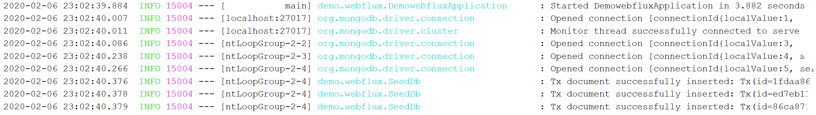
Running the Application
Run the Spring Boot application class
i.e. Application
See the following log messages in the console

Slide 22
Reminder of the Big Picture
Here's a reminder of the structure of the demo app
This section has shown how to implement the reactive MongoDB repository layer, to do async I/O to a MongoDB database
Reactive web
Reactive service
Reactive MongoDB repository
Spring
WebFlux
Reactive calls
Reactive calls
Async I/O

Slide 23
3. Implementing a Reactive Service Layer
Overview
Defining a service class
Implementing service operations

Slide 24
Overview
In the previous section we implemented a reactive MongoDB repository
Performs async (non-blocking) I/O on a MongoDB database
In this section we implement a reactive Spring service
A business component that consumes the reactive repository
Reactive web
Reactive service
Reactive MongoDB repository
Spring
WebFlux
Reactive calls
Reactive calls
Async I/O

Slide 25
Defining a Service Class
The service class is a regular Spring component, and we autowire two components:
TxRepository - to do reactive data access
ApplicationEventPublisher - to publish Spring events
import org.springframework.context.ApplicationEventPublisher;
@Log4j2
@Service
public class TxService {
private final TxRepository repo;
private final ApplicationEventPublisher pub;
TxService(TxRepository repo, ApplicationEventPublisher pub) {
this.repo = repo;
this.pub = pub;
}
…
}
TxService.java

Slide 26
Implementing Service Operations (1 of 4)
In our demo, the service is a skinny wrapper over the repo
It shows how to consume reactive repository operations
Our service has a couple of "getter" methods
getAll() returns many items reactively, i.e. a Flux<Tx>
getById() returns one item reactively, i.e. a Mono<Tx>
public class TxService {
public Flux<Tx> getAll() {
return repo.findAll();
}
public Mono<Tx> getById(String id) {
return repo.findById(id);
}
…
TxService.java

Slide 27
Implementing Service Operations (2 of 4)
Our service has a method to create a financial transaction
Calls repository's save() method, which returns Mono<Tx>
Mono and Flux have many hook methods, e.g. doOnSuccess()
doOnSuccess() takes a Consumer<Tx> to process the result
Our service also publishes an event if the tx value is high
public Mono<Tx> create(double amount) {
checkAmount(amount);
return repo.save(new Tx(null, amount, LocalDateTime.now()))
.doOnSuccess(tx -> pub.publishEvent(new TxCreatedEvent(tx)));
}
private void checkAmount(double amount) {
if (amount > 1_000_000) {
pub.publishEvent(new TxHighValueEvent(amount));
}
}
TxService.java

Slide 28
Implementing Service Operations (3 of 4)
Our service has a method to update a financial transaction
Calls repository's findById() method, returns a Mono<T>
We call map() on the Mono<Tx> to update it locally
Then we call flatMap() to save it to the database reactively
Use map() for sync operation, returns result immediately
map( Function<T,R> )
Use flatMap() for async operation, returns a publisher
flatMap( Function<T,Publisher<R>> )
public Mono<Tx> update(String id, double amount, LocalDateTime when) {
checkAmount(amount);
return repo.findById(id)
.map(t -> new Tx(t.getId(), amount, when))
.flatMap(t -> repo.save(t).thenReturn(t));
}
TxService.java

Slide 29
Implementing Service Operations (4 of 4)
Our service has a method to delete a financial transaction
Similar idea to previous slide
What does it return?
public Mono<Tx> delete(String id) {
return repo.findById(id)
.flatMap(t -> repo.deleteById(t.getId()).thenReturn(t));
}
TxService.java

Slide 30
4. Testing the Reactive Service Layer
Overview
Test dependencies
Defining a test class
Autowiring dependencies into the test class
How to define reactive tests
Defining reactive tests
Exercise

Slide 31
Overview
In this section we'll see how to test the functions in our reactive service class
The service methods are reactive
i.e. they return publishers (Mono or Flux)
So we need a way to test results asynchronously
Project Reactor provides a test API that allows us to test reactive publishers
We can subscribe to a publisher and specify expectations about the results it will publish

Slide 32
Test Dependencies
Here's a reminder of the test dependencies in the pom file
JUnit 5
Project Reactor tests
<dependency>
<groupId>org.springframework.boot</groupId>
<artifactId>spring-boot-starter-test</artifactId>
<scope>test</scope>
</dependency>
<dependency>
<groupId>io.projectreactor</groupId>
<artifactId>reactor-test</artifactId>
<scope>test</scope>
</dependency>
pom.xml

Slide 33
Defining a Test Class
Here's a test class for our reactive service
@DataMongoTest and @Import create a test slice
They add components into the application context
Specifically…
@DataMongoTest adds MongoDB-related components
@Import adds a TxService component
@Log4j2
@DataMongoTest
@Import(TxService.class)
public class TxServiceModificationsTest {
…
}
TxServiceModificationsTest.java

Slide 34
Autowiring Dependencies into the Test Class
You can autowire dependencies into the test class
@Log4j2
@DataMongoTest
@Import(TxService.class)
public class TxServiceModificationsTest {
private final TxService service;
private final TxRepository repo;
public TxServiceModificationsTest(@Autowired TxService service,
@Autowired TxRepository repo) {
this.service = service;
this.repo = repo;
}
…
}
TxServiceModificationsTest.java

Slide 35
How to Define Reactive Tests
To define a reactive test:
Invoke a reactive method-under-test (i.e. it returns a publisher)
Then use StepVerifier to verify it publishes expected results
Here's the general way to use a StepVerifier:
Call StepVerifier.create() to set up a StepVerifier
Call expectXxx() to specify what you expect to be published
Call verifyXxx() to trigger the expected results were published
Publisher<XXX> resultPublisher = someReactiveMethod();
StepVerifier.create(resultPublisher)
.expectNext(next-expected-published-result)
.expectNextMatches(predicate-to-test-next-published-result)
.expectNextCount(expected-number-of-published-items)
.verifyComplete();
general syntax

Slide 36
Defining Reactive Tests (1 of 3)
Here's a reactive test for the service create() method
@Test
public void createTx_returnsCreatedTxWithId() {
Mono<Tx> createdTx = service.create(1234);
StepVerifier
.create(createdTx)
.expectNextMatches(tx -> tx.getId() != null && tx.getId().length() != 0)
.verifyComplete();
}
TxServiceModificationsTest.java

Slide 37
Defining Reactive Tests (2 of 3)
Here's a reactive test for the service update() method
@Test
public void updateTx_txUpdated() {
Mono<Tx> updatedTx = service.create(4321)
.flatMap(tx -> service.update(tx.getId(),
8888,
LocalDateTime.now()));
StepVerifier
.create(updatedTx)
.expectNextMatches(tx -> tx.getAmount() == 8888)
.verifyComplete();
}
TxServiceModificationsTest.java

Slide 38
Defining Reactive Tests (3 of 3)
Here's a reactive test for the service delete() method
@Test
public void deleteTx_txDeleted() {
Mono<Tx> deletedTx = service.create(5678)
.flatMap(tx -> service.delete(tx.getId()));
StepVerifier
.create(deletedTx)
.expectNextMatches(tx -> tx.getAmount() == 5678)
.verifyComplete();
}
TxServiceModificationsTest.java

Slide 39
Exercise
Take a look at the test in here:
TxServiceQueryTest.java
What does it do?

Slide 40
Summary
Project Reactor and Spring WebFlux
Implementing a reactive data layer
Implementing a reactive service layer
Testing the reactive service layer

