Slide 1
Creating Enterprise Reactive Apps
Part Two
Understanding Spring WebFlux
Implementing a REST controller endpoint
Implementing a REST handler endpoint
Testing Spring WebFlux endpoints
Demo project: demo-webflux [continued]

Slide 2
1. Understanding Spring WebFlux
Overview
About Spring Web MVC
About Spring WebFlux

Slide 3
Overview
In the previous chapter we implemented a reactive data repository and reactive service
The reactive service returned a publisher (i.e. Mono or Flux)
In this chapter we'll implement a reactive web layer
Runs on Spring WebFlux
We'll also see how to test the Reactive web layer
Reactive web
Reactive service
Reactive MongoDB repository
Spring
WebFlux
Reactive calls
Reactive calls
Async I/O

Slide 4
About Spring Web MVC
Spring Web MVC was the original web framework in Spring
Purpose-built for the Servlet API and Servlet containers
Spring Web MVC is a blocking API
Servlet containers assume calls will block the current thread
Servlet containers therefore use a large thread pool, to absorb potential blocking during request handling
To implement a REST service using Spring Web MVC:
Define a blocking MVC controller class with synchronous logic

Slide 5
About Spring WebFlux
Spring WebFlux was introduced in Spring Framework 5.0
Purpose-built for the Reactive Streams API
Spring WebFlux is a non-blocking API
Reactive servers assume calls will not block the current thread
Reactive servers therefore use a small, fixed-size large thread pool, to handle the request event loop
To implement a REST service using Spring WebFlux:
Either implement an MVC-like non-blocking controller class
Or implement a handler class using a functional programming style
We'll examine both techniques in the following sections
For the full demo code, see the demo.webflux.rest package

Slide 6
2. Implementing a REST Controller Endpoint
Overview
Defining a reactive controller class
Implementing reactive REST methods
Pinging the reactive REST controller

Slide 7
Overview
You can implement a Spring WebFlux REST endpoint using familiar REST controller techniques and annotations
org.springframework.web.bind.annotation.*
E.g. you can use familiar annotations such as:
@Controller, @RestController
@CrossOrigin, @RequestMapping
@GetMapping, @PostMapping, @PutMapping, @DeleteMapping
@PathVariable, @RequestParam, @RequestBody, @ResponseBody, etc.
So what's different?
Your methods will be called reactively by the server, e.g. Netty
So your methods must return a publisher (Mono or Flux)

Slide 8
Defining a Reactive Controller Class
To define a reactive controller class, the class definition itself is just like a traditional Spring Web MVC controller
Note the @Profile annotation in our example
This is because our demo has two REST services…
We define a different profile for each, to avoid interference
We set the active profile in application.properties
@Log4j2
@RestController
@RequestMapping(value="/tx", produces=MediaType.APPLICATION_JSON_VALUE)
@Profile("controller-style-endpoint")
class TxRestController {
private final TxService service;
TxRestController(TxService service) {
this.service = service;
}
// Define reactive methods here, using familiar MVC techniques…
}
TxRestController.java

Slide 9
Implementing Reactive REST Methods (1 of 2)
In a reactive REST controller, endpoints must return a publisher
So the reactive server can offer all the benefits of reactive APIs…
Asynchrony, back pressure, etc.
Here are some examples of reactive REST methods
Their inputs are just like Spring Web MVC REST methods
But their outputs are always a publisher
@GetMapping
Publisher<Tx> getAll() {
return this.service.getAll();
}
@GetMapping("/{id}")
Publisher<Tx> getById(@PathVariable("id") String id) {
return this.service.getById(id);
}
TxRestController.java

Slide 10
Implementing Reactive REST Methods (2 of 2)
Here are some more interesting reactive REST methods
Discuss!
@PostMapping
Publisher<ResponseEntity<Tx>> create(@RequestBody Tx tx) {
return this.service
.create(tx.getAmount())
.map(t -> ResponseEntity.created(URI.create("/tx/" + t.getId()))
.contentType(MediaType.APPLICATION_JSON)
.build());
}
@PutMapping("/{id}")
Publisher<ResponseEntity<Tx>> update(@PathVariable String id, @RequestBody Tx tx) {
return this.service
.update(id, tx.getAmount(), tx.getWhen())
.map(t -> ResponseEntity.ok()
.contentType(MediaType.APPLICATION_JSON)
.build());
}
@DeleteMapping("/{id}")
Publisher<Tx> delete(@PathVariable String id) {
return this.service.delete(id);
}
TxRestController.java

Slide 11
Pinging the Reactive REST Controller (1 of 2)
Set the active profile in application.properties
Then run the Application class
The application starts the Netty server, by default
You can also switch to Tomcat or Jetty
Spring WebFlow uses their support for Servlet 3.1 non-blocking I/O
You can also switch to use Undertow
Spring WebFlow uses Undertow APIs directly (not the Servlet API)
spring.profiles.active=onlyForDemoPurposes,controller-style-endpoint

Slide 12
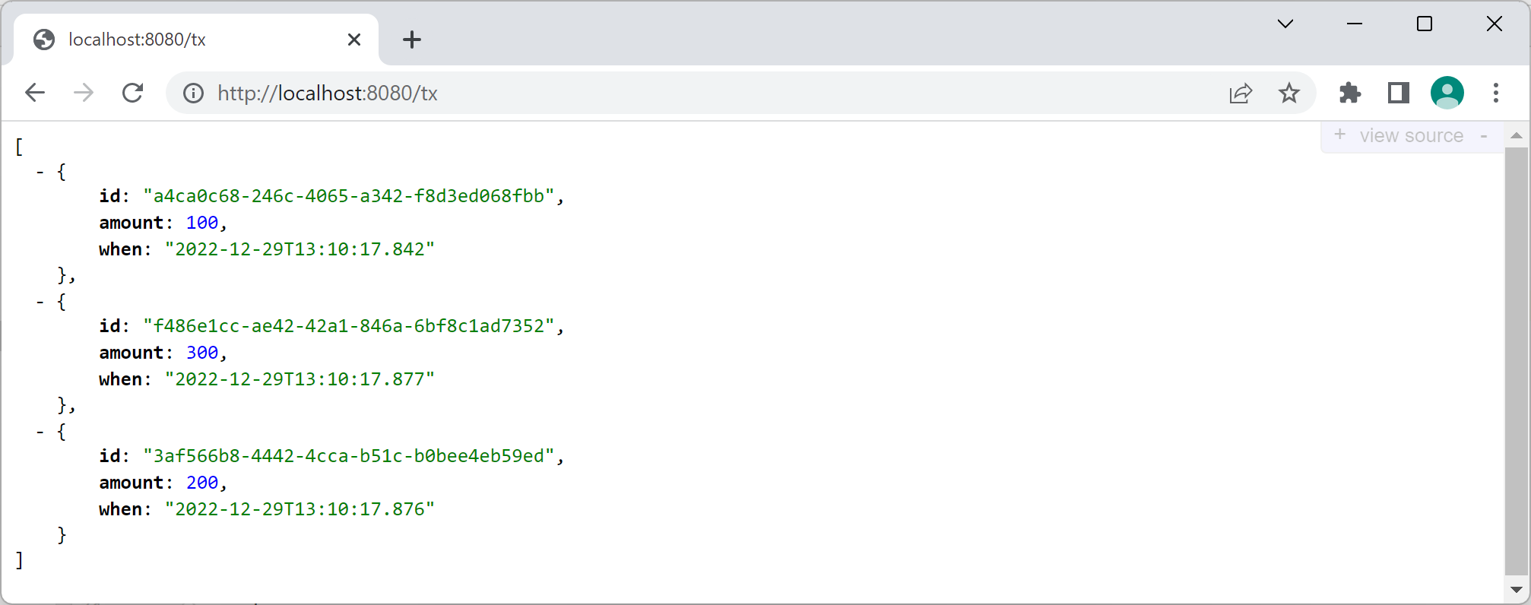
Pinging the Reactive REST Controller (2 of 2)
You can ping the REST controller as normal
E.g. browse to http://localhost:8080/tx

Slide 13
3. Implementing a REST Handler Endpoint
Overview
Defining a reactive handler class
Accessing HTTP request / response Info
Implementing reactive REST methods
Configuring a routing table
Pinging the reactive REST handler

Slide 14
Overview
As stated earlier, Spring WebFlux offers two ways to create a reactive REST endpoint…
As an MVC-like non-blocking controller class
Convenient if you want to port a synchronous Spring Web MVC controller to the reactive world
As a non-blocking handler class
Not coupled to DispatcherServlet or centralized routing
You can define dynamic route tables for agility and flexibility
You can leverage lambdas, FP, and DSL programming techniques

Slide 15
Defining a Reactive Handler Class
You define a reactive handler class as a Spring component, i.e. using @Component
Not as a controller class via @Controller/ @RestController
Example:
@Log4j2
@Component
@Profile("handler-style-endpoint")
public class TxRestHandler {
private final TxService service;
TxRestHandler(TxService service) {
this.service = service;
}
// Define reactive methods here, using DSL functional programming techniques
…
}
TxRestHandler.java

Slide 16
Accessing HTTP Request / Response Info
When you define a reactive handler class, it is not hooked up to a DispatcherServlet
No DisptcherServlet to detect inbound HTTP info!
Instead, your method always receives a ServerRequest
Gives reactive access to incoming HTTP info
No DisptcherServlet to set outbound HTTP info!
Instead, your method always returns a Mono<ServerRequest>
Publishes reactive result to client
So you'll need the following imports:
import org.springframework.web.reactive.function.server.ServerRequest;
import org.springframework.web.reactive.function.server.ServerResponse;

Slide 17
Implementing Reactive REST Methods (1 of 2)
Here are some examples of reactive REST methods in a Spring WebFlux handler class
Use a very contemporary DSL builder programming style
Mono<ServerResponse> getAll(ServerRequest req) {
Flux<Tx> gotten = this.service.getAll();
return ServerResponse.ok()
.contentType(MediaType.APPLICATION_JSON)
.body(gotten, Tx.class);
}
Mono<ServerResponse> getById(ServerRequest req) {
String id = req.pathVariable("id");
Mono<Tx> gotten = this.service.getById(id);
return ServerResponse.ok()
.contentType(MediaType.APPLICATION_JSON)
.body(gotten, Tx.class);
}
TxRestHandler.java

Slide 18
Implementing Reactive REST Methods (2 of 2)
Mono<ServerResponse> create(ServerRequest req) {
Flux<Tx> created = req.bodyToFlux(Tx.class)
.flatMap(tx -> this.service.create(tx.getAmount()));
return Mono.from(created)
.flatMap(tx -> ServerResponse.created(URI.create("/tx/" + tx.getId()))
.contentType(MediaType.APPLICATION_JSON)
.build());
}
Mono<ServerResponse> update(ServerRequest req) {
String id = req.pathVariable("id");
Flux<Tx> updated = req.bodyToFlux(Tx.class)
.flatMap(tx -> this.service.update(
id, tx.getAmount(), tx.getWhen()));
return ServerResponse.ok()
.contentType(MediaType.APPLICATION_JSON)
.body(updated, Tx.class);
}
Mono<ServerResponse> delete(ServerRequest req) {
String id = req.pathVariable("id");
Mono<Tx> deleted = this.service.delete(id);
return ServerResponse.ok()
.contentType(MediaType.APPLICATION_JSON)
.body(deleted, Tx.class);
}
TxRestHandler.java

Slide 19
Configuring a Routing Table (1 of 2)
Recall the handler class is just a @Component
It's not a @Controller / @RestController
So no DispatcherServlet to route requests automatically
Instead you must configure a routing table
You must explicitly map URL patterns to handler methods
This provides a great deal of flexibility
You can use sophisticated pattern-matching to map routes
You can adjust the routing table dynamically at run time
You can implement endpoints as lambdas etc.

Slide 20
Configuring a Routing Table (2 of 2)
Here's the routing table configuration in our demo
import org.springframework.web.reactive.function.server.RouterFunction;
import org.springframework.web.reactive.function.server.ServerResponse;
import org.springframework.web.reactive.function.server.RouterFunctions;
import static org.springframework.web.reactive.function.server.RequestPredicates.*;
…
@Configuration
@Profile("handler-style-endpoint")
public class TxRestHandlerConfiguration {
@Bean
RouterFunction<ServerResponse> routes(TxRestHandler handler) {
return RouterFunctions.route(GET("/tx"), handler::getAll)
.andRoute(GET("/tx/{id}"), handler::getById)
.andRoute(POST("/tx"), handler::create)
.andRoute(PUT("/tx/{id}"), handler::update)
.andRoute(DELETE("/tx/{id}"), handler::delete);
}
}
TxRestHandlerConfiguration.java

Slide 21
Pinging the Reactive REST Handler (1 of 2)
Set the active profile in application.properties
Then run the DemowebfluxApplication class
The application starts the Netty server, as before
Netty supports both controller-based and handler-based styles
spring.profiles.active=onlyForDemoPurposes, handler-style-endpoint

Slide 22
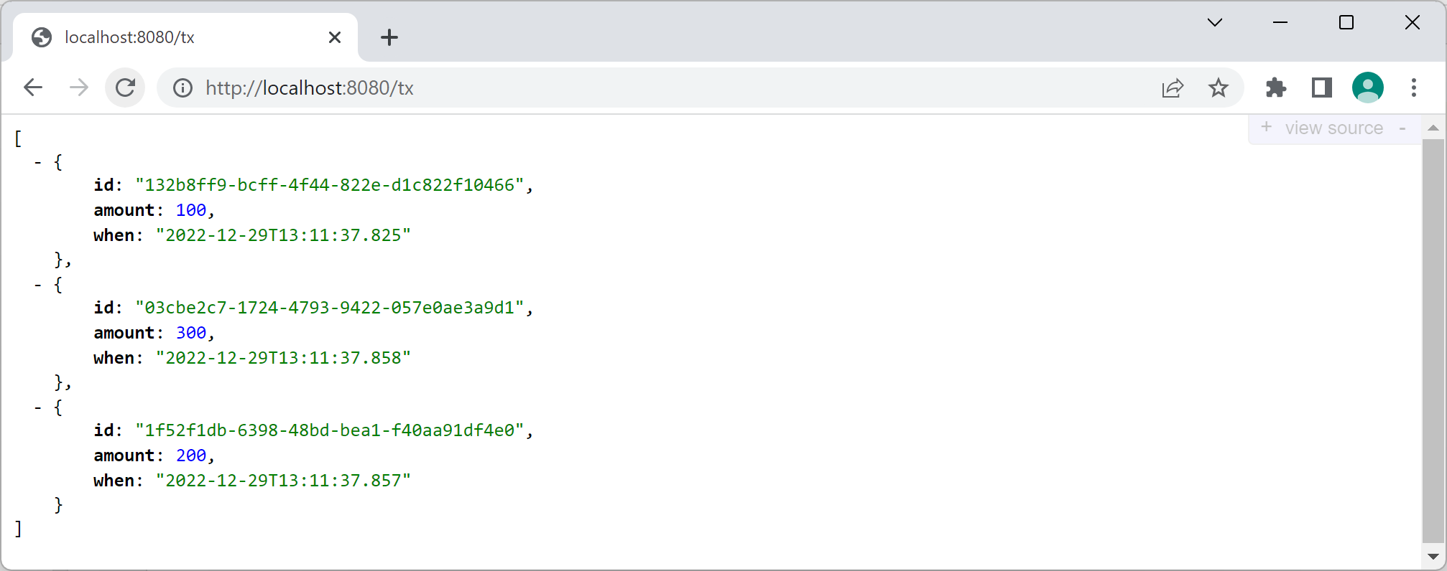
Pinging the Reactive REST Handler (2 of 2)
You can ping the REST controller as before
E.g. browse to http://localhost:8080/tx

Slide 23
3. Testing Spring WebFlux Endpoints
Overview
Test classes in the demo app
Defining a test superclass
Injecting test dependencies
Defining a test method
Defining test subclasses

Slide 24
Overview
The spring-test module has a WebTestClient class
You can use this to test Spring WebFlux server endpoints
Can be used with or without an actual server
Provides a fluent API to build a request and verify a response
Here are some of its methods to prepare a request:
uri(), get(), post(), put(), delete()
body(), contentType(), accept()
Here are some of its methods to verify a response:
expectStatus(), expectHeader(), expectBody()
jsonPath()

Slide 25
Test Classes in the Demo App (1 of 2)
The demo app has two separate REST classes:
TxRestController - Active profile "controller-style-endpoint"
TxRestHandler - Active profile "handler-style-endpoint"
These two classes are semantically equivalent, so the tests should be the same too
Therefore we've put all the tests in a common superclass
We've also defined 2 subclasses that set the correct active profile
See following slide…

Slide 26
Test Classes in the Demo App (2 of 2)
Here's how we've organized our test classes:
{abstract}
TxRestBaseTest
Defines common tests
for both REST classes
TxRestControllerTest
Sets the active profile to
"controller-style-endpoint"
TxRestHandlerTest
Sets the active profile to
"handler-style-endpoint"

Slide 27
Defining a Test Superclass
Here's the outline of the TxRestBaseTest class
@WebFluxTest defines a test slice, so we only get config relevant to Spring WebFlux tests
E.g. @Controller (but not @Service, @Repository, etc.)
@Log4j2
@WebFluxTest
public abstract class TxRestBaseTest {
…
}
TxRestBaseTest.java

Slide 28
Injecting Test Dependencies
Our test superclass has a couple of dependencies
A mock repository (to avoid talking to a real database)
A WebTestClient (passed in from subclass ctor, see later)
@Log4j2
@WebFluxTest
public abstract class TxRestBaseTest {
@MockBean
private TxRepository repo;
private final WebTestClient client;
public TxRestBaseTest(WebTestClient client) {
this.client = client;
}
…
}
TxRestBaseTest.java

Slide 29
Defining a Test Method
Here's a typical test method, to test the GET handler
See demo code for tests for POST, PUT, and DELETE handlers
Notice the use of jsonPath() to drill into the JSON response
@Test
public void getAll() {
Mockito.when(this.repo.findAll())
.thenReturn(Flux.just(new Tx("1", 1111, LocalDateTime.now()),
new Tx("2", 2222, LocalDateTime.now())));
this.client
.get()
.uri("/tx")
.accept(MediaType.APPLICATION_JSON)
.exchange()
.expectStatus().isOk()
.expectHeader().contentType(MediaType.APPLICATION_JSON)
.expectBody()
.jsonPath("$.[0].id").isEqualTo("1")
.jsonPath("$.[0].amount").isEqualTo(1111)
.jsonPath("$.[1].id").isEqualTo("2")
.jsonPath("$.[1].amount").isEqualTo(2222);
}
TxRestBaseTest.java

Slide 30
Defining Test Subclasses
Here are the test subclasses to test the REST controller class and the REST handler class, respectively
@Log4j2
@ActiveProfiles("controller-style-endpoint")
@Import({TxRestController.class, TxService.class})
public class TxRestControllerTest extends TxRestBaseTest {
TxRestControllerTest(@Autowired WebTestClient client) {
super(client);
}
}
TxRestControllerTest.java
@Log4j2
@ActiveProfiles("handler-style-endpoint")
@Import({TxRestHandlerConfiguration.class, TxRestHandler.class, TxService.class})
public class TxRestHandlerTest extends TxRestBaseTest {
TxRestHandlerTest(@Autowired WebTestClient client) {
super(client);
}
}
TxRestHandlerTest.java

Slide 31
Summary
Understanding Spring WebFlux
Implementing a REST controller endpoint
Implementing a REST handler endpoint
Testing Spring WebFlux endpoints

