Slide 1
Spring Batch
Introduction to Spring Batch
Example scenario
Defining a step in a job
Defining a job
Demo project: demo-spring-batch

Slide 2
1. Introduction to Spring Batch
Overview
How Spring Batch works
Spring Batch dependency

Slide 3
Overview
Spring Batch is a lightweight batch framework for ETL operations
Extract data from data source(s)
Transform the data
Load the data into the target system

Slide 4
How Spring Batch Works
You define and launch a job
A job comprises one or more steps
A step comprises:
A reader bean (implements ItemReader)
A processor bean (implements ItemProcessor)
A writer bean (implements ItemWriter)

Slide 5
Spring Batch Dependency
All you need is the following dependency:
In our demo, we've also added the H2 database dependency
… because we're going to be writing data to H2
<dependency>
<groupId>org.springframework.boot</groupId>
<artifactId>spring-boot-starter-batch</artifactId>
</dependency>
pom.xml
<dependency>
<groupId>com.h2database</groupId>
<artifactId>h2</artifactId>
<scope>runtime</scope>
</dependency>
pom.xml

Slide 6
2. Example Scenario
Overview
Extracting data from a CSV file
Transforming the data
Loading the transformed data into a database

Slide 7
Overview
The demo app defines a Spring Batch job that comprises a single step
The single step defines these ETL operations:
Extracts employee data from a CSV file into objects
Transforms the employee data (in memory)
Loads the transformed employee data into a database

Slide 8
Extracting Data from a CSV File
We'll extract data from the following CSV file:
We'll read each employee into an Employee record object:
John,Smith,20000
Mary,Evans,30000
Bill,Jones,40000
Jane,Sykes,50000
resources/employee-data.csv
public record Employee(String firstname, String lastname, long salary) {}
Employee.java

Slide 9
Transforming the Data
To transform data, define a class that implements the interface ItemProcessor<InType,OutType>
import org.springframework.batch.item.ItemProcessor;
public class EmployeeItemProcessor implements ItemProcessor<Employee, Employee> {
@Override
public Employee process(Employee emp) {
Employee transformedEmp = new Employee(
emp.firstname().toUpperCase(),
emp.lastname().toUpperCase(),
emp.salary()
);
System.out.printf("Transforming %s into %s\n", emp, transformedEmp);
return transformedEmp;
}
}
EmployeeItemProcessor.java

Slide 10
Loading the Transformed Data into a Database
We'll load the transformed data into an employee table in the H2 database
The employee table is created via the following SQL script:
Aside:
Spring Boot automatically runs schema.sql and data.sql scripts on the classpath, to create/populate database tables
DROP TABLE employee IF EXISTS;
CREATE TABLE employee (
id INT AUTO_INCREMENT PRIMARY KEY,
firstname VARCHAR,
lastname VARCHAR,
salary BIGINT
);
resources/schema.sql

Slide 11
3. Defining a Step in a Job
Overview
Defining a reader bean
Defining a processor bean
Defining a writer bean
Defining a step bean
Aside: Chunk-oriented batch processing

Slide 12
Overview
Remember a Spring Batch job comprises one or more steps
Each step comprises:
A reader bean
A processor bean
A writer bean
Let's see how to create all these beans…

Slide 13
Defining a Reader Bean (1 of 2)
A reader bean implements ItemReader
Spring Batch provides many off-the-shelf implementations
FlatFileItemReader
StaxEventItemReader
JsonItemReader
JdbcCursorItemReader
(You can also define custom ItemReader implementations)

Slide 14
Defining a Reader Bean (2 of 2)
Here's the reader bean in the demo
Reads from employee-data.csv into Employee objects
@Configuration
public class BatchConfiguration {
@Bean
public FlatFileItemReader<Employee> reader() {
return new FlatFileItemReaderBuilder<Employee>()
.name("employeeItemReader") // You can use any name here.
.resource(new ClassPathResource("employee-data.csv"))
.delimited()
.delimiter(",") // Comma is the default anyway.
.names("firstname", "lastname", "salary") // Must match Employee fields.
.targetType(Employee.class)
.build();
}
…
}
BatchConfiguration.java

Slide 15
Defining a Processor Bean
A processor bean implements ItemProcessor
You must implement it yourself
We've already seen this, EmployeeItemProcessor.java
We just need to create a bean of this type:
@Configuration
public class BatchConfiguration {
@Bean
public EmployeeItemProcessor processor() {
return new EmployeeItemProcessor();
}
…
}
BatchConfiguration.java

Slide 16
Defining a Writer Bean (1 of 2)
A writer bean implements ItemWriter
Spring Batch provides many off-the-shelf implementations
FlatFileItemWriter
StaxEventItemWriter
JsonFileItemWriter
JdbcBatchItemWriter
(You can also define custom ItemWriter implementations)

Slide 17
Defining a Writer Bean (2 of 2)
Here's the writer bean in the demo
Writes Employee objects to employee table in H2 database
@Configuration
public class BatchConfiguration {
@Bean
public JdbcBatchItemWriter<Employee> writer(DataSource dataSource) {
return new JdbcBatchItemWriterBuilder<Employee>()
.sql("""
INSERT INTO employee (firstname, lastname, salary)
VALUES (:firstname, :lastname, :salary) // Must match Employee fields.
""")
.dataSource(dataSource) // Via Spring Boot auto-config.
.beanMapped() // Maps Employee fields to params.
.build();
}
…
}
BatchConfiguration.java

Slide 18
Defining a Step Bean
Here's how to put together the reader bean, processor bean, and writer bean into a step bean:
@Configuration
public class BatchConfiguration {
@Bean
public Step step1(
JobRepository jobRepository,
DataSourceTransactionManager transactionManager,
ItemReader<Employee> reader,
ItemProcessor processor,
ItemWriter<Employee> writer) {
return new StepBuilder("step1", jobRepository)
.<Employee, Employee> chunk(3, transactionManager) // See next slide…
.reader(reader)
.processor(processor)
.writer(writer)
.build();
}
…
}
BatchConfiguration.java

Slide 19
Aside: Chunk-Oriented Batch Processing
On the previous slide, did you notice this function call?
Spring Batch uses a “chunk-oriented” processing style
Reads data items one at a time, into a chunk
Once the number of items equals the commit interval, the chunk is written out and the transaction is committed
<Employee, Employee> chunk(3, transactionManager)

Slide 20
4. Defining a Job
Overview
Defining a job bean
Defining a job completion notification listener
Running the application

Slide 21
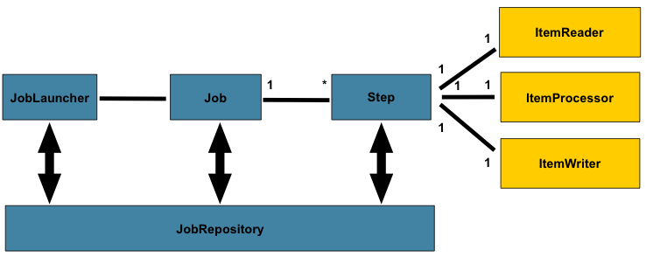
Overview
Here are all the moving parts in a Spring Batch job:

Slide 22
Defining a Job Bean
Here's how we define a Job bean in our demo:
@Configuration
public class BatchConfiguration {
@Bean
public Job job(
JobRepository jobRepository,
Step step1,
JobCompletionNotificationListener listener) {
return new JobBuilder("employeeEtlJob", jobRepository)
.listener(listener) // See next slide.
.start(step1) // Start the job with step1.
// .next(step2) // Then run step2.
// .next(step3) // Then run step3, etc.
.build();
} …
}
BatchConfiguration.java

Slide 23
Defining a Job Completion Notification Listener
You can define a job completion notification listener that executes when the job has completed
@Component
public class JobCompletionNotificationListener implements JobExecutionListener {
@Autowired
private JdbcTemplate jdbcTemplate;
@Override
public void afterJob(JobExecution jobExecution) {
if (jobExecution.getStatus() == BatchStatus.COMPLETED) {
System.out.println("IN JOB COMPLETION NOTIFICATION LISTENER:");
jdbcTemplate
.query("SELECT firstname, lastname, salary FROM employee",
new DataClassRowMapper<>(Employee.class))
.forEach(emp -> System.out.println(emp));
}
}
}
JobCompletionNotificationListener.java

Slide 24
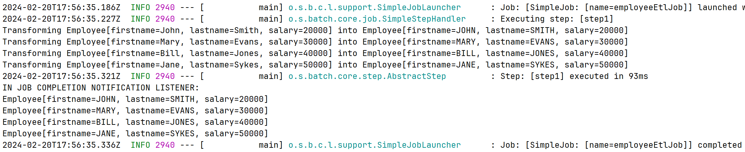
Running the Application
Run the application and take a look at the console output…

Slide 25
Summary
Introduction to Spring Batch
Example scenario
Defining a step in a job
Defining a job

