Slide 1
Liquibase
Introduction to Liquibase
Getting started with Liquibase in Spring Boot
Applying a changeset
Applying another changeset
Demo project: demo-liquibase

Slide 2
1. Introduction to Liquibase
Overview
How Liquibase works
Using Liquibase in a Spring Boot application

Slide 3
Overview
Liquibase is a database change management solution
Enables you to script database changes via code
Facilitates smoother CI/CD

Slide 4
How Liquibase Works
You define scripts specifying schema/data changes
In XML, YAML, or JSON
You apply the scripts against a database
The database is entirely specified by these scripts
What's the benefit of Liquibase?
Smooth database evolution, in synch with your codebase

Slide 5
Using Liquibase in a Spring Boot Application
You need the following dependencies:
In our demo, we've also added the H2 and web dependencies
We're going to evolve an H2 database, and view it in a browser
<dependency>
<groupId>org.liquibase</groupId>
<artifactId>liquibase-core</artifactId>
</dependency>
<dependency>
<groupId>org.springframework.boot</groupId>
<artifactId>spring-boot-starter-data-jpa</artifactId>
</dependency>
pom.xml

Slide 6
2. Getting Started with Liquibase in Spring Boot
Overview
Application properties
Liquibase master changelog
Running the application
Viewing the database in the H2 Console

Slide 7
Overview
The demo app defines a bare-bones Spring Boot application
All it contains is Liquibase scripts, to evolve a database
Specifically, our demo app doesn't contain:
Any explicit database-related code
Any explicit application functionality
This will help you understand what Liquibase is doing for you

Slide 8
Application Properties
Here are the application properties in our demo app:
spring.liquibase.change-log=classpath:db/changelog-master.xml # Specifies db changesets.
logging.level.liquibase=INFO
spring.datasource.url=jdbc:h2:file:~/liquibaseDB # Will be in user home dir.
spring.datasource.username=sa
spring.datasource.password=
spring.h2.console.enabled=true
resources/application.properties

Slide 9
Liquibase Master Changelog (1 of 2)
The Liquibase master changelog is the heart of Liquibase
It specifies all the database changesets over time
The cumulative effect of all these changesets is the definitive specification of the current database schema

Slide 10
Liquibase Master Changelog (2 of 2)
Our master changelog is effectively empty initially
Represents a database with no tables or data
Later in this chapter we'll uncomment the <include> tags
This will show you how to apply changesets over time…
To evolve the database schema/data
<?xml version="1.0" encoding="UTF-8"?>
<databaseChangeLog … >
<!-- <include file="release-1/changelog.xml" relativeToChangelogFile="true"/> -->
<!-- <include file="release-2/changelog.xml" relativeToChangelogFile="true"/> -->
</databaseChangeLog>
resources/db/changelog-master.xml

Slide 11
Running the Application
Run the application
Spring Boot auto-config creates various Liquibase-related beans
These Liquibase beans apply the database changesets, as specified in your Liquibase changelog script
Take a look in the console window in IntelliJ
Notice the database-related information messages

Slide 12
Viewing the Database in the H2 Console (1 of 2)
Open a browser and view the H2 console
http://localhost:8080/h2-console
Enter the following database connection properties:
JDBC URL: jdbc:h2:file:~/liquibaseDB
Username: sa
Password: (blank)

Slide 13
Viewing the Database in the H2 Console (2 of 2)
The database has two Liquibase-related tables…
DATABASECHANGELOG
Identifies cumulative changesets applied to the database
It's empty at the moment
DATABASECHANGELOGLOCK
Indicates whether the DATABASECHANGELOG table is locked
It's not locked at the moment

Slide 14
3. Applying a Changeset
Overview
Adding the changeset to the master changelog
Running the application
Viewing the database

Slide 15
Overview
In this section you'll apply a changeset to the database
You'll add a table named EMPLOYEE
You'll populate the table with some sample rows
You'll achieve this via scripts in the following folder:
resources/db/release-1
For full details about the syntax of Liquibase change files, see:
https://docs.liquibase.com/change-types

Slide 16
Adding the Changeset to the Master Changelog
To apply the changeset, go to the master changelog file and uncomment the first <include> tag
<?xml version="1.0" encoding="UTF-8"?>
<databaseChangeLog … >
<include file="release-1/changelog.xml" relativeToChangelogFile="true"/>
<!-- <include file="release-2/changelog.xml" relativeToChangelogFile="true"/> -->
</databaseChangeLog>
resources/db/changelog-master.xml

Slide 17
Running the Application
Re-run the Spring Boot application
Liquibase will apply the changeset against the database
See the info messages in the IntelliJ console window

Slide 18
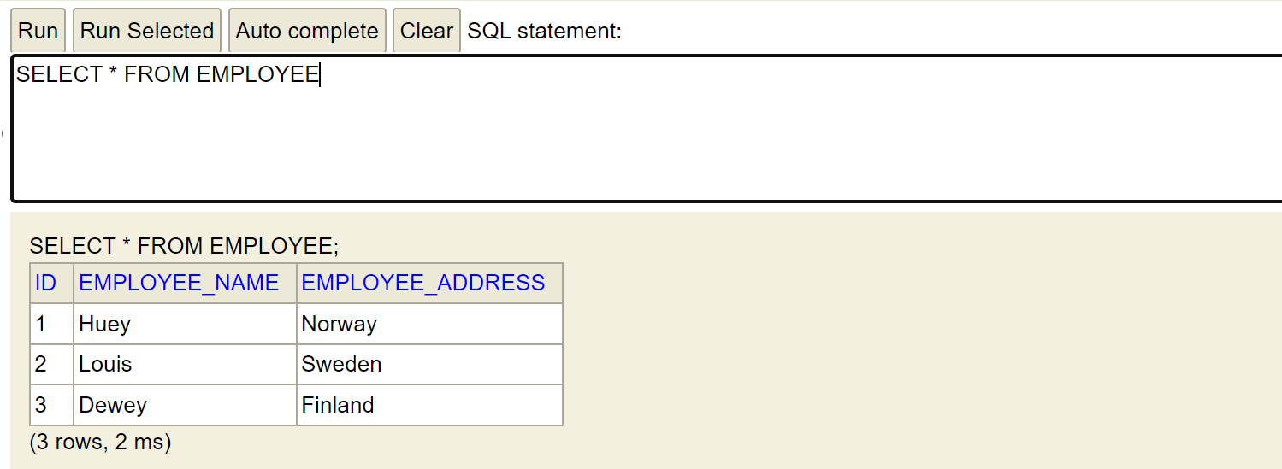
Viewing the Database (1 of 2)
Go back to the H2 console and refresh the view
The database now has an EMPLOYEE table
Query the EMPLOYEE table to verify it has the expected data

Slide 19
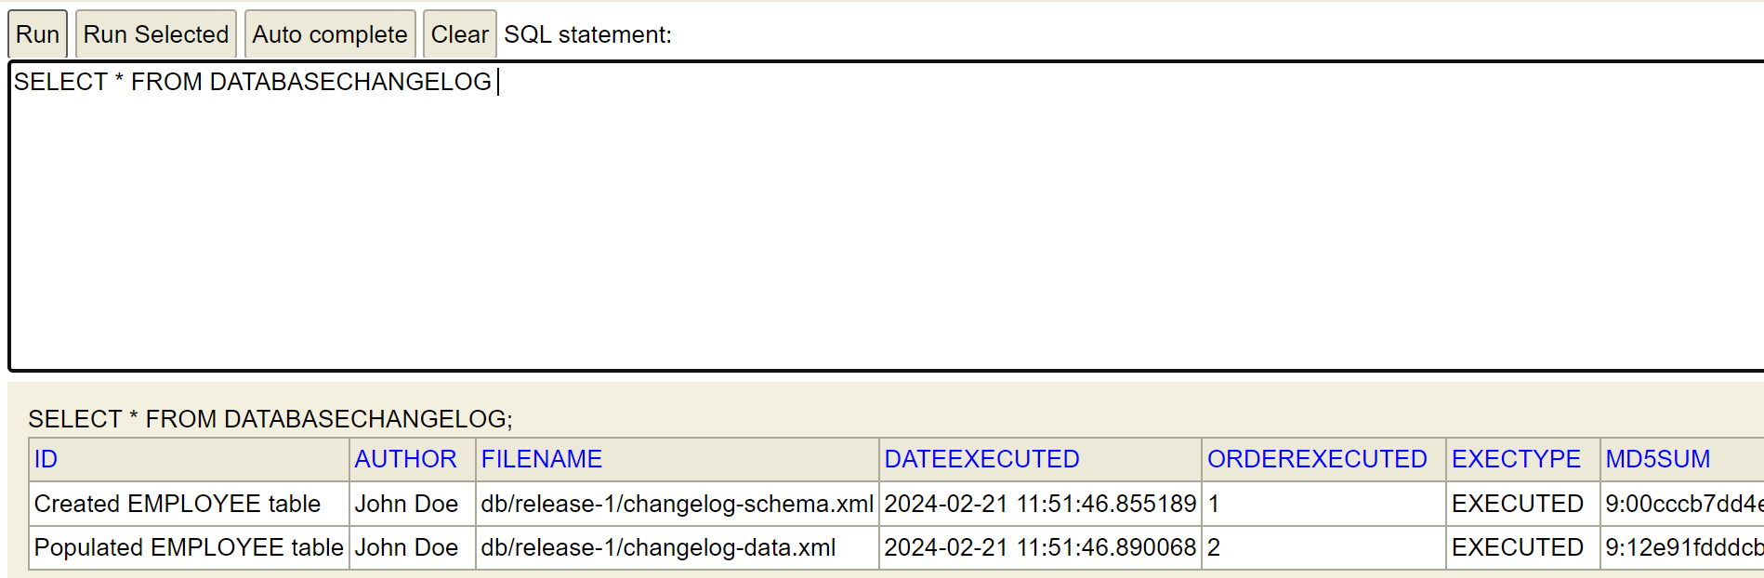
Viewing the Database (2 of 2)
Now query the DATABASECHANGELOG table
It has entries describing the changes in this changeset

Slide 20
4. Applying another Changeset
Overview
Adding the changeset to the master changelog
Running the application
Viewing the database

Slide 21
Overview
In this section you'll apply another changeset to the database, to illustrate the step-by-step evolution of a database over time
You'll add a table named CAR
You'll populate the table with some sample rows
You'll achieve this via scripts in the following folder:
resources/db/release-2
For a reminder about Liquibase change file syntax, see:
https://docs.liquibase.com/change-types

Slide 22
Adding the Changeset to the Master Changelog
To apply the changeset, go to the master changelog file and uncomment the second <include> tag
<?xml version="1.0" encoding="UTF-8"?>
<databaseChangeLog … >
<include file="release-1/changelog.xml" relativeToChangelogFile="true"/>
<include file="release-2/changelog.xml" relativeToChangelogFile="true"/>
</databaseChangeLog>
resources/db/changelog-master.xml

Slide 23
Running the Application
Re-run the Spring Boot application
Liquibase will apply the new changeset against the database
See the info messages in the IntelliJ console window

Slide 24
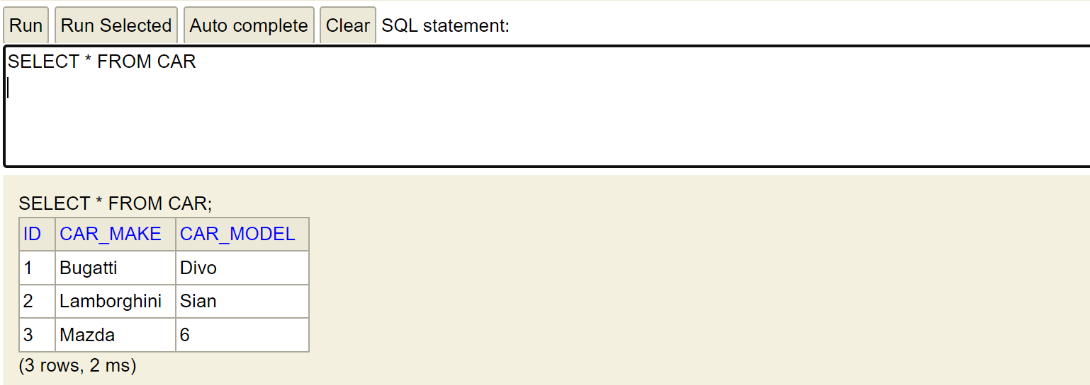
Viewing the Database (1 of 2)
Go back to the H2 console and refresh the view
The database now has a CAR table (as well as the EMPLOYEE table from the previous changeset)
Query the CAR table to verify it has the expected data

Slide 25
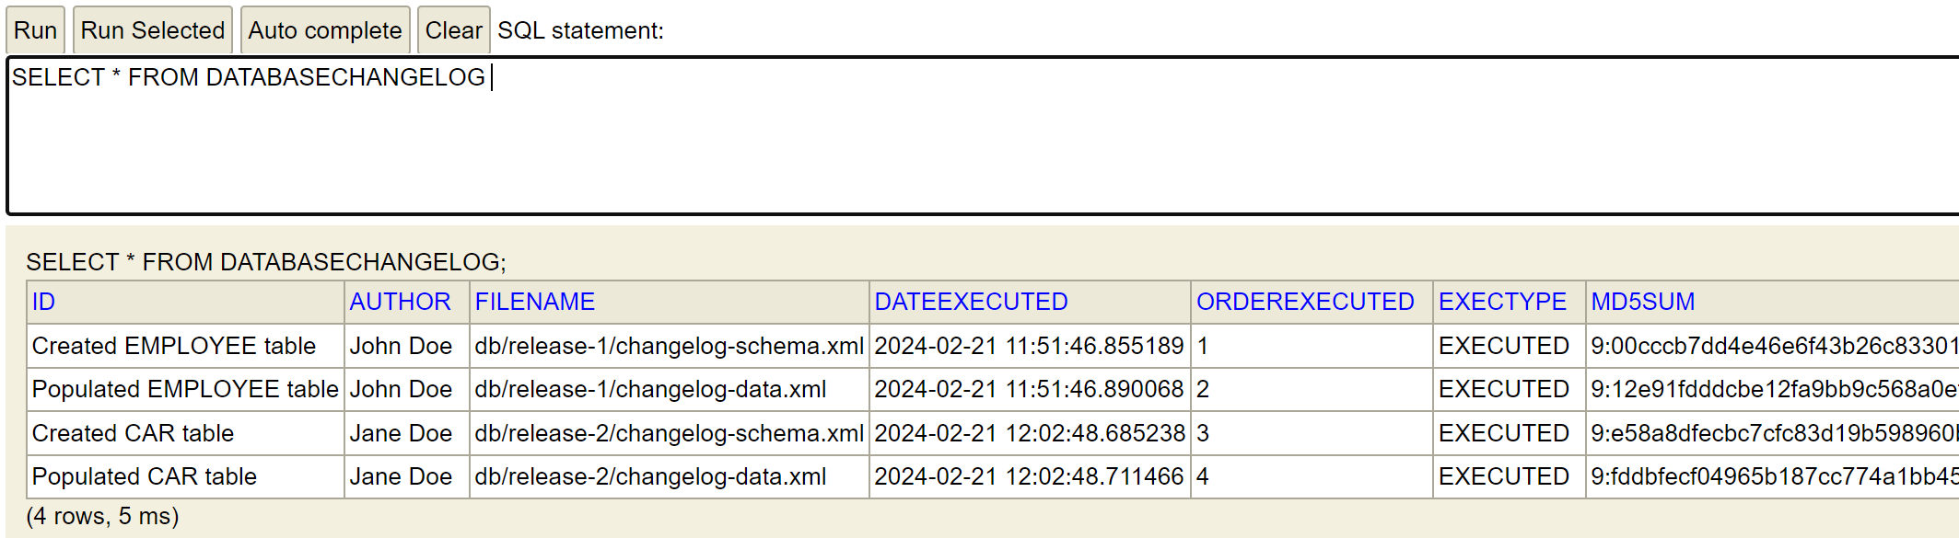
Viewing the Database (2 of 2)
Now query the DATABASECHANGELOG table
It has entries describing the changes in all changesets over time

Slide 26
Summary
Introduction to Liquibase
Getting started with Liquibase in Spring Boot
Applying a changeset
Applying another changeset

