Slide 1


Visualising Molecules with RDKit
Andy Paul Chen
26 September 2025

Slide 2
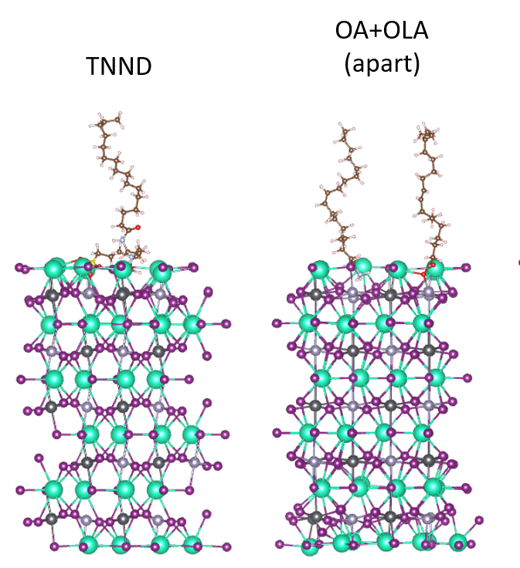
What is RDKit?
RDKit is an open-source cheminformatics tooklit
Applications: drug discovery, materials science, teaching
API with Python, Java, C++
What is NOT RDKit?
RDKit is not a molecular simulation tool, but it can interface with simulation tools

Slide 3
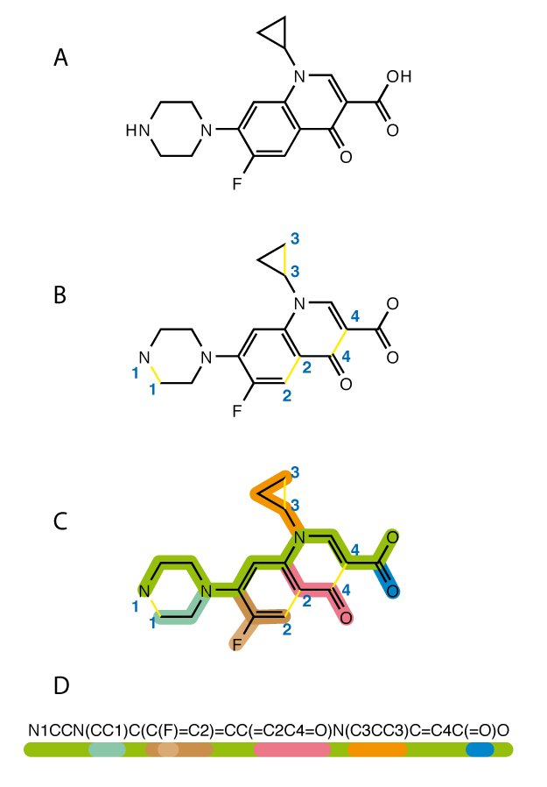
Making molecules with RDKit
3 formats to import: SMILES, MOL, SDF formats
SMILES: Simplified Molecular Input Line Entry System
Describes the structure of the chemical species as ASCII strings

Slide 4
Lesson Scope
Install RDKit
Visualise molecule in skeletal formula
Export skeletal formula to image
Visualise molecule in 3D format
Export 3D molecule into atomic coordinates (MOL)
Check for validity of the molecule
Simple characterisations

