Slide 1
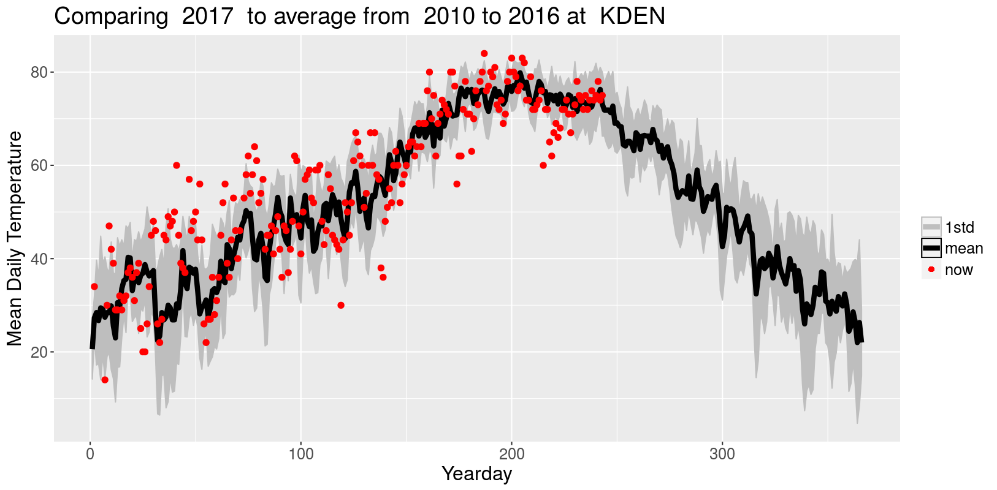
WeatherComparer (a Shiny App)
Denver R Users Meetup
Oct. 11 2017 - Lightning Talks
Andy Pickering

Slide 2
Quick About Me
Data analyst at ICF, working w/ commercial energy data. We help power utilities implement energy efficiency and rebate programs.
PhD. In Oceanography
Data science convert and enthusiast
Love weather and weather data
Golden Data Science Meetup

Slide 3
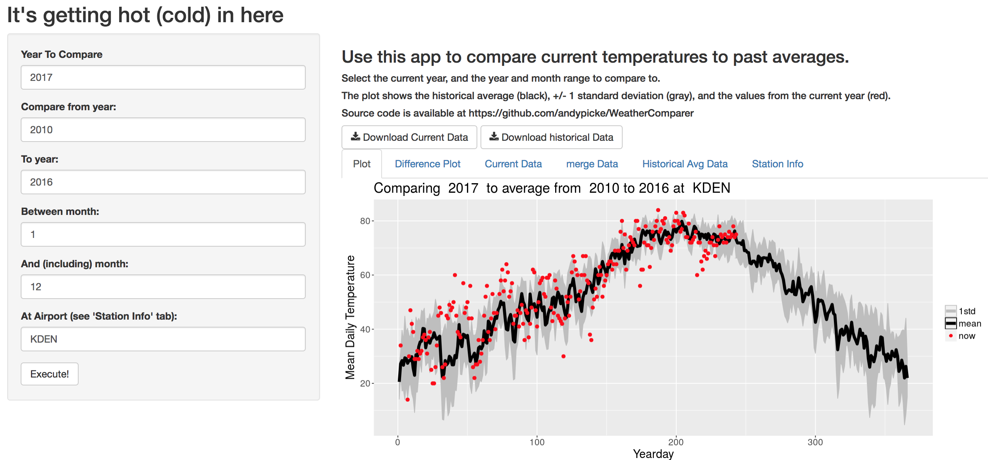
The App!
https://andypicke.shinyapps.io/WeatherComparer/
(Screenshot in case internet isn’t working ☺)
Notes:
Go to app in browser now, unless internet isn’t working.

Slide 4
How Does it Work?
https://github.com/andypicke/WeatherComparer
Data are from wunderground.com
Original Method:
App downloaded yearly files of historical weather data for specified station. Obviously not ideal (slow if you go back far in history).
New (current):
All historical data for each station is downloaded in separate (python, sorry ☺) script, cleaned, and uploaded to a public AWS S3 bucket. See https://github.com/andypicke/wunderground_data
App downloads single file from S3 for specified station.
Problem:
Wunderground no longer allows download of yearly historical data
So currently data only up to ~September 2017
Working on new method to get data (need API key now?)

Slide 5
Lessons/Experience
Building basic Shiny App and layout was relatively easy (Rstudio has awesome tutorials/examples)
Hardest part for me was figuring out reactivity and how to update only on button click. Shiny documentation and examples helped, but still took a bit of figuring out.
Being able to run app in local browser to test/debug super helpful. For problems after app deployed, you can get logs on ShinyApps website.
Rstudio makes it super easy to deploy app to Shiny server.
Issues with changes in data source… ☺

Slide 6
Contact
andypicke on Github/Twitter/LinkedIn
andypicke@gmail.com
App
https://andypicke.shinyapps.io/WeatherComparer/
Questions? Suggestions? Bugs?
https://github.com/andypicke/WeatherComparer
This presentation also available here
Weather Data
https://github.com/andypicke/wunderground_data

