Slide 1

Castle ActiveRecord
Andy Pike
Twitter: @andypike

Slide 2
History
Implementation of the ActiveRecord pattern as coined by Martin Fowler:
Heavily influenced by Ruby on Rails ActiveRecord.
Built on top of NHibernate.
Has been around since 2006
“An object that wraps a row in a database table or view, encapsulates the database access, and adds domain logic on that data.”

Slide 3
Where to get it
castleproject.org (downloads, svn, docs)
hornget.net (trunk builds)
github.com/castleproject (moving to git)
sourceforge.net/projects/castleproject (releases)

Slide 4
How to use it
Configure it
Decorate domain classes with Attributes
Derive domain classes from ActiveRecordBase<T>
Add static methods for querying
Alternatively, create a Repository with ActiveRecordMediator<T> passing commands

Slide 5
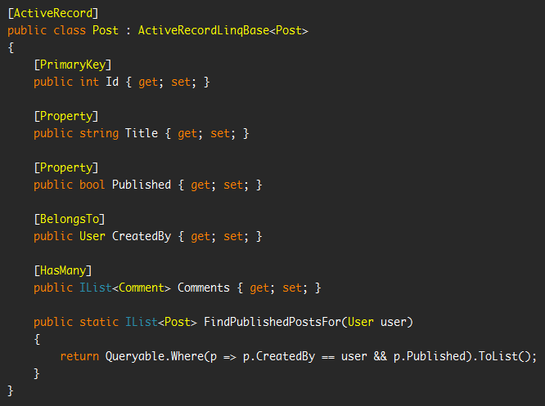
An Example

Slide 6
Demo
Over to Visual Studio...

Slide 7
Advantages
Very fast and easy to use
No code generation
Built on the solid foundation of NHibernate
No mapping files
Takes away a lot of the complexity of NHibernate
Integrates well with Castle MonoRail, Windsor and Validation
Allows querying with Linq*, NH Criteria and HQL
Can generate your database schema
Other NH tools/frameworks can be used like NHProf, NHSearch etc
* Using the current NHibernate Linq provider which is not complete.
A new fully featured one is in the works, see @srstrong

Slide 8
Disadvantages
“Pollutes” domain objects with AR specific detail (attributes)
When using AR base classes, static methods cannot be mocked when doing TDD
Some knowledge of NHibernate is required
Not great for complex legacy databases

Slide 9
Thank you
Look outside of what Microsoft provide, there are better options!
Any questions?
Follow me: @andypike
Source: github.com/andypike/talks

