Slide 1
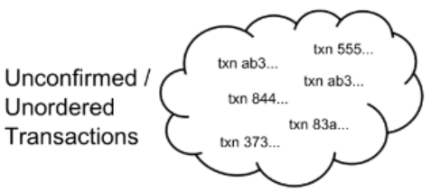
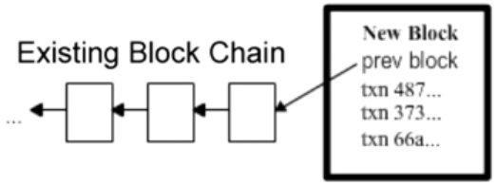
Recap: Blockchain with transaction
Longest Chain Competition
1

