Slide 1
Coins flow from Inputs to Outputs_TODO
Each bitcoin defined as a chain of digital signature
When A wants to transfer a bitcoin to B, A creates a digital signature with A’s private key, based on
The hash of The previous transaction of this coin
The public key of B
Everyone can verify the transaction by verifying the digital signature with public key of A
Create
Verify
Index

Slide 2
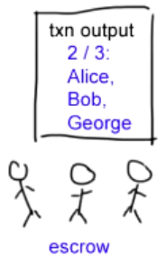
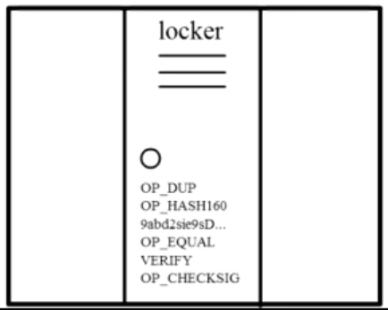
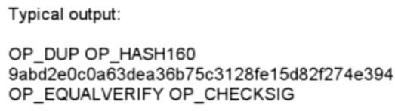
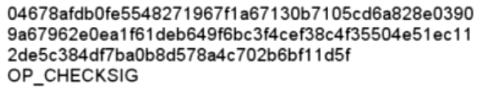
Complex Transactions: Mathematical Puzzles
Transactions: Mathematical Puzzles with locker
Defined with special Scripting language
Only owner can solve it
Support more complex conditions
First Transaction: 2009, Jan 3, 50BTC

