Slide 1
Kaunas University of Technology
P170M100 – Cryptographic systems
Cryptographic Currency: Bitcoin
Author: Ignas Jaruševičius RMIS-3
Kaunas 2014
1

Slide 2
Bitcoin
Bitcoin - decentralized peer-to-peer payment network and digital money.
Not controlled by central authority
Relies on cryptographic proof-of-work instead of trust
Uses public-key cryptography
All transactions are stored in public database

Slide 3
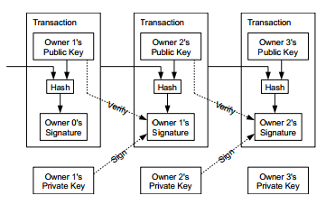
Transactions
Digital coin is a chain of signatures
New owner is indicated by a public key
Ownership of coins is proven by providing a signature

Slide 4
Actual Bitcoin transactions
Bitcoin uses 256-bit ECDSA
  Keys are stored in wallet file
Bitcoin address is only a hash of ECDSA public key
  RIPEMP160(SHA256(PubKey))
Transaction can have multiple inputs and outputs
Scripting is used to authorize inputs
Input:
Previous tx: f5d8ee39…
Index: 0
scriptSig: 30450220…
90db0221…
Output:
Value: 5000000000
scriptPubKey: OP_DUP OP_HASH160 40437170…
OP_EQUALVERIFY OP_CHECKSIG

Slide 5
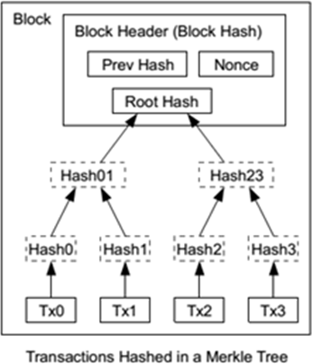
Blocks
Transactions are recorded through files called blocks
Merkle trees are used
Only a merkle root is included
into the block’s hash
Old transactions may be
removed to save space

Slide 6

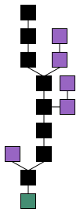
The block chain
A public transaction database
Blocks are chronologically connected by referencing the hash of the previous block
Honest nodes work on extending the longest valid chain
Blocks in shorter chains are not used

Slide 7
Mining (Block hashing)
A block must contain proof-of-work to be accepted as valid
Network nodes work on finding proof-of –work
  Generate hash lower than a set target
Difficulty is adjusted every 2016 blocks to keep steady block generation rate
Once proof-of-work is found, it can be easily verified by other nodes
Block cannot be changed without redoing the work
  All block after it would also have to be redone

Slide 8
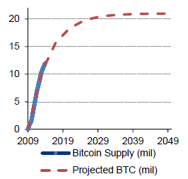
Mining (coin supply)
Node that generates a block is entitled to a reward:
All transaction fees of included transactions
Generation transaction:
Starts at 50 BTC
Reduced by half every 210,000 blocks
Maximum number of Bitcoins ~21 million
Last generation year 2140

Slide 9
Network summary
New transactions are broadcasted to all nodes.
Each full node collects transactions into a block.
Each full node works on finding proof-of-work.
Solved blocks are broadcasted.
Nodes accept blocks only if they follows the rules.
Full nodes express their acceptance by using the hash of the accepted block in the next block.

Slide 10

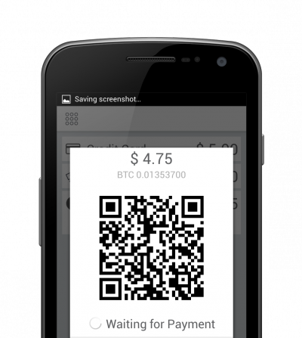
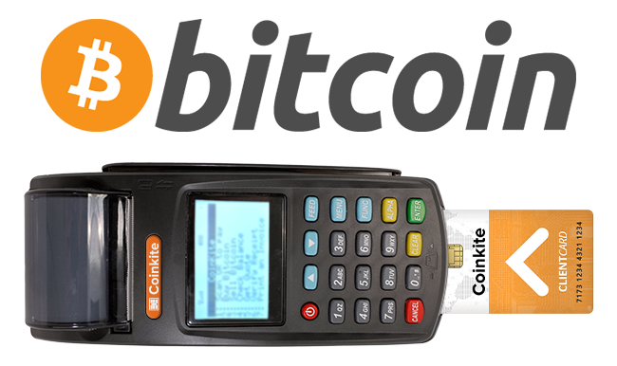
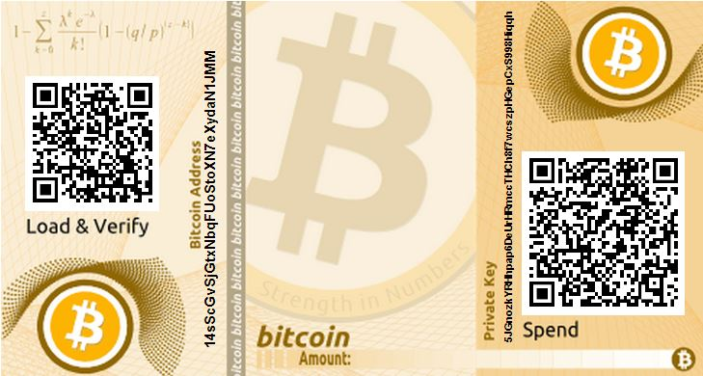
Accepting Bitcoins
Standard transfer to Bitcoin address
Payment processing services
Mobile phones and QR codes
Specialized terminals

Slide 11
Conclusion
Decentralized
  Neutral
  Predictable
  Low fees
  Gives users more control of their money
Money is only tied to cryptographic keys
Network is secure as long as honest nodes control majority of computing power
  Current network hashrate ~10 PHash/s
First realization of concept
Unstable exchange rate
Mostly unknown legal status
Small degree of acceptance

