Slide 1


How Future Technologies
Might Affect Our Lifes
Part 2
ADLUG Annual Meeting 2016, Portugalete
September 23, 2016
Wolfgang Singer, Honorary Member of IBM IT-Specialist Community
Singerw2@gmail.com
http://singerw2.wix.com/home

Slide 2
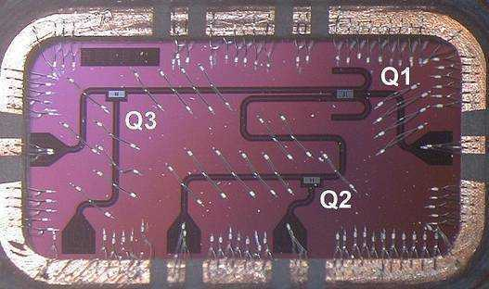
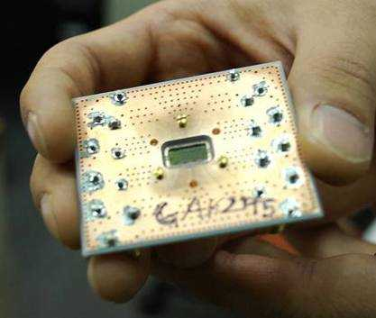
Cognitive Systems: Quantum computing
Extraordinary capabilities are expected…factoring a 3,000 digit number 10⁴⁰ faster than today
Silicon chip with three qubits
Superconducting qubits use established manufacturing techniques for silicon technology
Potential for dramatic advances in cryptanalysis, database sorting, pharmaceutical research
IBM is the world leader in this technology
http://www.computerworld.com/s/article/9224670/IBM_touts_quantum_computing_breakthrough
Notes:
And quantum computing. A new computing frontier.
Quantum computers are different from digital computers based on transistors.
Whereas digital computers require data to be encoded into bits, each of which is always in one of two definite states (0 or 1), quantum computation uses qubits or quantum bits, which can be in superpositions of states.
At a conference in 1981, Nobel Prize winner Richard Feynman challenged scientists to develop a new breed of computers based on quantum physics.
Since then, there has been a race to build quantum computers
There are many complexities in building a quantum computer:
challenges in finding the best materials from which to generate entangled photon pairs;
new types of logic gates and their fabrication on computer chips;
creation and control of qubits;
designs for storage mechanisms;
error detection.
But breakthroughs are being announced every month.
At the end of April, IBM scientists unveiled two critical advances toward the realization of a practical quantum computer.
For the first time, they showed the ability to detect and measure quantum errors.
And they demonstrated a new, square quantum bit (qubit) circuit design that is the only physical architecture that could successfully scale to larger dimensions.
Quantum computing will be able to solve a class of problems that are unsolvable today, opening up a new realm of applications, including searching for big data, designing better drugs and new materials, advanced machine learning, and sophisticated cryptography.
How long will it take until we have the first functional quantum computers? 10 years? 20 years?
Can’t say for sure now – but I can say that I think IBM will be the company to do it.
And I hope I can come back here to tell you all about it at a future State of Technology event.

Slide 3
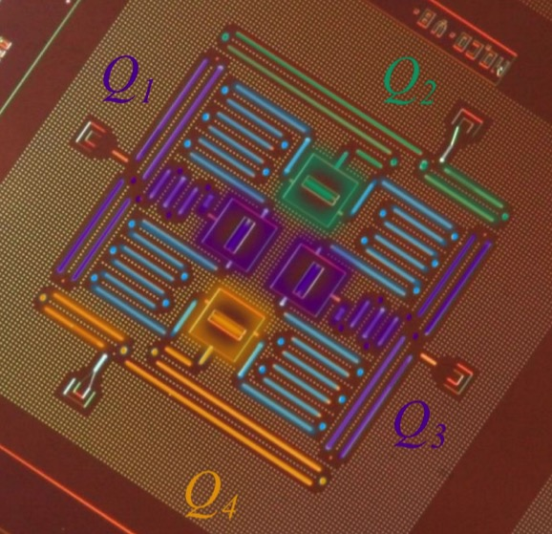
First working quantum computer is closer to reality
IBM scientists recently made important advancements with error detection and circuit design – steps toward realization of practical quantum computer
Notes:
And quantum computing. A new computing frontier.
Quantum computers are different from digital computers based on transistors.
Whereas digital computers require data to be encoded into bits, each of which is always in one of two definite states (0 or 1), quantum computation uses qubits or quantum bits, which can be in superpositions of states.
At a conference in 1981, Nobel Prize winner Richard Feynman challenged scientists to develop a new breed of computers based on quantum physics.
Since then, there has been a race to build quantum computers
There are many complexities in building a quantum computer:
challenges in finding the best materials from which to generate entangled photon pairs;
new types of logic gates and their fabrication on computer chips;
creation and control of qubits;
designs for storage mechanisms;
error detection.
But breakthroughs are being announced every month.
At the end of April, IBM scientists unveiled two critical advances toward the realization of a practical quantum computer.
For the first time, they showed the ability to detect and measure quantum errors.
And they demonstrated a new, square quantum bit (qubit) circuit design that is the only physical architecture that could successfully scale to larger dimensions.
Quantum computing will be able to solve a class of problems that are unsolvable today, opening up a new realm of applications, including searching for big data, designing better drugs and new materials, advanced machine learning, and sophisticated cryptography.
How long will it take until we have the first functional quantum computers? 10 years? 20 years?
Can’t say for sure now – but I can say that I think IBM will be the company to do it.
And I hope I can come back here to tell you all about it at a future State of Technology event.

Slide 4
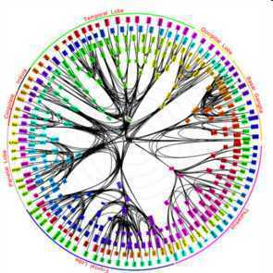
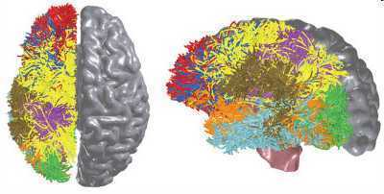
IBM gets DARPA cognitive computing contract
Simulate the brain's sensation, action, interaction, perception and cognition abilities
Supercomputing and nano-technology enable creation of simulated synapses
SyNAPSE project is only the first phase
Read more:
http://www.ibm.com/smarterplanet/us/en/business_analytics/article/cognitive_computing.html http://www.kurzweilai.net
http://venturebeat.com/2011/08/17/ibm-cognitive-computing-chips/
Simulation of neurons with Optogenetics
  Designer viruses and optical signals may take over functions in wound/stroke patients
  Mind-controlled prosthetic limbs
Notes:
Cognitive Computing - With Darpa funding, IBM and university researchers have been developing a computer chip that mimics the processes of the human brain. "IBM’s so-called cognitive computing chips could one day simulate and emulate the brain’s ability to sense, perceive, interact and recognize--all tasks that humans can currently do much better than computers can," reports Dean Takahashi at VentureBeat.
The brain-like processors with integrated memory don’t operate fast at all, sending data at a mere 10 hertz, or far slower than the 5 gigahertz computer processors of today. But the human brain does an awful lot of work in parallel, sending signals out in all directions and getting the brain’s neurons to work simultaneously. Because the brain has more than 10 billion neuron and 10 trillion connections (synapses) between those neurons, that amounts to an enormous amount of computing power.
Mind-controlled prosthetic limbs - Darpa isn't the only one working on this, but they're making major headway designing prosthetics that connect to the human brain. Unlike other robotic prosthetics, Darpa's limb would require an implant in the human brain that would allow the arm or leg to move the limb by simply thinking about it.
The brain has more than 10 billion neuron and 10 trillion connections (synapses) between those neurons .
IBM wants to build a computer with 10 billion neurons and 100 trillion synapses, Modha said (2020?). That’s as powerful than the human brain. The complete system will consume one kilowatt of power and will occupy less than two liters of volume (the size of our brains), Modha predicts.
"SyNAPSE" (Systems of Neuromorphic Adaptive Plastic Scalable Electronics), Modha prediction: Human Scale Brain Simulation by ~ 2017
Synapse is funded with a $21 million grant from DARPA, and it involve six IBM labs, four universities (Cornell, the University of Wisconsin, University of California at Merced, and Columbia) and a number of government researchers.

Slide 5
Health Care
Personal health devices will send data to databases
  Glucose levels will be analyzed from tears by contact lense
Access to patients and personal doctors
Data will be automatically analyzed
Warnings will be sent to doctors and to patient
Life threatening situations will notify emergency units
MRTs, CTs, ECGs, X-Rays will be automatically analyzed
  AI with Watson Healthcare (e.g. for oncologists)
Surgeons supported by augmented reality
Remote and robot-assisted surgeries

Slide 6
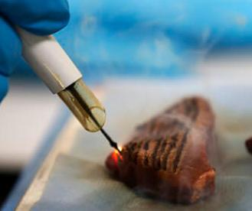
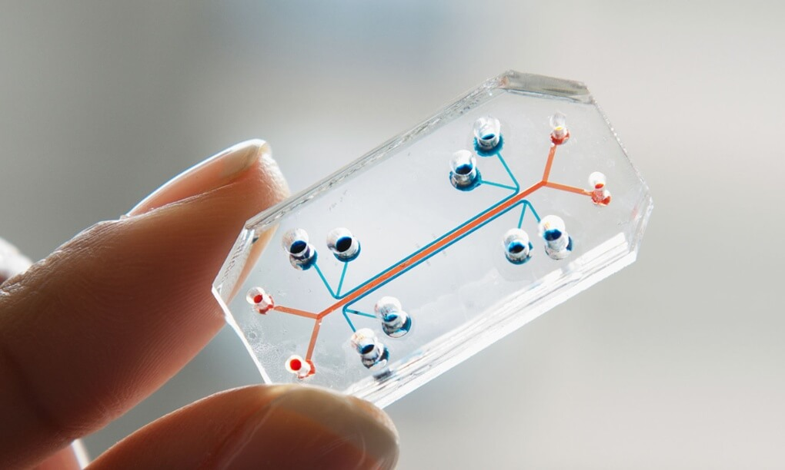
Health Care – cont.
Intelligent prosthetics controlled by nervous system
3D printing of drugs, bionic ears and simple organs
  3D models as surgery preparation
Genomic and genetic personal therapy
Gene manipulation
Intelligent surgical knife will indicate if tissue is malignant
Lab on a chip offers instant results
  Microfluid chip evaluates also plasma and bio markers
In silico trials use mimics cells for testing
  Much faster than today’s trials and replaces animal testing
Trust of doctors, nurses and regulators will be needed
Notes:
Major disruption for pharma instustry on molecular basis.
Bio,marker chips have keys and locks. Can recognize hundreds of illnesses. Liver functions.
2040 organs will be replaceable (liver, kidney, heart, skin) 3D printed bio-ink implanted in surgery room.
http://www.servustv.com/at/Medien/Ab-in-die-Zukunft3 min 43 guitar player
Biosensors in teeth, how often you eat, how sweet, how often you smoke
Medical Trocorders: measures your body temperature, but also traces ECG, measures pulse rate and rhythm, oxygen saturation, systolic blood pressure, physical activity and sleep
Watson will assist physicians in everyday medical decision-making, although it will not substitute humans at all. While a physician can follow a few papers, maybe a few dozens of papers with digital solutions, Watson has the capacity to read 40 million documents in 15 seconds and to suggest the most fitting therapies.
Telomerase I ALT gene deletion plus periodic stem cell reseeding. Aubre de Grey
Genmanipulation Jennifer Doudna, Danali, synthetic biology, simple and cheap, powers of change cannot be stopped, perhaps the can be steered.
Heated knive evaporates parts of cells. Damp is evaluated by spectrometers to spot cancer cells.
Alzheimer healing trials in Zürich: dissolve Amyloide Plaques. One reason: frequent use of sleeping pills.

Slide 7
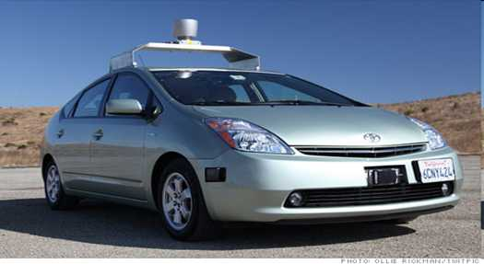
Transportation
Google Self Driving Car
(more than 1 mio miles driven without accident)
Additional projects by:
Tesla, Mercedes-Benz, BMW, Audi,
VW, Nissan, Toyota, Renault, etc..
Uber preparation?
Legal concerns in some countries
Singapore is using self-driving taxis from nuTonomy video
Helsinki is using self-driving buses
Uber is launching test-self driving Volvos in Pittsburg
Autonomous cars are going to save millions of lives
  Traffic accidents kill 1.2 million people worldwide a year
Notes:
People won‘t be allowed to drive on US highways in 2025.

Slide 8
Education
Interactive tutoring systems
Open Courseware
  Khan Academy
  Coursera.Org
  → 500,000 courses from 1000 universities
  → downloaded 700 mio times
More possible with natural language processing
Augment instructions by humans/coaches
Notes:
3.) Education
The OpenCourseware Movement took hold in 2001 when MIT started recording all their courses and making them available for free online. They currently have over 2080 courses available that have been downloaded 131 million times.
In 2004 the Khan Academy was started with a clear and concise way of teaching science and math. Today they offer over 2,400 courses that have been downloaded 116 million times.
Now, the 8,000 pound gorilla in the OpenCourseware space is Apple’s iTunes U. This platform offers over 500,000 courses from 1,000 universities that have been downloaded over 700 million times. Recently they also started moving into the K-12 space.
All of these courses are free for anyone to take. So how do colleges, that charge steep tuitions, compete with “free”?
As the OpenCourseware Movement has shown us, courses are becoming a commodity. Teachers only need to teach once, record it, and then move on to another topic or something else.
In the middle of all this we are transitioning from a teaching model to a learning model. Why do we need to wait for a teacher to take the stage in the front of the room when we can learn whatever is of interest to us at any moment?
Teaching requires experts. Learning only requires coaches.
With all of the assets in place, we are moving quickly into the new frontier of a teacherless education system.
Jobs Going Away
Teachers.
Trainers.
Professors.
New Jobs Created
Coaches.
Course designers.
Learning camps.
Teacherless education: http://www.youtube.com/watch?v=szy6kM4u3ds#t=12m20s
Today 18 mio teachers short globally

Slide 9
Industry 4.0
Artificial Intelligence, Robotics, etc. video
In 10 years 40% of Fortune 500 companies will not exist anymore
New Business Models appear
  Largest taxi company UBER – owns no cars
  Largest accomodation provider AIRBNB – owns no real estate
  Largest retailer ALIBABA – has no inventory
Blockchain Technology → disruptive
Notes:
Steam engine, 2. Assembly line, 3. Computerization, 4. Advanced digitization, AI, robotics
Effects more lower and middle class
Swiss voting: 75% against guaranteed income, €800-1000, cost in Germany €8 bio? Only a third is expected to work.
Alibaba: 3x Amazon, $248 bio in sales transactions 2013, projected 713 bio in 2017. owner Jack Ma,

Slide 10
Blockchain
Disruptive Technology
Created by “Satoshi Nakamoto”
Permanent and transparent records of transactions
  Distributed, encrypted, trusted ledgers
  Secure, indelible, consensus based, auditable
  Permissioned or permissionless, replicated
Potential of eliminating intermediaries
Notes:
Bill Gates: „Banking is necessary, banks are not“

Slide 11
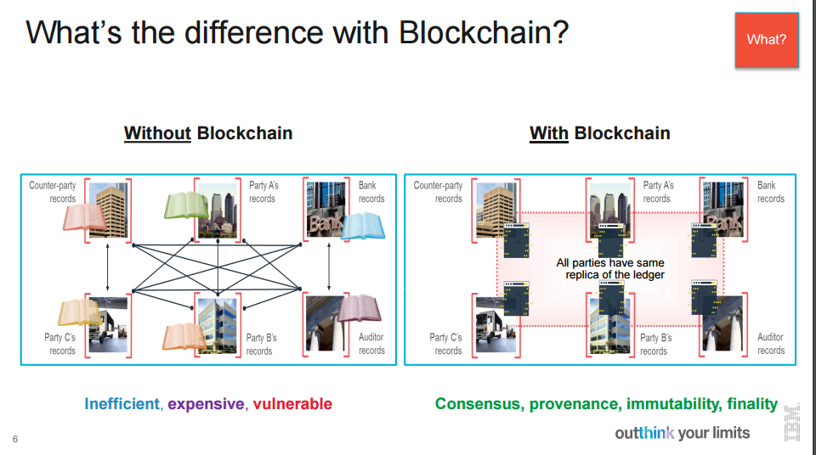
Blockchain – cont.

Slide 12
Blockchain
May be used in:
  Financial transactions
  Supply chain
  Buying/selling stocks, cars, realties, etc.
First used by Bitcoin and Ethereum (smart contracts)
  ‘Utility Settlement Coin’ created by UBS and Deutsche Bank
Hyperledger project
  IBM, Intel, Accenture, Hitachi, Fujitsu, Airbus, Deutsche Börse, etc.
  IBM Blochchain video local
Can be seen as the ‘Internet of Records’
Notes:
Good German Info: http://www.blicklog.com/2016/08/23/infografik-bitcoin-vs-ethereum-die-zukunft-der-digitalen-whrungen/
http://www.efinancelab.de/fileadmin/documents/results/video/2016/20160704_Lang/2016_07_04_Lang.html

Slide 13
Industry 4.0
Good news: AI will create 2 mio jobs
  Elon Musk: “Advance digital intelligence in the way that it is most likely to benefit humanity as a whole”
  Germany is investing $1.3 bio in Industry 4.0
Bad news: AI will destroy 7 mio jobs
  Stephen Hawking: “Development of full AI could spell the end of the human race”
Massive job losses might create more strikes and social unrest
Is “guaranteed basic income” the solution?
  Money would need to come from corporations who profit from AI and robotics
Notes:
http://www.futuristspeaker.com/2012/02/2-billion-jobs-to-disappear-by-2030/ ← education outlook
Futurist Thomas Frey predicts that over 2 billion jobs will disappear by 2030, roughly 50% of all the jobs on the planet.

Slide 14
Human Jobs Exposures
Computers are (and will be) replacing jobs
  Financial advisors
  Economists
  Brokers
  Bank officials
  Psychologists
  Teachers
  Interpreters/Translators
  Ground soldiers
  Jet Fighters, Airline Pilots
  Taxi and Bus drivers, etc.
Notes:
Watch Sugata Mitra Video.
Carolyne Odenwelder‘s feedback
In 10 years 40% of Fortune 500 companies will not exist anymore
Industries that will go away (with some news jobs created):
The power industry (micro grids)
Automobile transportation (going driverless)
Education (OpenCourseware replacing teachers)
Manufacturing (3D printers and bots taking over).

Slide 15
Human Jobs Exposures – cont.
Computers are still far from replacing humans in ‘easy’ tasks
  Gardener
  Cook
  Handyman, plumber
  Good nurses
  Scientists, engineers
  Jobs with ‘one of a kind’ situations
Digital Nomads
  completely independent from time and location
  Internet access is all they need
  mostly contract based (no lifelong employment, no pension plan, etc.)
Notes:
IDNX NET company evaluations. Animosities.

Slide 16
Robotics
Will improve
  Healthcare
  Hazardous environments
  Information services
  Entertainment
Boston Dynamics is the leading Robotics company
  Recently bought by Google
  Mainly military use video

Slide 17
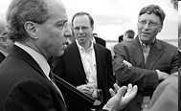
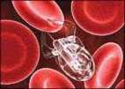
Ray Kurzweil Predictions
Most of the predictions are based on exponential growth of technology (doubles approx. every year)
  10 iteration: 1000x, 20 iteration: 1 mio fold
Cell phones in comparison to MIT computer (in 1965) are today
  1000 times more processing power
  1 mio times smaller
  1 mio times cheaper
  1 bio times increase in price/performance
Compute power that was 40 years ago in a building, is currently in a cell phone, will be in 25 years at the size of a red blood cell
Notes:
Exponential growth:
How many rice corns needed to duplicate on every field of chess board: 18 trillion
How often fold paper to reach the moon: 42 times.

Slide 18
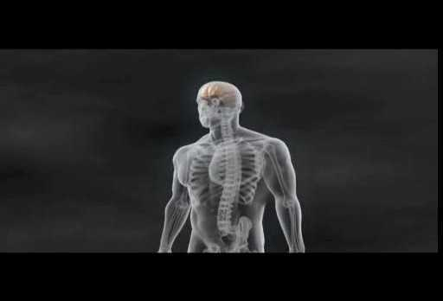
Ray Kurzweil Predictions
2020: Computers have same processing power as humans.
2030: Brain is reverse engineered.
Computers can communicate as humans and pass Turing test.
Copy of the brain/knowledge can be stored.
2040: Virtual reality will become more exciting than reality.
Biological intelligences is fixed.
Non-biological intelligence grows exponentially.
Human beings will be a million times more capable.
For more information visit: http://www.kurzweilai.net
Notes:
Kurzweil predictions (http://genius.com/Ray-kurzweil-how-the-world-will-change-annotated)
2017: Self-driving cars
Google self-driving cars have gone half a million miles without human drivers on highways and city streets, with no incidents.Within ten years they will be ubiquitous. Humans have a fairly narrow field of view, these cars have sensors, both visual and laser, and artificial intelligence to be able to assess what’s going on in their environment. Ultimately these cars will communicate with each other and co-ordinate their movements. You also won’t need to own a car, there’ll be a pool of them circulating, and you’ll just call one from your phone when you need it.
2018: Personal assistant search engines
Right now, search is based mostly on looking for key words. What I’m working on is creating a search engine that understands the meaning of these billion of documents. It will be more like a human assistant that you can talk things over with, that you can express complicated, even personal concerns to. If you’re wearing something like Google Glass, it could annotate reality; it could even listen in to a conversation, giving helpful hints. It might suggest an anecdote that would fit into your conversation in real time.
2020: Switch off our fat cells
It was in our interest a thousand years ago to store every calorie.There were no refrigerators, so you stored them in the fat cells of your body, which now means we have an epidemic of obesity and type 2 diabetes. Thanks to the Human Genome Project, medicine is now information technology, and we’re learning how to reprogram this outdated software of our bodies exponentially. In animals with diabetes, scientists have now successfully turned off the fat insulin receptor gene. So these animals ate ravenously, remained slim, didn’t get diabetes, and lived 20 per cent longer. I would say that this will be a human intervention in five to ten years, and we will have the means of really controlling our weight independent of our eating.
2020: Click and print designer clothes at home
Currently there is a lot of overenthusiasm about 3-D printing. Typically where people are prematurely very excited it leads to disillusionment and a bust, like the dot.com crash. I think we’re about five years away from the really important applications. By the early 2020s we’ll be replacing a significant part of manufacturing with 3-D printing. We’ll be able to print out clothing and there’ll be an open source market of free designs.There will be personal 3-D printers, but also shared ones in your local Starbucks, for example.
2023: Full-immersion virtual realities
Computer games have pioneered virtual reality, and within ten years — but probably more like five — these will be totally convincing, full-immersion virtual realities, at least for the visual and auditory senses, and there will be some simulation of the tactile sense. To fully master the tactile sense we have to actually tap into the nervous system. That will be a scenario within 20 years. We’ll be able to send little devices, nanobots, into the brain and capillaries, and they’ll provide additional sensory signals, as if they were coming from your real senses. You could for example get together with a friend, even though you were hundreds of thousands of miles apart, and take a virtual walk on a virtual Mediterranean beach and hold their hand and feel the warm spray of the moist air in your face.
2030: Vertical meat and vegetable farms
There will be a new vertical agriculture revolution, because right now we use up a third of the usable land of the world to produce food, which is very inefficient. Instead we will grow food in a computerised vertical factory building (which is a more efficient use of real estate) controlled by artificial intelligence, which recycles all of the nutrients so there’s no environmental impact at all. This would include hydroponic plants, fruits and vegetables, and in vitro cloning of meat. This could also be very healthy — we could have meat with Omega-3 fats instead of saturated fats, this sort of thing.
2033: 100 per cent of our energy from solar
We are applying new nanotechnologies to the design of solar panels, and the costs are coming down dramatically. A recent report by Deutsche Bank said that ‘the cost of unsubsidised solar power is about the same as the cost of electricity from the grid in India and Italy. By 2014 even more countries will achieve solar grid parity’. So I do believe that within 20 years we could get all our energy from solar energy. I presented this not so long ago to the Prime Minister of Israel, Benjamin Netanyahu, who was actuallymy classmate at MIT’s Sloan School of Management, and he said: “Ray, do we have enough sunlight to do this with?” and I said: “Yes, we’ve got 10,000 times more than we need.
2040: Stay young for ever
Twenty years from now, we will be adding more time than is going by to your remaining life expectancy. We’ve quadrupled life expectancy in the past 1,000 years and doubled it in the past 200 years. We’re now able to reprogram health and medicine as software, and so that pace is only going to continue to accelerate. There are three bridges to life extension. Bridge 1 is taking aggressive steps to stay healthy today, with today’s knowledge. The goal is to get to bridge 2: the biotechnology revolution, where we can reprogram biology away from disease. Bridge 3 is the nanotechnology revolution. The quintessential application of that is nanobots — little robots in the bloodstream that augment your immune system. We can create an immune system that recognises all disease, and could be reprogrammed to deal with new pathogens.
-------- Kurzweil predictions made in 2015:
By the late 2010s, glasses will beam images directly onto the retina. Ten terabytes of computing power (roughly the same as the human brain) will cost about $1,000.
By the 2020s, most diseases will go away as nanobots become smarter than current medical technology. Normal human eating can be replaced by nanosystems. The Turing test begins to be passable. Self-driving cars begin to take over the roads, and people won’t be allowed to drive on highways.
By the 2030s, virtual reality will begin to feel 100% real. We will be able to upload our mind/consciousness by the end of the decade.
By the 2040s, non-biological intelligence will be a billion times more capable than biological intelligence (a.k.a. us). Nanotech foglets will be able to make food out of thin air and create any object in physical world at a whim.
By 2045, we will multiply our intelligence a billionfold by linking wirelessly from our neocortex to a synthetic neocortex in the cloud.

