Slide 1
Bitcoin Double Spending Attack
Karame, Androulaki & Capkun
Presented by
Subhro Kar
CSCE 715, Fall 2013

Slide 2
Requirements of Digital Currencies
New methods of purchases requiring new methods of payments.
Security of payments.
Non ambiguous but preferably anonymous mapping between services/products and payments for them.
Non repudiation

Slide 3
Types of Digital Currencies
Credit/Debit cards
Echecks
Moneygram/Moneypack and similar services
E-gold
Bitcoin/Litecoin/Namecoin

Slide 4
What is Bitcoin?
Crypto currency
Has no central controlling authority
Secure
Non reversible
Anonymous
Based on Proof of Work

Slide 5
Bitcoin Operations
Peers transfer coins to each other
Each peer holds a wallet which is designated by a wallet ID
A transaction is formed by digitally signing hash of all previous transactions where the specific bitcoin in question was used previously.
Any peer can verify a transaction.

Slide 6
Bitcoin Transactions
An electronic coin is a chain of digital signatures
Each owner transfers the coin to the next by digitally signing a hash of the previous transactions and the public key of the next owner adding these to the end of the coin.
A payee can verify the signature to verify the chain of ownership.

Slide 7
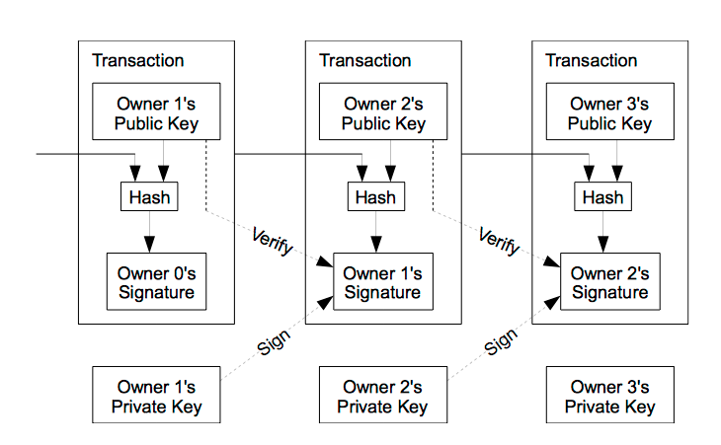
Bitcoin Transactions

Slide 8
Bitcoin Transactions and Double spending problems
The problem however remains that a payee can not verify that the owners did not double spend this coin.
The problem could be removed by designing a central coin issuing authority, but that again makes Bitcoin reliant on a central authority.

Slide 9
Bitcoin blocks and verification
Transactions are included in Bitcoin blocks that are broadcasted to the entire network
Bitcoin relies on a hash based Proof-of-Work (PoW) scheme to detect double spending on the same Bitcoin

Slide 10
Proof of Work
The proof-of-work involves scanning for a value that when hashed, such as with SHA-256, the hash begins with a number of zero bits. The average work required is exponential in the number of zero bits required and can be verified by executing a single hash.

Slide 11
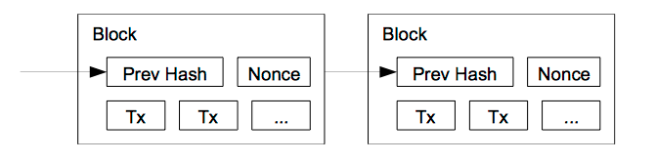
Proof of Work in Bitcoin
Proof-of-work is implemented by incrementing a nonce in the block until a value is found that gives the block's hash the required zero bits.
Once the CPU effort has been expended to make it satisfy the proof-of-work, the block cannot be changed without redoing the work. As later blocks are chained after it, the work to change the block would include redoing all the blocks after it.

Slide 12
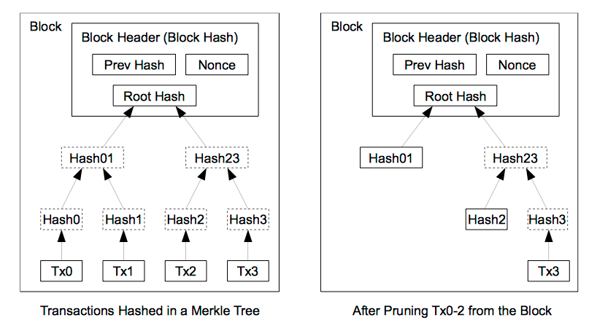
Managing the size of block chain
Once the latest transaction in a coin is buried under enough blocks, the spent transactions before it can be discarded to save disk space. To facilitate this without breaking the block's hash, transactions are hashed in a Merkle Tree [7][2][5], with only the root included in the block's hash. Old blocks can then be compacted by stubbing off branches of the tree.

Slide 13
Bitcoin block generation
Peers work to find a nonce value that when hashed with the Merkle hash of all valid and received transactions, the hash of the previous block and a timestamp is below a given target value.
When such a nonce is found, peers then include the hash and additional fields which can then be verified by all peers on the network.

Slide 14
Bitcoin block generation
Upon successful generation of a block, the generating peer is awarded 50 Bitcoins and the whole system is re-primed.
The resulting block is broadcasted on the network which after verification is added to the block chain by all clients.

Slide 15
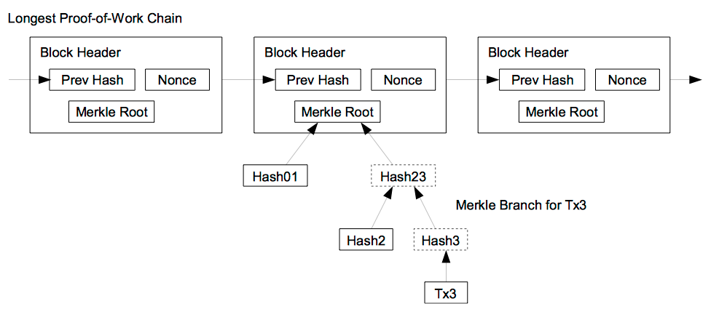
Block verification
A user only needs to keep a copy of the block headers of the longest proof-of-work chain, which he can get by querying network nodes until he's convinced he has the longest chain, and obtain the Merkle branch linking the transaction to the block it's timestamped in.
He can't check the transaction for himself, but by linking it to a place in the chain, he can see that a network node has accepted it, and blocks added after it further confirm the network has accepted it.

Slide 16
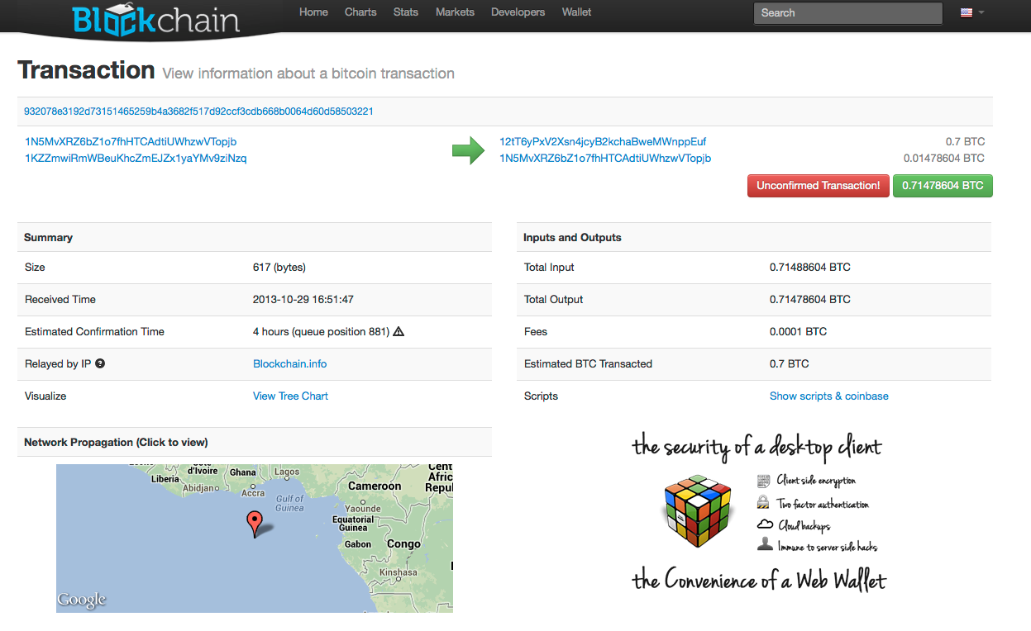
A bitcoin transaction

Slide 17
The attack scenario
A bitcoin transaction is accepted only if majority of the clients in the network mark it as valid.
As per the design of bitcoin, a transaction requires about 10 mins in the best case before it is included in a block and broadcasted for confirmation.
If a merchant client accepts a transaction initially and later on gets refusal from majority of peers in the network, the attack is successful.

Slide 18
Block generation time
It is possible for transactions to be delayed further depending on the difficulty of the hash being currently calculated.
The complexity of the hash is adjusted based on the generation time of the previous hash.

Slide 19
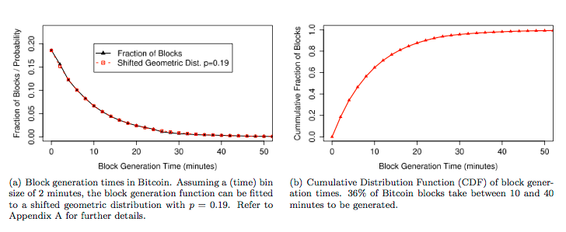
Block generation times

Slide 20
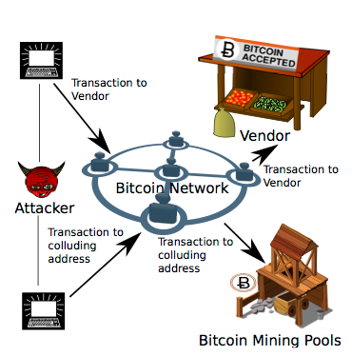
Attacker Model
A malicious client A forms the core of the attack model
Let us assume A is trying to spend a coin B at a merchant V which she had already spend earlier.
The attack will succeed if V accepts the bitcoin but can’t redeem it later on.

Slide 21
Attacker Model
A requires at least another helper peer to succeed with the attack. We assume that the helper is H.
The attack has a greater chance of succeeding if multiple helper peers are present in other parts of the planet.

Slide 22
The Attack
A connects to V and creates a transaction T1 with B.
Since A and V are in the same network, V receives T1 almost immediately.
Since bitcoin clients accept all connections, the transaction is received.

Slide 23
The Attack
A few seconds later A connects to H and transfers the same bitcoin B to H in transaction T2.
As per our assumption H is on the other side of the globe, so there is a good chance H does not know about T1 which A had with V using B.

Slide 24
The Attack
H immediately starts broadcasting T2 in its local network and starts waiting for confirmation.

Slide 25
Success of the Attack
The attack mentioned in the previous slides will succeed if:
  the time required for V to receive T1 is shorter than that for T2
  the number of hosts which had included T2 in its blockchain should be in majority.

Slide 26
Prevention of Double Spending Attack
Unfortunately, there is no way to prevent this attack as the problem of time lag between a transaction and its acceptance lies in the protocol.
Can contain a damage of a fraudulent transaction by limiting the number of bitcoins transferred in an unverified transaction.

Slide 27
Alternative currencies and prevention of double spending attacks
Alternate currencies like Litecoin, Namecoin and PrimeCoin has been developed which has a shorter block generation time.
Because SHA-256 is not used in any of the other currencies, the block generation is CPU bound. Therefore, the complexity of PoW remains under a threshold.

Slide 28
References
Nakamoto, Satoshi. Bitcoin: A Peer-to-Peer Electronic Cash System.
Karame, Ghassan O, Androulaki, Elli, Capkun, Srdjan, Two bit coins at the Price of One? Double-Spending Attacks on Fast Payments in Bitcoin
Bitcoin wiki, https://en.bitcoin.it/wiki/Category:Technical

