Slide 1
Preserving Crypto-Currency for Reanimation
Ben Best
Past President – Cryonics Institute
Employee – Life Extension Foundation

Slide 2
A Story of Money Management

Slide 3
Context of my Presentation
  I believe Bitcoin and cryptocurrencies are the future of money and that anyone serious about asset preservation for reanimation should be aware of them
  I gave an introduction to Bitcoin and cryptocurrencies two years ago at the asset preservation group meeting
  Many people here were not at that meeting
  Many people at that meeting did not understand me
  I am going to attempt to give simple explanations about this very complex, but very important subject

Slide 4
What is Money?
  Money is a social convention
  Money is a medium of exchange because people agree to readily trade entities called money for goods and services
  Money originated from non-perishable commodities
  The Greek word “drachma” means “handful” because handfuls of nails were relatively non-perishable, widely used, and easily divisible in ancient Greece , and therefore useful as a medium of exchange

Slide 5
What is Money?
  Money has not been backed by gold or anything else (other than guns and jails) for a long time
  Governments have declared non-government money to be illegal, and have declared government money to be “legal tender”
  Government money is called FIAT, which is Latin for “it shall be” – money created by command or decree

Slide 6
What is Money?
  Money is a social convention
  Language is a social convention
  I would not want to only speak Fiji or Esperanto
  You want to speak a language that is spoken by lots of other people, and you want to use money that is used by lots of other people
  Because money is not a physical object, but is a social convention, money doesn’t even need to be paper currency
  Only 10% of US Dollars is in the form of coins or paper currency, the other 90% is digital (electronic) entries – mostly at banks

Slide 7
Trends – paper and cards
Credit and Debit cards are replacing coins and paper currency
  More durable, sanitary and convenient
  Financial transactions are increasingly digital
    Online bill payments rather than checks
  Paper currency & coins gone in a couple of decades ?
Digital wallets will replace plastic cards
  Android pay, MasterPass, Apple Pay are more secure because the merchant does not have access to the credit card number (how many people use?)
  I use Apple Pay at Whole Foods

Slide 8
What Determines the Price of Money?
  Money has a price because it has limited supply
  The price of a pair of shoes in money could be $50, which would mean that the price of $50 is those shoes
  Both the price of shoes and the price of money is determined by supply and demand
  If there were no paper currency, and US dollars were only digital, the price of that pair of shoes would still be $50 even if you paid for it digitally
  The government does not change the supply of fiat money by printing more money, it changes the supply by creating more digital entries in banks

Slide 9
What Determines the Price of Money?
  Money has a price because it has limited supply
  When the Spanish discovered and distributed gold from South America, the price of gold dropped worldwide
  If the government doubled the number of digital entries representing its fiat money, the price of fiat would approximately halve, the shoes would cost about $100
  Bitcoin is a crypto-currency entirely represented by digital entries on computers
  Bitcoin has value because it can be used to buy goods and services and because the supply is limited by the Bitcoin protocol
  The price of bitcoin in US dollars is determined by supply and demand. Currently the price is about $450

Slide 10
Bitcoin
Decentralized digital currency based on cryptography
No government or central organization of any kind controls the creation bitcoin
The creation and supply of bitcoin is strictly limited by the Bitcoin computer protocol
There can never be more than 21 million bitcoin
Ownership and transfer of ownership is validated by a distributed network with no central authority
New bitcoins are created by validating bitcoin transactions, a process called “mining”

Slide 11
Bitcoin
First bitcoins created January 2009
Maximum 21 million bitcoins can ever be created
  Unlike fiat currencies which governments can inflate, bitcoin is not inflationary
  But bitcoin can lose value (like a stock price) if users sell their holdings
  The price of bitcoin is determined by the supply of bitcoins and the demand for bitcoins
  Why would anyone want (create a demand for) bitcoins?

Slide 12
Demand for Bitcoin
Bitcoin is used to rapidly and inexpensively spend money to other countries
  Banks take days and charge high fees to send money to other countries
  Bitcoin has commodity value for the same reason that cash registers have commodity value, because it facilitates financial transactions
Bitcoin has been used for years to buy real goods and services, mostly online, especially at first

Slide 13
Businesses accepting bitcoin May 2014
WordPress.com
Reddit
Virgin Galactic
Tesla motor company
Mises Institute
TigerDirect -- $1 million in sales after 2 months
Oversstock.com – $10-$15 million for 2014 expected
Yelp now lists “Accepts Bitcoin” below “Accepts credit cards”

Slide 14
Businesses accepting bitcoin May 2016
Amazon
CVS
Target
Victoria’s Secret
Expedia
Subway
Whole Foods (by gift card from Gyft)

Slide 15
Why businesses accept bitcoin
Convenient for on-line merchants
Superior to Credit cards
  Negligible transaction fees
  No chargebacks
  Simple international payment
  No risk of credit card theft
    In 2013 retailer TARGET had 40 million credit card numbers stolen
Merchants gain status as early adopters from the enthusiastic Bitcoin community

Slide 16
Non-Fiat Money is Illegal
Governments declare that ONLY fiat money is “legal tender”
Governments ferociously attack any attempt by anyone to compete with government-monopoly fiat money

Slide 17
Liberty Dollars
Liberty Dollars were coins produced in the United States beginning in 1998
Liberty Dollars were promoted as medallions which could be used in barter
In 2007 the FBI confiscated 2 tons of gold, silver, and platinum coins bearing the likeness of Ron Paul
The owner was accused of domestic terrorism and sentenced to 15 years in jail

Slide 18
Cryptocurrency is the Future of Money
Cryptocurrency simplifies worldwide monetary transactions, making them as simple as sending an e-mail message
E-mail has replaced the government postal system as a means of person-to-person written communication
I believe crypto-currency will replace fiat money for money transmission and purchase of goods and services worldwide

Slide 19
Cryptocurrency is the Future of Money
A deceased Cryonic Institute member had been keeping French Francs in a Safe Deposit box
French Francs had been replaced by Euros a decade earlier and were of no value
If all of your assets are in fiat money when you are reanimated, you may come back with nothing
Anyone who relies on fiat money being valuable in the future is like an ostrich with its head in the sand
I repeat, reliance on fiat money for future value upon reanimation is very foolish
Reliance on fiat money for future value could leave you with NOTHING

Slide 20
The Bitcoin Network
Bitcoin is created and maintained by 5,624 computers (“nodes”) worldwide
Bitcoin nodes compete to process transactions and record those transactions in a publically displayed ledger called the “blockchain”
The first node to successfully add a block the block-chain is rewarded with bitcoins
The full block-chain of over 412,000 blocks contains every bitcoin transaction in history back to January 2009 when the first block was created

Slide 21
Geeky technical details
Bitcoin is based on a form of cryptography in which there is a public key and a private key
The public key is like a bank account number
The private key is like a PIN number or signature on a check
The private key authorizes a transaction

Slide 22
Geeky technical details
The public key is created from the private key in a one-way calculation
It is easy to verify that the public key is derived from a private key, but virtually impossible to determine the private key from the public key
Over-simplified example:
  Calculate public key as first five numbers after the decimal of the square root of a prime number
  Square root of 89977 is 299.96166421727963
  Public key in this example is 96166

Slide 23
Bitcoin Exchanges
Company that exchanges bitcoin for fiat currencies
  And, in most cases, other cryptocurrencies
Coinbase now the largest and most reputable
  San Francisco company
  Treasury Department requires Coinbase to register as a money transaction business
  On-line transfer from bank account to Coinbase (and to bitcoin) – How I get my bitcoin
Others: Bitstamp, Poloniex, Crypsy, Gatecoin, Blockchain.info, etc.

Slide 24
Bitcoin Exchanges
Company that exchanges bitcoin for fiat currencies
  And, in most cases, other cryptocurrencies
Coinbase now the largest and most reputable
  San Francisco company
  Treasury Department requires Coinbase to register as a money transaction business
  On-line transfer from bank account to Coinbase (and to bitcoin) – How I get my bitcoin
Others: Bitstamp, Poloniex, Crypsy, Gatecoin, Blockchain.info, etc., all of which I have used
In January 2016 Crypsy disclosed it had been hacked and I lost all the cryptocurrencies I had stored there

Slide 25
Acquiring bitcoin without using an exchange
Bitcoin can be mined (with your computer)
Bitcoin can be received as a donation or gift (e.g., transfer to a relative in a foreign country)
Bitcoin acquired online as payment for service
  Computer programmers, artists, writers, etc.
LocalBitcoins.com
  Company in Finland that allows users to negotiate to meet in person to buy/sell bitcoins in exchange for local fiat currency
ATM (if available)

Slide 26
Storing bitcoin
A Wallet is a place to store bitcoins
  Software on your computer
  Software on the computer of a Bitcoin exchange
  Software on your smartphone
  Public address plus private key on a piece of paper
    (“cold storage”)
  “Brainwallet” – memorized phrase corresponding to address and private key

Slide 27
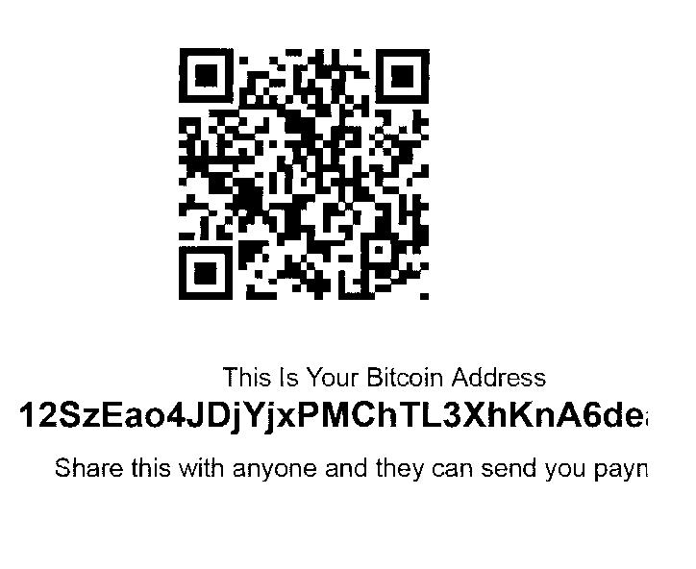
Ben Best’s Bitcoin Address at Blockchain.info (with QR code)

Slide 28
Storing bitcoin without using an exchange
Bitcoin can be sent directly to a bitcoin address on the blockchain, and you can store that address on a piece of paper
bitaddress.org allows you to generate a bitcoin address and private key online, which you can print
Physical coins can be purchased at denarium.com
  Or from me now for $10 (I paid $15 to $20)
TREZOR is a hardware wallet that generates a word list which can be used to retrieve your private key. The wordlist could be saved in a metal band in your Alcor Memory box created with a DYMO Tapewriter Metal Tape Embosser

Slide 29
Alcor Memory Box
Underground Vaults & Storage (UVS) company
Hutchinson, Kansas salt mine
Cost included in cryopreservation charge
Boxes 13”wide X 15”tall X 18”long
  Boxes are sealed in tape
  Only UVS employees have access
Precious metals might be safe to store
Additional boxes $250 each
Employee theft seems possible

Slide 30
Bitcoin Price in US$ (Coinbase)
DATE | PRICE
July 22, 2010 | $0.05
December 24, 2010 | $0.25
June 2, 2011 | $10.60
December 18, 2011 | $3.19
August 1, 2013 | $97.08
November 20, 2013 | $1,126.82
December 18, 2013 | $537.85
January 6, 2014 | $937.37
May 9, 2014 | $445.06
May 11, 2016 | $450.00

Slide 31
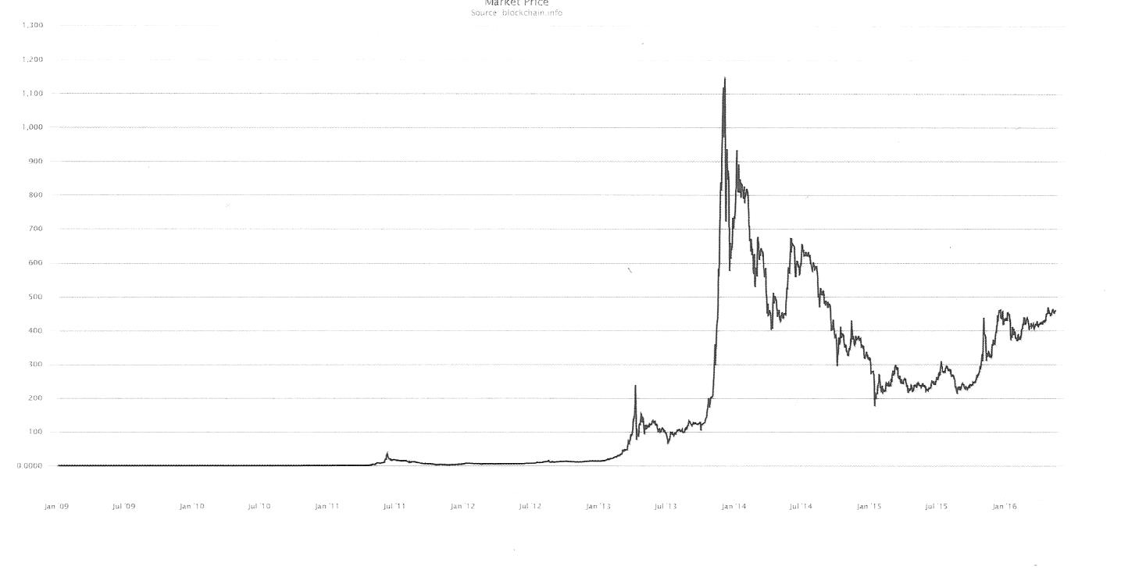
US$ Bitcoin Price from
January 2009 to May 2014
Notes:
December crash as a result of China’s central bank warning against treating bitcoins as legal tender, although did not ban bitcoins trading by individuals, but did barred financial institutions from using bitcoin. Rise $100 to $1,100
Mt.Gox stopped withdrawals in early February 2014, declared bankrupcy in late February 2014

Slide 32
Bitcoin Price in US$ (Blockchain.info)
DATE | PRICE
July 22, 2010 | $0.05
December 24, 2010 | $0.25
June 2, 2011 | $10.60
December 18, 2011 | $3.19
August 1, 2013 | $97.08
November 20, 2013 | $1,126.82
December 18, 2013 | $537.85
January 6, 2014 | $937.37
May 9, 2014 | $445.06
May 11, 2016 | $450.00

Slide 33
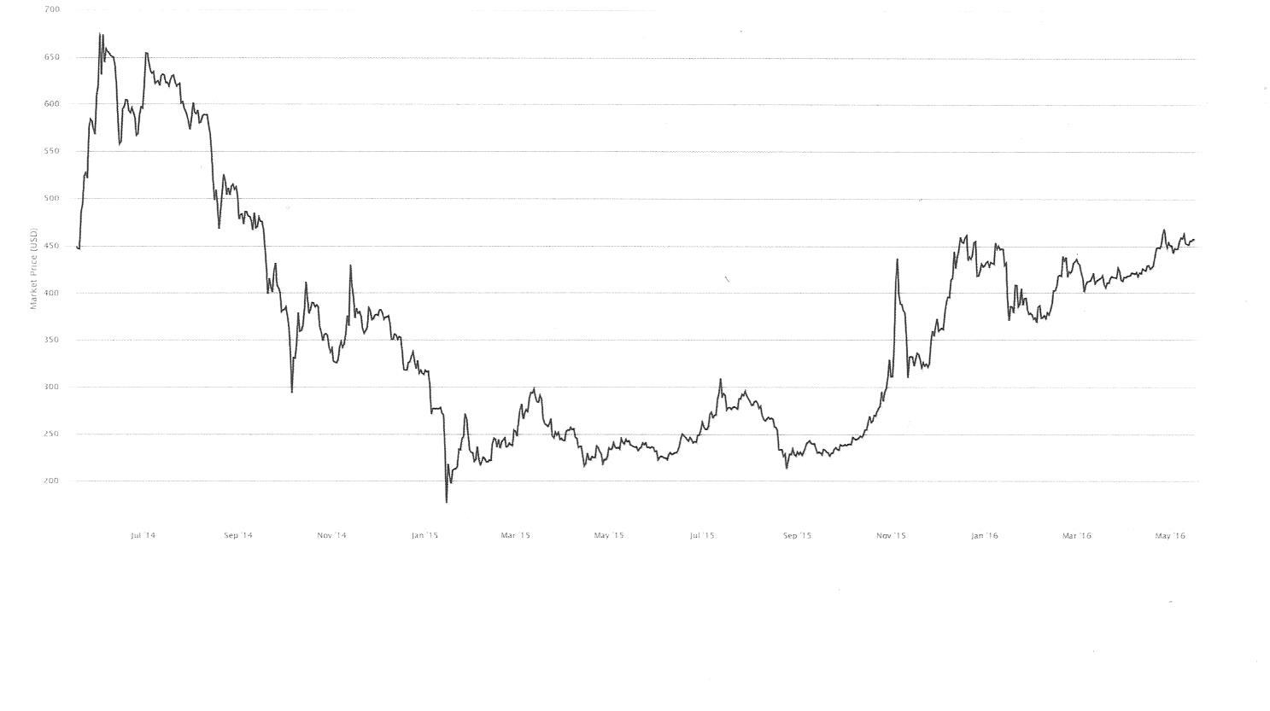
US$ Bitcoin Price from
May 2014 to May 2016
Notes:
December crash as a result of China’s central bank warning against treating bitcoins as legal tender, although did not ban bitcoins trading by individuals, but did barred financial institutions from using bitcoin. Rise $100 to $1,100
Mt.Gox stopped withdrawals in early February 2014, declared bankrupcy in late February 2014

Slide 34
Problems with Bitcoin
Price volatility
Confirmation time for transactions can be between ten minutes (one block) or an hour (six blocks)
Bitcoin nodes require lots of electrical energy
Bitcoin concentrating power into fewer nodes because of the computer hardware required
The upper limit of transactions the Bitcoin network can handle is about 10 transactions per second, less than 1,000 times the transaction volume of VISA
Bitcoin community is split by a controversy to double the block size, which could double volume capacity

Slide 35
My recent experiences
Before the summer of 2015 I was only dabbling in cryptocurrencies and exchanges with small purchases (I recommend others do this to gain familiarity)
In the summer of 2015 I invested about an eighth of my net worth into cryptocurrencies
Bitcoin price was about $280, currently is about $450
Although I lost money when Crypsy folded, my cryptocurrency is nonetheless between a third and half of my net worth
I made a lot of money by buying Ethereum Ether

Slide 36
Ethereum
Ethereum is a cryptocurrency network and blockchain intended to be superior to the Bitcoin network
Conceived and implemented by a 22 year-old genius named Vitalek Buterin
Unlike Bitcoin, Ethereum is written in a Turing complete language, which means it can implement any algorithm
The main cryptocurrency on the Ethereum blockchain is called Ether
Ether transaction volume capacity is only about 2.5 times greater than Bitcoin
Other cryptocurrencies can be written in Ethereum

Slide 37
Ethereum Price in US$ (Coinmarketcap)
DATE | PRICE
October 1, 2015 | $0.69
November 1, 2015 | $1.05
December 1, 2015 | $0.87
January 1, 2016 | $0.95
February 1, 2016 | $2.12
March 1, 2016 | $6.46
April 1, 2016 | $11.63
May 1, 2016 | $8.84
May 12, 2016 | $10.31
May 23, 2016 | $

Slide 38
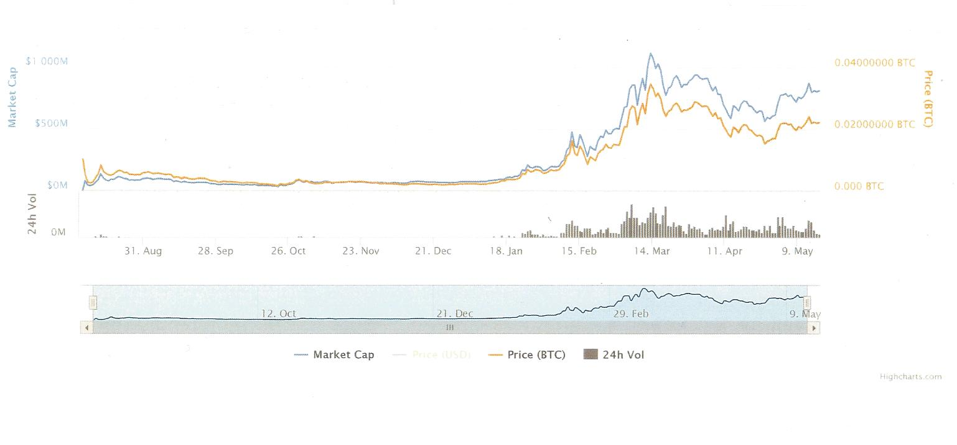
US$ Ethereum Price from July 30, 2015
Notes:
December crash as a result of China’s central bank warning against treating bitcoins as legal tender, although did not ban bitcoins trading by individuals, but did barred financial institutions from using bitcoin. Rise $100 to $1,100
Mt.Gox stopped withdrawals in early February 2014, declared bankrupcy in late February 2014

Slide 39
May 2014 Top 8 Cryptocurrencies by Market Capitalization
Name | Market Capitalization | Price
Bitcoin | $5.625 Billion | $440.73
Litecoin | $295 Million | $10.40
Ripple | $46 Million | $0.006
Peercoin | $44 Million | $2.08
Dogecoin | $35 Million | $0.00045
Nxt | $32 Million | $0.032
Namecoin | $18 Million | $2.05
Mastercoin | $17 Million | $29.28

Slide 40
May 2016 Top 8 Cryptocurrencies by Market Capitalization
Name | Market Capitalization | Price
Bitcoin | $7.042 Billion | $453.32
Ethereum | $797 Million | $9.98
Ripple | $216 Million | $0.006
Litecoin | $177 Million | $3.87
Dash | $44 Million | $6.76
DigixDAO | $28 Million | $14.22
MadeSafeCoin | $24 Million | $0.053
Dogecoin | $23 Million | $0.00022

Slide 41
The future of money
Fiat money may become worthless
  All central bank currencies, all government money
Bitcoin may lose considerable value to a superior cryptocurrency in the future
Bitcoin has deficiencies not in other cryptocurrencies
Bitcoin was the first cryptocurrency, but newer cryptocurrencies have been devised with improved features

Slide 42
The future of money
Investing in cryptocurrencies is risky, and not for the faint of heart
Anyone relying on fiat money and ignoring cryptocurrencies for future reanimation is foolish
I recommend at least small investments in cryptocurrencies to gain familiarity in preparation for the time that cryptocurrency replaces fiat money
Cryptocurrency prices are independent of the stock market, precious metals, etc.
I am bullish on Bitcoin, Ethereum, etc.
I think a diversified portfolio should have between one and five percent cryptocurrency

