Slide 1
SmartBike DC and How it Happened (for Free)
George Branyan
District Department of Transportation (DDOT), Washington, DC
Pro Walk/Pro Bike
2008

Slide 2
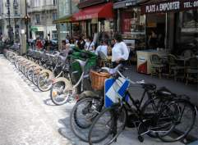
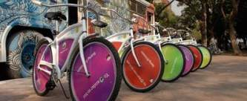
What is bike-sharing?
bike-sharing (\’bīk-,sher-iŋ\) - 1: short-term bicycle rental available at unattended urban locations; 2: bicycle transit (www.bike-sharing.blogspot.com)

Slide 3
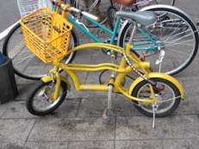
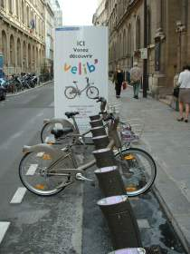
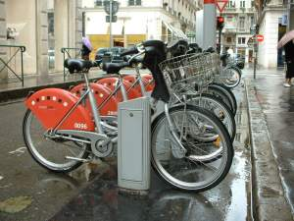

How did DDOT come up with this?
5 Years ago, we saw examples in Europe and the US
Researched options
Most high-tech systems were part of outdoor advertising systems

Slide 4

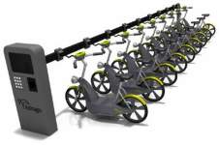
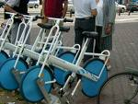
Low tech vs. High tech?
Low Tech
  Theft
  Vandalism
  Maintenance
  Where’s the bike?
High Tech
  Security
  Accountability
  Maintenance
  Fixed locations

Slide 5
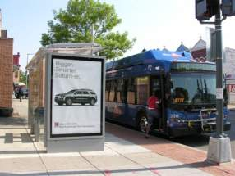
How did DDOT set it up?
Part of the ClearChannel Bus Shelter Contract
  RFP for ~700 shelters included bike sharing option in 2005. ClearChannel won.
  ClearChannel places ads, keeps part of the revenue, gives some to DDOT, and provides SmartBikeDC

Slide 6
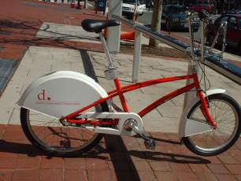
How Much does the Program Cost?
We don’t know (and if we did, we couldn’t tell you).

Slide 7
How Many Racks / Bikes?
1st Phase – 10 Racks / 120 Bikes
Evaluation after 6 months
2nd Phase in Spring of 2009
  Renegotiate contract

Slide 8

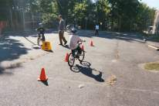
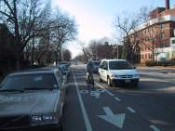

What About Safety?
Part of larger Bike / Ped Safety Program
  Bike Lanes, Trails
  Adult and child classes
  Public Outreach
Subscribers must read laws and sign agreement/waiver, and can take class

Slide 9
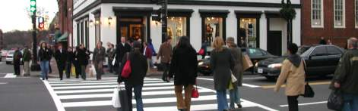
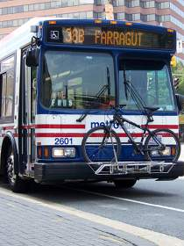
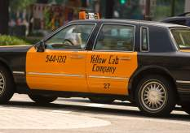
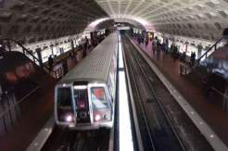
Who will use Smartbikes?
Same people who are making short trips already by bike, bus, taxi, metro.
Must be at least 18 years old
Tourists? Not really. Not yet.

Slide 10

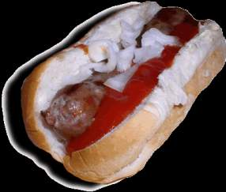
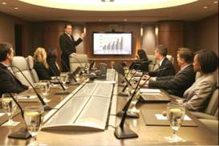
What Kinds of Trips?
Work, lunch, meetings, dentist, errands, etc.

Slide 11
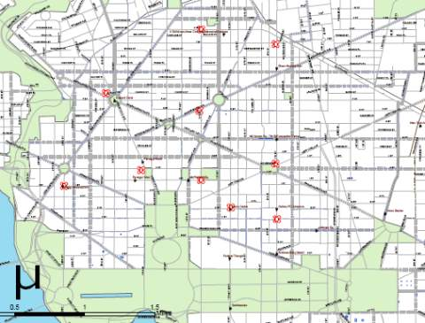
How Did DDOT Find Locations?
Criteria: Transit, Jobs, Density, Destinations
Survey
Common Sense

Slide 12
Who did DDOT work with?
BID’s (Business Improvement Districts)
  Location help
  Liaison with adjacent property owners
Residents
Commission of Fine Arts
PEPCO (electric company)

Slide 13
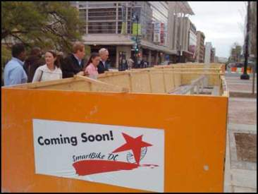
Challenges?
Finding Locations
Construction and Installation
Electrifying Racks
Still more to come

Slide 14
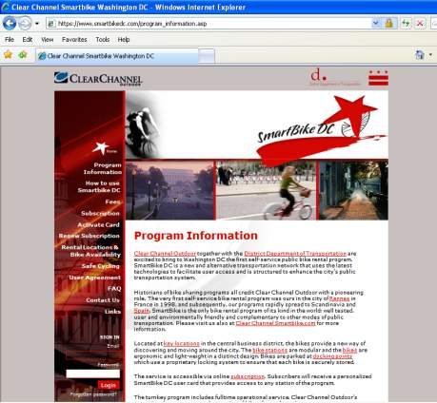

How Do I Sign Up?
On-line, Phone or Mail
Sign Member Agreement
Pay ($40/year)
Card arrives in the mail
www.SmartBikeDC.com

Slide 15
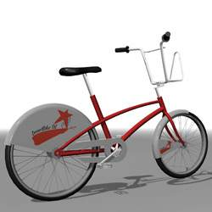
What kind of bike is it?
Custom design
Upright riding position
5th generation
Front and rear lights
Fenders and chain guard
3 speed, internal hub
…no excuses

Slide 16
Who else has bike sharing?
Oslo and Barcelona (Smartbike)
Paris (Velib)
Humana (HMO company campus)
  2008 Conventions
Montreal, Portland, Seattle, Chicago, Arlington, etc

Slide 17




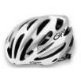
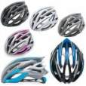
What about helmets?
Not required, not provided, but encouraged

Slide 18
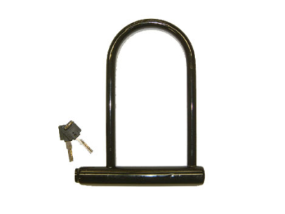
What about separate locks?
Not provided yet

Slide 19
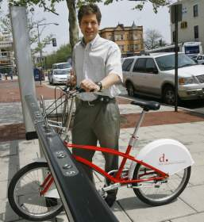
For More Information
Jim Sebastian
  E-Mail: jim.sebastian@dc.gov
  Direct Line: (202) 671-2331
  Address:
  Reeves Center, 7th Floor
  2000 14th Street, NW
  Washington, DC 20009

