Slide 1
How DLTs might impact the financial sector
ECB-PUBLIC
ECB-PUBLIC
Andrea Pinna
Market Infrastructure Expert
DG MIP/Market Integration Division
P2PFISY 2016
8 September
The views expressed are those of the author and do not necessarily reflect those of the ECB

Slide 2
Distributed ledger technologies
ECB-PUBLIC
A distributed ledger is a shared database to record either transactions or account balances for a set of assets and users
DLT users can modify accounts in the distributed ledger and consider it as authoritative even without central management system
The DLT landscape:
DLTs
BLOCKCHAINS
CONSENSUS
LEDGERS
SMART
CONTRACTS
BITCOIN
Notes:
Location,
Name of the Author

Slide 3






DLT as a potential enabler of P2PFISY?
ECB-PUBLIC
Disruptive potential of DLTs lies in the fact that it enables shared databases and trust is embedded through cryptographic proof
Today
Tomorrow?
bank
bank
FMI
trusted parties operating centralised ledgers
decentralised ledger with trust as a built-in feature

Slide 4
Unclear to what extent that might be possible even in niche markets
ECB-PUBLIC
Some details certainly matter:
Restricted DLT network
Unrestricted DLT network
closed system among identified and accountable entities
unknown entities can propose/validate transactions
Unrestricted DLTs do not allow to:
  punish illicit behaviour
  ensure compliance with KYC, AML, and ATF provisions
  use efficient validation methods
Financial institutions are focusing on restricted DLTs
  Governance, authentication and accessibility will be key issues

Slide 5
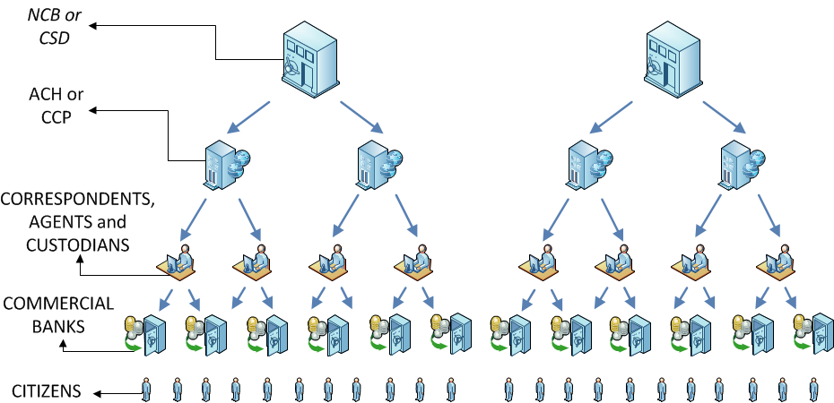
The current organisation of financial markets is highly intermediated
ECB-PUBLIC
Layers of intermediation require reconciliation processes
  both in the realm of payments and securities
  particularly in cross-border transactions
  before the settlement instruction reaches e.g. T2, T2S
Notes:
Location,
Name of the Author

Slide 6
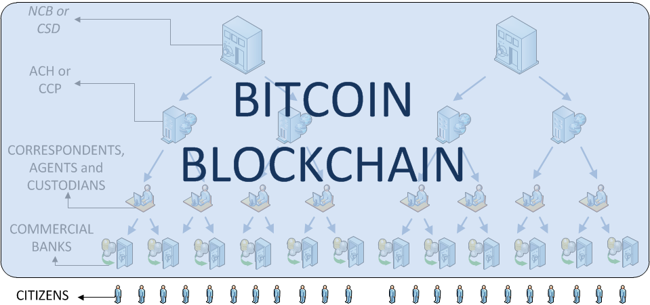
Bitcoin blockchain was developed to get rid of all intermediaries and authorities
ECB-PUBLIC
Some developers of DLTs still envisage full disintermediation
  Financial transactions would involve no regulated institution
  Monetary policy might be affected in the case of wide adoption
  No governance to take responsibility of what happens in the network (a deadlock?)
Notes:
Location,
Name of the Author

Slide 7
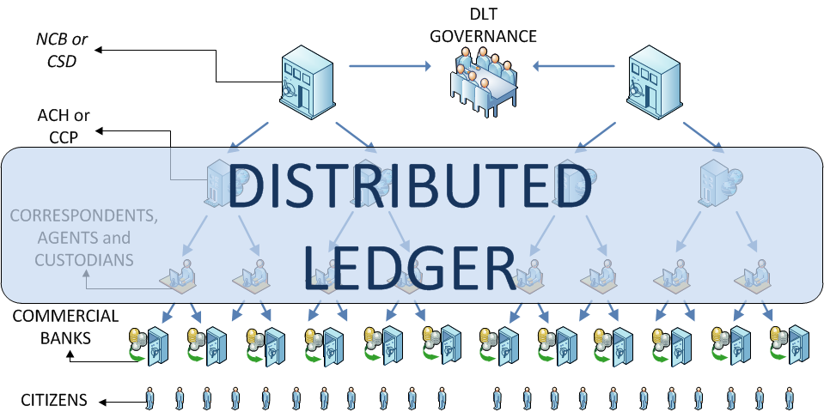
DLT projects from market participants show a different possible picture
ECB-PUBLIC
DLTs might be useful to increase market efficiency
  Settlement of transactions potentially instantaneous
  Some intermediaries and central clearing still in the picture (certainly for derivatives)
  Clear governance and responsibilities stay with regulated financial institutions
Notes:
Location,
Name of the Author

Slide 8
Why are financial institutions interested in DLTs?
ECB-PUBLIC
To reduce back-office costs
    Reconciliation of information across different layers of financial markets
      financial institutions expect to spend $1.2bn to reconcile data in 2016 (AITE)
    Reporting data to different authorities
      authorities could access the ledger with special privileges to get data
To lower risks to be hedged
    Shorter settlement cycle (potentially instantaneous)
      lower collateral needs
      lower capital requirements
      but: higher liquidity needs (possibly offset by automated lending on ledger)
To increase cyber resilience
    Multiplicity of validation nodes might make:
      cyber attack more difficult (that depends on the cyber awareness of participants)
      detection and recovery faster
To flatten the value chain
    Straight-through processing before the settlement layer (if standards are agreed)

Slide 9
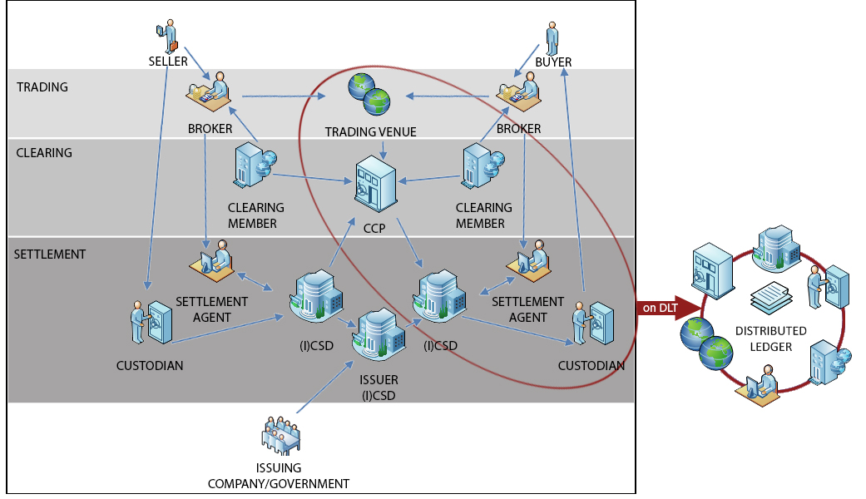
Scenario 1: DLT to improve cluster efficiency
What could be the impact of different adoption models in securities markets?
ECB-PUBLIC

Slide 10
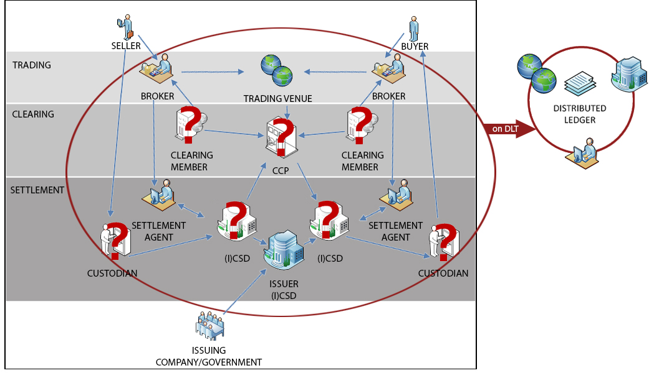
Scenario 2: market-wide adoption
What could be the impact of different adoption models in securities markets?
ECB-PUBLIC

Slide 11
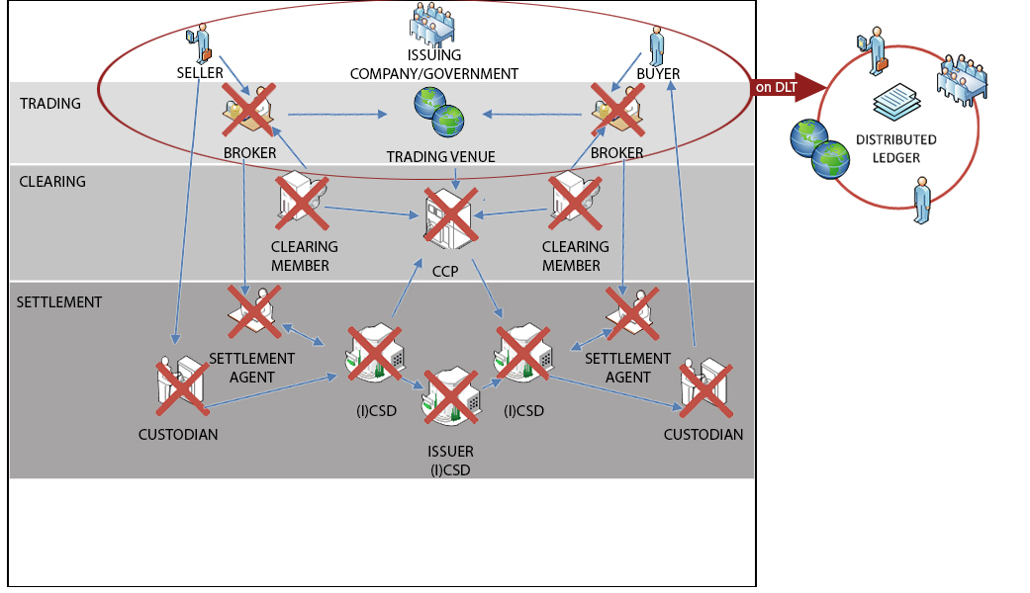
Scenario 3: peer-to-peer financial markets
What could be the impact of different adoption models in securities markets?
ECB-PUBLIC

Slide 12
Concluding remarks
ECB-PUBLIC
DLTs are a diverse set of technologies
    It is important to find a common understanding before DLTs can even be considered
      “Unrestricted”, “permissionless” (?!), “public” cannot be used interchangeably
    Need common approach and standards at a global level (e.g., CPMI, IOSCO, ISO)
Some features of financial markets appear non-negotiable
    Financial stability requires finality (irreversibility in DLTs often misunderstood)
    Consumers protection requires accountability (who is responsible under what law?)
    Efficiency requires a governance structure able to e.g. change protocol
    DLT as a technological innovation is unlikely to enable broad P2P financial systems
DLTs seem to have a real business case only if standardised
    DLTs do not offer better performance over central database technologies
    Potential gains are linked to changes in industrial organisation DLTs might facilitate
Public authorities seek safe and efficient markets
    Market participants are welcome to work towards safe and efficient innovations
    The ECB is committed to fully understand innovative technologies and their impact on financial markets, playing the role of catalyst when requested (e.g. T2S DLT TF)
The views expressed are those of the author and do not necessarily reflect those of the ECB

