Slide 1
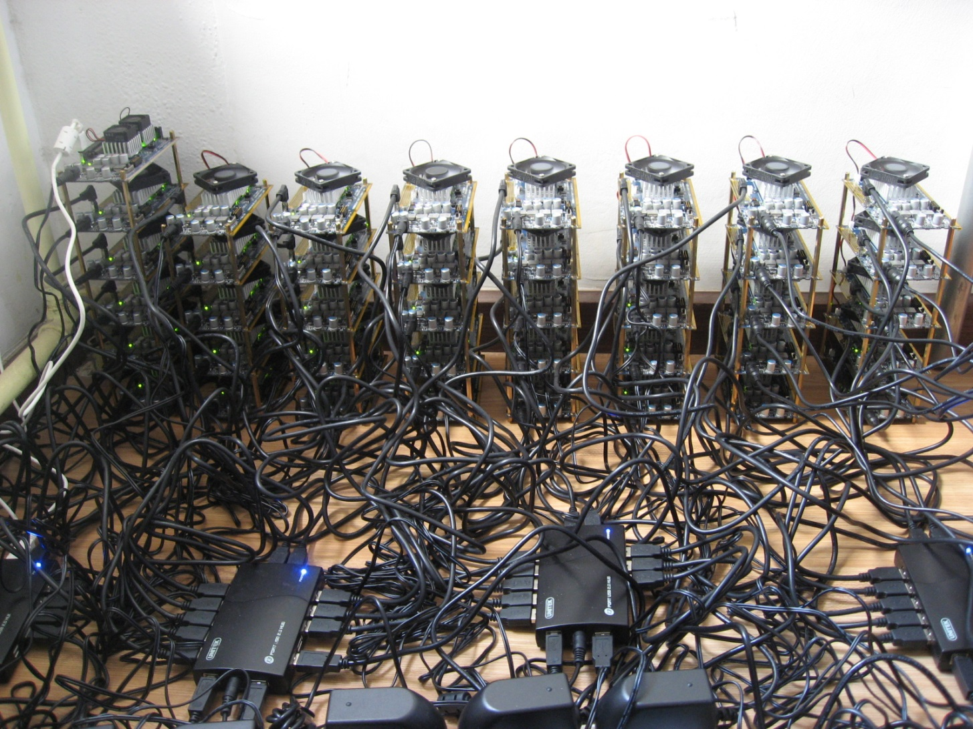
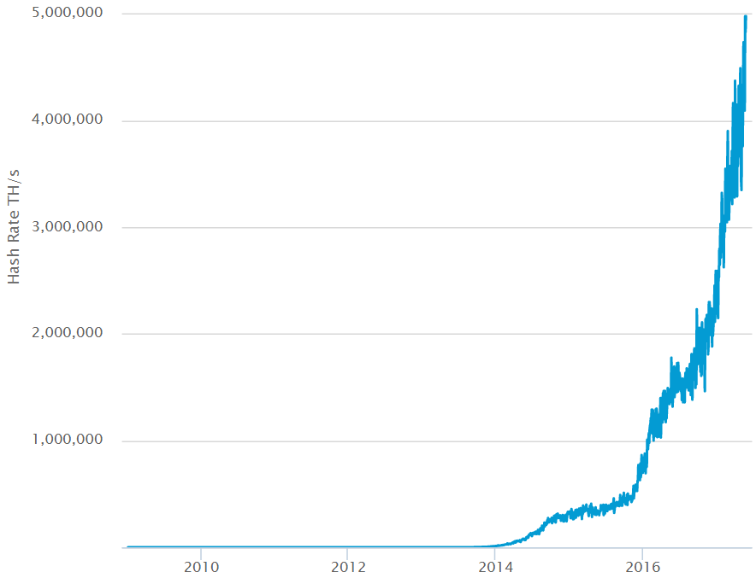
Mining
CPU
GPU
ASIC
Links

Slide 2
Blockchain
Miner machine keeps unconfirmed transactions
Mining process
Construct block, fill in unconfirmed transactions
txnHash = SHA256(transactions) : 0x 155c4f360385ac264470eb71cdab81c3d2155c4f360385ac264470eb71cdab81
blockID = SHA256(prev ID, txnHash, random number) : 0x 4470eb71cdab81c3d2155c4f360385ac264470eb71cdab81155c4f360385ac26
blockID < target difficulty
Target: 000000000000A1B7E…
System control one block every 10 minutes
Adjust difficulty every 2016 blocks
To calculate
const
const
variable

Slide 3

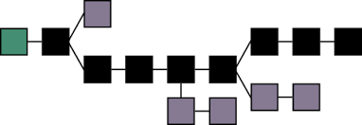
Blockchain – longest chain_TODO

Slide 4
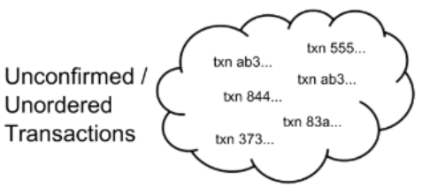
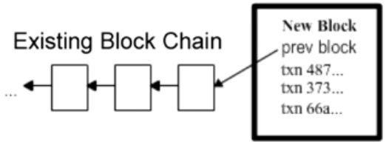
Blockchain with transaction
The Block Chain: Ordering Solution
Transactions
Confirmed Transactions → added
Unconfirmed Transactions → to add

Slide 5
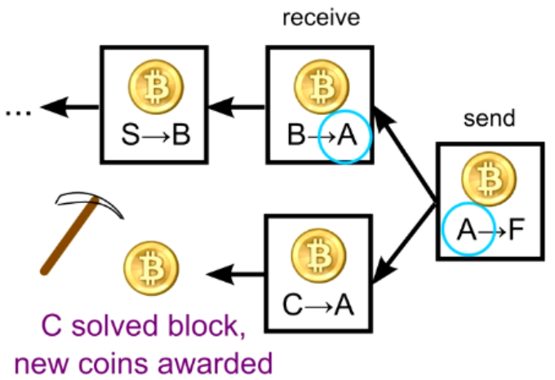
Summary
Mining:
Create block every 10 minutes
Adjust difficulty every 2016 blocks, (around 2 weeks)
Every 4 years, award cut in half,
Start from 50 BTC / block
Current: 12.5 coins,
Future: no award, depend on transactions
all 21 million in 2140, Current 16.3 million
Smallest transaction unit: 1/10^8 BTC = 1 Satoshi
Real purpose:
Verify transactions
Safeguard the blockchain
.32,A->B
1.0,J->Z
1.45,C->S
1.0,H->J
1.03,S->J
.23,B->C
1.2,E->J
.9,M->B
2.5,M->S
.1,S->F
.2,M->J
1.3,S->S
...
...
...
...
HASH
HASH
HASH
Block 1
Block 2
Block 3
Block 4

