Slide 1
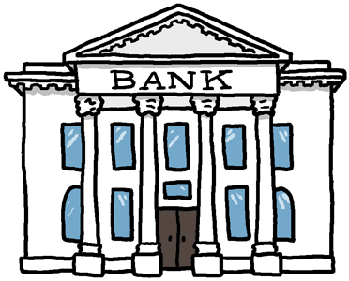
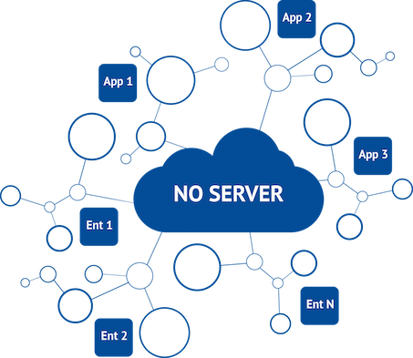
Transactions
Ledger
____ ____
____ ____
____
Ledger
____ ____
____ ____
____
Ledger
____ ____
____ ____
____
Ledger
____ ____
____ ____
____
Ledger
____ ____
____ ____
____
Ledger
____ ____
____ ____
____

Slide 2
Transactions
Ledger
____ ____
____ ____
____
Ledger
____ ____
____ ____
____
Ledger
____ ____
____ ____
____
Alice → Bob 5 BTC
Ledger
Alice 25
Bob 10
____ ____
20
15
Ledger
____ ____
____ ____
____
Ledger
Alice 25
Bob 10
____ ____
20
15
Ledger
____ ____
____ ____
____
Ledger
____ ____
____ ____
____
Ledger
Alice 25
Bob 10
____ ____
20
15
A→B
5 BTC
A→B
5 BTC
A→B
5 BTC
Passing other’s transactions along
A→B
5 BTC
Alice → Bob 5 BTC
June → Kaven 8 BTC
Sam → Tayler 8 BTC
… …
Index

Slide 3
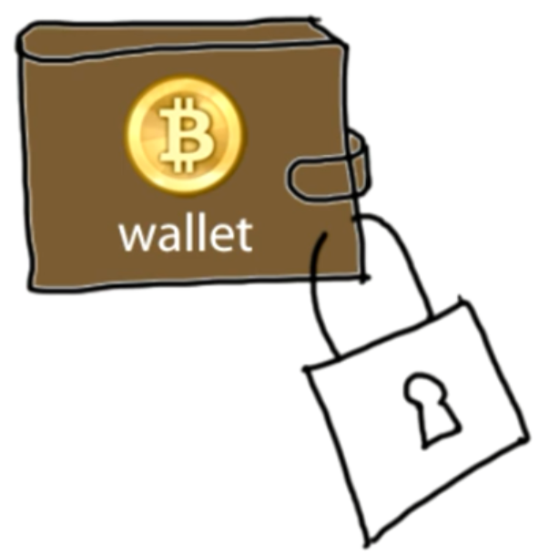
Authentication
Transaction Messages
Digital Signature
Alice → Bob 5 BTC d302721…
June → Dave 8 BTC 81758de…
Andy → Juan 6 BTC 17512c8…
Sam → John 4 BTC 9eac123…
? Alice ?
Digital Signature
Bf853d30272138df448817512c8de9cc3f75849eac1234cc …
different every time
Create
Verify
Signature = f(message, private key)
1=? V(message, public key, signature)
Index

Slide 4
Transactions in more detail
Create
Verify
Signature = create(message, private key)
1=? verify(message, public key, signature)
Input
Original Message
An ECDSA hash (Signature)
A public key
Output contains
Amount: being sent to the recipient.
Voluntary transaction fee
Change: being sent back to the original sender
Index
Notes:
Block chain
prevents the double spend attack
by giving other nodes the power to verify that transaction inputs were not already spent somewhere else.

Slide 5
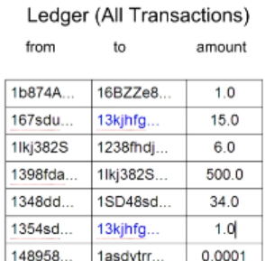
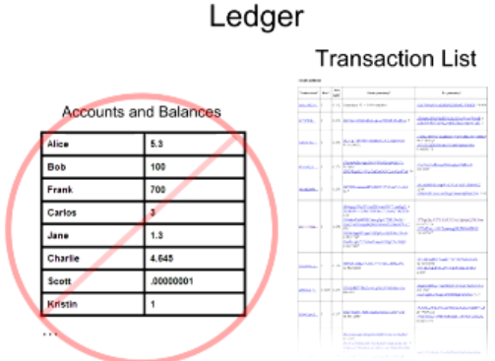

Balance Calculation
16
Index

Slide 6
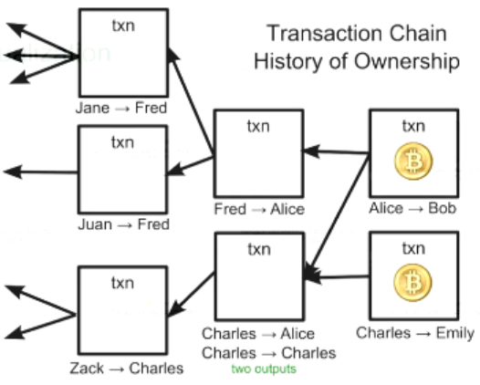
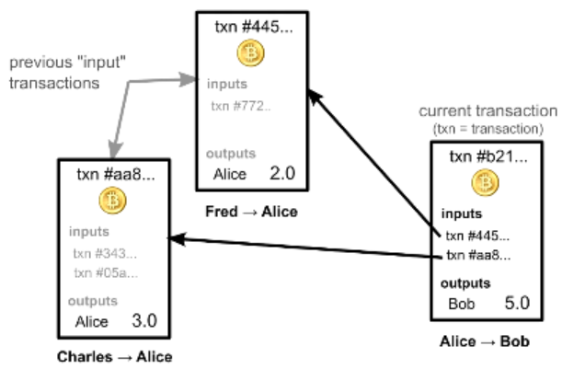
Transaction and Ledger
Bitcoins comes from chains of transactions
Ownership via previous transactions
Check previous transactions ~ 24h
Blockchain.info
Index
Notes:
?? How the process pay 1.2, 2.5, 3.4

Slide 7
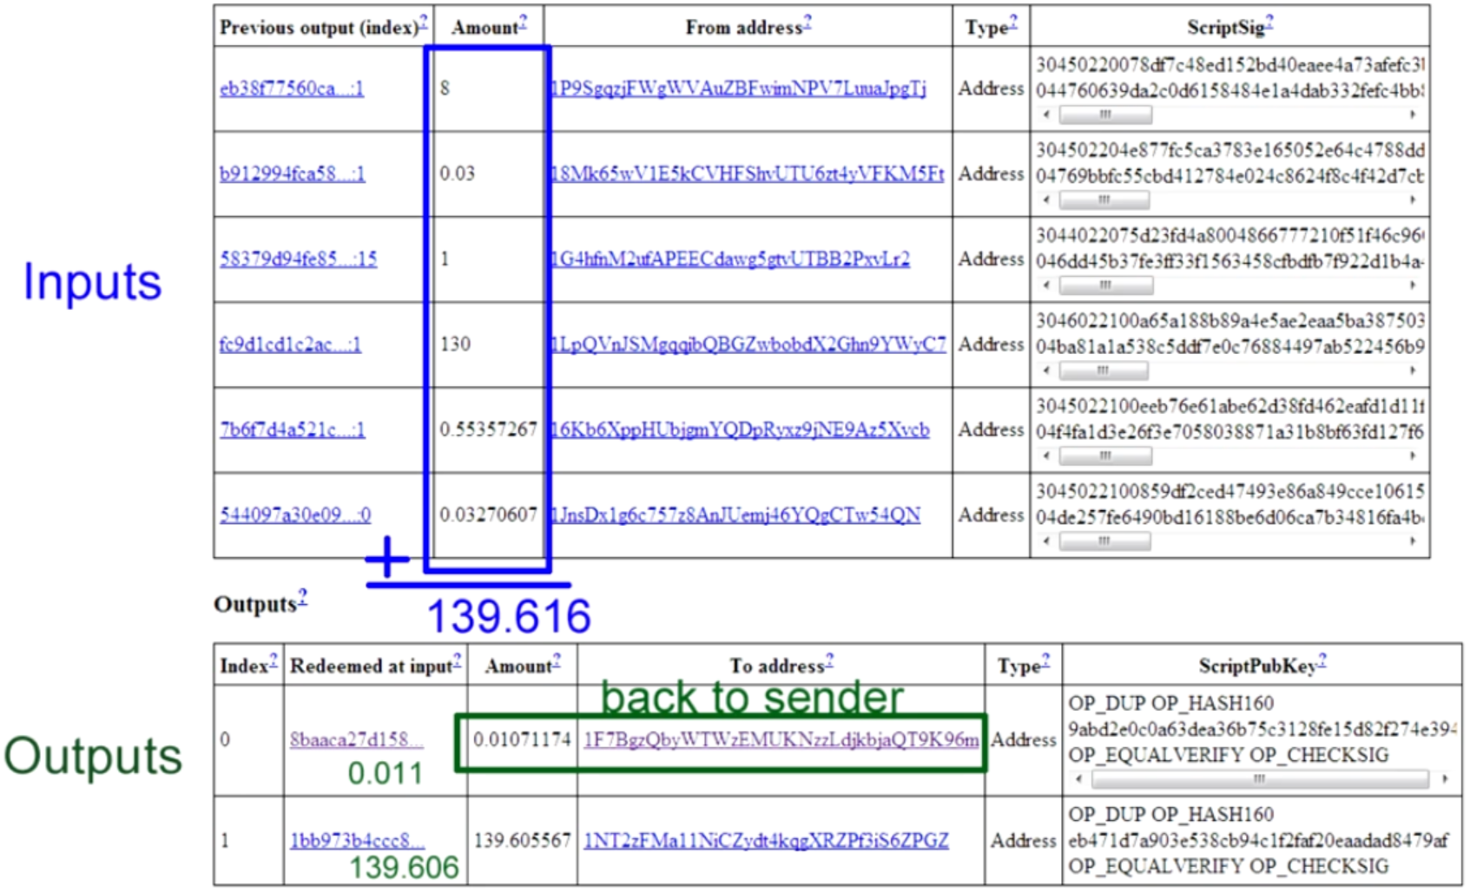
Real Transactions
Index

Slide 8
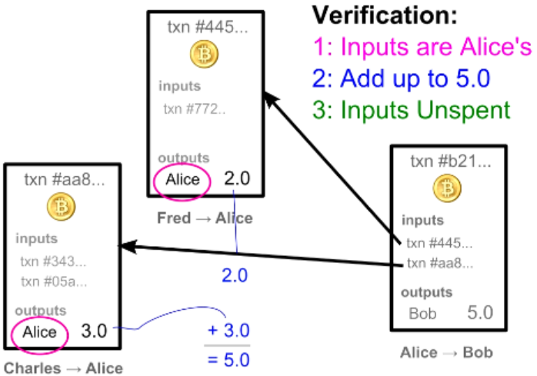
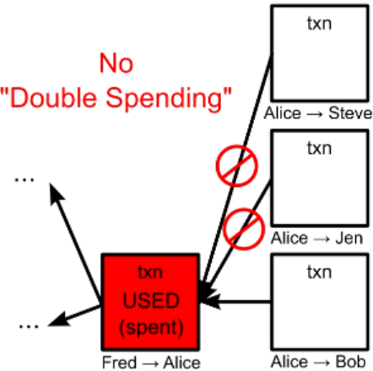
Transaction Verification
Each node verify block & txn before broadcast
Each txn Can Only be Used Once as an input
Index

Slide 9
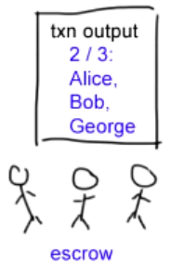
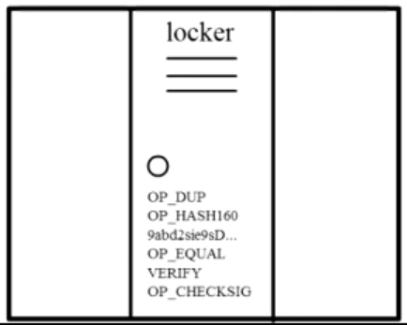
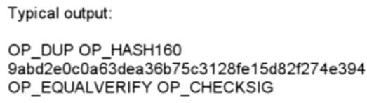
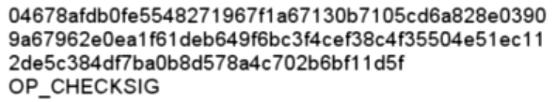
Complex Transactions: Mathematical Puzzles
Transactions: Mathematical Puzzles with locker
Defined with special Scripting language
Only owner can solve it
Support more complex conditions
First Transaction: 2009, Jan 3, 50BTC
Index

Slide 10
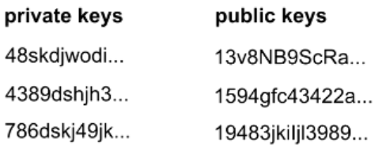
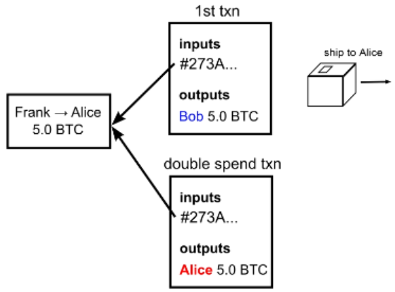
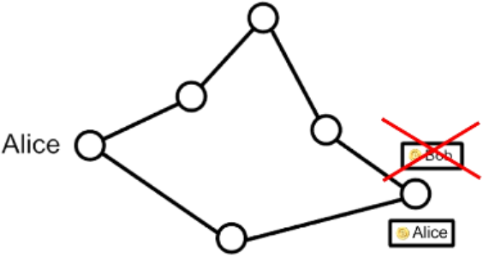
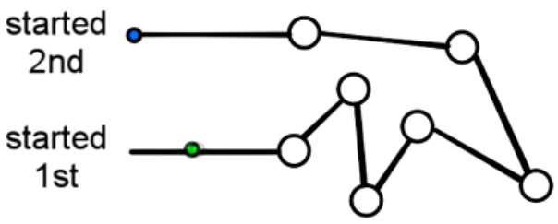
Transaction Security
Wallet
Anonymity
Possible bitcoin address: 2^160
Bitcoin transaction Security:
Digital Signatures
Referenced Transactions
Security Hole: Transaction Order
Double Spending Fraud
Nodes need to agree on transaction order
Index

Slide 11
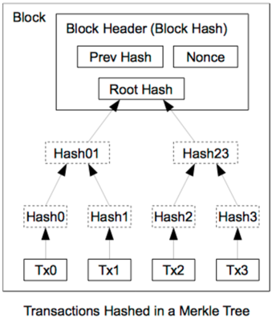
Block Header Hash Relations
Name | Byte Size | Description
Version (V) | 4 | Block Version Number.
Pre Hash (P_{h}) | 32 | This is the hash of the previous block header.
Merkle Root (H_{t}) | 32 | The hash based on all the transactions
Time (T) | 4 | Current Timestamp in seconds. unix fmt.
Target | 4 | Target value in compact form.
Nonce (R) | 4 | User adjusted value starting from 0
Index
3028237 ...

Slide 12
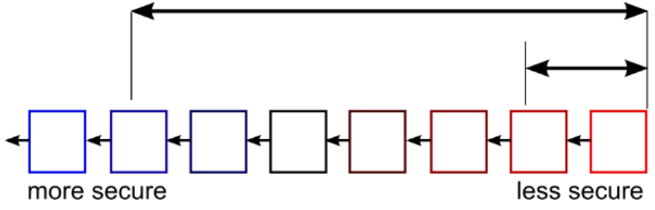
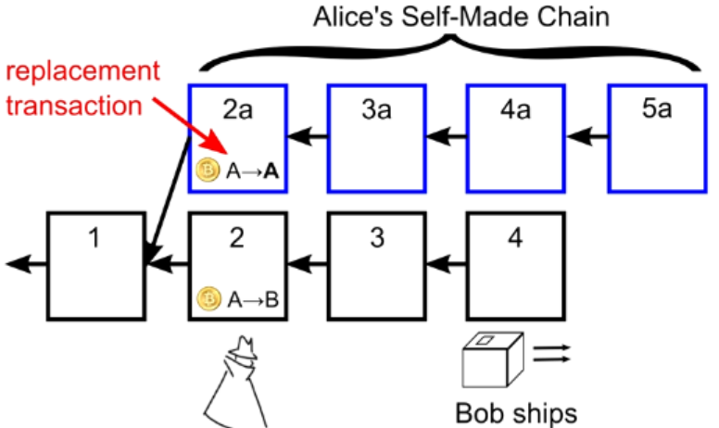
Double Spending Prevention
.32,A->B
1.0,J->Z
1.45,C->S
1.0,H->J
1.03,S->J
.23,B->C
1.2,E->J
.9,M->B
2.5,M->S
.1,S->F
.2,M->J
1.3,S->S
...
...
...
...
HASH
HASH
HASH
Block 1
Block 2
Block 3
Block 4
Wait for several block for safety
Index

Slide 13
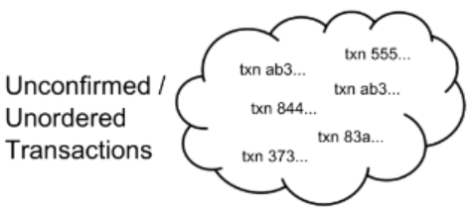
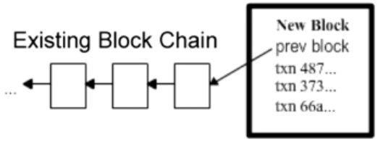
Blockchain with transaction
The Block Chain: Ordering Solution
Txn Chain: History of Ownership
Unconfirmed txn
Add to new Block

Slide 14
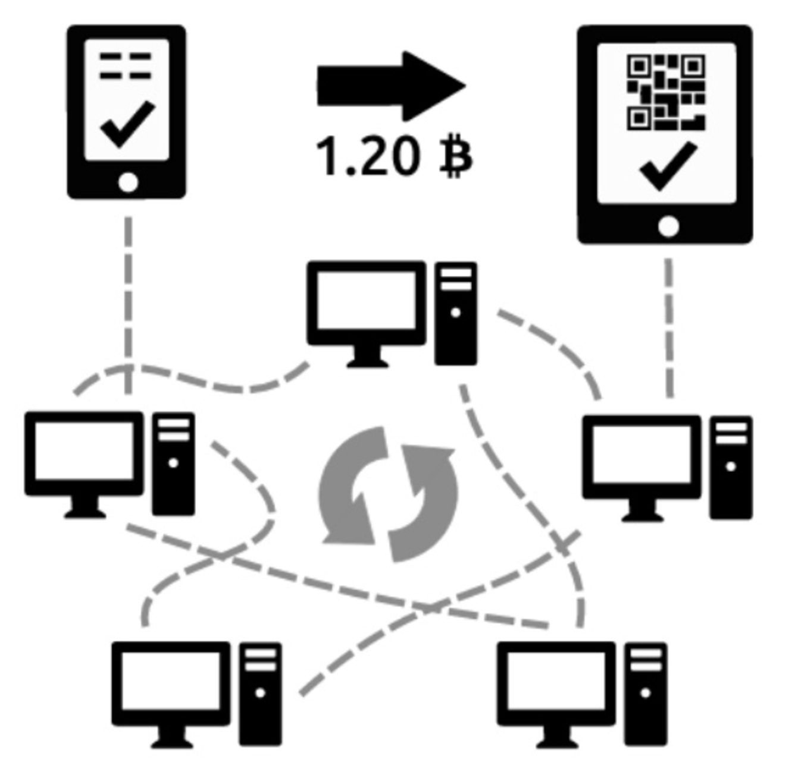


Recap
Blockchain:
block linked to a pre block → blockchain formed
Block Chain Orders Transactions
Transactions Chain transfers Ownership
How the Bitcoin network runs
New transactions are broadcasted to all users
Minters find the solution to the proof of work of the block
creates new block with Txn & broadcasted to all users
Each user accepts the received block if valid
existing blocks
new block
existing blocks
Index
Time
Time
branches

Slide 15
Summery
Benefits
Government can’t print money or manipulate currency
Anonymity
Lower global transaction costs
Challenges
Difficult to exchange
Used for illegal activity (Government can’t track
Mining, or solving blocks use large amount of energy
Mathematically protected digital currency
Maintained by a network of peers
Digital Signature:
Safeguard money
Transaction chains
Store history of ownership
Block Chain
Hold transaction order
Index

